Slide 1
Session 13 Pointers and dynamic arrays
CS 200 – Introduction to Programming

Slide 2
9.2
Dynamic Arrays

Slide 3
Dynamic Arrays
A dynamic array is an array whose size is determined when the program is running, not when you write the program

Slide 4
Pointer Variables and Array Variables
Array variables are actually pointer variables that point to the first indexed variable
Example: int a[10]; typedef int* IntPtr; IntPtr p;
Variables a and p are the same kind of variable
Since a is a pointer variable that points to a[0], p = a; causes p to point to the same location as a

Slide 5
Pointer Variables As Array Variables
Continuing the previous example: Pointer variable p can be used as if it were an array variable
Example: p[0], p[1], …p[9] are all legal ways to use p
Variable a can be used as a pointer variable except the pointer value in a cannot be changed
This is not legal: IntPtr p2; … // p2 is assigned a value a = p2 // attempt to change a
Display 9.4

Slide 6
Creating Dynamic Arrays
Normal arrays require that the programmer determine the size of the array when the program is written
What if the programmer estimates too large?
Memory is wasted
What if the programmer estimates too small?
The program may not work in some situations
Dynamic arrays can be created with just the right size while the program is running

Slide 7
Creating Dynamic Arrays
Dynamic arrays are created using the new operator
Example: To create an array of 10 elements of type double: typedef double* DoublePtr; DoublePtr d; d = new double[10];
d can now be used as if it were an ordinary array!
This could be an integer variable!

Slide 8
Dynamic Arrays (cont.)
Pointer variable d is a pointer to d[0]
When finished with the array, it should be deleted to return memory to the freestore
Example: delete [ ] d;
The brackets tell C++ a dynamic array is being deleted so it must check the size to know how many indexed variables to remove
Forgetting the brackets, is not legal, but would tell the computer to remove only one variable
Display 9.5 (1)
Display 9.5 (2)

Slide 9
Pointer Arithmetic (Optional)
Arithmetic can be performed on the addresses contained in pointers
Using the dynamic array of doubles, d, declared previously, recall that d points to d[0]
The expression d+1 evaluates to the address of d[1] and d+2 evaluates to the address of d[2]
Notice that adding one adds enough bytes for one variable of the type stored in the array

Slide 10
Pointer Arthmetic Operations
You can add and subtract with pointers
The ++ and - - operators can be used
Two pointers of the same type can be subtracted to obtain the number of indexed variables between
The pointers should be in the same array!
This code shows one way to use pointer arithmetic: for (int i = 0; i < array_size; i++) cout << *(d + i) << " " ; // same as cout << d[i] << " " ;

Slide 11
Multidimensional Dynamic Arrays
To create a 3x4 multidimensional dynamic array
View multidimensional arrays as arrays of arrays
First create a one-dimensional dynamic array
Start with a new definition: typedef int* IntArrayPtr;
Now create a dynamic array of pointers named m: IntArrayPtr *m = new IntArrayPtr[3];
For each pointer in m, create a dynamic array of int's
for (int i = 0; i<3; i++) m[i] = new int[4];

Slide 12
A Multidimensial Dynamic Array
The dynamic array created on the previous slide could be visualized like this:
m
IntArrayPtr's
IntArrayPtr *
int's

Slide 13
Deleting Multidimensional Arrays
To delete a multidimensional dynamic array
Each call to new that created an array must have a corresponding call to delete[ ]
Example: To delete the dynamic array created on a previous slide: for ( i = 0; i < 3; i++) delete [ ] m[i]; //delete the arrays of 4 int's delete [ ] m; // delete the array of IntArrayPtr's
Display 9.6 (1)
Display 9.6 (2)

Slide 14
Section 9.2 Conclusion
Can you
Write a definition for pointer variables that will be used to point to dynamic arrays? The array elements are of type char. Call the type CharArray.
Write code to fill array "entry" with 10 numbers typed at the keyboard? int * entry; entry = new int[10];

Slide 15
Chapter 9 -- End

Slide 16
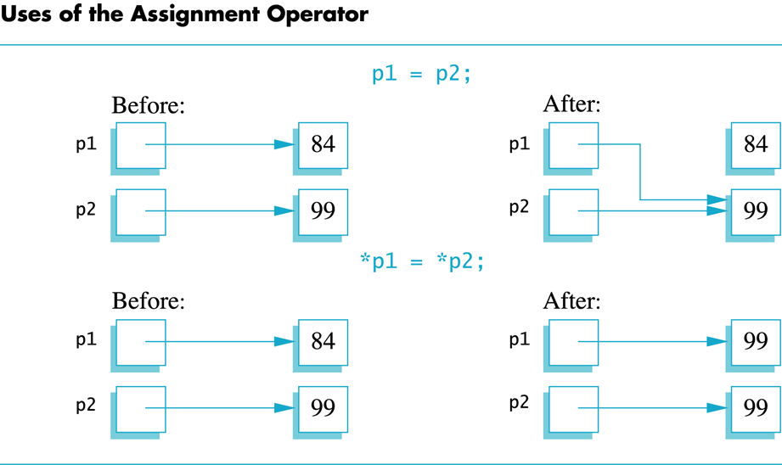
Display 9.1
Back
Next

Slide 17
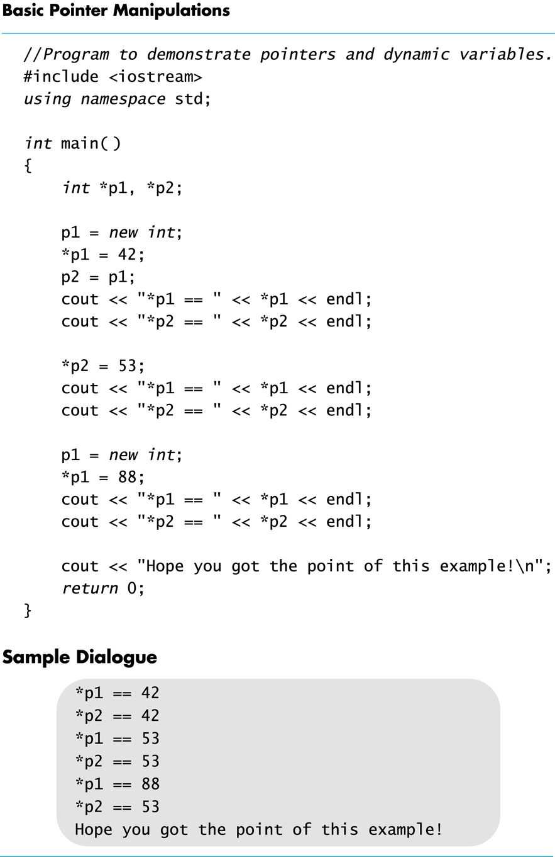
Display 9.2
Back
Next

Slide 18
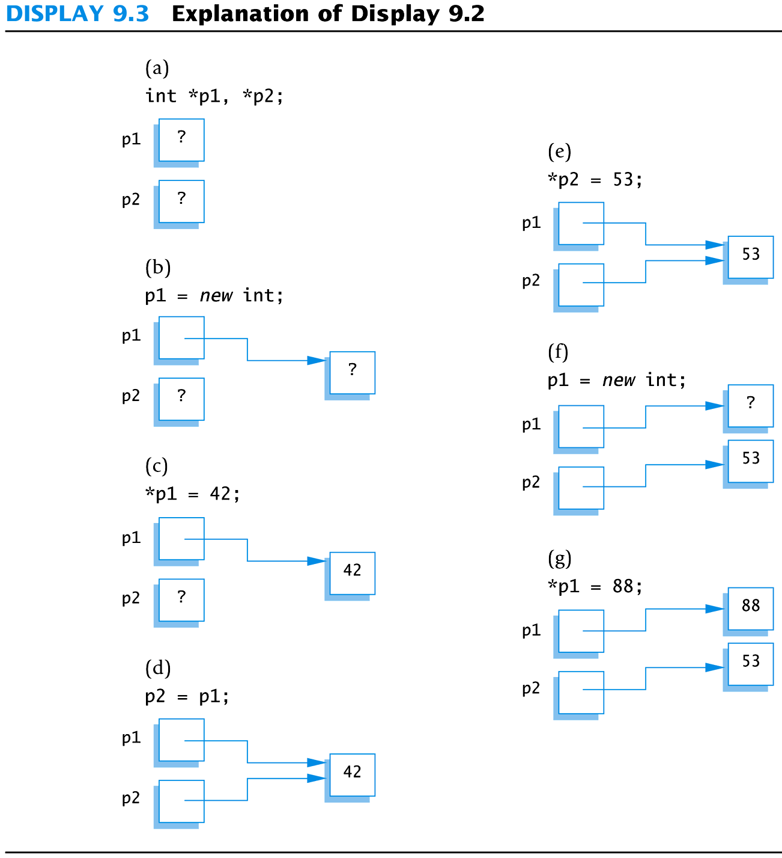
Display 9.3
Back
Next

Slide 19
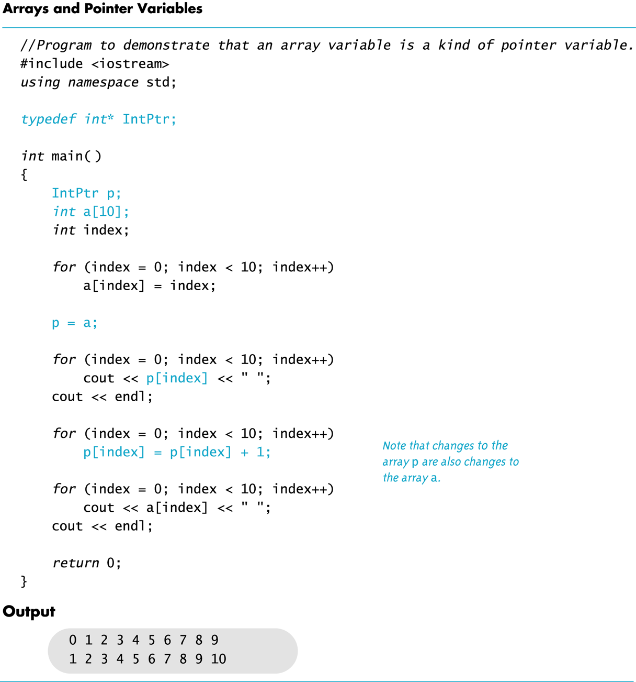
Display 9.4
Back
Next

Slide 20
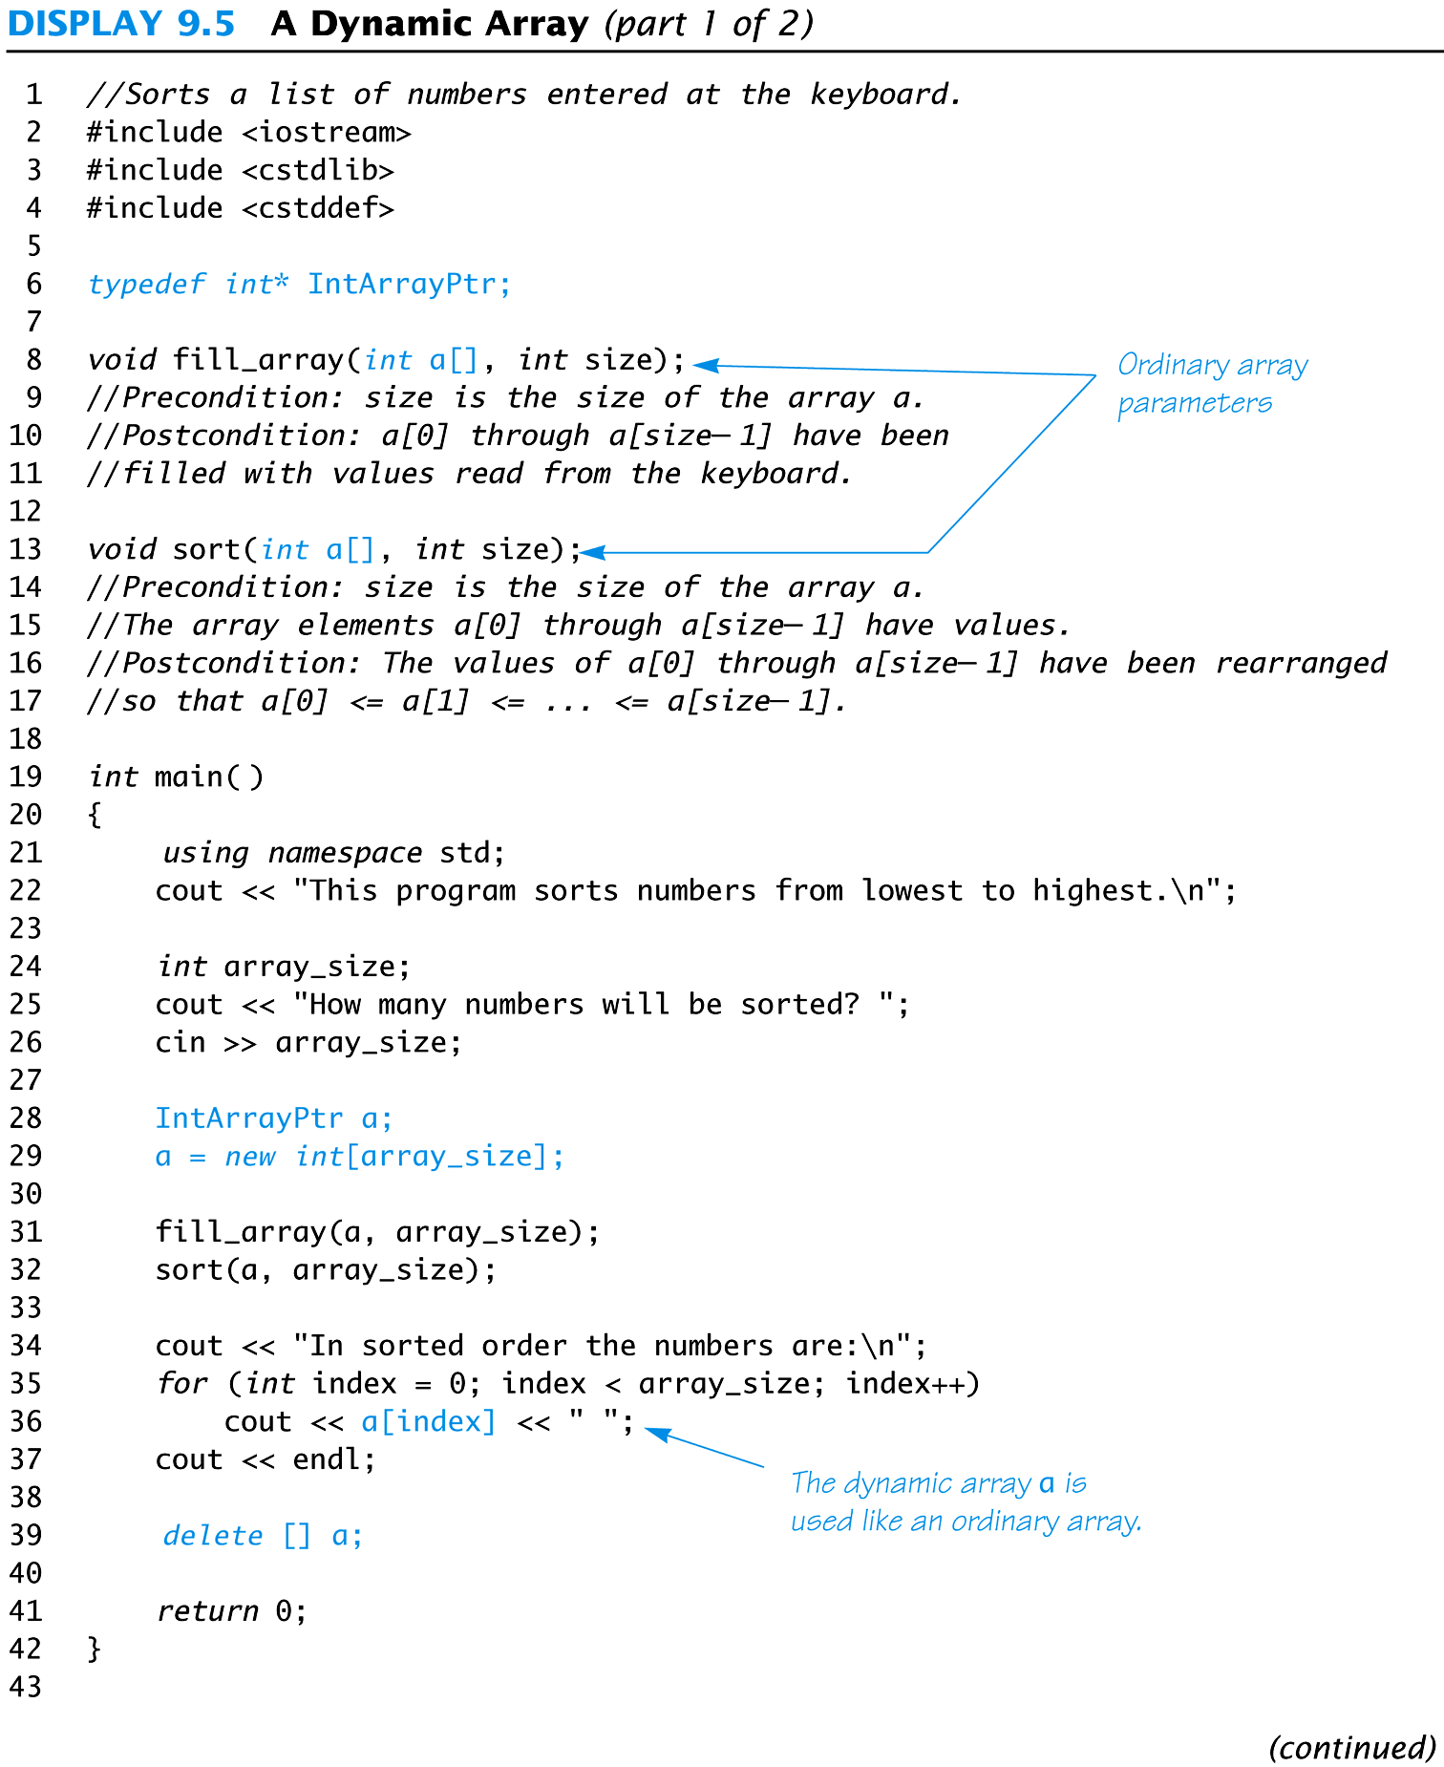
Display 9.5 (1/2)
Back
Next

Slide 21
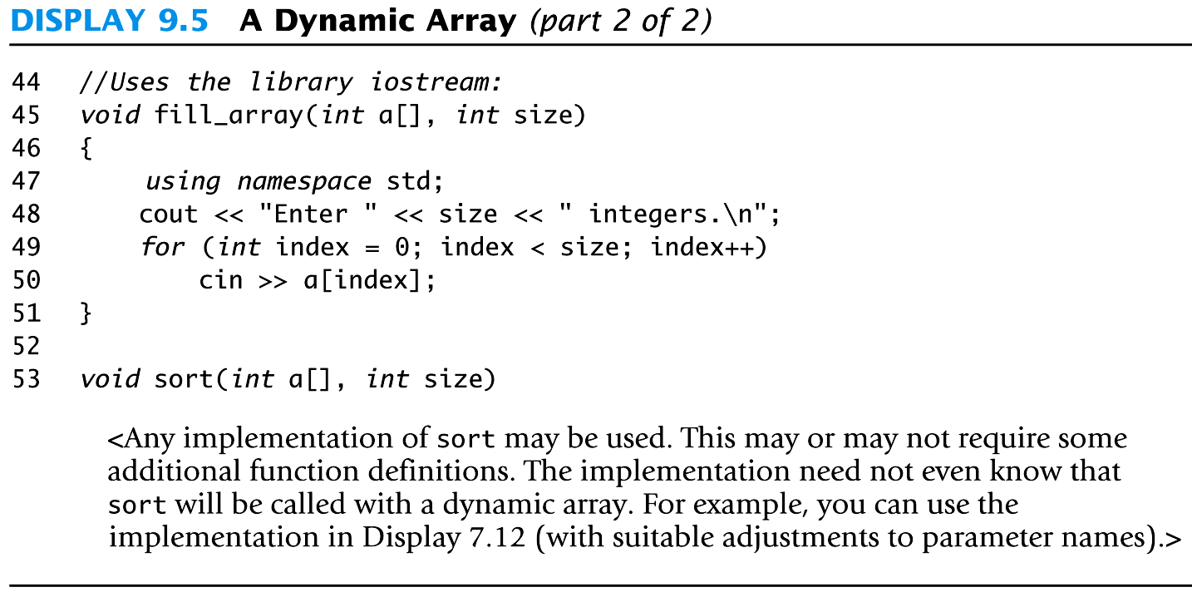
Display 9.5 (2/2)
Back
Next

Slide 22
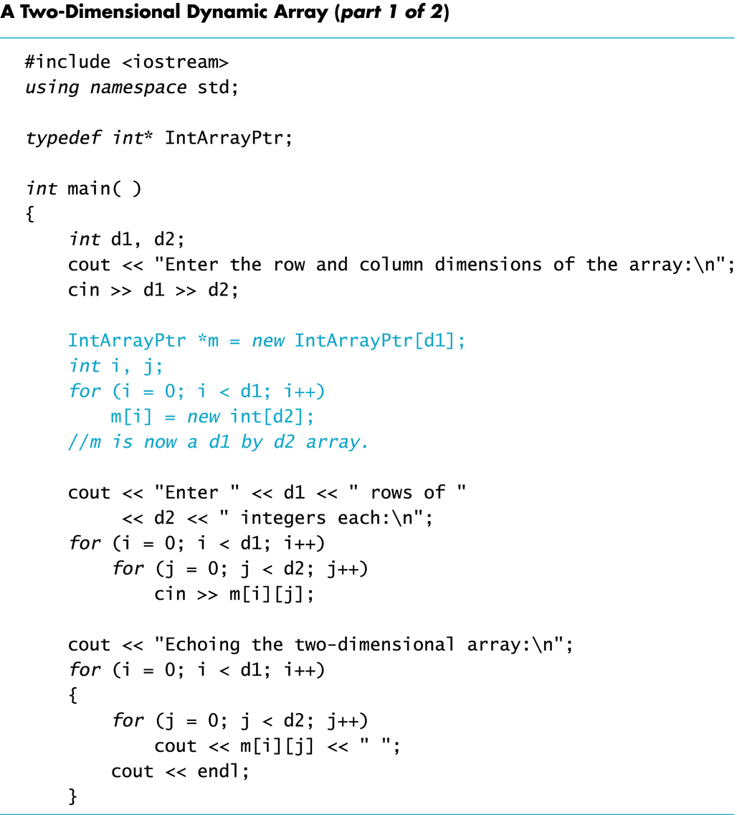
Display 9.6 (1/2)
Back
Next

Slide 23
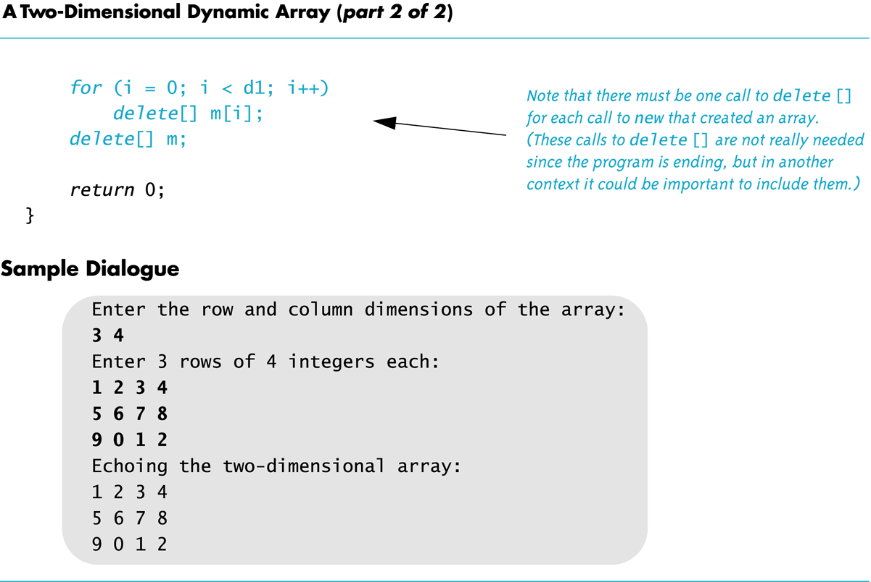
Display 9.6 (2/2)
Back
Next

