Slide 1
Recursion
Introduction to Programming
CS 200
Session 14

Slide 2
Why Recursion?
Why learn recursion?
New mode of thinking.
Powerful programming paradigm.
Many computations are naturally self-referential.
Many Sorting Techniques.
A folder contains files and other folders.
Factorial
Trees and Spirals

Slide 3
Recursion Defined
Models problems that are self-similar
Decompose whole task into smaller, simpler sub-tasks that are similar
Thus, each sub-task can be solved by applying similar technique
Whole task solved by combining solutions to sub-tasks
Special form of divide and conquer
Task is defined in terms of itself
In Java, modeled by method that calls itself
Requires base case (case simple enough to be solved directly, without recursion) to end recursion; otherwise infinite recursion

Slide 4
Recursion
Recursion solves a problem by solving a smaller instance of the same problem.
Think divide, conquer, and glue when all the subproblems have the same “shape” as the original problem.

Slide 5
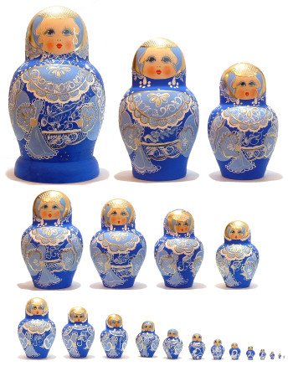
Russian Dolls
Take Example of the Russian Dolls
Each doll contains a smaller doll which in turn contains a smaller doll…
How do you know that there are no more dolls?
Could we apply the same procedure to count the participants of this class?

Slide 6
Counting the Number of Students
Lets try it out in pseudo-code ….
count(C)
if (C == 1)
{
return 1
}
else
{
count(C-1)
n = n + 1
}
This is the magic line

Slide 7
Remember Turtles
Use turtle to draw fractal shapes:
Fractals are complex shapes that are composed of smaller, simpler copies of some pattern
branch of mathematics developed by Benoit Mandelbrot: characteristic is self-similarity
natural for recursion!

Slide 8
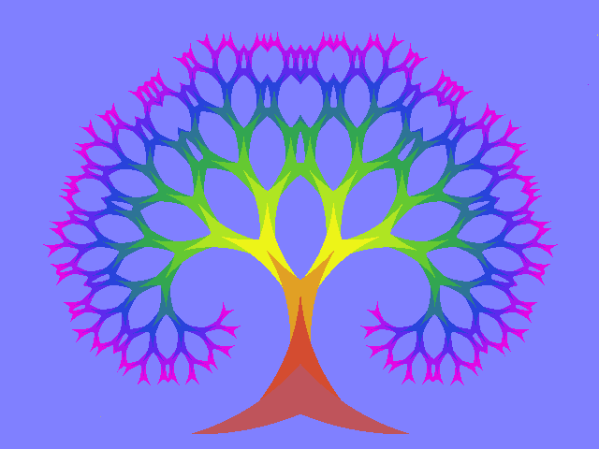

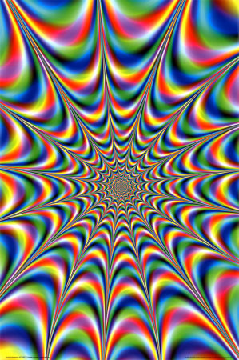
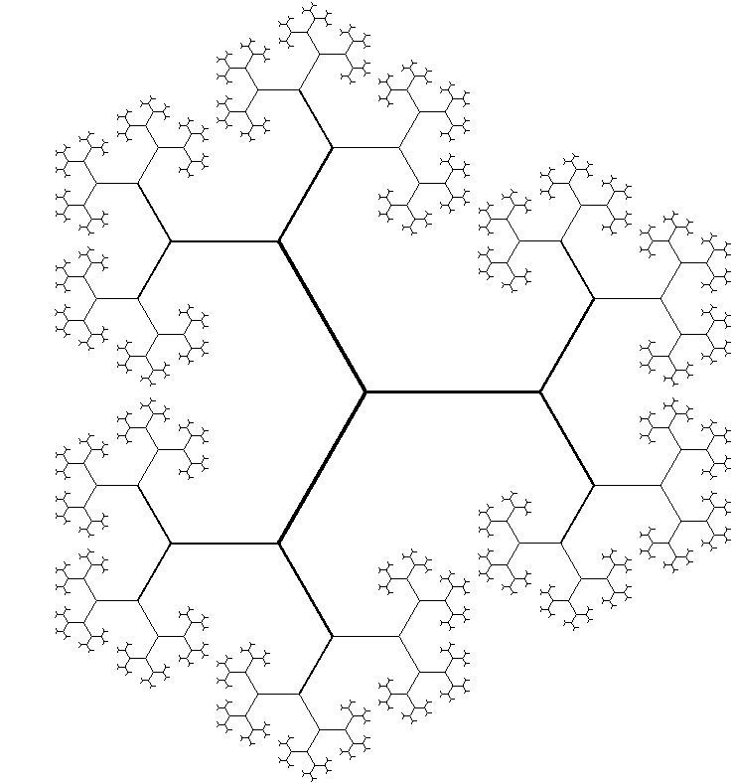
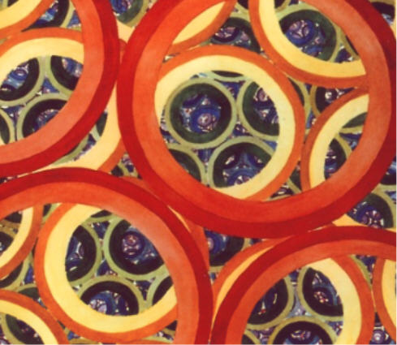
Some Example of Fractals

Slide 9

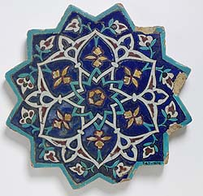
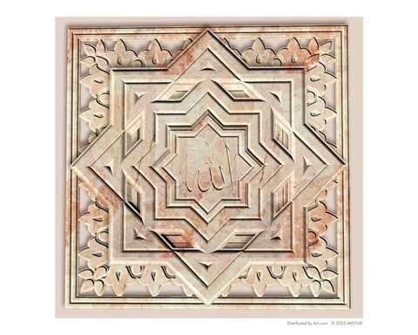
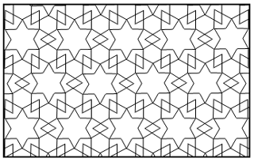
Some Islamic Art is Fractals Also

Slide 10
Three Basic Types of Recursion
Single void functions
Single functions that return values
Multiple functions calling each other

Slide 11
The Three Rules of Recursion
Approach every recursive problem as if it were a journey; if you follow these rules, you will complete the journey successfully.
RULE 1: Find out how to take just one step.
RULE 2: Break each journey down into one step plus a smaller journey.
RULE 3: Know when to stop.

Slide 12
Drawing a Spiral Using the Turtle
First Step: Move turtle forward to draw line and turn some degrees. What’s next?

Slide 13
Drawing a Spiral Using the Turtle
Draw smaller line and turn! Then another, and another...

Slide 14
Activation Records
With recursion,
Many activations of single method may
exist at once
At base case, as many exist as depth of
recursion
Each has its own copy of local variables as
well as parameters
Each activation of a method is stored on
the “stack”
Very Important
Concept

