Slide 1
Basics of Programming
Session 2
Introduction to Programming

Slide 2
About the Instructor
Naveed Arshad
Assistant Professor of Computer Science
Current chairman of the department until July 2017
At LUMS since 2006
PhD from University of Colorado at Boulder

Slide 3
Learning Outcomes
Understand simplistic view of a computer necessary for programming
Appreciate and understand the concept of a variable
Know the reason for an ‘assignment’ statement in programming

Slide 4

Outside of a Computer

Slide 5
Inside of a Computer

Slide 6
Simplistic View of a Computer

Slide 7
Very Simplistic View of a Computer
CPU
Location 0
Location 1
Location 2
Each location is
1 byte of memory
1 byte = 8 bits
Each bit is an electric
impulse carrying 1 or 0.
Location 3
Location 4
Location 5
This simplistic view is enough to explain the basic concepts
of programming to students

Slide 8
Value
The only task a computer can do is arithmetic e.g. multiplying, dividing, subtracting, etc.
Therefore, everything in the computer is represented as a value
Numbers, letters, characters, etc are all represented as values
Values could change depending on their nature. For example
the temperature today is different from the temperature yesterday
The number of cars inside Lahore is different then the number of in cars Islamabad.

Slide 9
Variable
To store a value inside a computer a ‘variable’ is used.
A variable is a space in the memory to store a value.
This space is reserved until the variable is required.

Slide 10
What Makes a Variable
Variable has three important characteristics:
Type
How much memory do a variable need.
This information is determined by a type.
Name
How to differentiate a variable with another variable of the same type.
Name refers to the memory location assigned to this variable.
Value
What is the value?
The actual value contained by a variable.

Slide 11
An Example of a Variable
Type of the variable is integer (written as “int” in C++)
int temperature = 35
A name of the variable
An initial value of the variable

Slide 12
Example of a Variable (Memory View)
int temperature = 35
00000000
Location 0
Locations 0 – 3 are collectively
called as ‘temperature’
00000000
Location 1
00000000
Location 2
00100011
Location 3
Location 4
100011 is the binary equivalent of 35
Location 5

Slide 13
Changing the Value of Variable
Lets change the value of ‘temperature’.
temperature = 45902
00000000
Location 0
Locations 0 – 3 are collectively
called as ‘temperature’
00000000
Location 1
10110011
Location 2
01001110
Location 3
Location 4
1011001101001110 is the binary equivalent of 45902
Location 5

Slide 14
Type of a Variable
Among other advantages a ‘type’ binds the memory to a variable name.
The type int is of 4 bytes in C++.
Therefore, it can hold maximum of 2,147,483,647 value.
It can also hold values in negative down to
-2,147,483,648.

Slide 15
Initializing Variables
Declaring a variable does not give it a value
Giving a variable its first value is initializing the variable
Variables are initialized in assignment statements double mpg; // declare the variable mpg = 26.3; // initialize the variable
Declaration and initialization can be combined using two methods
Method 1 double mpg = 26.3, area = 0.0 , volume;
Method 2 double mpg(26.3), area(0.0), volume;

Slide 16
Variable for Real Numbers
int cannot hold a real value.
Therefore, a type “double” is used to hold real values.
Double takes 8 bytes of memory instead of 4 bytes of a double.
Out of the 8 bytes in a double 4 bytes are used to hold the value before the decimal point and 4 bytes for the value after the decimal point.

Slide 17
Relative Comparison of int and double
int numPeople = 2;
Reserves 32 bits (4 bytes)
and sets the value stored
in that space to 2. The name
‘numPeople’ is associated with
this space.
double bill = 32.45;
Reserves 64 bits (8 bytes)
and sets the value stored
in that space to 32.45. The name
‘bill’ is associated with
this space.

Slide 18
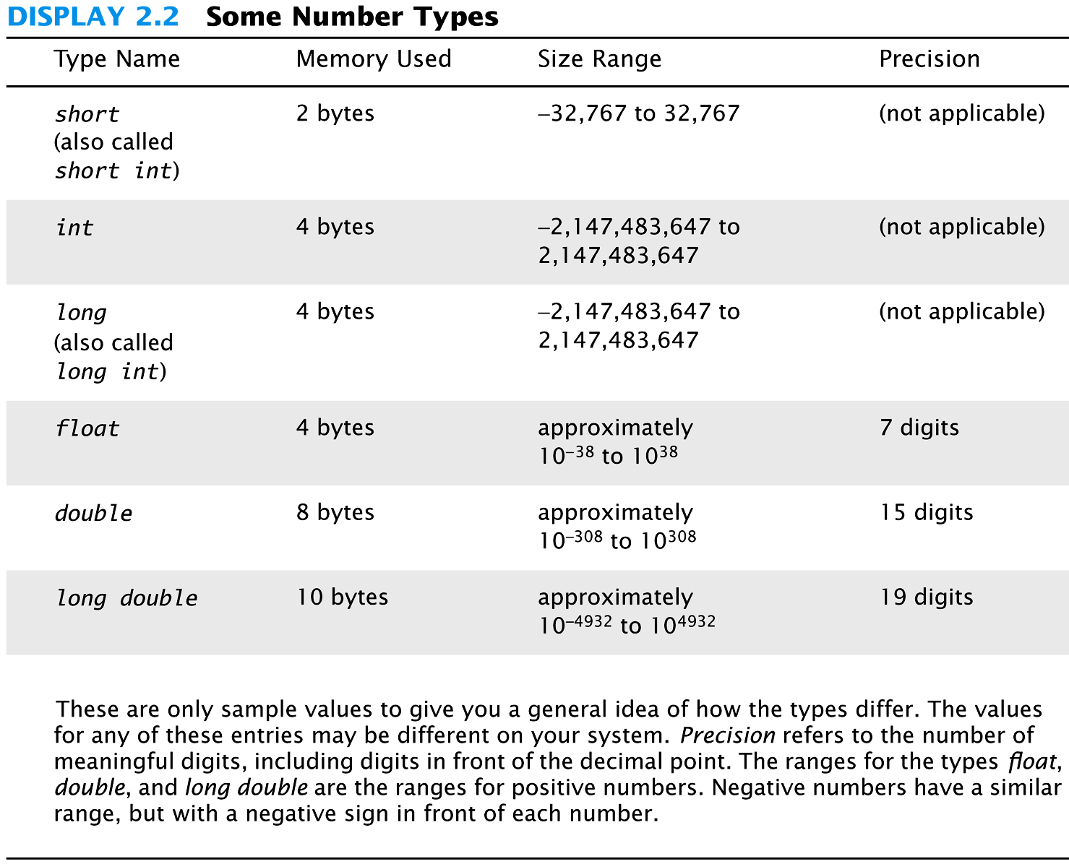

Slide 19
Manipulating Variables
Assignment Statement
In Mathematics the value x = x + 1 is not possible why?
In C++ x = x +1 is possible because “=” is an assignment operator and not an equality operator.
Assignment operator means that the contents of the right hand side is transferred to the memory location of the left hand side.

Slide 20
Assignment Statement
x
=
5671
5671 is written at the memory location reserved for x

Slide 21
Constants
Constants are values which cannot be modified e.g. the value of Pi
To declare a constant in C++, we write a keyword “const” before the variable type.
const double pi = 3.14;

Slide 22
Reserved Words
Some names cannot be declared as variable names because they are reserved words in C++

Slide 23
Manipulating Values
Mathematical Operators
Common mathematical operators are available in C++ for manipulating values e.g. addition(+), subtraction(-), multiplication(*), division(/), and modulus (%).
C++ has many other operators also which we will study in due course.

Slide 24
Arithmetic Expression Evaluation
To evaluate an arithmetic expression two concepts needs to be understood
Operator Precedence
Operator precedence controls the order in which operations are performed
Operator Associativity
The associativity of an operator specifies the order in which operations of the same precedence are performed

Slide 25
Operator Precedence and Associativity
Operators Precedence and Associativity for C++ is following
*, /, % → Do all multiplications, divisions and remainders from left to right.
+, - → Do additions and subtractions from left to right.

Slide 26
Evaluating an Expression
6 + 2 * 3 / 6
Three operators are in this expression.
However, * and / both have the same precedence and + has lower precedence then these two.
* and / will be evaluated first but both have the same precedence level.
Therefore, operator associatively will be used here to determine the first to get evaluated i.e. left to right.
The left most sub expression will be evaluated followed by the next right one and so on.

Slide 27
Primitive Data Types
So far the variable types that we have studied are primitive data types.
Primitive data types only have a memory space for storing values.

Slide 28
Type char
Computers process character data too
char
Short for character
Can be any single character from the keyboard
To declare a variable of type char:
char letter;

Slide 29
char constants
Character constants are enclosed in single quotes char letter = 'a';
Strings of characters, even if only one character is enclosed in double quotes
"a" is a string of characters containing one character
'a' is a value of type character

Slide 30
Reading Character Data
cin skips blanks and line breaks looking for data
The following reads two characters but skips any space that might be between char symbol1, symbol2; cin >> symbol1 >> symbol2;
User normally separate data items by spaces J D
Results are the same if the data is not separated by spaces JD

Slide 31
Type bool
bool is a new addition to C++
Short for boolean
Boolean values are either true or false
To declare a variable of type bool: bool old_enough;

Slide 32
Operator Shorthand
Some expressions occur so often that C++ contains to shorthand operators for them
All arithmetic operators can be used this way
+= count = count + 2; becomes count += 2;
*= bonus = bonus * 2; becomes bonus *= 2;
/= time = time / rush_factor; becomes time /= rush_factor;
%= remainder = remainder % (cnt1+ cnt2); becomes remainder %= (cnt1 + cnt2);

Slide 33
Input and Output

Slide 34
Input and Output
A data stream is a sequence of data
Typically in the form of characters or numbers
An input stream is data for the program to use
Typically originates
at the keyboard
at a file
An output stream is the program’s output
Destination is typically
the monitor
a file

Slide 35
Output using cout
cout is an output stream sending data to the monitor
The insertion operator "<<" inserts data into cout
Example: cout << number_of_bars << " candy bars\n";
This line sends two items to the monitor
The value of number_of_bars
The quoted string of characters " candy bars\n"
Notice the space before the ‘c’ in candy
The ‘\n’ causes a new line to be started following the ‘s’ in bars
A new insertion operator is used for each item of output

Slide 36
Examples Using cout
This produces the same result as the previous sample cout << number_of_bars ; cout << " candy bars\n";
Here arithmetic is performed in the cout statement cout << "Total cost is $" << (price + tax);
Quoted strings are enclosed in double quotes ("Walter")
Don’t use two single quotes (')
A blank space can also be inserted with cout << " " ; if there are no strings in which a space is desired as in " candy bars\n"

Slide 37
Include Directives
Include Directives add library files to our programs
To make the definitions of the cin and cout available to the program: #include <iostream>
Using Directives include a collection of defined names
To make the names cin and cout available to our program: using namespace std;

Slide 38
Escape Sequences
Escape sequences tell the compiler to treat characters in a special way
'\' is the escape character
To create a newline in output use \n – cout << "\n"; or the newer alternative cout << endl;
Other escape sequences: \t -- a tab \\ -- a backslash character \" -- a quote character

Slide 39
Formatting Real Numbers
Real numbers (type double) produce a variety of outputs double price = 78.5; cout << "The price is $" << price << endl;
The output could be any of these: The price is $78.5 The price is $78.500000 The price is $7.850000e01
The most unlikely output is: The price is $78.50

Slide 40
Showing Decimal Places
cout includes tools to specify the output of type double
To specify fixed point notation
setf(ios::fixed)
To specify that the decimal point will always be shown
setf(ios::showpoint)
To specify that two decimal places will always be shown
precision(2)
Example: cout.setf(ios::fixed); cout.setf(ios::showpoint); cout.precision(2); cout << "The price is " << price << endl;

Slide 41
Input Using cin
cin is an input stream bringing data from the keyboard
The extraction operator (>>) removes data to be used
Example: cout << "Enter the number of bars in a package\n"; cout << " and the weight in ounces of one bar.\n"; cin >> number_of_bars; cin >> one_weight;
This code prompts the user to enter data then reads two data items from cin
The first value read is stored in number_of_bars
The second value read is stored in one_weight
Data is separated by spaces when entered

Slide 42
Reading Data From cin
Multiple data items are separated by spaces
Data is not read until the enter key is pressed
Allows user to make corrections
Example: cin >> v1 >> v2 >> v3;
Requires three space separated values
User might type 34 45 12 <enter key>

Slide 43
Designing Input and Output
Prompt the user for input that is desired
cout statements provide instructions cout << "Enter your age: "; cin >> age;
Notice the absence of a new line before using cin
Echo the input by displaying what was read
Gives the user a chance to verify data cout << age << " was entered." << endl;

Slide 44
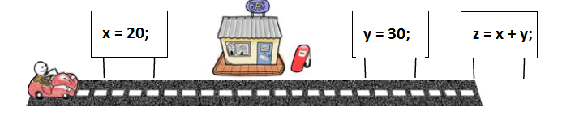
Sequential Programs

Slide 45
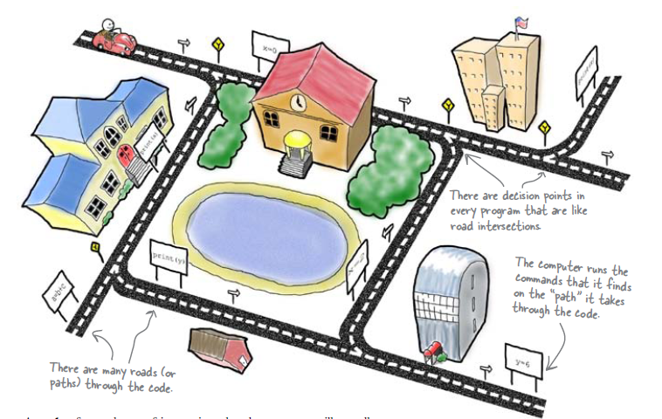
Your Program is Like a Network of Roads in a City

Slide 46
Simple Flow of Control
Flow of control
The order in which statements are executed
Branch
Lets program choose between two alternatives

Slide 47
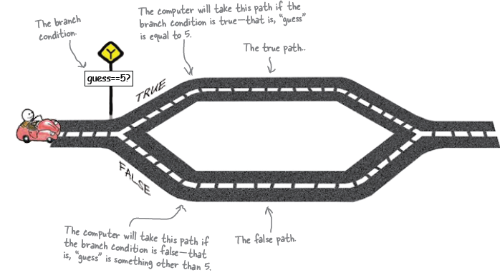
Branching Example

Slide 48
Branch Example
To calculate hourly wages there are two choices
Regular time ( up to 40 hours)
gross_pay = rate * hours;
Overtime ( over 40 hours)
gross_pay = rate * 40 + 1.5 * rate * (hours - 40);
The program must choose which of these expressions to use

Slide 49
Designing the Branch
Decide if (hours >40) is true
If it is true, then use gross_pay = rate * 40 + 1.5 * rate * (hours - 40);
If it is not true, then use gross_pay = rate * hours;

Slide 50
Implementing the Branch
if-else statement is used in C++ to perform a branch
if (hours > 40) gross_pay = rate * 40 + 1.5 * rate * (hours - 40);
else
gross_pay = rate * hours;

Slide 51
Boolean Expressions
Boolean expressions are expressions that are either true or false
comparison operators such as '>' (greater than) are used to compare variables and/or numbers
(hours > 40) Including the parentheses, is the boolean expression from the wages example
A few of the comparison operators that use two symbols (No spaces allowed between the symbols!)
>= greater than or equal to
!= not equal or inequality
= = equal or equivalent

Slide 52
if-else Flow Control (1)
if (boolean expression) true statement else false statement
When the boolean expression is true
Only the true statement is executed
When the boolean expression is false
Only the false statement is executed

Slide 53
if-else Flow Control (2)
if (boolean expression) { true statements } else {
false statements }
When the boolean expression is true
Only the true statements enclosed in { } are executed
When the boolean expression is false
Only the false statements enclosed in { } are executed

Slide 54
AND
Boolean expressions can be combined into more complex expressions with
&& -- The AND operator
True if both expressions are true
Syntax: (Comparison_1) && (Comparison_2)
Example: if ( (2 < x) && (x < 7) )
True only if x is between 2 and 7
Inside parentheses are optional but enhance meaning

Slide 55
OR
| | -- The OR operator (no space!)
True if either or both expressions are true
Syntax: (Comparison_1) | | (Comparison_2)
Example: if ( ( x = = 1) | | ( x = = y) )
True if x contains 1
True if x contains the same value as y
True if both comparisons are true

Slide 56
NOT
! -- negates any boolean expression
!( x < y)
True if x is NOT less than y
!(x = = y)
True if x is NOT equal to y
! Operator can make expressions difficult to understand…use only when appropriate

Slide 57
Inequalities
Be careful translating inequalities to C++
if x < y < z translates as if ( ( x < y ) && ( y < z ) ) NOT if ( x < y < z )

Slide 58
Pitfall: Using = or ==
' = ' is the assignment operator
Used to assign values to variables
Example: x = 3;
'= = ' is the equality operator
Used to compare values
Example: if ( x == 3)
The compiler will accept this error: if (x = 3) but stores 3 in x instead of comparing x and 3
Since the result is 3 (non-zero), the expression is true

Slide 59
Compound Statements
A compound statement is more than one statement enclosed in { }
Branches of if-else statements often need to execute more that one statement
Example: if (boolean expression) { true statements } else {
false statements }

Slide 60
Branches Conclusion
Can you
Write an if-else statement that outputs the word High if the value of the variable score is greater than 100 and Low if the value of score is at most 100? The variables are of type int.
Write an if-else statement that outputs the word Warning provided that either the value of the variable temperature is greater than or equal to 100, or the of the variable pressure is greater than or equal to 200, or both. Otherwise, the if_else sttement outputs the word OK. The variables are of type int.

Slide 61
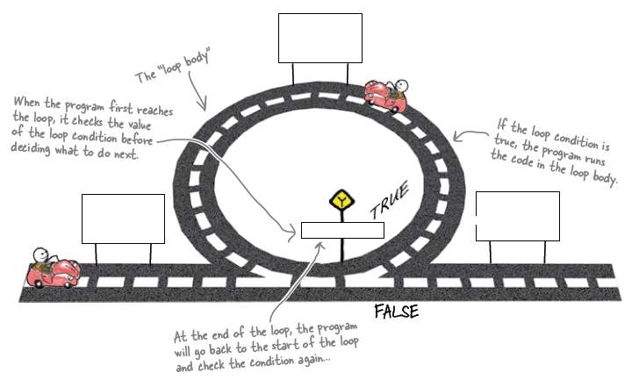
Simple Loops

Slide 62
Simple Loops
When an action must be repeated, a loop is used
C++ includes several ways to create loops
We start with the while-loop
Example: while (count_down > 0) { cout << "Hello "; count_down -= 1; }
Output: Hello Hello Hello when count_down starts at 3

Slide 63
While Loop Operation
First, the boolean expression is evaluated
If false, the program skips to the line following the while loop
If true, the body of the loop is executed
During execution, some item from the boolean expression is changed
After executing the loop body, the boolean expression is checked again repeating the process until the expression becomes false
A while loop might not execute at all if the boolean expression is false on the first check

Slide 64
while Loop Syntax
while (boolean expression is true) { statements to repeat }
Semi-colons are used only to end the statements within the loop
While (boolean expression is true) statement to repeat

Slide 65
do-while loop
A variation of the while loop.
A do-while loop is always executed at least once
The body of the loop is first executed
The boolean expression is checked after the body has been executed
Syntax: do { statements to repeat } while (boolean_expression);

Slide 66
Increment/Decrement
Unary operators require only one operand
+ in front of a number such as +5
- in front of a number such as -5
++ increment operator
Adds 1 to the value of a variable x ++; is equivalent to x = x + 1;
-- decrement operator
Subtracts 1 from the value of a variable x --; is equivalent to x = x – 1;

Slide 67
Sample Program
Bank charge card balance of $50
2% per month interest
How many months without payments before your balance exceeds $100
After 1 month: $50 + 2% of $50 = $51
After 2 months: $51 + 2% of $51 = $52.02
After 3 months: $52.02 + 2% of $52.02 …

Slide 68
Infinite Loops
Loops that never stop are infinite loops
The loop body should contain a line that will eventually cause the boolean expression to become false
Example: Print the odd numbers less than 12 x = 1; while (x != 12) { cout << x << endl; x = x + 2; }
Better to use this comparison: while ( x < 12)

Slide 69
Excercise
Can you
Show the output of this code if x is of type int? x = 10; while ( x > 0) { cout << x << endl; x = x – 3; }
Show the output of the previous code using the comparison x < 0 instead of x > 0?

Slide 70
Programmer’s Toolbox
Variables and their basic variable types
Assignment statement
Expressions and their evaluation
Variable type compatibilities
If-else statement
Simple loops

