Slide 1
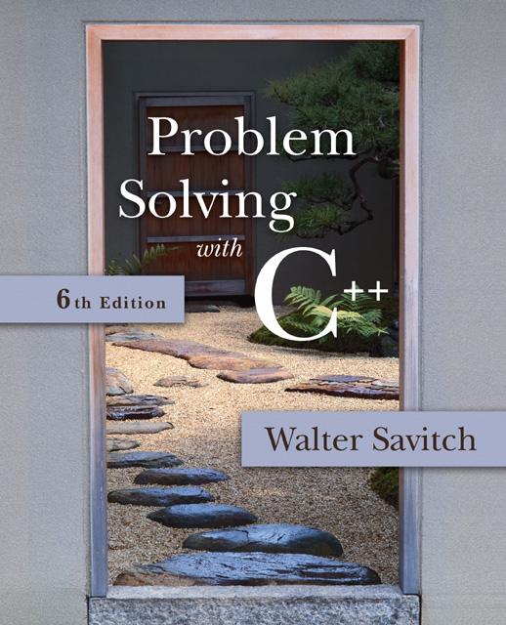

Slide 2
Session 20
Pointers and Linked Lists

Slide 3
Overview
13.1 Nodes and Linked Lists
13.2 Stacks and Queues

Slide 4
13.1
Nodes and Linked Lists

Slide 5
Nodes and Linked Lists
A linked list is a list that can grow and shrink while the program is running
A linked list is constructed using pointers
A linked list often consists of structs or classes that contain a pointer variable connecting them to other dynamic variables
A linked list can be visualized as items, drawn as boxes, connected to other items by arrows
head
10
12
14 | end

Slide 6
Nodes
The boxes in the previous drawing represent the nodes of a linked list
Nodes contain the data item(s) and a pointer that can point to another node of the same type
The pointers point to the entire node, not an individual item that might be in the node
The arrows in the drawing represent pointers
Display 13.1

Slide 7
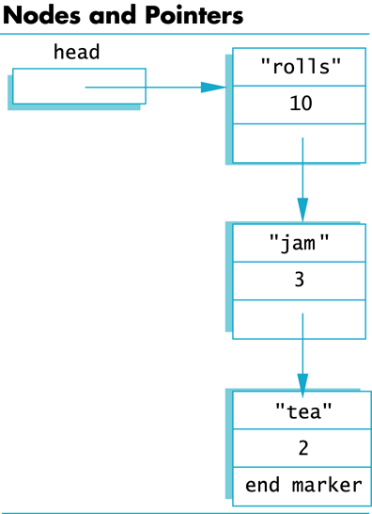
Display 13.1
Back
Next

Slide 8
Implementing Nodes
Nodes are implemented in C++ as structs or classes
Example: A structure to store two data items and a pointer to another node of the same type, along with a type definition might be: struct ListNode { string item; int count; ListNode *link; };
This circular definition is allowed in C++

Slide 9
The head of a List
The box labeled head, in display 13.1, is not a node, but a pointer variable that points to a node
Pointer variable head is declared as: ListNode* head;

Slide 10
Accessing Items in a Node
Using the diagram of 13.1, this is one way to change the number in the first node from 10 to 12: (*head).count = 12;
head is a pointer variable so *head is the node that head points to
The parentheses are necessary because the dot operator . has higher precedence than the dereference operator *

Slide 11
The Arrow Operator
The arrow operator -> combines the actions of the dereferencing operator * and the dot operator to specify a member of a struct or object pointed to by a pointer
(*head).count = 12; can be written as head->count = 12;
The arrow operator is more commonly used
Display 13.2

Slide 12
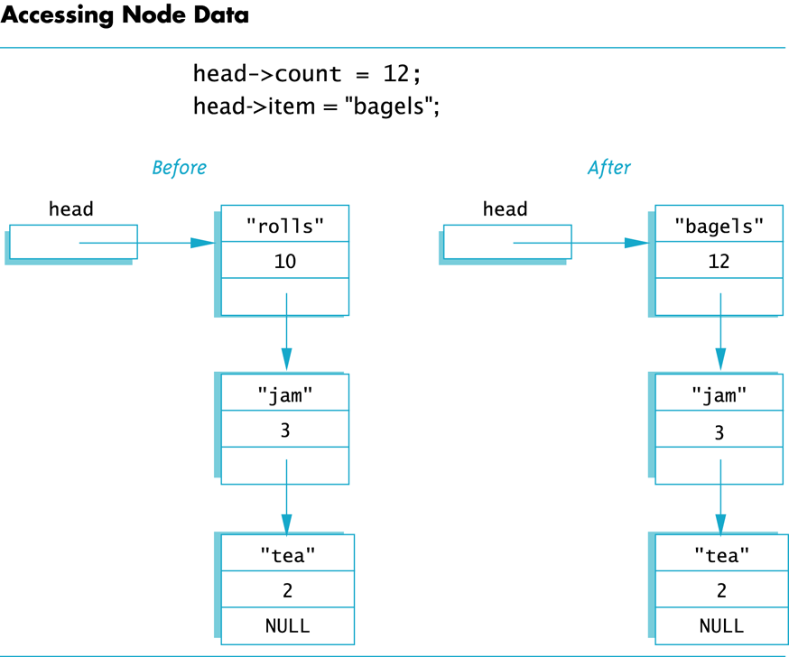
Display 13.2
Back
Next

Slide 13
NULL
The defined constant NULL is used as…
An end marker for a linked list
A program can step through a list of nodes by following the pointers, but when it finds a node containing NULL, it knows it has come to the end of the list
The value of a pointer that has nothing to point to
The value of NULL is 0
Any pointer can be assigned the value NULL: double* there = NULL;

Slide 14
To Use NULL
A definition of NULL is found in several libraries, including <iostream> and <cstddef>
A using directive is not needed for NULL

Slide 15
Linked Lists
The diagram in Display 13.2 depicts a linked list
A linked list is a list of nodes in which each node has a member variable that is a pointer that points to the next node in the list
The first node is called the head
The pointer variable head, points to the first node
The pointer named head is not the head of the list…it points to the head of the list
The last node contains a pointer set to NULL

Slide 16
Building a Linked List: The node definition
Let's begin with a simple node definition: struct Node { int data; Node *link; };

Slide 17
Building a Linked List: Declaring Pointer Variable head
With the node defined and a type definition to make or code easier to understand, we can declare the pointer variable head: Node* head;
head is a pointer variable that will point to the head node when the node is created

Slide 18
Building a Linked List: Creating the First Node
To create the first node, the operator new is used to create a new dynamic variable: head = new Node;
Now head points to the first, and only, node in the list

Slide 19
Building a Linked List: Initializing the Node
Now that head points to a node, we need to give values to the member variables of the node: head->data = 3; head->link = NULL;
Since this node is the last node, the link is set to NULL

Slide 20
Function head_insert
It would be better to create a function to insert nodes at the head of a list, such as:
void head_insert(Node*& head, int the_number);
The first parameter is a NodePtr parameter that points to the first node in the linked list
The second parameter is the number to store in the list
head_insert will create a new node for the number
The number will be copied to the new node
The new node will be inserted in the list as the new head node

Slide 21
Pseudocode for head_insert
Create a new dynamic variable pointed to by temp_ptr
Place the data in the new node called *temp_ptr
Make temp_ptr's link variable point to the head node
Make the head pointer point to temp_ptr
Display 13.3

Slide 22
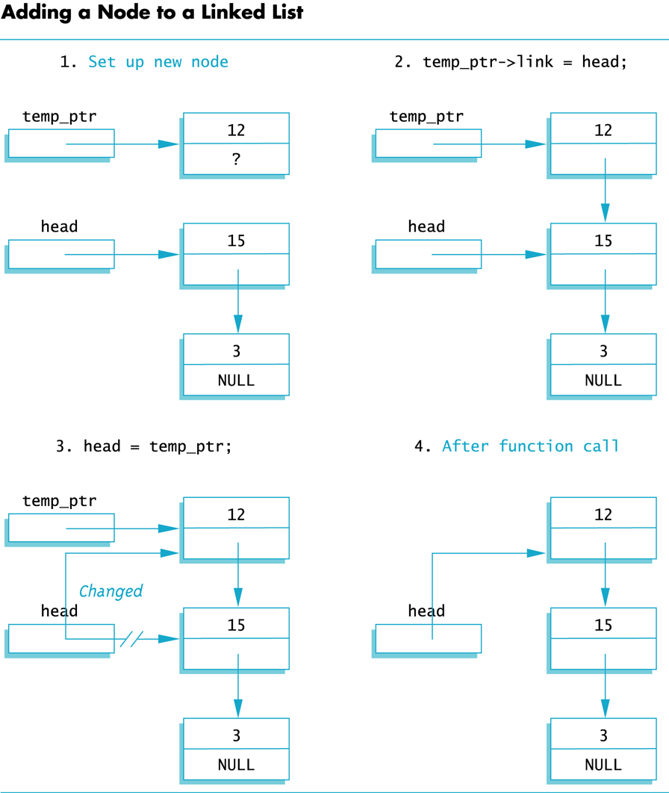
Display 13.3
Back
Next

Slide 23
Translating head_insert to C++
The pseudocode for head_insert can be written in C++ using these lines in place of the lines of pseudocode:
Node* temp_ptr; //create the temporary pointer temp_ptr = new Node; // create the new node
temp_ptr->data = the_number; //copy the number
temp_ptr->link = head; //new node points to first node head = temp_ptr; // head points to new // first node
Display 13.4

Slide 24
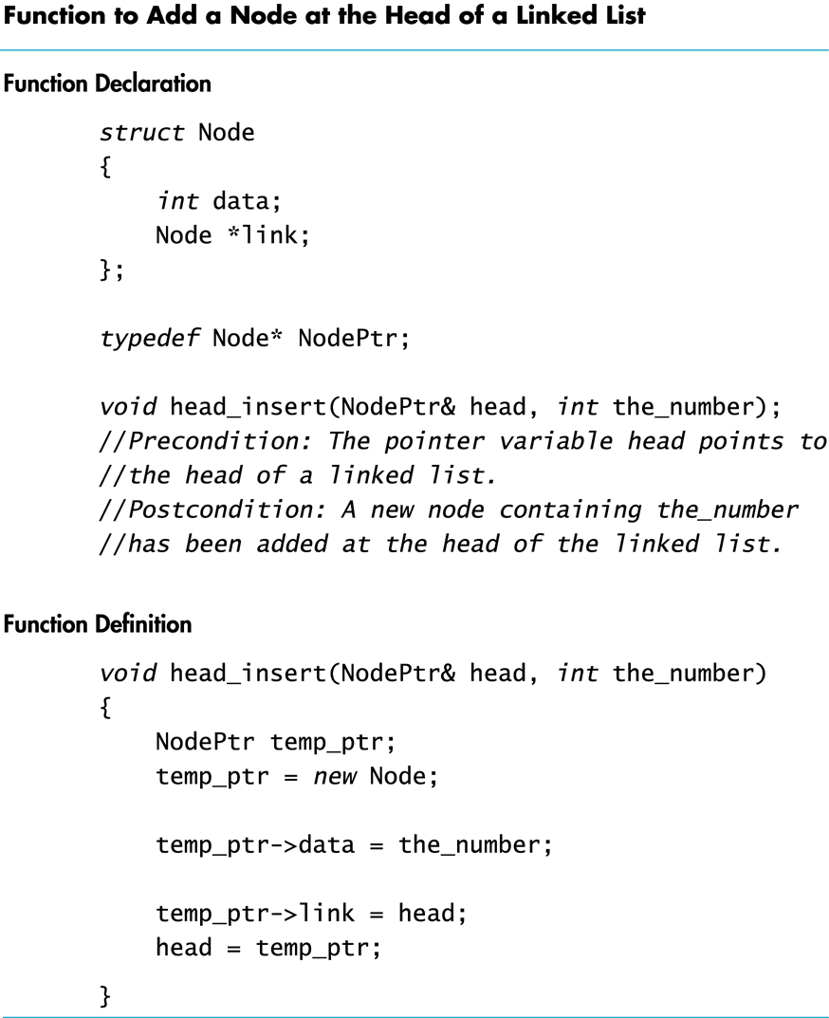
Display 13.4
Back
Next

Slide 25
An Empty List
A list with nothing in it is called an empty list
An empty linked list has no head node
The head pointer of an empty list is NULL head = NULL;
Any functions written to manipulate a linked list should check to see if it works on the empty list

Slide 26
Losing Nodes
You might be tempted to write head_insert using the head pointer to construct the new node: head = new Node; head->data = the_number;
Now to attach the new node to the list
The node that head used to point to is now lost!
Display 13.5

Slide 27
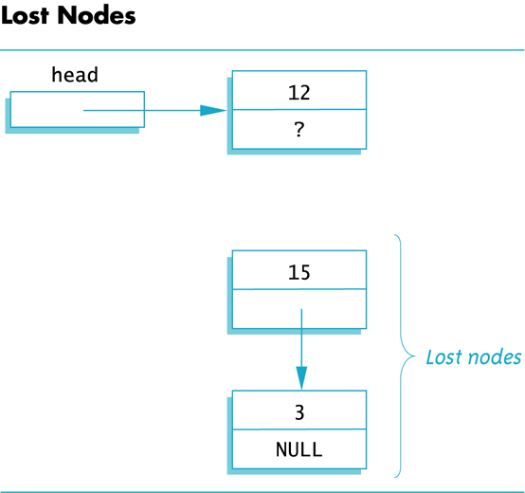
Display 13.5
Back
Next

Slide 28
Memory Leaks
Nodes that are lost by assigning their pointers a new address are not accessible any longer
The program has no way to refer to the nodes and cannot delete them to return their memory to the freestore
Programs that lose nodes have a memory leak
Significant memory leaks can cause system crashes

Slide 29
Searching a Linked List
To design a function that will locate a particular node in a linked list:
We want the function to return a pointer to the node so we can use the data if we find it, else return NULL
The linked list is one argument to the function
The data we wish to find is the other argument
This declaration will work: Node* search(Node* head, int target);

Slide 30
Function search
Refining our function
We will use a local pointer variable, named here, to move through the list checking for the target
The only way to move around a linked list is to follow pointers
We will start with here pointing to the first node and move the pointer from node to node following the pointer out of each node
Display 13.6

Slide 31
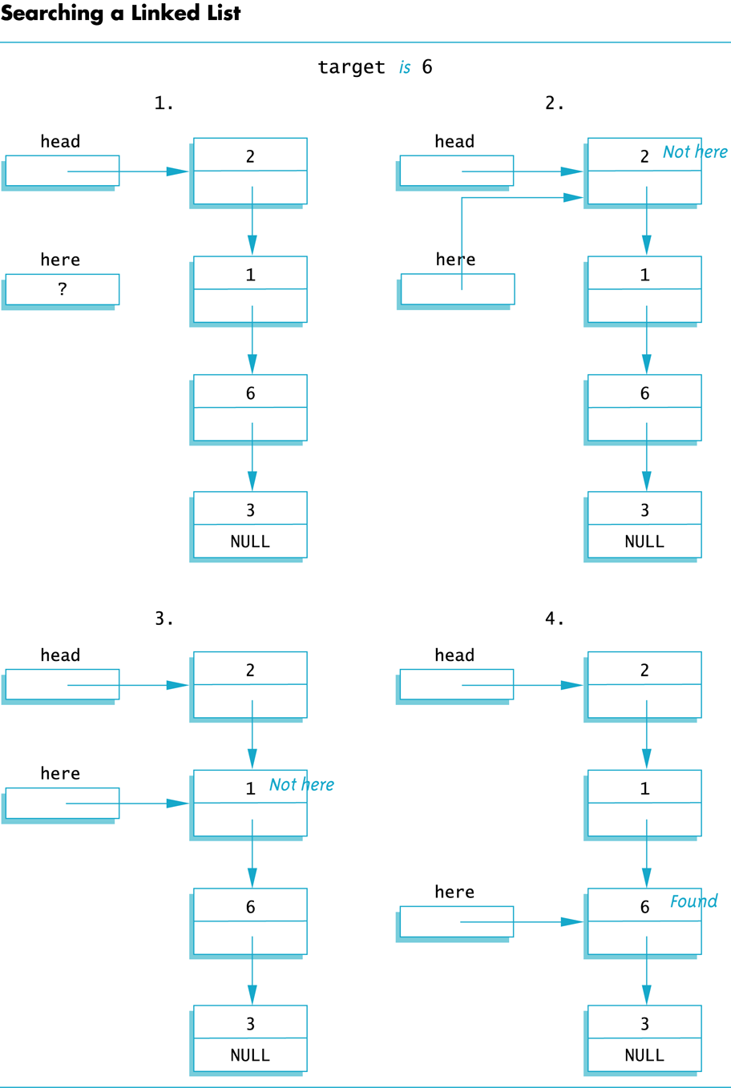
Display 13.6
Back
Next

Slide 32
Pseudocode for search
Make pointer variable here point to the head node
while(here does not point to a node containing target AND here does not point to the last node) { make here point to the next node }
If (here points to a node containing the target) return here; else return NULL;

Slide 33
Moving Through the List
The pseudocode for search requires that pointer here step through the list
How does here follow the pointers from node to node?
When here points to a node, here->link is the address of the next node
To make here point to the next node, make the assignment: here = here->link;

Slide 34
A Refinement of search
The search function can be refined in this way: here = head; while(here->data != target && here->link != NULL) { here = here->next; } if (here->data = = target) return here; else return NULL;
Check for last node

Slide 35
Searching an Empty List
Our search algorithm has a problem
If the list is empty, here equals NULL before the while loop so…
here->data is undefined
here->link is undefined
The empty list requires a special case in our search function
A refined search function that handles an empty list is shown in
Display 13.7

Slide 36
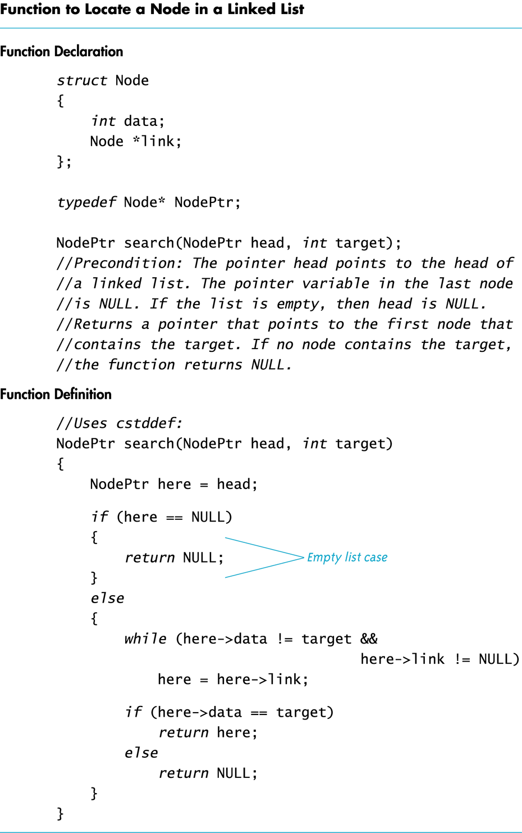
Display 13.7
Back
Next

Slide 37
Pointers as Iterators
An iterator is a construct that allows you to cycle through the data items in a data structure to perform an action on each item
An iterator can be an object of an iterator class, an array index, or simply a pointer
A general outline using a pointer as an iterator: Node_Type *iter; for (iter = Head; iter != NULL; iter = iter->Link) //perform the action on the node iter points to
Head is a pointer to the head node of the list

Slide 38
Iterator Example
Using the previous outline of an iterator we can display the contents of a linked list in this way: Node* iter; for (iter = Head; iter != NULL; iter = iter->Link) cout << (iter->data);

Slide 39
Inserting a Node Inside a List
To insert a node after a specified node in the linked list:
Use another function to obtain a pointer to the node after which the new node will be inserted
Call the pointer after_me
Use function insert, declared here to insert the node: void insert(Node* after_me, int the_number);
Display 13.8

Slide 40
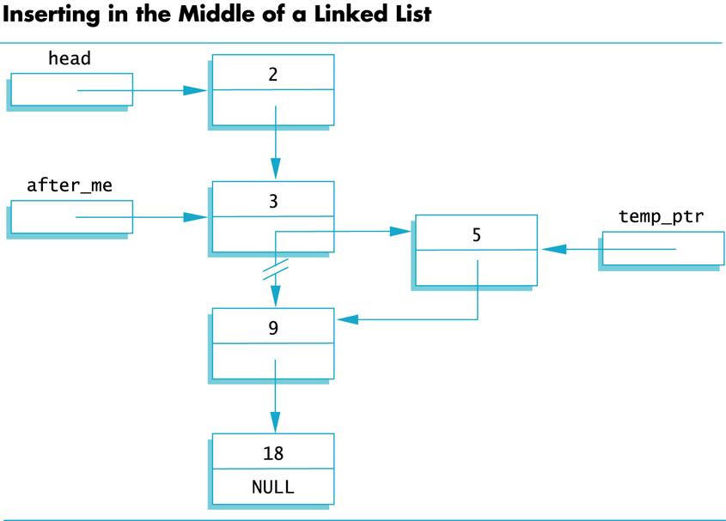
Display 13.8
Back
Next

Slide 41
Inserting the New Node
Function insert creates the new node just as head_insert did
We do not want our new node at the head of the list however, so…
We use the pointer after_me to insert the new node

Slide 42
Inserting the New Node
This code will accomplish the insertion of the new node, pointed to by temp_ptr, after the node pointed to by after_me: temp_ptr->link = after_me->link; after_me->link = temp_ptr;
2
3
7
9
head
2
2
2
0
5
after_me
temp_ptr
2

Slide 43
Caution!
The order of pointer assignments is critical
If we changed after_me->link to point to temp_ptr first, we would loose the rest of the list!
The complete insert function is shown in
Display 13.9

Slide 44
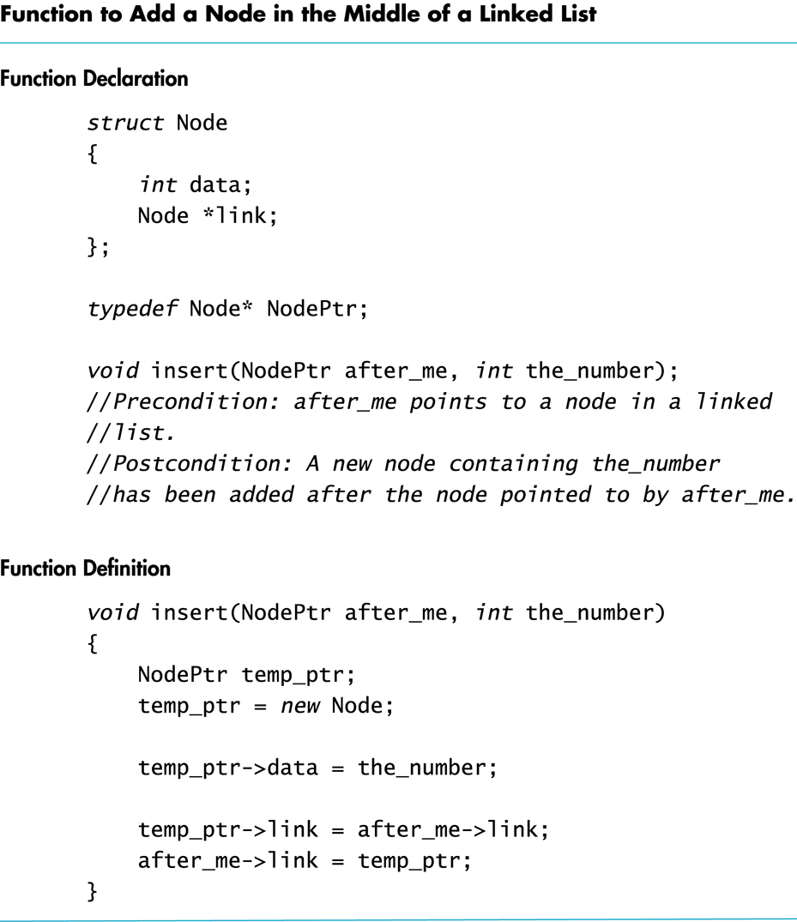
Display 13.9
Back
Next

Slide 45
Function insert Again
Notice that inserting into a linked list requires that you only change two pointers
This is true regardless of the length of the list
Using an array for the list would involve copying as many as all of the array elements to new locations to make room for the new item
Inserting into a linked list is often more efficient than inserting into an array

Slide 46
Removing a Node
To remove a node from a linked list
Position a pointer, before, to point at the node prior to the node to remove
Position a pointer, discard, to point at the node to remove
Perform: before->link = discard->link;
The node is removed from the list, but is still in memory
Return *discard to the freestore: delete discard;
Display 13.10

Slide 47
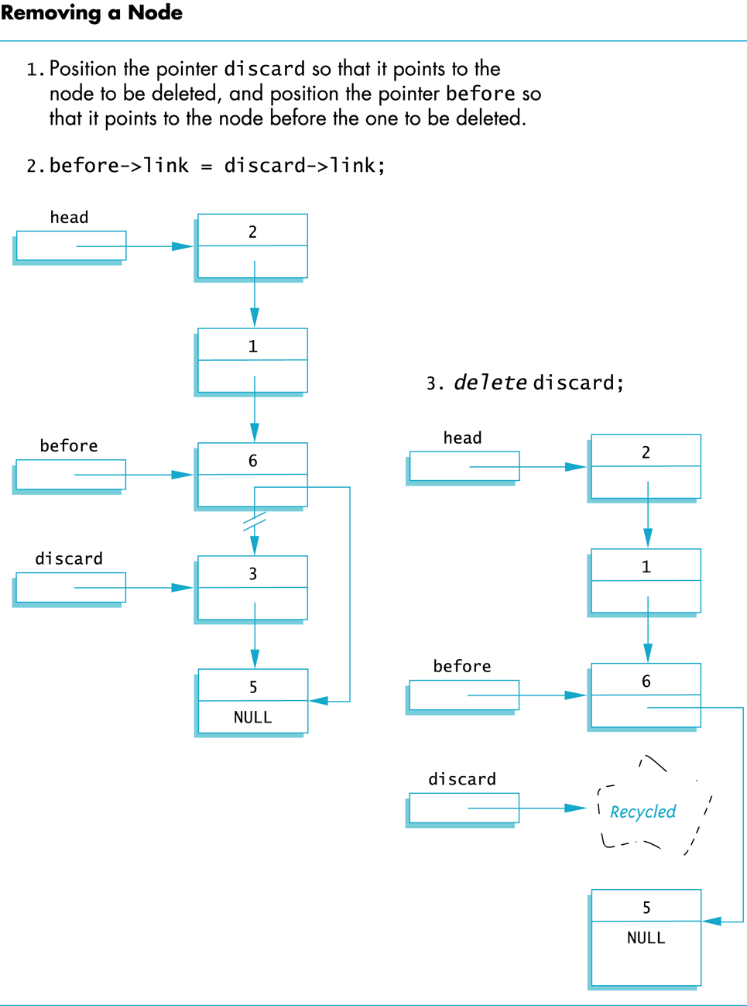
Display 13.10
Back
Next

Slide 48
AssignmentWith Pointers
If head1 and head2 are pointer variables and head1 points to the head node of a list: head2 = head1; causes head2 and head1 to point to the same list
There is only one list!
If you want head2 to point to a separate copy, you must copy the list node by node or overload the assignment operator appropriately

Slide 49
Section 13.1 Conclusion
Can you
Write type definitions for the nodes and pointers in a linked list? Call the node type NodeType and call the pointer type PointerType. The linked lists will be lists of letters.
Explain why inserting into an array can be less efficient than inserting into a linked list?

Slide 50
13.2
Stacks and Queues

Slide 51
A Linked List Application
A stack is a data structure that retrieves data in the reverse order the data was stored
If 'A', 'B', and then 'C' are placed in a stack, they will be removed in the order 'C', 'B', and then 'A'
A stack is a last-in/first-out data structure like the stack of plates in a cafeteria; adding a plate pushes down the stack and the top plate is the first one removed
Display 13.11

Slide 52
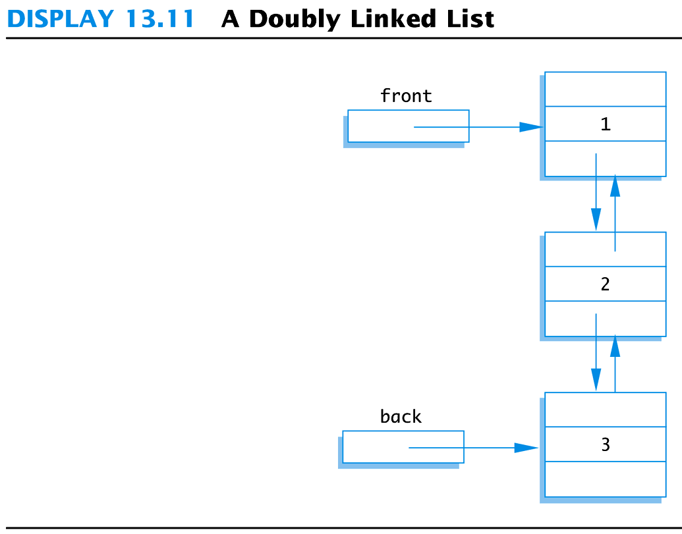
Display 13.11
Back
Next

Slide 53
Program Example: A Stack Class
We will create a stack class to store characters
Adding an item to a stack is pushing onto the stack
Member function push will perform this task
Removing an item from the stack is popping the the item off the stack
Member function pop will perform this task
contains the stack class interface
Display 13.12

Slide 54
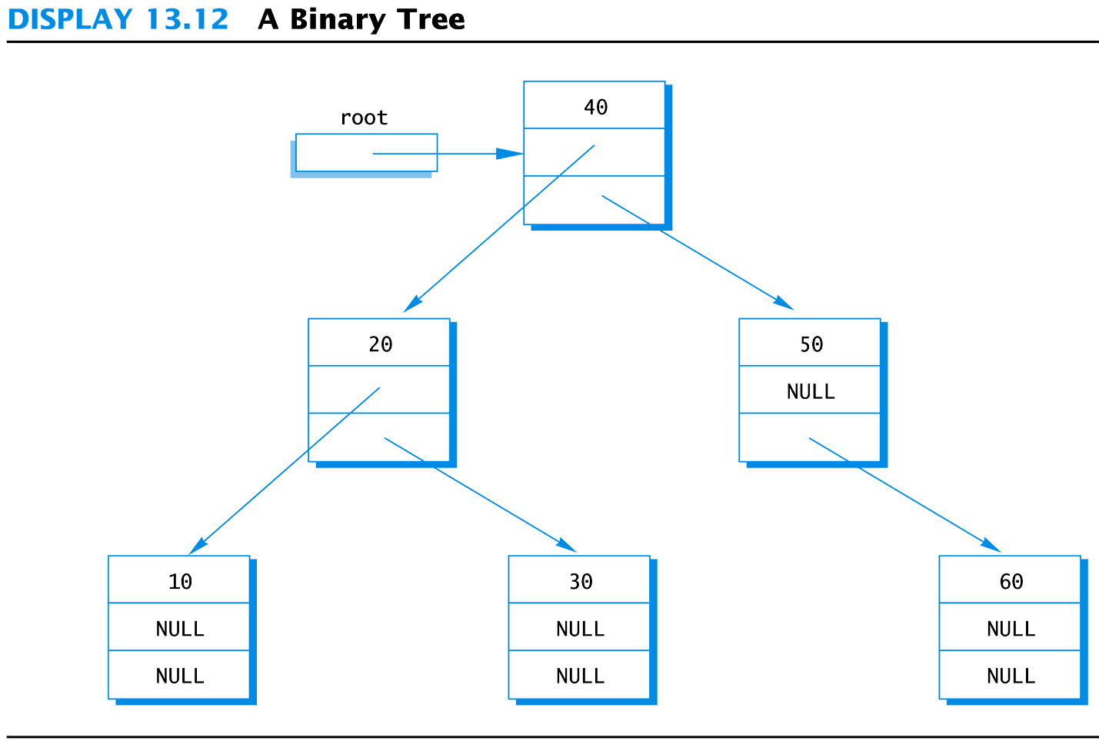
Display 13.12
Back
Next

Slide 55
Using the stack Class
demonstrates the use of the stack class
Display 13.13 (1-2)

Slide 56
Function push
The push function adds an item to the stack
It uses a parameter of the type stored in the stack void push(char the_symbol);
Pushing an item onto the stack is precisely the same task accomplished by function head_insert of the linked list
For a stack, a pointer named top is used instead of a pointer named head

Slide 57
Empty Stack
An empty stack is identified by setting the top pointer to NULL top = NULL;

Slide 58
The Copy Constructor
Because the stack class uses a pointer and creates new nodes using new, a copy constructor is needed
The copy constructor (a self-test exercise) must make a copy of each item in the stack and store the copies in a new stack
Items in the new stack must be in the same position in the stack as in the original

Slide 59
Function pop
The pop function returns the item that was at the top of the stack char pop( );
Before popping an item from a stack, pop checks that the stack is not empty
pop stores the top item in a local variable result, and the item is "popped" by: top = top->link;
A temporary pointer must point to the old top item so it can be "deleted" to prevent a memory leak
pop then returns variable result

Slide 60
The stack destructor
Because function pop calls delete each time an item is popped off the stack, ~stack only needs to call pop until the stack is empty char next; while( ! empty ( ) ) { next = pop( ); }

Slide 61
stack Class Implementation
The stack class implementation is found in
Display 13.14 (1)
Display 13.14 (2)

Slide 62
Section 13.2 Conclusion
Can you
Give the definition of member function push?
Create a definition for the stack class copy constructor?

Slide 63
Chapter 13 -- End

Slide 64
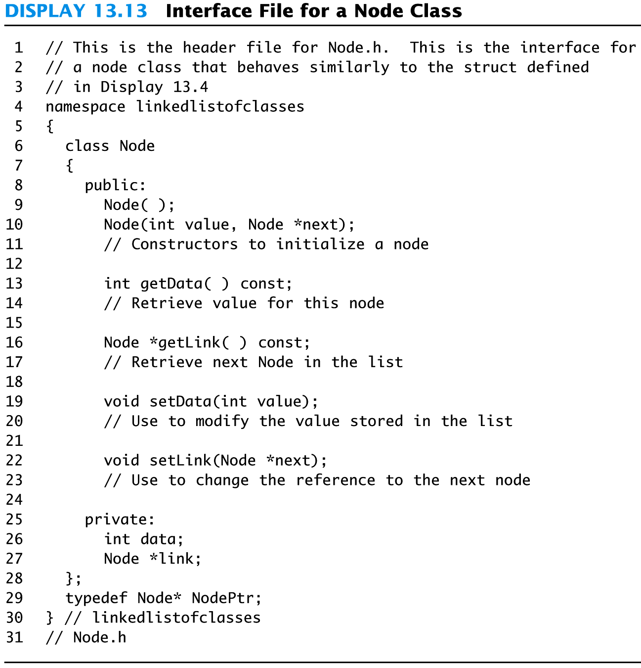
Display 13.13
Back
Next

Slide 65
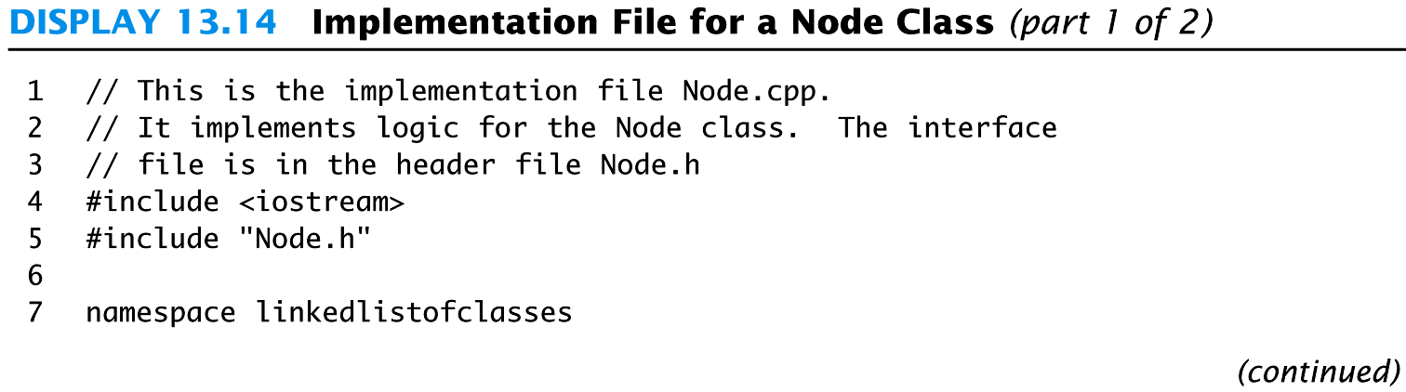
Display 13.14 (1/2)
Back
Next

Slide 66
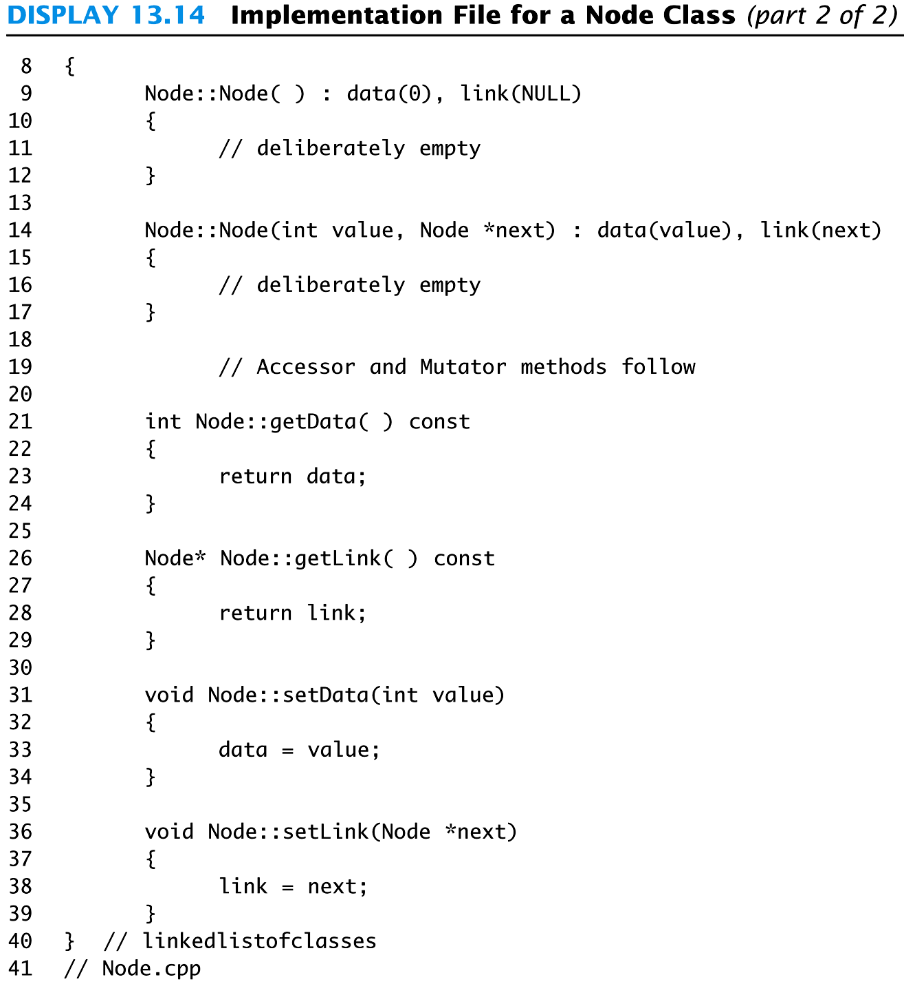
Display 13.14 (2/2)
Back
Next

Slide 67
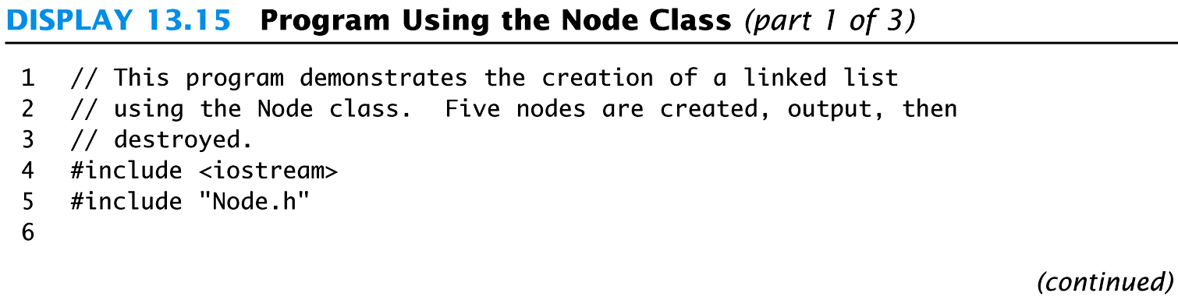
Display 13.15 (1/3)
Back
Next

Slide 68
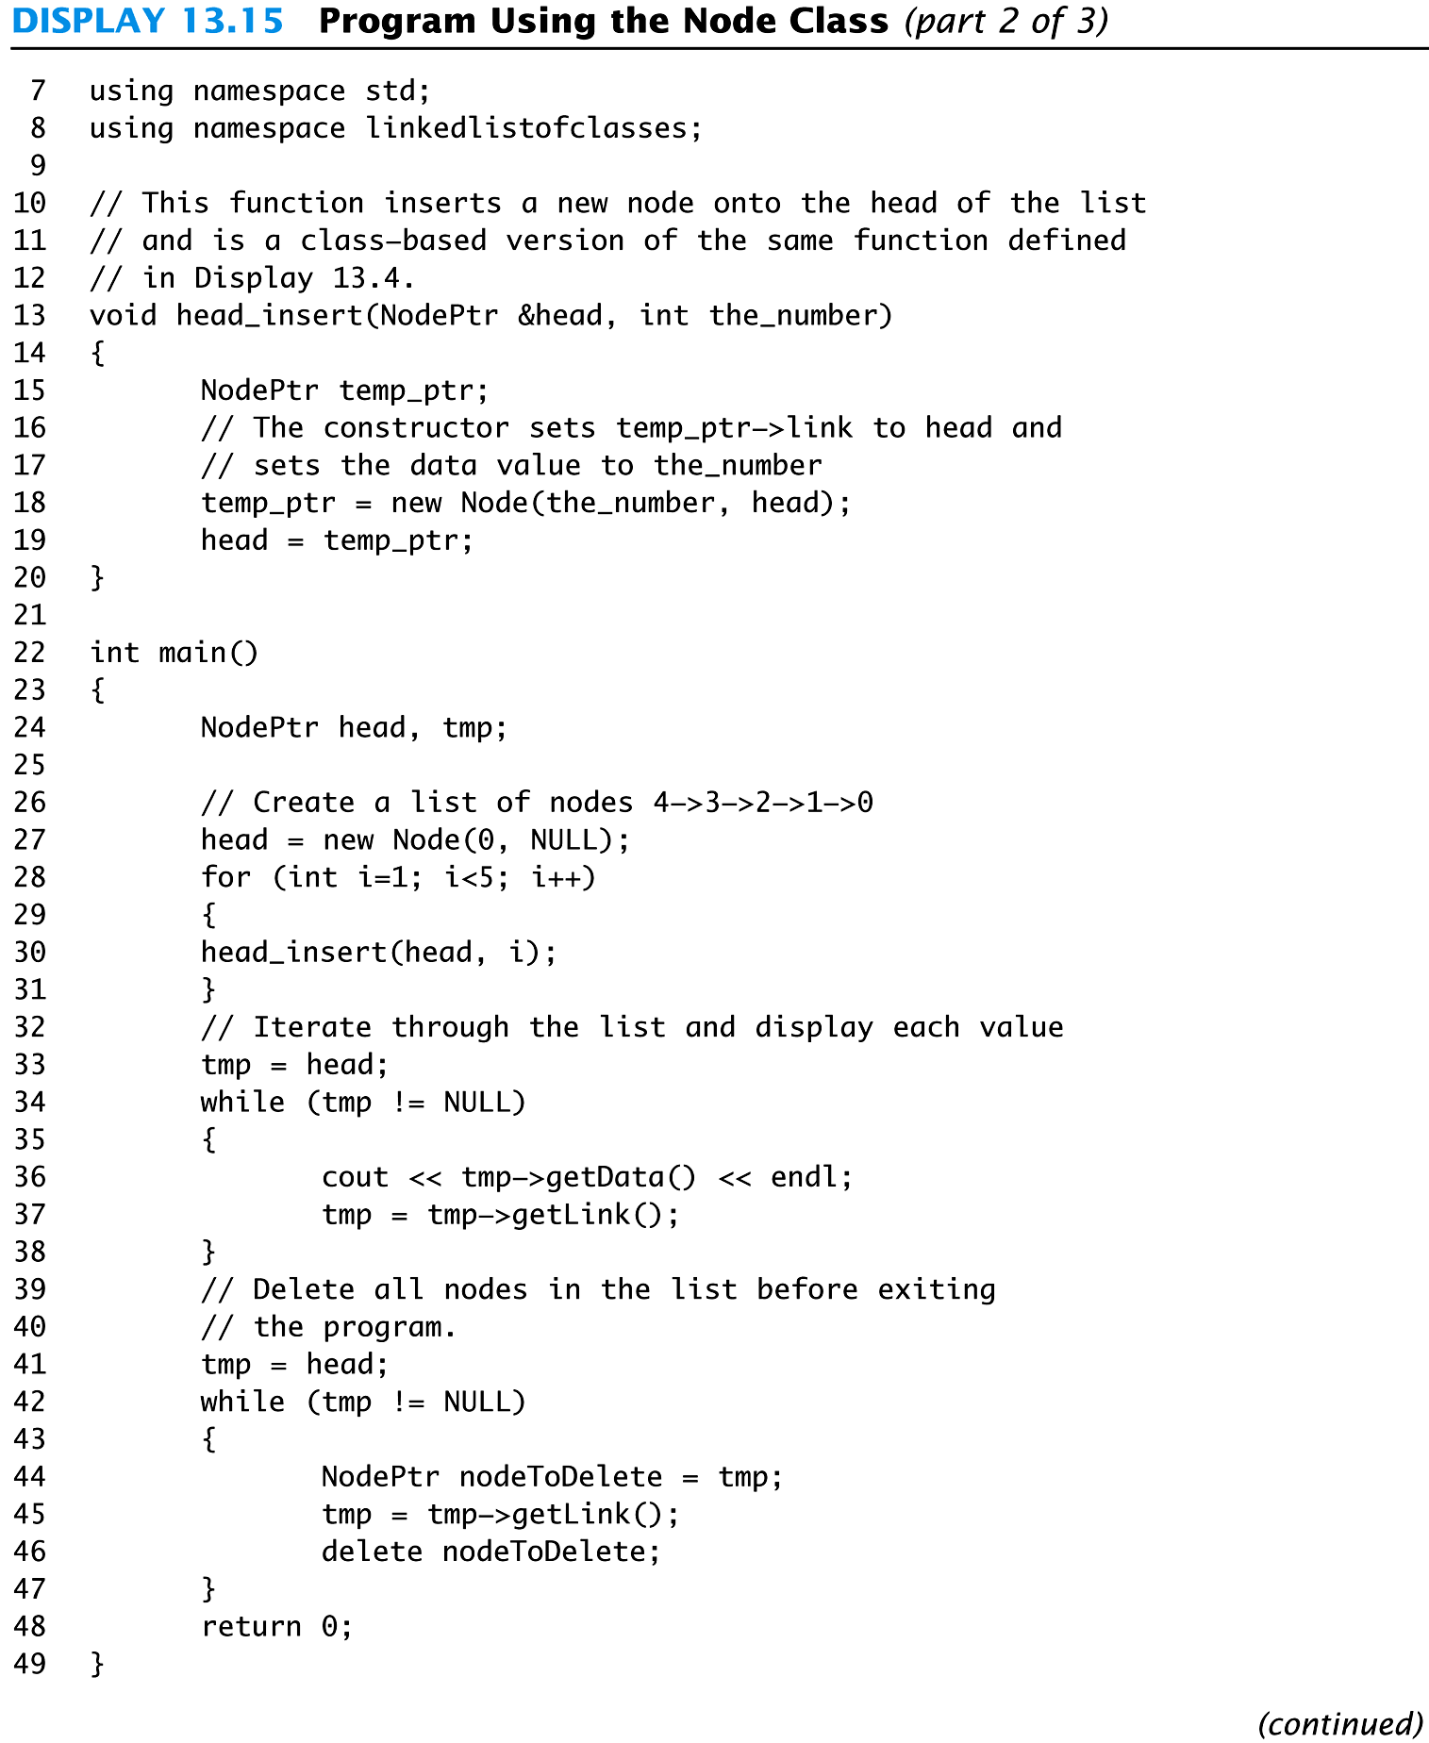
Display 13.15 (2/3)
Back
Next

Slide 69
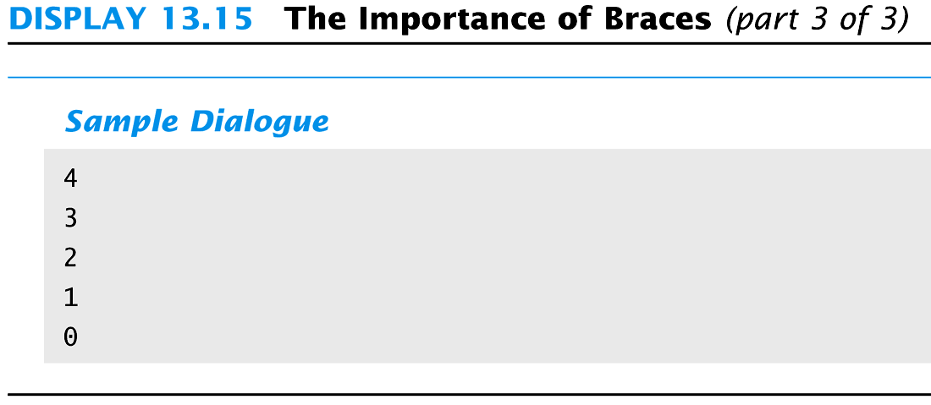
Display 13.15 (3/3)
Back
Next

Slide 70
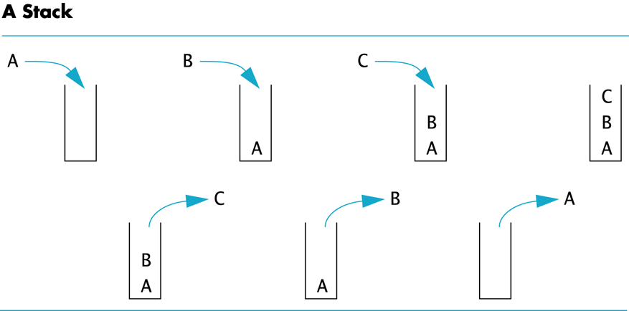
Display 13.16
Back
Next

Slide 71
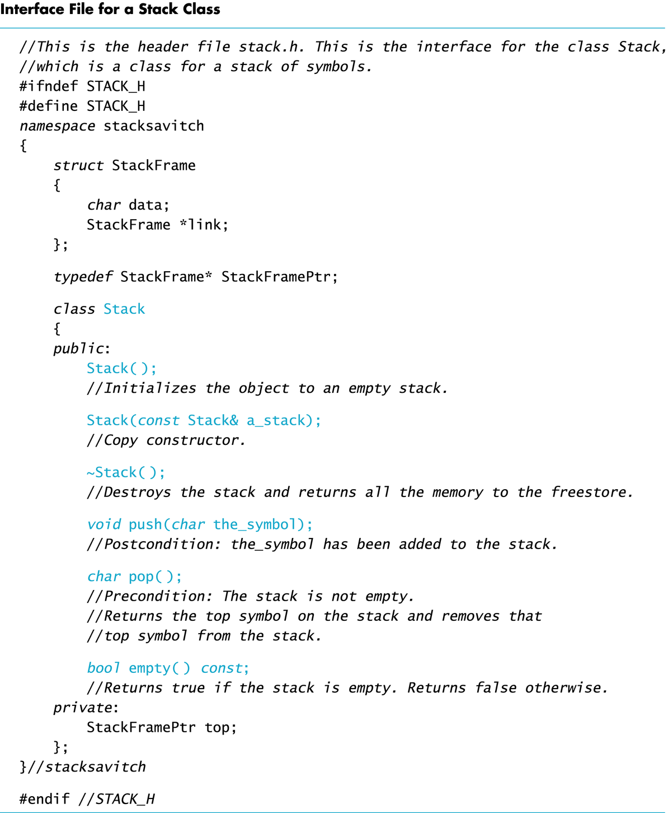
Display 13.17
Back
Next

Slide 72
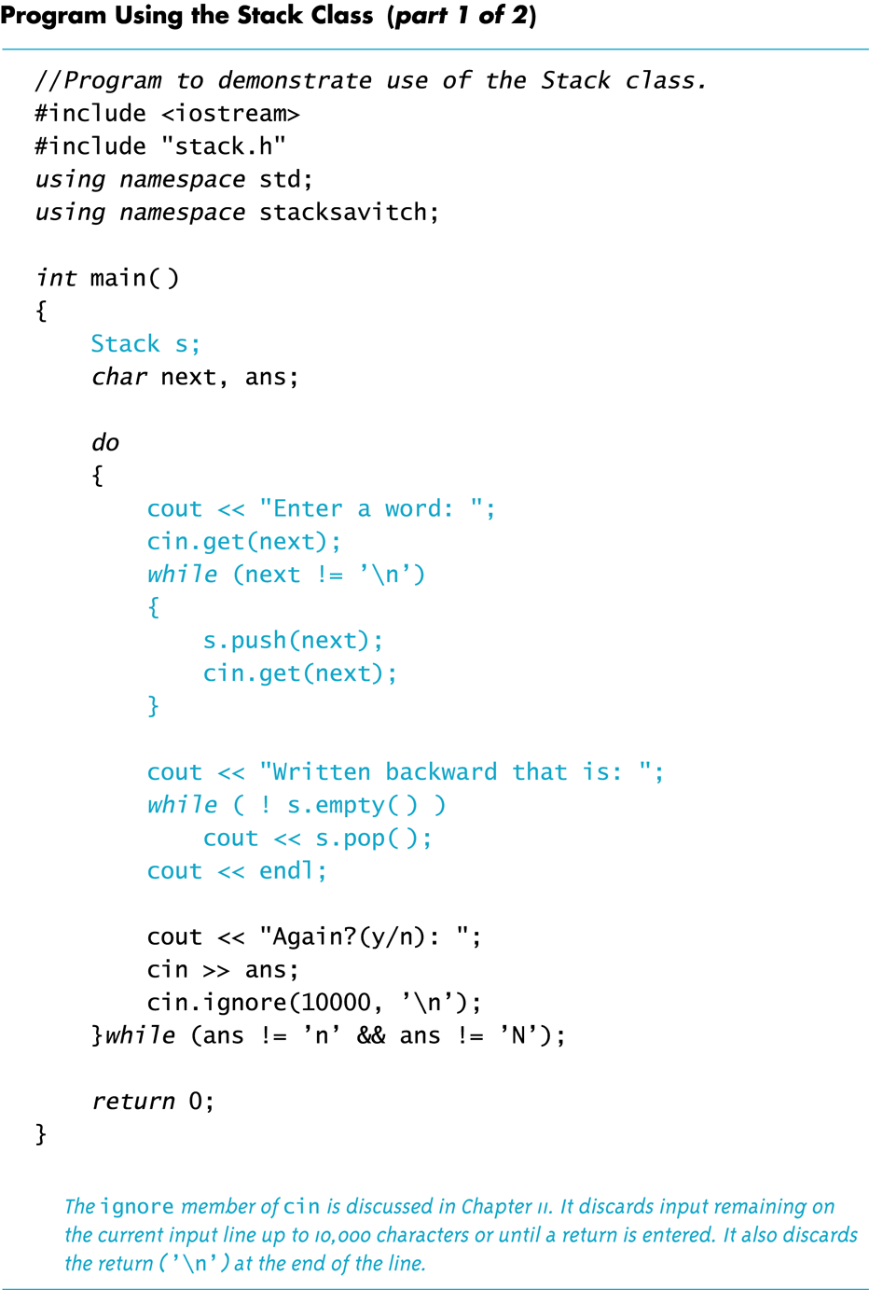
Display 13.18 (1/2)
Back
Next

Slide 73
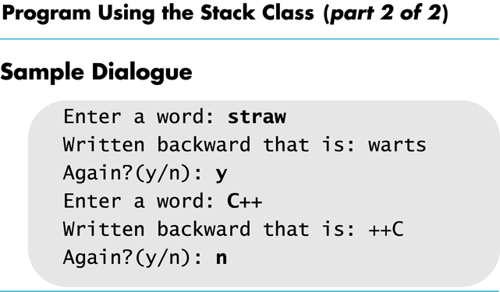
Display 13.18 (2/2)
Back
Next

Slide 74
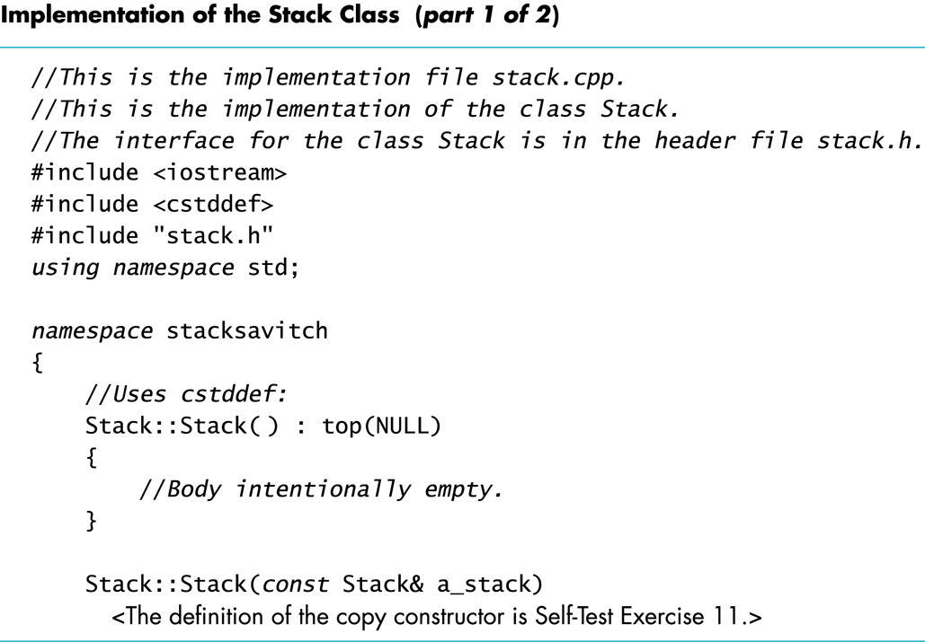
Display 13.19 (1/2)
Back
Next

Slide 75
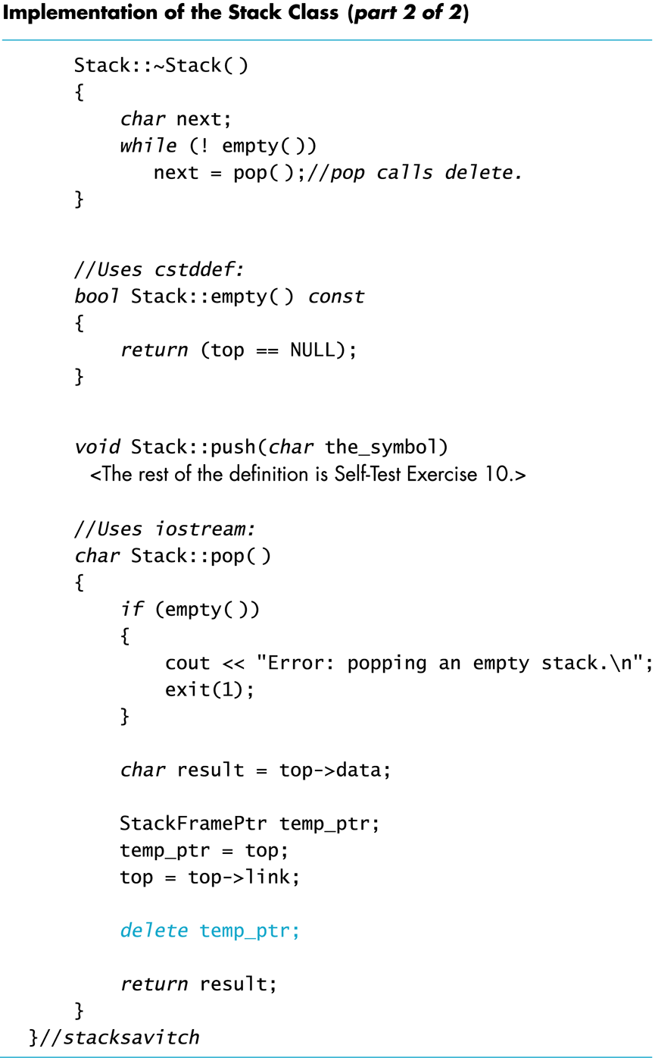
Display 13.19 (2/2)
Back
Next

Slide 76
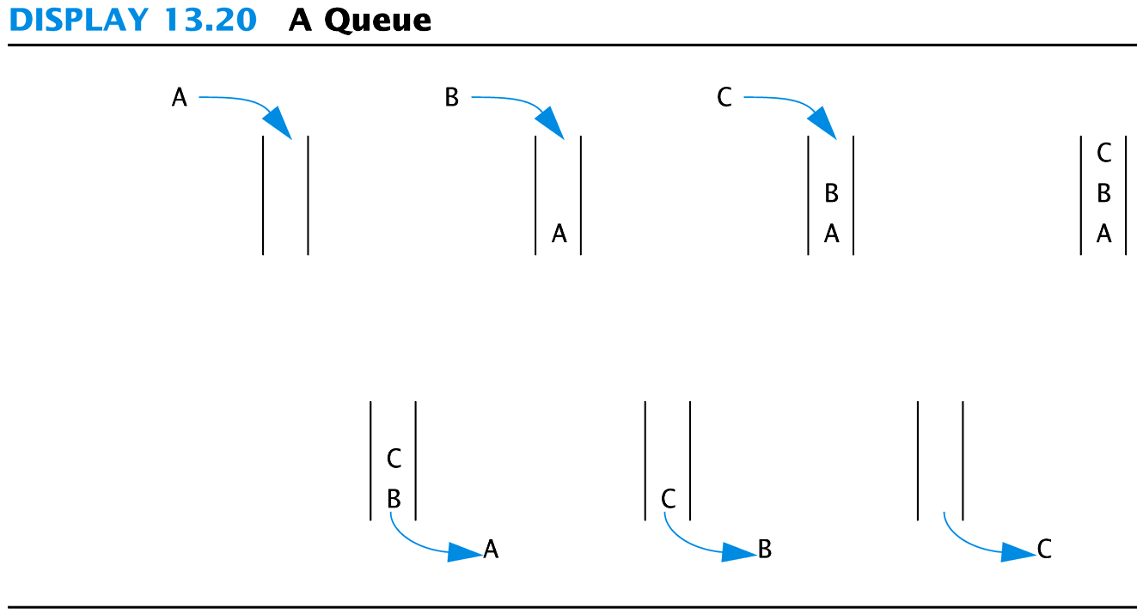
Display 13.20
Back
Next

Slide 77
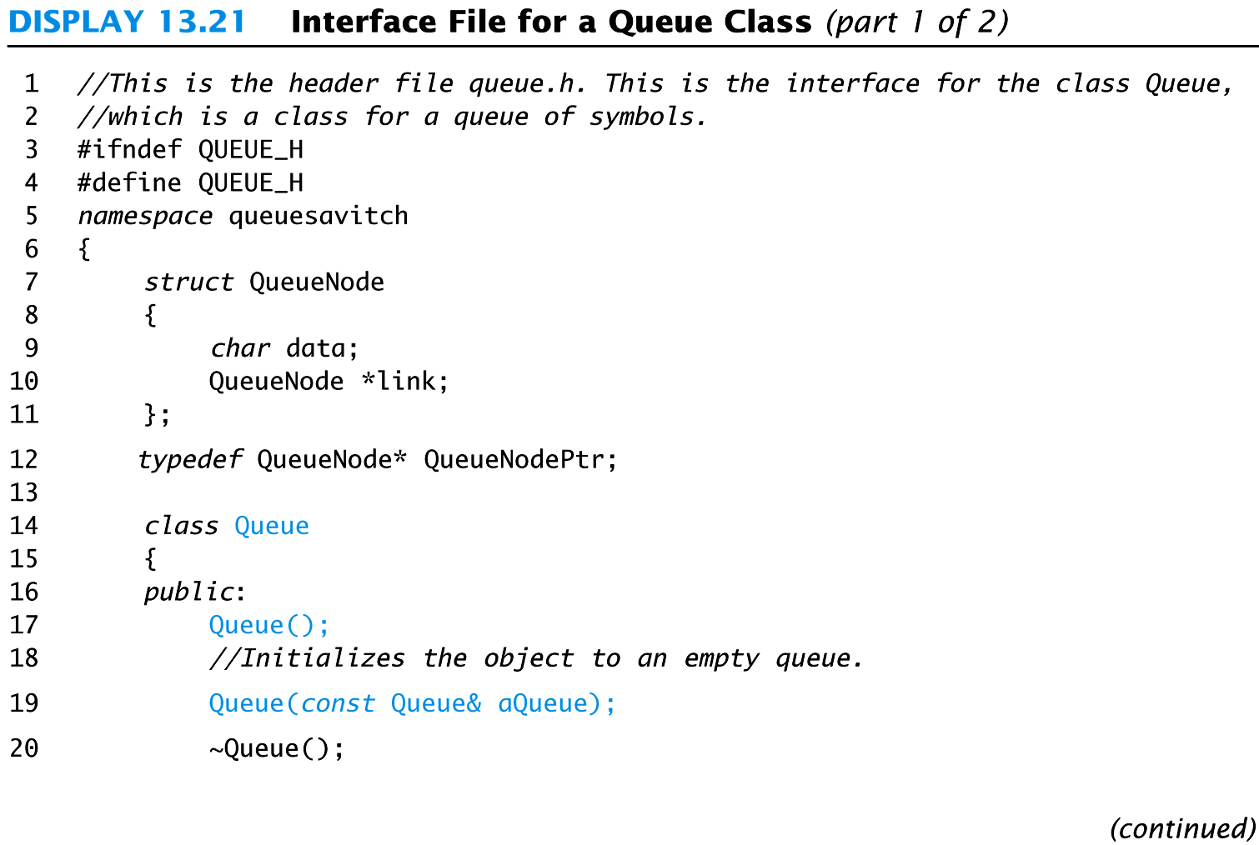
Display 13.21 (1/2)
Back
Next

Slide 78
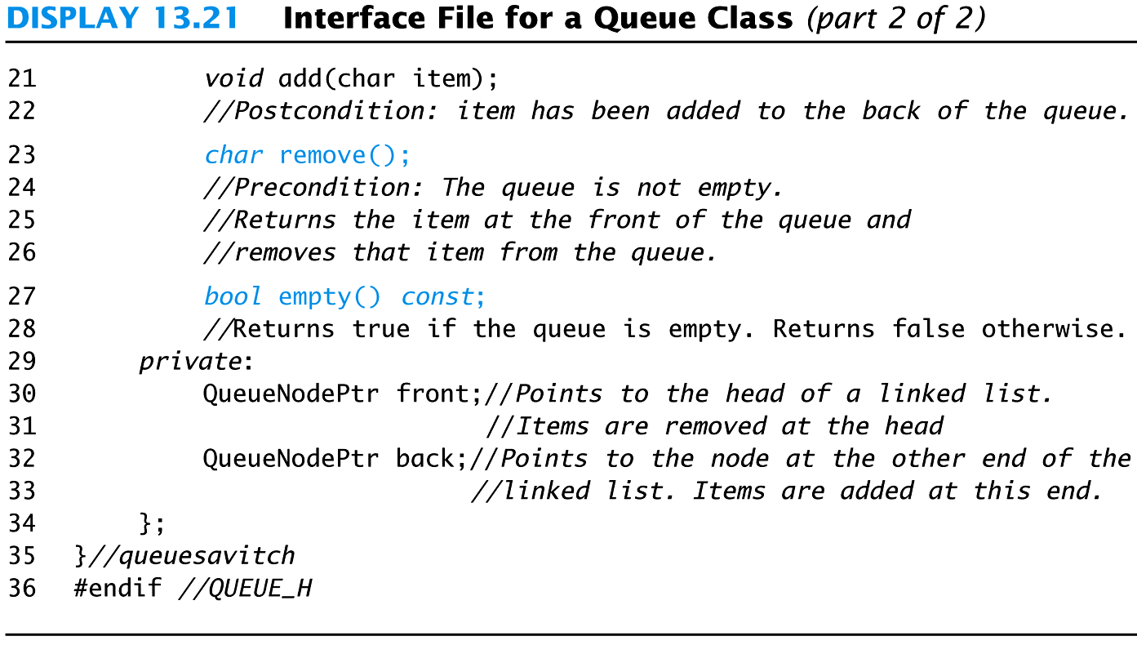
Display 13.21 (2/2)
Back
Next

Slide 79
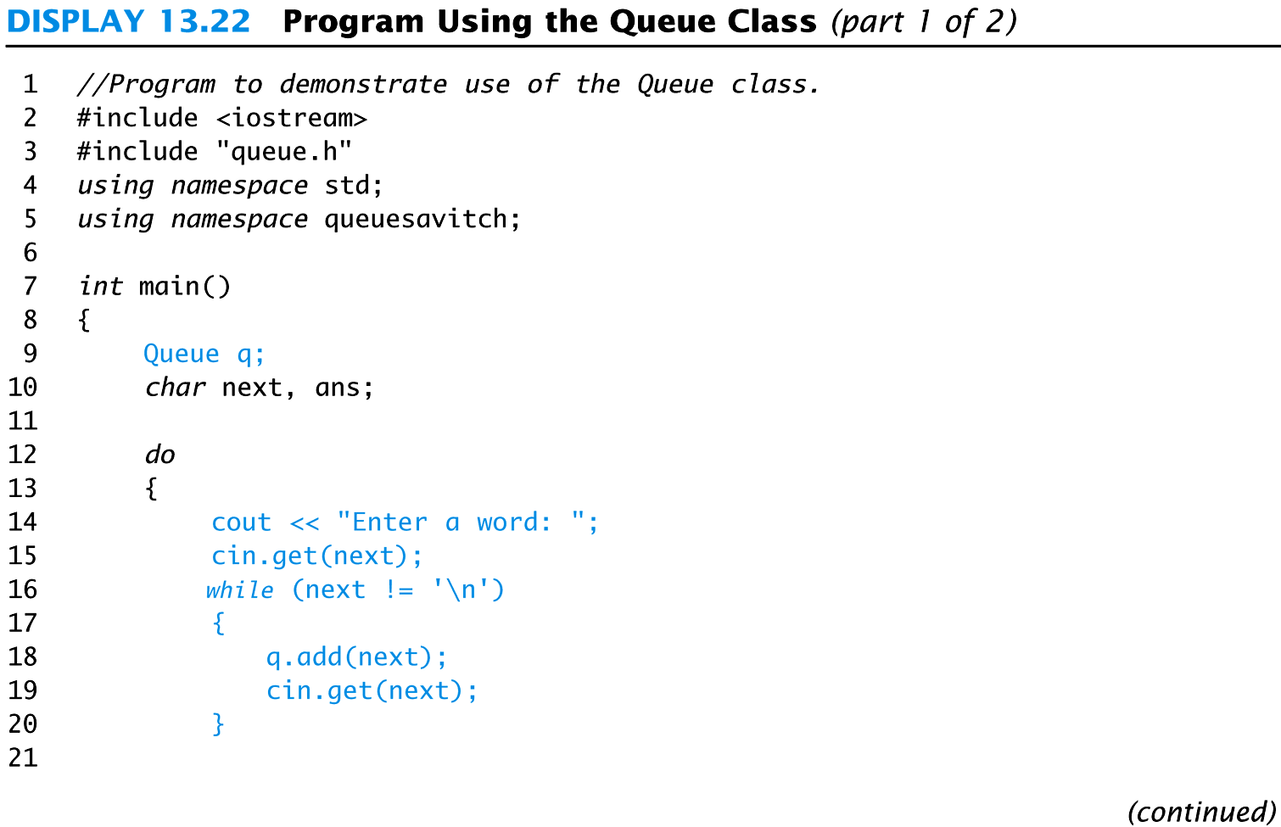
Display 13.22 (1/2)
Back
Next

Slide 80
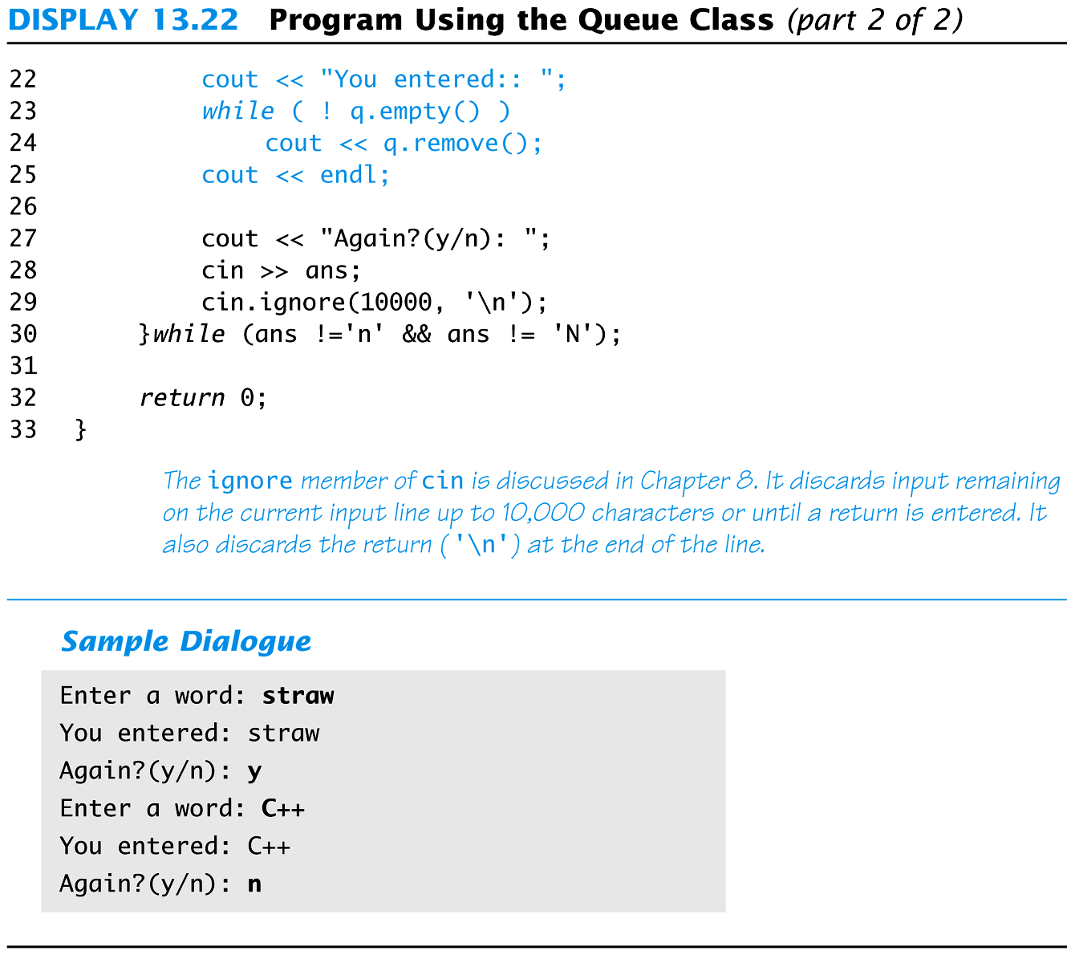
Display 13.22 (2/2)
Back
Next

