Slide 1
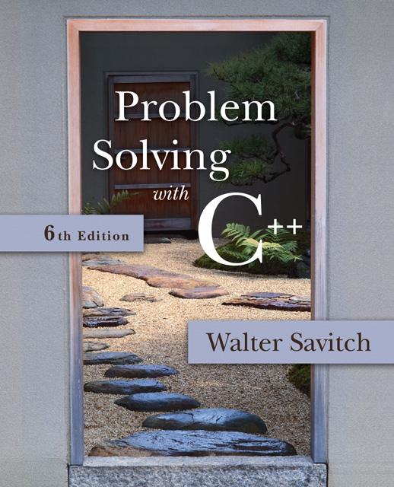

Slide 2
Session 21
Inheritance

Slide 3
Overview
15.1 Inheritance Basics
15.2 Inheritance Details
15.3 Polymorphism

Slide 4
15.1
Inheritance

Slide 5
Inheritance Basics
Inheritance is the process by which a new class, called a derived class, is created from another class, called the base class
A derived class automatically has all the member variables and functions of the base class
A derived class can have additional member variables and/or member functions
The derived class is a child of the base or parent class

Slide 6
Employee Classes
To design a record-keeping program with records for salaried and hourly employees…
Salaried and hourly employees belong to a class of people who share the property "employee"
A subset of employees are those with a fixed wage
Another subset of employees earn hourly wages
All employees have a name and SSN
Functions to manipulate name and SSN are the same for hourly and salaried employees

Slide 7
A Base Class
We will define a class called Employee for all employees
The Employee class will be used to define classes for hourly and salaried employees
A definition of the employee class is found in
Display 15.1
Display 15.2

Slide 8
Function print_check
Function print_check will have different definitions to print different checks for each type of employee
An Employee object lacks sufficient information to print a check
Each derived class will have sufficient information to print a check

Slide 9
Class HourlyEmployee
HourlyEmployee is derived from Class Employee
HourlyEmployee inherits all member functions and member variables of Employee
The class definition begins class HourlyEmployee : public Employee
:public Employee shows that HourlyEmployee is derived from class Employee
HourlyEmployee declares additional member variables wage_rate and hours
Display 15.3

Slide 10
Inherited Members
A derived class inherits all the members of the parent class
The derived class does not re-declare or re-define members inherited from the parent, except…
The derived class re-declares and re-defines member functions of the parent class that will have a different definition in the derived class
The derived class can add member variables and functions

Slide 11
Implementing a Derived Class
Any member functions added in the derived class are defined in the implementation file for the derived class
Definitions are not given for inherited functions that are not to be changed
The HourlyEmployee class is defined in
Display 15.5

Slide 12
Class SalariedEmployee
The class SalariedEmployee is also derived from Employee
Function print_check is redefined to have a meaning specific to salaried employees
SalariedEmployee adds a member variable salary
The interface for SalariedEmployee is found in contains the implementation
Display 15.4
Display 15.6 (1-2)

Slide 13
Parent and Child Classes
Recall that a child class automatically has all the members of the parent class
The parent class is an ancestor of the child class
The child class is a descendent of the parent class
The parent class (Employee) contains all the code common to the child classes
You do not have to re-write the code for each child

Slide 14
Derived Class Types
An hourly employee is an employee
In C++, an object of type HourlyEmployee can be used where an object of type Employee can be used
An object of a class type can be used wherever any of its ancestors can be used
An ancestor cannot be used wherever one of its descendents can be used

Slide 15
Derived Class Constructors
A base class constructor is not inherited in a derived class
The base class constructor can be invoked by the constructor of the derived class
The constructor of a derived class begins by invoking the constructor of the base class in the initialization section: HourlyEmployee::HourlyEmployee : Employee( ), wage_rate( 0), hours( ) { //no code needed }
Any Employee constructor could be invoked

Slide 16
Default Initialization
If a derived class constructor does not invoke a base class constructor explicity, the base class default constructor will be used
If class B is derived from class A and class C is derived from class B
When a object of class C is created
The base class A's constructor is the first invoked
Class B's constructor is invoked next
C's constructor completes execution

Slide 17
Private is Private
A member variable (or function) that is private in the parent class is not accessible to the child class
The parent class member functions must be used to access the private members of the parent
This code would be illegal: void HourlyEmployee::print_check( ) { net_pay = hours * wage_rage;
net_pay is a private member of Employee!

Slide 18
The protected Qualifier
protected members of a class appear to be private outside the class, but are accessible by derived classes
If member variables name, net_pay, and ssn are listed as protected (not private) in the Employee class, this code, illegal on the previous slide, becomes legal: HourlyEmployee::print_check( ) { net_pay = hours * wage_rage;

Slide 19
Programming Style
Using protected members of a class is a convenience to facilitate writing the code of derived classes.
Protected members are not necessary
Derived classes can use the public methods of their ancestor classes to access private members
Many programming authorities consider it bad style to use protected member variables

Slide 20
Redefinition of Member Functions
When defining a derived class, only list the the inherited functions that you wish to change for the derived class
The function is declared in the class definition
HourlyEmployee and SalariedEmployee each have their own definitions of print_check
demonstrates the use of the derived classes defined in earlier displays.
Display 15.7 (1-2)

Slide 21
Redefining or Overloading
A function redefined in a derived class has the same number and type of parameters
The derived class has only one function with the same name as the base class
An overloaded function has a different number and/or type of parameters than the base class
The derived class has two functions with the same name as the base class
One is defined in the base class, one in the derived class

Slide 22
Function Signatures
A function signature is the function's name with the sequence of types in the parameter list, not including any const or '&'
An overloaded function has multiple signatures
Some compilers allow overloading based on including const or not including const

Slide 23
Access to a Redefined Base Function
When a base class function is redefined in a derived class, the base class function can still be used
To specify that you want to use the base class version of the redefined function: HourlyEmployee sally_h; sally_h.Employee::print_check( );

Slide 24
Section 15.1 Conclusion
Can you
Explain why the declaration for get_name is not part of the definition of SalariedEmployee?
Give a definition for a class TitledEmployee derived from class SalariedEmployee with one additional string called title? Add two member functions get_title and set_title. It should redefine set_name.

Slide 25
15.2
Inheritance Details

Slide 26
Inheritance Details
Some special functions are, for all practical purposes, not inherited by a derived class
Some of the special functions that are not effectively inherited by a derived class include
Destructors
Copy constructors
The assignment operator

Slide 27
Copy Constructors and Derived Classes
If a copy constructor is not defined in a derived class, C++ will generate a default copy constructor
This copy constructor copies only the contents of member variables and will not work with pointers and dynamic variables
The base class copy constructor will not be used

Slide 28
Operator = and Derived Classes
If a base class has a defined assignment operator = and the derived class does not:
C++ will use a default operator that will have nothing to do with the base class assignment operator

Slide 29
Destructors and Derived Classes
A destructor is not inherited by a derived class
The derived class should define its own destructor

Slide 30
The Assignment Operator
In implementing an overloaded assignment operator in a derived class:
It is normal to use the assignment operator from the base class in the definition of the derived class's assignment operator
Recall that the assignment operator is written as a member function of a class

Slide 31
The Operator = Implementation
This code segment shows how to begin the implementation of the = operator for a derived class: Derived& Derived::operator= (const Derived& rhs) { Base::operator=(rhs)
This line handles the assignment of the inherited member variables by calling the base class assignment operator
The remaining code would assign the member variables introduced in the derived class

Slide 32
The Copy Constructor
Implementation of the derived class copy constructor is much like that of the assignment operator: Derived::Derived(const Derived& object) :Base(object), <other initializing> {…}
Invoking the base class copy constructor sets up the inherited member variables
Since object is of type Derived it is also of type Base

Slide 33
Destructors in Derived Classes
If the base class has a working destructor, defining the destructor for the defined class is relatively easy
When the destructor for a derived class is called, the destructor for the base class is automatically called
The derived class destructor need only use delete on dynamic variables added in the derived class, and data they may point to

Slide 34
Destruction Sequence
If class B is derived from class A and class C is derived from class B…
When the destructor of an object of class C goes out of scope
The destructor of class C is called
Then the destructor of class B
Then the destructor of class A
Notice that destructors are called in the reverse order of constructor calls

Slide 35
Section 15.2 Conclusion
Can you
List some special functions that are not inherited by a derived class?
Write code to invoke the base class copy constructor in defining the derived class's copy constructor?

Slide 36
15.3
Polymorphism

Slide 37
Polymorphism
Virtual function are accessible if pointers are used
In polymorphism i.e if we just put derived object in base
variable, it can not access derived functions, variable
And virtual functions until pointers are used.
Polymorphism refers to the ability to associate multiple meanings with one function name using a mechanism called late binding
Polymorphism is a key component of the philosophy of object oriented programming
If we do polymorphesim only public variables of base class
Are accessible. Not even protected ones. Also we can
Not access any variable from derived class. We also can not
Access any function from derived class, but the virtual ones (Refer to above).
To access those functions we have to use there own objects.
Note: Watch bucky before paper ☺

Slide 38
A Late Binding Example
Imagine a graphics program with several types of figures
Each figure may be an object of a different class, such as a circle, oval, rectangle, etc.
Each is a descendant of a class Figure
Each has a function draw( ) implemented with code specific to each shape
Class Figure has functions common to all figures

Slide 39
A Problem
Suppose that class Figure has a function center
Function center moves a figure to the center of the screen by erasing the figure and redrawing it in the center of the screen
Function center is inherited by each of the derived classes
Function center uses each derived object's draw function to draw the figure
The Figure class does not know about its derived classes, so it cannot know how to draw each figure

Slide 40
Virtual Functions
Because the Figure class includes a method to draw figures, but the Figure class cannot know how to draw the figures, virtual functions are used
Making a function virtual tells the compiler that you don't know how the function is implemented and to wait until the function is used in a program, then get the implementation from the object.
This is called late binding

Slide 41
Virtual Functions in C++
As another example, let's design a record- keeping program for an auto parts store
We want a versatile program, but we do not know all the possible types of sales we might have to account for
Later we may add mail-order and discount sales
Functions to compute bills will have to be added later when we know what type of sales to add
To accommodate the future possibilities, we will make the bill function a virtual function

Slide 42
The Sale Class
All sales will be derived from the base class Sale
The bill function of the Sale class is virtual
The member function savings and operator < each use bill
The Sale class interface and implementation are shown in
Display 15.8
Display 15.9

Slide 43
Virtual Function bill
Because function bill is virtual in class Sale, function savings and operator <, defined only in the base class, can in turn use a version of bill found in a derived class
When a DiscountSale object calls its savings function, defined only in the base class, function savings calls function bill
Because bill is a virtual function in class Sale, C++ uses the version of bill defined in the object that called savings

Slide 44
DiscountSale::bill
Class DiscountSale has its own version of virtual function bill
Even though class Sale is already compiled, Sale::savings( ) and Sale::operator< can still use function bill from the DiscountSale class
The keyword virtual tells C++ to wait until bill is used in a program to get the implementation of bill from the calling object
DiscountSale is defined and used in
Display 15.10
Display 15.11

Slide 45
Virtual Details
To define a function differently in a derived class and to make it virtual
Add keyword virtual to the function declaration in the base class
virtual is not needed for the function declaration in the derived class, but is often included
virtual is not added to the function definition
Virtual functions require considerable overhead so excessive use reduces program efficiency

Slide 46
Overriding
Virtual functions whose definitions are changed in a derived class are said to be overridden
Non-virtual functions whose definitions are changed in a derived class are redefined

Slide 47
Type Checking
C++ carefully checks for type mismatches in the use of values and variables
This is referred to as strong type checking
Generally the type of a value assigned to a variable must match the type of the variable
Recall that some automatic type casting occurs
Strong type checking interferes with the concepts of inheritance

Slide 48
Type Checking and Inheritance
Consider class Pet { public: virtual void print(); string name; } and class Dog :public Pet { public: virtual void print(); string breed; }

Slide 49
A Sliced Dog is a Pet
C++ allows the following assignments: vdog.name = "Tiny"; vdog.breed = "Great Dane"; vpet = vdog;
However, vpet will loose the breed member of vdog since an object of class Pet has no breed member
This code would be illegal: cout << vpet.breed;
This is the slicing problem

Slide 50
The Slicing Problem
It is legal to assign a derived class object into a base class variable
This slices off data in the derived class that is not also part of the base class
Member functions and member variables are lost

Slide 51
Extended Type Compatibility
It is possible in C++ to avoid the slicing problem
Using pointers to dynamic variables we can assign objects of a derived class to variables of a base class without loosing members of the derived class object

Slide 52
Dynamic Variables and Derived Classes
Example:
ppet->print( ); is legal and produces: name: Tiny breed: Great Dane
Pet *ppet; Dog *pdog; pdog = new Dog; pdog->name = "Tiny"; pdog->breed = "Great Dane"; ppet = pdog;
void Dog::print( ) { cout << "name: " << name << endl; cout << "breed: " << breed << endl; }
Display 15.12 (1-2)

Slide 53
Use Virtual Functions
The previous example: ppet->print( ); worked because print was declared as a virtual function
This code would still produce an error: cout << "name: " << ppet->name << "breed: " << ppet->breed;

Slide 54
Why?
ppet->breed is still illegal because ppet is a pointer to a Pet object that has no breed member
Function print( ) was declared virtual by class Pet
When the computer sees ppet->print( ), it checks the virtual table for classes Pet and Dog and finds that ppet points to an object of type Dog
Because ppet points to a Dog object, code for Dog::print( ) is used

Slide 55
Remember Two Rules
To help make sense of object oriented programming with dynamic variables, remember these rules
If the domain type of the pointer p_ancestor is a base class for the for the domain type of pointer p_descendant, the following assignment of pointers is allowed p_ancestor = p_descendant; and no data members will be lost
Although all the fields of the p_descendant are there, virtual functions are required to access them

Slide 56
Virtual Compilation
When using virtual functions, you will have to define each virtual function before compiling
Declaration is no longer sufficient
Even if you do not call the virtual function you may see error message: "undefined reference to Class_Name virtual table"

Slide 57
Virtual Destructors
Destructors should be made virtual
Consider Base *pBase = new Derived; … delete pBase;
If the destructor in Base is virtual, the destructor for Derived is invoked as pBase points to a Derived object, returning Derived members to the freestore
The Derived destructor in turn calls the Base destructor

Slide 58
Non-Virtual Destructors
If the Base destructor is not virtual, only the Base destructor is invoked
This leaves Derived members, not part of Base, in memory

Slide 59
Section 15.3 Conclusion
Can you
Explain why you cannot assign a base class object to a derived class object?
Describe the problem with assigning a derived class object to a base class object?

Slide 60
Chapter 15 -- End

Slide 61
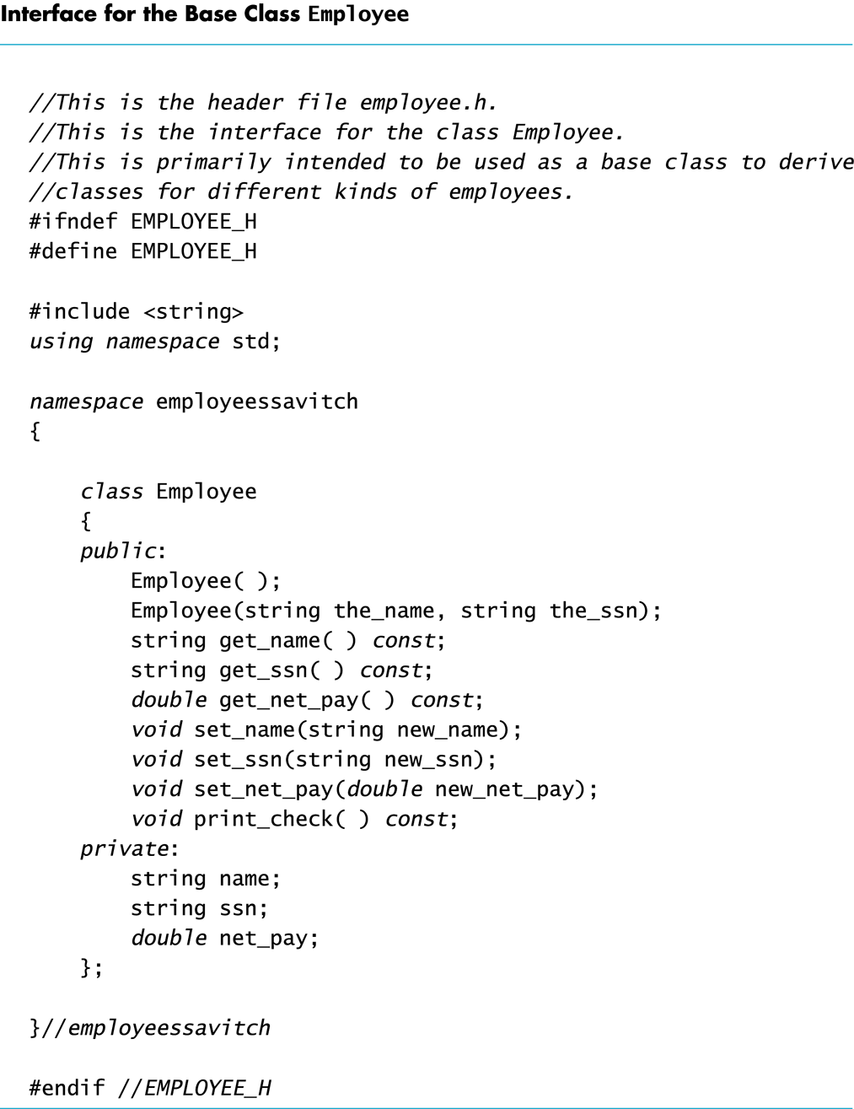
Display 15.1
Back
Next

Slide 62
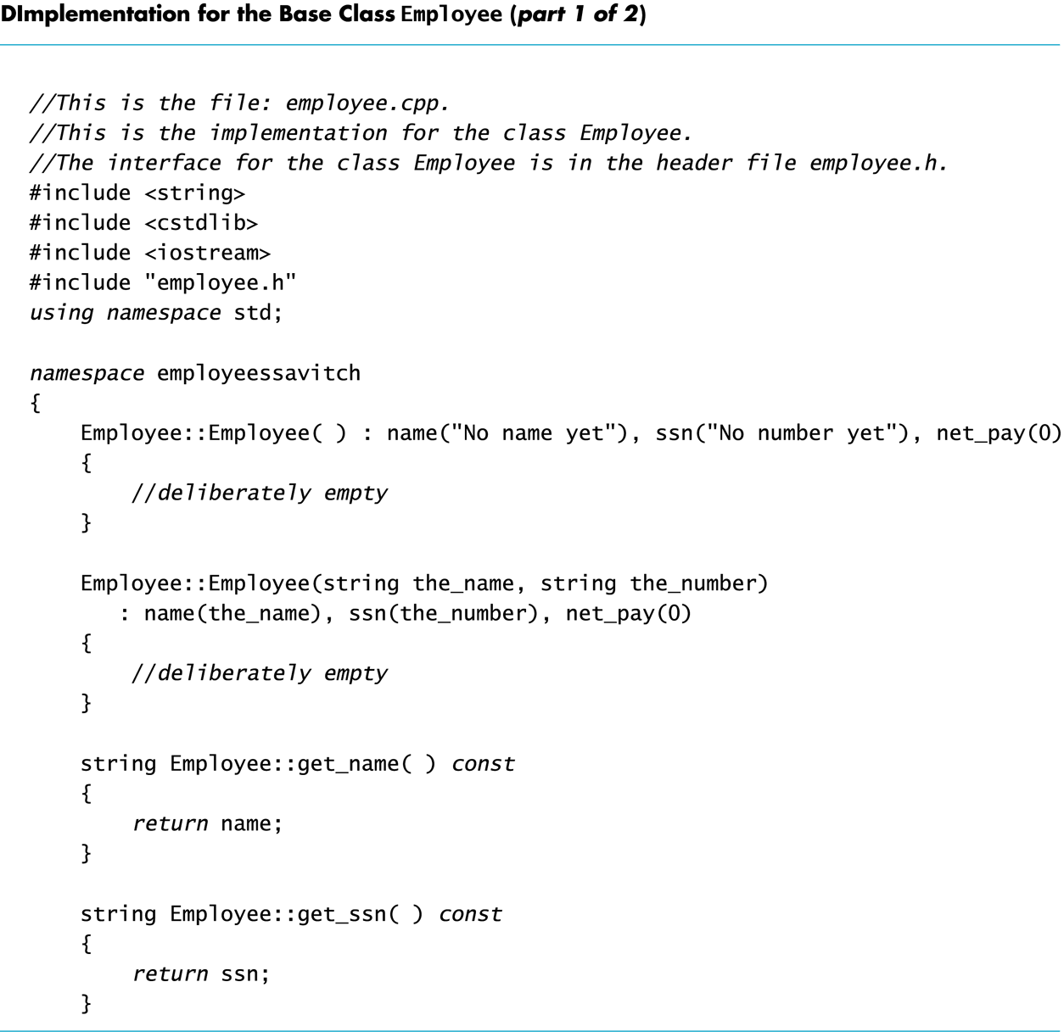
Display 15.2 (1/2)
Back
Next

Slide 63
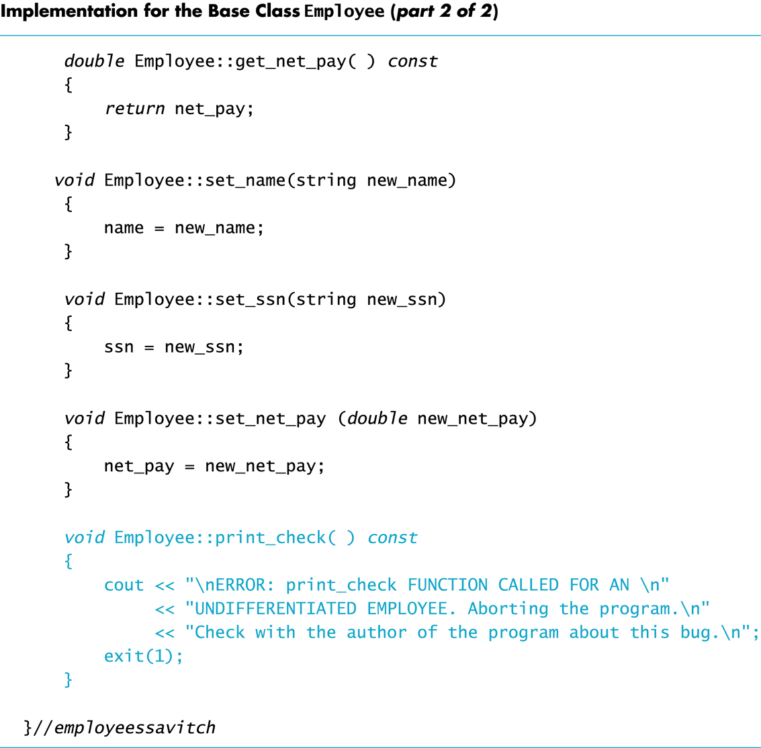
Display 15.2 (2/2)
Back
Next

Slide 64
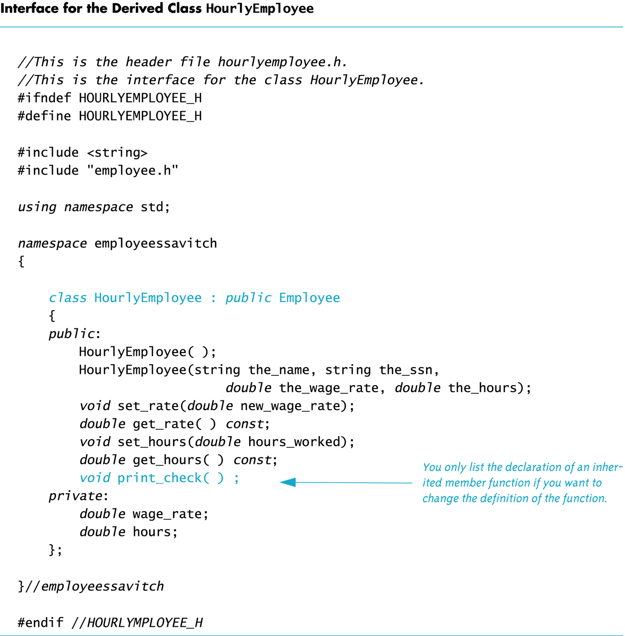
Display 15.3
Back
Next

Slide 65
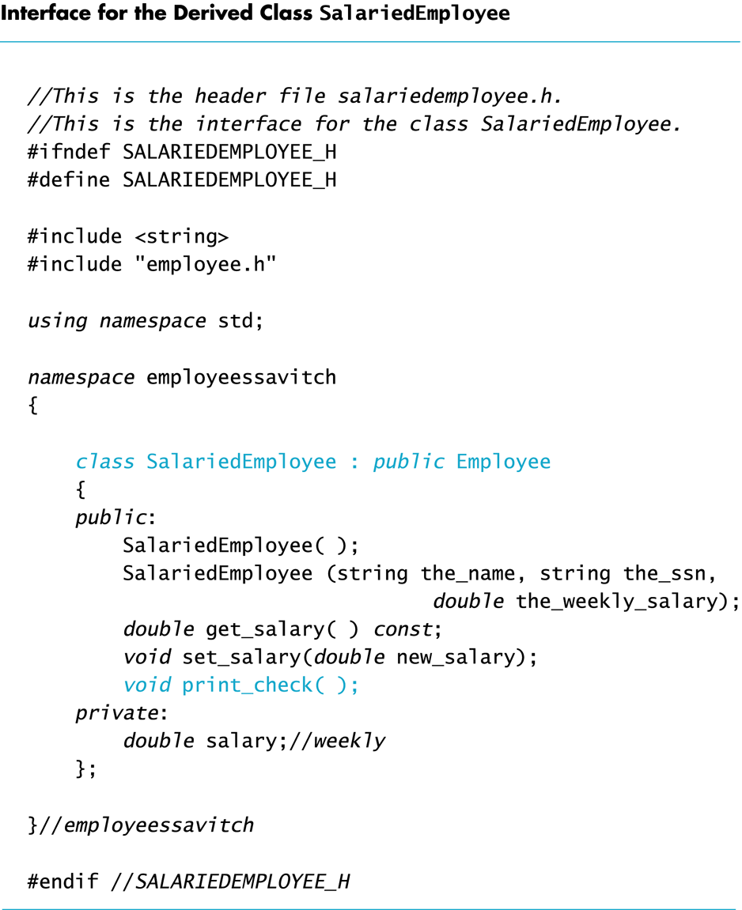
Display 15.4
Back
Next

Slide 66
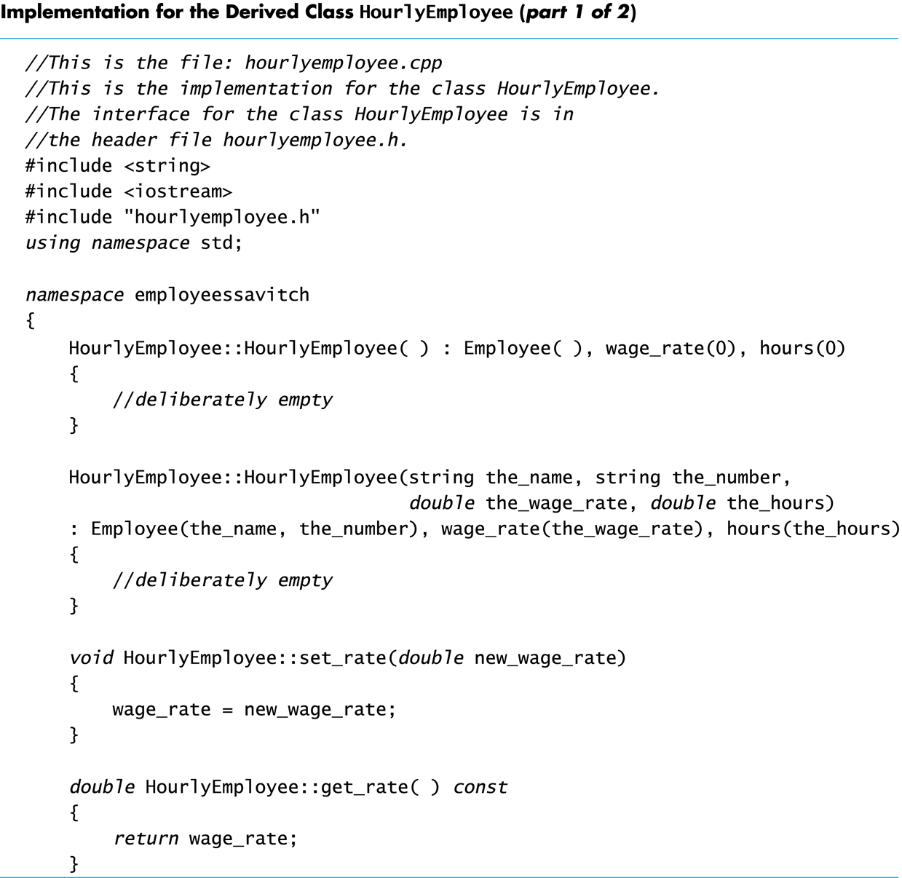
Display 15.5 (1/2)
Back
Next

Slide 67
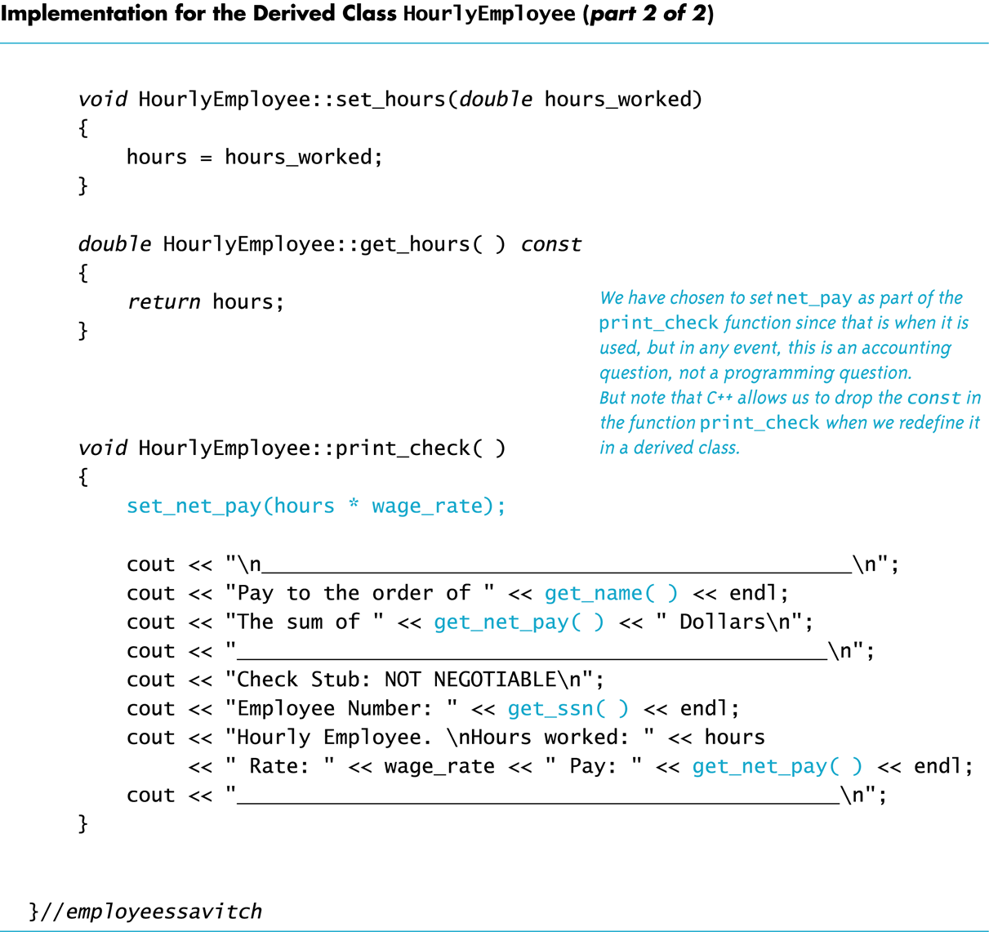
Display 15.5 (2/2)
Back
Next

Slide 68
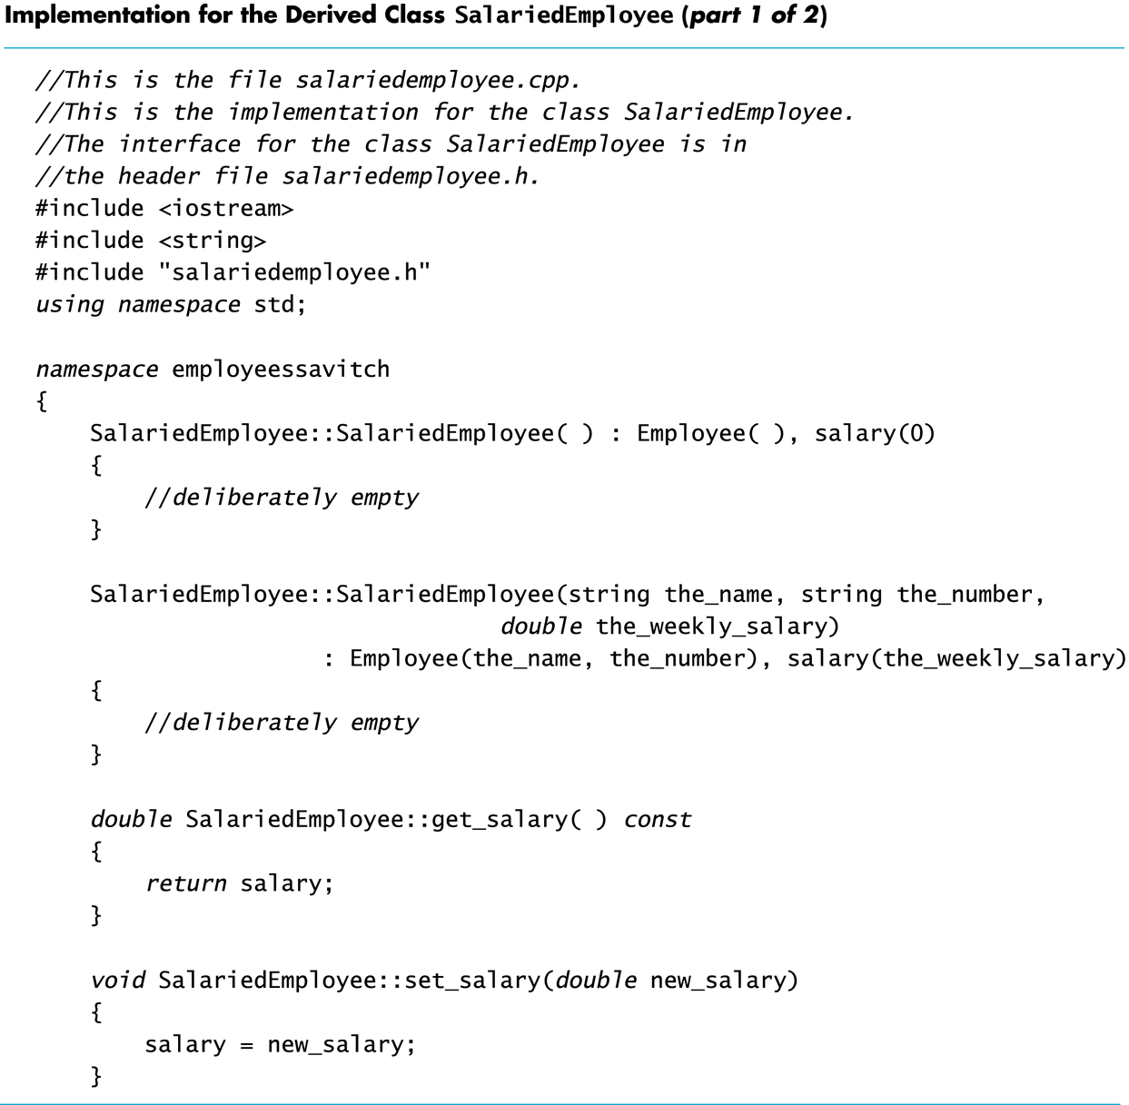
Display 15.6 (1/2)
Back
Next

Slide 69
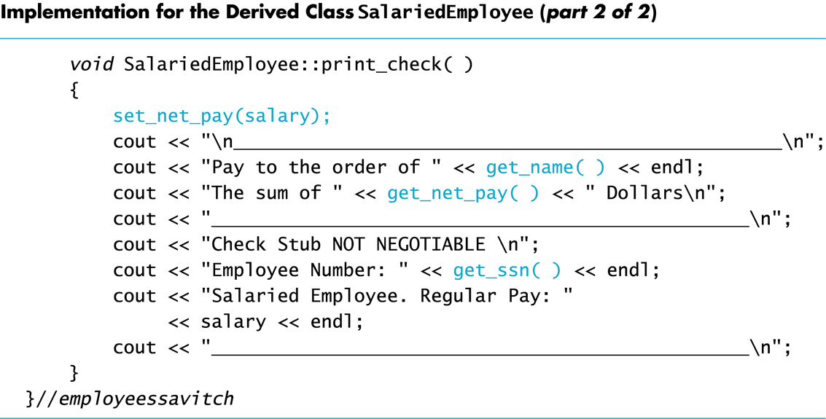
Display 15.6 (2/2)
Back
Next

Slide 70
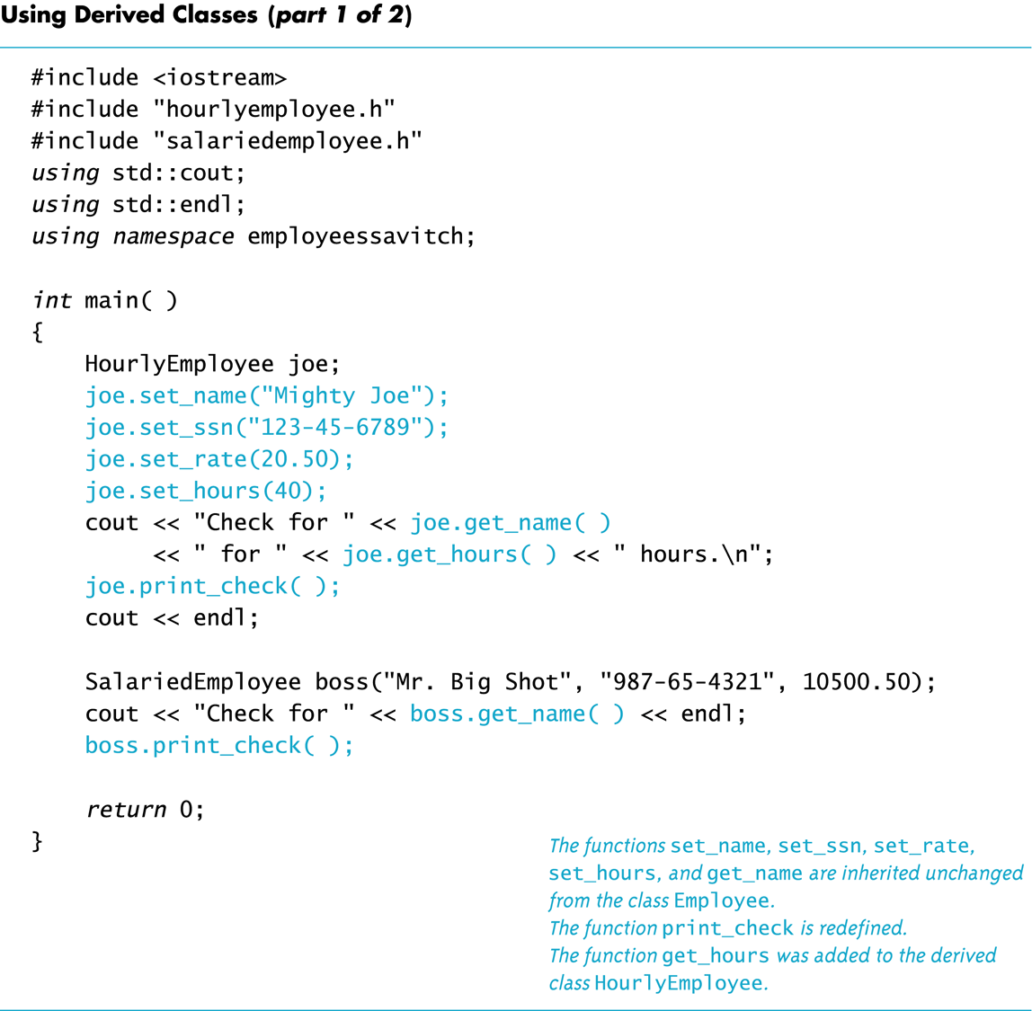
Display 15.7 (1/2)
Back
Next

Slide 71
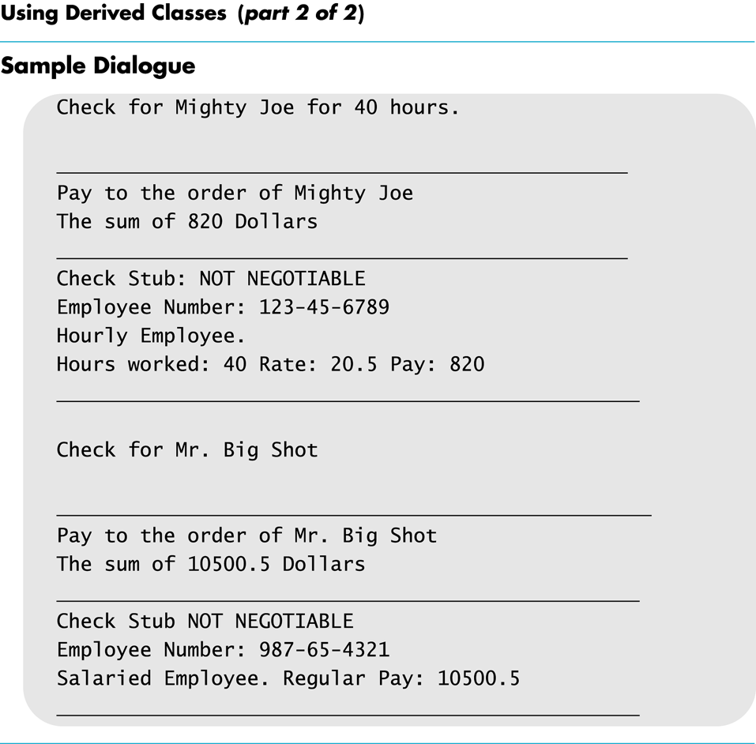
Display 15.7 (2/2)
Back
Next

Slide 72
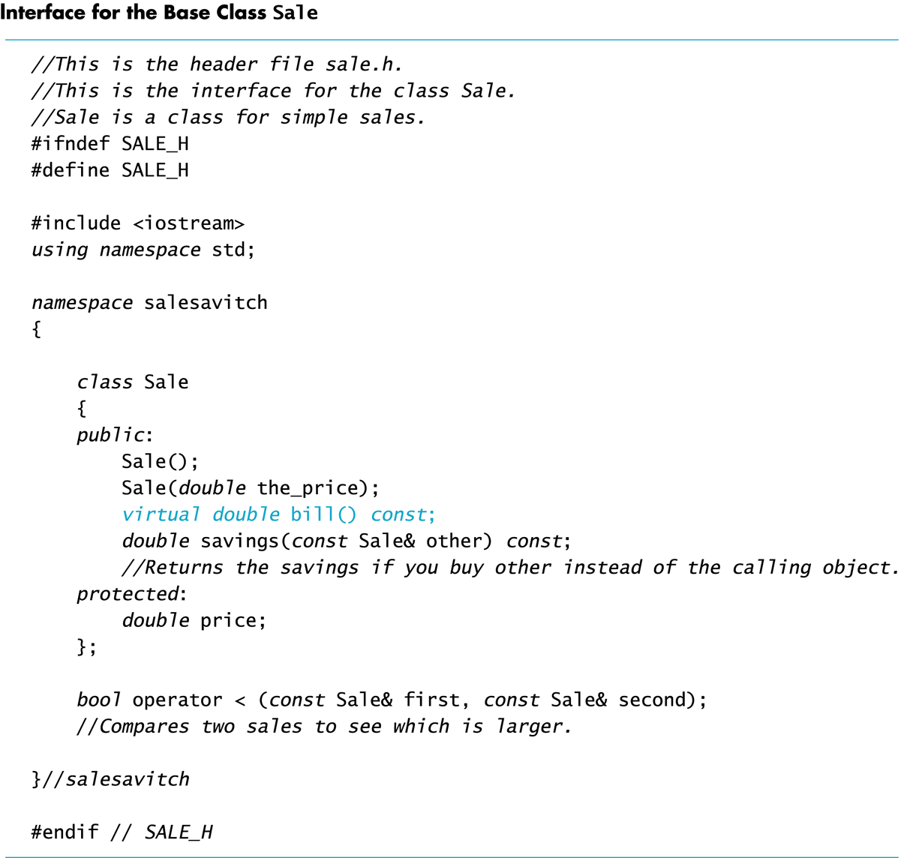
Display 15.8
Back
Next

Slide 73
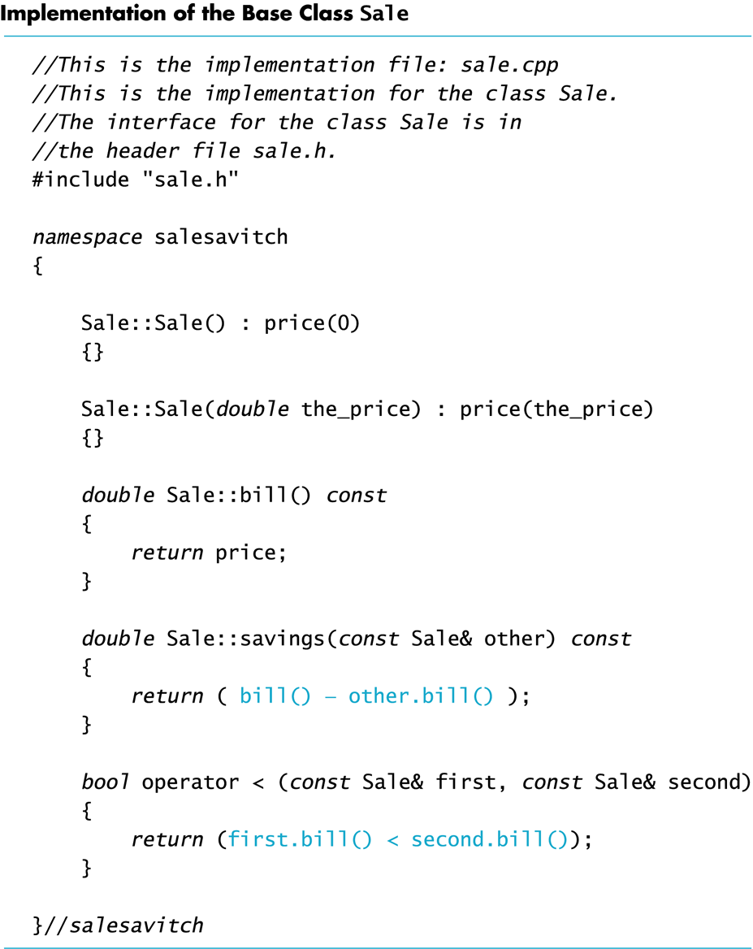
Display 15.9
Back
Next

Slide 74
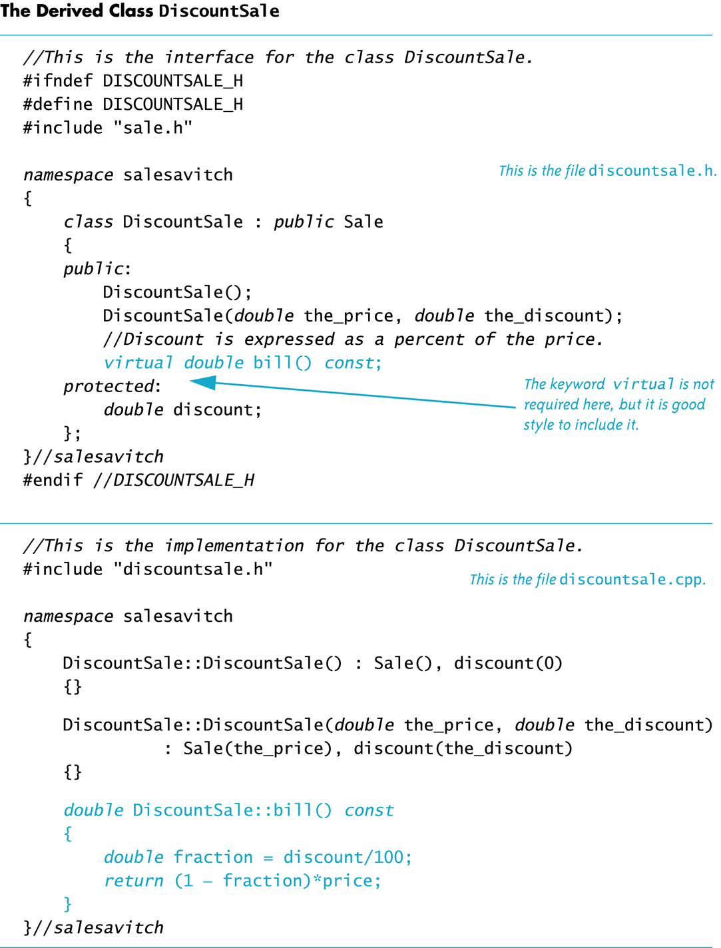
Display 15.10
Back
Next

Slide 75
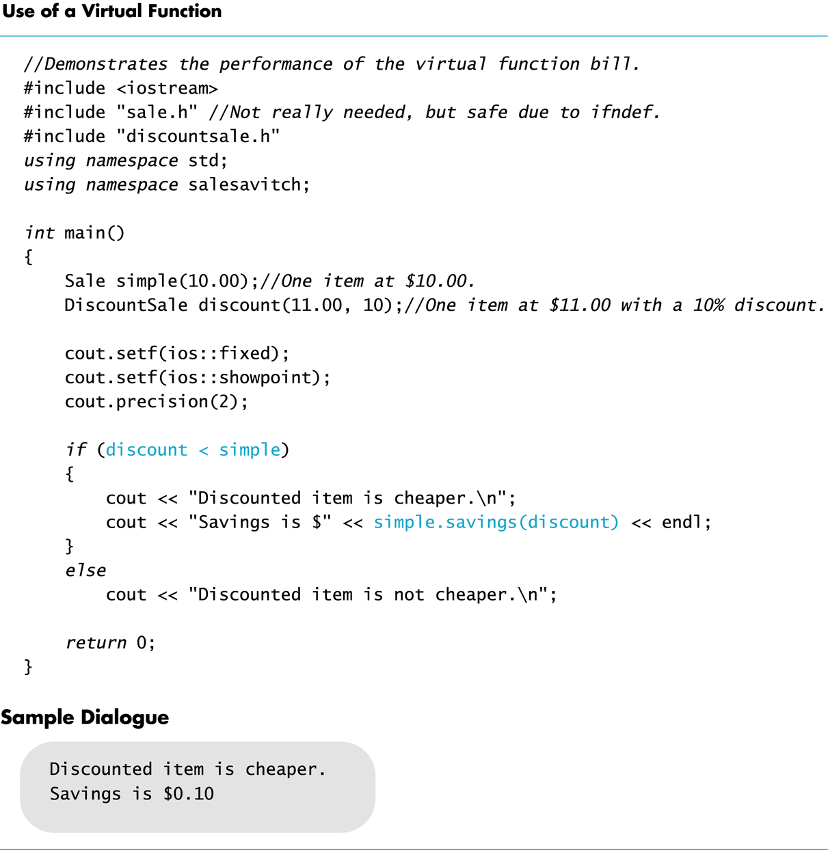
Display 15.11
Back
Next

Slide 76
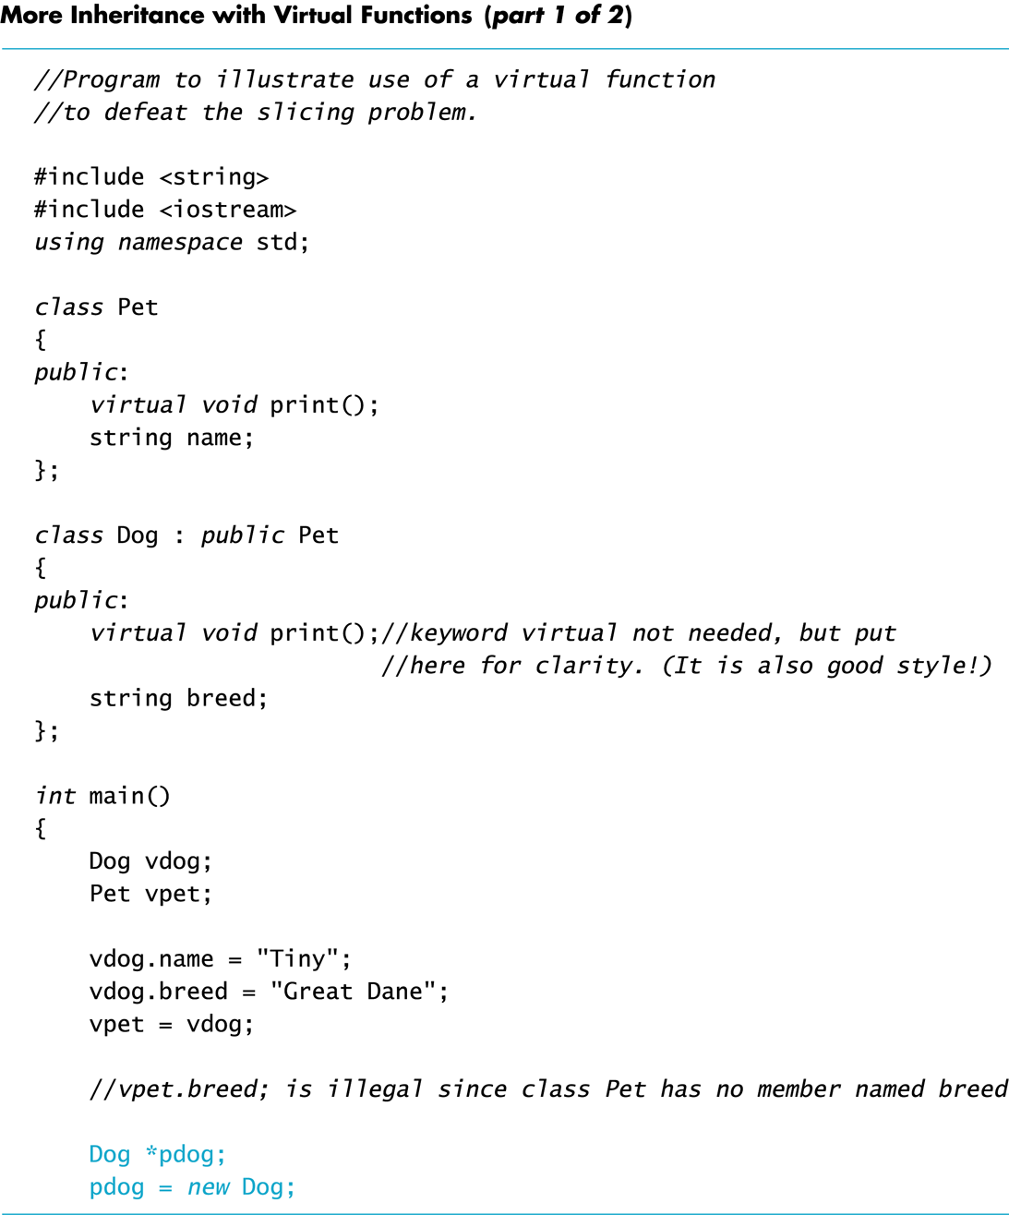
Display 15.12 (1/2)
Back
Next

Slide 77
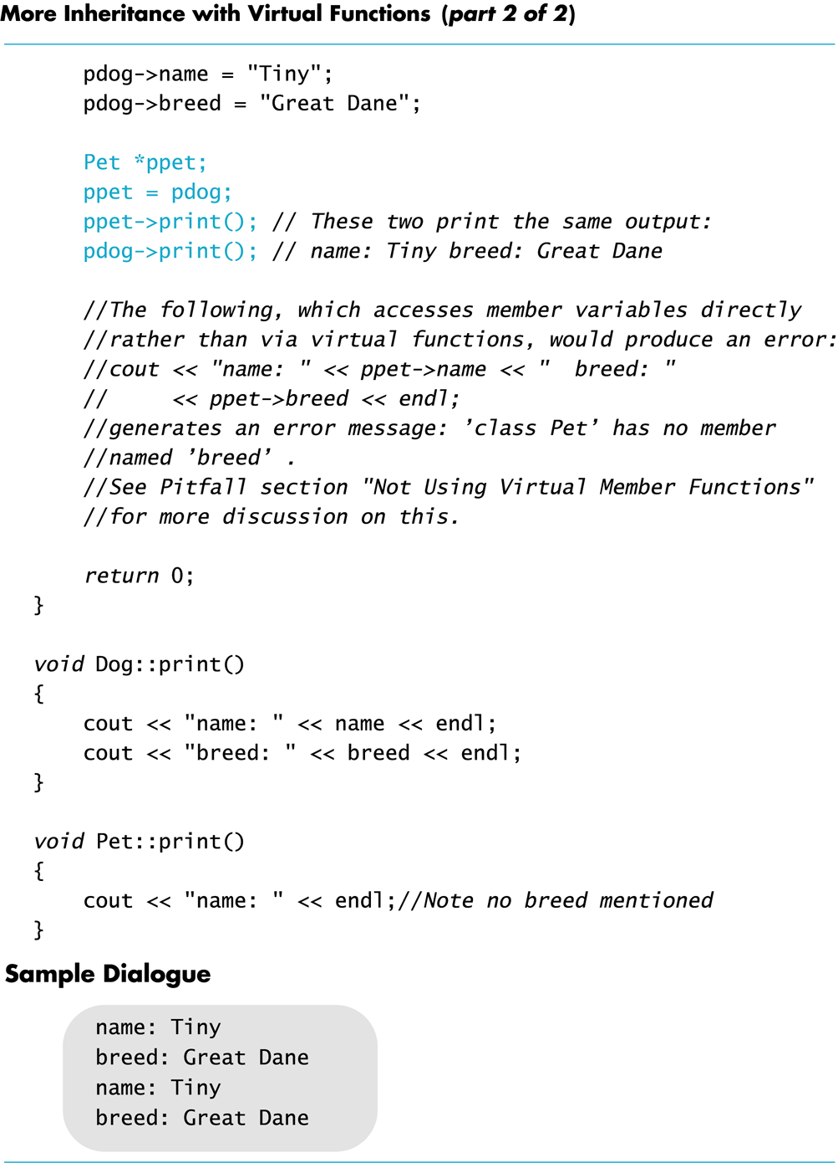
Display 15.12 (2/2)
Back
Next

