Slide 1
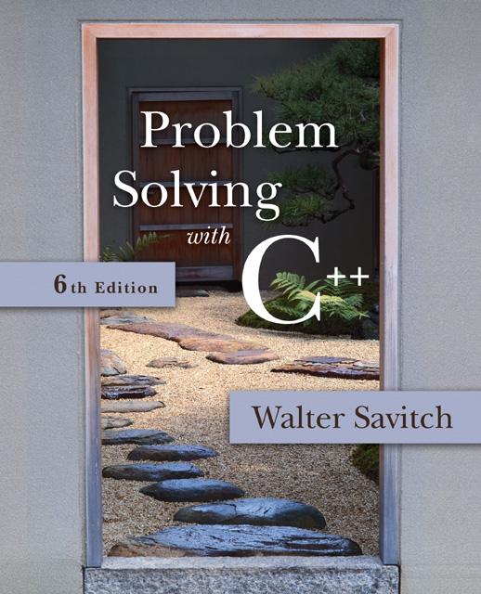

Slide 2
Session 24
Templates

Slide 3
Overview
17.1 Templates for Algorithm Abstraction
17.2 Templates for Data Abstraction

Slide 4
Finding the Maximum of Two Integers
Here’s a small function that you might write to find the maximum of two integers.
int maximum(int a, int b)
{
if (a > b)
return a;
else
return b;
}
Notes:
To illustrate template functions, let’s look at this simple function. It would appear as part of a program that needs to find the larger of two integers. The function returns a copy of the larger of its two arguments.

Slide 5
Finding the Maximum of Two Doubles
Here’s a small function that you might write to find the maximum of two double numbers.
int maximum(double a, double b)
{
if (a > b)
return a;
else
return b;
}
Notes:
Suppose your program also needs to find the larger of two double numbers. Then you could add a second function for double numbers. By the way, you may use the same name, maximum, for the two functions. The compiler is smart enough to determine which function your program is using at any given point, by looking at the types of the parameters.

Slide 6
Finding the Maximum of Two Knafns
Here’s a small function that you might write to find the maximum of two knafns.
int maximum(knafn a, knafn b)
{
if (a > b)
return a;
else
return b;
}
Notes:
Suppose your program also has another data type, called knafn. This could be a class that you wrote yourself for some purpose.
Anyway, perhaps knafn objects can be compared with the > operation (because the knafn implementation includes an overloaded > operator). In this case, your program might have a third function to compare two knafn objects.

Slide 7
One Hundred Million Functions...
Suppose your program uses 100,000,000 different data types, and you need a maximum function for each...
int maximum(Hoo a, Hoo b)
{
if (a > b)
return a;
else
return b;
}
int maximum(Hoo a, Hoo b)
{
if (a > b)
return a;
else
return b;
}
int maximum(Hoo a, Hoo b)
{
if (a > b)
return a;
else
return b;
}
int maximum(Noo a, Noo b)
{
if (a > b)
return a;
else
return b;
}
int maximum(Moo a, Moo b)
{
if (a > b)
return a;
else
return b;
}
int maximum(Doo a, Doo b)
{
if (a > b)
return a;
else
return b;
}
int maximum(Moo a, Moo b)
{
if (a > b)
return a;
else
return b;
}
int maximum(Doo a, Doo b)
{
if (a > b)
return a;
else
return b;
}
int maximum(Noo a, Noo b)
{
if (a > b)
return a;
else
return b;
}
int maximum(Moo a, Moo b)
{
if (a > b)
return a;
else
return b;
}
int maximum(Doo a, Doo b)
{
if (a > b)
return a;
else
return b;
}
int maximum(Noo a, Noo b)
{
if (a > b)
return a;
else
return b;
}
int maximum(Foo a, Foo b)
{
if (a > b)
return a;
else
return b;
}
int maximum(Foo a, Foo b)
{
if (a > b)
return a;
else
return b;
}
int maximum(Foo a, Foo b)
{
if (a > b)
return a;
else
return b;
}
int maximum(Poo a, Poo b)
{
if (a > b)
return a;
else
return b;
}
int maximum(Boo a, Boo b)
{
if (a > b)
return a;
else
return b;
}
int maximum(Poo a, Poo b)
{
if (a > b)
return a;
else
return b;
}
int maximum(Koo a, Koo b)
{
if (a > b)
return a;
else
return b;
}
int maximum(Poo a, Poo b)
{
if (a > b)
return a;
else
return b;
}
int maximum(Boo a, Boo b)
{
if (a > b)
return a;
else
return b;
}
int maximum(Boo a, Boo b)
{
if (a > b)
return a;
else
return b;
}
int maximum(Joo a, Joo b)
{
if (a > b)
return a;
else
return b;
}
int maximum(Koo a, Koo b)
{
if (a > b)
return a;
else
return b;
}
int maximum(Koo a, Koo b)
{
if (a > b)
return a;
else
return b;
}
int maximum(Knafn a, Knafn b)
{
if (a > b)
return a;
else
return b;
}
int maximum(Ioo a, Ioo b)
{
if (a > b)
return a;
else
return b;
}
int maximum(Joo a, Joo b)
{
if (a > b)
return a;
else
return b;
}
int maximum(Joo a, Joo b)
{
if (a > b)
return a;
else
return b;
}
int maximum(Knafn a, Knafn b)
{
if (a > b)
return a;
else
return b;
}
int maximum(Ioo a, Ioo b)
{
if (a > b)
return a;
else
return b;
}
int maximum(Knafn a, Knafn b)
{
if (a > b)
return a;
else
return b;
}
int maximum(Ioo a, Ioo b)
{
if (a > b)
return a;
else
return b;
}
int maximum(Coo a, Coo b)
{
if (a > b)
return a;
else
return b;
}
int maximum(Coo a, Coo b)
{
if (a > b)
return a;
else
return b;
}
int maximum(Coo a, Coo b)
{
if (a > b)
return a;
else
return b;
}
int maximum(Loo a, Loo b)
{
if (a > b)
return a;
else
return b;
}
int maximum(Goo a, Goo b)
{
if (a > b)
return a;
else
return b;
}
int maximum(Goo a, Goo b)
{
if (a > b)
return a;
else
return b;
}
int maximum(Loo a, Loo b)
{
if (a > b)
return a;
else
return b;
}
int maximum(Goo a, Goo b)
{
if (a > b)
return a;
else
return b;
}
int maximum(Loo a, Loo b)
{
if (a > b)
return a;
else
return b;
}
Notes:
In fact, for your next programming assignment, I’m going to give you a printed list of 100,000,000 different data types, each of which has the > operator defined. Your job will be to implement a maximum function for each of the types. How long do you think this job will take?
How many of you think it will take more than one day’s work? Raise your hands.
Okay, now how many of you think you’ll need less than a day--in fact less than five minutes? Raise your hands. These are the people that have been reading ahead in Chapter 6 about a feature called template functions.

Slide 8
A Template Function for Maximum
This template function can be used with many data types.
template <class Item>
Item maximum(Item a, Item b)
{
if (a > b)
return a;
else
return b;
}
Notes:
This is our first example of a template function. It is a single function that depends on an underlying data type that I’ve called Item. The actual Item type could be any of many different types: int, double, char--in fact any type that has two features: (1) the data values can be compared with the > operator, and (2) the data type has a copy constructor. (By the way, where is the copy constructor needed? It is needed to initialized the two parameters from their actual arguments, and also needed when the function returns a value.)
Anyway, let’s look at the pattern for converting an ordinary function to a template function...

Slide 9
A Template Function for Maximum
When you write a template function, you choose a data type for the function to depend upon...
template <class Item>
Item maximum(Item a, Item b)
{
if (a > b)
return a;
else
return b;
}
Notes:
Our maximum function depends on the type of the item that we are comparing. This is the type of the two parameters, and also the return type. So, in the template function, we choose a name for this type--we use the name Item--and you use that name instead of the actual data type name.

Slide 10
A Template Function for Maximum
A template prefix is also needed immediately before the function’s implementation:
template <class Item>
Item maximum(Item a, Item b)
{
if (a > b)
return a;
else
return b;
}
Notes:
Before an implementation, a special template prefix is also require. The prefix consists of the keyword template followed by angle brackets. Inside the angle brackets is the keyword class and the name that you choose to describe the underlying data type.

Slide 11
Using a Template Function
Once a template function is defined, it may be used with any adequate data type in your program...
template <class Item>
Item maximum(Item a, Item b)
{
if (a > b)
return a;
else
return b;
}
cout << maximum(1,2);
cout << maximum(1.3, 0.9);
...
Notes:
Here are two examples of how the single template function can be used in two different ways in a program. In the first example, the compiler sees two integer arguments, so the compiler will automatically create a version of the function where the Item is an int. In the second example, the compiler sees two double arguments, so the compiler will automatically create a version of the function where the Item is a double. We could have a third example where the two arguments were Knafn objects, and the compiler would automatically create a version of the function where the Item is a Knafn.

Slide 12
Finding the Maximum Item in an Array
Here’s another function that can be made more general by changing it to a template function:
int array_max(int data[ ], size_t n)
{
size_t i;
int answer;
assert(n > 0);
answer = data[0];
for (i = 1; i < n; i++)
if (data[i] > answer) answer = data[i];
return answer;
}
Notes:
Here’s another function that can be improved by making it into a template function. In this form, the function can find the largest integer in an array of integers. But it can’t be used for an array of double numbers, or an array of some other kind of objects.
In this case, the function depends on the underlying data type of the components of the array. We can call this component type Item, and rewrite the function as a template function...

Slide 13
Finding the Maximum Item in an Array
Here’s the template function:
template <class Item>
Item array_max(Item data[ ], size_t n)
{
size_t i;
Item answer;
assert(n > 0);
answer = data[0];
for (i = 1; i < n; i++)
if (data[i] > answer) answer = data[i];
return answer;
}
Notes:
Here’s the template version. Notice these things:
1. the template prefix
2. The change of the data type of at least one parameter (the array)
3. The change of the return type (this might not occur for every template function)
4. In the implementation, we can use the Item type for local variables

Slide 14
17.1
Templates for Algorithm Abstraction

Slide 15
Templates for Algorithm Abstraction
Function definitions often use application specific adaptations of more general algorithms
For example: The general algorithm used in swap_values could swap variables of any type: void swap_values(type_of_var& v1, type_of_var& v2) { type_of_var temp; temp = v1; v1 = v2; v2 = temp; }

Slide 16
swap_values for char
Here is a version of swap_values to swap character variables:
void swap_values(char& v1, char& v2) { char temp; temp = v1; v1 = v2; v2 = temp; }

Slide 17
A General swap_values
A generalized version of swap_values is shown here.
void swap_values(type_of_var& v1, type_of_var& v2) { type_of_var temp; temp = v1; v1 = v2; v2 = temp; }
This function, if type_of_var could accept any type, could be used to swap values of any type

Slide 18
Templates for Functions
A C++ function template will allow swap_values to swap values of two variables of the same type
Example: template<class T> void swap_values(T& v1, T& v2) { T temp; temp = v1; v1 = v2; v = temp; }
Type parameter
Template prefix

Slide 19
Template Details
template<class T> is the template prefix
Tells compiler that the declaration or definition that follows is a template
Tells compiler that T is a type parameter
class means type in this context (typename could replace class but class is usually used)
T can be replaced by any type argument (whether the type is a class or not)
A template overloads the function name by replacing T with the type used in a function call

Slide 20
Calling a Template Function
Calling a function defined with a template is identical to calling a normal function
Example: To call the template version of swap_values char s1, s2; int i1, i2; … swap_values(s1, s2); swap_values(i1, i2);
The compiler checks the argument types and generates an appropriate version of swap_values

Slide 21
Templates and Declarations
A function template may also have a separate declaration
The template prefix and type parameter are used
Depending on your compiler
You may, or may not, be able to separate declaration and definitions of template functions just as you do with regular functions
To be safe, place template function definitions in the same file where they are used…with no declaration
A file included with #include is, in most cases, equivalent to being "in the same file"

Slide 22
The Type Parameter T
T is the traditional name for the type parameter
Any valid, non-keyword, identifier can be used
"VariableType" could be used template <class VariableType> void swap_values(VariableType& v1, VariableType& v2) { VariableType temp; … }
Display 17.1

Slide 23
Templates with Multiple Parameters
Function templates may use more than one parameter
Example: template<class T1, class T2>
All parameters must be used in the template function

Slide 24
Algorithm Abstraction
Using a template function we can express more general algorithms in C++
Algorithm abstraction means expressing algorithms in a very general way so we can ignore incidental detail
This allows us to concentrate on the substantive part of the algorithm

Slide 25
Program Example: A Generic Sorting Function
The sort function below uses an algorithm that does not depend on the base type of the array void sort(int a[], int number_used) { int index_of_next_smallest; for (int index = 0; index < number_used -1; index++) { index_of_next_smallest = index_of_smallest(a, index, number_used); swap_values(a[index], a[index_of_next_smallest]); } }
The same algorithm could be used to sort an array of any type

Slide 26
Generic Sorting: Helping Functions
sort uses two helper functions
index_of_smallest also uses a general algorithm and could be defined with a template
swap_values has already been adapted as a template
All three functions, defined with templates, are demonstrated in
Display 17.2
Display 17.3 (1-2)

Slide 27
Templates and Operators
The function index_of_smallest compares items in an array using the < operator
If a template function uses an operator, such as <, that operator must be defined for the types being compared
If a class type has the < operator overloaded for the class, then an array of objects of the class could be sorted with function template sort

Slide 28
Defining Templates
When defining a template it is a good idea…
To start with an ordinary function that accomplishes the task with one type
It is often easier to deal with a concrete case rather than the general case
Then debug the ordinary function
Next convert the function to a template by replacing type names with a type parameter

Slide 29
Inappropriate Types for Templates
Templates can be used for any type for which the code in the function makes sense
swap_values swaps individual objects of a type
This code would not work, because the assignment operator used in swap_values does not work with arrays: int a[10], b[10]; <code to fill the arrays> swap_values(a, b);

Slide 30
Section 17.1 Conclusion
Can you
Identify a template prefix?
Identify a parameter type in a template prefix?
Compare and contrast function overloading with the use of templates?
What additional complexities are involved when class types are involved as parameter types?

Slide 31
17.2
Templates for Data Abstraction

Slide 32
Templates for Data Abstraction
Class definitions can also be made more general with templates
The syntax for class templates is basically the same as for function templates
template<class T> comes before the template definition
Type parameter T is used in the class definition just like any other type
Type parameter T can represent any type

Slide 33
A Class Template
The following is a class template
An object of this class contains a pair of values of type T
template <class T> class Pair { public: Pair( ); Pair( T first_value, T second_value); … continued on next slide

Slide 34
Template Class Pair (cont.)
void set_element(int position, T value); //Precondition: position is 1 or 2 //Postcondition: position indicated is set to value T get_element(int position) const; // Precondition: position is 1 or 2 // Returns value in position indicated private: T first; T second; };

Slide 35
Declaring Template Class Objects
Once the class template is defined, objects may be declared
Declarations must indicate what type is to be used for T
Example: To declare an object so it can hold a pair of integers: Pair<int> score; or for a pair of characters: Pair<char> seats;

Slide 36
Using the Objects
After declaration, objects based on a template class are used just like any other objects
Continuing the previous example: score.set_element(1,3); score.set_element(2,0); seats.set_element(1, 'A');

Slide 37
Defining the Member Functions
Member functions of a template class are defined the same way as member functions of ordinary classes
The only difference is that the member function definitions are themselves templates

Slide 38
Defining a Pair Constructor
This is a definition of the constructor for class Pair that takes two arguments template<class T> Pair<T>::Pair(T first_value, T second_value) : first(first_value), second(second_value) { //No body needed due to initialization above }
The class name includes <T>

Slide 39
Defining set_element
Here is a definition for set_element in the template class Pair void Pair<T>::set_element(int position, T value) { if (position = = 1) first = value; else if (position = = 2) second = value; else … }

Slide 40
Template Class Names as Parameters
The name of a template class may be used as the type of a function parameter
Example: To create a parameter of type Pair<int>: int add_up(const Pair<int>& the_pair); //Returns the sum of two integers in the_pair

Slide 41
Template Functions with Template Class Parameters
Function add_up from a previous example can be made more general as a template function: template<class T> T add_up(const Pair<T>& the_pair) //Precondition: operator + is defined for T //Returns sum of the two values in the_pair

Slide 42
Program Example: An Array Class
The example in the following displays is a class template whose objects are lists
The lists can be lists of any type
The interface is found in The program is in The implementation is in
Display 17.4 (1-2)
Display 17.5
Display 17.6 (1-3)

Slide 43
typedef and Templates
You specialize a class template by giving a type argument to the class name such as Pair<int>
The specialized name, Pair<int>, is used just like any class name
You can define a new class type name with the same meaning as the specialized name: typedef Class_Name<Type_Arg> New_Type_Name; For example: typedef Pair<int> PairOfInt; PairOfInt pair1, pair2;

Slide 44
Section 17.2 Conclusion
Can you
Give the definition for the member function get_element for the class template Pair?
Give the definition for the constructor with zero arguments for the template class Pair?

Slide 45
Chapter 17 -- End

Slide 46
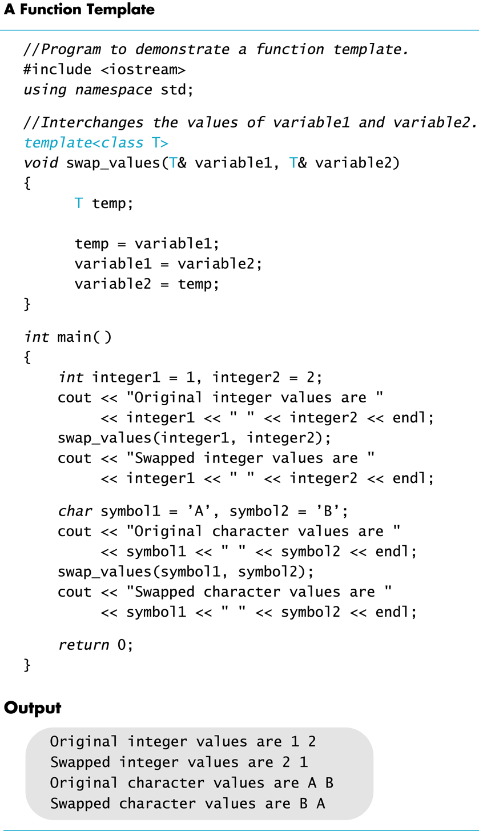
Display 17.1
Back
Next

Slide 47
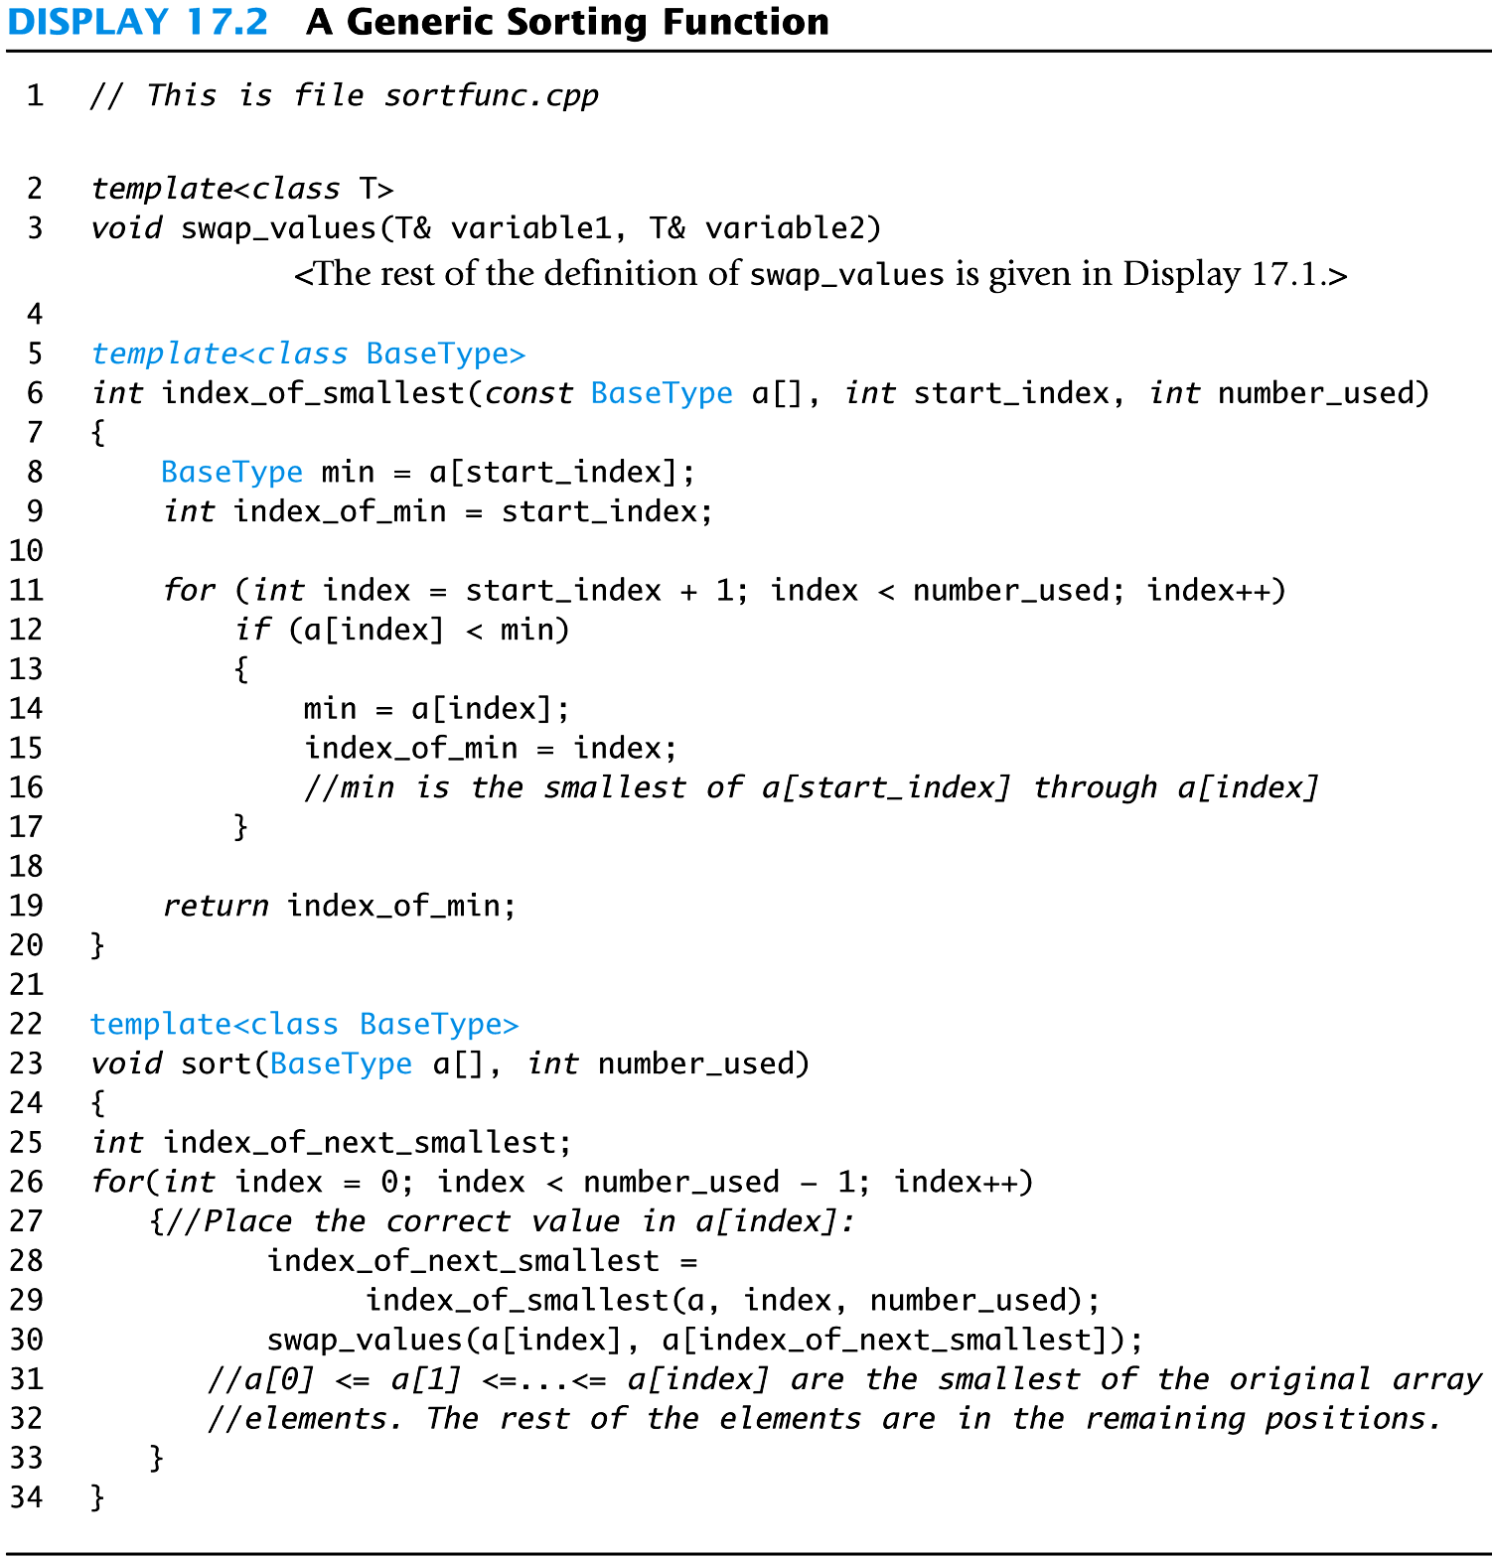
Display 17.2
Back
Next

Slide 48
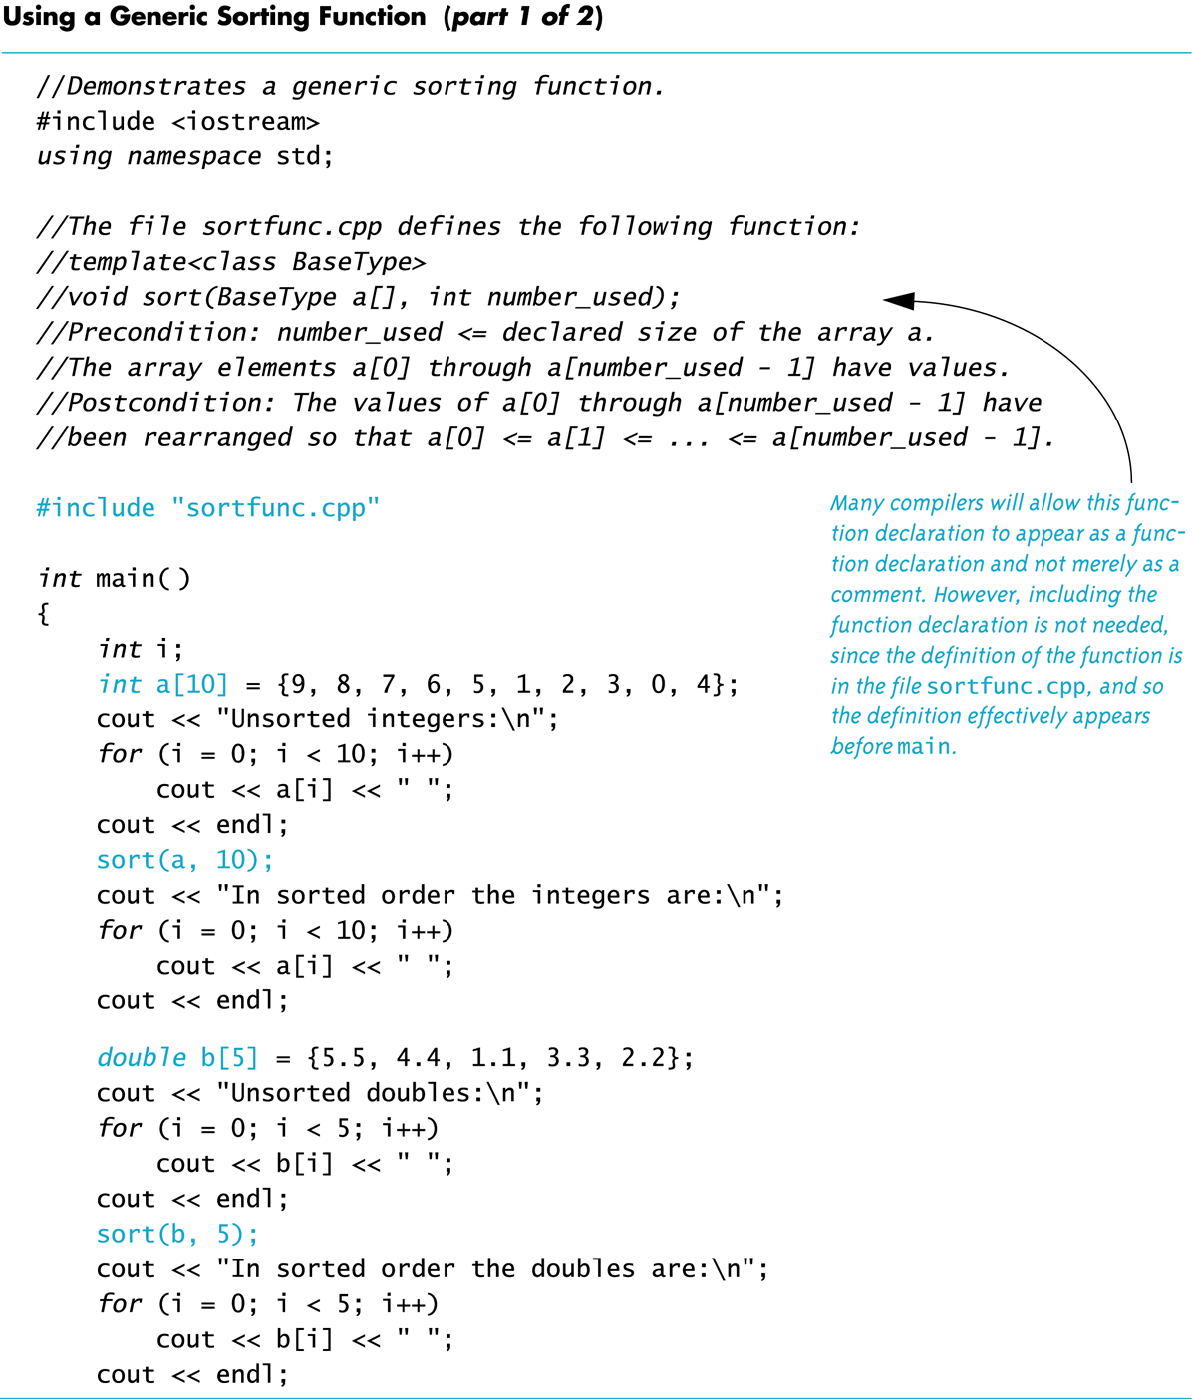
Display 17.3 (1/2)
Back
Next

Slide 49
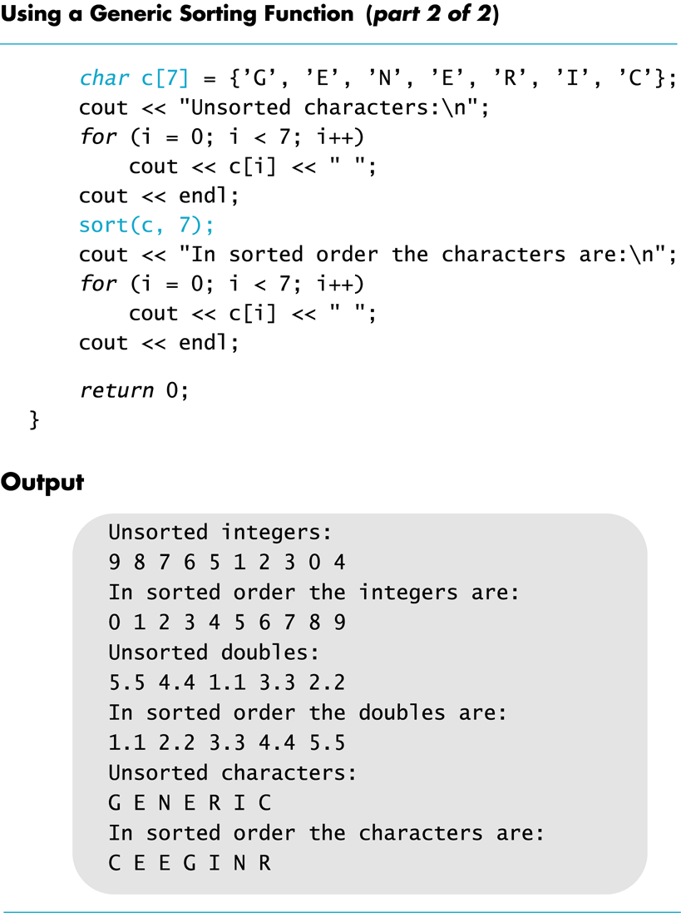
Display 17.3 (2/2)
Back
Next

Slide 50
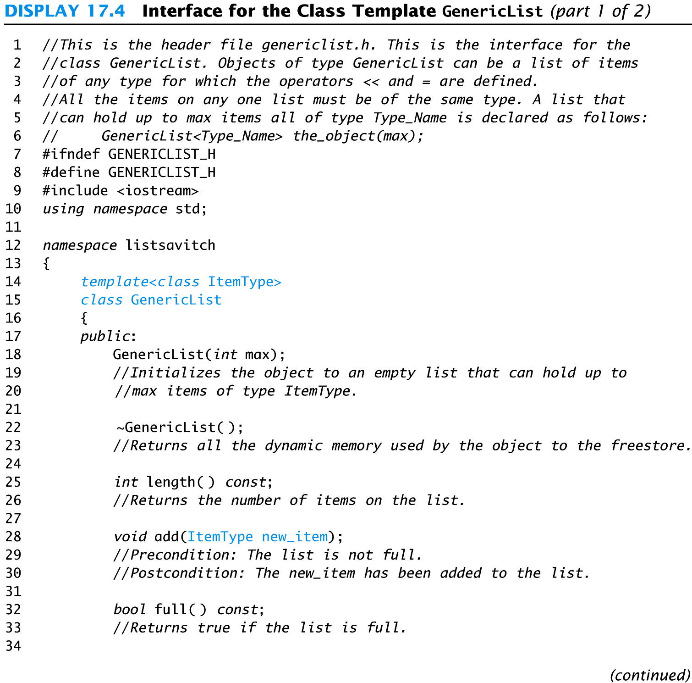
Display 17.4 (1/2)
Back
Next

Slide 51
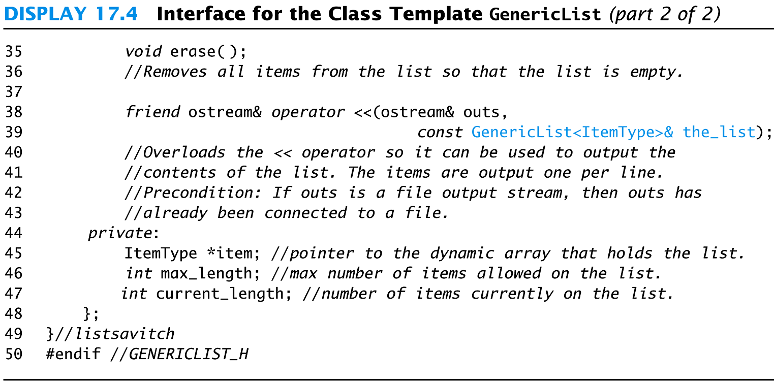
Display 17.4 (2/2)
Back
Next

Slide 52
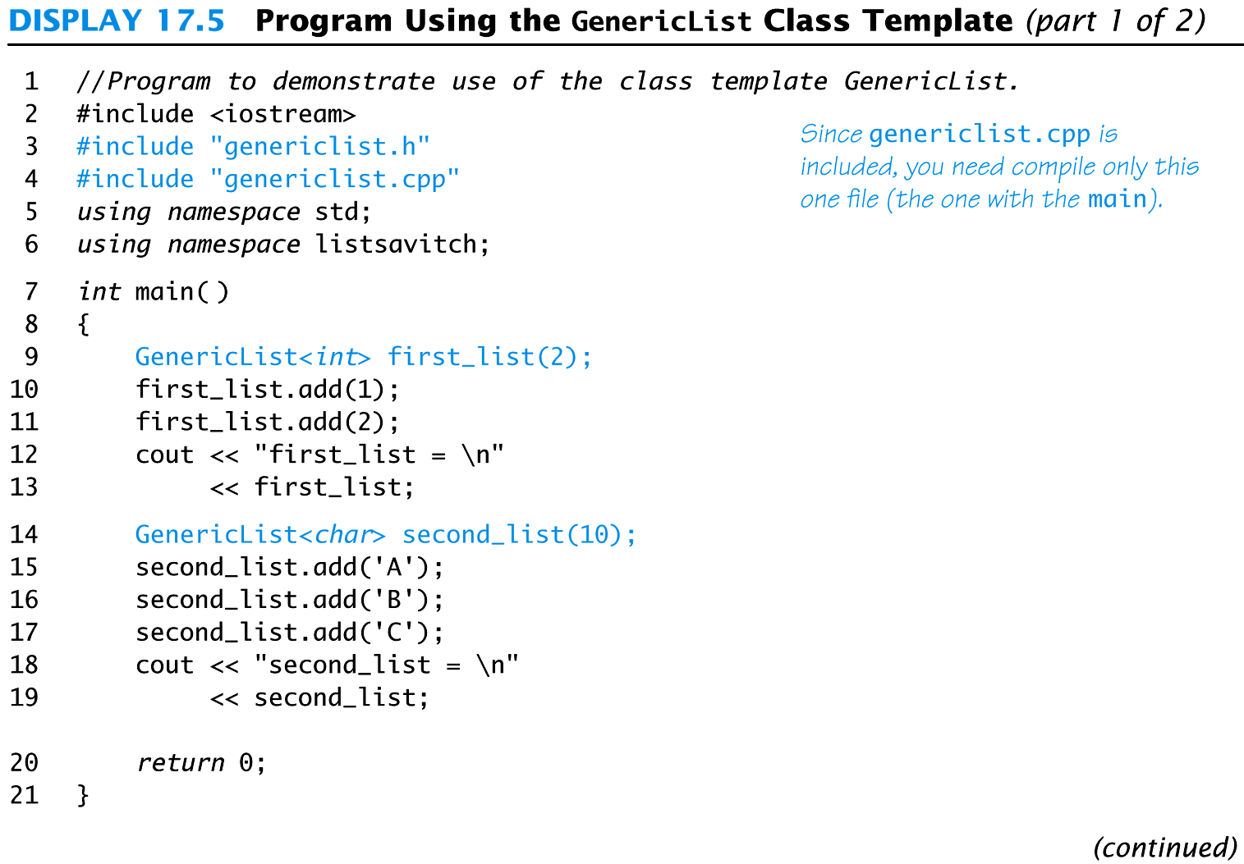
Display 17.5 1/2
Back
Next

Slide 53
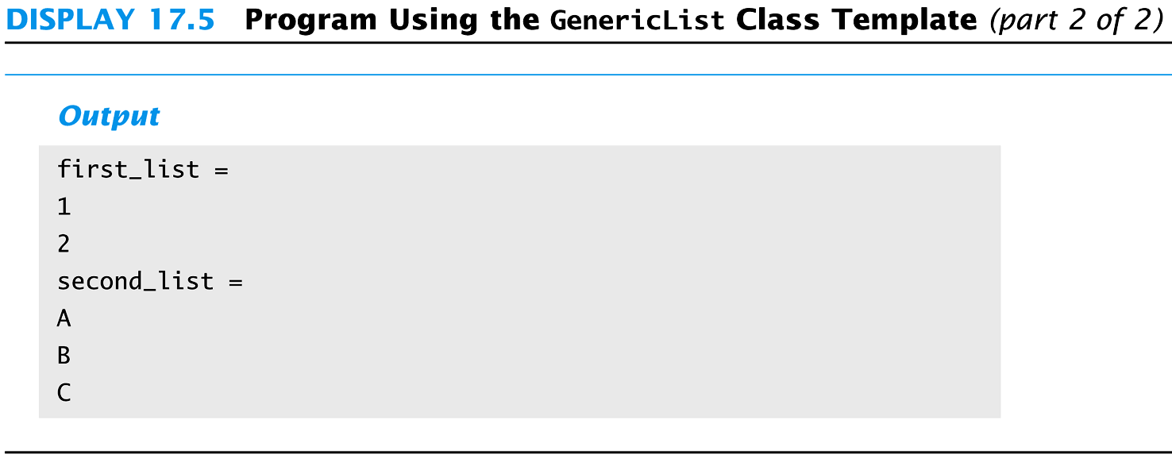
Display 17.5 2/2
Back
Next

Slide 54
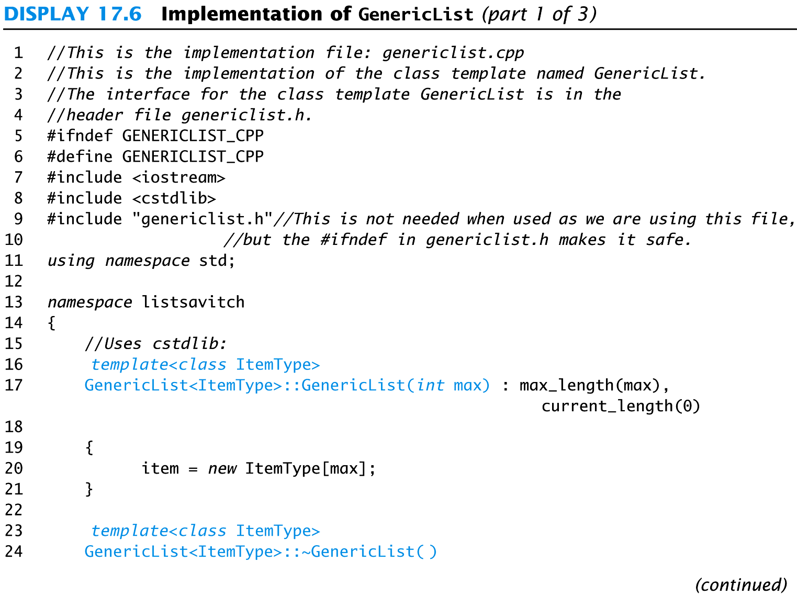
Display 17.6 1/3
Back
Next

Slide 55
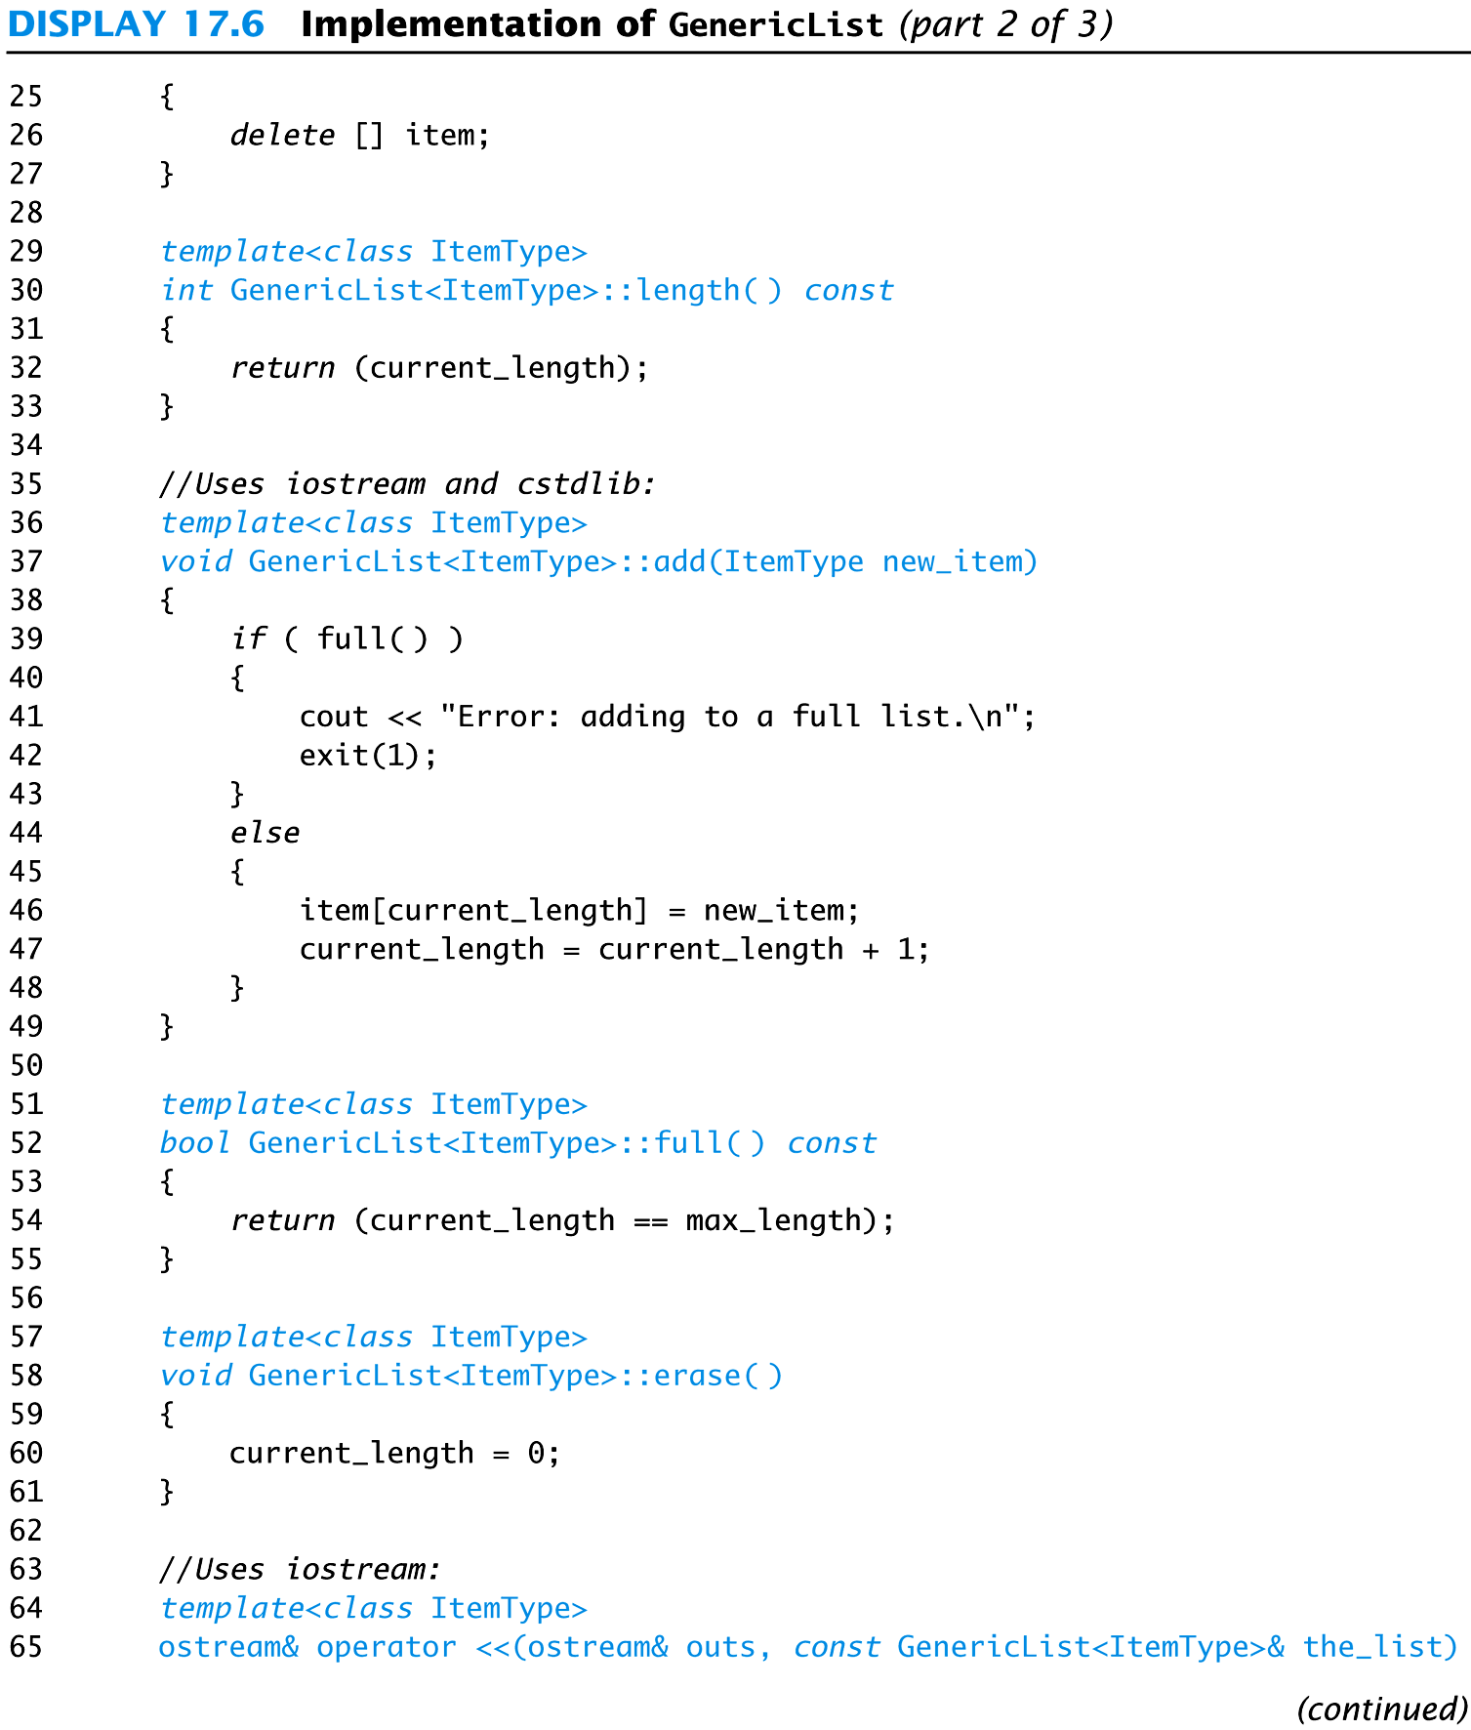
Display 17.6 (2/3)
Back
Next

Slide 56
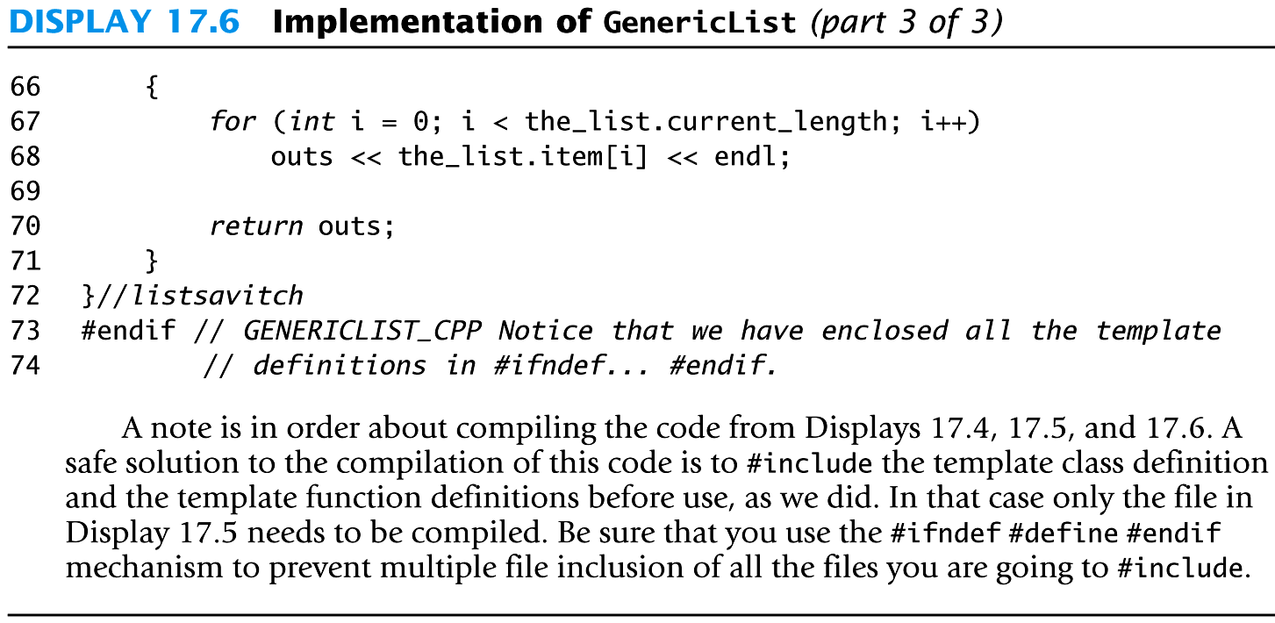
Display 17.6 (3/3)
Back
Next

