Slide 1
Decisions and Loops
CS 200 – Introduction to Programming

Slide 2
Learning Outcomes
Develop an understanding of simple ‘while’ loops
Determine appropriate increment and decrement operators and respective variables
Be able to use loops for solving simple programming problems

Slide 3
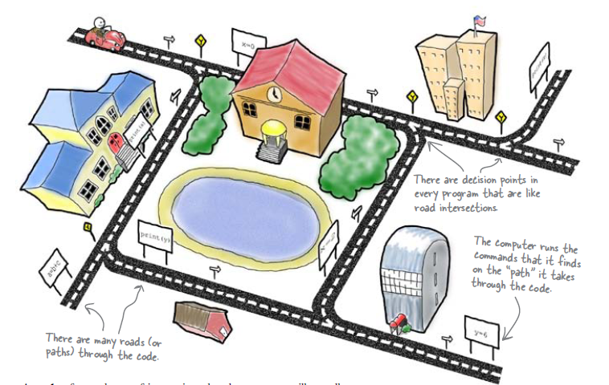
Your Program is Like a Network of Roads in a City

Slide 4
Boolean Expressions
Boolean expressions are expressions that are either true or false
comparison operators such as '>' (greater than) are used to compare variables and/or numbers
(hours > 40) Including the parentheses, is the boolean expression from the wages example
A few of the comparison operators that use two symbols (No spaces allowed between the symbols!)
>= greater than or equal to
!= not equal or inequality
= = equal or equivalent

Slide 5
Using Boolean Expressions
A Boolean Expression is an expression that is either true or false
Boolean expressions are evaluated using relational operations such as
= = , < , and >= which produce a boolean value
and boolean operations such as
&&, | |, and ! which also produce a boolean value
Type bool allows declaration of variables that carry the value true or false

Slide 6
Evaluating Boolean Expressions
Boolean expressions are evaluated using values from the Truth Tables in
For example, if y is 8, the expression !( ( y < 3) | | ( y > 7) ) is evaluated in the following sequence
! ( false | | true )
! ( true )
false

Slide 7
Precedence Rules
Items in expressions are grouped by precedence rules for arithmetic and boolean operators
Operators with higher precedence are performed first
Binary operators with equal precedence are performed left to right
Unary operators of equal precedence are performed right to left

Slide 8
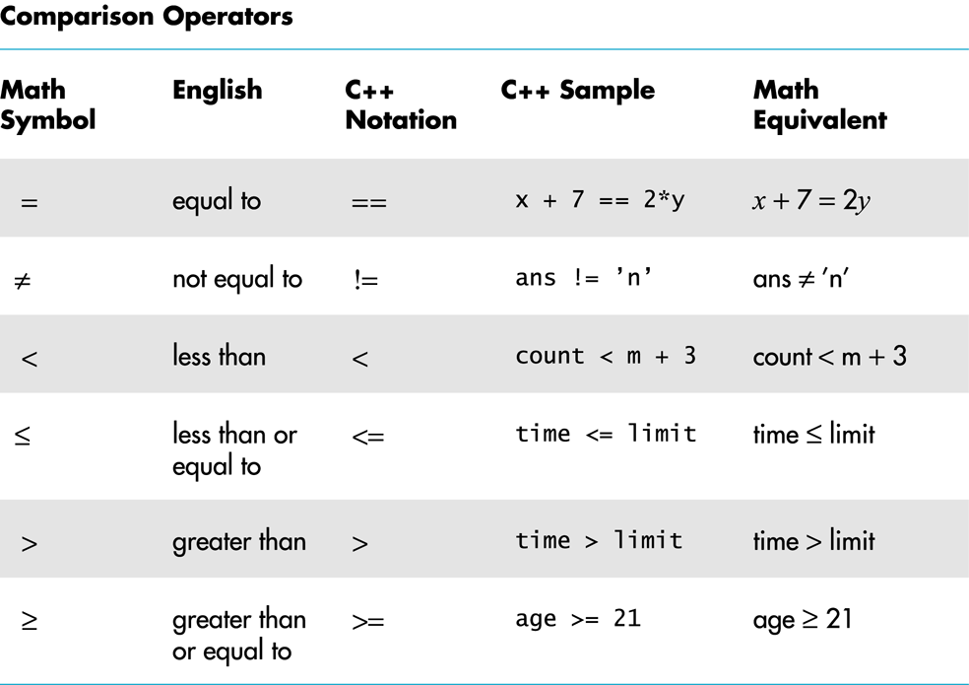

Slide 9
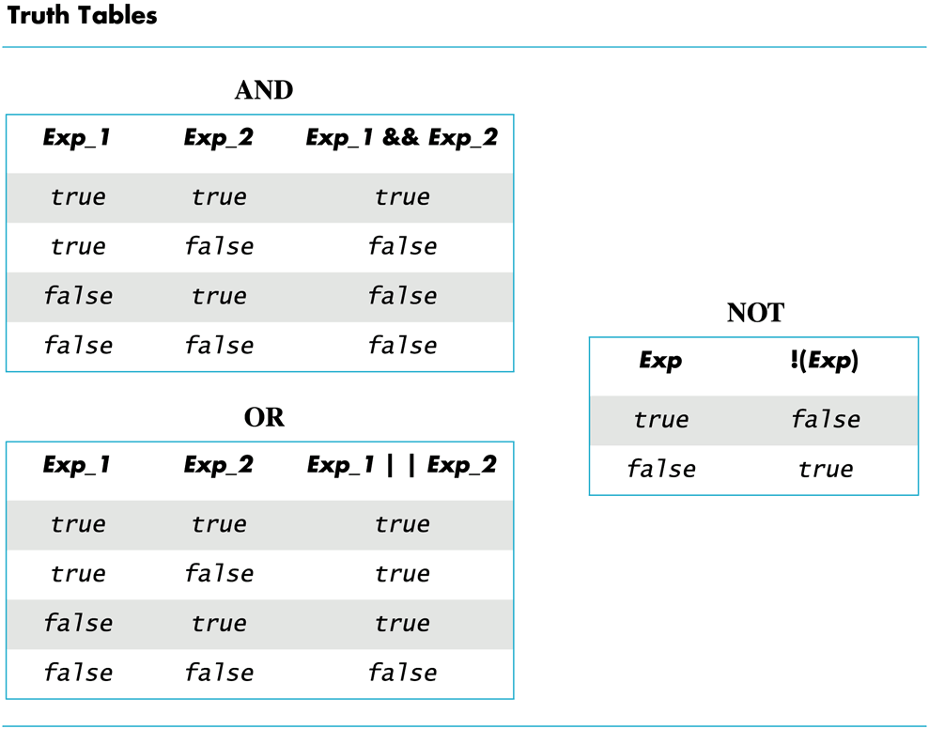
Complex Boolean Expression

Slide 10
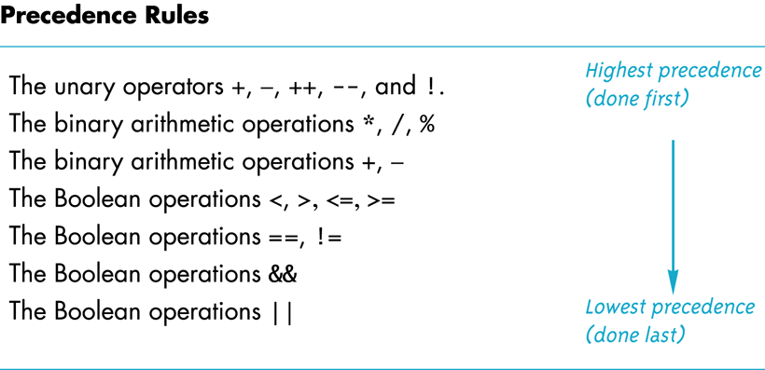
Precedence Rules

Slide 11
Precedence Rule Example
The expression (x+1) > 2 || (x + 1) < -3 is equivalent to ( (x + 1) > 2) || ( ( x + 1) < -3)
Because > and < have higher precedence than | |
and is also equivalent to x + 1 > 2 || x + 1 < - 3

Slide 12
Evaluating x + 1 > 2 | | x + 1 < - 3
Using the precedence rules
First apply the unary –
Next apply the +'s
Now apply the > and <
Finally do the | |

Slide 13
Block
What is a block?
Properties of a block?
Scoping of a block?

Slide 14
Blocks
Each branch of a switch or if-else statement is a separate sub-task
If the action of a branch is too simple to warrant a function call, use multiple statements between braces
A block is a section of code enclosed by braces
Variables declared within a block, are local to the block or have the block as their scope.
Variable names declared in the block can be reused outside the block

Slide 15
Statement Blocks
A statement block is a block that is not a function body or the body of the main part of a program
Statement blocks can be nested in other statement blocks
Nesting statement blocks can make code difficult to read
It is generally better to create function calls than to nest statement blocks

Slide 16
Scope Rule for Nested Blocks
If a single identifier is declared as a variable in each of two blocks, one within the other, then these are two different variables with the same name
One of the variables exists only within the inner block and cannot be accessed outside the inner block
The other variable exists only in the outer block and cannot be accessed in the inner block

Slide 17
While Loop Operation
First, the boolean expression is evaluated
If false, the program skips to the line following the while loop
If true, the body of the loop is executed
During execution, some item from the boolean expression is changed
After executing the loop body, the boolean expression is checked again repeating the process until the expression becomes false
A while loop might not execute at all if the boolean expression is false on the first check

Slide 18
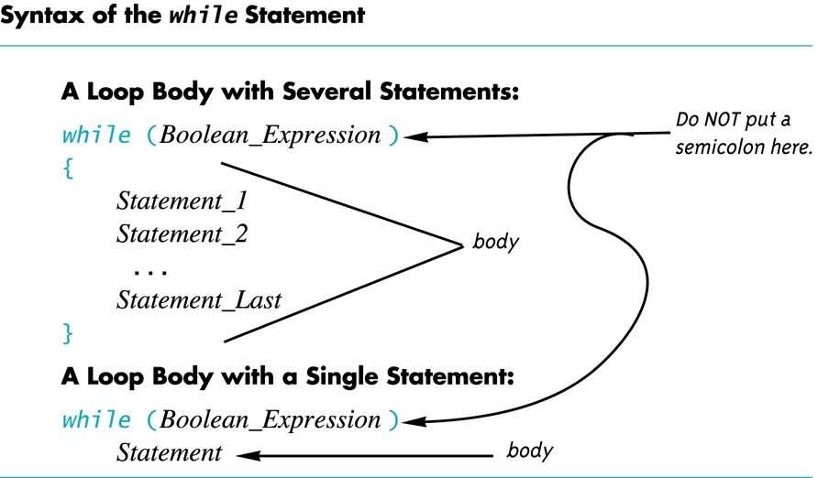

Slide 19
In Class Exercise
Write a program that takes a number from the user and sum all the numbers from zero upto the entered number?
For example if user enters 5 the program counts 5+4+3+2+1 and the sum is 15.

Slide 20
do-while loop
A variation of the while loop.
A do-while loop is always executed at least once
The body of the loop is first executed
The boolean expression is checked after the body has been executed
Syntax:
do { statements to repeat }
while (boolean_expression);

Slide 21
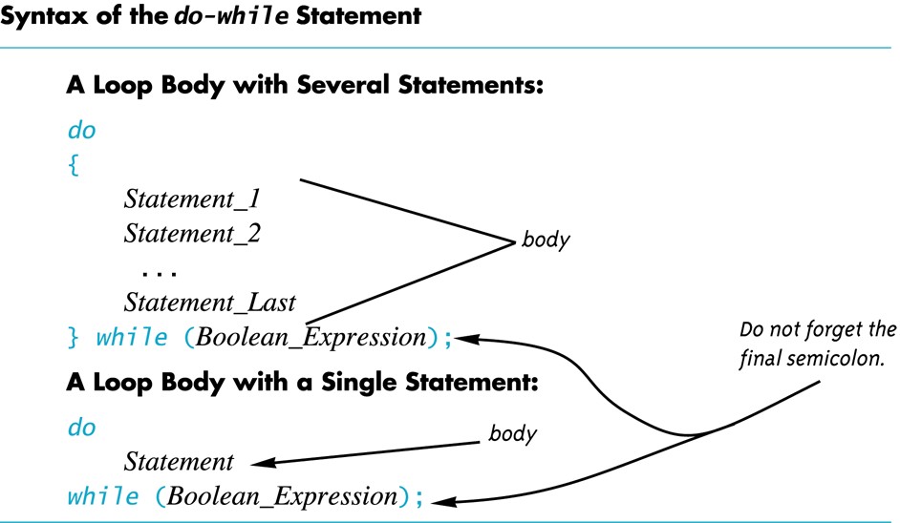

Slide 22
Increment/Decrement
Unary operators require only one operand
+ in front of a number such as +5
- in front of a number such as -5
++ increment operator
Adds 1 to the value of a variable x ++; is equivalent to x = x + 1;
-- decrement operator
Subtracts 1 from the value of a variable x --; is equivalent to x = x – 1;

Slide 23
Infinite Loops
Loops that never stop are infinite loops
The loop body should contain a line that will eventually cause the boolean expression to become false
Example: Print the odd numbers less than 12 x = 1; while (x != 12) { cout << x << endl; x = x + 2; }
Better to use this comparison: while ( x < 12)

Slide 24
Short-Circuit Evaluation
Some boolean expressions do not need to be completely evaluated
if x is negative, the value of the expression (x >= 0) && ( y > 1) can be determined by evaluating only (x >= 0)
C++ uses short-circuit evaluation
If the value of the leftmost sub-expression determines the final value of the expression, the rest of the expression is not evaluated

Slide 25
Using Short-Circuit Evaluation
Short-circuit evaluation can be used to prevent run time errors
Consider this if-statement if ((kids != 0) && (pieces / kids >= 2) ) cout << "Each child may have two pieces!";
If the value of kids is zero, short-circuit evaluation prevents evaluation of (pieces / 0 >= 2)
Division by zero causes a run-time error

Slide 26
Multiway Branches
A branching mechanism selects one out of a number of alternative actions
The if-else-statement is a branching mechanism
Branching mechanisms can be a subpart of another branching mechanism
An if-else-statement can include another if-else-statement as a subpart

Slide 27
Nested Statements
A statement that is a subpart of another statement is a nested statement
When writing nested statements it is normal to indent each level of nesting
Example: if ( x < y) cout << x << " is less than " << y; else cout << y << " is less than " << x;
indented

Slide 28
Nested if-else Statements
Use care in nesting if-else-statements
Example: To design an if-else statement to warn a driver when fuel is low, but tells the driver to bypass pit stops if the fuel is close to full. Other wise there should be no output. Pseudocode: if fuel gauge is below ¾ then: if fuel gauge is below ¼ then: issue a warning otherwise (gauge > ¾) then: output a statement saying don't stop

Slide 29
Braces and Nested Statements
Braces in nested statements are like parenthesis in arithmetic expressions
Braces tell the compiler how to group things
Use braces around substatements

Slide 30
Multi-way if-else-statements
An if-else-statement is a two-way branch
Three or four (or more) way branches can be designed using nested if-else-statements
Example: The number guessing game with the number stored in variable number, the guess in variable guess. How do we give hints?

Slide 31
Nested if-else Syntax
A Multiway if-else statement is written as
if (Boolean_Expression_1) Statement_1 else if ( Boolean_Expression_2) Statement_2 … else if (Boolean_Expression_n) Statement _n else Statement_For_All_Other_Possibilities

Slide 32
Class Exercise
Write a program for a state that computes tax according to the rate schedule:
No tax on first $15,000 of income
5% tax on each dollar from $15,001 to $25,000
10% tax on each dollar over $25,001 to $50,000
15% tax on each dollar over $50,001 to $75,000
20% tax on each dollar over $75,001 to $100,000
25% tax on each dollar over $100,001

Slide 33
The switch-statement
The switch-statement is an alternative for constructing multi-way branches

Slide 34
switch-statement Syntax
switch (controlling expression) { case Constant_1: statement_Sequence_1 break; case Constant_2: Statement_Sequence_2 break; . . . case Constant_n: Statement_Sequence_n break; default: Default_Statement_Sequence }

Slide 35
The Controlling Statement
A switch statement's controlling statement must return one of these types
A bool value
An enum constant
An integer type
A character
The value returned is compared to the constant values after each "case"
When a match is found, the code for that case is used

Slide 36
The break Statement
The break statement ends the switch-statement
Omitting the break statement will cause the code for the next case to be executed!
Omitting a break statement allows the use of multiple case labels for a section of code
case 'A': case 'a': cout << "Excellent."; break;
Runs the same code for either 'A' or 'a'

Slide 37
The default Statement
If no case label has a constant that matches the controlling expression, the statements following the default label are executed
If there is no default label, nothing happens when the switch statement is executed
It is a good idea to include a default section

Slide 38
More About C++ Loop Statements
A loop is a program construction that repeats a statement or sequence of statements a number of times
The body of the loop is the statement(s) repeated
Each repetition of the loop is an iteration
Loop design questions:
What should the loop body be?
How many times should the body be iterated?

Slide 39
Designing Loops
Designing a loop involves designing
The body of the loop
The initializing statements
The conditions for ending the loop

