Slide 1
functions

Slide 2
Learning Outcomes
Begin to understand function definition and declaration
Be able to Identify parameters and return types for functions
Recognize the difference between formal parameters and actual parameters

Slide 3
Programmer-Defined Functions
Two components of a function definition
Function declaration (or function prototype)
Shows how the function is called
Must appear in the code before the function can be called
Syntax: Type_returned Function_Name(Parameter_List); //Comment describing what function does
Function definition
Describes how the function does its task
Can appear before or after the function is called
Syntax: Type_returned Function_Name(Parameter_List) { //code to make the function work }
;

Slide 4
Function Declaration
Tells the return type
Tells the name of the function
Tells how many arguments are needed
Tells the types of the arguments
Tells the formal parameter names
Formal parameters are like placeholders for the actual arguments used when the function is called
Formal parameter names can be any valid identifier
Example: double total_cost(int number_par, double price_par); // Compute total cost including 5% sales tax on // number_par items at cost of price_par each

Slide 5
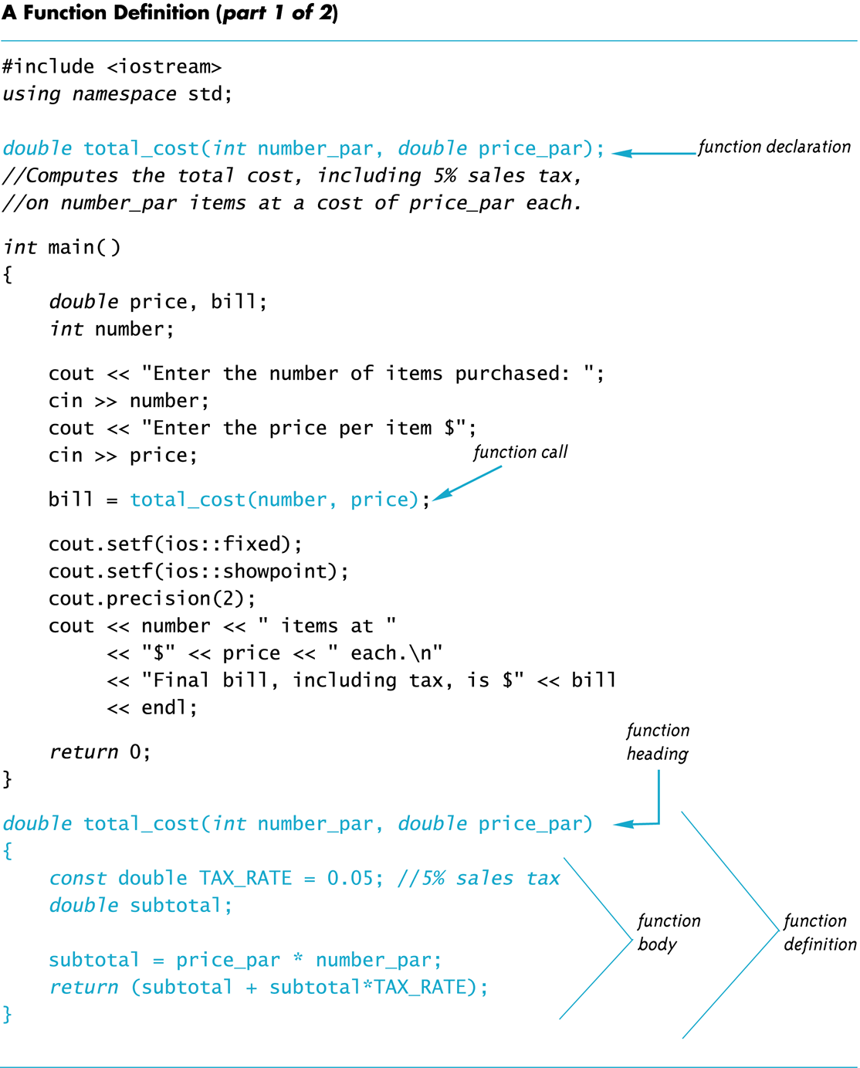

Slide 6
Function Definition
Provides the same information as the declaration
Describes how the function does its task
Example: double total_cost(int number_par, double price_par) { const double TAX_RATE = 0.05; //5% tax double subtotal; subtotal = price_par * number_par; return (subtotal + subtotal * TAX_RATE); }
function header
function body

Slide 7
The Return Statement
Ends the function call
Returns the value calculated by the function
Syntax: return expression;
expression performs the calculation or
expression is a variable containing the calculated value
Example: return subtotal + subtotal * TAX_RATE;

Slide 8
The Function Call
Tells the name of the function to use
Lists the arguments
Is used in a statement where the returned value makes sense
Example: double bill = total_cost(number, price);

Slide 9
Function Call Details
The values of the arguments are plugged into the formal parameters (Call-by-value mechanism with call-by-value parameters)
The first argument is used for the first formal parameter, the second argument for the second formal parameter, and so forth.
The value plugged into the formal parameter is used in all instances of the formal parameter in the function body

Slide 10
Alternate Declarations
Two forms for function declarations
List formal parameter names
List types of formal parmeters, but not names
First aids description of the function in comments
Examples: double total_cost(int number_par, double price_par); double total_cost(int, double);
Function headers must always list formal parameter names!

Slide 11
Order of Arguments
Compiler checks that the types of the arguments are correct and in the correct sequence.
Compiler cannot check that arguments are in the correct logical order
Example: Given the function declaration: char grade(int received_par, int min_score_par); int received = 95, min_score = 60; cout << grade( min_score, received);
Produces a faulty result because the arguments are not in the correct logical order. The compiler will not catch this!

Slide 12
Function Definition Syntax
Within a function definition
Variables must be declared before they are used
Variables are typically declared before the executable statements begin
At least one return statement must end the function
Each branch of an if-else statement might have its own return statement

Slide 13
Placing Definitions
A function call must be preceded by either
The function’s declaration or
The function’s definition
If the function’s definition precedes the call, a declaration is not needed
Placing the function declaration prior to the main function and the function definition after the main function leads naturally to building your own libraries in the future.

Slide 14
Section 4.3 Conclusion
Can you
Write a function declaration and a function definition for a function that takes three arguments, all of type int, and that returns the sum of its three arguments?
Describe the call-by-value parameter mechanism?
Write a function declaration and a function definition for a function that takes one argument of type int and one argument of type double, and that returns a value of type double that is the average of the two arguments?

Slide 15
Procedural Abstraction
The Black Box Analogy
A black box refers to something that we know how to use, but the method of operation is unknown
A person using a program does not need to know how it is coded
A person using a program needs to know what the program does, not how it does it
Functions and the Black Box Analogy
A programmer who uses a function needs to know what the function does, not how it does it
A programmer needs to know what will be produced if the proper arguments are put into the box

Slide 16
Information Hiding
Designing functions as black boxes is an example of information hiding
The function can be used without knowing how it is coded
The function body can be “hidden from view”

Slide 17
Function Implementations and The Black Box
Designing with the black box in mind allows us
To change or improve a function definition without forcing programmers using the function to change what they have done
To know how to use a function simply by reading the function declaration and its comment

Slide 18
Procedural Abstraction and C++
Procedural Abstraction is writing and using functions as if they were black boxes
Procedure is a general term meaning a “function like” set of instructions
Abstraction implies that when you use a function as a black box, you abstract away the details of the code in the function body

Slide 19
Procedural Abstraction and Functions
Write functions so the declaration and comment is all a programmer needs to use the function
Function comment should tell all conditions required of arguments to the function
Function comment should describe the returned value
Variables used in the function, other than the formal parameters, should be declared in the function body

Slide 20
Formal Parameter Names
Functions are designed as self-contained modules
Different programmers may write each function
Programmers choose meaningful names for formal parameters
Formal parameter names may or may not match variable names used in the main part of the program
It does not matter if formal parameter names match other variable names in the program
Remember that only the value of the argument is plugged into the formal parameter

Slide 21
Use Pseudocode
Pseudocode is a mixture of English and the programming language in use
Pseudocode simplifies algorithm design by allowing you to ignore the specific syntax of the programming language as you work out the details of the algorithm
If the step is obvious, use C++
If the step is difficult to express in C++, use English

Slide 22
Local Variables
Variables declared in a function:
Are local to that function, they cannot be used from outside the function
Have the function as their scope
Variables declared in the main part of a program:
Are local to the main part of the program, they cannot be used from outside the main part
Have the main part as their scope

Slide 23
Global Constants
Global Named Constant
Available to more than one function as well as the main part of the program
Declared outside any function body
Declared outside the main function body
Declared before any function that uses it
Example: const double PI = 3.14159; double volume(double); int main() {…}
PI is available to the main function and to function volume

Slide 24
Global Variables
Global Variable -- rarely used when more than one function must use a common variable
Declared just like a global constant except const is not used
Generally make programs more difficult to understand and maintain

Slide 25
Formal Parameters are Local Variables
Formal Parameters are actually variables that are local to the function definition
They are used just as if they were declared in the function body
Do NOT re-declare the formal parameters in the function body, they are declared in the function declaration
The call-by-value mechanism
When a function is called the formal parameters are initialized to the values of the arguments in the function call

Slide 26
Example: Factorial
n! Represents the factorial function
n! = 1 x 2 x 3 x … x n
The C++ version of the factorial function
Requires one argument of type int, n
Returns a value of type int
Uses a local variable to store the current product
Decrements n each time it does another multiplication n * n-1 * n-2 * … * 1

Slide 27
Overloading Function Names
C++ allows more than one definition for the same function name
Very convenient for situations in which the “same” function is needed for different numbers or types of arguments
Overloading a function name means providing more than one declaration and definition using the same function name

Slide 28
Overloading Examples
double ave(double n1, double n2) { return ((n1 + n2) / 2); }
double ave(double n1, double n2, double n3) { return (( n1 + n2 + n3) / 3); }
Compiler checks the number and types of arguments in the function call to decide which function to use cout << ave( 10, 20, 30); uses the second definition

Slide 29
Overloading Details
Overloaded functions
Must have different numbers of formal parameters AND / OR
Must have at least one different type of parameter
Must return a value of the same type

Slide 30
Automatic Type Conversion
Given the definition double mpg(double miles, double gallons) { return (miles / gallons); } what will happen if mpg is called in this way? cout << mpg(45, 2) << “ miles per gallon”;
The values of the arguments will automatically be converted to type double (45.0 and 2.0)

Slide 31
Type Conversion Problem
Given the previous mpg definition and the following definition in the same program int mpg(int goals, int misses) // returns the Measure of Perfect Goals { return (goals – misses); } what happens if mpg is called this way now? cout << mpg(45, 2) << “ miles per gallon”;
The compiler chooses the function that matches parameter types so the Measure of Perfect Goals will be calculated
Do not use the same function name for unrelated functions

Slide 32
Section 4.6 Conclusion
Can you
Describe Top-Down Design?
Describe the types of tasks we have seen so far that could be implemented as C++ functions?
Describe the principles of
The black box
Procedural abstraction
Information hiding
Define “local variable”?
Overload a function name?

