Slide 1
Session 7 Functions
CS 200 – Introduction to Programming

Slide 2
Learning Outcomes
Black-box analogy of functions
Global variables
Void functions
Pass by value and Pass by reference parameters

Slide 3
Procedural Abstraction
The Black Box Analogy
A black box refers to something that we know how to use, but the method of operation is unknown
A person using a program does not need to know how it is coded
A person using a program needs to know what the program does, not how it does it
Functions and the Black Box Analogy
A programmer who uses a function needs to know what the function does, not how it does it
A programmer needs to know what will be produced if the proper arguments are put into the box

Slide 4
Information Hiding
Designing functions as black boxes is an example of information hiding
The function can be used without knowing how it is coded
The function body can be “hidden from view”

Slide 5
Function Implementations and The Black Box
Designing with the black box in mind allows us
To change or improve a function definition without forcing programmers using the function to change what they have done
To know how to use a function simply by reading the function declaration and its comment

Slide 6
Formal Parameter Names
Functions are designed as self-contained modules
Different programmers may write each function
Programmers choose meaningful names for formal parameters
Formal parameter names may or may not match variable names used in the main part of the program
It does not matter if formal parameter names match other variable names in the program
Remember that only the value of the argument is plugged into the formal parameter

Slide 7
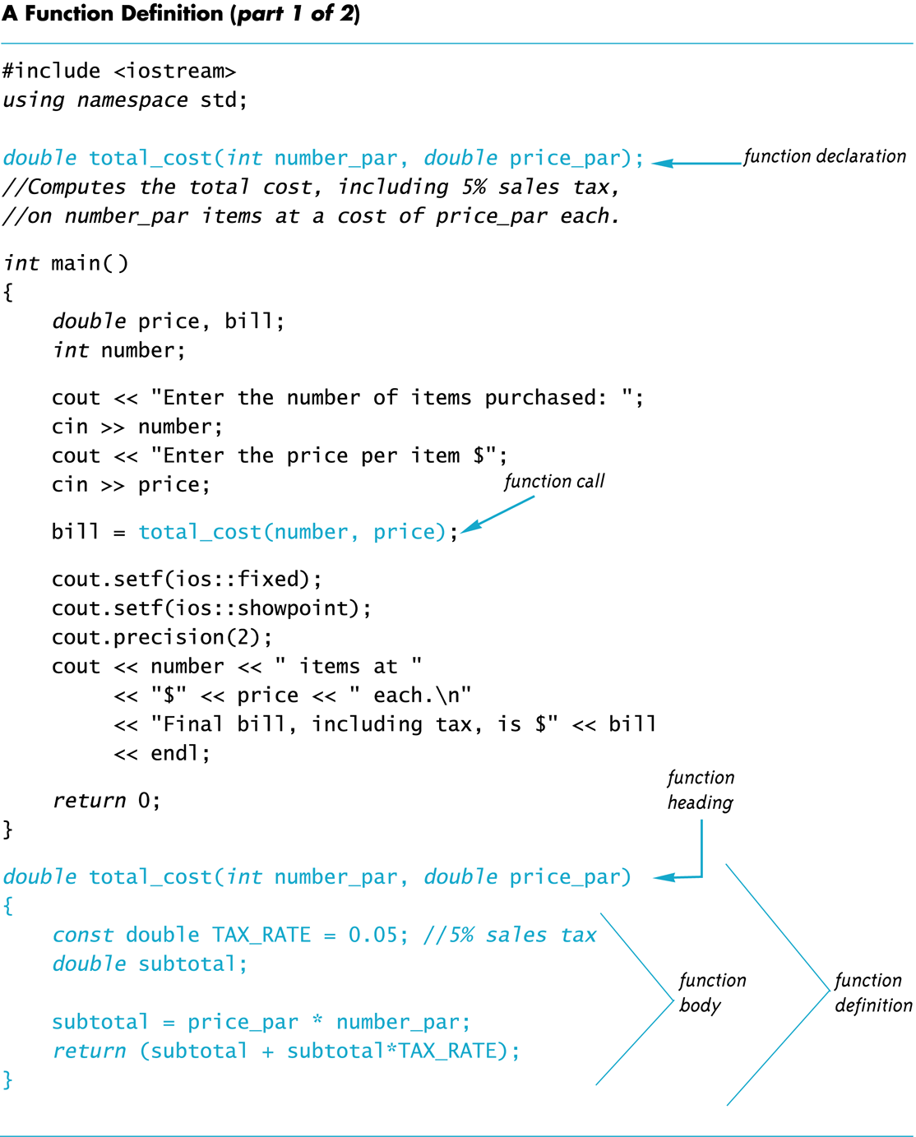

Slide 8
Global Constants
Global Named Constant
Available to more than one function as well as the main part of the program
Declared outside any function body
Declared outside the main function body
Declared before any function that uses it
Example: const double PI = 3.14159; double volume(double); int main() {…}
PI is available to the main function and to function volume

Slide 9
Global Variables
Global Variable -- rarely used when more than one function must use a common variable
Declared just like a global constant except const is not used
Generally make programs more difficult to understand and maintain

Slide 10
Formal Parameters are Local Variables
Formal Parameters are actually variables that are local to the function definition
They are used just as if they were declared in the function body
Do NOT re-declare the formal parameters in the function body, they are declared in the function declaration
The call-by-value mechanism
When a function is called the formal parameters are initialized to the values of the arguments in the function call

Slide 11
Overloading Function Names
C++ allows more than one definition for the same function name
Very convenient for situations in which the “same” function is needed for different numbers or types of arguments
Overloading a function name means providing more than one declaration and definition using the same function name

Slide 12
Overloading Examples
double ave(double n1, double n2) { return ((n1 + n2) / 2); }
double ave(double n1, double n2, double n3) { return (( n1 + n2 + n3) / 3); }
Compiler checks the number and types of arguments in the function call to decide which function to use cout << ave( 10, 20, 30); uses the second definition

Slide 13
Overloading Details
Overloaded functions
Must have different numbers of formal parameters
and/or
Must have at least one different type of parameter
Must return a value of the same type

Slide 14
void-Functions
In top-down design, a subtask might produce
No value (just input or output for example)
One value
More than one value
We have seen how to implement functions that return one value
A void-function implements a subtask that returns no value or more than one value

Slide 15
void-Function Definition
Two main differences between void-function definitions and the definitions of functions that return one value
Keyword void replaces the type of the value returned
void means that no value is returned by the function
The return statement does not include an expression
Example: void show_results(double f_degrees, double c_degrees) { using namespace std; cout << f_degrees << “ degrees Fahrenheit is euivalent to “ << endl << c_degrees << “ degrees Celsius.” << endl; return; }

Slide 16
Using a void-Function
void-function calls are executable statements
They do not need to be part of another statement
They end with a semi-colon
Example: show_results(32.5, 0.3); NOT: cout << show_results(32.5, 0.3);

Slide 17
void-Function Calls
Mechanism is nearly the same as the function calls we have seen
Argument values are substituted for the formal parameters
It is fairly common to have no parameters in void-functions
In this case there will be no arguments in the function call
Statements in function body are executed
Optional return statement ends the function
Return statement does not include a value to return
Return statement is implicit if it is not included

Slide 18
Example: Converting Temperatures
The functions just developed can be used in a program to convert Fahrenheit temperatures to Celcius using the formula C = (5/9) (F – 32)
Do you see the integer division problem?

Slide 19
void-Functions Why Use a Return?
Is a return-statement ever needed in a void-function since no value is returned?
Yes!
What if a branch of an if-else statement requires that the function ends to avoid producing more output, or creating a mathematical error?

Slide 20
The Main Function
The main function in a program is used like a void function…do you have to end the program with a return-statement?
Because the main function is defined to return a value of type int, the return is needed
C++ standard says the return 0 can be omitted, but many compilers still require it

Slide 21
Call-by-Reference Parameters
Call-by-value is not adequate when we need a sub-task to obtain input values
Call-by-value means that the formal parameters receive the values of the arguments
To obtain input values, we need to change the variables that are arguments to the function
Recall that we have changed the values of formal parameters in a function body, but we have not changed the arguments found in the function call
Call-by-reference parameters allow us to change the variable used in the function call
Arguments for call-by-reference parameters must be variables, not numbers

Slide 22
Call-by-Reference Example
void get_input(double& f_variable) { using namespace std; cout << “ Convert a Fahrenheit temperature” << “ to Celsius.\n” << “ Enter a temperature in Fahrenheit: “; cin >> f_variable; }
‘&’ symbol (ampersand) identifies f_variable as a call-by-reference parameter
Used in both declaration and definition!

Slide 23
Call-By-Reference Details
Call-by-reference works almost as if the argument variable is substituted for the formal parameter, not the argument’s value
In reality, the memory location of the argument variable is given to the formal parameter
Whatever is done to a formal parameter in the function body, is actually done to the value at the memory location of the argument variable

Slide 24
Call Comparisons Call By Reference vs Value
Call-by-value
The function call: f(age); void f(int var_par);
Call-by-reference
The function call: f(age);
void f(int& ref_par);
Memory
Name | Location | Contents
age | 1001 | 34
initial | 1002 | A
hours | 1003 | 23.5
 | 1004

Slide 25
Example: swap_values
void swap(int& variable1, int& variable2) { int temp = variable1; variable1 = variable2; variable2 = temp; }
If called with swap(first_num, second_num);
first_num is substituted for variable1 in the parameter list
second_num is substituted for variable2 in the parameter list
temp is assigned the value of variable1 (first_num) since the next line will loose the value in first_num
variable1 (first_num) is assigned the value in variable2 (second_num)
variable2 (second_num) is assigned the original value of variable1 (first_num) which was stored in temp

Slide 26
Mixed Parameter Lists
Call-by-value and call-by-reference parameters can be mixed in the same function
Example: void good_stuff(int& par1, int par2, double& par3);
par1 and par3 are call-by-reference formal parameters
Changes in par1 and par3 change the argument variable
par2 is a call-by-value formal parameter
Changes in par2 do not change the argument variable

Slide 27
Choosing Parameter Types
How do you decide whether a call-by-reference or call-by-value formal parameter is needed?
Does the function need to change the value of the variable used as an argument?
Yes? Use a call-by-reference formal parameter
No? Use a call-by-value formal parameter

Slide 28
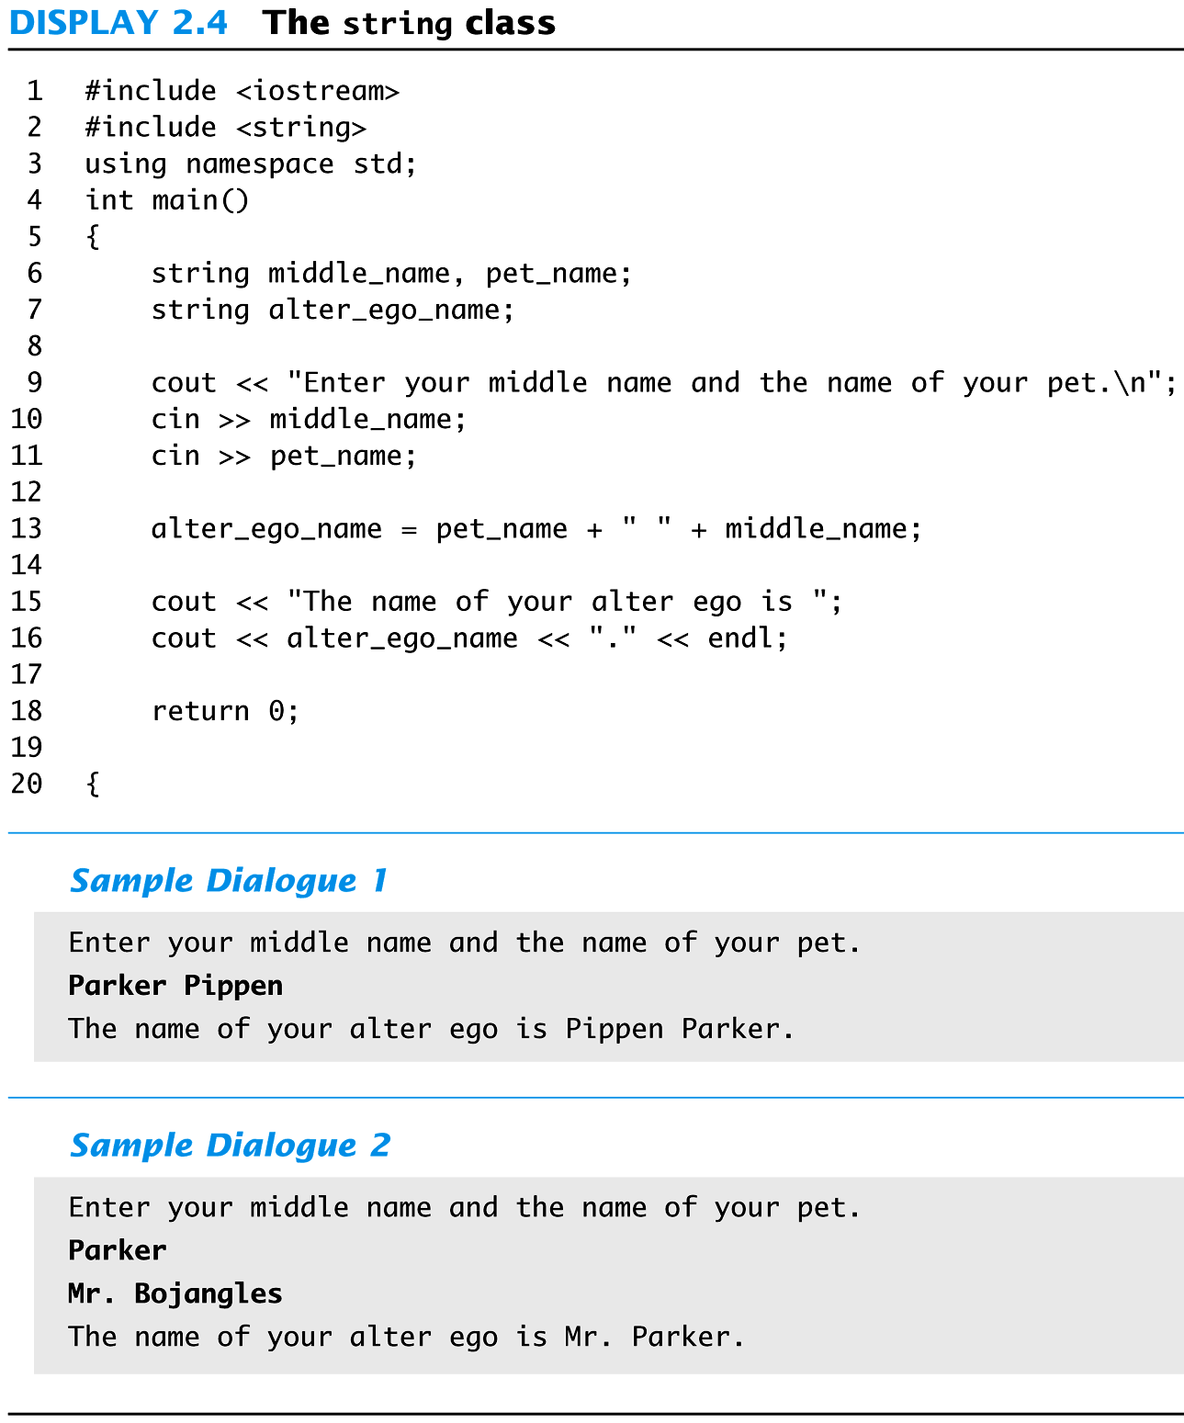

Slide 29
Inadvertent Local Variables
If a function is to change the value of a variable the corresponding formal parameter must be a call-by-reference parameter with an ampersand (&) attached
Forgetting the ampersand (&) creates a call-by-value parameter
The value of the variable will not be changed
The formal parameter is a local variable that has no effect outside the function
Hard error to find…it looks right!

