Slide 1
Session 8 Arrays
CS 200 – Introduction to Programming

Slide 2
Introduction to Arrays
An array is used to process a collection of data of the same type
Examples: A list of names A list of temperatures
Why do we need arrays?
Imagine keeping track of 5 test scores, or 100, or 1000 in memory
How would you name all the variables?
How would you process each of the variables?

Slide 3
Declaring an Array
An array, named score, containing five variables of type int can be declared as int score[ 5 ];
This is like declaring 5 variables of type int: score[0], score[1], … , score[4]
The value in brackets is called
A subscript
An index

Slide 4
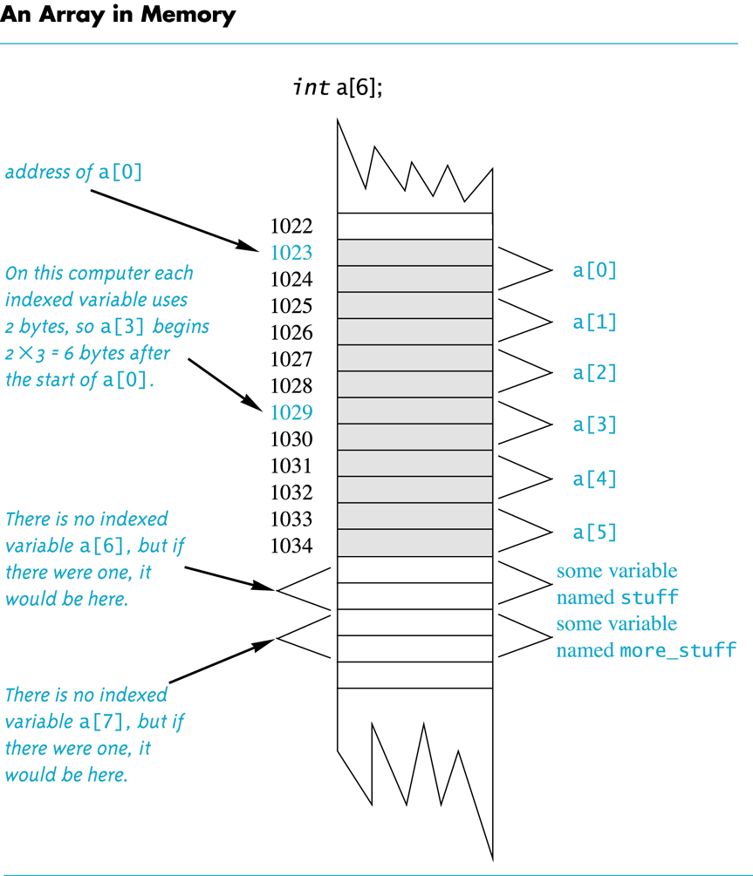
Back
Next

Slide 5
The Array Variables
The variables making up the array are referred to as
Indexed variables
Subscripted variables
Elements of the array
The number of indexed variables in an array is the declared size, or size, of the array
The largest index is one less than the size
The first index value is zero

Slide 6
Array Variable Types
An array can have indexed variables of any type
All indexed variables in an array are of the same type
This is the base type of the array
An indexed variable can be used anywhere an ordinary variable of the base type is used

Slide 7
Using [ ] With Arrays
In an array declaration, [ ]'s enclose the size of the array such as this array of 5 integers: int score [5];
When referring to one of the indexed variables, the [ ]'s enclose a number identifying one of the indexed variables
score[3] is one of the indexed variables
The value in the [ ]'s can be any expression that evaluates to one of the integers 0 to (size -1)

Slide 8
Indexed Variable Assignment
To assign a value to an indexed variable, use the assignment operator: int n = 2; score[n + 1] = 99;
In this example, variable score[3] is assigned 99

Slide 9
Loops And Arrays
for-loops are commonly used to step through arrays
Example: for (i = 0; i < 5; i++) { cout << score[i] << " off by " << (max – score[i]) << endl; } could display the difference between each score and the maximum score stored in an array
First index is 0
Last index is (size – 1)
Display 7.1

Slide 10
Constants and Arrays
Use constants to declare the size of an array
Using a constant allows your code to be easily altered for use on a smaller or larger set of data
Example: const int NUMBER_OF_STUDENTS = 50; int score[NUMBER_OF_STUDENTS]; … for ( i = 0; i < NUMBER_OF_STUDENTS; i++) cout << score[i] << " off by " << (max – score[i]) << endl;
Only the value of the constant must be changed to make this code work for any number of students

Slide 11
Array Declaration Syntax
To declare an array, use the syntax: Type_Name Array_Name[Declared_Size];
Type_Name can be any type
Declared_Size can be a constant to make your program more versatile
Once declared, the array consists of the indexed variables: Array_Name[0] to Array_Name[Declared_Size -1]

Slide 12
Computer Memory
Computer memory consists of numbered locations called bytes
A byte's number is its address
A simple variable is stored in consecutive bytes
The number of bytes depends on the variable's type
A variable's address is the address of its first byte

Slide 13
Arrays and Memory
Declaring the array int a[6]
Reserves memory for six variables of type int
The variables are stored one after another
The address of a[0] is remembered
The addresses of the other indexed variables is not remembered
To determine the address of a[3]
Start at a[0]
Count past enough memory for three integers to find a[3]
Display 7.2

Slide 14
Array Index Out of Range
A common error is using a nonexistent index
Index values for int a[6] are the values 0 through 5
An index value not allowed by the array declaration is out of range
Using an out of range index value doe not produce an error message!

Slide 15
Out of Range Problems
If an array is declared as: int a[6]; and an integer is declared as: int i = 7;
Executing the statement a[i] = 238; causes…
The computer to calculate the address of the illegal a[7]
(This address could be where some other variable is stored)
The value 238 is stored at the address calculated for a[7]
No warning is given!

Slide 16
Initializing Arrays
To initialize an array when it is declared
The values for the indexed variables are enclosed in braces and separated by commas
Example: int children[3] = { 2, 12, 1 }; Is equivalent to: int children[3]; children[0] = 2; children[1] = 12; children[2] = 1;

Slide 17
Default Values
If too few values are listed in an initialization statement
The listed values are used to initialize the first of the indexed variables
The remaining indexed variables are initialized to a zero of the base type
Example: int a[10] = {5, 5}; initializes a[0] and a[1] to 5 and a[2] through a[9] to 0

Slide 18
Un-initialized Arrays
If no values are listed in the array declaration, some compilers will initialize each variable to a zero of the base type
DO NOT DEPEND ON THIS!

Slide 19
Arrays in Functions
Indexed variables can be arguments to functions
Example: If a program contains these declarations: int i, n, a[10]; void my_function(int n);
Variables a[0] through a[9] are of type int, making these calls legal: my_function( a[ 0 ] ); my_function( a[ 3 ] ); my_function( a[ i ] );
Display 7.3

Slide 20
Arrays as Function Arguments
A formal parameter can be for an entire array
Such a parameter is called an array parameter
It is not a call-by-value parameter
It is not a call-by-reference parameter
Array parameters behave much like call-by-reference parameters

Slide 21
Array Parameter Declaration
An array parameter is indicated using empty brackets in the parameter list such as void fill_up(int a[ ], int size);

Slide 22
Function Calls With Arrays
If function fill_up is declared in this way: void fill_up(int a[ ], int size);
and array score is declared this way: int score[5], number_of_scores;
fill_up is called in this way: fill_up(score, number_of_scores);
Display 7.4

Slide 23
Function Call Details
A formal parameter is identified as an array parameter by the [ ]'s with no index expression void fill_up(int a[ ], int size);
An array argument does not use the [ ]'s fill_up(score, number_of_scores);

Slide 24
Array Formal Parameters
An array formal parameter is a placeholder for the argument
When an array is an argument in a function call, an action performed on the array parameter is performed on the array argument
The values of the indexed variables can be changed by the function

Slide 25
Array Argument Details
What does the computer know about an array?
The base type
The address of the first indexed variable
The number of indexed variables
What does a function know about an array argument?
The base type
The address of the first indexed variable

Slide 26
Array Parameter Considerations
Because a function does not know the size of an array argument…
The programmer should include a formal parameter that specifies the size of the array
The function can process arrays of various sizes
Function fill_up from Display 7.4 can be used to fill an array of any size: fill_up(score, 5); fill_up(time, 10);

Slide 27
const Modifier
Array parameters allow a function to change the values stored in the array argument
If a function should not change the values of the array argument, use the modifier const
An array parameter modified with const is a constant array parameter
Example: void show_the_world(const int a[ ], int size);

Slide 28
Using const With Arrays
If const is used to modify an array parameter:
const is used in both the function declaration and definition to modify the array parameter
The compiler will issue an error if you write code that changes the values stored in the array parameter

Slide 29
Function Calls and const
If a function with a constant array parameter calls another function using the const array parameter as an argument…
The called function must use a constant array parameter as a placeholder for the array
The compiler will issue an error if a function is called that does not have a const array parameter to accept the array argument

Slide 30
const Parameters Example
double compute_average(int a[ ], int size); void show_difference(const int a[ ], int size) { double average = compute_average(a, size); … }
compute_average has no constant array parameter
This code generates an error message because compute_average could change the array parameter

Slide 31
Returning An Array
Recall that functions can return a value of type int, double, char, …, or a class type
Functions cannot return arrays
We learn later how to return a pointer to an array

Slide 32
Programming With Arrays
The size needed for an array is changeable
Often varies from one run of a program to another
Is often not known when the program is written
A common solution to the size problem
Declare the array size to be the largest that could be needed
Decide how to deal with partially filled arrays

Slide 33
Partially Filled Arrays
When using arrays that are partially filled
Functions dealing with the array may not need to know the declared size of the array, only how many elements are stored in the array
A parameter, number_used, may be sufficient to ensure that referenced index values are legal
A function such as fill_array in Display 7.9 needs to know the declared size of the array
Display 7.9 (1)
Display 7.9 (2)
Display 7.9 (3)

Slide 34
Constants as Arguments
When function fill_array (Display 7.9) is called, MAX_NUMBER_SCORES is used as an argument
Can't MAX_NUMBER_SCORES be used directly without making it an argument?
Using MAX_NUMBER_SCORES as an argument makes it clear that fill_array requires the array's declared size
This makes fill_array easier to be used in other programs

Slide 35
Multi-Dimensional Arrays
C++ allows arrays with multiple index values
char page [30] [100]; declares an array of characters named page
page has two index values: The first ranges from 0 to 29 The second ranges from 0 to 99
Each index in enclosed in its own brackets
Page can be visualized as an array of 30 rows and 100 columns

Slide 36
Index Values of page
The indexed variables for array page are page[0][0], page[0][1], …, page[0][99] page[1][0], page[1][1], …, page[1][99]
… page[29][0], page[29][1], … , page[29][99]
page is actually an array of size 30
page's base type is an array of 100 characters

Slide 37
Multidimensional Array Parameters
Recall that the size of an array is not needed when declaring a formal parameter: void display_line(const char a[ ], int size);
The base type of a multi-dimensional array must be completely specified in the parameter declaration
void display_page(const char page[ ] [100], int size_dimension_1);

Slide 38
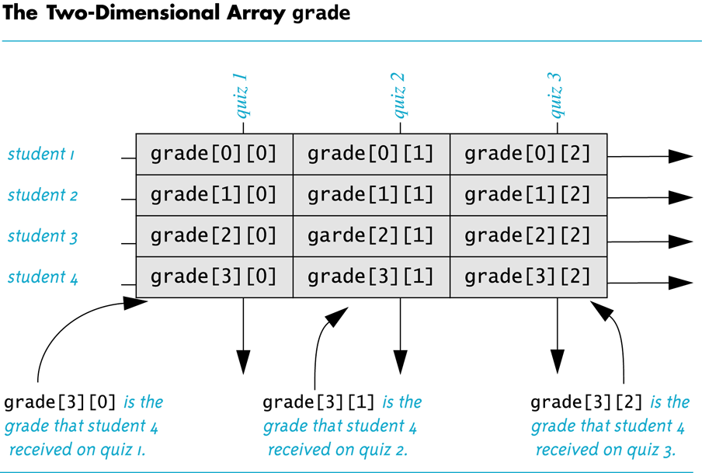
Display 7.14
Back
Next

Slide 39
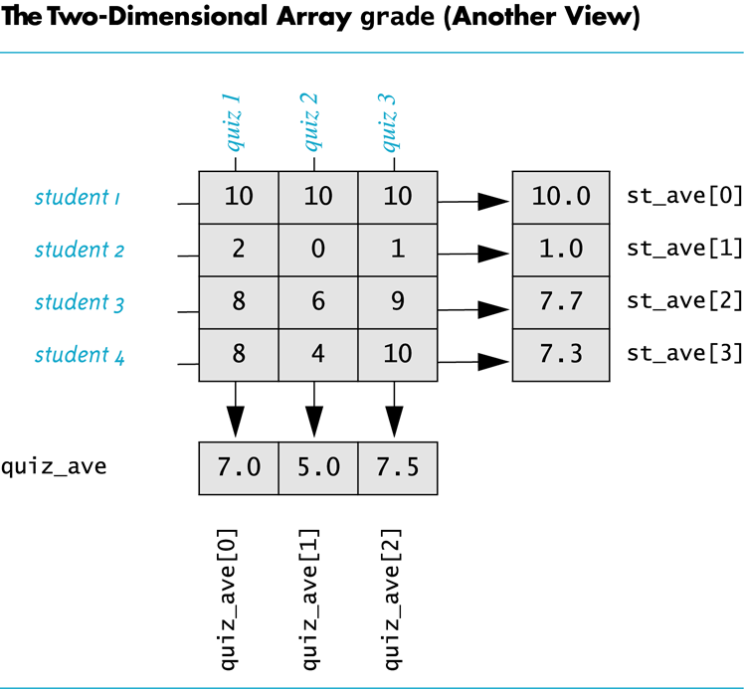
Display 7.15
Back
Next

Slide 40
Section 7.5 Conclusion
Can you
Write code that will fill the array a(declared below) with numbers typed at the keyboard? The numbers will be input fiver per line, on four lines. int a[4][5];

Slide 41
Chapter 7 - End

