Slide 1
I/O Streams as an Introduction to Objects and Classes
CS 200
Session 9

Slide 2
Overview
6.1 Streams and Basic File I/O
6.2 Tools for Stream I/O
6.3 Character I/O
6.4 Inheritance

Slide 3
I/O Streams
I/O refers to program input and output
Input is delivered to your program via a stream object
Input can be from
The keyboard
A file
Output is delivered to the output device via a stream object
Output can be to
The screen
A file

Slide 4
Objects
Objects are special variables that
Have their own special-purpose functions
Set C++ apart from earlier programming languages

Slide 5
Streams and Basic File I/O
Files for I/O are the same type of files used to store programs
A stream is a flow of data.
Input stream: Data flows into the program
If input stream flows from keyboard, the program will accept data from the keyboard
If input stream flows from a file, the program will accept data from the file
Output stream: Data flows out of the program
To the screen
To a file

Slide 6
cin And cout Streams
cin
Input stream connected to the keyboard
cout
Output stream connected to the screen
cin and cout defined in the iostream library
Use include directive: #include <iostream>
You can declare your own streams to use with files.

Slide 7
Why Use Files?
Files allow you to store data permanently!
Data output to a file lasts after the program ends
An input file can be used over and over
No typing of data again and again for testing
Create a data file or read an output file at your convenience
Files allow you to deal with larger data sets

Slide 8
File I/O
Reading from a file
Taking input from a file
Done from beginning to the end (for now)
No backing up to read something again (OK to start over)
Just as done from the keyboard
Writing to a file
Sending output to a file
Done from beginning to end (for now)
No backing up to write something again( OK to start over)
Just as done to the screen

Slide 9
Stream Variables
Like other variables, a stream variable…
Must be declared before it can be used
Must be initialized before it contains valid data
Initializing a stream means connecting it to a file
The value of the stream variable can be thought of as the file it is connected to
Can have its value changed
Changing a stream value means disconnecting from one file and connecting to another

Slide 10
Streams and Assignment
A stream is a special kind of variable called an object
Objects can use special functions to complete tasks
Streams use special functions instead of the assignment operator to change values

Slide 11
Declaring An Input-file Stream Variable
Input-file streams are of type ifstream
Type ifstream is defined in the fstream library
You must use the include and using directives #include <fstream> using namespace std;
Declare an input-file stream variable using ifstream in_stream;

Slide 12
Declaring An Output-file Stream Variable
Ouput-file streams of are type ofstream
Type ofstream is defined in the fstream library
You must use these include and using directives #include <fstream> using namespace std;
Declare an input-file stream variable using ofstream out_stream;

Slide 13
Connecting To A File
Once a stream variable is declared, connect it to a file
Connecting a stream to a file is opening the file
Use the open function of the stream object in_stream.open("infile.dat");
Double quotes
Period
File name on the disk

Slide 14
Using The Input Stream
Once connected to a file, the input-stream variable can be used to produce input just as you would use cin with the extraction operator
Example: int one_number, another_number; in_stream >> one_number >> another_number;

Slide 15
Using The Output Stream
An output-stream works similarly to the input-stream
ofstream out_stream; out_stream.open("outfile.dat"); out_stream << "one number = " << one_number << "another number = " << another_number;

Slide 16
External File Names
An External File Name…
Is the name for a file that the operating system uses
infile.dat and outfile.dat used in the previous examples
Is the "real", on-the-disk, name for a file
Needs to match the naming conventions on your system
Usually only used in the stream's open statement
Once open, referred to using the name of the stream connected to it.

Slide 17
Closing a File
After using a file, it should be closed
This disconnects the stream from the file
Close files to reduce the chance of a file being corrupted if the program terminates abnormally
It is important to close an output file if your program later needs to read input from the output file
The system will automatically close files if you forget as long as your program ends normally
Display 6.1

Slide 18
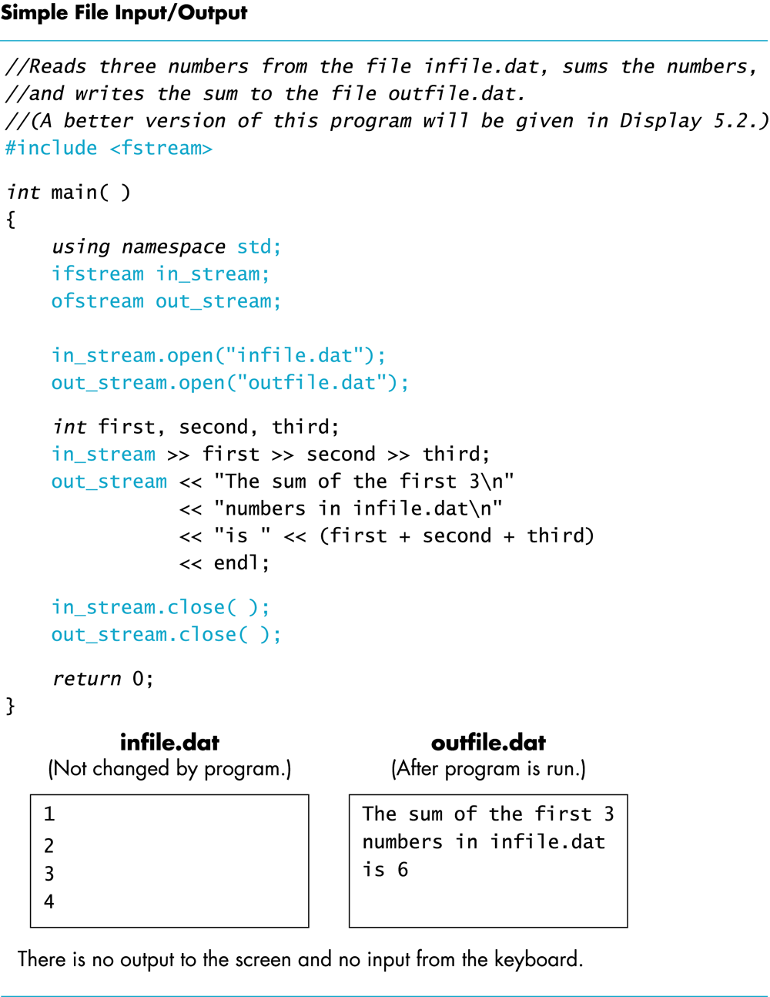
Display 6.1
Back
Next

Slide 19
Objects
An object is a variable that has functions and data associated with it
in_stream and out_stream each have a function named open associated with them
in_stream and out_stream use different versions of a function named open
One version of open is for input files
A different version of open is for output files

Slide 20
Member Functions
A member function is a function associated with an object
The open function is a member function of in_stream in the previous examples
A different open function is a member function of out_stream in the previous examples

Slide 21
Objects and Member Function Names
Objects of different types have different member functions
Some of these member functions might have the same name
Different objects of the same type have the same member functions

Slide 22
Classes
A type whose variables are objects, is a class
ifstream is the type of the in_stream variable (object)
ifstream is a class
The class of an object determines its member functions
Example: ifstream in_stream1, in_stream2;
in_stream1.open and in_stream2.open are the same function but might have different arguments

Slide 23
Class Member Functions
Member functions of an object are the member functions of its class
The class determines the member functions of the object
The class ifstream has an open function
Every variable (object) declared of type ifstream has that open function

Slide 24
Calling a Member Function
Calling a member function requires specifying the object containing the function
The calling object is separated from the member function by the dot operator
Example: in_stream.open("infile.dat");
Calling object
Member function
Dot operator

Slide 25
Member Function Calling Syntax
Syntax for calling a member function: Calling_object .Member_Function_Name(Argument_list);

Slide 26
Errors On Opening Files
Opening a file could fail for several reasons
Common reasons for open to fail include
The file might not exist
The name might be typed incorrectly
May be no error message if the call to open fails
Program execution continues!

Slide 27
Catching Stream Errors
Member function fail, can be used to test the success of a stream operation
fail returns a boolean type (true or false)
fail returns true if the stream operation failed

Slide 28
Halting Execution
When a stream open function fails, it is generally best to stop the program
The function exit, halts a program
exit returns its argument to the operating system
exit causes program execution to stop
exit is NOT a member function
Exit requires the include and using directives #include <cstdlib> using namespace std;

Slide 29
Using fail and exit
Immediately following the call to open, check that the operation was successful: in_stream.open("stuff.dat"); if( in_stream.fail( ) ) { cout << "Input file opening failed.\n"; exit(1) ; }
Display 6.2

Slide 30
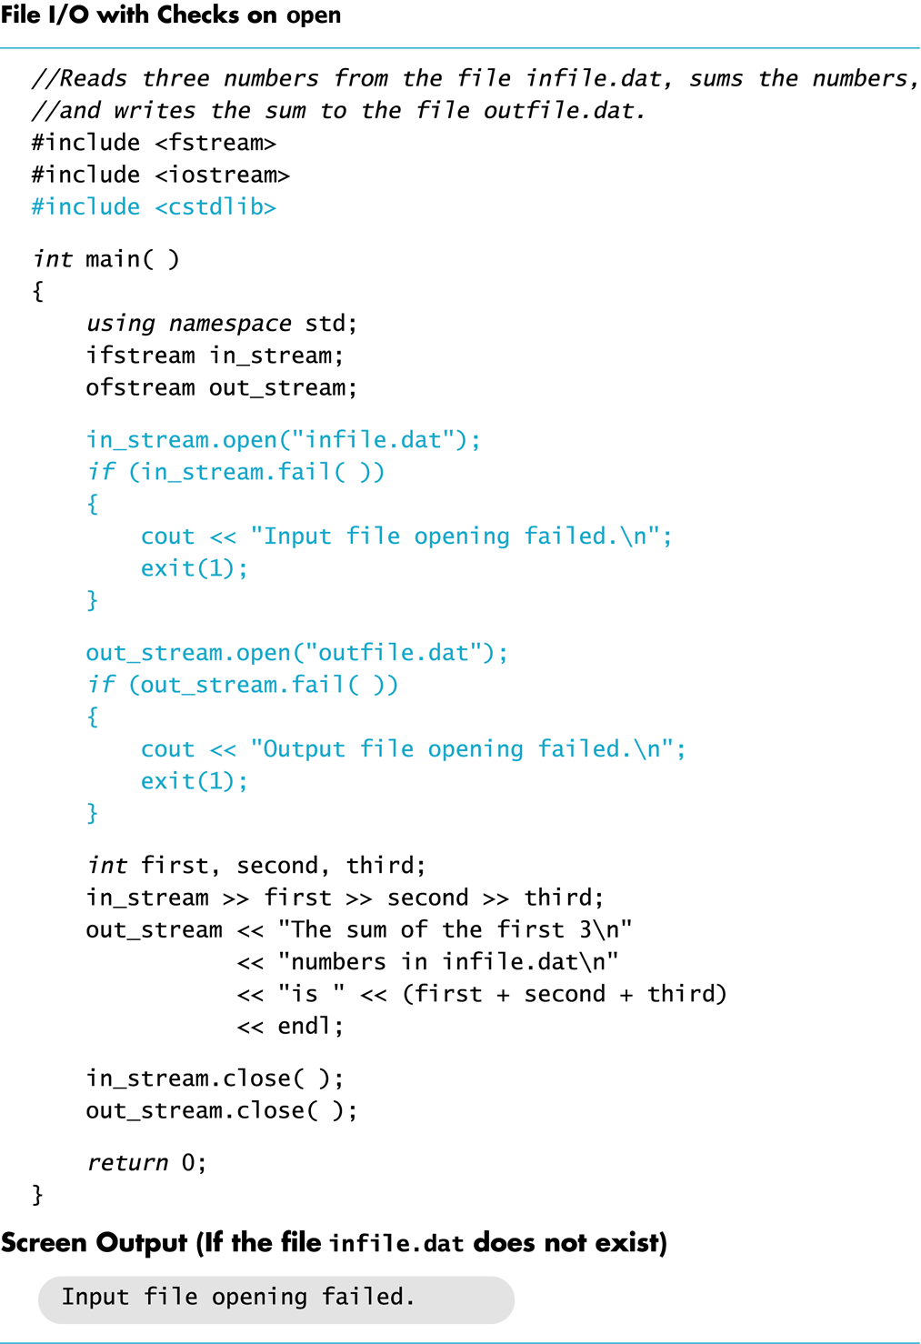
Display 6.2
Back
Next

Slide 31
Techniques for File I/O
When reading input from a file…
Do not include prompts or echo the input
The lines cout << "Enter the number: "; cin >> the_number; cout << "The number you entered is " << the_number; become just one line in_file >> the_number;
The input file must contain exactly the data expected

Slide 32
Appending Data (optional)
Output examples so far create new files
If the output file already contains data, that data is lost
To append new output to the end an existing file
use the constant ios::app defined in the iostream library: outStream.open("important.txt", ios::app);
If the file does not exist, a new file will be created
Display 6.3

Slide 33
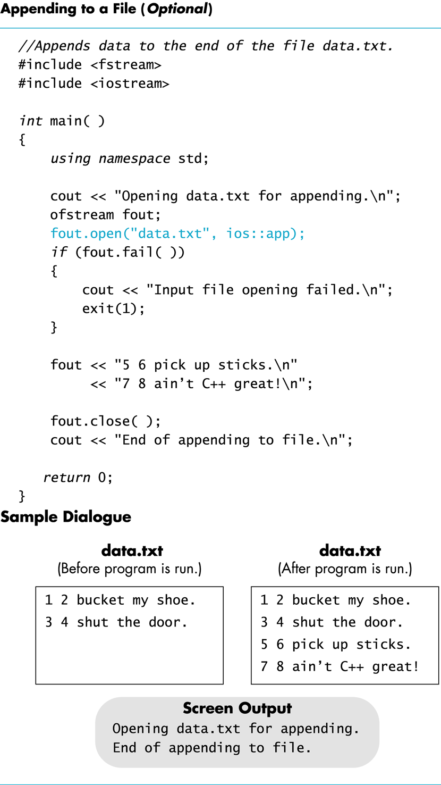
Display 6.3
Back
Next

Slide 34
File Names as Input (optional)
Program users can enter the name of a file to use for input or for output
Program must use a variable that can hold multiple characters
A sequence of characters is called a string
Declaring a variable to hold a string of characters: char file_name[16];
file_name is the name of a variable
Brackets enclose the maximum number of characters + 1
The variable file_name contains up to 15 characters

Slide 35
Using A Character String
char file_name[16]; cout << "Enter the file_name "; cin >> file_name; ifstream in_stream; in_stream.open(file_name); if (in_stream.fail( ) ) { cout << "Input file opening failed.\n"; exit(1); }
Display 6.4 (1)
Display 6.4 (2)

Slide 36
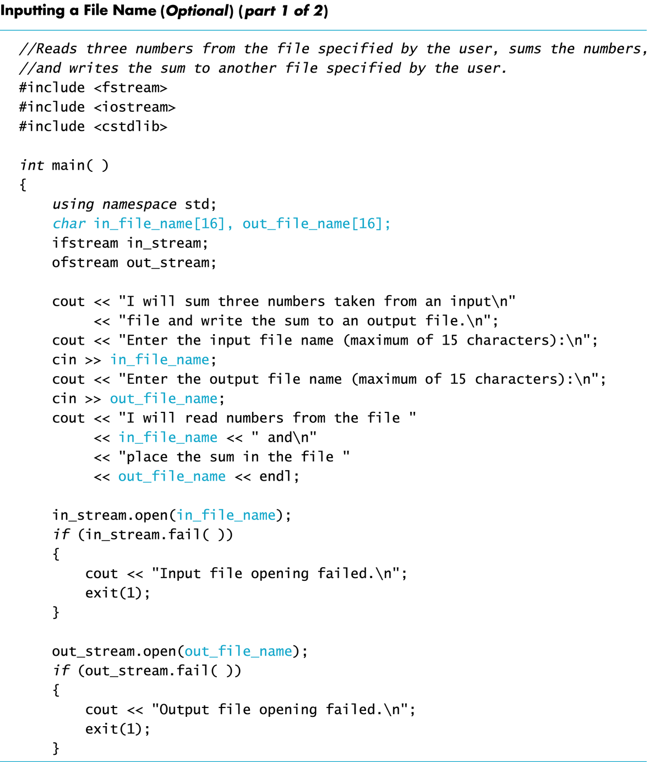
Display 6.4 (1/2)
Back
Next

Slide 37
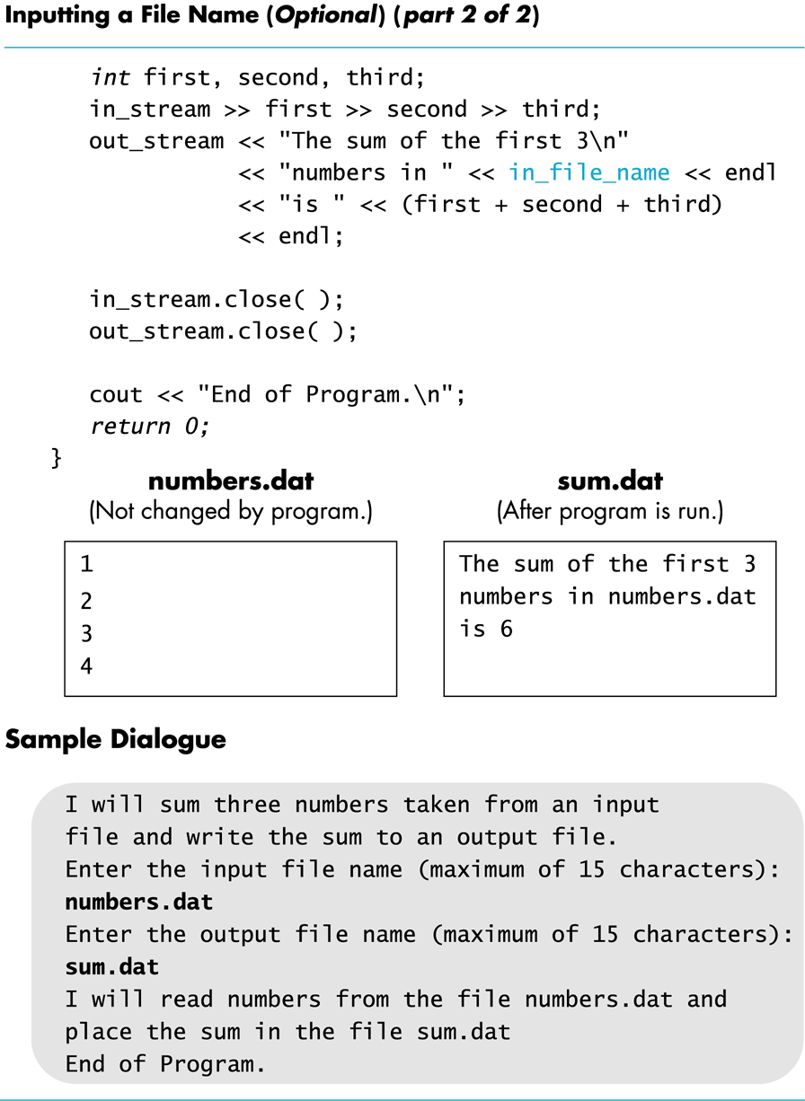
Display 6.4 (2/2)
Back
Next

