Slide 1
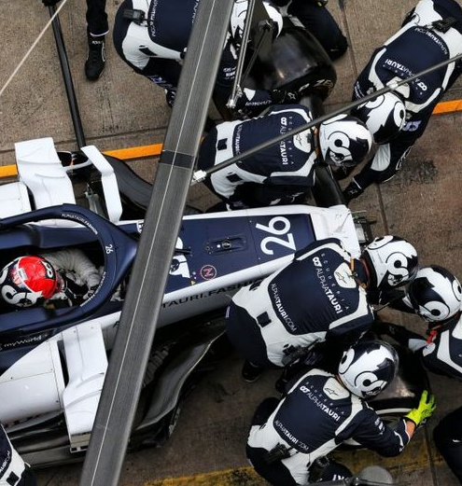
Evolution of Pit Stop Strategies in Formula 1
Presented by:
Faiz Karol(743555)
Date: 28.06.2025

Slide 2
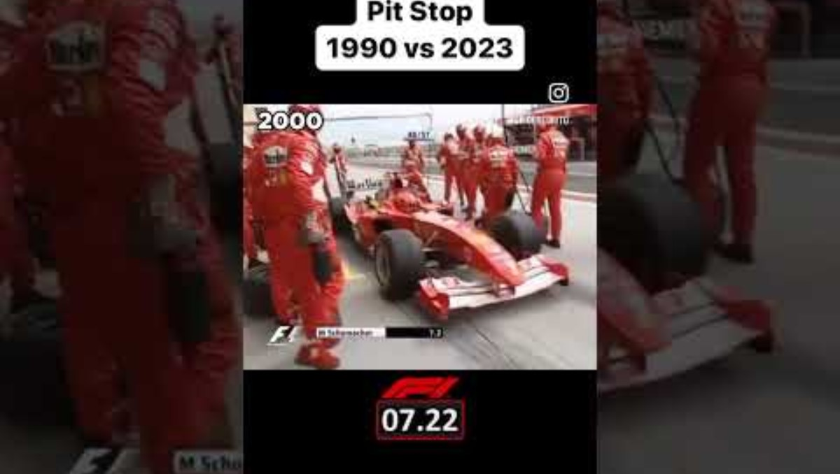
Why Pit Stops Matter

Slide 3
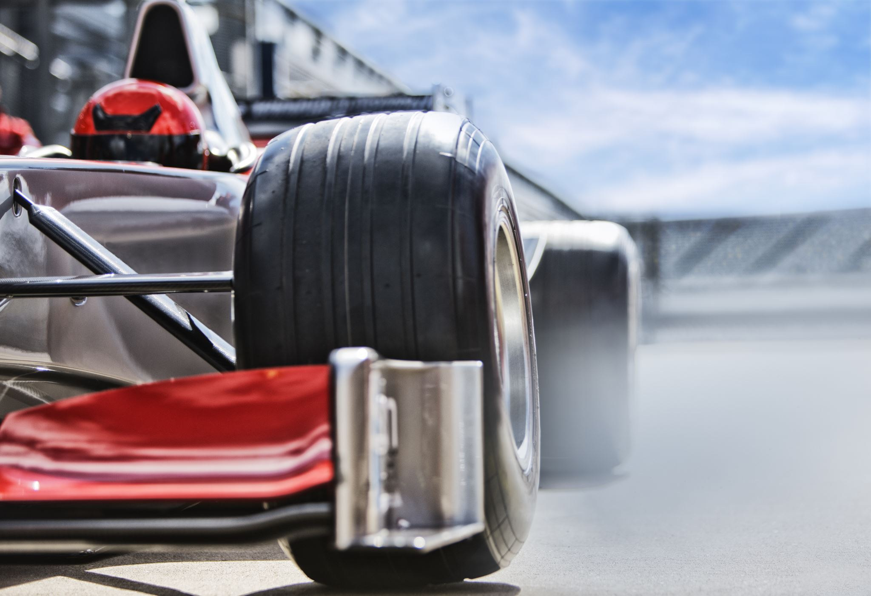
Research Problem & Motivation
Pit stops are crucial in determining F1 race outcomes.
Changes in regulations, car designs, and tire types from 2018–2024 have transformed pit strategies.
The project seeks to understand and quantify these changes across seasons, teams, and tracks.

Slide 4

Research Question
How have Formula 1 pit stop strategies evolved between 2018 and 2024 in terms of:
- Pit stop frequency
- Pit stop duration
- Tire compound usage
…across different teams and circuits?

Slide 5
Literature Review
Optimization of Pit-Stop Strategies in Formula 1 Racing
Utilizes regression-based modeling of tire wear and lap-time behavior.
Proposes a real-time decision framework for pit strategy. (Carrasco & Thraves, 2022)
On the Optimization of Pit-Stop Strategies via Dynamic Programming
Models uncertainty using stochastic dynamic programming.
Includes parameters like yellow flags, tire degradation, and track features. (Carrasco & Thraves, 2023)
These studies provide a theoretical foundation for our regression-based modeling and race strategy simulation.

Slide 6
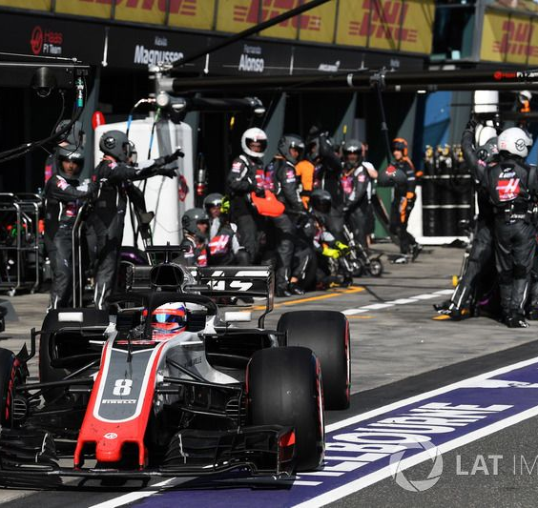
Theoretical Background
Regression: Predicting pit stop duration using lap-based metrics.
Dynamic Programming: Modeling sequential decision-making under uncertainty.
Feature engineering based on historical race data.

Slide 7
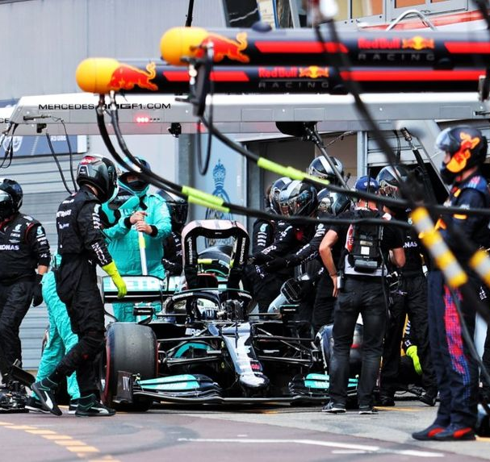
Research Design & Methodology
Data: 2018–2024 F1 pit stop dataset (cleaned, filtered).
Quantitative approach with regression modeling.
Variables: Pit Stop Time (target), Tire Type, Team, Track, Lap Number, etc.
Tools: Python (pandas, sklearn, seaborn, matplotlib)

Slide 8
Data Preparation
Checked and handled missing values.
Removed duplicates.
Converted date columns, normalized numeric types.
Data preprocessed for model input and visualization.

Slide 9
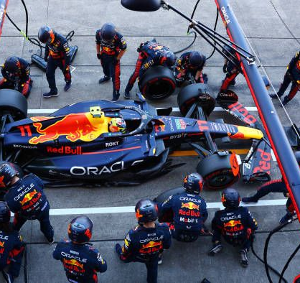
Exploratory Data Analysis
Descriptive stats for pit stop durations across teams.
Correlation matrix for numeric features.
Visualization of trends in tire usage and average pit times.

Slide 10
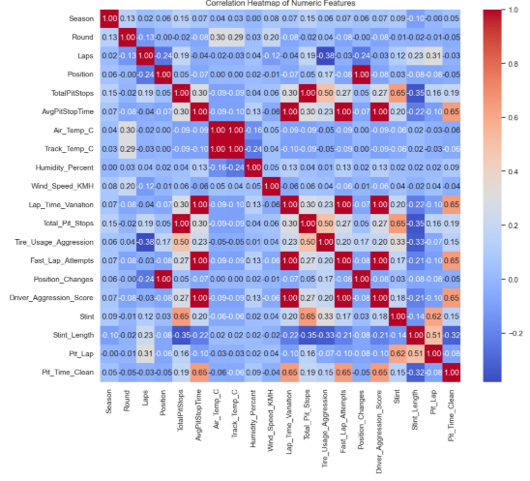

Slide 11
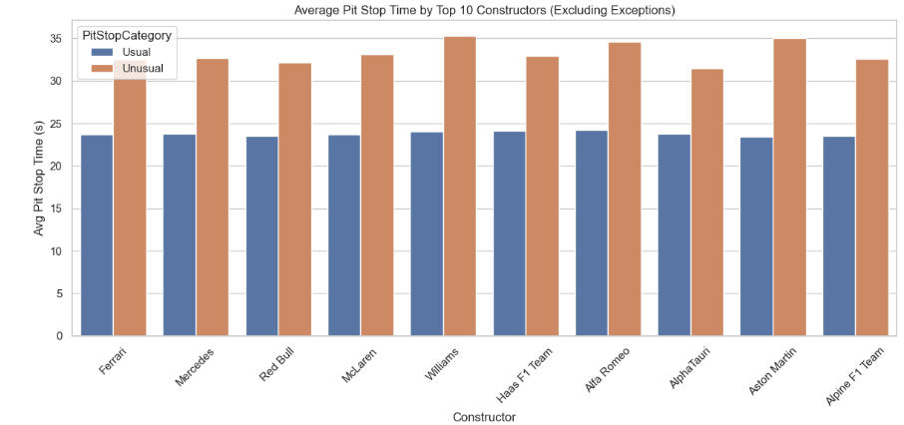
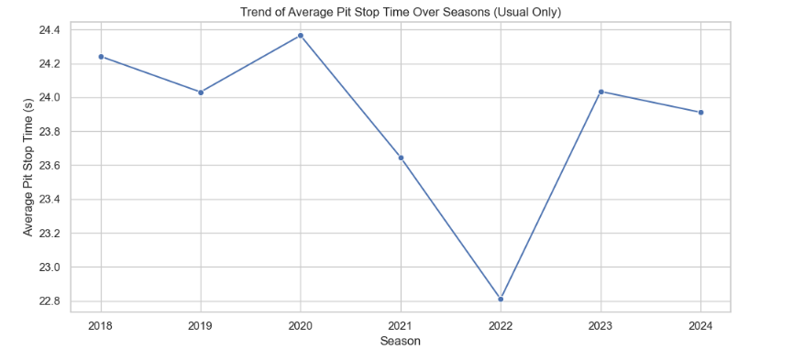

Slide 12
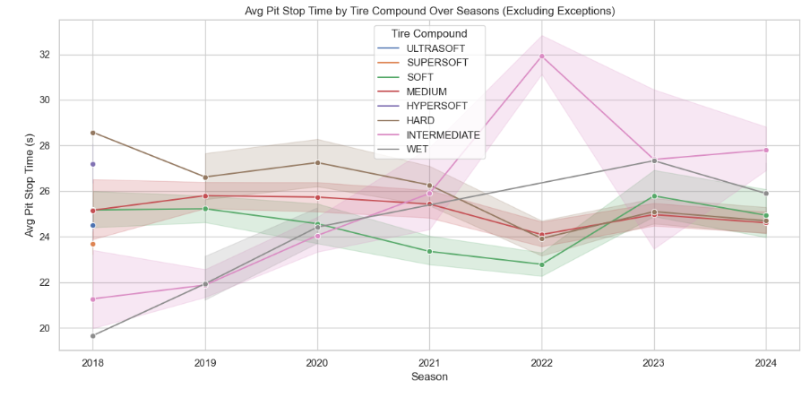

Slide 13

Regression Analysis
Linear Regression applied to model pit stop time.
Variables: Lap number, tire compound, team, track.
Performance evaluated using R² score.
Helps identify which factors most affect pit stop performance.

Slide 14
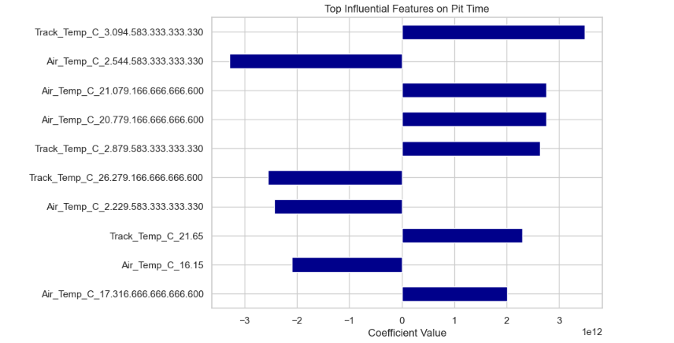
Feature importance

Slide 15
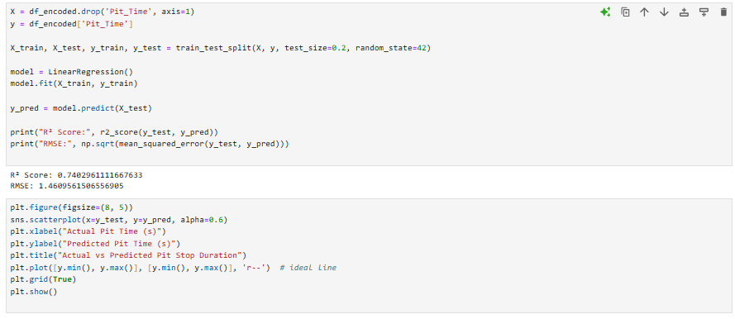
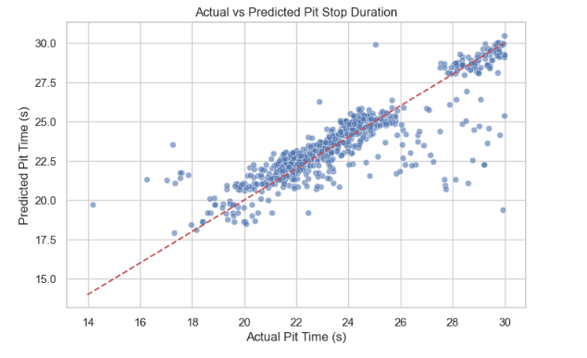

Slide 16
Results
Notable trends in reduced pit time across top teams (e.g., Red Bull, Ferrari).
Tire compound and lap number significantly affect pit durations.
Strategies vary by track type and weather-related conditions.

Slide 17
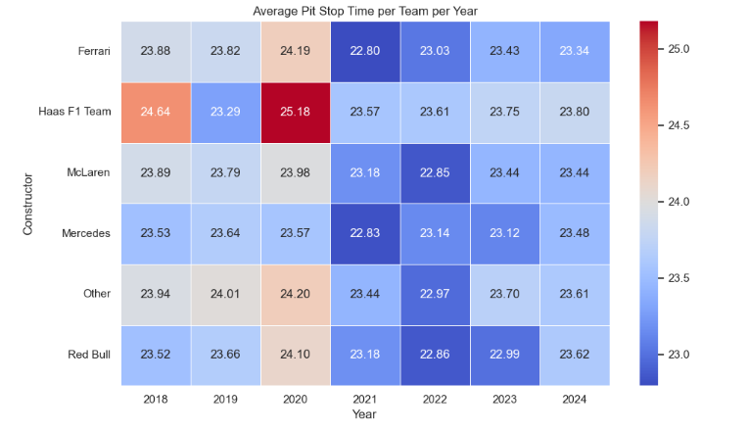

Slide 18
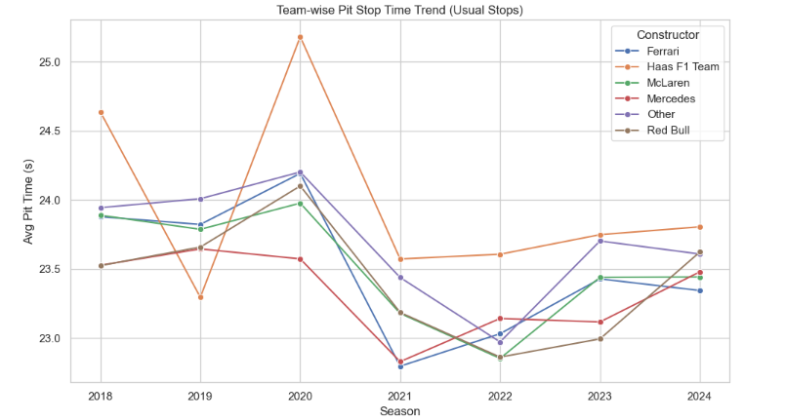

Slide 19
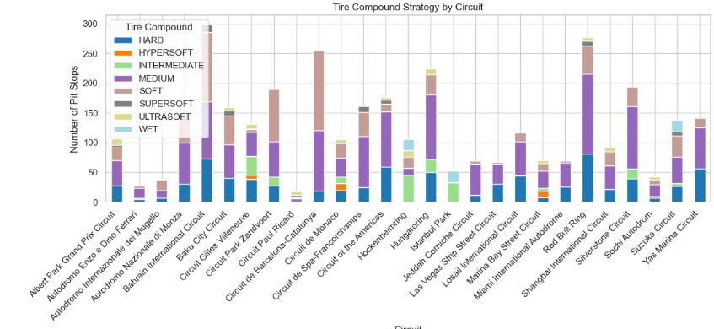

Slide 20
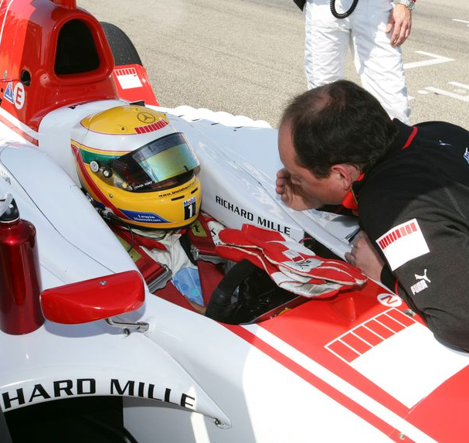
Interpretation & Discussion
Findings align with dynamic decision theory from literature.
Teams appear to adapt strategies based on regulation and performance constraints.
Some anomalies suggest potential team-specific strategies worth deeper review.

Slide 21
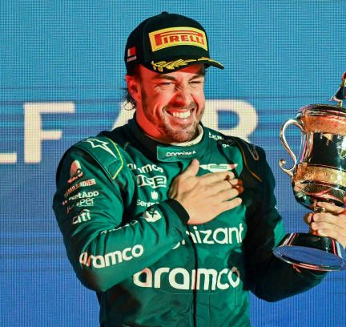
Conclusion
Pit stop strategies have become more data-driven over time.
Key variables include tire compound and lap strategy.
Teams continuously optimize based on competition and real-time variables.

Slide 22
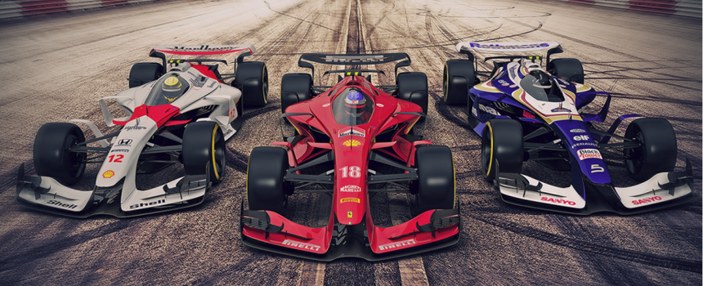
Future Research
Integrate weather and traffic data for enhanced prediction.
Use machine learning models (XGBoost, LSTM) for better forecasting.
Evaluate effect of rule changes across seasons.

Slide 23
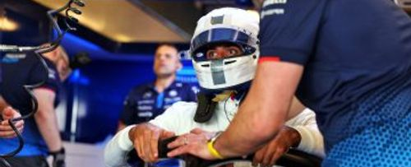
References
Carrasco, J., & Thraves, A. (2022). Optimization of Pit-Stop Strategies in Formula 1 Racing.
Carrasco, J., & Thraves, A. (2023). On the Optimization of Pit-Stop Strategies via Dynamic Programming.
F1 Pit Stop Dataset (2018–2024).
Python Libraries: pandas, sklearn, seaborn, matplotlib.

Slide 24
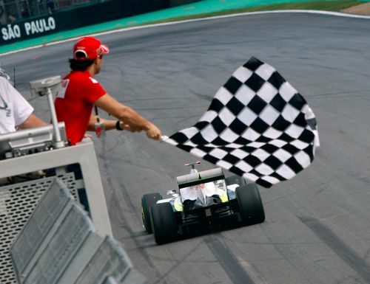
Thank You!

