Slide 1

The Cloud
A short presentation on The Cloud, the different cloud platforms and a Data Engineers’ role
By Data 204

Slide 2





A time before the cloud
Server rooms
Collaboration
Working remotely
Backups
Sending large files

Slide 3
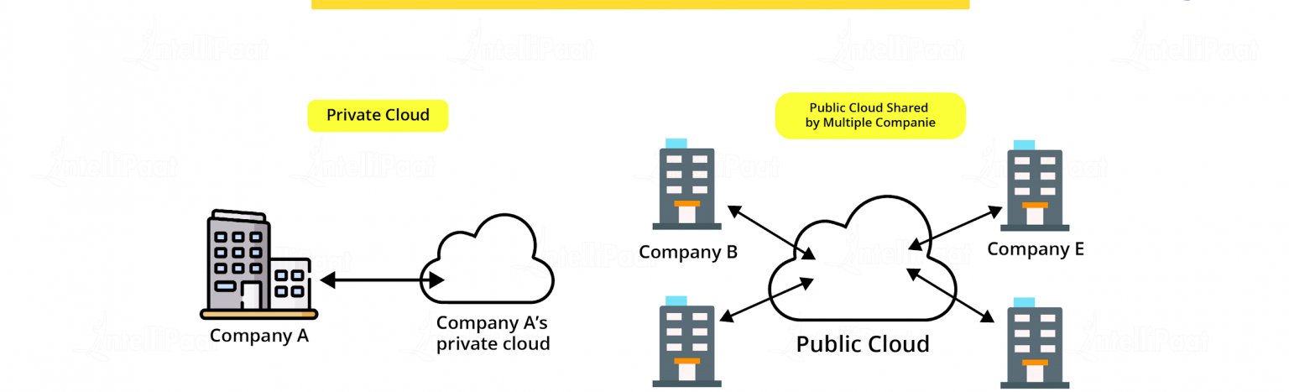
What is the cloud?
The cloud is not a physical entity but instead a vast network of remote servers around the globe, which are connected to work as a single ecosystem.
The cloud enables users to access the same files and applications from almost any device as the computing and storage takes place in a data center instead of locally on the user's device.
Examples of cloud usage are to store and manage data , run applications or deliver content such as streaming videos.
Businesses use four different methods to deploy cloud resources, there is the public cloud which offers services to the public, a private cloud which offers services over a private internal network, a hybrid cloud that does both of the above and a community cloud which shares resources between organizations.
Notes:
"The cloud" refers to servers that are accessed over the Internet, and the software and databases that run on those servers. Cloud servers are located in data centers all over the world. By using cloud computing, users and companies do not have to manage physical servers themselves or run software applications on their own machines.

Slide 4
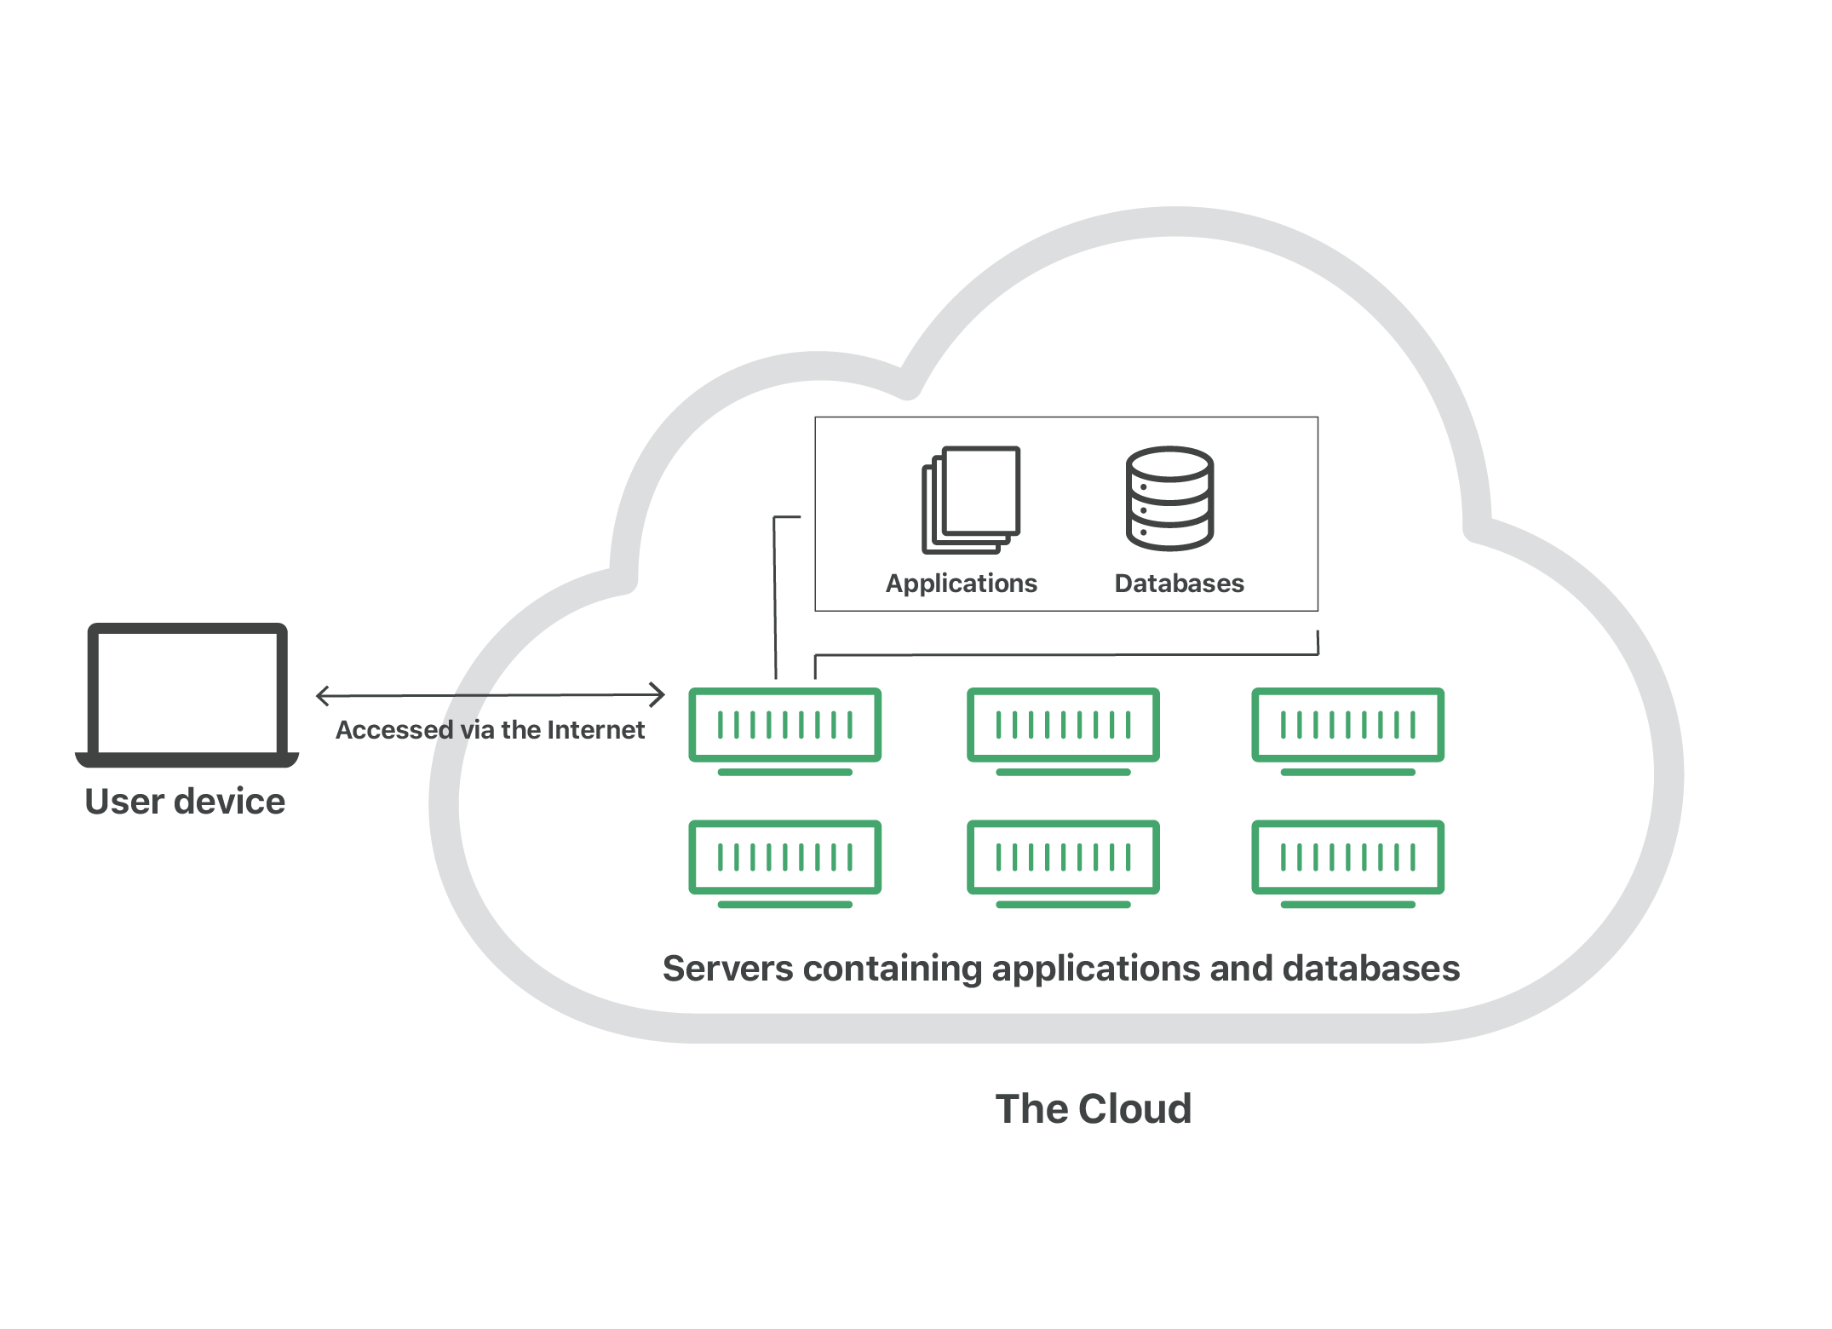
How does the cloud work?
Notes:
Cloud Storage uses remote servers to save data, such as files, business data, videos, or images. Users upload data to servers through an internet connection, where it's saved on a virtual machine on a physical server. To maintain availability and provide redundancy, cloud providers will often spread data to multiple virtual machines in data centers located across the world. If storage needs increase, the cloud provider will spin up more virtual machines to handle the load. Users can access data in Cloud Storage through an internet connection and software such as web portal, browser, or mobile app through an API.
Advantages:
Scalability – allows u to pay only for how much u use with much easier and faster provisions to scale up and down.
Server storage - solutions are managed by cloud service providers who manage and maintain servers which saves money and space.
Data security – better security and don’t need to constantly monitor and manage.
Data loss – robust disaster recovery measures in place to ensure faster and easier data recovery.
Maintenance – maintained by cloud service providers – reduces costs and resource allocation.
Some disadvantages of cloud computing include
data loss or theft.
data leakage.
and
technology vulnerabilities, especially on shared environments.
Cloud Storage is available in four different models:

Slide 5
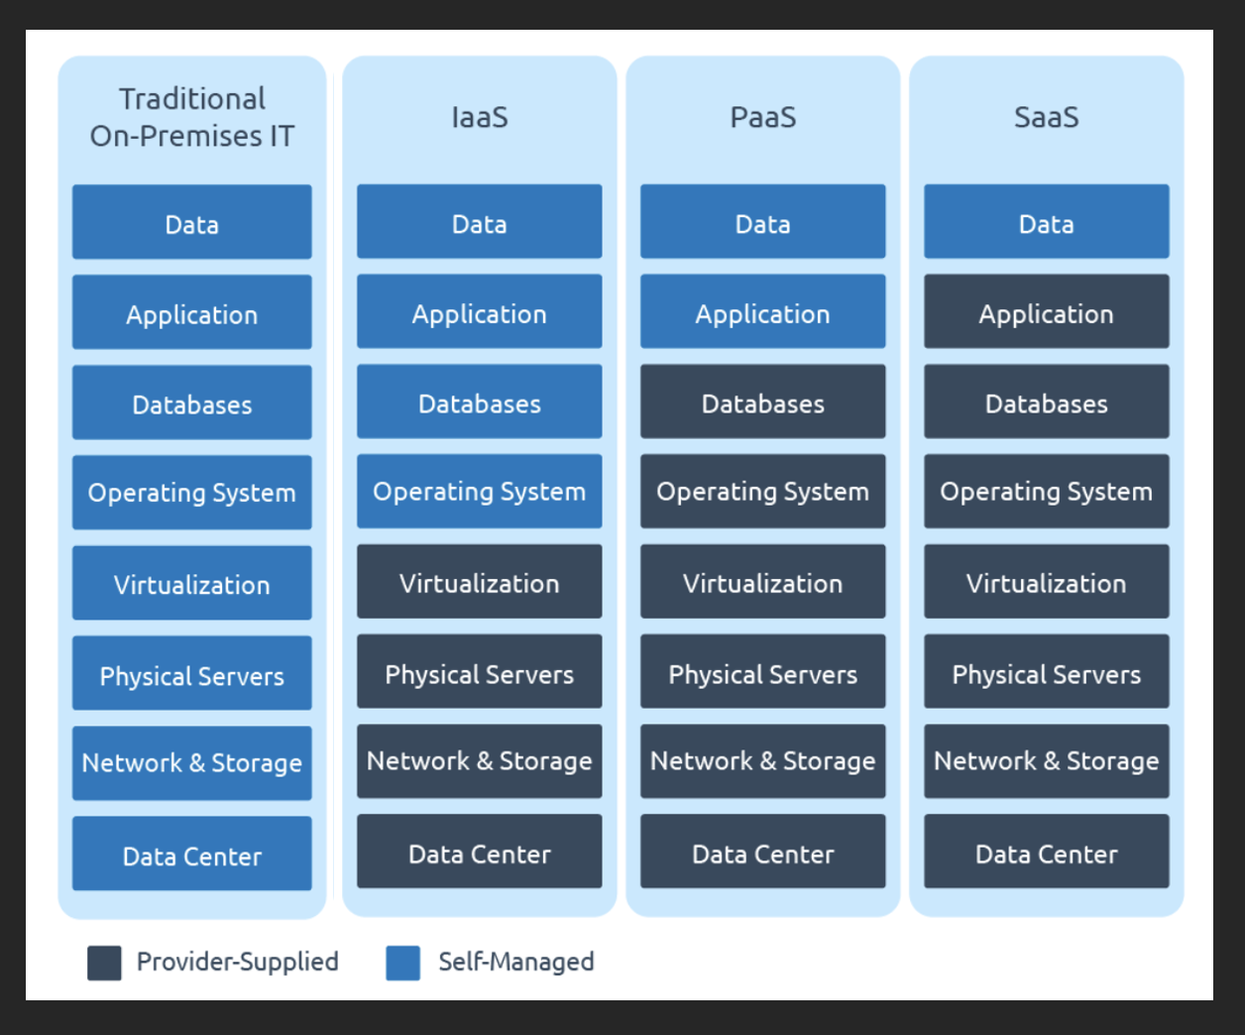
Cloud Services
Infrastructure-as-a-Service (IaaS):
Renting access to the physical hardware
Platform-as-a-Service (PaaS):
Renting access to managed hardware
Software-as-a-Service (SaaS):
Renting online and ready to use applications
Notes:
https://medium.com/chenjd-xyz/azure-fundamental-iaas-paas-saas-973e0c406de7

Slide 6
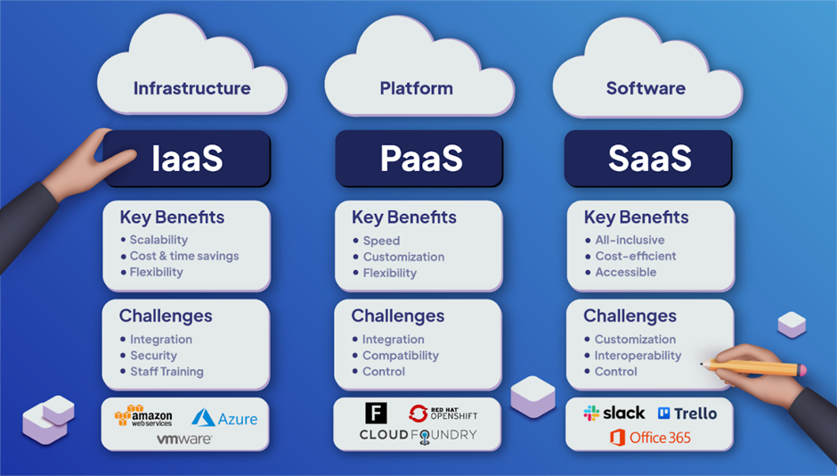
IaaS vs. PaaS vs. SaaS
Notes:
How Do the 3 Cloud Computing Service Models Differ?

Slide 7
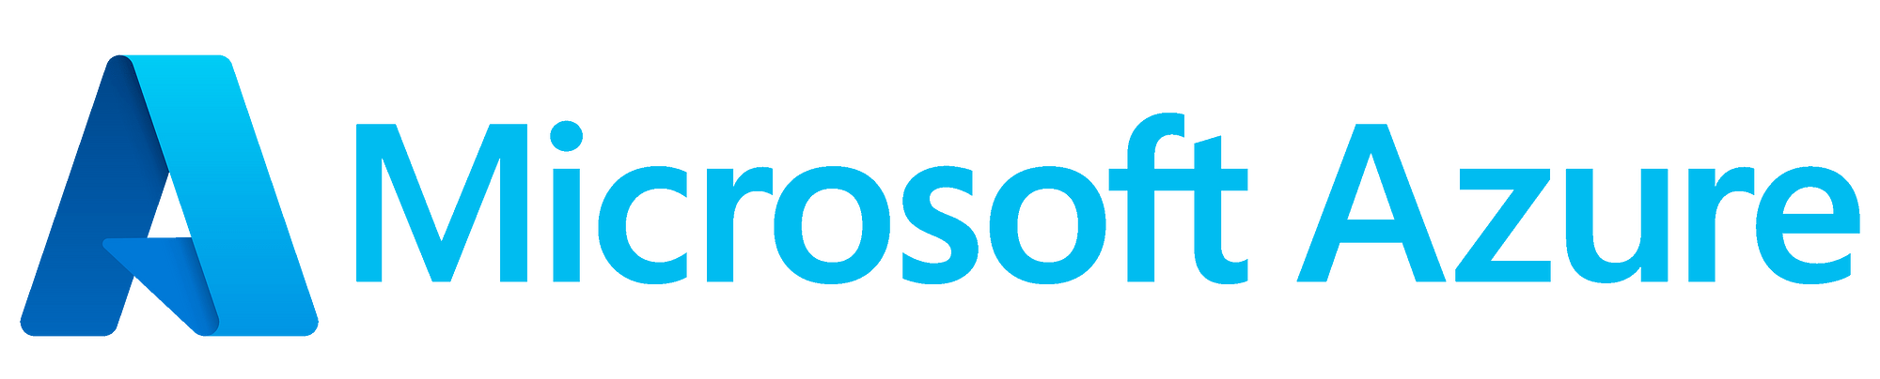
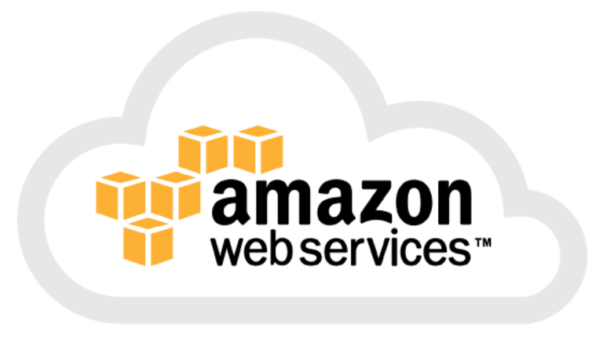
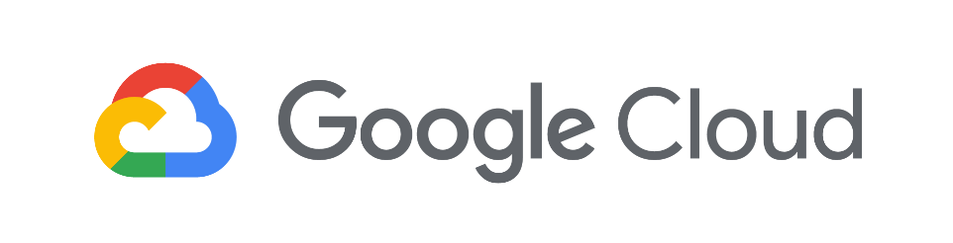
What Cloud Service Providers are Available?
A Cloud Service Provider (CSP) is a company that offers components of cloud computing
There are many different Cloud Service Providers
The Big 3 are Amazon Web Services (AWS), Microsoft Azure and Google Cloud Platform (GPT)
Notes:
Mainly platform, infrastructure, application, or storage services.
AWS is the oldest cloud service provider, launching in 2006. It has led the IaaS market since its inception
Microsoft Azure was launched in 2010 and is an attractive cloud option for companies that already rely on a Microsoft-centric IT foundations
Google Cloud stands out thanks to its deep investments in analytics and machine learning. It is also a leader in Open-source software (OSS) development with over 2,000 open-source projects
I’ll now pass it over to viki

Slide 8
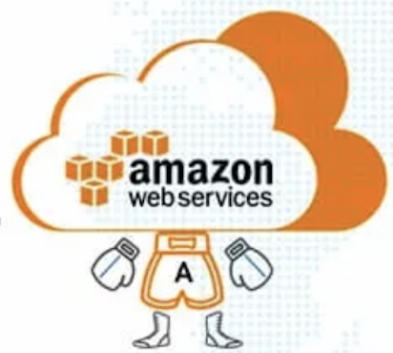
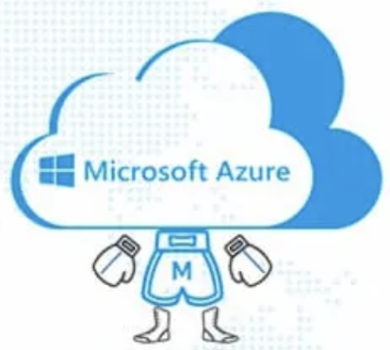
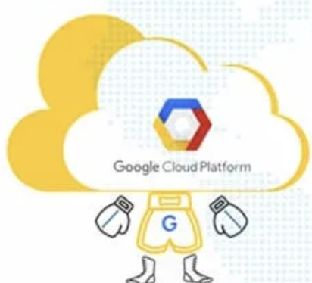
Availability Zones and Services
99 Availability zones
(within 31 regions)
Developer and management tools
Machine learning and predictive analytics
Databases and storage solutions
Business productivity tools
IoT / App integration
Compute
On par with AWS (54 regions)
Big data and predictive analytics
Game and app development
Scalable data warehousing
Blockchain technology
DevOps
IoT integration
106 Availability zones
(within 35 regions)
Data management and storage
App development
SMB business analytics and AI
Productivity and workload management tools
Compute
Notes:
In terms of availability zones all 3 cloud providers are continuing expanding covering more and more regions.
AWS has been around nearly twice as long as its competitors and offers the most depth of services. It typically offers the broadest range of general tools and services, and it possesses the largest market share by appealing to a broad customer base ranging from individual developers to major enterprises to government agencies.
Microsoft Azure has proven particularly attractive to Microsoft-based environments. Azure is the second-largest public cloud, often catering to larger enterprise users. Azure’s services are largely on par with AWS. Essentially, Azure offers the best support and capabilities for hybrid clouds. It provides all the tools you need to develop modern apps, unify DevOps, streamline identity management and integrate security in hybrid environments.
Google Cloud Google Cloud offers fewer cloud services than its competitors in the security and DevOps categories but pulls ahead in machine learning and analytics.
All three providers also take open approaches to partnerships and allow customers to run external apps and services in their cloud environments.

Slide 9
Existing Customer Base
AWS​ | Azure​ | Google Cloud Platform (GCP)​
Netflix​ | Airbnb | Spotify​
Twitch​ | BMW​ | Twitter​
LinkedIn​ | HSBC | Target​
Facebook​ | Adobe​ | PayPal​
Pfizer | General motors​ | Snapchat​
BBC​ | Coca-Cola | Philips​

Slide 10
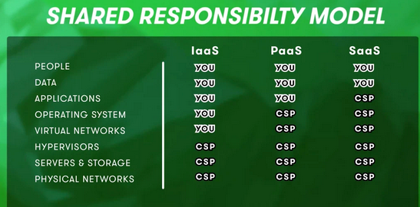
Security
GCP, AWS and Azure offer various security features:
data encryption, access controls, identity management, and compliance certifications. SOC 1/2/3, HIPAA, and ISO 27001, making them suitable for organizations in regulated industries.
GCP offers advanced threat detection and mitigation tools ​
AWS is known for its Virtual Private Cloud (VPC) and Elastic Load Balancing (ELB) services​ IAM system
Azure includes built-in threat intelligence tools and security management features such as Azure Security Center​
​
All three offer similar security processes. AWS, Azure have additional security management features.

Slide 11
Pricing
Machine Type | AWS |  | Azure |  | GCP
Smallest Instance | 2 virtual CPUs and 8 GB of RAM | $69/month | 2 virtual CPUs and 8 GB of RAM | $70/month | 2 virtual CPUs and 8 GB of RAM | $52/month
Largest Instance | 3.84 TB of RAM and 128 vCPUs | $3.97/hour | 3.89 TB of RAM and 128 vCPUs | $6.79/hour | 3.75 TB of RAM and 160 vCPUs | US$5.32/hour
AWS, Azure and Google all offer slightly different pay-as-you-go pricing models and discounts for various services
A comparison among the pricing models of AWS, Azure, and GCP based on the machine type that they offer:
It's important to note that pricing may vary for specific services or regions
AWS has been known to have difficult to understand pricing

Slide 12

Choosing the right cloud provider comes down to your business needs, wants and workloads.

Slide 13
How the Cloud is used by Data Engineers

Slide 14
Cloud Data Engineer
Database Management: SQL, NoSQL, MySQL
Programming Languages: Python, Scala, Java, and so on.
Distributed Data Storage Systems: AWS S3 or MongoDB and so on.
Distributed Data Processing Systems: Apache Spark, Map Reduce.
Cloud Computing Platforms: Services from AWS, GCP, and other cloud providers
Frameworks: JVM Based Frameworks, Apache Hadoop
Linux OS
Data warehouse
Data modeling
ETL (extra, transform, load)
Big data analytics
Software development
Web Services and APIs: Cloud services are mostly web-based, foundational knowledge of different APIs and web services is needed.

Slide 15
Day in the Life
Spending time in design, architecture and development of data engineering solutions
Collaborating with data platforms and stakeholders
Implementing frameworks to establish better standards
Using services such as AWS and Azure
Other technologies used include Python, Spark SQL and Databricks

Slide 16
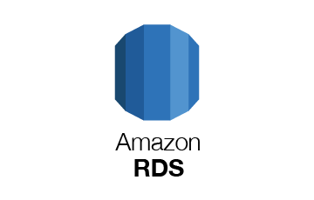
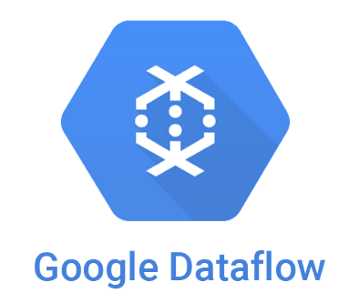


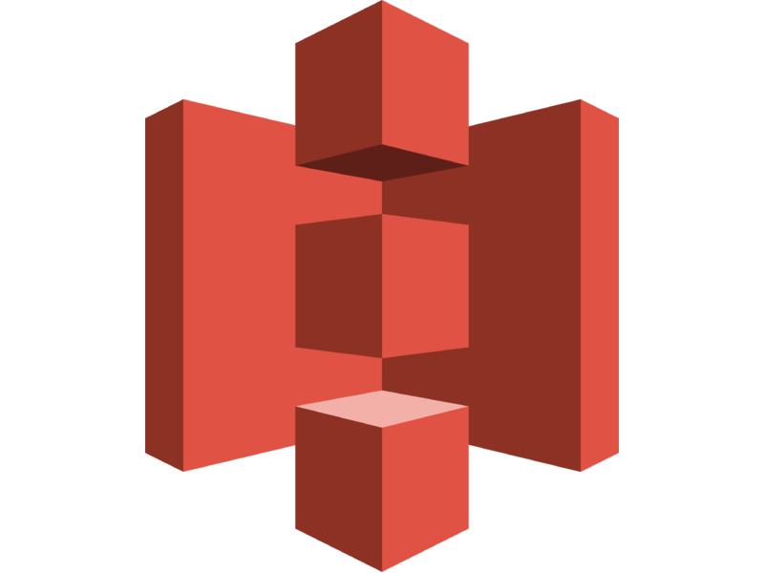
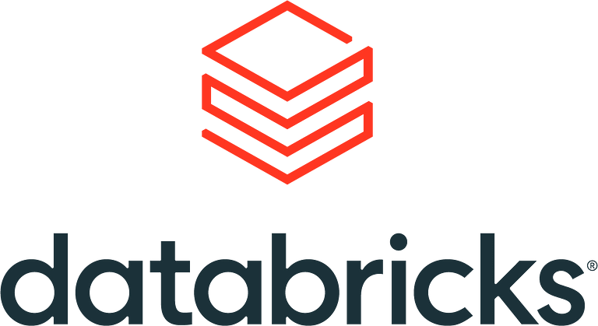
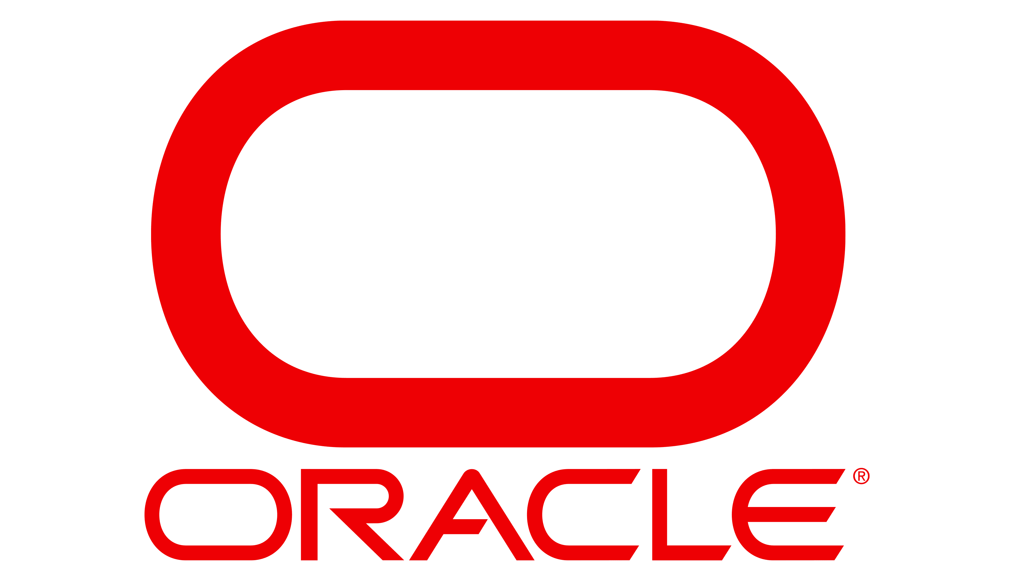
Cloud Tools
Data Processing Pipelines
Data Storage and Management
Notes:
Data engineers could work with a wide range of cloud tools,
Data Storage and Management
Amazon RDS (Relational Database Service) – Cloud managed SQL database service provided by Amazon Web Services (AWS). Compatible with database engines that Data Engineers may already be familiar with, such as MySQL and Oracle. Cost-effectiveness - The time spent maintaining instances is reduced, because maintenance tasks, such as backups and patching, are automated.
#Oracle - Another relational database management system. Built in SQL but also supports programming in Java.
MongoDB Atlas, NoSQL - MongoDB's fully-managed global cloud database-as-a-service that comes with a free tier. MongoDB Atlas works in the same way as MongoDB, except the data is handled across multiple database clusters. The advantages of scale provided by being cloud-based has allowed the addition of new related services such as full-text search (called Atlas Search) and cross-storage querying (Atlas Data Lake).
#Snowflake -
#Amazon s3 - Amazon Simple Storage Service is another AWS service that provides object storage through a web service interface.
Data Processing
Google Cloud Dataflow – Fully managed service to execute pipelines within the Google Cloud Platform ecosystem. It is a serverless approach where users can focus on programming instead of managing server clusters and lets you monitor and troubleshoot pipelines as they are running.
Databricks – From the creators of ApacheSpark. Founded to provide an alternative to the MapReduce system and provides a cloud-based platform for big data. DataBricks was created for data scientists, engineers and analysts to unifying the pipeline involved with developing machine learning tools,

Slide 17
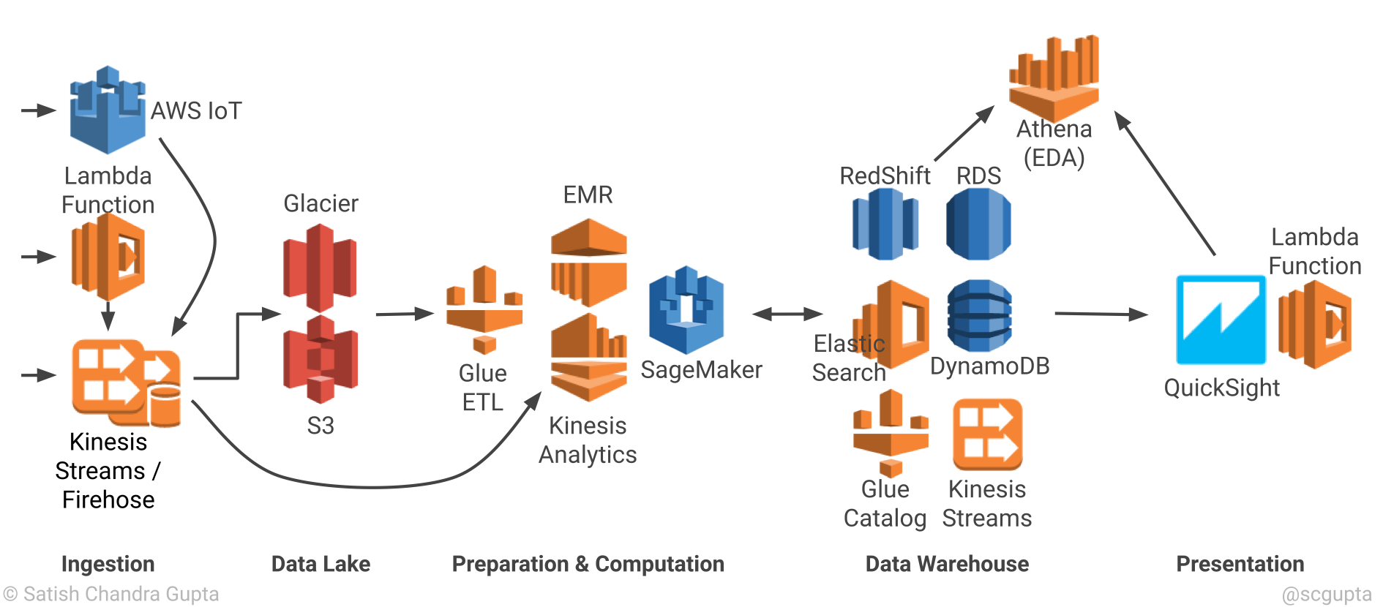
Notes:
S3 – Storage/Datalake
RedShift - SQL to analyze structured and semi-structured data across data warehouses, operational databases, and data lakes
Summary:
Data engineers will slowly transition into a broader role as cloud technology advances. They may fall into a data/software positive where they help build and design the architecture that will be the foundation for entire pipelines of data. They will actively be learning how to transition current working processes from local based designs to cloud based infrastructure. They will be actively expected keep up with new technologies to ensure data is actively being transformed and stored both efficiently and fast.

Slide 18
Kweschuns?

