Slide 1
Introduction to Keras
Francois Chollet March 9th, 2018

Slide 2
Outline
What’s Keras?
What’s special about it?
TensorFlow integration
How to use Keras
3 API styles
An image captioning example
Distributed, multi-GPU, and TPU training
Eager execution (a.k.a define-by-run, a.k.a. dynamic graphs)

Slide 3
What’s Keras?

Slide 4
Keras: an API for specifying & training differentiable programs
Keras API
TensorFlow / CNTK / MXNet / Theano / ...
GPU
CPU
TPU

Slide 5
Keras is the official high-level API of TensorFlow
tensorflow.keras (tf.keras) module
Part of core TensorFlow since v1.4
Full Keras API
Better optimized for TF
Better integration with TF-specific features
tf.keras
TensorFlow
GPU
CPU
TPU
Estimator API
Eager execution
etc.

Slide 6


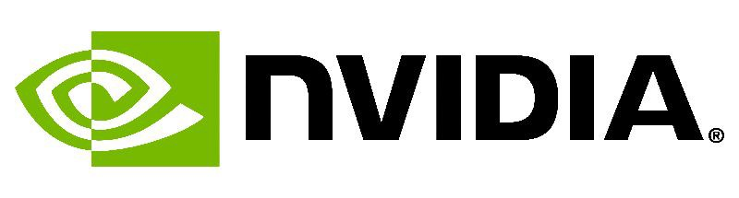


Who makes Keras? Contributors and backers

Slide 7
What’s special about Keras?
A focus on user experience.
Large adoption in the industry and research community.
Multi-backend, multi-platform.
Easy productization of models.

Slide 8





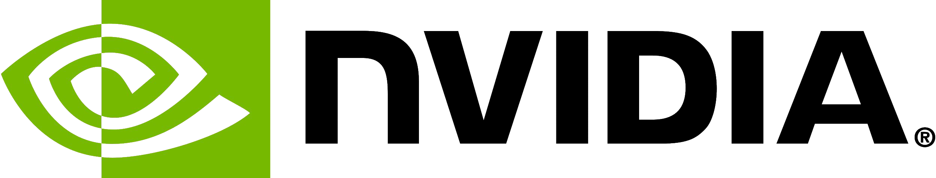




Industry traction
etc...

Slide 9
The Keras user experience
Keras is an API designed for human beings, not machines. Keras follows best practices for reducing cognitive load: it offers consistent & simple APIs, it minimizes the number of user actions required for common use cases, and it provides clear and actionable feedback upon user error.
This makes Keras easy to learn and easy to use. As a Keras user, you are more productive, allowing you to try more ideas than your competition, faster -- which in turn helps you win machine learning competitions.
This ease of use does not come at the cost of reduced flexibility: because Keras integrates with lower-level deep learning languages (in particular TensorFlow), it enables you to implement anything you could have built in the base language. In particular, as tf.keras, the Keras API integrates seamlessly with your TensorFlow workflows.

Slide 10
Keras is multi-backend, multi-platform
Develop in Python, R
On Unix, Windows, OSX
Run the same code with…
TensorFlow
CNTK
Theano
MXNet
PlaidML
- ??
CPU, NVIDIA GPU, AMD GPU, TPU...

Slide 11
Largest array of options for productizing models
TF-Serving
In-browser, with GPU acceleration (WebKeras, Keras.js, WebDNN…)
Android (TF, TF Lite), iPhone (native CoreML support)
Raspberry Pi
JVM
Go build cool AR apps with Keras + TF + CoreML + ARKit

Slide 12
How to use Keras:
An introduction

Slide 13
Three API styles
The Sequential Model
Dead simple
Only for single-input, single-output, sequential layer stacks
Good for 70+% of use cases
The functional API
Like playing with Lego bricks
Multi-input, multi-output, arbitrary static graph topologies
Good for 95% of use cases
Model subclassing
Maximum flexibility
Larger potential error surface

Slide 14
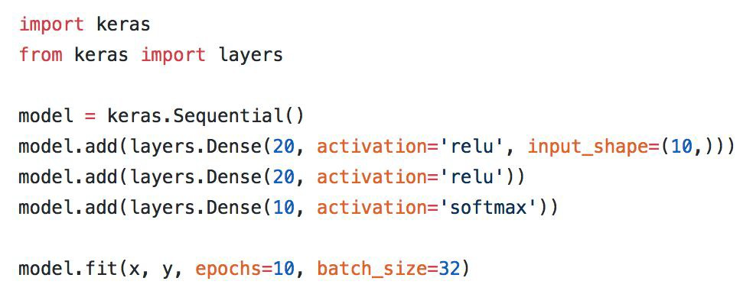
The Sequential API

Slide 15
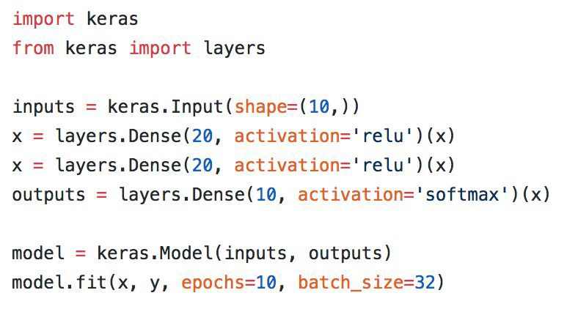
The functional API

Slide 16
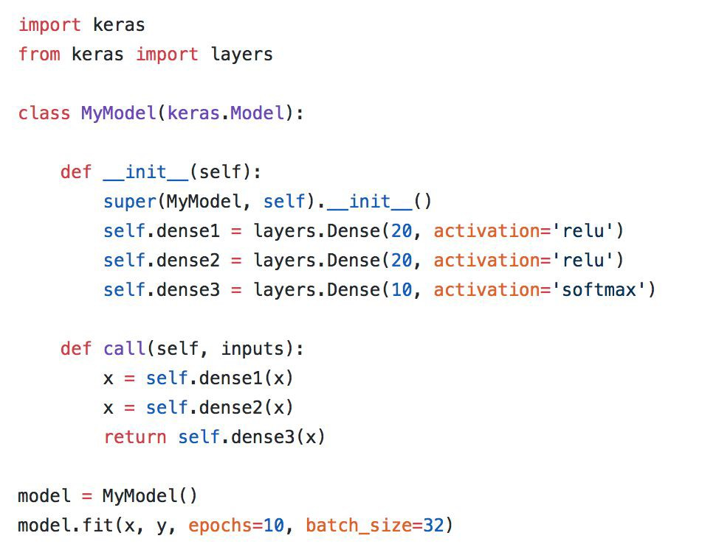
Model subclassing

Slide 17
Remember: use the right tool (API) for the job!

Slide 18
Distributed, multi-GPU,
& TPU training

Slide 19
Distributed
Uber’s Horovod
Estimator API (TF built-in option)
Dist-Keras (Spark)
Also Elephas (Spark)

Slide 20
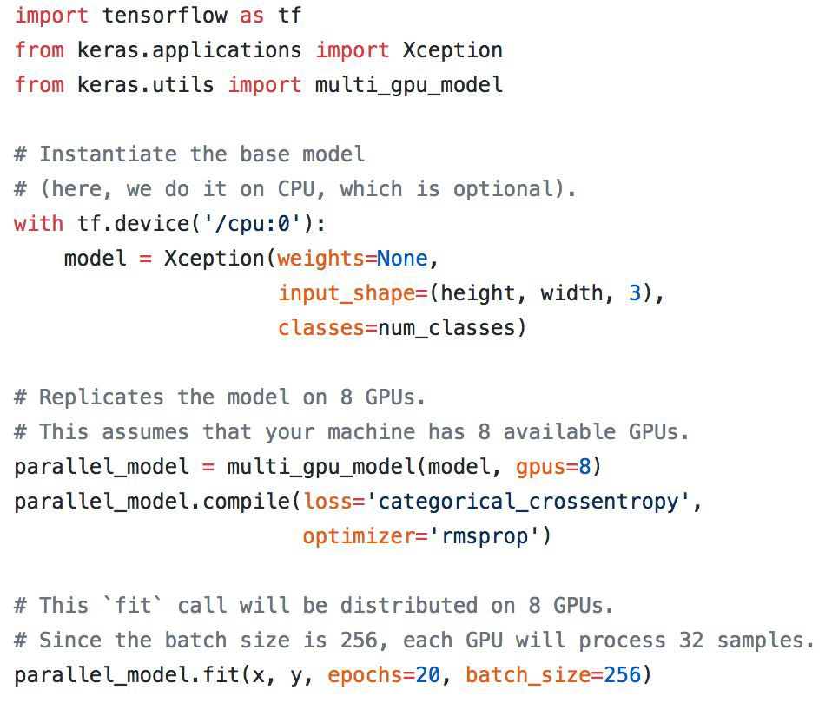
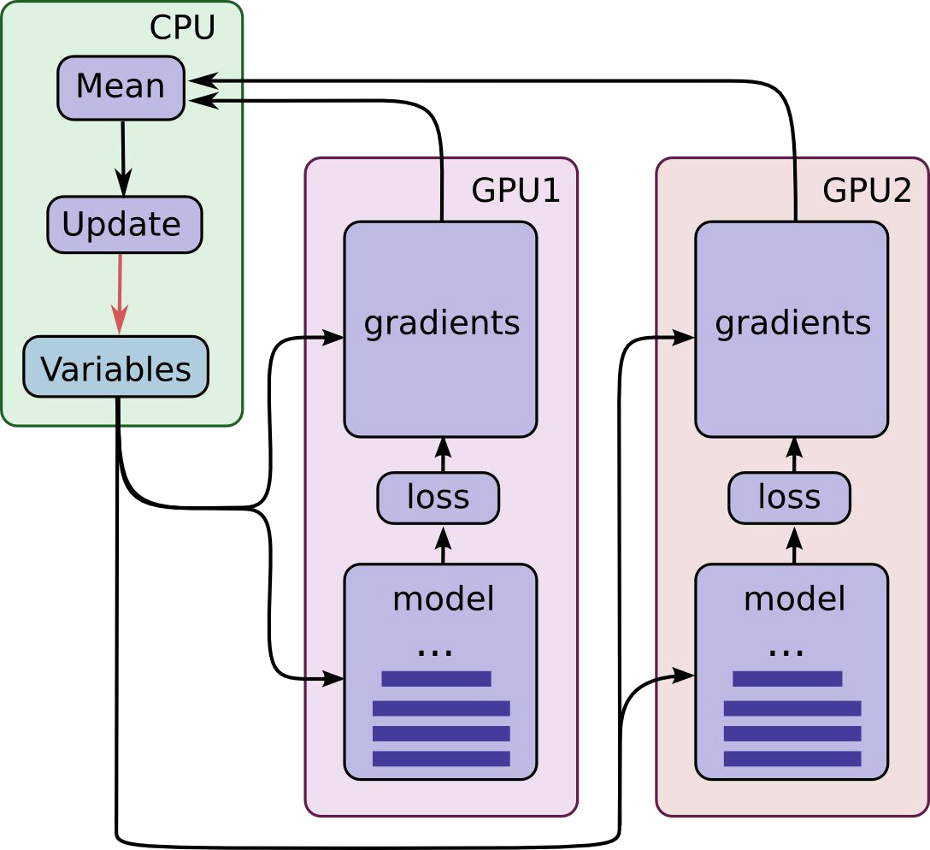
Built-in multi-GPU support

Slide 21
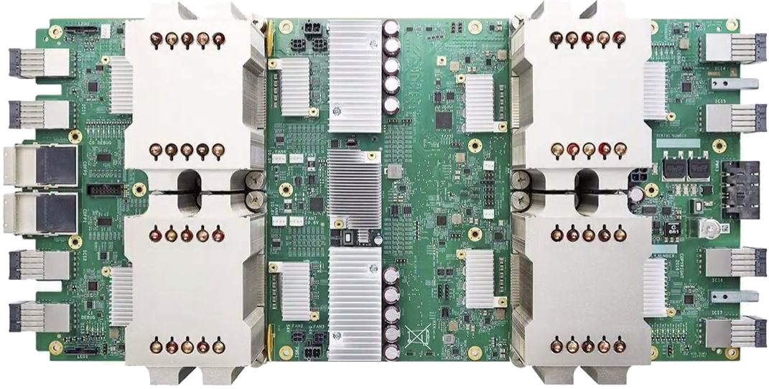
TPU support
Training + inference
Via Estimator API

Slide 22
That’s it. Thank you!

