Slide 1
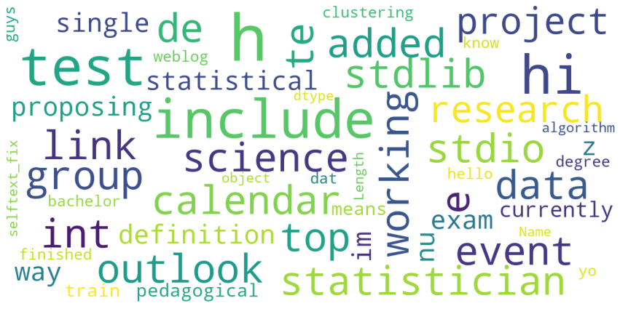
Survey on Subreddit Post Using NLP approach
By: Faiz Puad

Slide 2
Agenda
Problem Statement
Exploratory Data Analysis
Findings & Conclusion
Recommendation
Reference

Slide 3
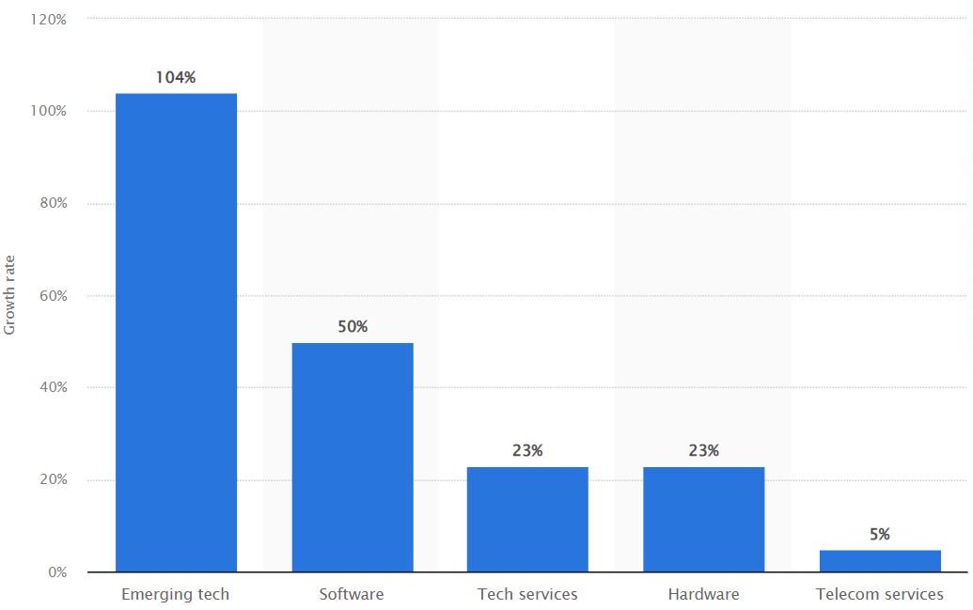
Problem Statement
Findings the latest update of career pathway is a must. However, industry such as digital keeps growing at fast pace for the past few years.
Image from:
Statistica.com
- IT industry growth forecast by segment

Slide 4
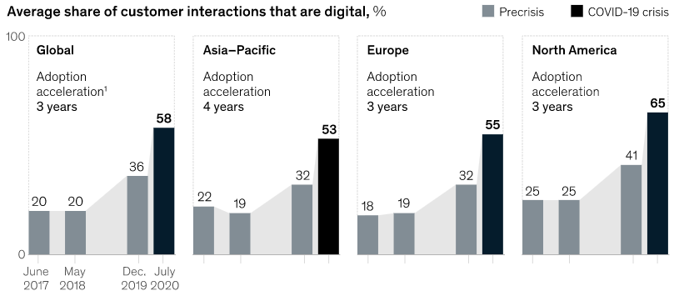
Rely On Traditional Approach:
Refer to online articles
Pamphlet online
Depend on available survey
Might not feasible as it is time consuming and might even be costly
Image from:
mckinsey.com
- Covid 19 impact on technology acceleration

Slide 5
Exploratory Data Analysis
Data Overview
Data Cleaning
Features Engineering
Model Evaluation

Slide 6
Data Overview
Data science subreddit
10000 rows, 16 columns
Unique author: 6968
Top author post: 33
Average comment /post: 2
Highest comment/post: 346
Lowest subscribers: 608,935
Highest subscribers: 783,616
Computer science subreddit
15000 rows, 16 columns
Unique author: 15080
Top author post is 471
Average comment /post: 5
Highest comment/post: 341
Lowest subscribers: 308,929
Highest subscribers: 2 million

Slide 7
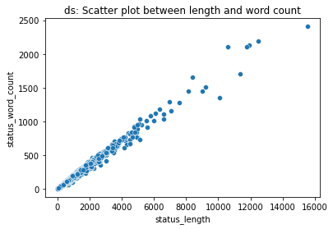
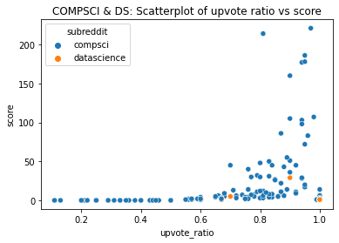

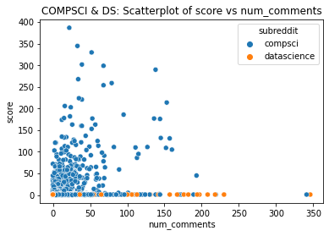

A
C
B
D

Slide 8
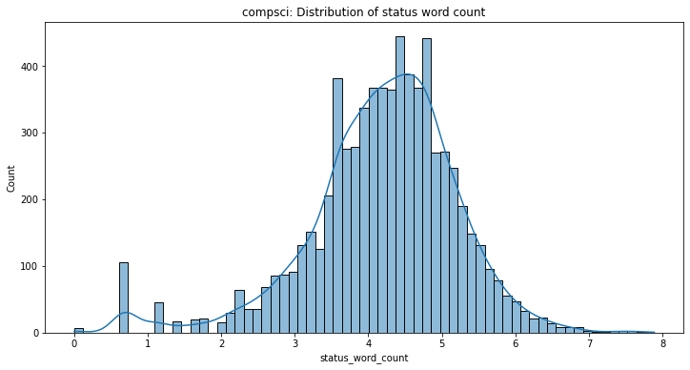
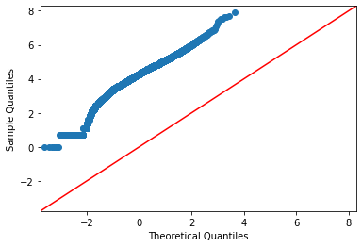

Original:
Skewness: 6.788906574552096
Kurtosis: 86.11276298774011
After log:
Skewness: -0.8105170015250748
Kurtosis: 1.8747987098655061

Slide 9
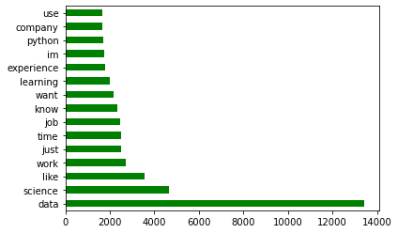
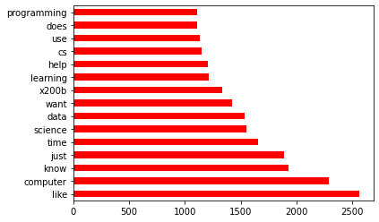
Data Science Subreddit
Computer Science Subreddit

Slide 10
Data Cleaning
Drop rows with null values & status [‘deleted’]
Compsc row removed: 73
New shape is:
Ds(rows, columns), Compsc(rows,columns)
(8160, 12), (7016, 12)
Drop 1144 rows in DS to balance dataset
Remove symbol, emoji, hyperlink using regex and custom function
Include: “https”, “www.”, “$”, “@”

Slide 11
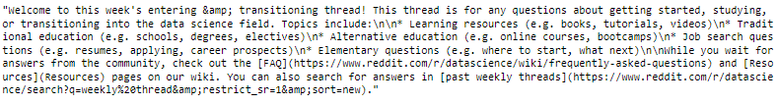

Slide 12
Feature Engineering
Apply PorterStemmer on selftext column
Change word to its base form
Flies > fly
Encode target variable into 1 (compsc) & 0 (datascience)
Train & test split data with test size 20%
Instantiate transformer and estimator inside pipeline
Transformer use: CountVectorizer & TfidVectorizer
Estimator use: Multinomial Naïve Bayes

Slide 13
Model Evaluation
Test size | Row | Estimator | Transformer | Train Score | Test Score | ROC_AUC Score
0.3 | 2000 | Multinomial NB | Count Vectorize | 0.903 | 0.835
0.3 | 2000 | Multinomial NB | TfidVectorize | 0.918 | 0.840
0.3 | 4000 | Multinomial NB | Count Vectorize | 0.887 | 0.873
0.3 | 4000 | Multinomial NB | TfidVectorize | 0.897 | 0.871
0.3 | 6000 | Multinomial NB | Count Vectorize | 0.890 | 0.870
0.3 | 6000 | Multinomial NB | TfidVectorize | 0.890 | 0.870
0.2 | 6000 | Multinomial NB | Count Vectorize | 0.884 | 0.879 | 0.8797
0.2 | 6000 | Multinomial NB | TfidVectorize | 0.888 | 0.885 | 0.8848

Slide 14
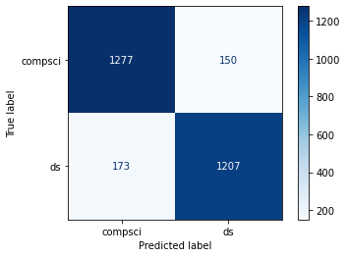
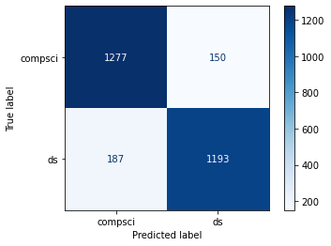
True Negatives: 1277
False Positives: 150
False Negatives: 173
True Positives: 1207
Specificity: 0.8949
Precision: 0.8895
Sensitivity: 0.8746
F1 score: 0.882
ROC AUC score: 0.8848
Multinomial +
TfidVectorize
True Negatives: 1277
False Positives: 150
False Negatives: 187
True Positives: 1193
Specificity: 0.8949
Precision: 0.8883
Sensitivity: 0.8645
F1 score: 0.8762
ROC AUC score: 0.8797
Multinomial +
CountVectorize

Slide 15
Conclusion
Multinomial Naïve Bayes with TfidVectorizer is chosed as the best model as it produce the highest accuracy mark for this study.
Model is slightly overfit and can be further improve using other classification model
Few possible reason are:
train data is not enough. This is proved as I increase from initial data of 2000 to 6000, train score drop from 95% to 88% but increase test score from 80% to 88%
data still contain unnecessary symbol including emoji which cause inaccurate prediction

Slide 16
Recommendation
Model found to be useful for detecting sentiment and classifying a post into category. Thus, it can be fitted generally to all industry such as marketing to promote their product.
Model results can be utilized as providing snapshot of a person to be filter for job application based on finding above.
Introduce more data to fight overfit issue and there is possibility model perform higher than 90% using other model including decision tree, random forest and adaboost

Slide 17
Reference
How COVID-19 has pushed companies over the technology tipping point—and transformed business forever. (2021, February 18). McKinsey & Company. Available at:
https://www.mckinsey.com/business-functions/strategy-and-corporate-finance/our-insights/how-covid-19-has-pushed-companies-over-the-technology-tipping-point-and-transformed-business-forever#
Statista. (2022, February 21). IT industry growth rate forecast worldwide from 2018 to 2023, by segment. Available at:
https://www.statista.com/statistics/967095/worldwide-it-industry-growth-rate-forecast-segment/
Varshney, P. (2021b, December 14). Q-Q Plots Explained - Towards Data Science. Medium. Available at:
https://towardsdatascience.com/q-q-plots-explained-5aa8495426c0
Yadav, K. (2022, January 22). Cleaning & Preprocessing Text Data by Building NLP Pipeline. Medium. Available at:
https://towardsdatascience.com/cleaning-preprocessing-text-data-by-building-nlp-pipeline-853148add68a

