Slide 1

Analysis on Ames,Iowa Houseprice
By : Faiz Puad

Slide 2

Agenda
Introduction
Problem Statement
Research Question
Data Exploration
Methodology
Findings & Conclusion
Recommendation
Reference

Slide 3

Introduction
Survey by KPMG Global, 49% said AI, big data & data analysis will have impact on real estate in long run.
Why choose ANALYTICS ?
Traditional prediction depend on historical data
Hyperlocal pattern cannot be detected by traditional approach
McKinsey claimed 60% of unseen influence is by hyperlocal pattern
In 2019, about 50% buyers found their home online, 28% use real estate agent according to National Association of Realtors

Slide 4
Problem Statement
Recent Partnership Between
Right Eye Real Estate Pte Ltd
&
Samad Analytics Pte Ltd
The real estate firm is having difficulty in giving valuation of house price due to price fluctuation over years.
Moreover, their traditional approach is difficult to adapt with variety indicators for each city. The firm is losing revenue and tight competition in convincing and securing client due to these traditional act.
The real estate firm requires Samad Analytics company to help with Data Science approach.

Slide 5
What key indicators relevant?
Which model is good predictor ?

Slide 6
Data Exploration
Data Overview
Data Cleaning
Model Setup
Missing Values?
Wrong data type?
Features Engineering
Best Model Selection
Transform Data
Features Selection

Slide 7
Data Overview
81 Features
2051 Rows
Year 2006 – 2010

Slide 8
Data Cleaning
Missing Values (26 Features)
Alley – 1911
Fireplace quality – 330
Pool quality – 2042
Fence – 1651
Initial Data Types
Object - 42
Integer - 28
Float – 11
Cleaning Technique
Object ( Category )
Frequent data ( Mode )
Majority Empty ( None )
Integer & Float
Average data ( Mean )
Rank
Good
Good
Good
Bad
Good

Slide 9
Feature Engineering
Dummy Variable
Category type to Integer
New features equal 265
Rank
Good
Bad
Average
Rank_Good | Rank_Bad | Rank_Average
1 | 0 | 0
0 | 1 | 0
0 | 0 | 1

Slide 10
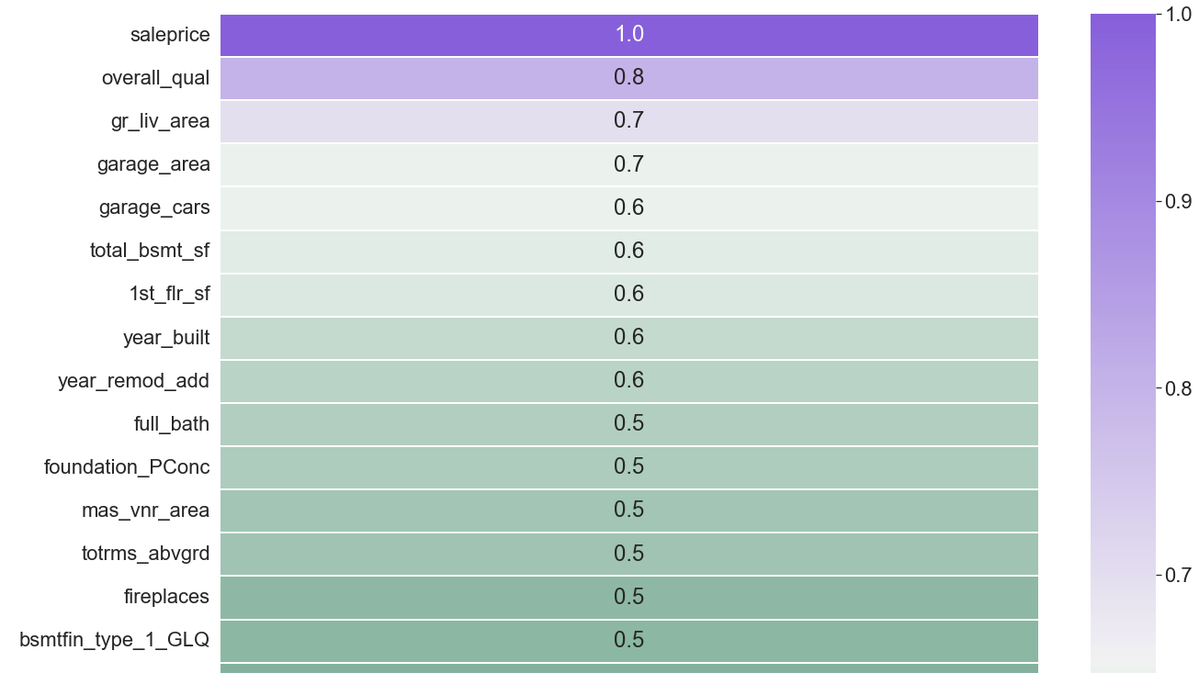
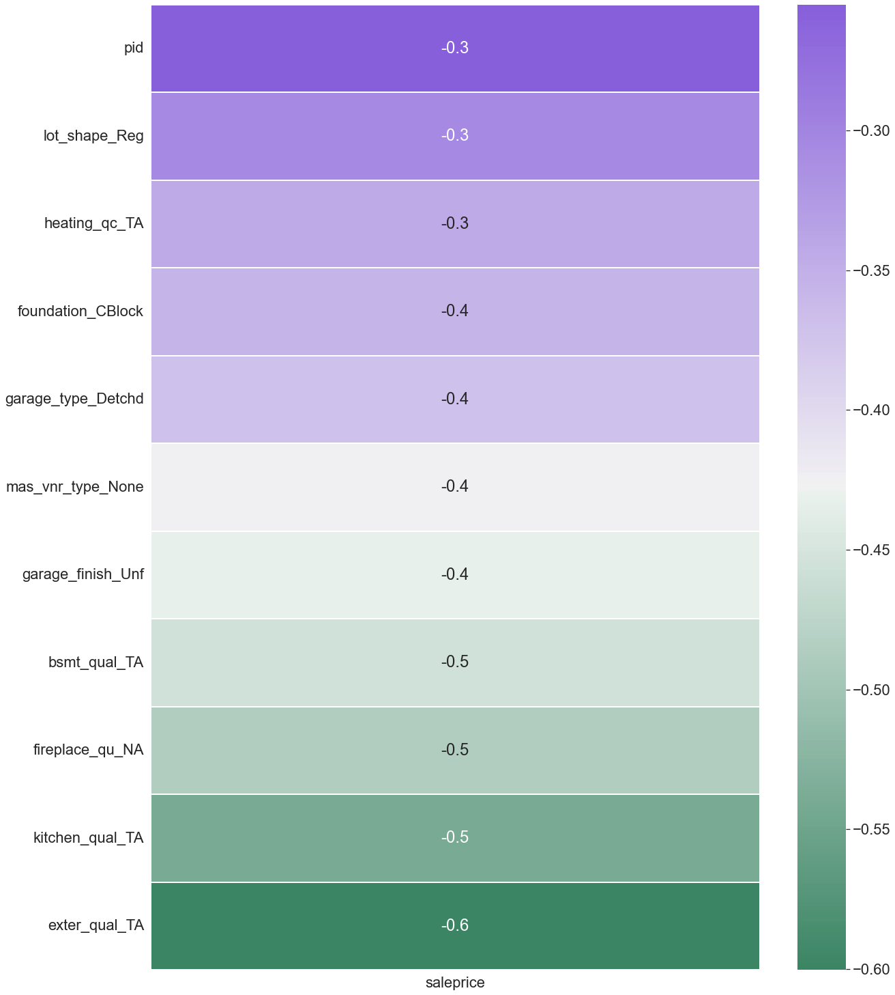
Rank of Positive Correlation ( >0.3 )
Overall Quality ( Finishing )
Living Area Size
Size of Garage
Car Fit in Garage
Total Basement, First Floor
Year House Built
Rank of Negative Correlation ( > - 0.3 )
Quality External Material ( Average)
Kitchen Quality ( Average )
Fireplace Quality ( No fireplace )
Height of Basement ( 80 – 89 inch )
Interior Finish ( Unfinished )
Masonry Veneer Type ( None )
Final Features
265 => 237

Slide 11
Model Selection
Model Name | Model Score ( R2 )
Linear Regression | 0.78
Lasso Regularization | 0.82
Ridge Regularization | 0.82
Elastic Net Regularization | 0.83

Slide 12
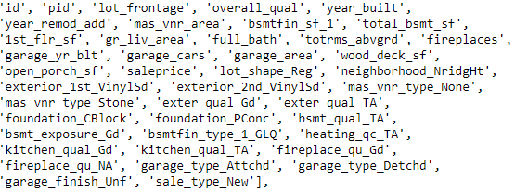
Conclusion
Elastic Net perform the best among the models tested where:
R2 score is 0.83
83% variance is explained by features for the predicting target, Sale Price
Features in hand is not enough. Model perform poorly in overall
Findings of significant features:

Slide 13

Recommendation
Model can further be used for predicting when listing probably be sold.
Model results can be utilized as providing snapshot of buyer based on historical trends including financial capability and preference of house.
Introduce more data ( > 2051 rows ) of user’s

Slide 14
Reference
C. (2020, October 27). When Real Estate Meets Data Science – 5 Ways Data Science Is Disrupting Real Estate. Co-Libry. https://co-libry.com/blogs/data-science-real-estate/
2021 National Association of Realtors Home Buyer and Seller Generational Trends. Available at: https://cdn.nar.realtor/sites/default/files/documents/2021-highlights-nar-member-profile-05-19-2021.pdf
Petrov, C. (2022, January 14). 19+ real estate statistics every buyer and realtor must know in 2022. SpendMeNot. Retrieved June 16, 2022, from https://spendmenot.com/blog/real-estate-statistics/
Institute of Data. (2021, March 23). Reaching new heights in real estate with data science and AI. https://www.institutedata.com/blog/reaching-new-heights-in-real-estate-with-data-science-and-ai/
Asaftei, G. M., Doshi, S., Means, J., & Sanghvi, A. (2021, March 30). Getting ahead of the market: How big data is transforming real estate. McKinsey & Company. https://www.mckinsey.com/industries/real-estate/our-insights/getting-ahead-of-the-market-how-big-data-is-transforming-real-estate

