Slide 1
Heap Sort

Slide 2
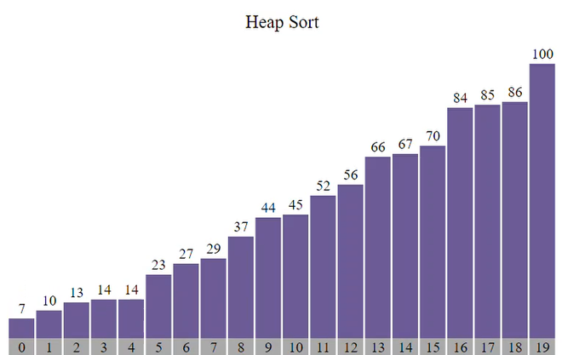
Heap Sort
01
02
03
Heap sort is a comparison-based sorting technique based on the Binary Heap data structure.
It is similar to the selection sort where we first find the minimum element and place the minimum element at the beginning.
Repeat the same process for the remaining elements. Heap sort is an in-place algorithm.

Slide 3
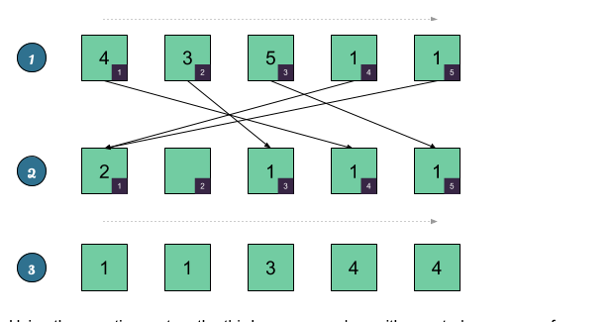
Real Life Application
01
Heap Sort
02
03
Heap Sorting can be applied to a sim card store where there are many customers in line
The customers who have to pay bills can be dealt with first because their work will take less time. This method will save time for many customers in line and avoid unnecessary waiting

Slide 4
Heap Sort - Working
01
Heapify is the process of creating a heap data structure from a binary tree represented using an array
02
Step 1 - Construct a Binary Tree with given list of Elements.
Step 2 - Transform the Binary Tree into Min Heap.
Step 3 - Delete the root element from Min Heap using the Heapify method.
Step 4 - Put the deleted element into the Sorted list.
Step 5 - Repeat the same until Min Heap becomes empty.
Step 6 - Display the sorted list.
Array = {1, 3, 5, 4, 6, 13, 10, 9, 8, 15, 17} Corresponding Complete Binary Tree is:
03
1 / \ 3 5 / \ / \ 4 6 13 10 / \ / \ 9 8 15 17

Slide 5
Heap Sort - Working
01
Heapify is the process of creating a heap data structure from a binary tree represented using an array
02
The task to build a Max-Heap from above array.
Total Nodes = 11. Last Non-leaf node index = (11/2) – 1 = 4. Therefore, last non-leaf node = 6.
To build the heap, heapify only the nodes: [1, 3, 5, 4, 6] in reverse order.
Heapify 5: Swap 6 and 17.
03
1 / \ 3 5 / \ / \ 4 17 13 10 / \ / \ 9 8 15 6

Slide 6
Heap Sort - Working
01
Heapify is the process of creating a heap data structure from a binary tree represented using an array
02
Heapify 4: Swap 4 and 9.
1 / \ 3 5 / \ / \ 9 17 13 10 / \ / \ 4 8 15 6
Heapify 3 Swap 13 and 5.
1 / \ 3 13 / \ / \ 9 17 5 10 / \ / \ 4 8 15 6 .
03

Slide 7
Heap Sort - Working
01
Heapify is the process of creating a heap data structure from a binary tree represented using an array
02
Heapify 2: First Swap 3 and 17, again swap 3 and 15.
1 / \ 17 13 / \ / \ 9 15 5 10 / \ / \ 4 8 3 6
Heapify 1: First Swap 1 and 17, again swap 1 and 15, and finally swap 1 and 6.
17 / \ 15 13 / \ / \ 9 6 5 10 / \ / \ 4 8 3 1
03

Slide 8
Merits & Demerits
01
Heap Sort
02
03
Memory usage is minimal:
because apart from what is necessary to hold the initial list of items to be sorted, it needs no additional memory space to work
Unstable
Expensive
Not very efficient when working with highly complex data.

Slide 9
Complexity Analysis
01
Heap Sort
02
03
 | Worst Time | Average Time | Best Time
Time Complexity | O(n*log(n)) | O(n*log(n)) | O(n*log(n))
Space Complexity | O(1) | O(1) | O(1)

Slide 10
Thank You

