Slide 1
Merge Sort

Slide 2
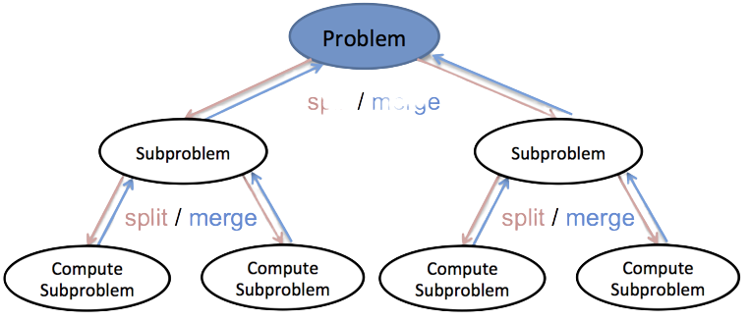
Merge Sort
01
Divide and Conquer
Strategy of solving a large problem by breaking the problem it into smaller sub-problems, solving the sub-problems and merging results
02
Merge sort is one of the most efficient sorting techniques and is based on the divide-conquer-combine paradigm.
With mergesort, the problem is split into two sub-problems for each iteration.
Divide the problem into two sub-problems until only one item remains in the problem set.
Sort the two sub-arrays while conquering.
Combine basically merges two sorted arrays into the original array.
03

Slide 3
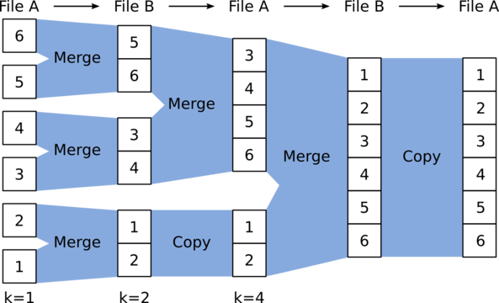
Real Life Application
01
Merge Sort
02
03
A merge sort algorithm is used in External Sorting
External sorting is required when the data being sorted do not fit into the main memory of a computing device and instead they must reside in the slower external memory, usually a disk drive.

Slide 4
Merge Sort - Working
01
Pseudocode
02
void mergeSort(int a[], int low, int high) {
// the array to be sorted is a[low..high]
if (low < high) { // base case: low >= high (0 or 1 item)
int mid = (low+high) / 2;
mergeSort(a, low , mid ); // log(N) divide into two halves
mergeSort(a, mid+1, high); // then recursively sort them
merge(a, low, mid, high); // O(N) conquer: the merge subroutine }
}
03

Slide 5
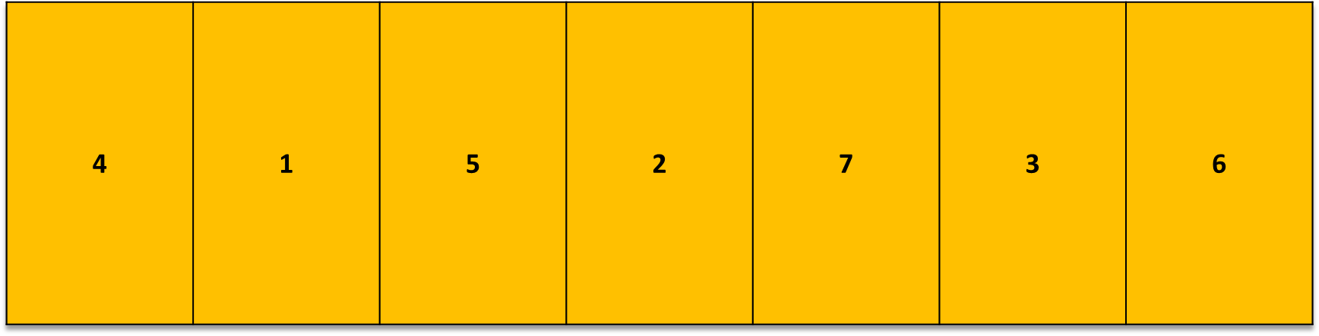
Merge Sort - Working
01
Divide and Conquer
Strategy of solving a large problem by breaking the problem it into smaller sub-problems, solving the sub-problems and merging results
02
Now we have 7 tables with different numbers we have to sort them in ascending order.
As you may remember we split the array of table ‘X’ into two sub arrays: ‘L’ denoting the left array and ‘R’ denoting the right array and splits L and R more until there is one element.
.
03

Slide 6
Merge Sort - Working
01
Divide and Conquer
Strategy of solving a large problem by breaking the problem it into smaller sub-problems, solving the sub-problems and merging results
02
4 | 1 | 5 | 2
.
03
7 | 3 | 6
mid = ceil(3 / 2) ;
mid = 4 / 2 ;
5 | 2
7 | 3
6
4 | 1
mid = 2 / 2 ;
mid = 2 / 2 ;
mid = 2 / 2 ;
mid = ceil(1 / 2) ;
4
1
5
2
7
3
6
L
R

Slide 7
Merge Sort - Working
01
Merge left halve of array.
.
Divide and Conquer
Strategy of solving a large problem by breaking the problem it into smaller sub-problems, solving the sub-problems and merging results
02
03
4 | 1 | 5 | 2
Compare 1 with 2 and 5
Compare 4 with 2 and 5
1 | 4
2 | 5
(4>1)? Swap 4,1: let it remain
(5>2)? Swap 5,2: let it remain
4
1
5
2
L

Slide 8
Merge Sort - Working
01
Divide and Conquer
Strategy of solving a large problem by breaking the problem it into smaller sub-problems, solving the sub-problems and merging results
02
Merge right halve of array.
03
3 | 6 | 7
Compare 3 and 6, and swap if needed
Compare 7 and 6, and swap if needed
3 | 7
6
(7>3)? Swap 7,3: let it remain
Single Element is already sorted
3
6
7
R

Slide 9
Merge Sort - Working
01
Merging of Elements
02
Notice that all the elements in X are either present in L or R.
Therefore we can start overwriting X from right to left. We will start at
from index 0 in X.
At any point, the smallest element will be either the smallest
unpicked in L or the smallest unpicked in R.
The figure below shows the smallest unpicked in both the sub arrays L and R in red.
03
4 | 1 | 5 | 2 | 7 | 3 | 6
1 | 2 | 4 | 5
3 | 6 | 7
L
R

Slide 10
Merge Sort - Working
01
Divide and Conquer
Strategy of solving a large problem by breaking the problem it into smaller sub-problems, solving the sub-problems and merging results
02
In ‘L’ the smallest element is 1. In ‘R’ the smallest element is 3. Now out of these two, the smallest is 1. This suggests 1 belongs to index 0 of X. Therefore, we will write 1 at index 0.
Now smallest unpicked of L and R in color red.
03
1 | 1 | 5 | 2 | 7 | 3 | 6
L
R
1 | 2 | 4 | 5
3 | 6 | 7
1 | 2 | 4 | 5
3 | 6 | 7

Slide 11
Merge Sort - Working
01
Divide and Conquer
Strategy of solving a large problem by breaking the problem it into smaller sub-problems, solving the sub-problems and merging results
02
In ‘L’ the smallest element is 2. In ‘R’ the smallest element is 3. Now out of these two, the smallest is 2. This suggests 2 belongs to index 1 of X. Therefore, we will write 2 at index 1.
Now smallest unpicked of L and R in color red.
In ‘L’ the smallest element is 4. In ‘R’ the smallest element is 3. Now out of these two, the smallest is 3. This suggests 3 belongs to index 2 of X. Therefore, we will write 3 at index 2.
03
1 | 2 | 5 | 2 | 7 | 3 | 6
1 | 2 | 4 | 5
3 | 6 | 7
1 | 2 | 4 | 5
3 | 6 | 7
1 | 2 | 4 | 5
3 | 6 | 7
1 | 2 | 3 | 2 | 7 | 3 | 6

Slide 12
Merge Sort - Working
01
Divide and Conquer
Strategy of solving a large problem by breaking the problem it into smaller sub-problems, solving the sub-problems and merging results
02
In ‘L’ the smallest element is 4. In ‘R’ the smallest element is 6. Now out of these two, the smallest is 3. This suggests 4 belongs to index 3of X. Therefore, we will write 4 at index 3.
Now smallest unpicked of L and R in color red.
Do the same steps for other two elements. And here we get the final sorted Array.
03
1 | 2 | 3 | 4 | 7 | 3 | 6
1 | 2 | 4 | 5
3 | 6 | 7
1 | 2 | 4 | 5
3 | 6 | 7
1 | 2 | 3 | 4 | 5 | 3 | 6
1 | 2 | 3 | 4 | 5 | 6 | 7

Slide 13
Merits & Demerits
01
Merge Sort
02
03
goes through the whole process even i he list is sorted
Space cost: store the sub elements of the initial split list.
It is quicker for larger lists because it doesn't go through the whole list several times.
Stable sorting algorithm.

Slide 14
Complexity Analysis
01
Merge Sort
02
03
 | Worst Time | Average Time | Best Time
Time Complexity | O(n*log(n)) | O(n*log(n)) | O(n*log(n))
Space Complexity | O(n) | O(n) | O(n)

Slide 15
Thank You

