Slide 1

RB TREE Red-black tree
Advanced Analysis of Algorithms

Slide 2

INTRODUCTION
Red-Black tree is a self-balancing binary search tree in which each node contains an extra bit for denoting the color of the node, either red or black.
A red-black tree satisfies the following properties:
Red/Black Property: Every node is colored, either red or black.
Root Property: The root is black.
Leaf Property: Every leaf (NIL) is black.
Red Property: If a red node has children then, the children are always black.
Depth Property: For each node, any simple path from this node to any of its successor leaf has the same number of black nodes.

Slide 3

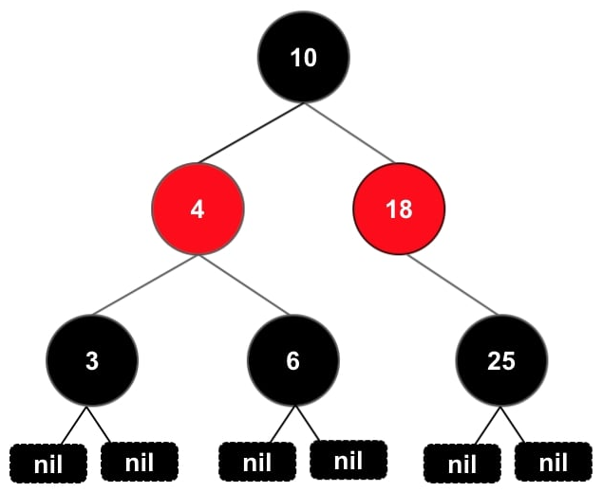
RULES THAT EVERY RED-BLACK TREE FOLLOWS:
Every node has a color either red or black.
The root of the tree is always black.
For any red node, both children are black.
Every path from a node (including root) to any of its successor NULL nodes has the same number of black nodes.
All leaf nodes are black nodes.

Slide 4

ALGORITHM TO INSERT A NODE
Let y be the leaf (ie. NIL) and x be the root of the tree.
Check if the tree is empty, If yes, insert newNode as a root node and color it black.
Else, repeat steps following steps until leaf (NIL) is reached.
Compare newKey with rootKey.
If newKey is > than rootKey, traverse through the right subtree.
Else traverse through the left subtree.
Assign the parent of the leaf as a parent of newNode.
If leafKey is > than newKey, make newNode as rightChild.
Else, make newNode as leftChild.
Assign NULL to the left and rightChild of newNode.
Assign RED color to newNode.

Slide 5
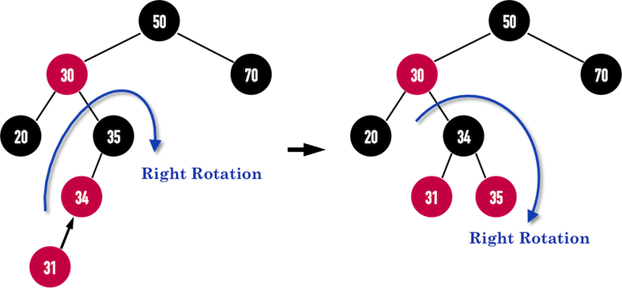

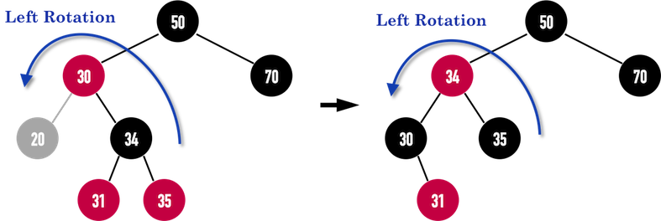
ROTATIONS (For balancing)
Why We Need Rotations ?
After insertion of a new node,
if the tree is violating the properties of the red-black (Leaf RED Nodes) tree then, we do… 1. Recoloring
2. Rotations

Slide 6
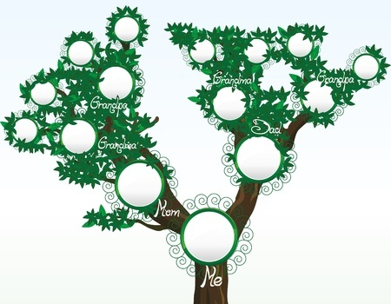

INSERTION WORKING CONT…
Creating a red-black tree with elements 3, 21, 32 and 15 in an empty tree.
Let y be the leaf (ie. NIL) and x be the root of the tree.
Check if the tree is empty, If yes, insert newNode as a root node and color it black.
Else, repeat steps following steps until leaf (NIL) is reached.

Slide 7

INSERTION WORKING CONT…
3, 21, 32 and 15
Compare newKey with rootKey.
If 21 is > than 3, traverse through the right subtree.

Slide 8
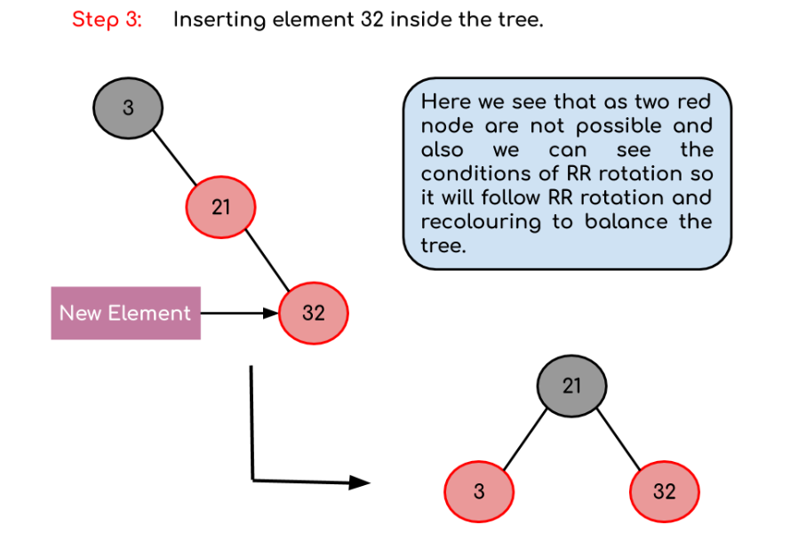
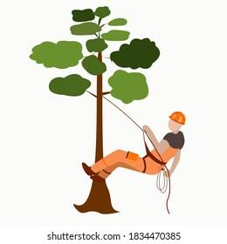
INSERTION WORKING CONT…
3, 21, 32 and 15
Now, as we insert 32 we see there is a red father-child pair which violates the Red-Black tree rule so we have to rotate it.

Slide 9
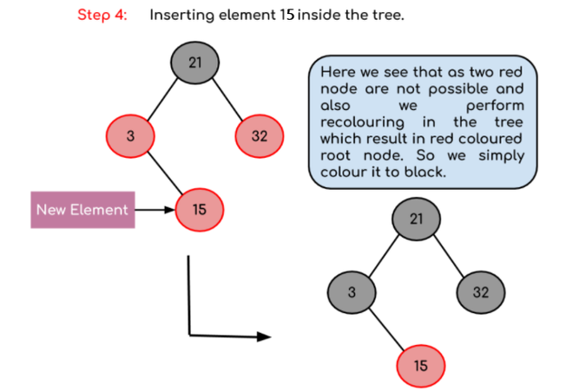
INSERTION WORKING
3, 21, 32 and 15
Now, as we insert 15
Why newly inserted nodes are always red in a red-black tree ?
This is because inserting a red node does not violate the depth property of a red-black tree.

Slide 10
ALGORITHM TO DELETE A NODE
Save the color of nodeToBeDeleted in origrinalColor.
If the left child of nodeToBeDeleted is NULL
Assign the right child of nodeToBeDeleted to x.
Transplant nodeToBeDeleted with x.
Else if the right child of nodeToBeDeleted is NULL
Assign the left child of nodeToBeDeleted into x.
Transplant nodeToBeDeleted with x.
Else
Assign the rightChild of y into x. Assign the minimum of right subtree of noteToBeDeleted into y.
Save the color of y in originalColor.
If y is a child of nodeToBeDeleted, then set the parent of x as y.
Else, transplant y with rightChild of y.
Transplant nodeToBeDeleted with y.
Set the color of y with originalColor.
If the originalColor is BLACK, call DeleteFix(x).

Slide 11

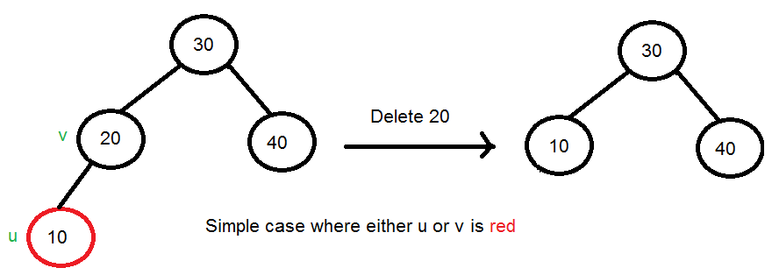
DELETION WORKING CONT…
If either u or v is red, we mark the replaced child as black. Note that both u and v cannot be red as v is parent of u and two consecutive reds are not allowed in red-black tree.
Case :1

Slide 12
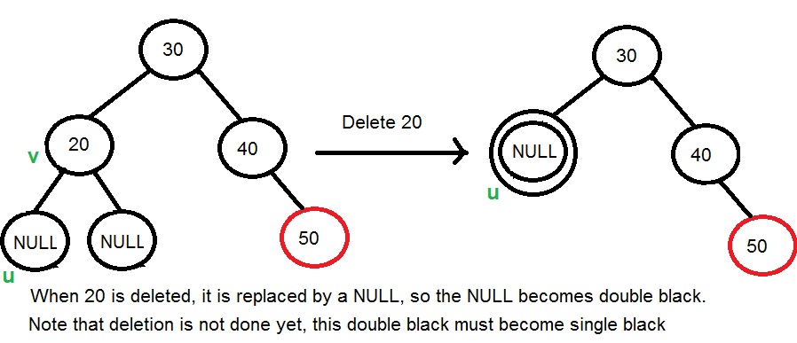
DELETION WORKING CONT…
If Both u and v are Black, Now our task reduces to convert this double black to single black. Case :2
Note that If v is leaf, then u is NULL and color of NULL is considered black. So the deletion of a black leaf also causes a double black.

Slide 13
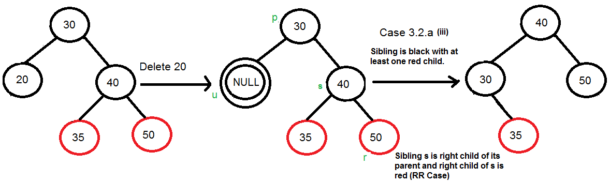
DELETION WORKING CONT…
Do following while the current node u is double black:
Case :3

Slide 14
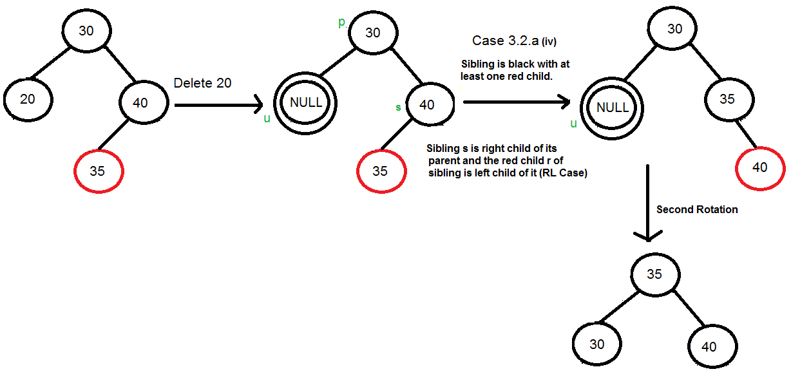
DELETION WORKING CONT…
s is right child of its parent and r is left child of s

Slide 15
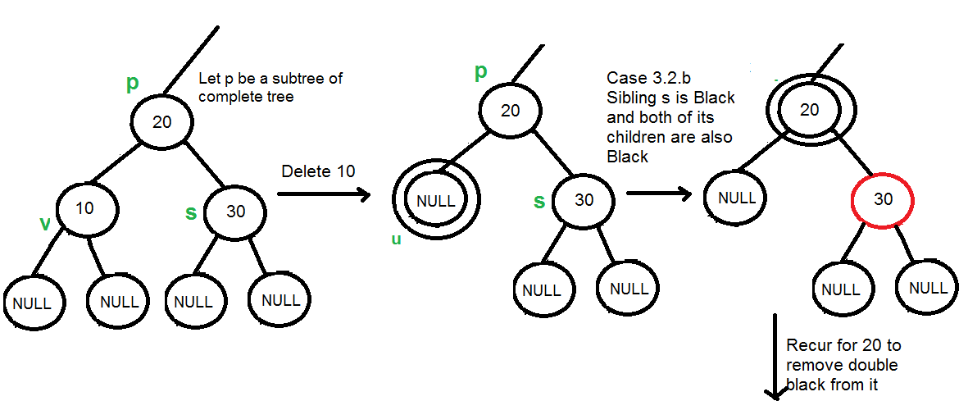
DELETION WORKING CONT…
If sibling is black and its both children are black

Slide 16
TIME COMPLEXITY
Why Red-Black Trees?
The cost of these operations may become O(n). If we make sure that the height of the tree remains O(log n) after every insertion and deletion, then we can guarantee an upper bound of O(log n) for all these operations. The height of a Red-Black tree is always O(log n) where n is the number of nodes in the tree.
Sr. No. | Algorithm | Time Complexity
1. | Insert | O(log n)
2. | Delete | O(log n)

Slide 17

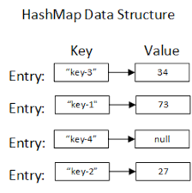
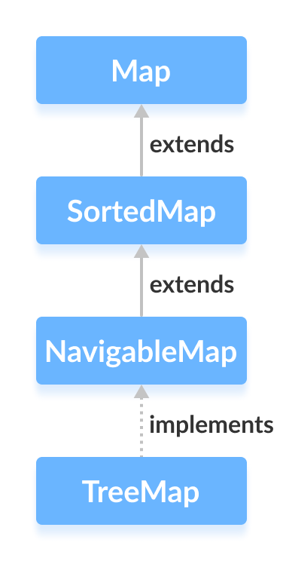
APPLICATIONS
RB trees are used to construct associative arrays/finite maps.
To implement Java packages: java.util.TreeMap and java.util.TreeSet
Associative arrays are arrays that use named keys that you assign to them.

Slide 18
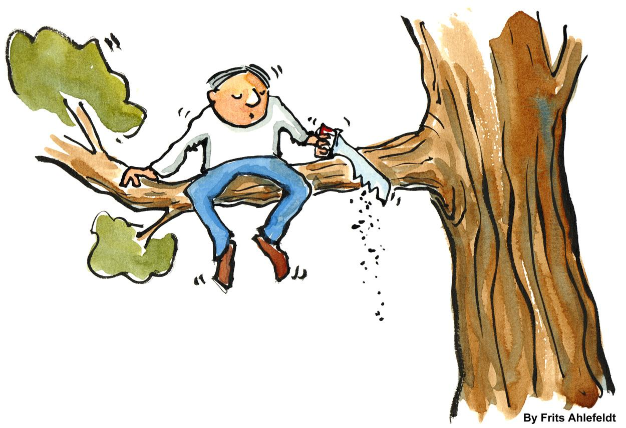
DRAWBACKS
One notable disadvantage of a red black trees in a lot of cases is that it is a binary tree and thus lookups are O (lg (n)) where as hash tables have a lookup of O (1)
Complicated to use due to all the Leaf/Child/Edge cases.

Slide 19
REFERENCES
https://www.programiz.com/dsa/red-black-tree
https://www.geeksforgeeks.org/introduction-to-red-black-tree/

Slide 20


