Slide 1
Course Code: COE 3201
Course Title: Data Communication Lab
Dept. of Computer Engineering
Faculty of Engineering
Introduction to MATLAB
Lab No: | 1 | Week No: | 1 | Semester:
Lecturer: | Farhan Ahmed Wasim

Slide 2
Lab Objective
To understand the use of MATLAB for solving communication engineering problems.
To develop understanding of MATLAB environment, commands and syntax.

Slide 3
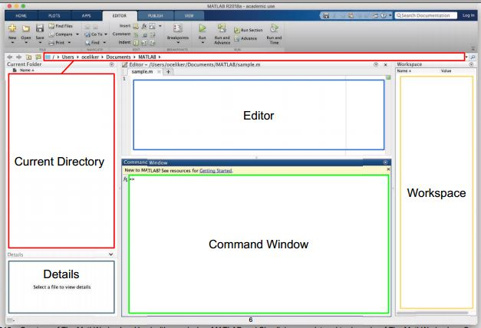
Getting Started

Slide 4
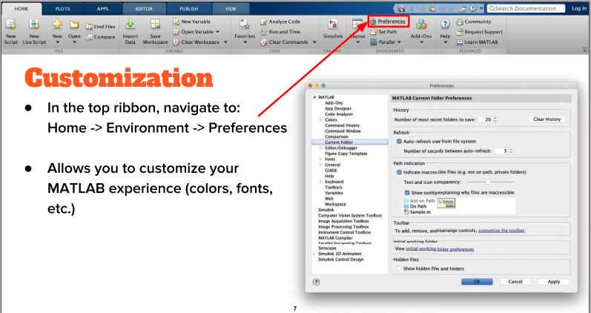
Getting Started

Slide 5
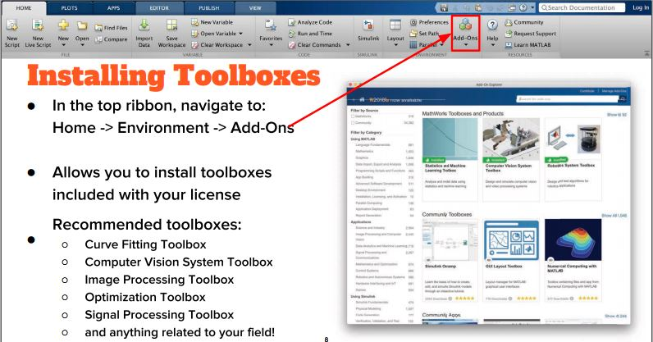
Getting Started

Slide 6
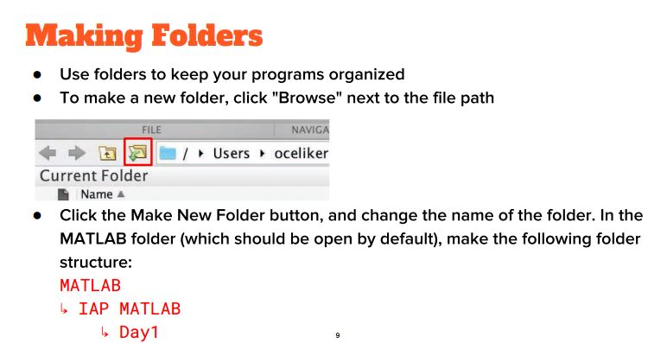
Getting Started

Slide 7
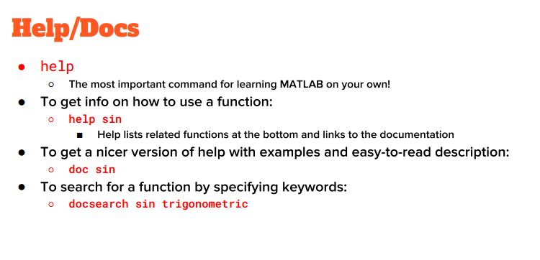
Getting Started

Slide 8
Practice
LET’S START! OPEN LAB MANUAL & RUN PRACTICE PROBLEM IN COMMAND WINDOW THEN TRY PERFORMANCE PROBLEM

Slide 9
Instruction
Performance Task : (your ID = AB-CDEFG-H)
**Generate two CDEF hertz sinusoids with different amplitudes and phases. x1(t) = A1 cos(2π(CDEF)t + j1) x2(t) = A2 cos(2π(CDEF)t + j2)
Select the value of the amplitudes as follows: let A1 = AB and A2 = GH. For the phases, use j1 = DG (in degrees), and take j2 = 30º. When doing computations in Matlab, make sure to convert degrees to radians.
Make a plot of both signals over a range of t that will exhibit approximately 3 cycles. Make sure the plot starts at a negative time so that it will include t = 0, and make sure that you have at least 20 samples per period of the wave.
Verify that the phase of the two signals x1(t) and x2(t) is correct at t = 0, and also verify that each one has the correct maximum amplitude.

Slide 10
Instruction
(d) Use subplot(3,1,1) and subplot(3,1,2) to make a three-panel subplot that puts both of these plots on the same window. See help subplot.
(e) Create a third sinusoid as the sum: x3(t) = x1(t) + x2(t). In Matlab this amounts to summing the vectors that hold the samples of each sinusoid. Make a plot of x3 (t) over the same range of time as used in the previous two plots. Include this as the third panel in the window by using subplot (3,1,3).
(f) Measure the magnitude and phase of x3 (t) directly from the plot. In your lab report, explain how the magnitude and phase were measured by making annotations on each of the plots.

Slide 11
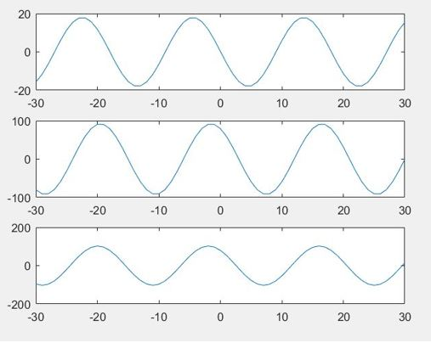
Predicted Result

Slide 12
Reference
Matlab User Guide
MIT Oper Source Course- MATLAB 2019

