Slide 1

Zada Pharmacy
Website presentation
Online shopping and prescription submissions
with a connected store administration system
18 October 2026
01
Notes:
Source: E:/Online-Shop-for-SSI-Client/frontend/src/Pages/HomePage.jsx
Application source review dated 17 October 2026. Live workflows and external integrations have not been tested.

Slide 2
Website scope
Customer website
Store administration
Product browsing and shopping
Accounts, addresses, and wishlists
Order history and cancellations
Prescription image submissions
Products, stock, and vendors
Order and prescription processing
Promotions and delivery settings
Homepage and navigation editing
02
Notes:
Source: E:/Online-Shop-for-SSI-Client/frontend/src/App.jsx
Application source review dated 17 October 2026. Live workflows and external integrations have not been tested.

Slide 3
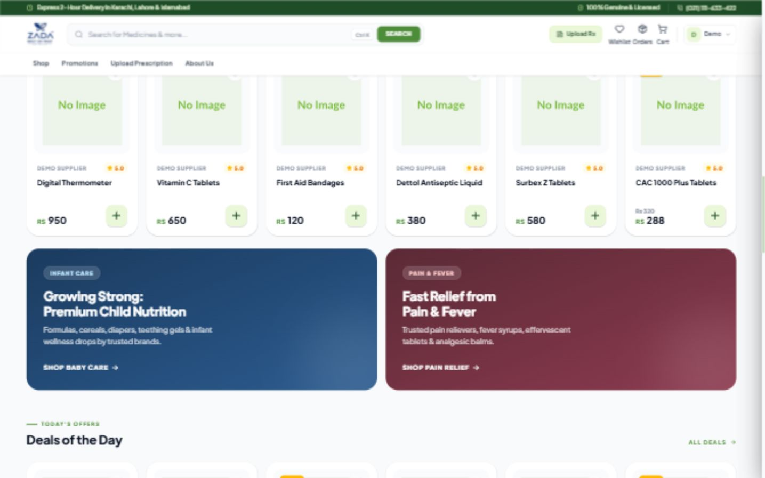
Storefront sections on desktop
Homepage shopping sections and promotional banners
Local demo with sample records and placeholder product images
Notes:
Actual app screenshot captured from http://127.0.0.1:5173/ on 18 October 2026. Local demo records, prices, order totals, and promotional copy are illustrative. The temporary MongoDB database contains sample records only. Product image placeholders appear because production assets are not configured. Website marketing claims visible in the screenshot are UI content and have not been independently verified. The product page includes a missing-icon import fix. The homepage builder includes an initial-layout reference fix.

Slide 4
Product discovery
Search products with paginated results
Switch between product grid and list views
View images, descriptions, prices, and stock
Read ratings and customer reviews
See promotional prices and flash deals
04
Notes:
Source: E:/Online-Shop-for-SSI-Client/backend/controllers/product.controller.js
Application source review dated 17 October 2026. Live workflows and external integrations have not been tested.
Additional sources: frontend/src/Pages/ProductListPage.jsx; backend/controllers/review.controller.js. The product API supports category, price, product type, and vendor filters. The current public listing explicitly submits search and page parameters.

Slide 5
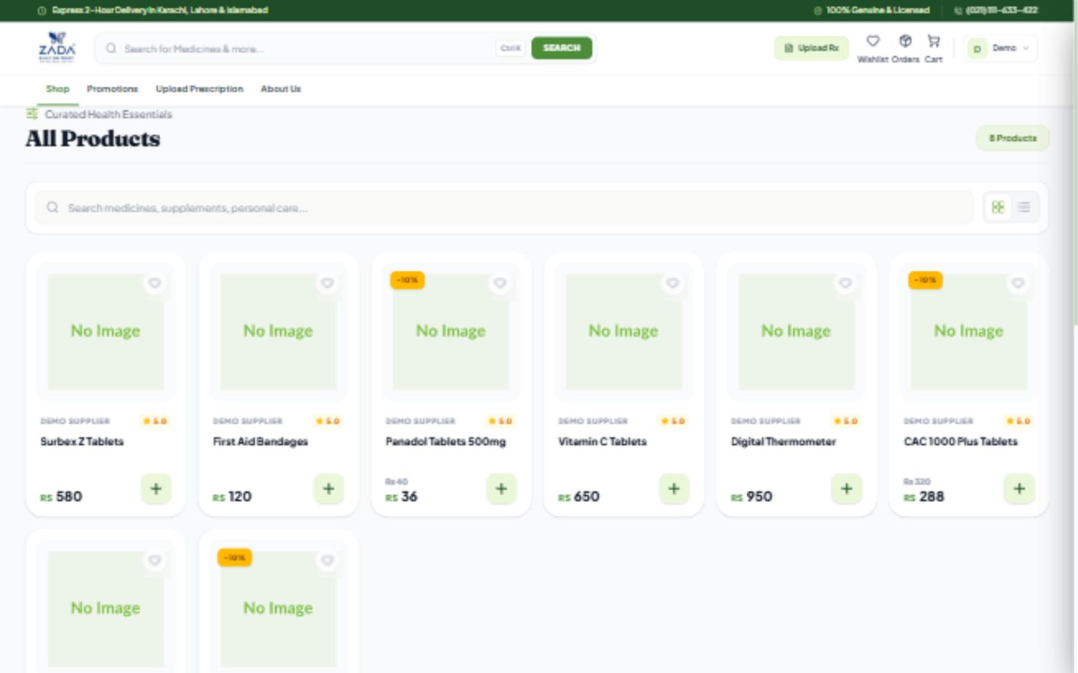
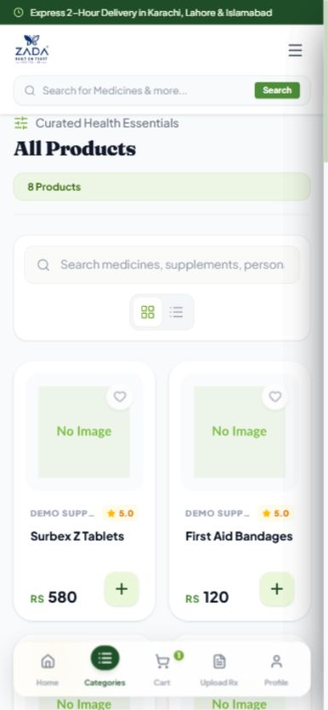
Product catalog on desktop and mobile
Desktop
Mobile
Responsive product browsing with search and cart actions
Local demo with sample records and placeholder product images
Notes:
Actual app screenshot captured from http://127.0.0.1:5173/products on 18 October 2026. Local demo records, prices, order totals, and promotional copy are illustrative. The temporary MongoDB database contains sample records only. Product image placeholders appear because production assets are not configured. Website marketing claims visible in the screenshot are UI content and have not been independently verified. The product page includes a missing-icon import fix. The homepage builder includes an initial-layout reference fix.

Slide 6
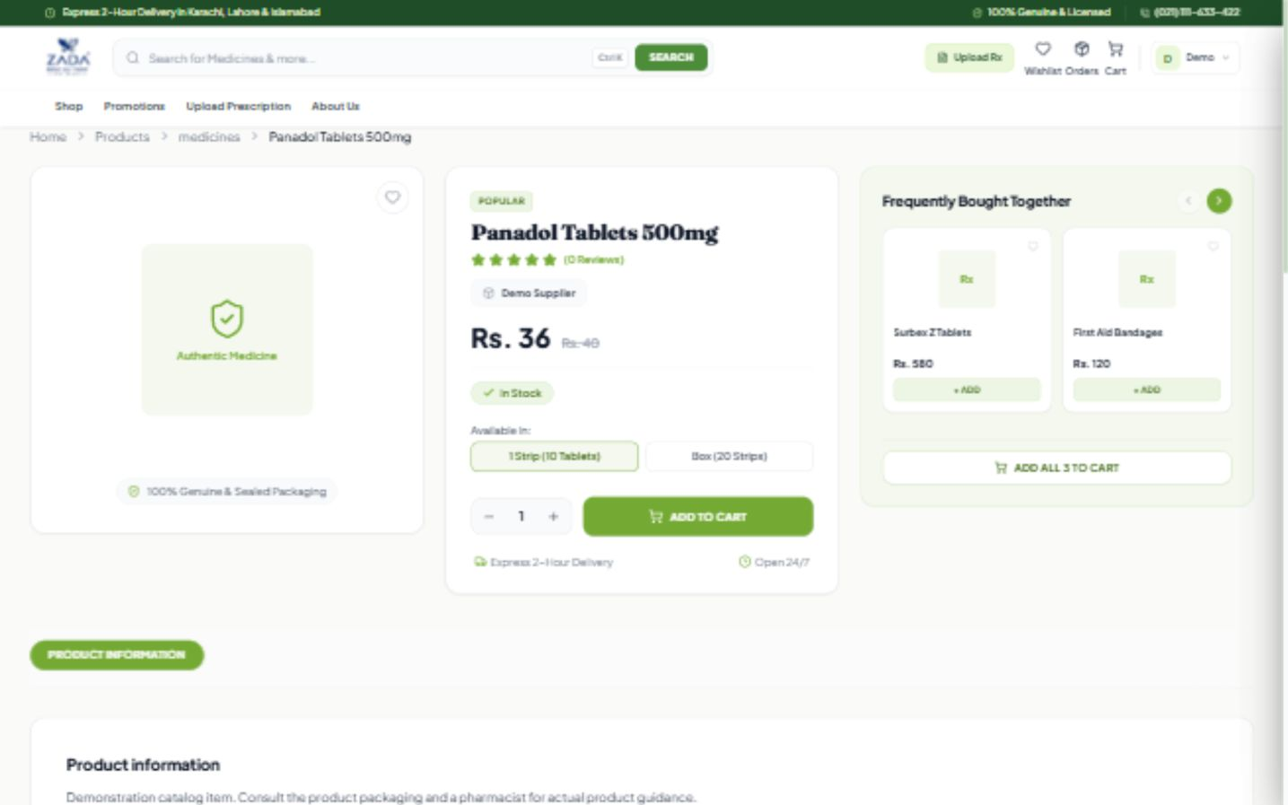
Product details on desktop
Product pricing, stock, pack selection, and cart controls
Local demo with sample records and placeholder product images
Notes:
Actual app screenshot captured from http://127.0.0.1:5173/product on 18 October 2026. Local demo records, prices, order totals, and promotional copy are illustrative. The temporary MongoDB database contains sample records only. Product image placeholders appear because production assets are not configured. Website marketing claims visible in the screenshot are UI content and have not been independently verified. The product page includes a missing-icon import fix. The homepage builder includes an initial-layout reference fix.

Slide 7
Customer accounts
Registration and access
Personal information
Phone verification through SMS OTP
Login with email or phone and password
JWT cookies with token refresh
Profile details and avatar
Saved delivery addresses
Product wishlist
07
Notes:
Source: E:/Online-Shop-for-SSI-Client/backend/controllers/user.controller.js
Application source review dated 17 October 2026. Live workflows and external integrations have not been tested.

Slide 8
Cart and checkout
Add products and adjust quantities within stock limits
Select specific cart items for checkout
Choose a delivery address and map location
Review product total, tax, and shipping charges
Select a configured payment option
08
Notes:
Source: E:/Online-Shop-for-SSI-Client/frontend/src/Pages/CheckoutPage.jsx
Application source review dated 17 October 2026. Live workflows and external integrations have not been tested.
Additional source: frontend/src/store/slices/cartSlice.js. Checkout provides a COD fallback when configured methods are unavailable. Payment selection does not establish online payment processing.

Slide 9
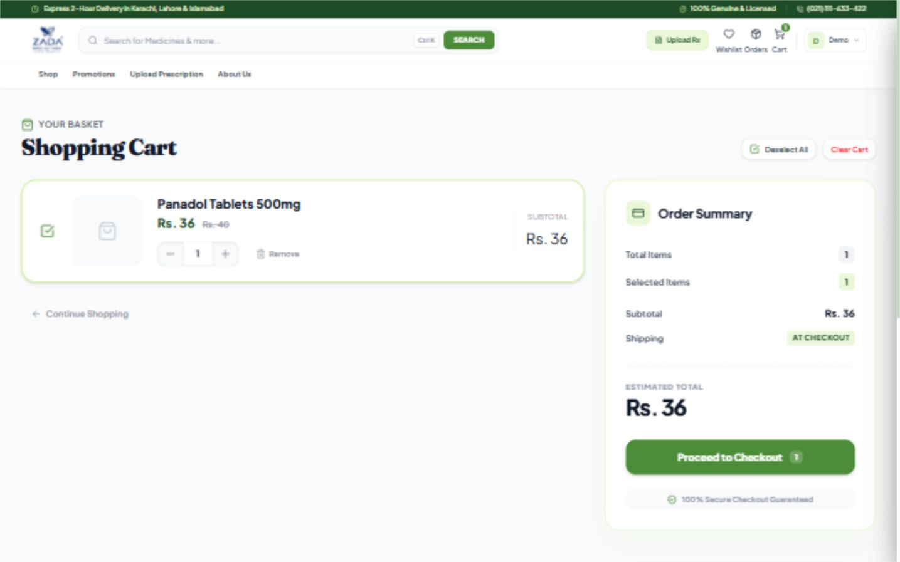
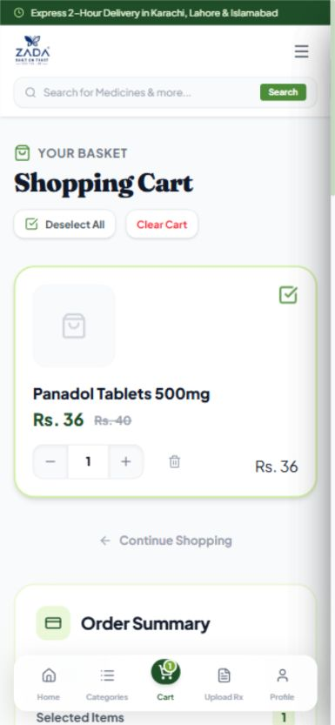
Shopping cart on desktop and mobile
Desktop
Mobile
Selected products, quantities, totals, and checkout access
Local demo with sample records and placeholder product images
Notes:
Actual app screenshot captured from http://127.0.0.1:5173/cart on 18 October 2026. Local demo records, prices, order totals, and promotional copy are illustrative. The temporary MongoDB database contains sample records only. Product image placeholders appear because production assets are not configured. Website marketing claims visible in the screenshot are UI content and have not been independently verified. The product page includes a missing-icon import fix. The homepage builder includes an initial-layout reference fix.

Slide 10
Orders and customer updates
Customer actions
Store actions
View order history and details
Follow pending, shipped, and delivered statuses
Cancel pending orders with a reason
Create customer orders
Update fulfillment and payment status
Cancel individual items and restore stock
10
Notes:
Source: E:/Online-Shop-for-SSI-Client/backend/controllers/order.controller.js
Application source review dated 17 October 2026. Live workflows and external integrations have not been tested.

Slide 11
Prescription submissions
Upload a prescription image with contact information
Provide an address and map coordinates
Submit through an API that supports guests
Staff review submissions and add notes
Track pending, processing, completed, or rejected status
11
Notes:
Source: E:/Online-Shop-for-SSI-Client/backend/controllers/prescription.controller.js
Application source review dated 17 October 2026. Live workflows and external integrations have not been tested.
Additional source: backend/routers/prescription.router.js. Optional authentication permits guest uploads. Prescription submission is a separate workflow from the standard product checkout.

Slide 12
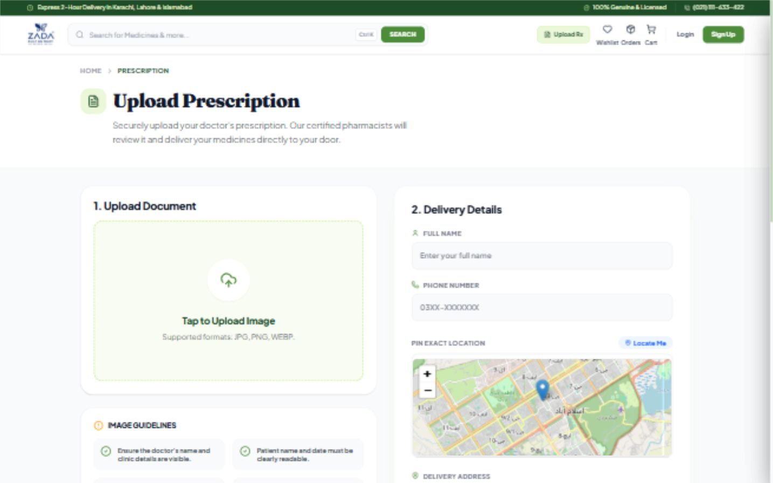
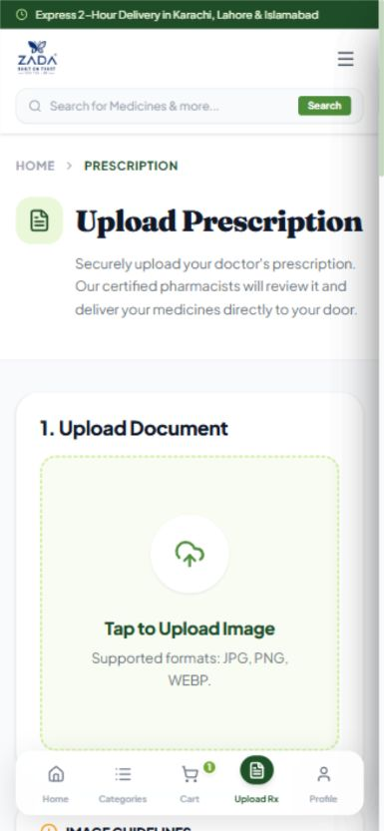
Prescription upload on desktop and mobile
Desktop
Mobile
Prescription image upload and delivery information
Local demo with sample records and placeholder product images
Notes:
Actual app screenshot captured from http://127.0.0.1:5173/upload-prescription on 18 October 2026. Local demo records, prices, order totals, and promotional copy are illustrative. The temporary MongoDB database contains sample records only. Product image placeholders appear because production assets are not configured. Website marketing claims visible in the screenshot are UI content and have not been independently verified. The product page includes a missing-icon import fix. The homepage builder includes an initial-layout reference fix.

Slide 13
Catalog and inventory administration
Catalog management
Inventory and suppliers
Product creation, editing, and deletion
Multiple product images
Rich-text product detail sections
Categories and subcategories
Stock and sold counts
Low-stock and out-of-stock alerts
Vendor records and branding
Customer records and account creation
13
Notes:
Source: E:/Online-Shop-for-SSI-Client/backend/models/product.model.js
Application source review dated 17 October 2026. Live workflows and external integrations have not been tested.
Additional sources: backend/controllers/order.controller.js; frontend/src/Pages/Admin/VendorsListPage.jsx; frontend/src/Pages/Admin/UsersListPage.jsx.

Slide 14
Dashboard and notifications
Reporting
Operational updates
Sales and order totals
Product and customer counts
Daily sales and category charts
Order status analysis and date filters
Unread order and prescription counts
Socket.IO order and prescription events
SMS order and prescription messages
Editable SMS templates
14
Notes:
Source: E:/Online-Shop-for-SSI-Client/backend/controllers/order.controller.js
Application source review dated 17 October 2026. Live workflows and external integrations have not been tested.
Additional sources: backend/config/socket.js; backend/utils/smsService.js. Dashboard totalSales sums stored order grand totals and should not be interpreted as confirmed collected revenue. External SMS delivery requires a configured gateway.

Slide 15
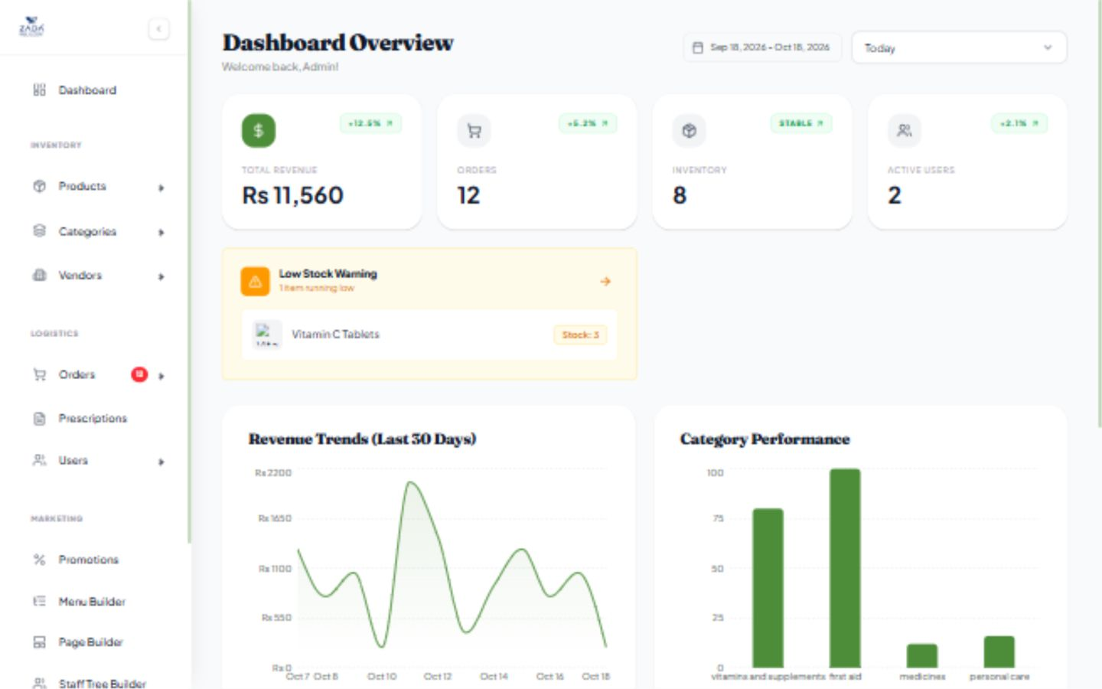
Admin dashboard on desktop
Sample order totals, inventory alerts, and reporting charts
Local demo with sample records and placeholder product images
Notes:
Actual app screenshot captured from http://127.0.0.1:5173/admin-dashboard on 18 October 2026. Local demo records, prices, order totals, and promotional copy are illustrative. The temporary MongoDB database contains sample records only. Product image placeholders appear because production assets are not configured. Website marketing claims visible in the screenshot are UI content and have not been independently verified. The product page includes a missing-icon import fix. The homepage builder includes an initial-layout reference fix.

Slide 16
Promotions and delivery settings
Promotions
Checkout configuration
Flash deals and offers
Percentage or fixed-amount discounts
Scheduled start and end dates
Selected products and promotion statuses
Tax and payment method information
Flat, distance, percentage, or city fees
Delivery overrides by order value
Store location for distance calculation
16
Notes:
Source: E:/Online-Shop-for-SSI-Client/backend/models/settings.model.js
Application source review dated 17 October 2026. Live workflows and external integrations have not been tested.
Additional sources: backend/models/promotion.model.js; frontend/src/Pages/CheckoutPage.jsx.

Slide 17
Website content management
Edit the homepage with a live preview
Add, reorder, hide, or remove content sections
Customize text, images, colors, buttons, and links
Manage hero slides, product grids, banners, and FAQs
Build nested navigation and a public staff hierarchy
17
Notes:
Source: E:/Online-Shop-for-SSI-Client/frontend/src/Pages/Admin/HomePageBuilderPage.jsx
Application source review dated 17 October 2026. Live workflows and external integrations have not been tested.
Additional sources: backend/models/homePage.model.js; frontend/src/Pages/Admin/MenuBuilderPage.jsx; frontend/src/Pages/Admin/StaffTreeBuilderPage.jsx. The homepage builder also includes testimonials, brands, custom HTML, spacing, and other configurable sections.

Slide 18
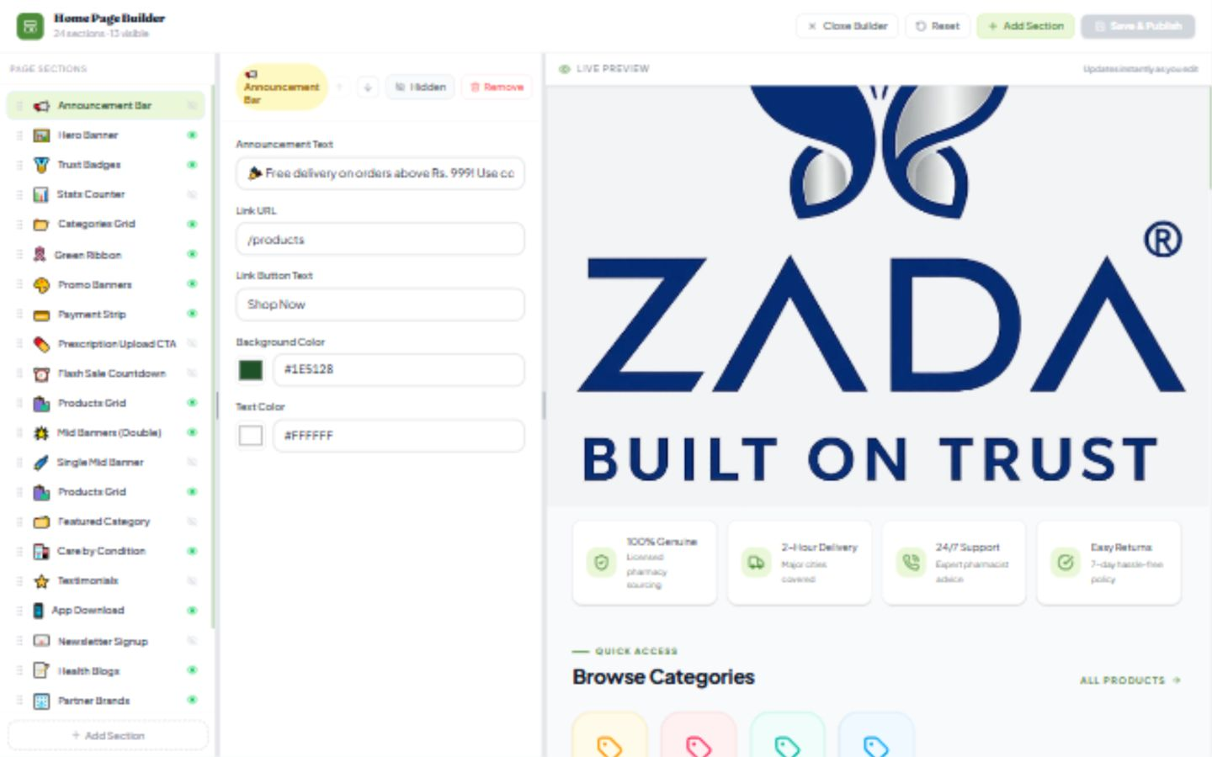
Homepage builder on desktop
Section controls, content editing, and live preview
Local demo with sample records and placeholder product images
Notes:
Actual app screenshot captured from http://127.0.0.1:5173/admin-dashboard/homepage-builder on 18 October 2026. Local demo records, prices, order totals, and promotional copy are illustrative. The temporary MongoDB database contains sample records only. Product image placeholders appear because production assets are not configured. Website marketing claims visible in the screenshot are UI content and have not been independently verified. The product page includes a missing-icon import fix. The homepage builder includes an initial-layout reference fix.

Slide 19
Technical structure
Customer and admin interface
React 19, Vite, Tailwind CSS, React Router
Redux Toolkit, TanStack Query, Axios
API and persistence
Node.js and Express with MongoDB and Mongoose
ImageKit uploads, Leaflet maps, Socket.IO, and SMS
19
Notes:
Source: E:/Online-Shop-for-SSI-Client/frontend/package.json
Application source review dated 17 October 2026. Live workflows and external integrations have not been tested.
Additional sources: backend/package.json; backend/config/localDb.js; frontend/src/api/apiClient.js. The app also uses Redux Persist, Recharts, lazy-loaded routes, reusable components, and centralized error handling.

Slide 20
Current limitations and next priorities
Protect promotion management APIs with admin authorization
Complete the Messages page and newsletter integration
Integrate a payment processor if online payments are required
Update the README to match the current implementation
Verify live workflows and external integrations before release
20
Notes:
Source: E:/Online-Shop-for-SSI-Client/backend/routers/promotion.router.js
Application source review dated 17 October 2026. Live workflows and external integrations have not been tested.
Additional sources: frontend/src/App.jsx (Messages placeholder); frontend/src/Components/HomeSections/NewsletterSection.jsx (submit only prevents default); frontend/src/Pages/CheckoutPage.jsx (payment selection). These are review observations and proposed priorities, not completed fixes.

