Slide 1
POWERS OF THE SUPREME COURT
As the highest court in the Philippines

Slide 2
the Supreme Court has several powers, including:
Judicial Review: The Supreme Court has the power to review the constitutionality of laws, acts, and executive orders.
Original Jurisdiction: The Supreme Court has original jurisdiction over cases involving ambassadors, public ministers, and consuls, as well as cases involving petitions for certiorari, prohibition, and mandamus against lower courts.
Appellate Jurisdiction: The Supreme Court has appellate jurisdiction over final judgments and orders of lower courts in all cases, including civil and criminal cases.

Slide 3
4. Administrative Supervision: The Supreme Court has administrative supervision over all lower courts and their personnel.
5. Rulemaking Power: The Supreme Court has the power to promulgate rules concerning the protection and enforcement of constitutional rights, pleading, practice, and procedure in all courts.
6. Disciplinary Power: The Supreme Court has the power to discipline judges and lawyers for misconduct.
7. Advisory Power: The Supreme Court may issue advisory opinions upon the request of the President or the Congress on matters of law and constitutionality.

Slide 4
The Philippine judiciary system

Slide 5
The Judiciary of the Philippines consists of the Supreme Court, which is established in the Constitution, and three levels of lower courts, which are established through law by the Congress of the Philippines. The Supreme Court has expansive powers, able to overrule political and administrative decisions, and with the ability to craft rules and law without precedent. It further determines the rules of procedure for lower courts, and its members sit on electoral tribunals.

Slide 6
Below the Supreme Court is the Court of Appeals, which also has national scope with different divisions based in different regions of the country. Decisions from this court can only be appealed to the Supreme Court. Below this level are Regional Trial Courts, which are spread throughout the country among judicial regions. Some of these courts are specialized to deal with certain types of cases. Below these courts are the first level Metropolitan and Municipal Trial Courts, which are located in cities and municipalities throughout the country.

Slide 7
Outside of the regular court systems, special courts have been set up to deal with particular cases. These include the Court of Tax Appeals and the Sandiganbayan, which are considered equivalent to the Court of Appeals. In some parts of the country, Sharia courts have been established. Outside of the court system, a number of quasi-judicial bodies have some powers established via law.

Slide 8
The Supreme Court was given its expansive powers following a period of martial law, where the Executive dominated. While the Judiciary oversees the other branches of government, judges are appointed to the Judiciary by the President of the Philippines from a shortlist submitted by the Judicial and Bar Council, a body the President can influence.

Slide 9
MUNICIPAL TRIAL COURT And municipal circuit trial court
The Municipal Trial Court (MTC) is a type of trial court in the Philippines that has jurisdiction over civil and criminal cases arising within its territorial jurisdiction.
It is referred to as such if it covers only one municipality; otherwise, it is called Municipal Circuit Trial Court if it covers two or more municipalities.
The MTC is presided over by a judge who is appointed by the President of the Philippines. The judge is assisted by court personnel, such as clerks and stenographers.

Slide 10
In civil cases, the MTC can hear cases where the amount involved is up to Php 400,000 Examples of civil cases that may be heard by the MTC include small claims cases, unlawful detainer (ejectment) cases, and cases involving property disputes.
In criminal cases, the MTC can hear cases where the maximum penalty is imprisonment for not more than six years or a fine of not more than Php 100,000, or both. Examples of criminal cases that may be heard by the MTC include cases involving violations of city or municipal ordinances, traffic violations, and other minor offenses.

Slide 11
METROPOLITAN Trial court AND MUNICIPAL TRIAL COURTS IN CITIES
Municipal Trial Courts in the towns and cities in the Metropolitan Manila area, as distinguished from the other political subdivisions in the Philippines, are referred to as Metropolitan Trial Courts.
In the Philippines, the Metropolitan Trial Court (MeTC) is a type of trial court that has jurisdiction over civil and criminal cases arising within its territorial jurisdiction. It is a lower court that handles cases that are less serious in nature compared to those handled by higher courts.

Slide 12
In civil cases, the MeTC can hear cases where the amount involved is up to Php 400,000, the same as the Municipal Trial Court. However, the MeTC may also hear cases involving forcible entry and unlawful detainer (ejectment) where the amount of damages or unpaid rentals does not exceed Php 400,000.
In criminal cases, the MeTC can hear cases where the maximum penalty is imprisonment of up to six years or a fine of up to Php 100,000, or both. Examples of criminal cases that may be heard by the MeTC include cases involving violations of city or municipal ordinances, traffic violations, and other minor offenses.

Slide 13
Regional Trial Courts (RTCs)
Trial courts in the Philippines that have jurisdiction

Slide 14
Regional Trial Courts (RTCs) are trial courts in the Philippines that have jurisdiction over criminal and civil cases within their territorial jurisdiction. These courts are located in each of the 17 regions of the country, with several branches within each region.
RTCs have jurisdiction over cases involving amounts exceeding Php 300,000 (approximately US$6,000) and all criminal cases not falling within the exclusive jurisdiction of the lower courts. They also have jurisdiction over certain special cases, such as family law cases, cases involving intellectual property, and cases involving violations of environmental laws.

Slide 15
The RTCs are presided over by judges appointed by the President of the Philippines. The judges are required to be lawyers and members of the Philippine Bar, and they are appointed for a term of six years.
RTCs are an important part of the Philippine legal system, as they handle a wide variety of cases that affect the lives of ordinary Filipinos. These courts are responsible for ensuring that justice is served in a fair and impartial manner, and they play a vital role in upholding the rule of law in the country.

Slide 16
Shari'a courts

Slide 17
Shari'a courts are legal systems that operate in many Muslim-majority countries. They are responsible for interpreting and enforcing Islamic law, or Shari'a, which governs a wide range of personal, family, and commercial matters. The exact structure and jurisdiction of these courts vary widely from country to country, but they generally handle matters such as marriage, divorce, inheritance, and financial transactions.

Slide 18
Shari'a courts are often seen as controversial due to their strict interpretation of Islamic law, which can conflict with secular laws and human rights standards. Critics argue that they discriminate against women and non-Muslims, and that they are not transparent or accountable enough. Others argue that they are an important aspect of religious freedom and cultural autonomy, and that they provide a valuable service to Muslim communities.

Slide 19
Despite their controversies, Shari'a courts continue to play a significant role in many Muslim-majority countries, and their influence is spreading to some non-Muslim countries as well. Some countries have attempted to reform or modernize their Shari'a courts to address criticisms and improve transparency and accountability.

Slide 20
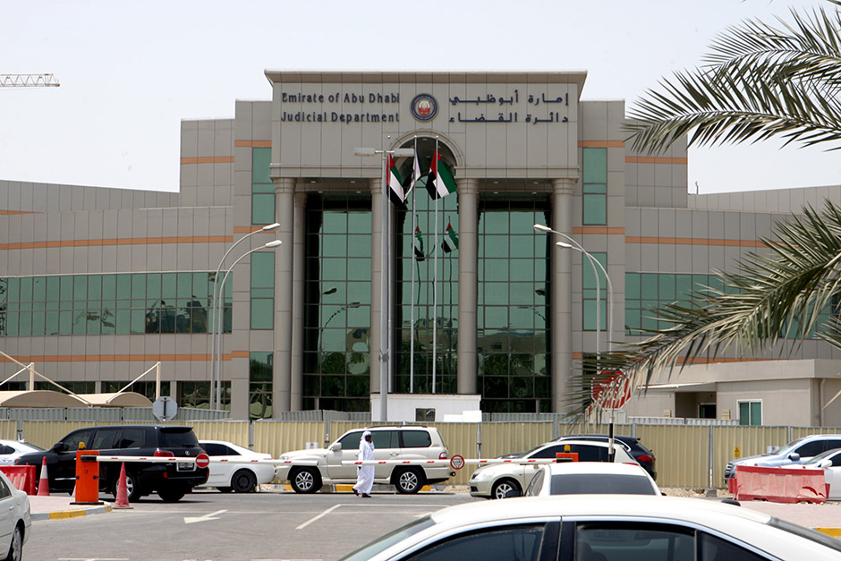
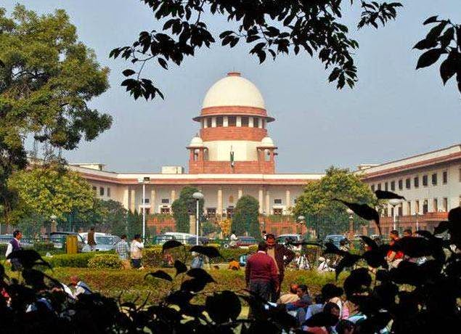
There are many examples of Shari'a courts operating around the world
SAUDI ARABIA
IRAN

Slide 21
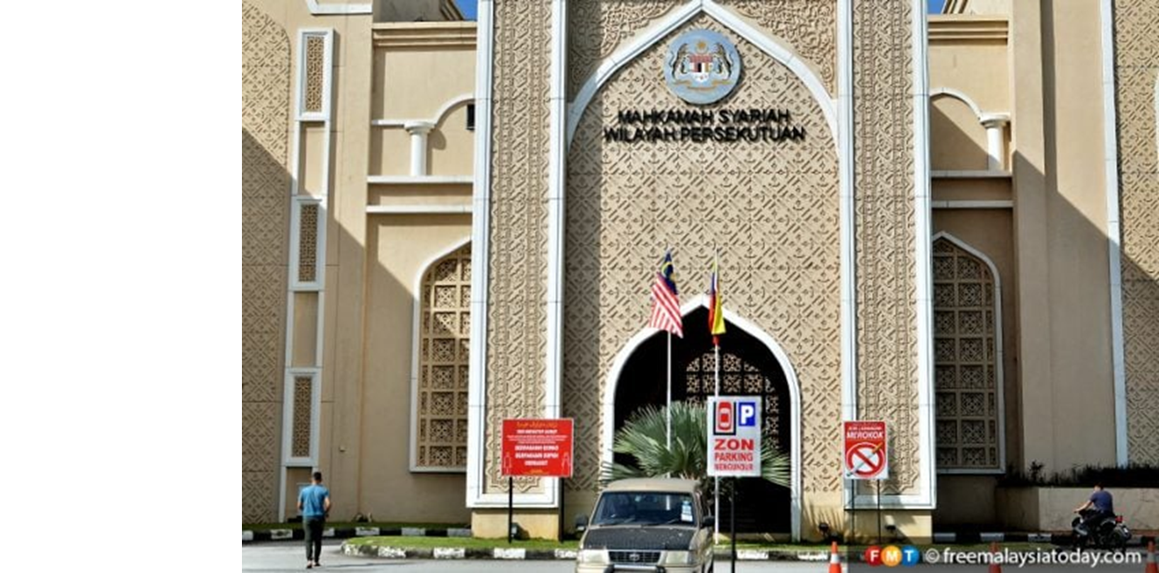
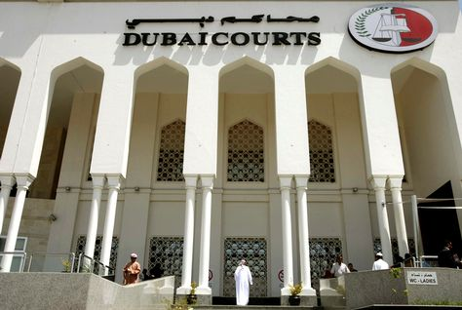
Malaysia
United Arab Emirates

Slide 22
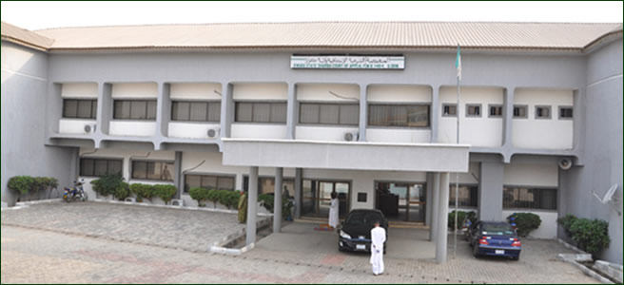
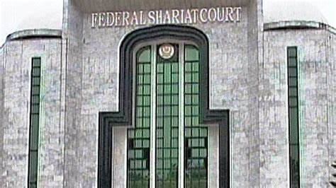
Nigeria
Pakistan

Slide 23
Court of Appeals
(Hukuman ng Paghahabol ng Pilipinas)

Slide 24
Court of Appeals (Hukuman ng Paghahabol ng Pilipinas)
Is the Philippines' second-highest judicial court, just after the Supreme Court.
This was established under batas pambansa bilang 129 known as " The Judiciary Reorganization Act. Of 1980"
The court is composed of one presiding justice and sixty eight associate justice. They are all appointed by the president.
It operates in twenty three division each comprising of three members.
The Court may sit en banc for the purpose of exercising administrative, ceremonial or other non-adjudicatory functions.

Slide 25
The Court of Appeals shall have the power to try cases and conduct hearings, receive evidence and perform any and all acts necessary to resolve factual issues raised in
cases falling within its original jurisdiction, such as actions for annulment of judgments of RTCs,
cases falling within its appellate jurisdiction where a motion for new trial based only on newly discovered evidence is granted by it. The CA has the power to grant and conduct new trials or further proceedings. (As amended by RA No. 7902, February 23, 1995.)

Slide 26
Sandiganbayan (SB)

Slide 27
The Sandiganbayan (SB) tries and decides criminal and civil cases against government officials and employees accused of graft and corruption and similar other offenses. In republic act no. 3019, The Batasang Pambansa shall create a special court, to be known as Sandiganbayan, which shall have jurisdiction over criminal and civil cases involving graft and corrupt practices and such other offenses committed by public officers and employees, including those in government-owned or controlled corporations, in relation to their office as may be determined by law.

Slide 28
The Court of Tax Appeals

Slide 29
The Court of Tax Appeals was originally created by virtue of Republic Act. No. 1125 (R.A.1125) which was enacted on June 16, 1954, composed of three (3) Judges with Mariano B. Nable as the first Presiding Judge.
With the passage of Republic Act Number 9282 (R.A. 9282) on April 23, 2004, the CTA became an appellate Court, equal in rank to the Court of Appeals. Under Section 1 of the new law, the Court is headed by a Presiding Justice and assisted by five (5) Associate Justices.

Slide 30
They shall have the same qualifications, rank, category, salary, emoluments and other privileges, be subject to the same inhibitions and disqualifications and enjoy the same retirement and other benefits as those provided for under existing laws for the Presiding Justice and Associate Justices of the Court of Appeals. A decision of a division of the CTA may be appealed to the CTA En Banc, and the latter's decision may further be appealed by verified petition for certiorari to the Supreme Court.
Enter

Slide 31
On June 12, 2008, Republic Act Number 9503 (R.A. 9503) was enacted and took effect on July 5, 2008. This enlarged the organizational structure of the CTA by creating a Third Division and providing for three additional justices. Hence, the CTA is now composed of one Presiding Justice and eight Associate Justices. The CTA may sit en banc or in three divisions with each division consisting of three justices. The CTA, as one of the courts comprising the Philippine Judiciary, is under the supervision of the Supreme Court of the Philippines.

Slide 32
The Supreme Court colloquially referred to as the Korte Suprema is the highest court in the Philippines.Under the Constitution, the Supreme Court shall be composed of a Chief Justice and fourteen Associate Justices.It may sit en banc or, in its discretion, in divisions of three, five, or seven members. (Art. VIII, §4) Its members shall be appointed by the President from a list of at least three nominees prepared by the Judicial and Bar Council for every vacancy, without need of confirmation by the Commission on Appointments. (Art. VIII, §9)Under Article VIII, §1 of the Constitution, the judicial power shall be vested in one Supreme Court and in such lower courts as may be provided by law.

Slide 33
This power includes the duty to settle actual controversies involving rights that are legally demandable and enforceable and to determine if any branch or instrumentality of government has acted with grave abuse of discretion amounting to lack of excess of jurisdiction.The Supreme Court has both original and appellate jurisdiction. It exercises original jurisdiction (cases are directly filed with the SC in the first instance without passing through any of the lower courts) over cases affecting ambassadors, other public ministers and consuls, and over petitions for certiorari, prohibition, mandamus, quo warranto, and habeas corpus.

Slide 34
(Art. VIII, §5(1)). It also has original jurisdiction over writs of amparo, habeas data and the environmental writ of kalikasan. On the other hand, the SC has appellate jurisdiction to review, revise, reverse, modify, or affirm final judgments, and orders of the lower courts in: a) All cases in which the constitutionality or validity of any treaty, international or executive agreement, law, presidential decree, proclamation, order, instruction, ordinance, or regulation is in question.

Slide 35
(b) All cases involving the legality of any tax, impost, assessment, or toll, or any penalty imposed in relation thereto.
(c) All cases in which the jurisdiction of any lower court is in issue.
(d) All criminal cases in which the penalty imposed is reclusion perpetua or higher.
(e) All cases in which only an error or question of law is involved. (Art. VIII, §5(1), (2))

Slide 36
The Supreme Court has the power to promulgate rules concerning the protection and enforcement of constitutional rights, pleading, practice, and procedure in all courts, the admission to the practice of law, the integrated bar, and legal assistance to the underprivileged.

Slide 37
Quasi-courts/quasi-judicial agencies

Slide 38
Quasi-judicial agencies in the Philippines are government bodies that have the power to make decisions and rulings that affect the rights and interests of individuals or organizations,
The decisions and rulings of quasi-judicial agencies are generally subject to review by the courts, and individuals or organizations who are aggrieved by their decisions may appeal to higher authorities or file a case in court.

Slide 39
Examples of quasi-judicial agencies in the Philippines include :
Securities and Exchange Commission (SEC), which regulates the securities industry and resolves disputes between investors and companies;
National Labor Relations Commission (NLRC), which adjudicates labor disputes and cases involving employer-employee relations;
Land Transportation Franchising and Regulatory Board (LTFRB), which regulates and oversees the public transportation industry.

Slide 40
Other Judicial Procedure
Presidential Decree No. 1508, also known as the Katarungang Pambarangay Law, is a law in the Philippines that established the Barangay Justice System. It was signed into law by President Ferdinand Marcos on June 11, 1978.
The Katarungang Pambarangay Law aims to promote speedy, impartial, and inexpensive resolution of disputes at the barangay level, which is the smallest administrative division in the Philippines. It encourages the use of alternative dispute resolution mechanisms, such as mediation and conciliation, to resolve disputes before they escalate to formal court proceedings.

Slide 41
Under the law, the Punong Barangay (Barangay Captain) and members of the Lupong Tagapamayapa (Barangay Justice Council) are authorized to mediate and conciliate disputes between parties within the barangay. If a settlement is reached, a written agreement called a “Pangkat ng Katuwang na Pag-aayos” (Agreement for Assistance in Settlement) is executed by the parties and signed by the members of the Barangay Justice Council.

