Slide 1
BigData
Faiz ul haque Zeya
MS CS University of Tulsa,OK,USA

Slide 2
Topics covered
1. Introduction
2.Bigdata: how big it is
3.Bigdata Technology.
4. Few examples of Big Data.
5. Airline reservation system
6. Google Translate.
7.Amazon recommendation.
8. Netflix recommendation.
9. Hadoop, Map reduce.
10. Q&A.

Slide 3
Introduction
Large set of data. Site of peta byte, exa byte.
Not stored relational.
Massive scale computational.
NO SQL queries.
New technology like MAP REDUCE,HADOOP.
Reason: Scalability and poor performance on large scale.

Slide 4
How large it is
Peta byte 10^15 Exabyte 10^ 18
Zetta byte 10^21
Google processed about 24 petabytes of data per day in 2009.[
Yahoo stores 2 petabytes of data on behavior.
eBay.com uses two data warehouses at 7.5 petabytes and 40PB as well as a 40PB Hadoop cluster for search, consumer recommendations, and merchandising.

Slide 5
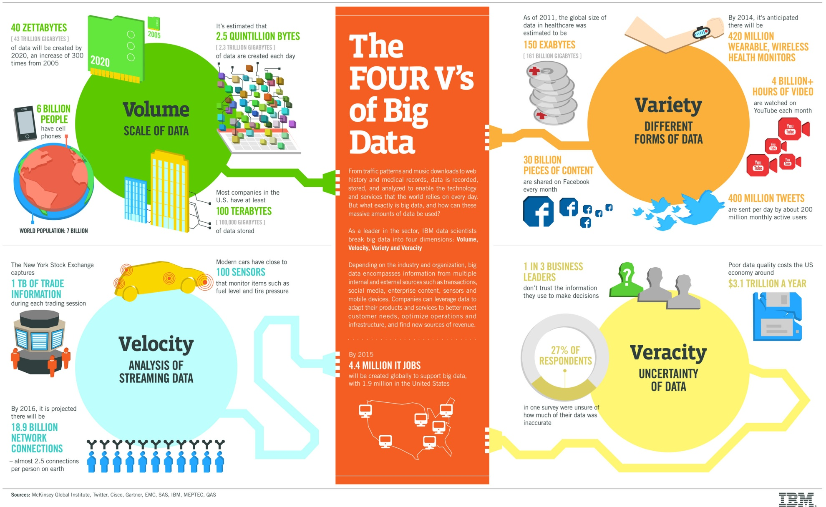

Slide 6
BigData Technologies
Relational database,SQL queries cannot handle such amount of data.
Therefore other technologies are requried
MAP REDUCE parallel computation.

Slide 7
Few examples of Big Data
Airplane reservation system.
Google Translate.
Netflix Movie recommendation
Amazon Book recommendation

Slide 8
Airline reservation system
Oren Etzioni of Washington ‘s venture capital based startup Farecast.
It predicts based on past data whether airline prices will go up or down.
Etzioni uses predictive model for that.
Microsoft purchase it for 110 M $
Make it part of BING search engine.

Slide 9
GOOGLE Translate
Whole internet as training data.Corpus
Google release Trillion word corpus in 2009.
They accept messy data.
Candide uses 3 million translated sentences.
Google uses billions of pages from intenet.

Slide 10
Netflix Million $ prize
Netflix announced to award 1M$ prize for the team who improves the recommendation algorithm by 5%.
They are movie recommender.
Most of the sales are due to recommendations from the site.
Reason is that so many shows that the user don’t even know.

Slide 11
Amazon’s recommendation
Amazon uses item to item recommendation instead of traditional collaborative recommendation.
Item to item recommendation search for similar items rather than similar users.
This approach is scalable to large data set.

Slide 12
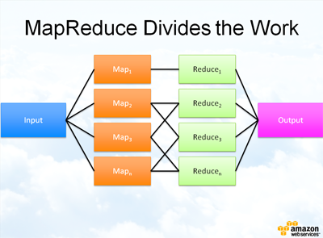
Map Reduce

Slide 13
Q&A

