Slide 1
Query expansion for search improvement
Faiz ul haque Zeya
ASSociate PROFESSOR BAHRIA University
Ceo Transys

Slide 2
Agenda
Introduction of the problem
Product review
Literature review
Our approach
Results
Conclusion
Question and answer

Slide 3
Introduction
This research is about a novel concept which is to improve search by adding supplementary keywords to the original query.

Slide 4
Problem statement
The problem is called word mismatch problem
When the word used by author in concept is different from that used by the used by the user.
AI computational rationality
Nano technology molecular level computation

Slide 5
Google query expansion
Stemming, acronyms, misspelling, synonyms.
Aristot to aristotle.
Internet connexion to internet connection
Suggestion for autocompletion.

Slide 6
Product overview
Google search appliance.
Google search appliance is the box shipped by Google that can be used for intranet and website search of the intranet.
Query expansion synonyms file.

Slide 7
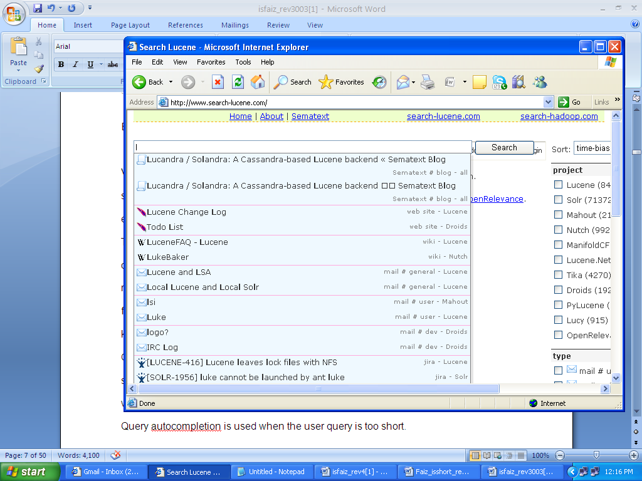
Lucene

Slide 8
Literature review
Bodo Billerbeck
Approach used by Billerbeck is to use past queries from logs to find the keywords.
Chou
Chou assumes that the term will be informative or is more likely to be the candidate of query expansion if it appears in pseudo relevant document set more often.

Slide 9
Chou’s approach
First pass is to get documents from query and uses them to find expansion term
This approach is Local analysis.
Another approach in global analysis which uses whole corpus

Slide 10
Implementation
prob_doc[doc,term] = count of term / count_per_doc[doc];
prob_total[doc,term] = count of term / total_corpus;
weightofterm[doc,term]= prob_doc[doc,term]*Math.Log(prob_doc[doc,term]/prob_total[doc,term1])/Math.Log(2);

Slide 11
My approach
Local analysis based search. Retrieval of pseudo relevant documents.
Calculation of probabilities.
Selection of expansion terms from
Title or Description
Selection of synsets from Wordnet
Selection of terms from history
Combination of three to get expanded query
FLOW CHART OF THE PROCESS

Slide 12
Experiment details
Experiments with description and title were conducted .
sum_weight = factor * sum_weight / countofterms;
Experiments with different factors.
if (weightofterm[doc,term] > sum_weight)
query_terms = query_terms + " " + term[doc,term];

Slide 13
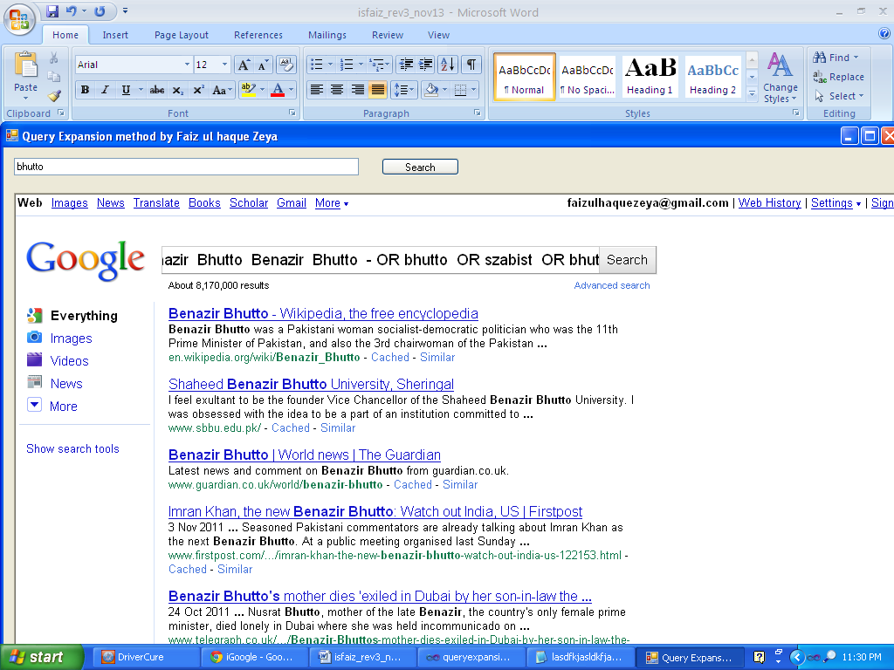
Results

Slide 14
Results
Few terms of experiment
SZABIST
Faiz ul haque Zeya
Information technology
Computer science

Slide 15
Results
Chou with history gives better result.
SZABIST first and then Bhutto returns Szabist

Slide 16
Conclusion
There are three items needs consideration and these are:
The wrights are adjusted for the query. Chou also experimented with many factors and discussed all of them in the result. Their precision is given for many values of factor. This research found out that value of factor should be selected differently for different number of elements of query and this should be learnt from large data sets and is proposed as future work.
The ratio with and without log is selected and experimented and it is found out that with ratio the terms are not getting much weight age than required and without ratio more terms are coming in result.
The good functions for similarity measurements are required and are proposed as future work.
Software agent, human computer interaction based approach with interaction Is suggested to be used in this research.

Slide 17
Possible applications
Context based searching while writing a document
Software agents with user modeling.
Proactive search

Slide 18
References:
[1] Bodo Billerbeck and Justin Zobel. Techniques for Efficient query expansion.
[2] Robertson, S.E., Spärck Jones, K. (1976), "Relevance weighting of search terms", Journal of the American Society for Information Science, Vol. 27 No.3, pp.129-46.
[3] Rocchio, J. (1971), Relevance feedback in information retrieval, in Salton, G. (Eds),The SMART Retrieval System – Experiments in Automatic Document Processing, Prentice-Hall, Englewood Cliffs, NJ, pp.313-23.\
[4] Shihchiech Chou and Chinyi Cheng. A ranking algorithm for query expansion based on the terms ‘s appearing based on the term’s appearing in probability in the single document. Online Information Review, Vol 35. No2. 2011.
[5] Xu, J (1996), Query expansion using local and global document analysis, Proceedings of the 19th Annual International ACM SIGIR Conference on Research and Development in Information Retrieval, Zurich, ACM Press, New York, NY, pp.4-11.
[6] ZHeng Ye, Xiangi Huang and Honfei Lin. A Bayesian Network approach to Context Sensitive Query . Expansion SAC 11, TaiChaung , Taiwan
[7] Ziyang Liu , Sivaramakrishnan Natarajan, Yi Chen. Query Expansion based on Clustered Results.. Proceeding of the VLDB Endowment, Vol 5. No 6 2011.
[8] ZIv Bar – Yossef ,Naama Kraus Context sensitive query auto completion. WWW-2011.
[9].Global search appliance http://www.google.com/enterprise/search/gsa.html
[10] Lucene project http://lucene.apache.org/java/docs/index.html

Slide 19
Question and answers

Slide 20
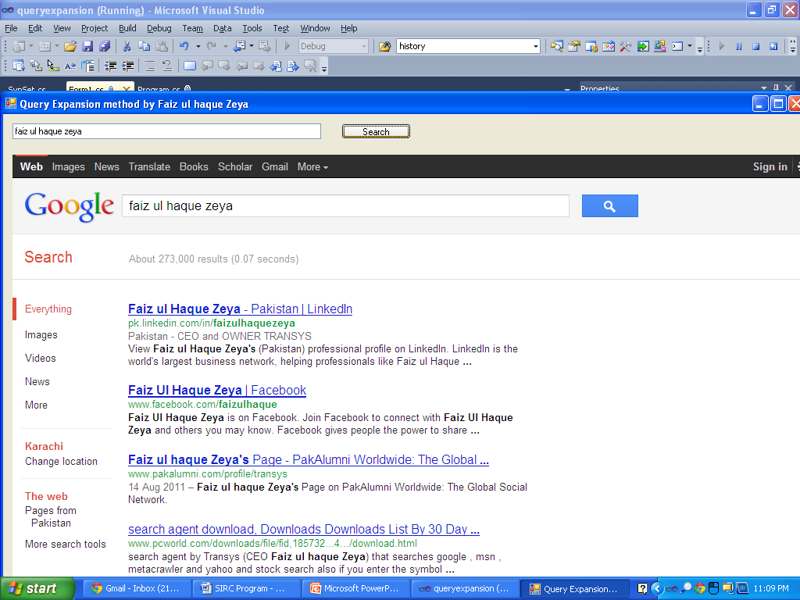
faiz ul haque zeya only google

Slide 21
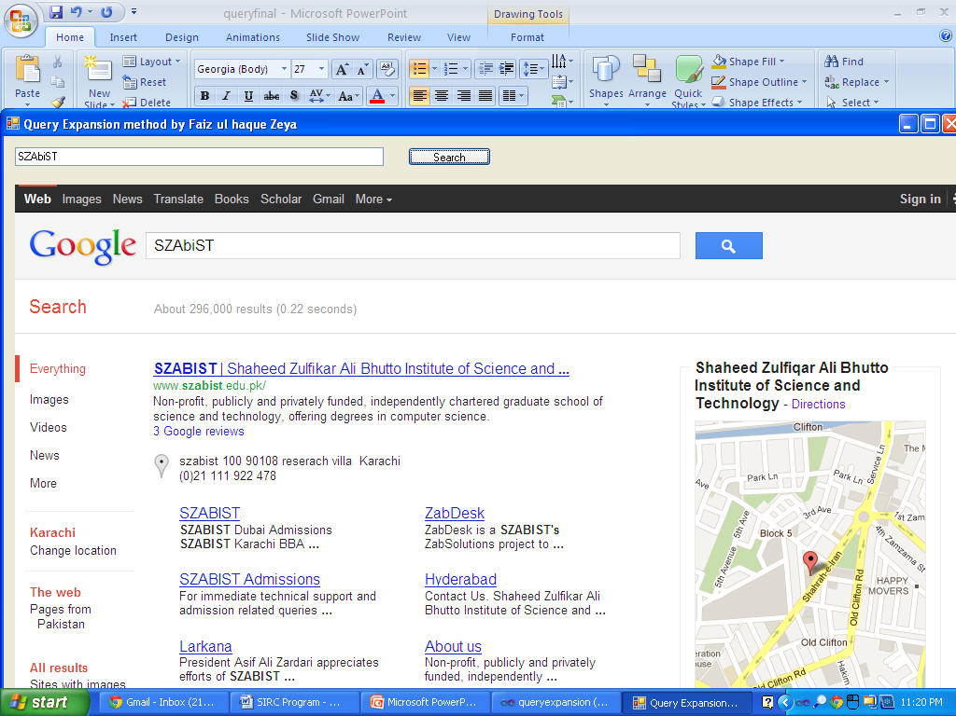
Szabist only google

Slide 22
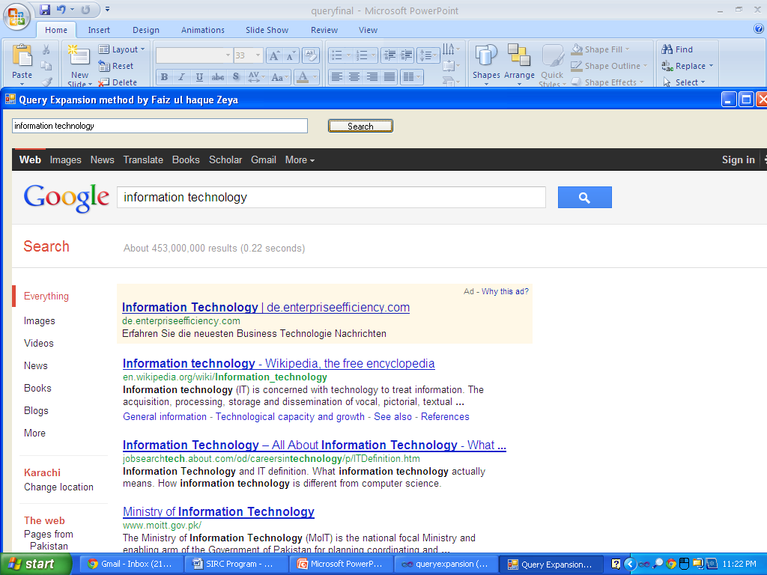
information technology only google

Slide 23
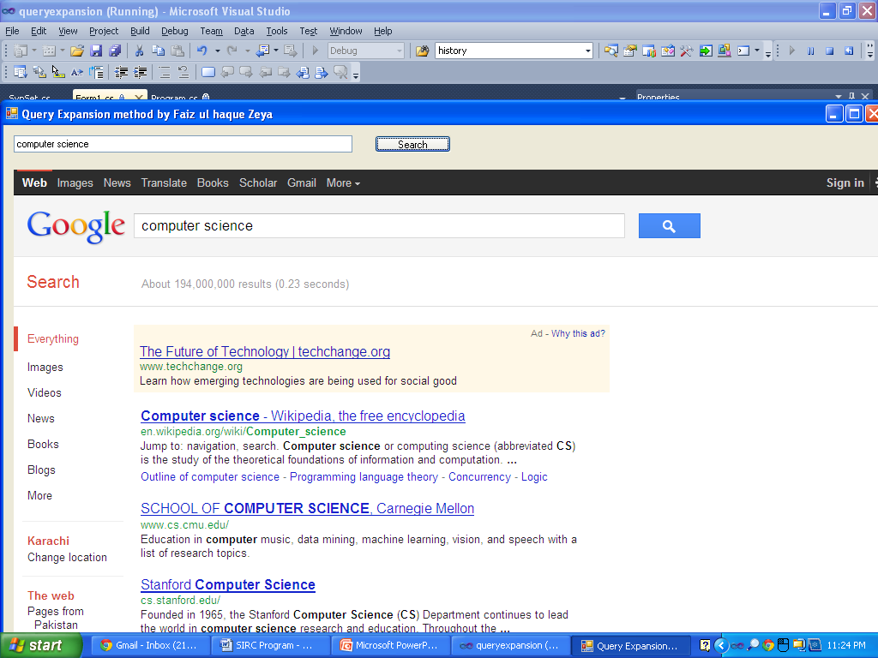
computer science only google

Slide 24
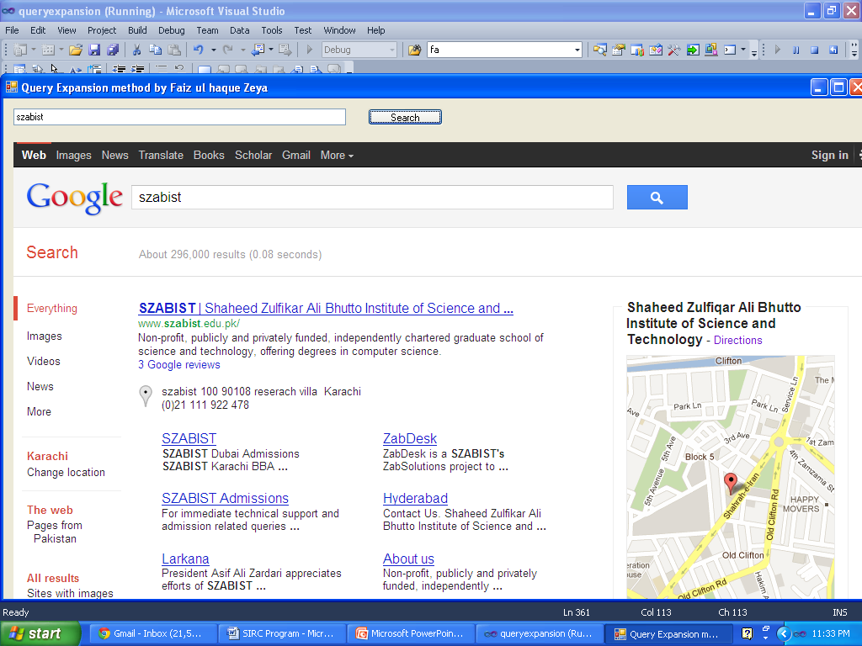
Szabist synsets

Slide 25
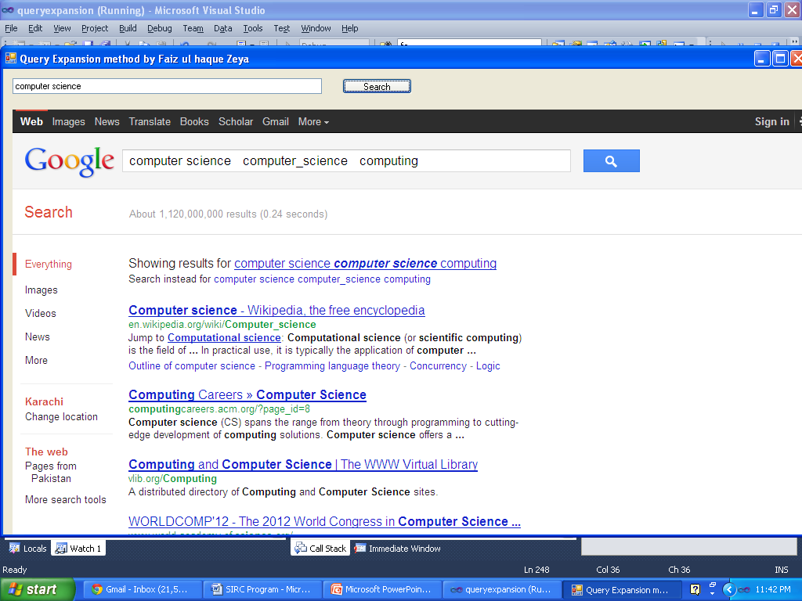
Computer sceince synsets

Slide 26
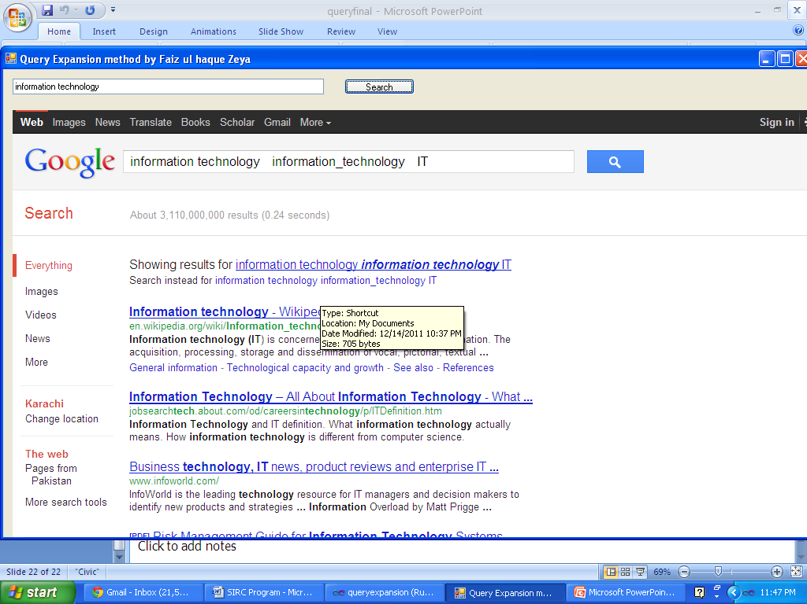
Information technology synsets

Slide 27
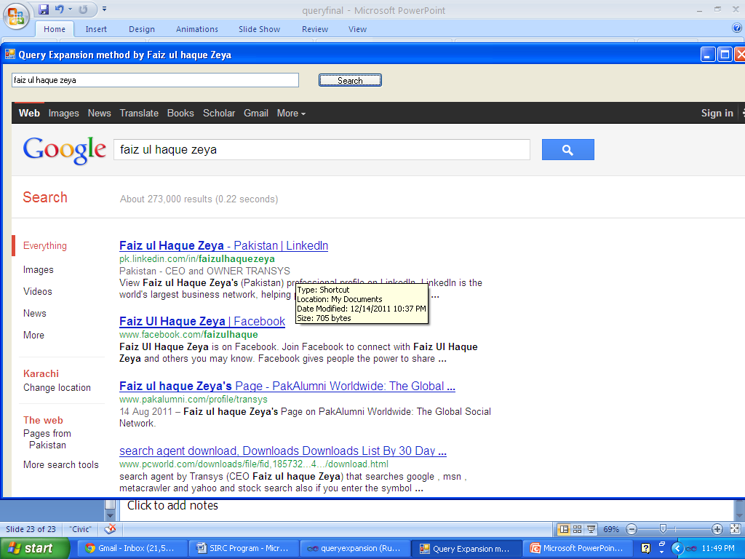
Faiz ul haque Zeya synsets

Slide 28
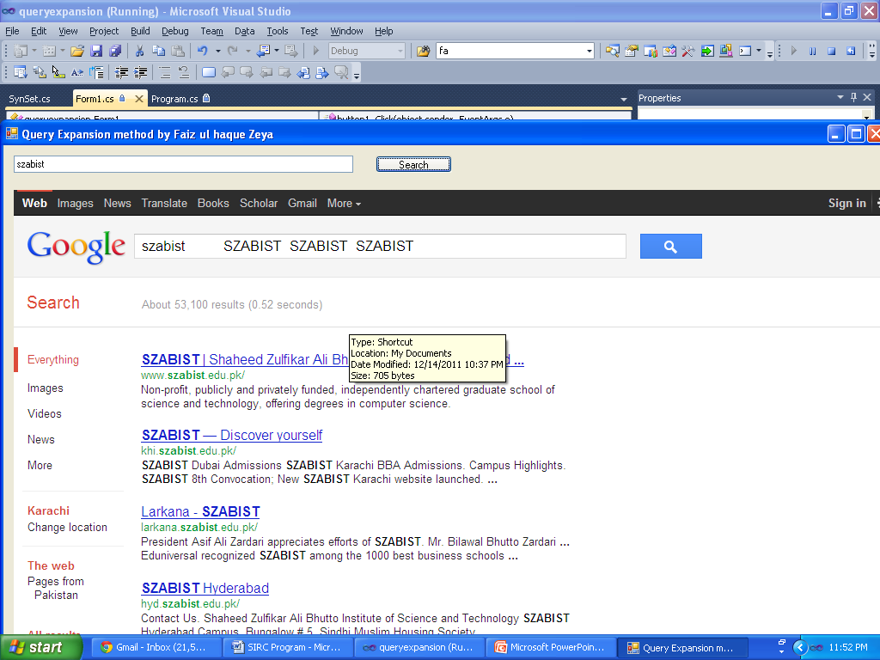
Szabist with synsets and chou

Slide 29
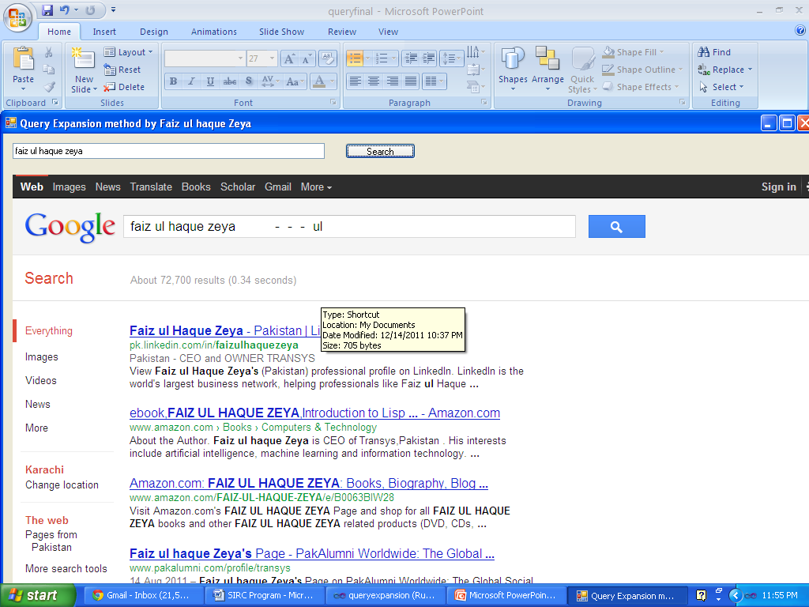
Faiz ul haque zeya with synsets and chou factor =1

Slide 30
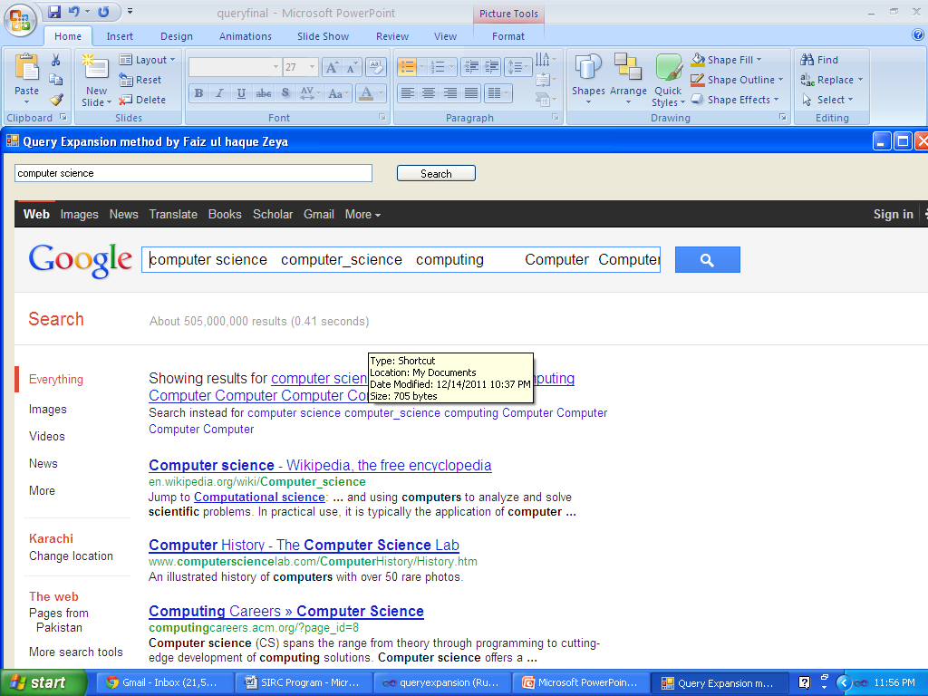
Computer science with synset,chou factor=1

Slide 31
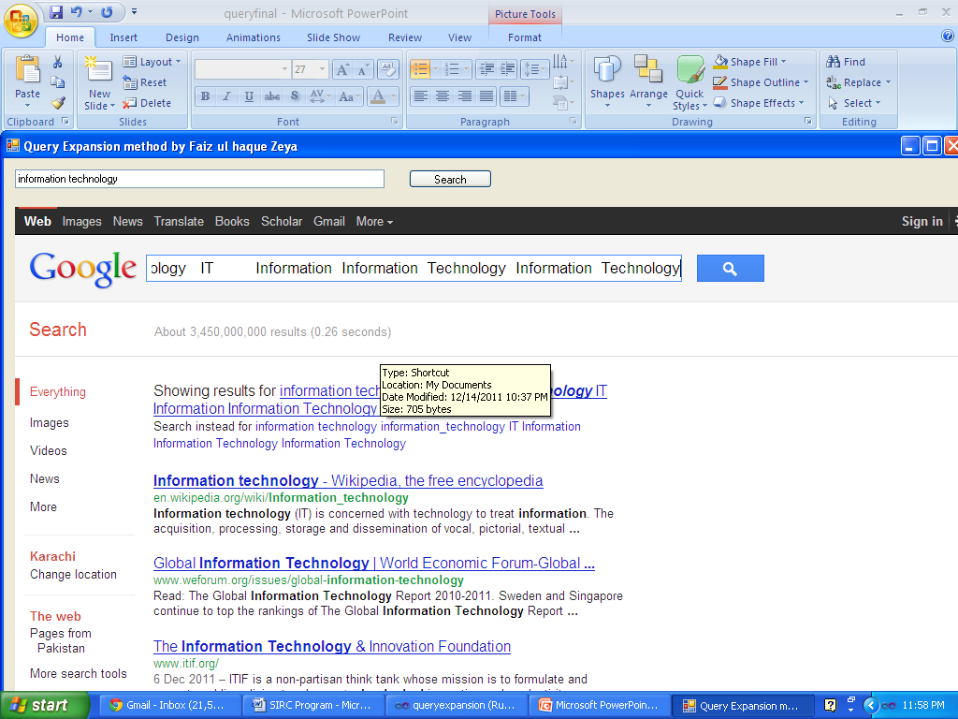
Information technology with chou,synset factor=1

Slide 32
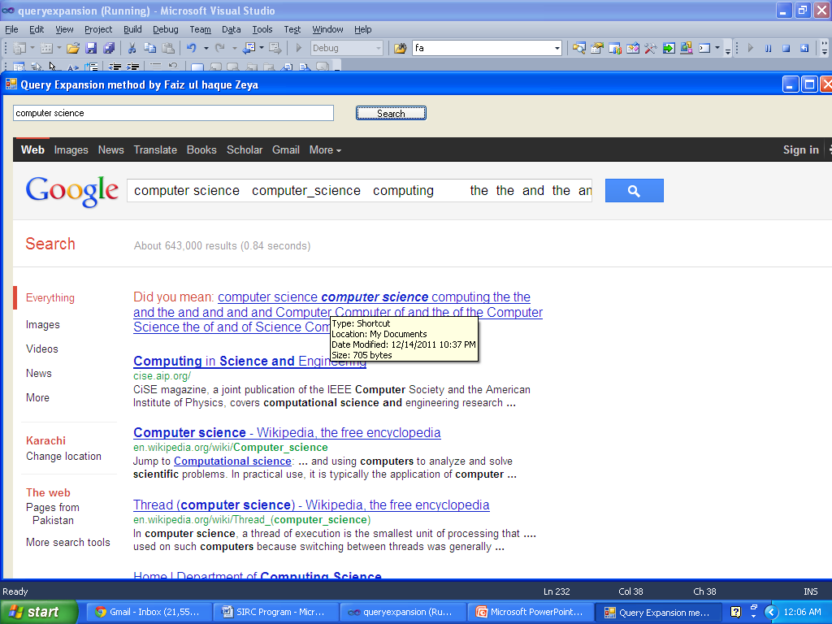
Description computer science

Slide 33
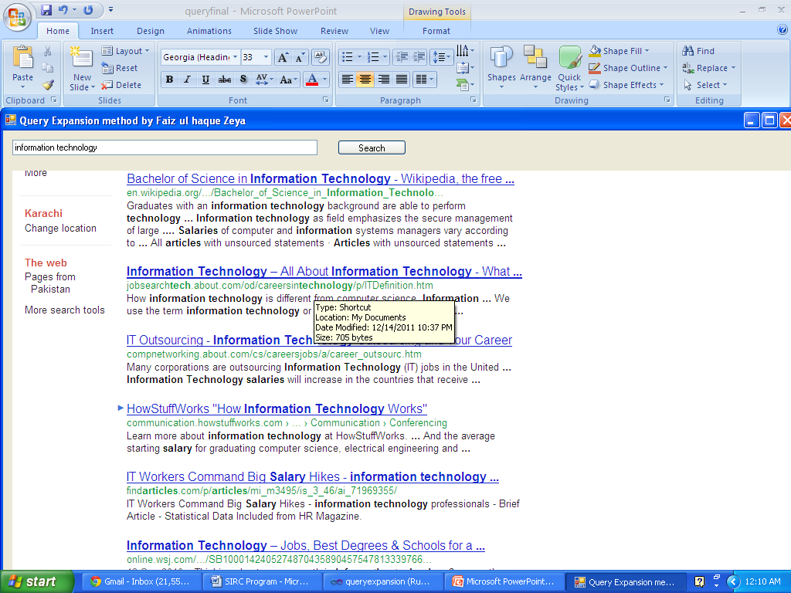
Description information technology

