Slide 1
Scriptable Sensor Network

Slide 2
Outline
Project Background
Basic Idea
Application Architecture

Slide 3
Background
We are implementing a scriptable sensor network which can add more scripts to the sensor network after the deployment of the sensor application.
The SunSpot node works a service provider.

Slide 4
We do not know what applications we need in the future. We might need to install new applications later on.
We can not bear the tedious work of collecting thousands of SunSPOTs from all locations to upgrade the application.

Slide 5
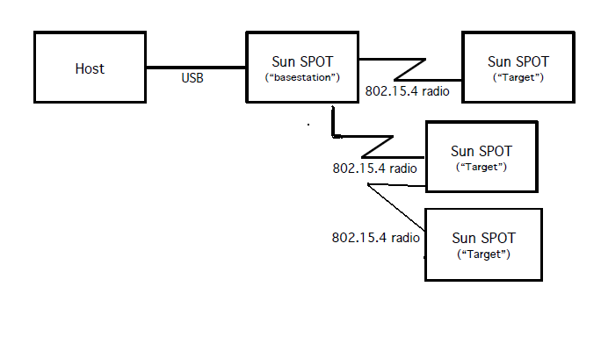
The basestation in our experiment runs in shared mode.
Host can send the message to the sensor network via the basestation and collect the response from the sensor network also via the basestation.

Slide 7


Message format:
Message example: install an application
Message example: run an application

Slide 8
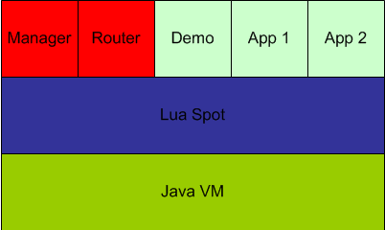
Architecture

Slide 9
Service Provider
Sensor network as a service provider
Messages are function calls (RPC)
Bootstrapped by dispatch() function
Execution is stateless and isolated
Persistent memory storage is provided

Slide 10
dispatch(sender, message)
Create new Lua VM for each invocation
Select correct application
Invoke the requested function
Lua VM is destroyed after the function returns

Slide 11
Lua API
SunSpotLib
  Access SunSPOT functions: sensors, leds, sleep, ...
LuaSpotLib
  Persistent memory, send(), ...

Slide 12
Application Manager
Install and remove application
Install function accepts fragmented data
c manager install name index fragments data

Slide 13
Routing
Implemented as a Lua Application
Contains nested message that will be dispatch()-ed
Parameters:
id hop src dst message
c router route id hop src dst c app func param a b c

Slide 14
Limitation
Memory handling
Application compilation (?)
Need better routing algorithm

Slide 15
Future works

