Slide 1

MRP Trends & Product Analytics
A comprehensive Power BI Dashboard Overview that analyzes product pricing trends, category performance, and outlet distribution across various product types in the retail sector.
This presentation will guide you through our data analysis findings, highlighting key metrics and providing actionable insights to optimize your retail strategy and maximize profitability.
by Fajar Aqdhas

Slide 2

Project Overview
Our analysis focuses on product pricing trends (MRP), category performance, and outlet distribution across various product types using Power BI. This dashboard provides a comprehensive view of how different products perform across outlets and categories.
The data source includes detailed retail item information covering item types, MRP (Maximum Retail Price), fat content classifications, and various outlet characteristics. This rich dataset allows us to identify patterns and opportunities for optimization.
Pricing Analysis
Category Performance
Examining MRP trends across different product categories and outlets to identify pricing optimization opportunities.
Evaluating how different product types contribute to overall sales and pricing strategies.
Outlet Distribution
Analyzing how products are distributed across various outlet types and their respective performance.

Slide 3
Key Metrics
Our dashboard highlights three essential KPIs that provide a snapshot of our retail data. With an average MRP of ₹264.09 across all products, we can see that pricing falls within a moderate range for the retail sector.
The item count breakdown reveals an interesting pattern: Low Fat items significantly outnumber Regular items by nearly 2:1, with 250 Low Fat items compared to 137 Regular items. This indicates a strong market presence of healthier alternatives in our product mix.
₹264.09
137
250
Average MRP
Regular Items
Low Fat Items
Moderate pricing across all products
Standard fat content products
Healthier alternatives dominate the dataset

Slide 4
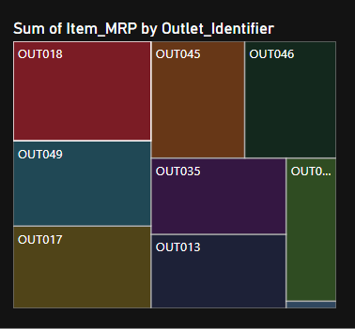
MRP Contribution by Outlet
The treemap visualization reveals significant variations in how different outlets contribute to the overall MRP. Certain outlets stand out as major contributors, particularly OUT018 and OUT045, which account for a disproportionately large share of the total MRP.
This uneven distribution suggests that some outlets may be carrying higher-priced items or a larger volume of products. Understanding these patterns can help optimize inventory allocation and pricing strategies across the retail network.

Slide 5
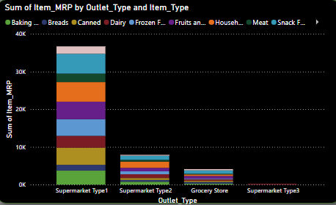
MRP Breakdown by Outlet Type & Category
Our stacked column visualization breaks down MRP contributions by both outlet type and item category. Supermarket Type1 clearly dominates with the widest category distribution and highest overall MRP contribution among all outlet types.
This outlet type carries a diverse range of products across multiple categories, suggesting it serves as a comprehensive shopping destination. Other outlet types show more specialized category focus, which may indicate targeted market positioning or space constraints.

Slide 6
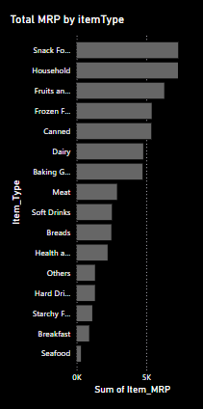




Total MRP by Item Type
The horizontal bar chart reveals the MRP contribution by item type, highlighting which categories drive the most value. Snack Foods emerge as the clear leader, followed closely by Household products and Fruits & Vegetables.
This visualization helps identify high-value categories that should receive priority in marketing efforts and shelf space allocation. The significant gap between top and bottom contributors suggests opportunities for category management optimization.
Snack Foods
Highest MRP contributor overall
Household
Second highest contributor
Fruits & Vegetables
Strong third-place category
Breads & Cereals
Moderate MRP contribution

Slide 7
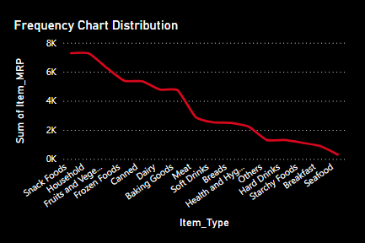
MRP Distribution by Category
The line chart illustrates the frequency distribution of MRP across different product categories. We observe a clear declining pattern from high to low MRP contributors, with a steep drop-off after the top few categories.
This distribution pattern suggests a Pareto-like effect where a small number of categories account for a large portion of the total MRP. Understanding this distribution helps in prioritizing inventory management and promotional activities for maximum impact.

Slide 8








Fat Content Distribution by Outlet
The 100% stacked column chart reveals how Regular and Low Fat items contribute to MRP across different outlets. Despite Low Fat items being more numerous in the dataset, Regular items actually command a higher MRP share in most outlet types.
This suggests that while health-conscious options are widely available, traditional Regular fat products still drive significant value. The variation across outlets indicates different customer preferences or purchasing patterns depending on location and outlet type.
Grocery Store
Higher proportion of Regular fat items by MRP
Supermarket Type3
Premium pricing on Regular fat items
Supermarket Type1
Balanced distribution between Regular and Low Fat items
Supermarket Type2
Growing share of Low Fat items

Slide 9




Summary of Insights
Our analysis has revealed several key insights about product pricing and distribution across outlets. Snack Foods and Household items consistently lead in pricing contribution, indicating their importance to overall revenue generation.
Supermarket Type1 stands out as the most profitable outlet type with the widest category distribution. We've also observed that Regular and Low Fat items vary significantly in pricing impact by outlet, suggesting targeted marketing opportunities.
Category Leaders
Outlet Performance
Snack Foods and Household items lead in pricing contribution across most outlets.
Supermarket Type1 is the most profitable outlet type with the widest category distribution.
Fat Content Impact
Key Outlets
Regular and Low Fat items vary in pricing impact by outlet, with Regular items often commanding higher prices.
Outlets OUT018 and OUT045 drive a significant share of pricing, suggesting strategic importance.

Slide 10
Recommendations
Based on our analysis, we recommend focusing marketing and promotional efforts on high MRP categories like Snack Foods and Household items to maximize revenue potential. Underperforming outlets with low MRP contribution should be re-evaluated for potential improvements.
Fat content pricing strategy should be tailored by outlet type, recognizing the different value contributions of Regular versus Low Fat items across locations. Finally, expanding top-performing categories into more outlets could drive additional revenue growth.
Expand Top Categories
Tailor Fat Content Strategy
Introduce successful high-MRP categories to additional outlets to drive growth and increase overall revenue contribution.
Address Underperforming Outlets
Optimize Category Focus
Develop outlet-specific pricing and promotion strategies for Regular and Low Fat items based on their performance in each location.
Focus marketing and promotions on high MRP categories like Snack Foods and Household items to maximize revenue potential.
Re-evaluate outlets with low MRP contribution to identify improvement opportunities through product mix adjustments or targeted promotions.

Slide 11
Conclusion
Thank you for your Time
I hope this presentation was helpful.
Thank you for your time. We hope you found the presentation informative.
To summarize, we covered the main points. We want to express our appreciation to the audience. Consider this a call to action to learn more.
Contact:
Fajar Aqdhas
fajarqdhas@gmail.com
Ph:8891220599
By Fajar Aqdhas

