Slide 1

COFFEE SALES ANALYSIS-
SQL + DASBOARD insights
Fatolu Adedoyin Juliana

Slide 2
Project Objective & Scope Objective:
Objective:
Understand sales trends, top products, and demand by time/day.
Show the ability to perform the analysis both in Excel (dashboard) and SQL (queries).
Fatolu Adedoyin Juliana

Slide 3
Approach
Step 1: Excel Dashboard
  Built an interactive dashboard using Pivot Tables, Slicers, and Charts.
  Showed KPIs, sales trends, top products, weekday and time-of-day patterns.
Step 2: SQL Analysis
  Replicated the same metrics and breakdowns with SQL queries.
  Created queries for KPIs, weekday sales, monthly sales, and top products.
Fatolu Adedoyin Juliana

Slide 4
Data & SQL Approach
Created a Database Coffee
Created table coffee_sales and imported source data.
Validated data types (dates, numeric), handled nulls/outliers.
Built KPI queries (sales, orders, AUP, units) + segment queries (weekday, hour, product type).
Aggregated monthly & daily trends for dashboard.
Fatolu Adedoyin Juliana

Slide 5
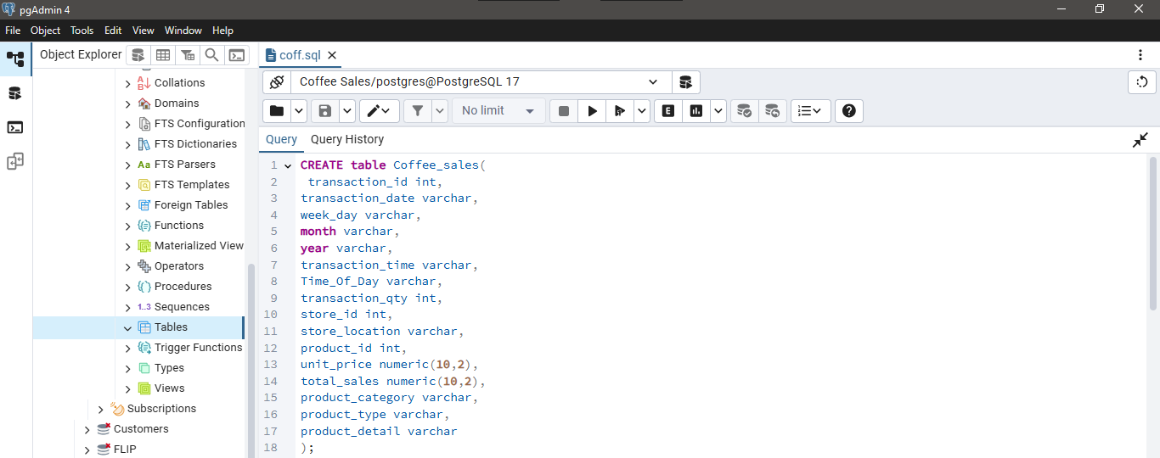
Creating a Table called “coffee_sales”
Fatolu Adedoyin Juliana

Slide 6
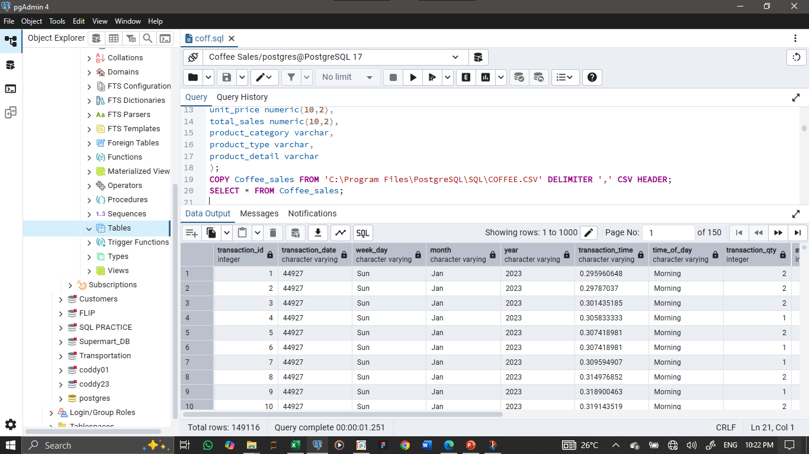
Data Importation and Calling
Using the “COPY and SELECT statement”
Fatolu Adedoyin Juliana

Slide 7
KPI Summary (Metric Cards)
Total Sales – Overall revenue across the dataset.
Total Orders – Number of orders processed.
Avg. Unit Price – Revenue ÷ Units Sold.
Total Units Sold – Quantity sold.
SQL Note:
These were generated in SQL with SUM(), COUNT(), and AVG() queries.
Fatolu Adedoyin Juliana

Slide 8
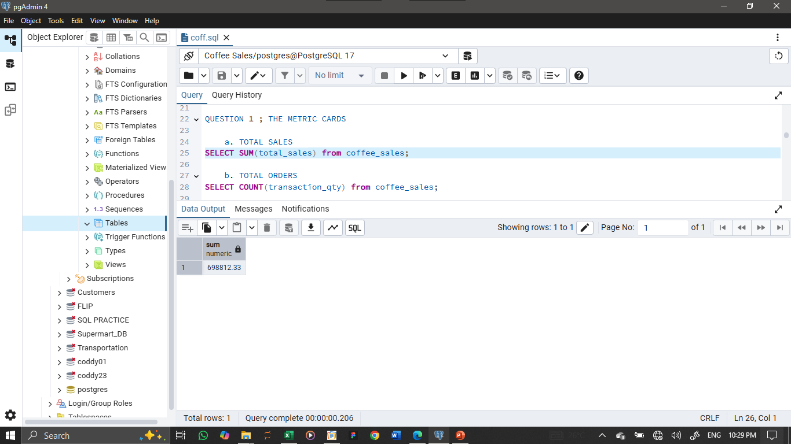
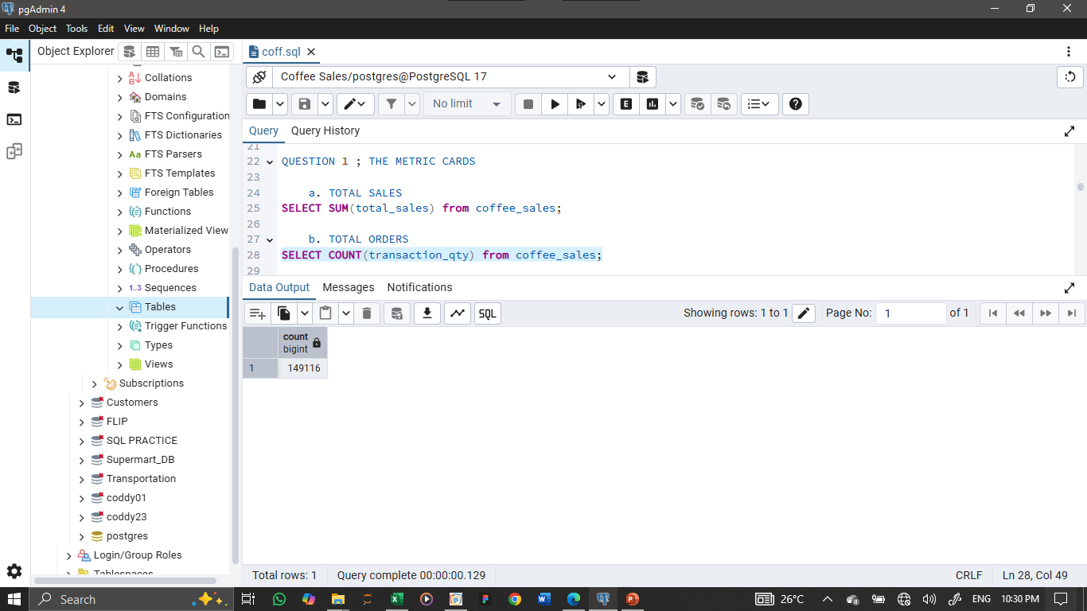
TOTAL SALES &TOTAL ORDERS
Total Sales: The business generated ₦ 698812.33 in total sales during the period,
showing strong revenue performance.
Total Orders: A total of 149116 orders were placed, highlighting customer demand and transaction volume.
Fatolu Adedoyin Juliana

Slide 9
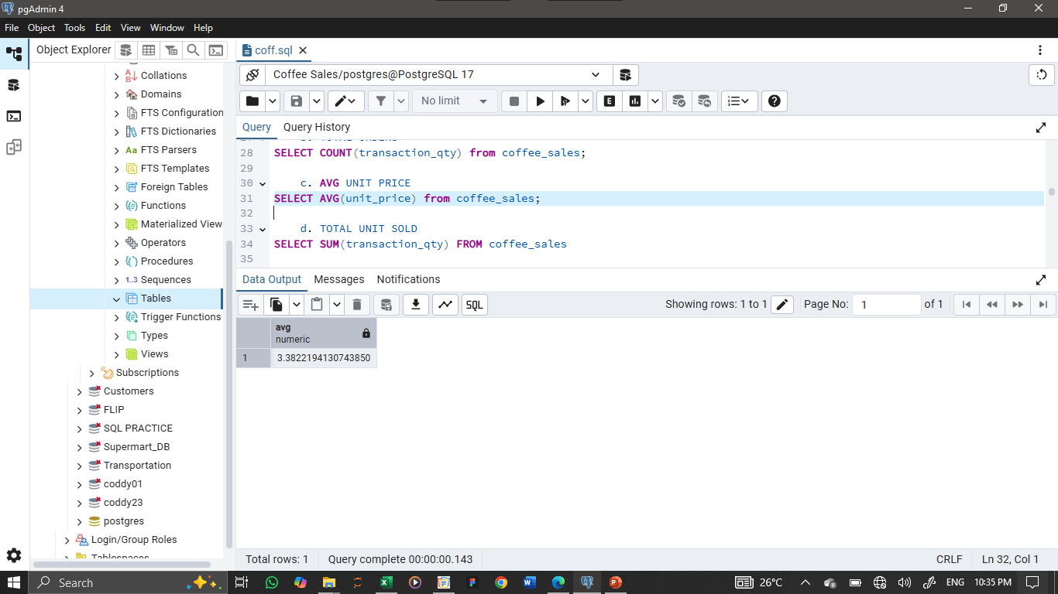
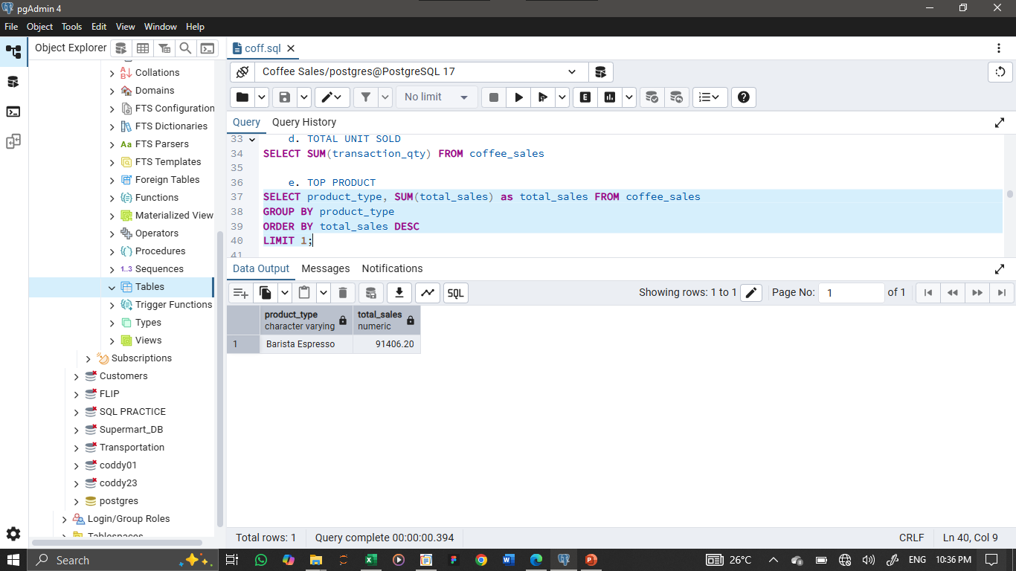
AVG UNIT PRICE, TOTAL UNIT SOLD, TOP PRODUCT….
Average Unit Price:
The average selling price per unit was ₦3.388, reflecting pricing strategy and product mix.
Total Units Sold: Overall, 214470 coffee units were sold, confirming high product movement.
Top Product: Barista Expresso is the best-selling product, contributing 13% of total revenue. This makes it the key driver of overall sales.
Fatolu Adedoyin Juliana

Slide 10
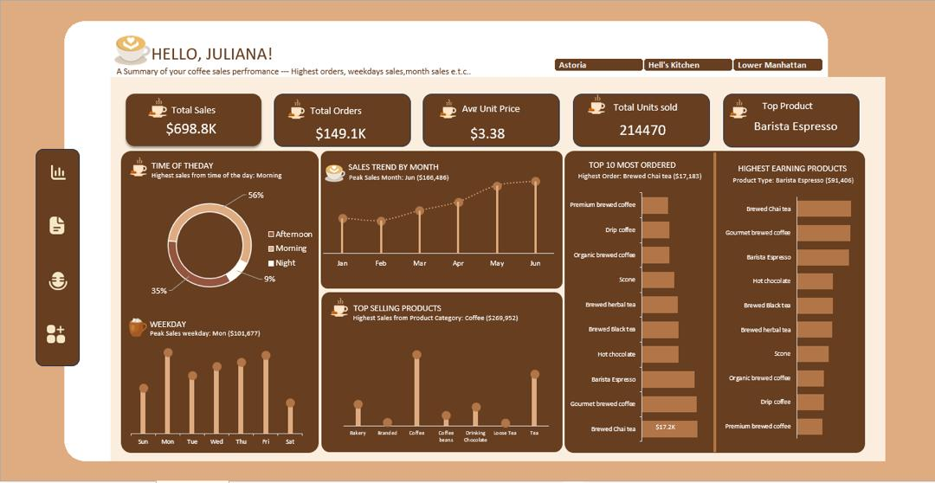
THE DASHBORD
Fatolu Adedoyin Juliana

Slide 11
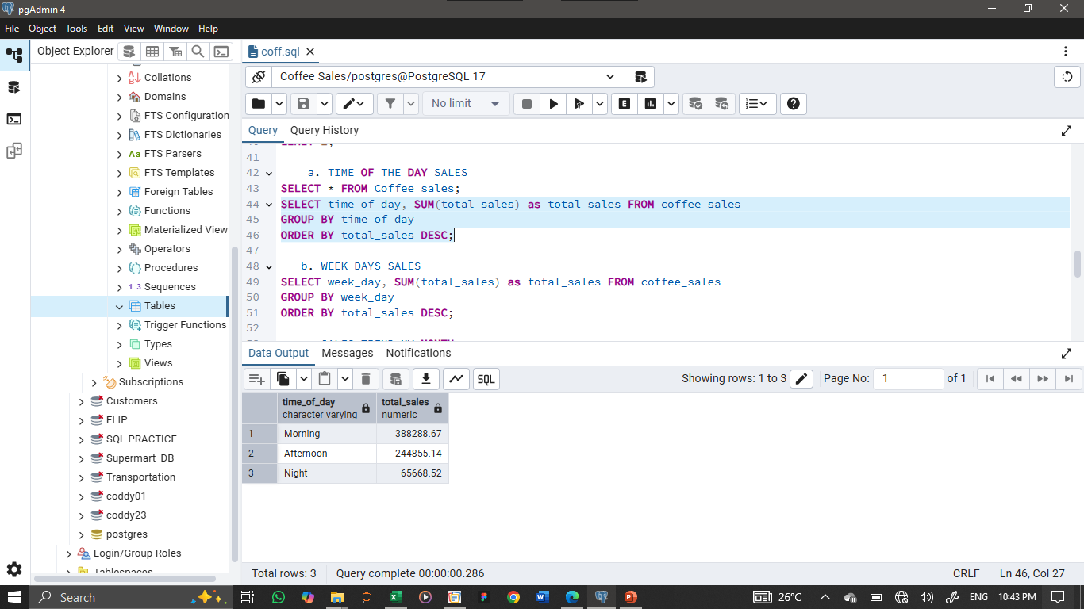
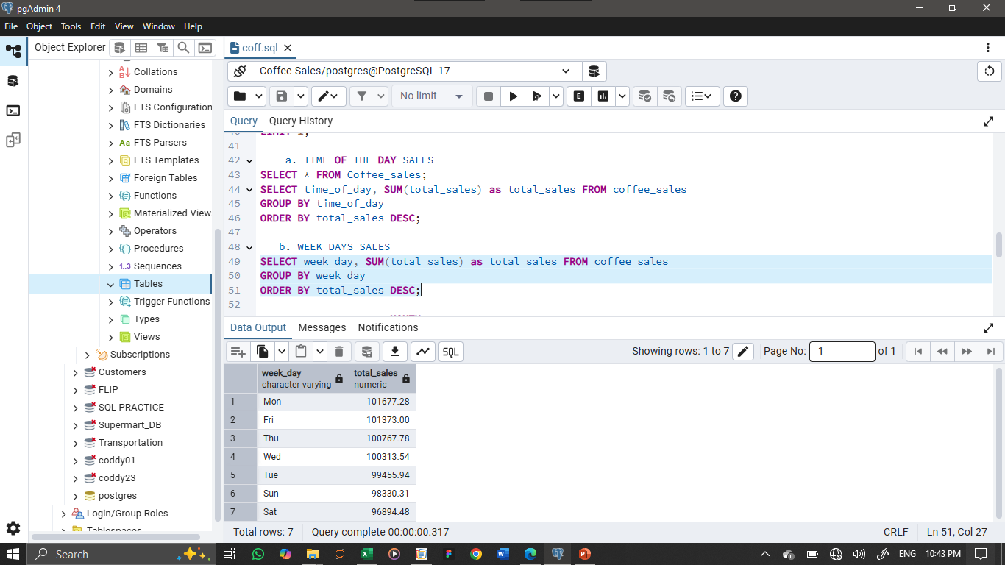
TIME OF THE DAY SALES & WEEK DAYS SALES
Comment:
Morning sales (56%) dominate, followed by afternoon (35%), while night sales remain low at 9%.
Monday is the strongest sales day with $101,677, while Saturday records the lowest sales, showing weaker weekend demand.

Slide 12
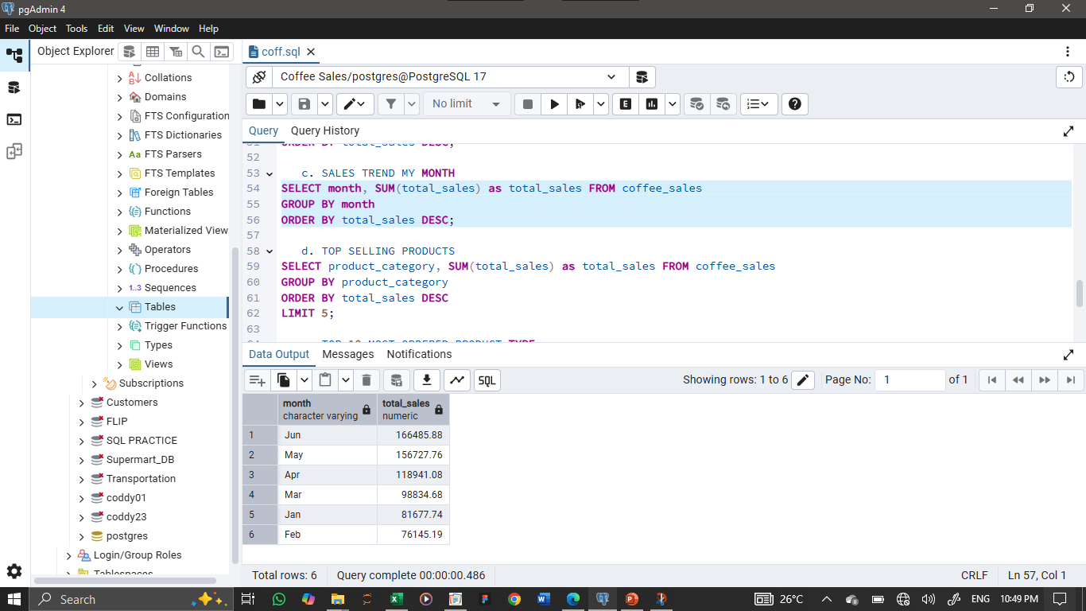
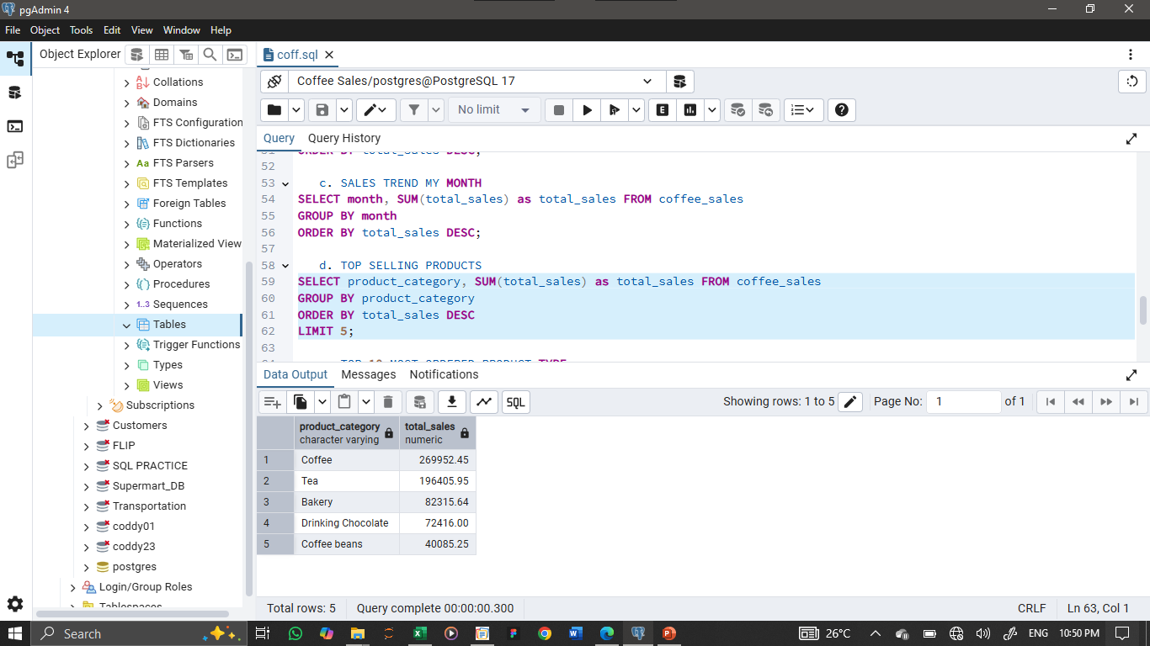
SALES TREND MY MONTH &TOP SELLING PRODUCTS
Comment:
Sales show steady growth from February, peaking in June at $166,486
Coffee dominates sales with $209,892, far ahead of other product categories.”.

Slide 13
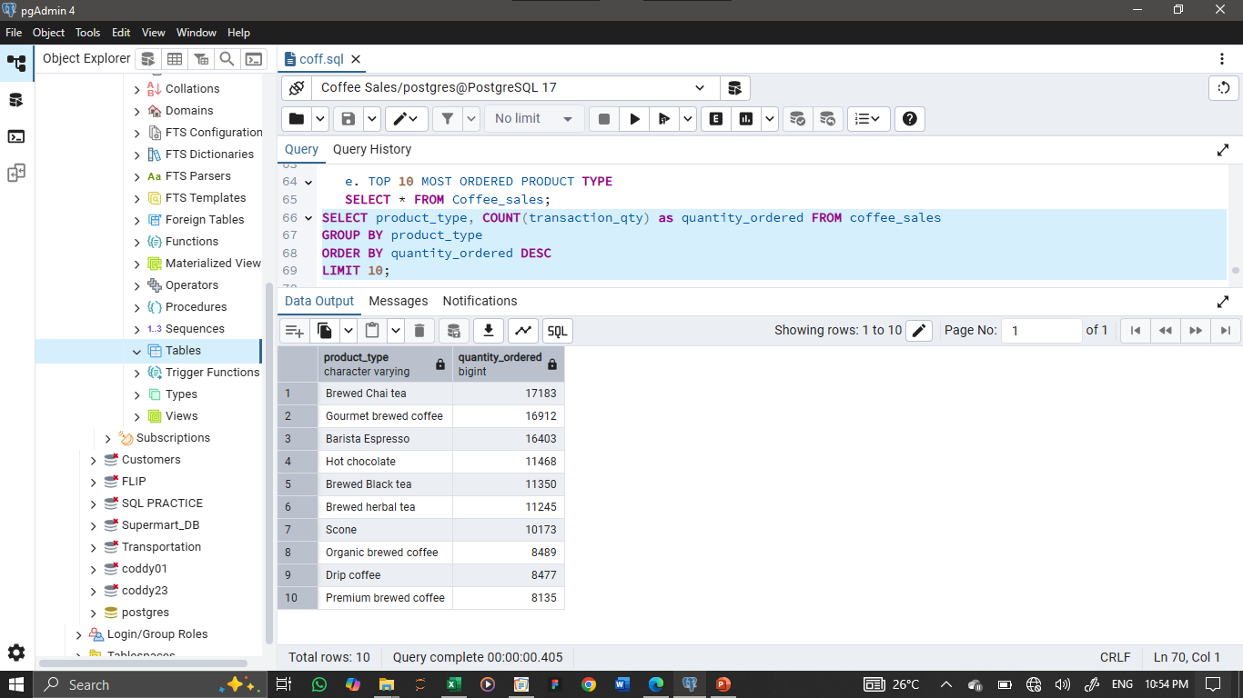
TOP 10 MOST ORDERED PRODUCT TYPE
Comment: Brewed Chai Tea is the most frequently ordered product ype ($17,183), followed by Gourment Brewed Coffee and Barista Espresso.

Slide 14
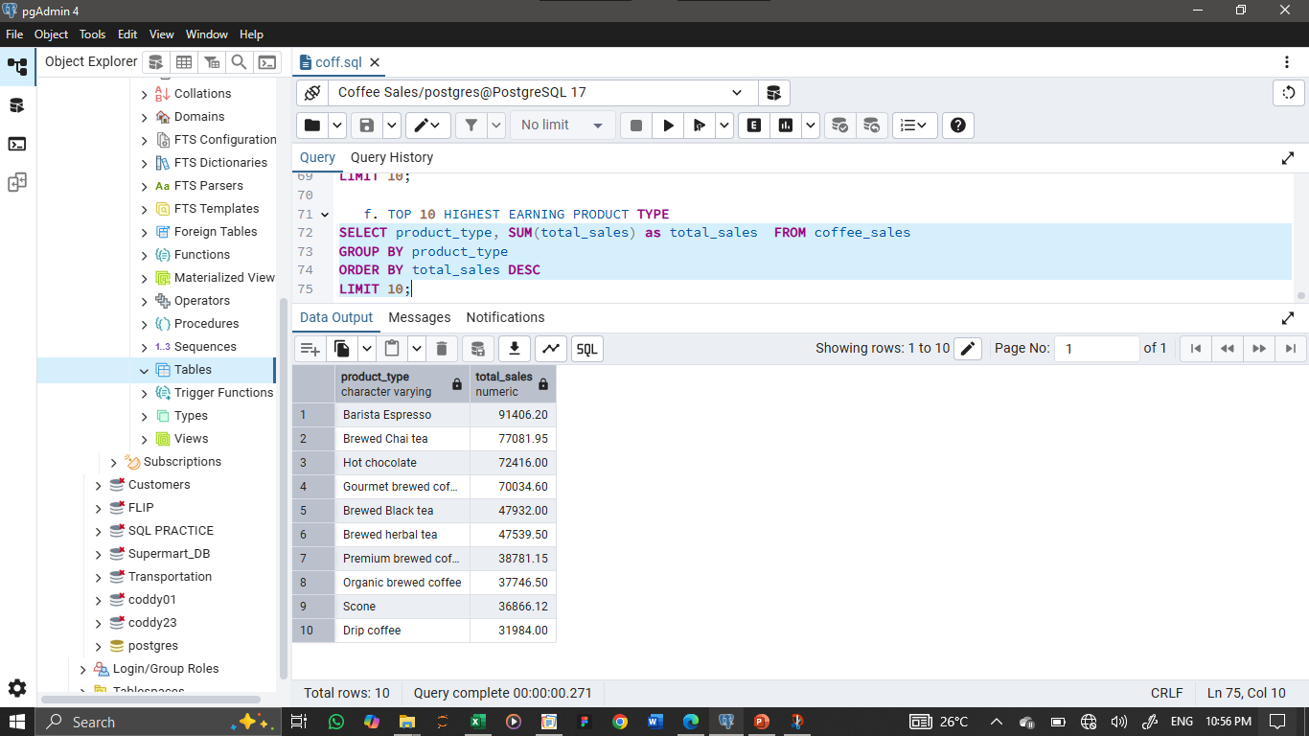
TOP 10 HIGHEST EARNING PRODUCT TYPE
Comment: Barista Espresso generates the highest revenue ($91,466), followed by Brewed Chai Tea and Hot Chocolate.

Slide 15
Recommendations & Business Impact
Boost Weekend Sales: Sales are weaker on Saturdays and Sundays compared to weekdays. Introduce weekend-only offers, loyalty bonuses, or family bundles to encourage more purchases during these slower days.
Optimize Morning Operations: Since mornings are the busiest period, ensure adequate staff scheduling, inventory, and faster service options to capture every possible sale.
Leverage Best-Selling Products: Products like Barista Espresso and Brewed Chai Tea are customer favorites. Use them in promotions or bundles to attract buyers and drive sales of less popular items.
Protect Premium Pricing: High-earning products already show customers are willing to pay. Maintain their premium pricing while focusing discounts on lower-margin products instead.
Diversify Beyond Coffee: While coffee dominates revenue, categories like tea, bakery items, and hot chocolate still have room to grow. Cross-sell these with coffee orders to balance sales across the menu.
Prepare for Seasonal Peaks: Since certain months show higher demand, plan ahead with early marketing campaigns and stronger inventory stocking to fully capitalize on peak periods.
Fatolu Adedoyin Juliana

