Slide 1
SECURE AND EFFICIENT ONLINE EXAM MANAGEMENT SYSTEM
FOR THIAGARAJAR COLLEGE
Front End : PHP
Back End : MYSQL
M Sriharish Kumar (20suca24)
A Hepsy Joannah (20suca35)
S Sangeetha (20suca42)

Slide 2
OBJECTIVE
To evaluate students efficiently using an automated approach that takes less time and produces reliable results
MODULES
Login Module
Forget Password
Registration Module
Department Module
Subject Module
Exam Module
Result Module
Logout

Slide 3
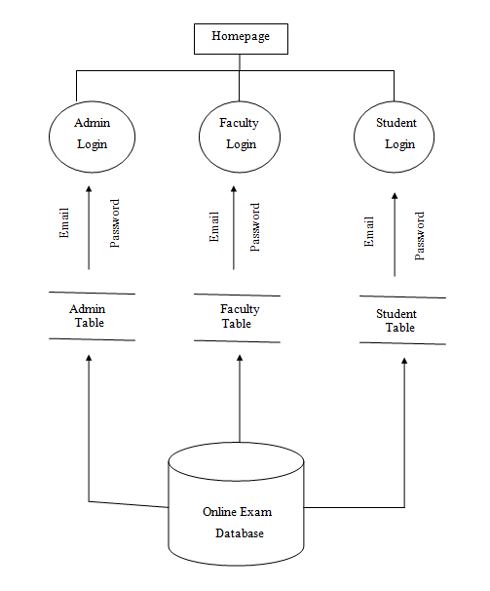
OVERALL DFD

Slide 4

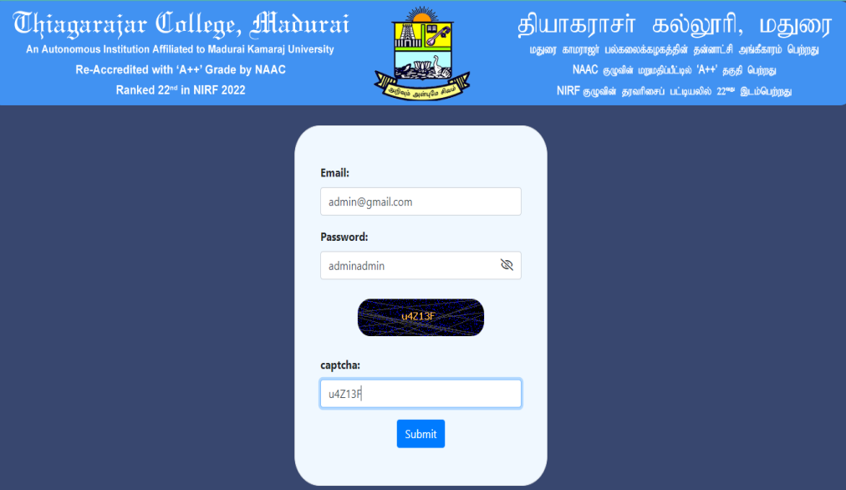
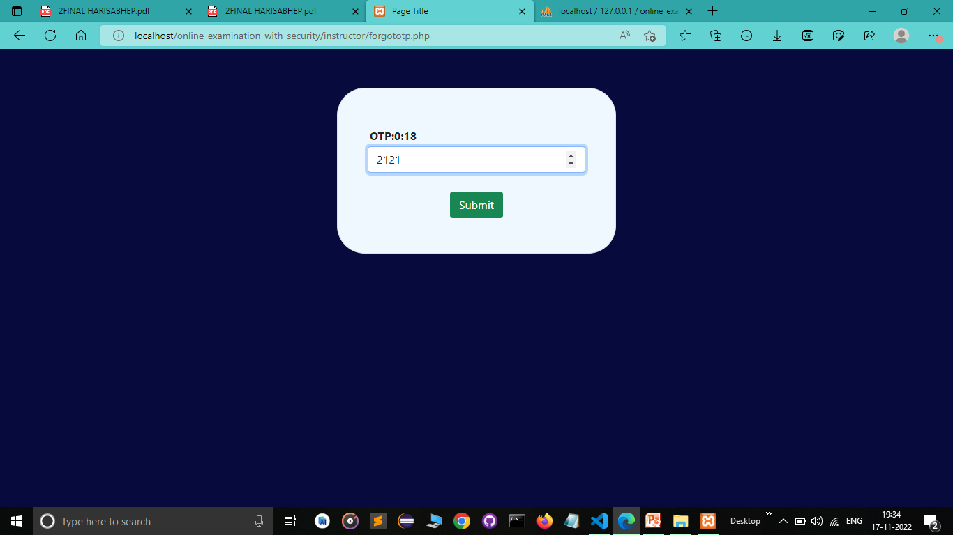
LOGIN MODULE
The login module manage access permissions for different users
Prevents from unauthorized individuals
Each administrator, instructor, and student has their own login module
Admin Login

Slide 5
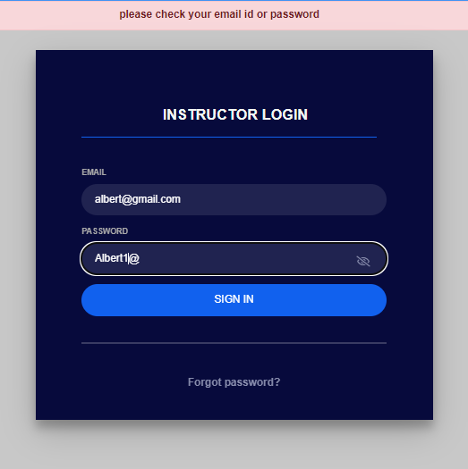
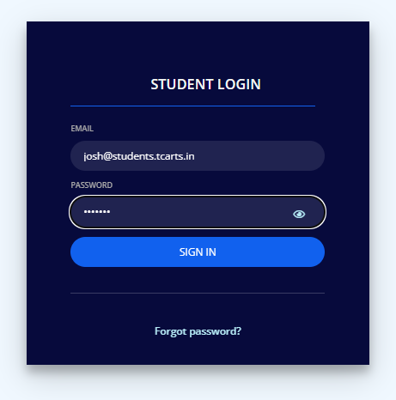
Faculty Login
Student Login

Slide 6
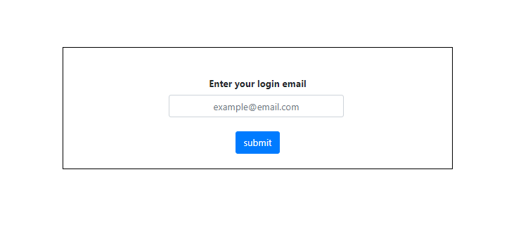
FORGET PASSWORD
End users such as instructors and students, can change their password on their own.
Forget password option is inaccessible to the administrator
Forgot password for Faculty Module

Slide 7
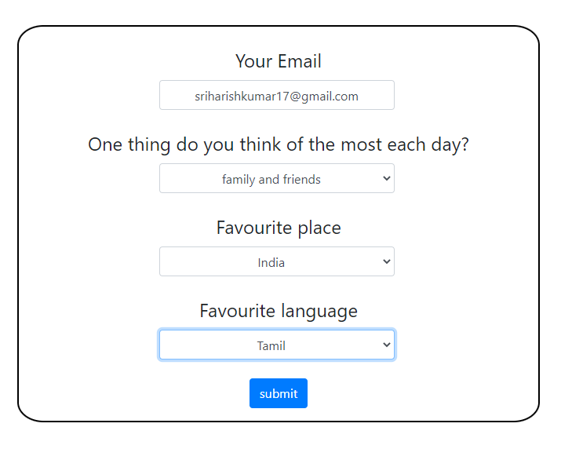
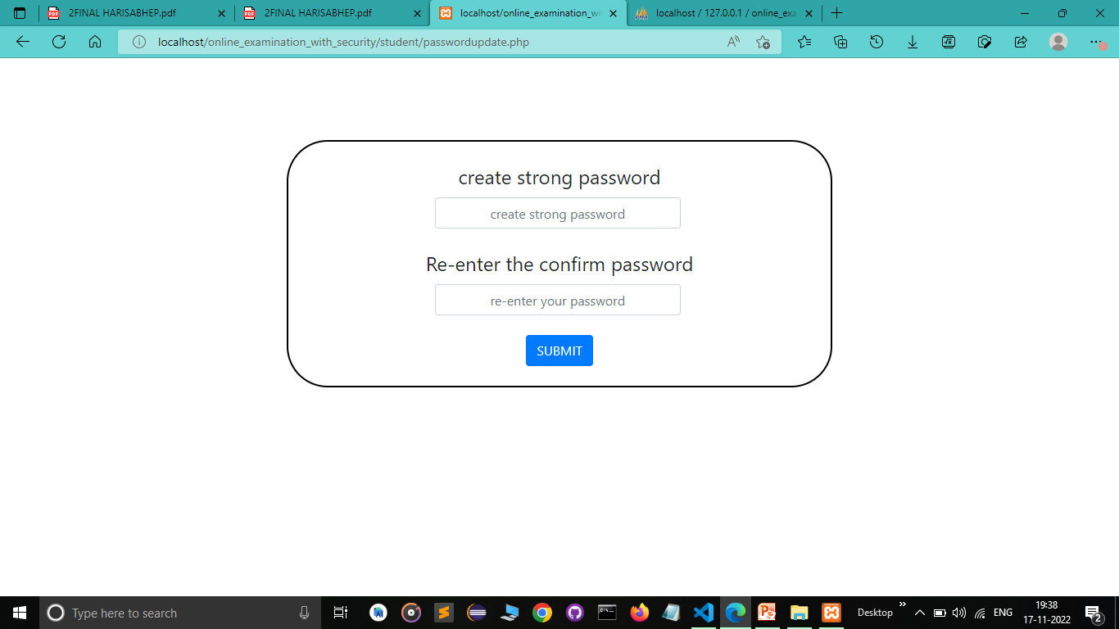
Forgot password for Student Module

Slide 8
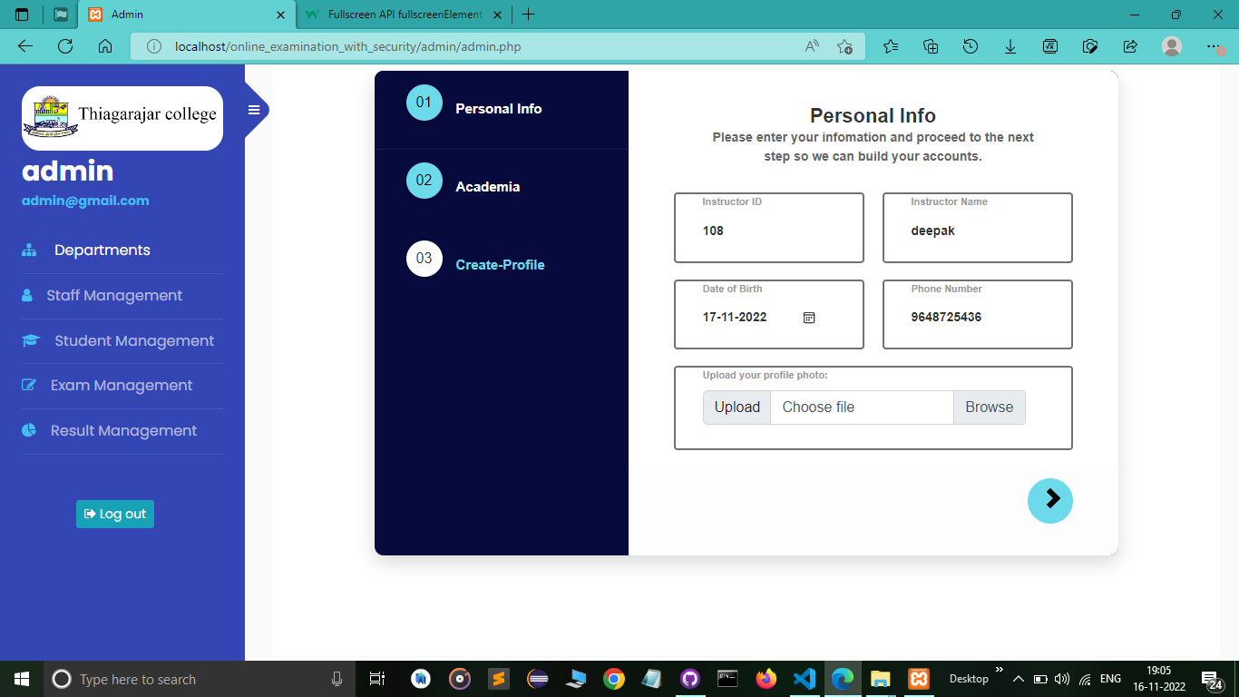
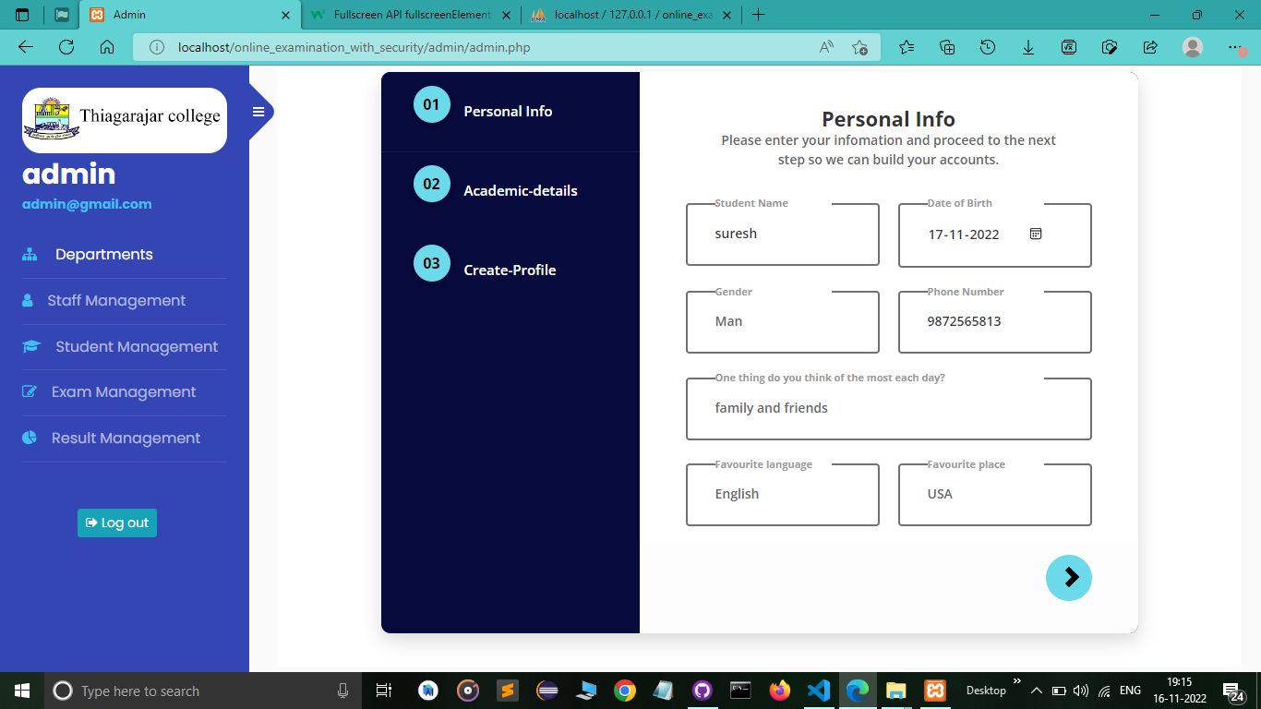
Faculty Registration
REGISTRATION MODULE
The administrator offers both a password and an email address to instructors and students for login
Student Registration

Slide 9
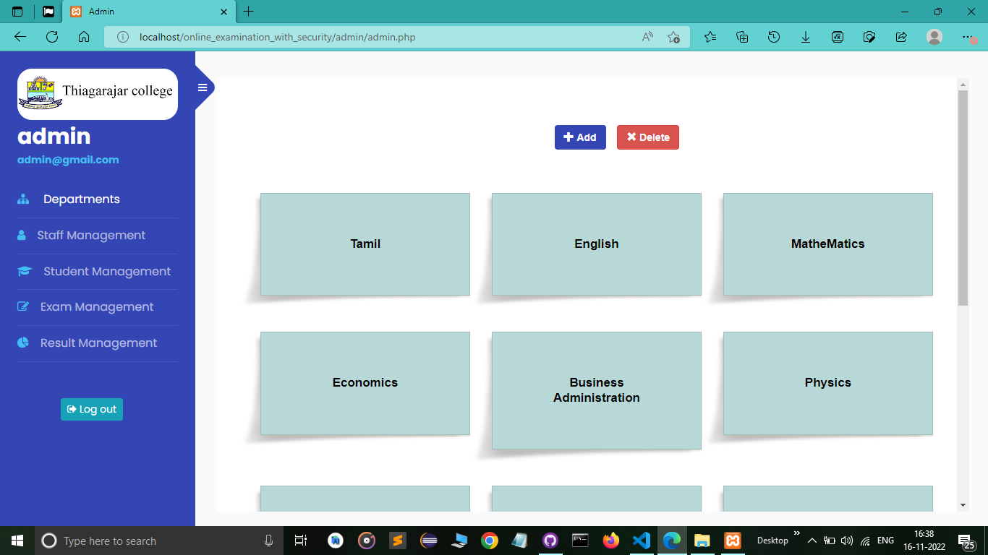
DEPARTMENT MODULE
Admin can view all the departments in the college currently has.
Administrators can create new departments and eliminate dormant ones

Slide 10
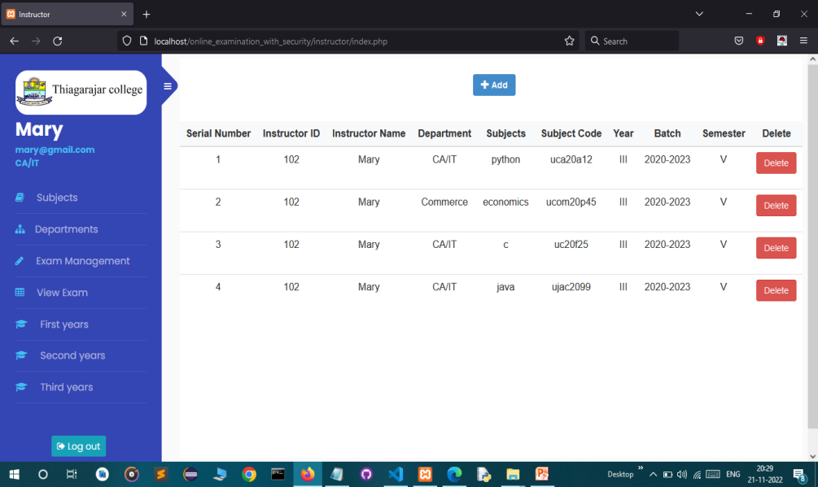
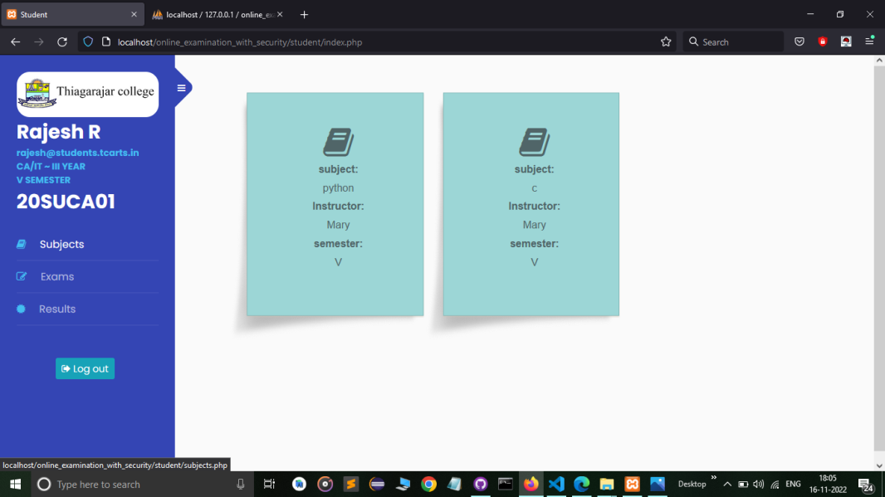
SUBJECT MODULE
Subjects can be deleted or added by the instructor
The students in the respective department are automatically updated with the new or modified subjects when instructors add or delete subjects
Instructor subject creation
Student subject view

Slide 11
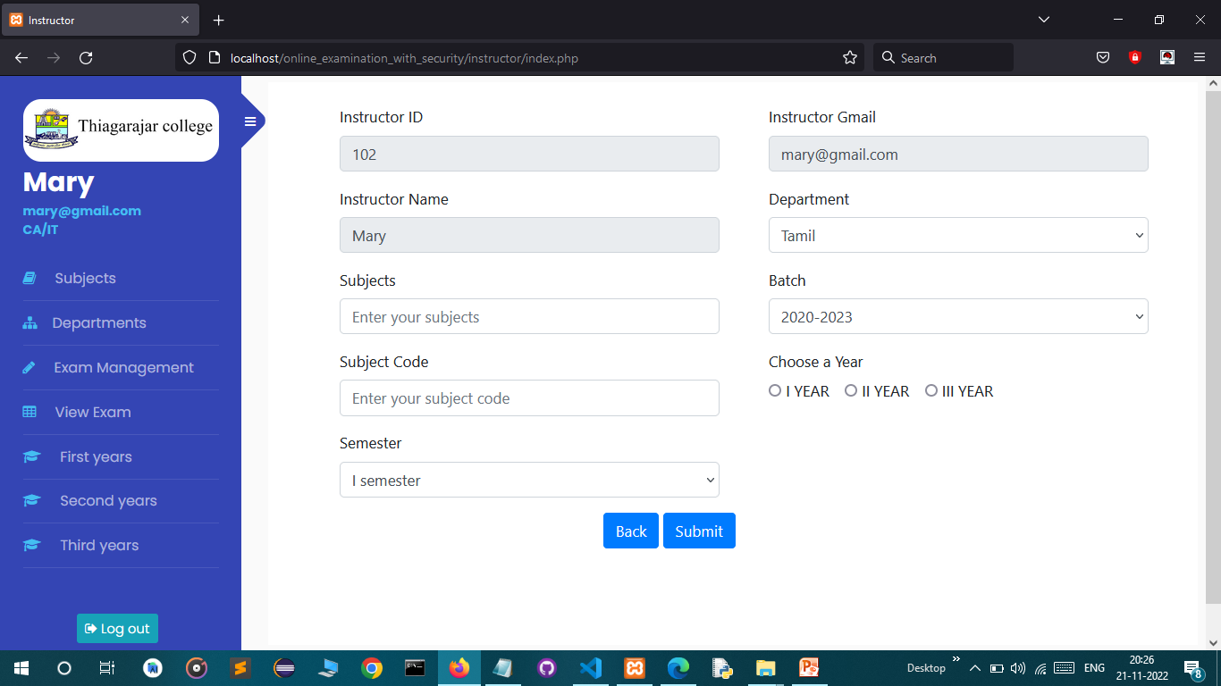
Instructor subject creation form

Slide 12
EXAM MODULE
Administrators have a log of all exams
Information about exams is automatically updated to the students in the relevant department
Exams are only available to students for a limited period of time
Before the exams, students should follow all guidelines
Exams are automatically submitted if a student tries to switch tabs to deceive

Slide 13
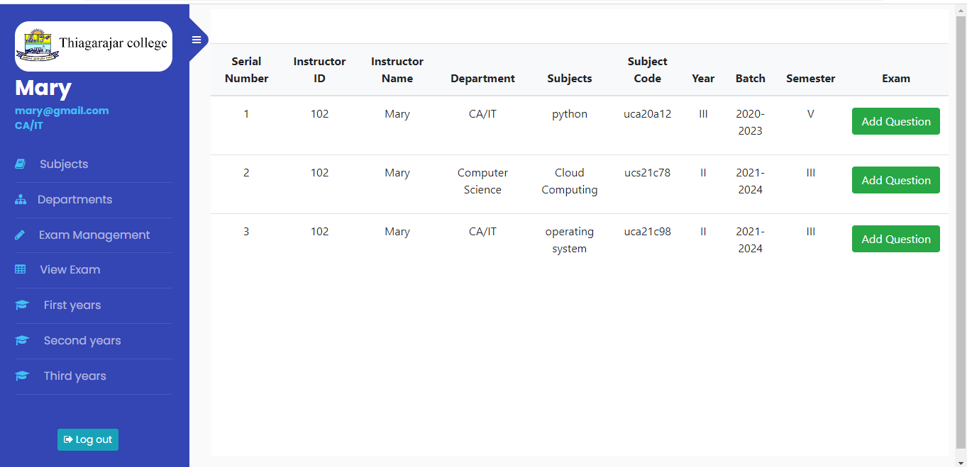
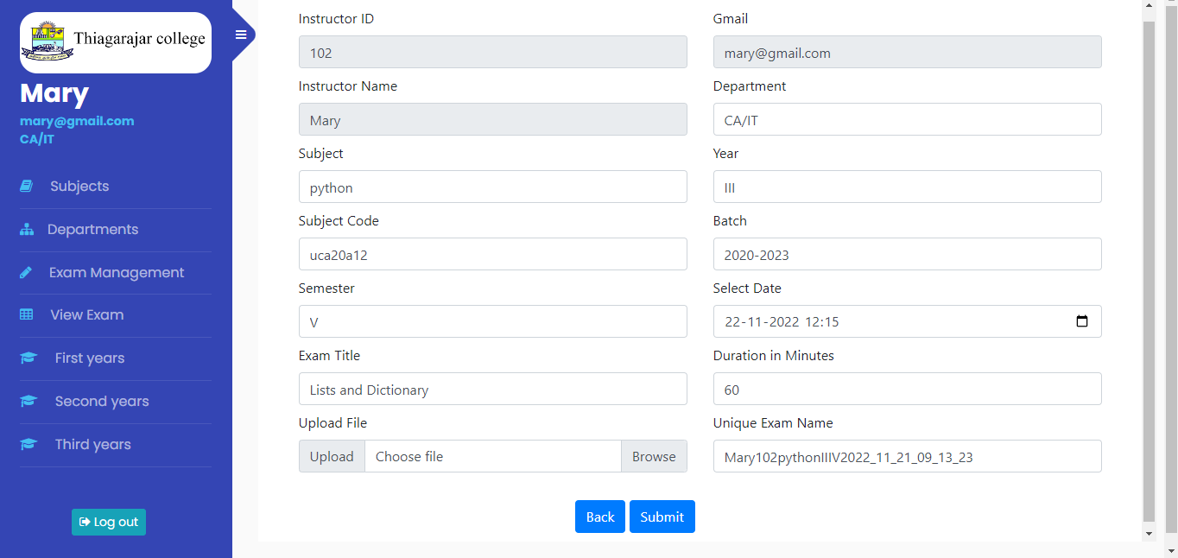
Exam Management
Create Exam Form

Slide 14
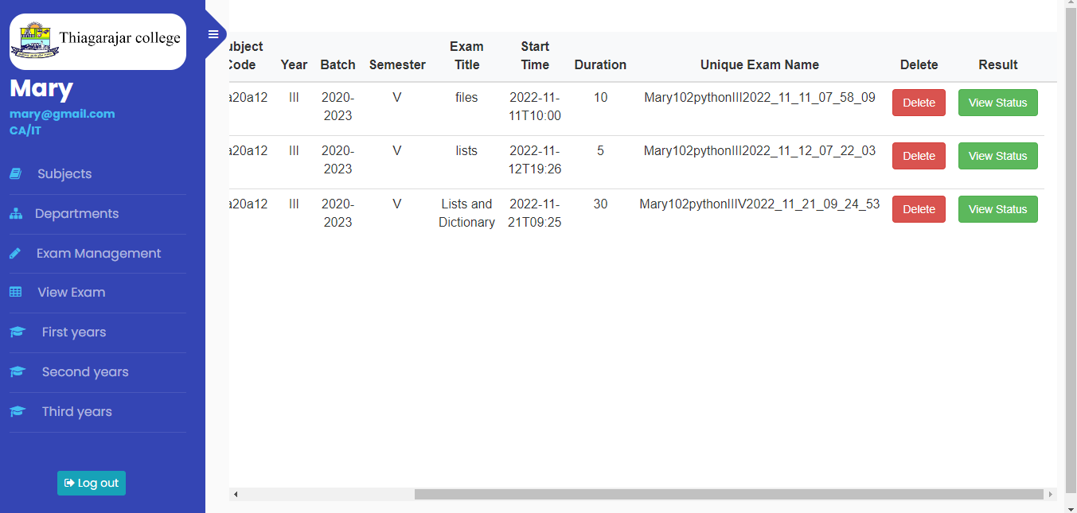
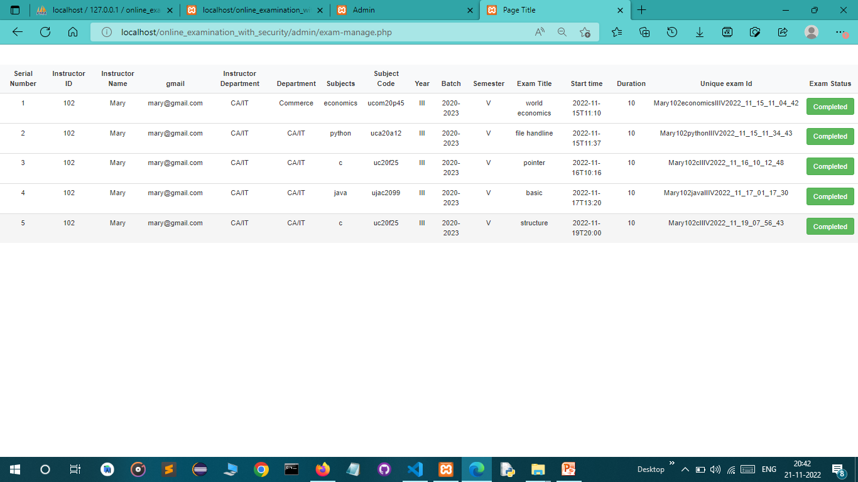
Instructor View Exam
Admin View Exam

Slide 15
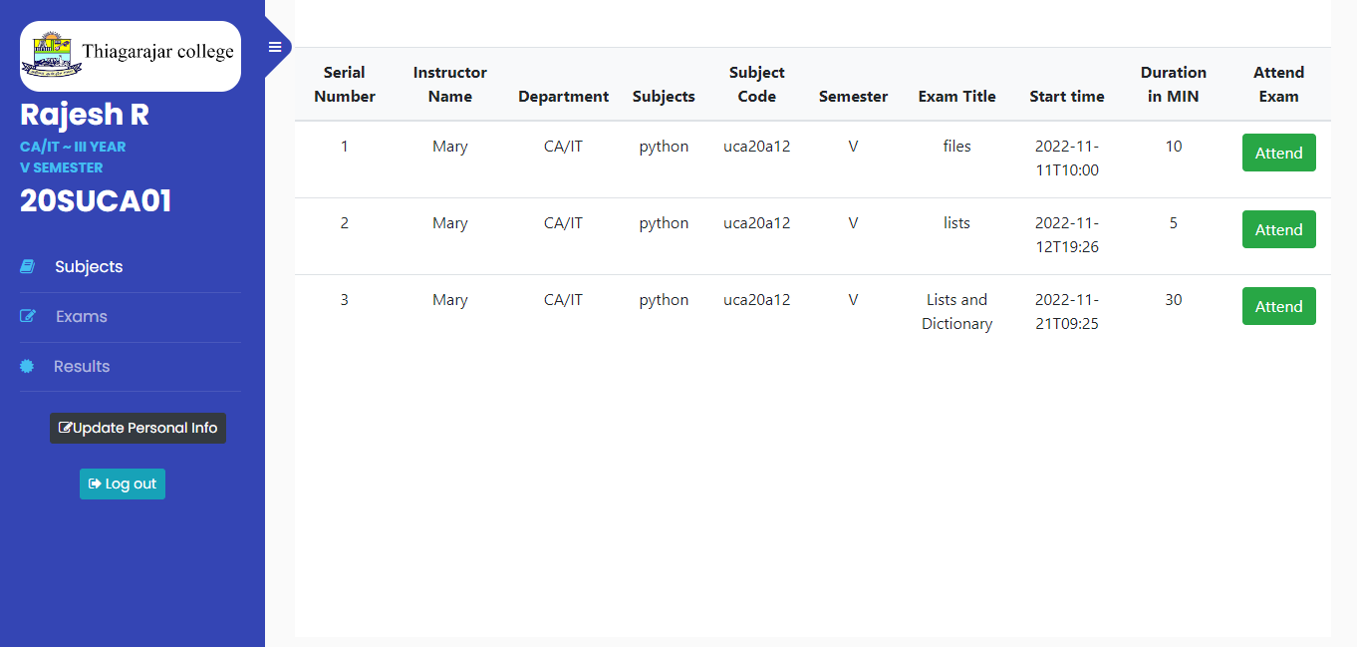
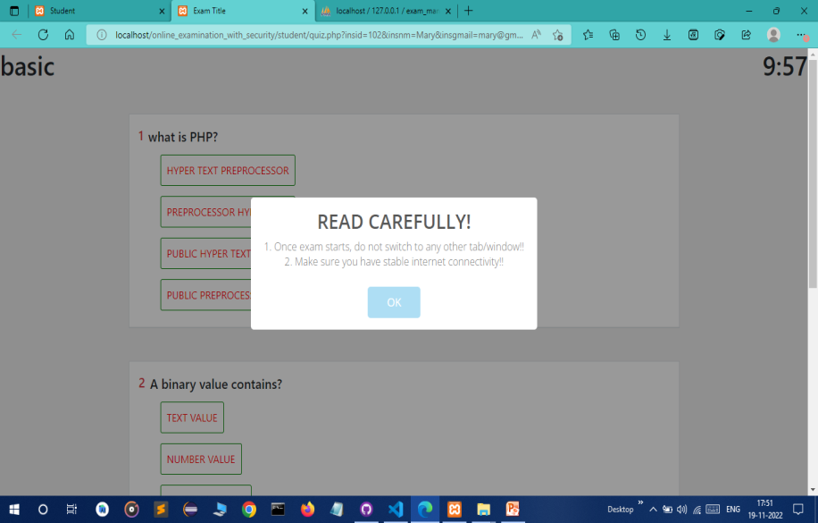
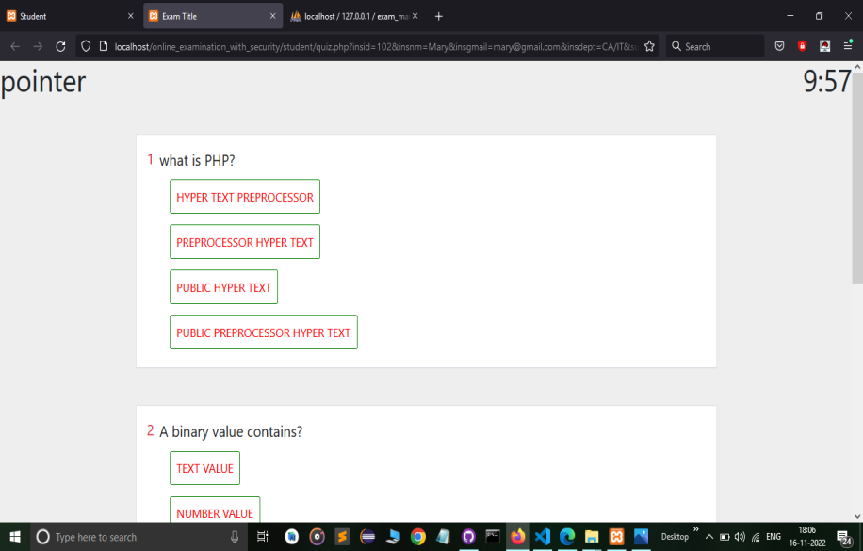
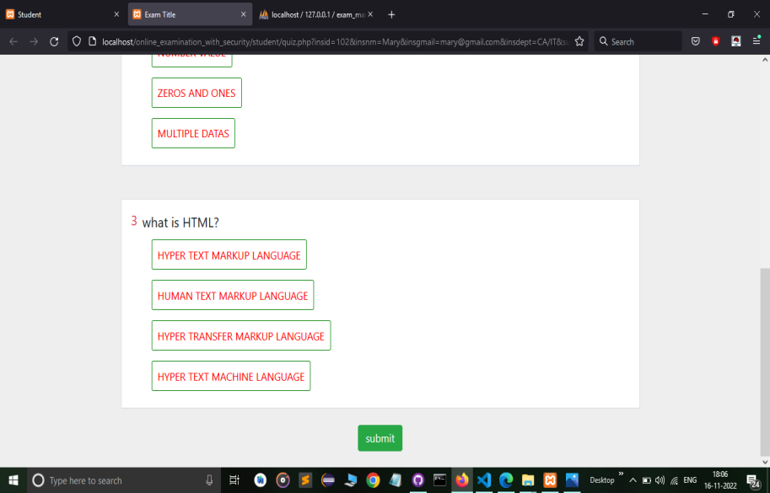
Exam Guidelines
Students View Exam
Exam Question

Slide 16
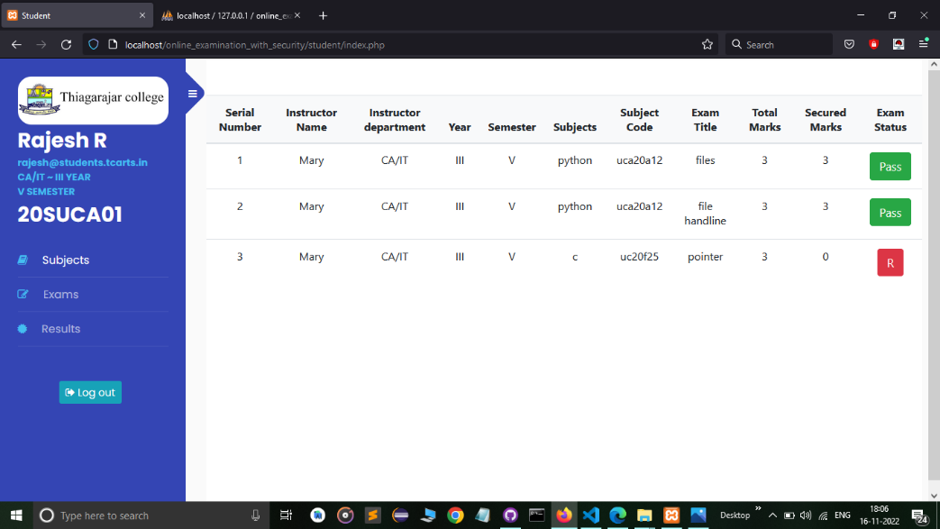
RESULT MODULE
Exams are automatically evaluated, and the results are reported to admin
The instructor and students can view the results
Student can view Result instantly

Slide 17
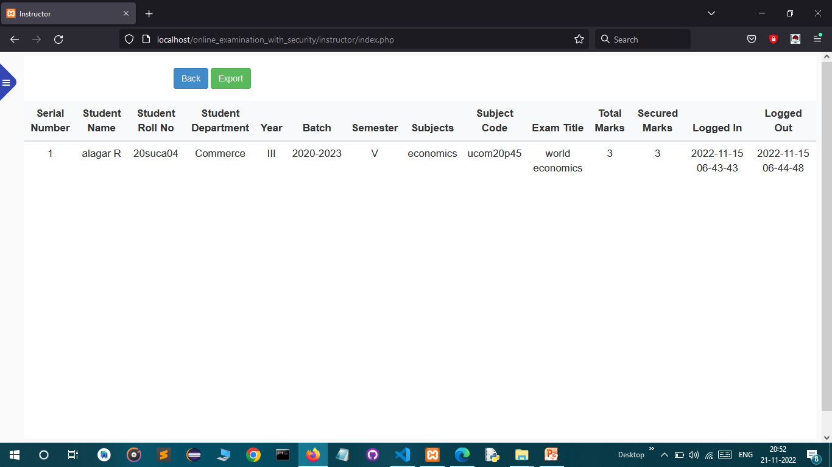
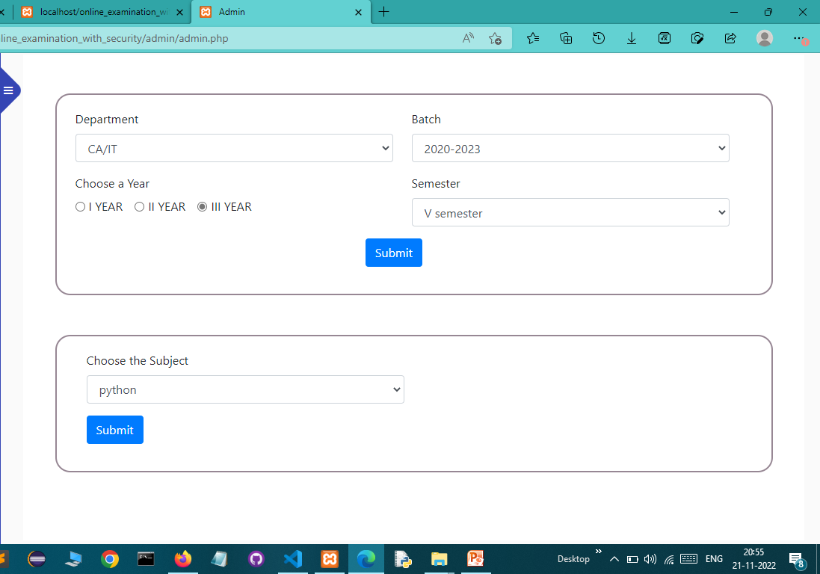
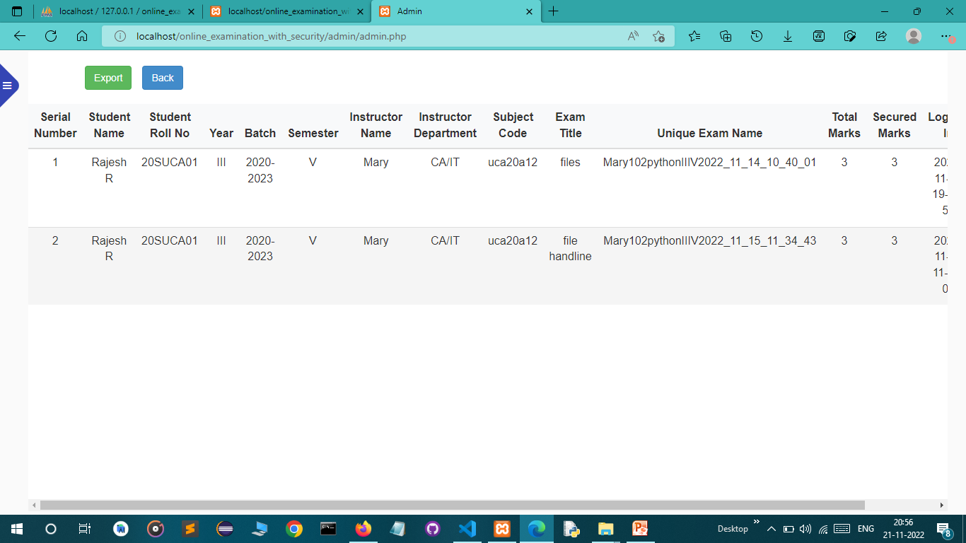
Faculty can view student
Result instantly and export data as excel file
Admin can view student Result instantly and export data as excel file

Slide 18

LOGOUT MODULE
Logout to prevent unauthorised access to
your data
Administrators, teachers, and students have independent access to
this logout option
The browser's user session can be ended
Logout widgets, which will subsequently send to a login page

Slide 19
PROS
Online exam provides flexibility and security to the examination process
Questions uploaded to the system are shuffled and sent in different orders to various students.
The results are calculated instantly and accurately
CONS
Internet dependency is a vulnerability of conducting online exams
Difficulty in grading long answer-type
Susceptible to cheating

Slide 20
CONCLUSION
The primary objective of creating an online examination system to thoroughly and efficiently evaluate the candidate using a fully automated system has been attempted and resulted in this project called ‘Secure And Efficient Online Exam Management System for Thiagarajar College’

