Slide 1
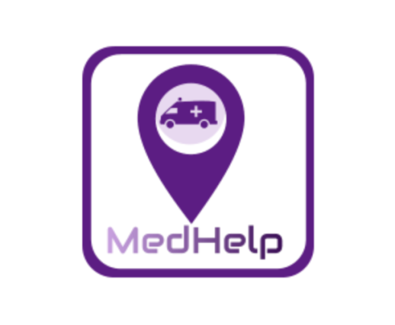
Med Help
Ivy Hacks
By: Taha, Prasad, Rosen, Lakshika

Slide 2
Problem Description
Inspired by the ambulance tracking app, we wanted to have transparency and save people time in transportation to the ER, as every second saved is important.
We also want to help both sides: the ambulance drivers and the patients who need transportation.
To accommodate the COVID-19 pandemic, we have added reminder for the driver to wear a mask and let the driver know if the user needs COVID-19 special care.

Slide 3
Target Audience & Market
Ambulance Drivers
Hospitals
People with health risks
Older population
General Population

Slide 4


App Description
Implemented Ambulance tracking app usable by people to use similar to a Uber Taxi App.
We expect this to save a lot of time on transportation of patients to the ER.
We used Figma for the UI design of the app.
We used Google Maps API, Flutter, and Google Firebase to implement this app.

