Slide 1
第四章
配接Cisco设备

Slide 2
本章目标
通过本章的学习，您应该掌握以下内容:
  能够识别路由器或交换机之间连接所需要的连接组件，并能正确连接
  能够识别通过串口或ISDN BRI口连接WAN所需要的连接组件，并能正确连接
Notes:
Purpose: this figure states the chapter objectives.
Emphasize: Read or state each objective so each student has a clear understanding of the chapter objectives.

Slide 3
本章目标(续)
  在路由器或交换机与一个终端之间建立控制台连接
  正确记录包括每个互连网设备的连接类型和连接位置等在内的物理拓扑信息
Notes:
(cont.)
Purpose: this figure states the chapter objectives.
Emphasize: Read or state each objective so each student has a clear understanding of the chapter objectives.

Slide 4




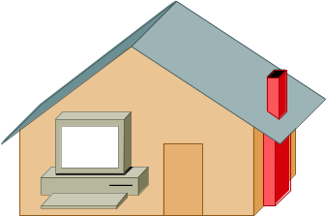

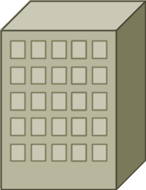
连接典型网络
图例
快速以太网/
以太网
ISDN
专线
核心
服务器
core_sw_a
专线/
帧中继
ISDN 云
Notes:
Purpose: this figure highlights the LAN network. In this section, students will learn how to cable the LAN.
Note: The figure illustrates two workgroup LANS, both connecting into core switches.

Slide 5
LAN的物理层实现
物理层实现多种多样
有些物理层实现方式支持多种物理介质
数据链路层
(MAC子层)
802.3
Ethernet
物理层
10Base2
10Base5
10BaseT
10BaseF
100baseTX
100baseFX
100baseT4
DIX
标准
802.3 说明了10mb
以太网规范
802.3u 说明了100mb
(快速) 以太网规范
Notes:
Emphasize: You may want to explain how cable names are determined. They follow the following pattern:
The first number describes the speed of the cable.
The next word describes whether it is baseband or broadband cable.
The final letter(s) describe the media.
100 Mbps cables are used for Fast Ethernet.
T represents twisted pair media. F represents fiber.
For example, 10BaseT is 10 Mbps baseband twisted-pair cable.

Slide 6


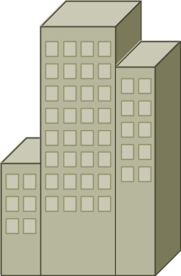
定义网络组件
家庭办公
用户
移动办公 用户
因特网
分部
公司总部
Notes:
Note: The two connections between the same sites are for redundency.
Emphasize: The type of connections typical in a home office may be asynchronous dial-up or ISDN BRI. Mobile users only use dial-up. Branch offices and Central sites have the connections just stated. In addition they may have leased lines and packet switched services, to list just a few.

Slide 7





定义网络组件(续)
分部
层 2
服务器农场
ISDN
家庭办公
层 1
远程
典型网络
Notes:
Emphasize: Breaking up the corporate network into smaller components makes network design and management more managable.
Transition: The next few pages a heirarchical model used in network design.

Slide 8

层次化的网络结构定义
核心层
分布层
访问层
Notes:
Purpose: This page introduces the hierarchical model.
Emphasize: This model has evolved from real-life experience in configuring very large networks.
Campus network designs have traditionally placed basic network-level intelligence and services at the center of the network and shared bandwidth at the user level. Over the past few years distributed network services and switching has migrated to the user level.
One approach to ensure a level of network performance is to segment the network into layers of functionality. These layers of functionality are defined by the following layers:
Access
Distribution
Core Layer.
This model permits enables designers to define building blocks that interconnect users and services.
It is important to remember that the hierarchical model refers to conceptual layers that provide functionality. The actual demarcation between layers does not necessarily have to be a physical link. This demarcation can also refer to the backplane of a particular device
Transition: The following describes the access layer of the hierarchical model.

Slide 9

访问层特性
访问层
端接设备到网络的接入点
Notes:
Purpose: This page defines local services.
Emphasize:
A local service is when the entities that provide these common functions reside on the same subnet or virtual network as the user.
Local services remain in specific area of the network.
Traffic to and from local services is confined between a server, a switch, and an end user.
Local traffic does not enter the network backbone or move through a router.
Local services are confined to a common workgroups.
Transition: The following describes remote services

Slide 10
分布层特性
访问层的汇接点
路由数据
分割广播域/多点传送域
介质转换
安全性
远程访问的接入点
分布层
Notes:
Purpose: This page defines enterprise services.
Emphasize:
Enterprise services are services common to all users.
Examples of enterprise services would be e-mail, Internet access, or video conferencing.
Enterprise servers and services exist within a separate subnet placed close to the backbone of the network. Placing the enterprise servers close to the backbone ensures the same administrative distance from each user; however, this also means that all traffic going to an enterprise server crosses the backbone.
Because enterprise services exist outside of the broadcast domain of the end user, these services are surrounding by Layer 3 functionality.
The Layer 3 switch allows servers to be centralized with no performance penalty, eliminating the cost of numerous server repositories.
Layer 3 devices also provide a level of security which protects the information stored on the servers.
Transition: The following describes the multilayer model.

Slide 11
核心层特性
核心层
高速传送数据
对数据不作任何处理
Notes:
Purpose: This page discusses the characteristics of the core layer.
Emphasize:
The sole purpose of the core layer of the network is to switch packets as fast as possible.
Routing, access lists, and packet filtering should not take place in the core as these functions will slow the data packet transfer rate.
Transition: The following discusses how Cisco products fit with the multilayer design.

Slide 12
典型网络中的以太网定位
10BaseT以太网定位
快速以太网定位
Access Layer
提供端接用户设备与访问层交换机之间的连接.
为高性能PC和工作站提供对服务器的高速(100-Mbps)访问.
访问层
Distribution Layer
一般不会本层使用.
提供访问层与分布层之间的连接. 提供从分布层到核心层的连接. 提供从服务器群到核心层的连接.
分布层
一般不会在本层使用.
提供交换机间的互连.
核心层
Core Layer
Notes:
Emphasize: The table in the figure, compares 10baseT and Fast Ethernet. It also describes where in the hierarchical model Ethernet and Fast Ethernet can be seen.

Slide 13
以太网介质比较
10Base5
10BaseT
100BaseTX
100BaseFX
50-欧姆 同轴电缆 (粗)
EIA/TIA 3, 4, 5 类双绞线
2 对
EIA/TIA
5 类双绞线
2 对
62.5/125
微米多模光纤
使用介质
最大段长
500 米
100米
100米
400米
拓扑类型
总线
星形
星形
点到点
ISO 8877
(RJ-45)
ISO 8877
(RJ-45)
双工型介质接口连接器
(MIC) ST
连接器
AUI
Notes:
Purpose: This figure further compares various Ethernet options.

Slide 14
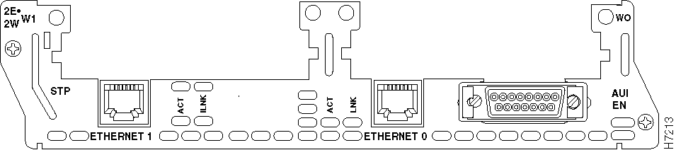
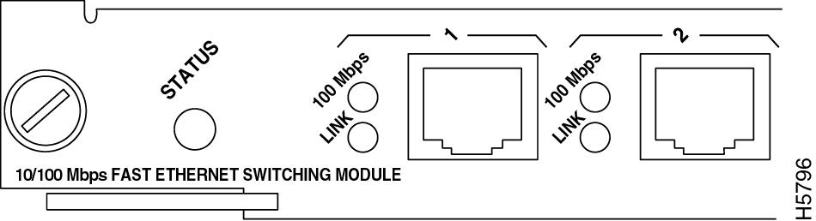
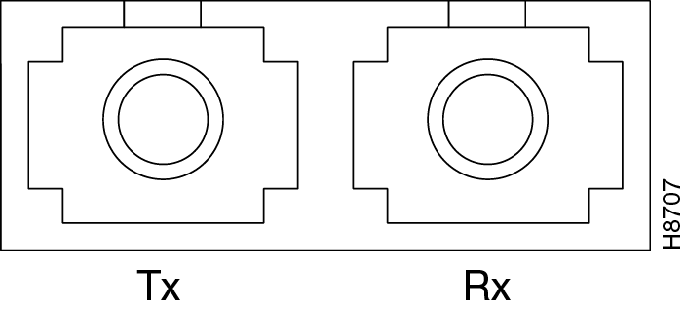
区分不同的连接类型
ISO 8877 (RJ-45)
连接器和插孔比电话连接器RJ-11和插孔略大
AUI 连接器是DB15
光纤连接器接口
Notes:
Purpose: This figure illustrates the different ports used in Ethernet.
Emphasize: RJ-45 ports are common on Cisco platforms. Some devices also offer DB-15 interfaces for AUI. If the cable is fiber, the port will look different. Point each port out to the students.
Note: If you have devices available that have the various ports, show the actual ports to your students.

Slide 15
UTP设备
线对
T 代表发送
R 代表接收
针
1
线对2 T2
2
线对2 R2
1
3
线对3 T3
4
线对1 R1
8
5
线对1 T1
6
线对3 R3
7
线对4 T4
RJ-45 连接器
8
线对4 R4
Notes:
Purpose: This figure illustrates an unshielded twisted-pair RJ-45 connector.
Emphasize: the RJ-45 has eight pins. Some are for tip (T) and some for ring(R).

Slide 16


UTP实现直连线
直连10BaseT/
100BaseT
直连线
8
1
集线器/交换机
服务器/路由器
针 线
1 RD+
2 RD-
3 TD+
4 NC
5 NC
6 TD-
7 NC
8 NC
针 线
1 TD+
2 TD-
3 RD+
4 NC
5 NC
6 RD-
7 NC
8 NC
1
8
8
1
8
1
绿
白
蓝
绿
白
蓝
棕
绿
蓝
白
橙
棕
棕
白
绿
蓝
白
橙
橙
白
棕
白
橙
白
两端的线序相同
Notes:
Emphasize: Make sure each student has seen a Cat 5 cable. Describe the test for straight through cable determination. If you hold the two ends of an RJ-45 cable side by side, you'll see eight colored strips, or pins, at each end.
If the order of the colored pins is the same at each end, then the cable is straight through.
If the order of the colors is reversed at each end, then the cable is crossed over or rolled.
Straight-thru Ethernet uses pins 1, 2, 3, and 6.
Straight-thru cables are used for switch to router cabling, switch to PC or server cabling, or hub to PC or server cabling.

Slide 17
UTP实现交叉线
交叉连接10BaseT/
100BaseT
交叉线
集线器/交换机
集线器/交换机
8
1
针 线
1 RD+
2 RD-
3 TD+
4 NC
5 NC
6 TD-
7 NC
8 NC
针 线
1 RD+
2 RD-
3 TD+
4 NC
5 NC
6 TD-
7 NC
8 NC
1
8
8
1
8
1
棕
棕
白
绿
蓝
蓝
白
绿
白
橙
橙
白
棕
棕
白
橙
蓝
蓝
白
橙
白
绿
绿
白
部分线序交叉
Notes:
Emphasize: Make sure each student has seen a Cat 5 cable. Describe the test for crossover cable determination. If you hold the two ends of an RJ-45 cable side by side, you'll see eight colored strips, or pins, at each end.
If the order of the colored pins is the same at each end, then the cable is straight through.
If the order of the colors is reversed at each end, then the cable is crossed over or rolled.
Ethernet uses pins 1, 2, 3, and 6. For crossover, pin 1 is connected to 3, and oin 2 is connected to 6.
Crossover cables are used for switch to switch cabling, PC to PC cabling, switch to hub cabling, hub to hub cabling, or router to router cabling.

Slide 18
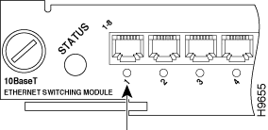
UTP直连线与交叉线对比
1x
2x
3x
4x
有且仅有一个端口标记有“ X”时使用直连线.
1x
2x
3x
4x
2x
3x
4x
1x
两个端口均标有或均没标有“X”时用交叉线.
Notes:
Purpose: This figure describes a simple way to determine whether one should use a crossover or straight thru cable.

Slide 19

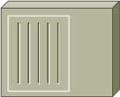

连接典型网
  决定使用10mb或100mb的物理介质
    指明需要使用什么线类
  确认面板上的端口，查看是否标记“ X”
    指明需要使用交叉线或直连线
100 Mbps
5类交叉线
10 Mbps
3, 4, 5类交叉线
10 Mbps
3, 4, 5类直连线
10 Mbps
3, 4, 5类直连线
100 Mbps
5类直连线
Notes:
Emphasize: Highlight the various cables and the devices they connect.
Reference: for more information, the following URL providees more information on LAN cabling: http://www.cisco.com/warp/public/701/14.html
Also see the Cable Specifications appendix that is included in most Installation and configuration guides.

Slide 20
连接广域网
图例
快速以太网/
以太网
ISDN
专线
ISL
核心
服务器
core_sw_b
core_sw_b
core_sw_a
专线/
帧中继
ISDN 云
Notes:
Purpose: This figure highlights the WAN network. In this section, students will learn how to cable the WAN.
Note: The figure illustrates two workgroup WANs. One is an ISDN connection to a home office. The other illustrates a serial Frame Relay or leased line connection to a branch office.

Slide 21
WAN物理层实现
物理层实现多种多样
连线规范定义了连接速率
HDLC
PPP
帧中继
ISDN BRI (用PPP协议)
EIA/TIA-232
EIA/TIA-449
X.121 V.24 V.35
HSSI
RJ-45
注意: 插脚引线不同于 典型网中用到的RJ-45
Notes:
Purpose: This figure illustrates the various WAN standards.
Emphasize: The serial standards presented in this course, are presented in the figure.
For ISDN, use an RJ-45 port. The cable differs from ports used for serial connections. Note that RJ-45 connections will fit into an RJ-48 and vice versa. Tell students not to connect an ISDN cable into anything other than an ISDN port.

Slide 22
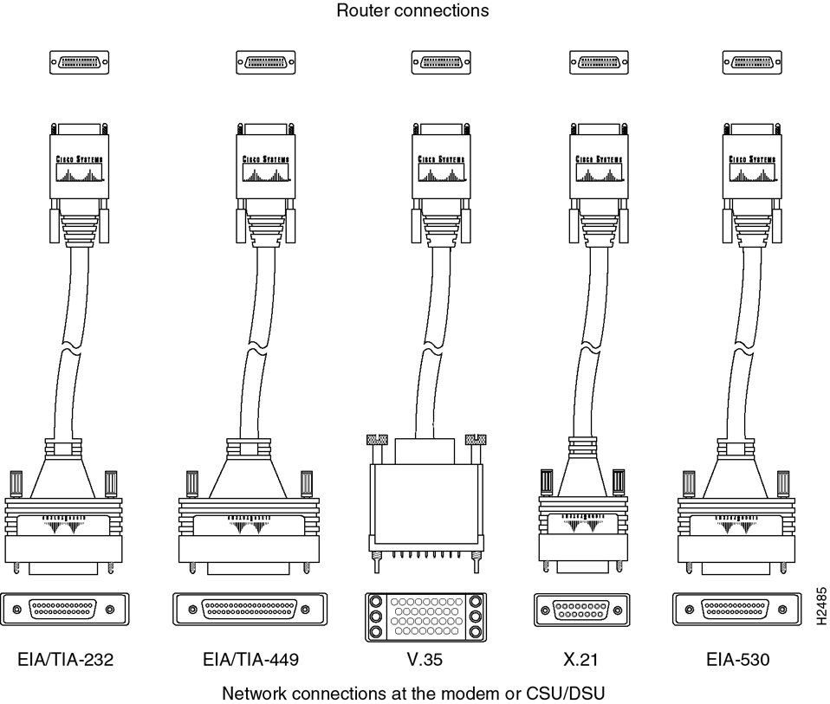


区分不同的WAN串行连接器
端接用户设备
连接到路由器
DTE
CSU/
DSU
DCE
服务商
EIA/TIA-232
EIA/TIA-449
V.35
X.21
EIA-530
通过CSU/DSU接入网络
Notes:
Purpose: This section describes the various serial standards that support leased line connections.
Emphasize: The same 60-pin end that attaches to a Cisco device supports all standards illustrated.

Slide 23
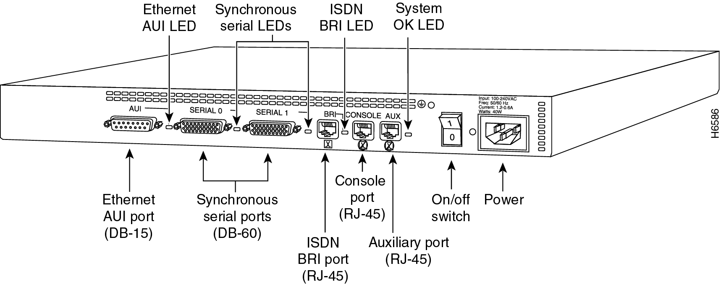
固化的端口
2500 路由器—背板一览
WAN串口可以采用固化方式
Notes:
Purpose: This figure shows fixed interface router such as a 2500.
Emphasize: The router in the figure is a Cisco 2500 router with Ethernet, serial, and ISDN interfaces..
A fixed interface router requires no additional hardware interfaces to operate. However, once you acquire a fixed component router such as a 2500, you cannot change interfaces.
Note: Show students the physical router used in the laboratory exercise.

Slide 24
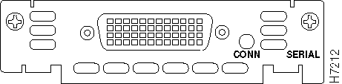
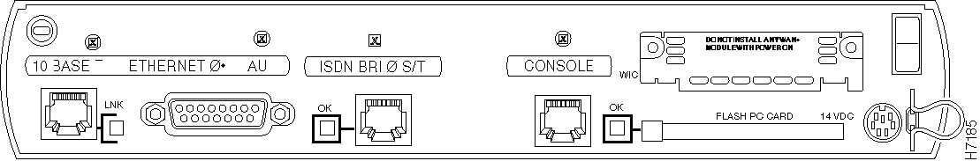
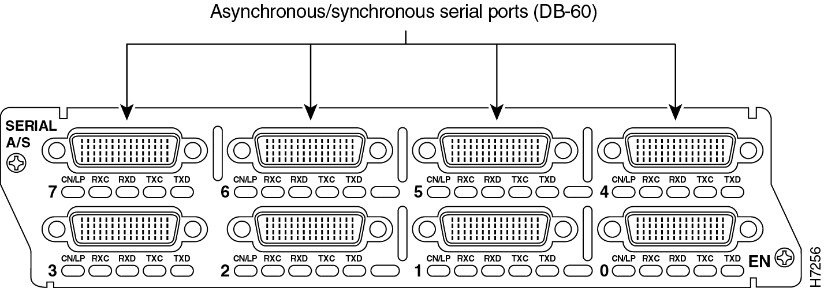
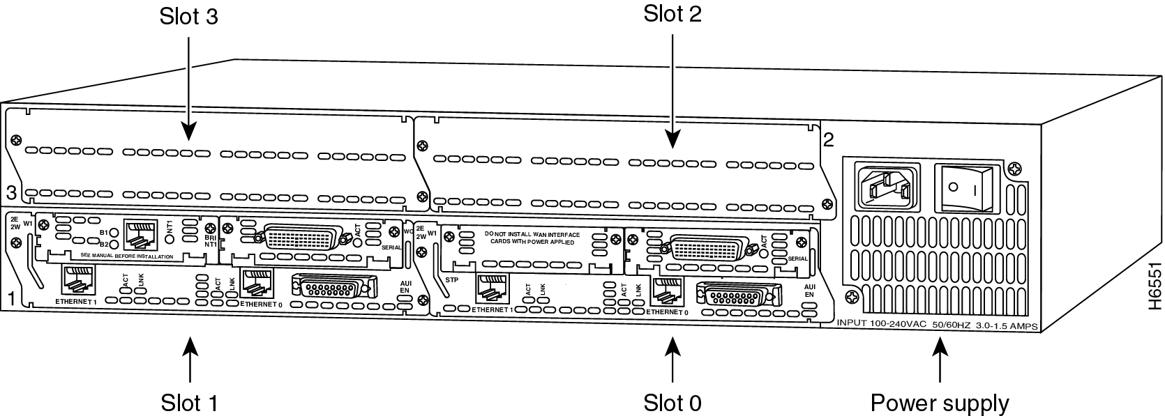
模块化端口
WAN串口可以采用模块化方式
WAN 接口卡
1603 路由器—背板一览
10BaseT以太网口
AUI以太网口
ISDN BRI S/T
控制口
模块
3640 路由器—
背板一览
Notes:
Purpose: This figure shows modular interface routers.
Emphasize: A modular interface router requires additional hardware network modules and/or WAN interface cards. This generally costs more than a fixed interface router. However, you have the flexibility to change the interface components as your network scales.
When configuring an interface on a fixed configuration router, some interfaces must be called out with the slot and port.
Note:
The figure displays a 1603 router with a 60-pin WAN interface card. It also displays a 3640 with an 8 port serial network module.
The laboratory exercise suggests the use of a 3640 as the core router. If you use this router, show the students the various network modules you have installed.

Slide 25
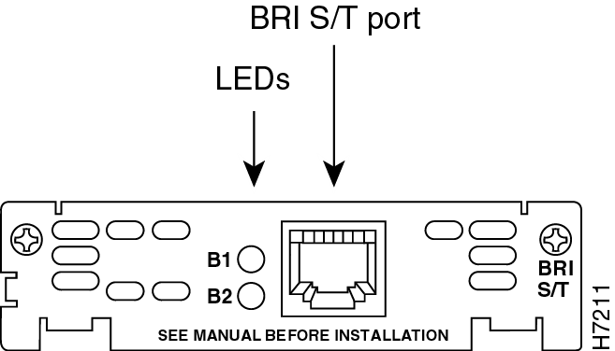
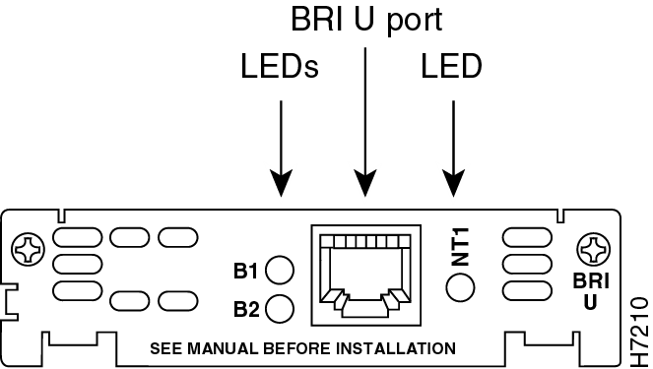
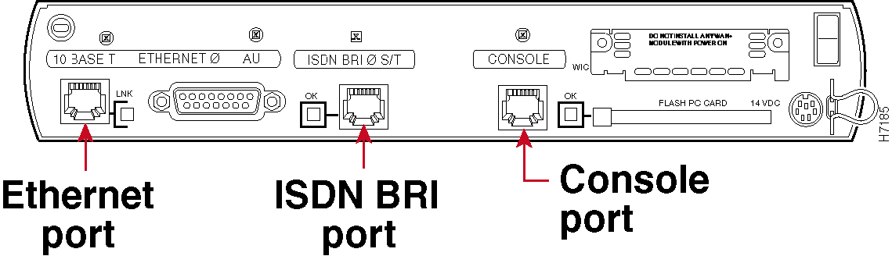
用ISDN连接路由器
确定是用BRI S/T或U端口
  路由器可能具有一种或两种类型的端口
注意端口类型
Notes:
Purpose: This figure describes which IADN BRI port may be required.
Emphasize: Routers with native ISDN BRI interfaces will have S/T or U interfaces. U interfaces have a built in NT1. S/T interfaces do not.
In the United States, the service provider generally requires that the customer supply the NT1. If you must supply the NT1, select a router with a U interface, or select a router with an S/T interface attached to an external NT1. In Europe, the NT1 is supplied by the service provider. So, acquire a device with and S/T interface.

Slide 26
用ISDN连接路由器(续)
Cisco 路由器
ISDN BRI 端口
!!!警告!!!
不要把非ISDN设备接入路由器的ISDN端口！
如果把非ISDN设备连入路由器ISDN端口将损坏该设备！
Notes:
Emphasize: Stress that damage to ISDN equipment will occur if you connect non-ISDN cables to ISDN ports, interface, and switches.
Transition: To configure ISDN or any network device parameters, you must have a console connection.

Slide 27
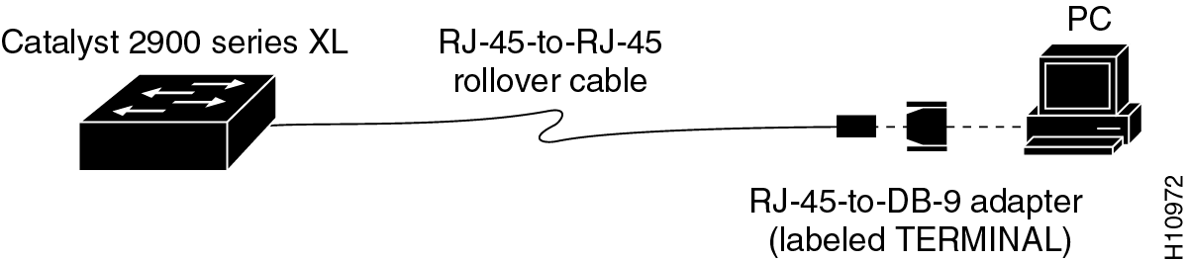
控制台连接
带控制口的设备
  PCs需要一个将RJ-45转换到DB-9或DB-25的转换器
  通讯口设置为9600波特率, 8个数据位, 不设奇偶校验位, 1个停止位, 不设流量控制
  这是通过控制口的一种管外管理方式
  AUX端口用于调制解调器的远程连接访问
Notes:
Emphasize:
Rollover cables are not the same as crossover cables. The pinouts for a rollover cable are 1-8, 2-7, 3-6, 4-5, 5-4, 6-3, and so on.
Students must also set up a HyperTerminal console session if they are on a Microsoft Windows ‘95 platform. The instructions to establish a console session using HyperTerminal are in the HyperTerminal appendix.

Slide 28
本章总结
通过本章的学习，您应该掌握以下内容:
  能够识别路由器或交换机之间连接所需要的连接组件，并能正确连接
  能够识别通过串口或ISDN BRI口连接WAN所需要的连接组件，并能正确连接
  在路由器或交换机与一个终端之间建立控制台连接
  正确记录包括每个互连网设备的连接类型和连接位置等在内的物理拓扑信息
Notes:
Purpose: Review the summary items with your students.
Emphasize: Read or restate the summary statements. By now, your presentation and classroom discussion should have students able to meet the chapter learning objectives.

Slide 29
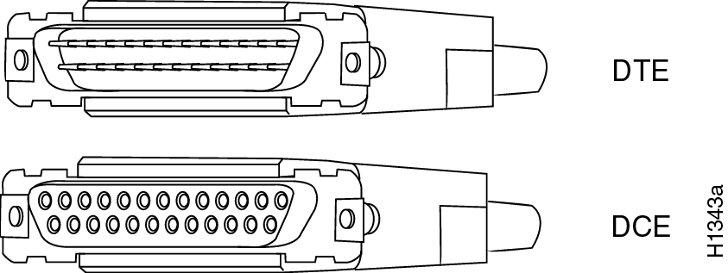
问题回顾
  1. 说明实现以太局域网所基于的三个标准.
  2. 如果需将交换机之间的连接升级到100BaseT, 应该选择什么线类?
  3. 判断下列引脚情况是直连线或交叉线或翻转线?
  4. 下列各类连接器分别可用于哪些介质?
1
8
1
8
w
0
o
w
g
w
b
b
g
w
br
br
w
g
g
w
o
w
b
b
o
w
br
br
A
B
C
Notes:
Purpose: Review the chapter with open ended questions.
Note: The questions in this section are open ended questions designed to foster further discussion.
Answers the the review questions are in the “Answers” appendix.

