Slide 1
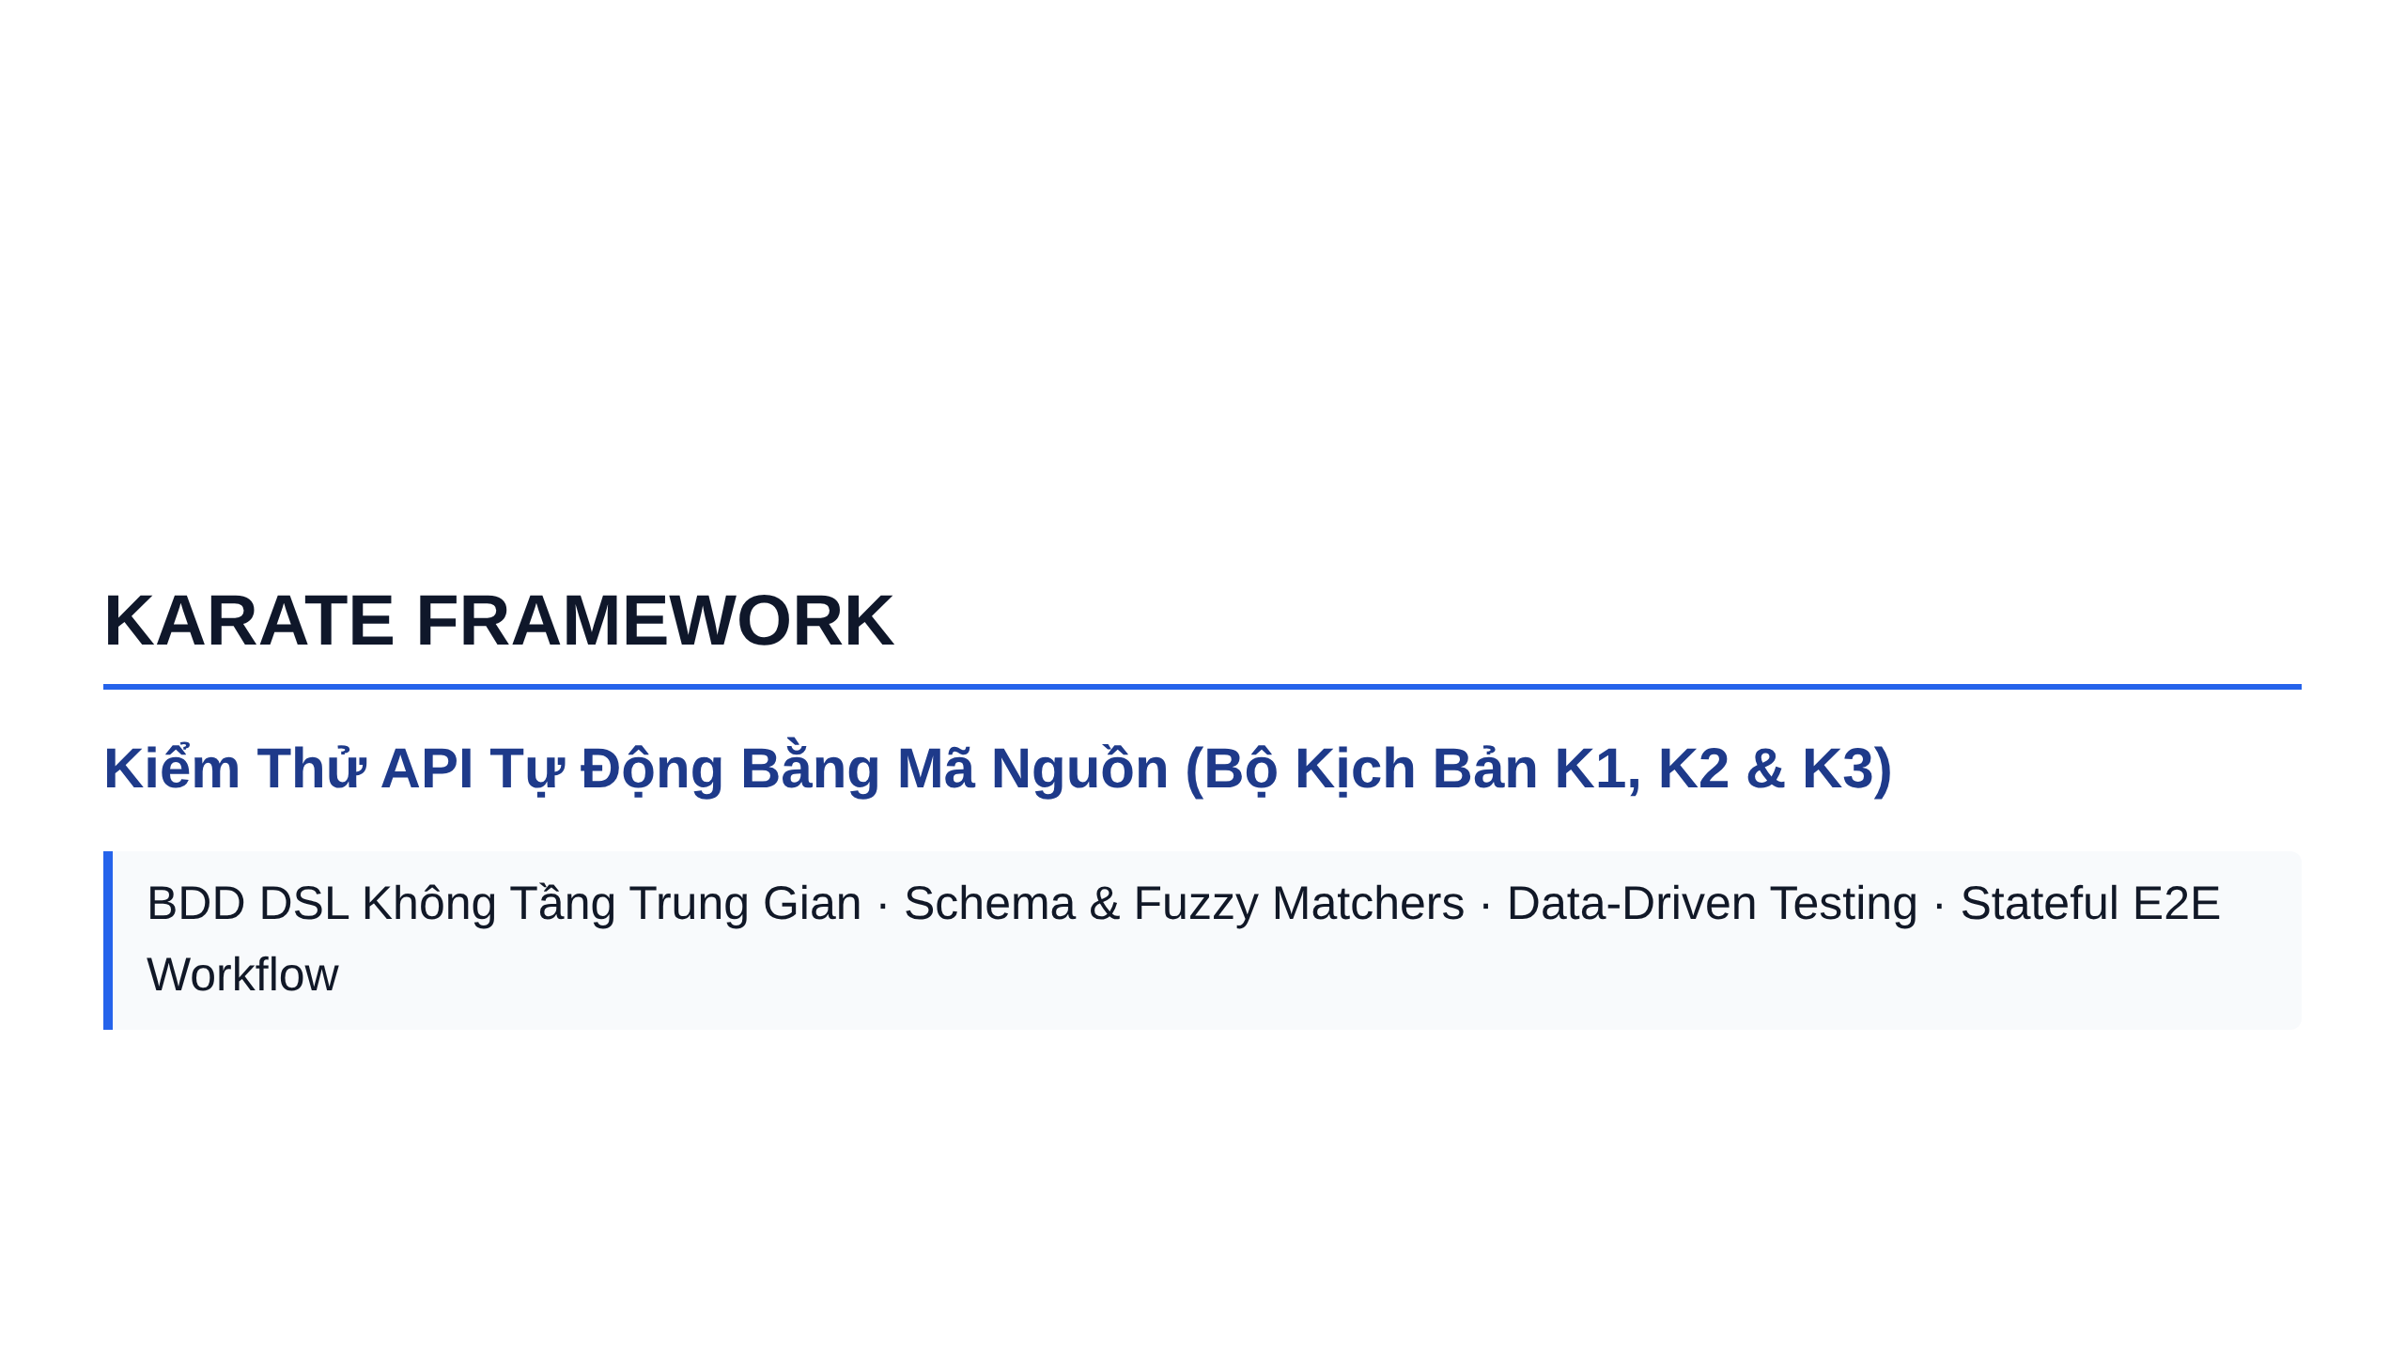
Notes:
Slide 1: Section Title Slide

Slide 2
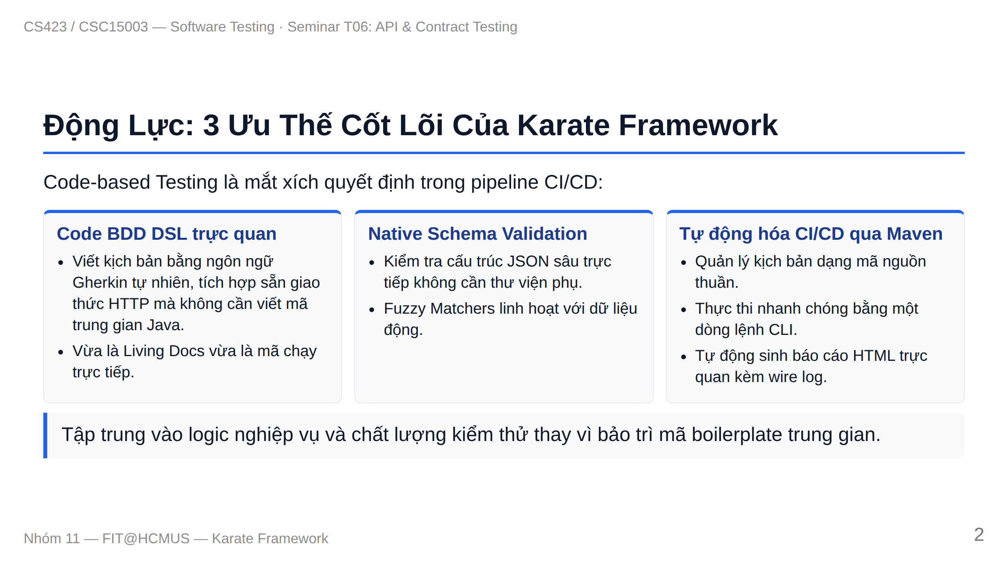
Notes:
Slide 2: Motivation & Core Advantages

Slide 3
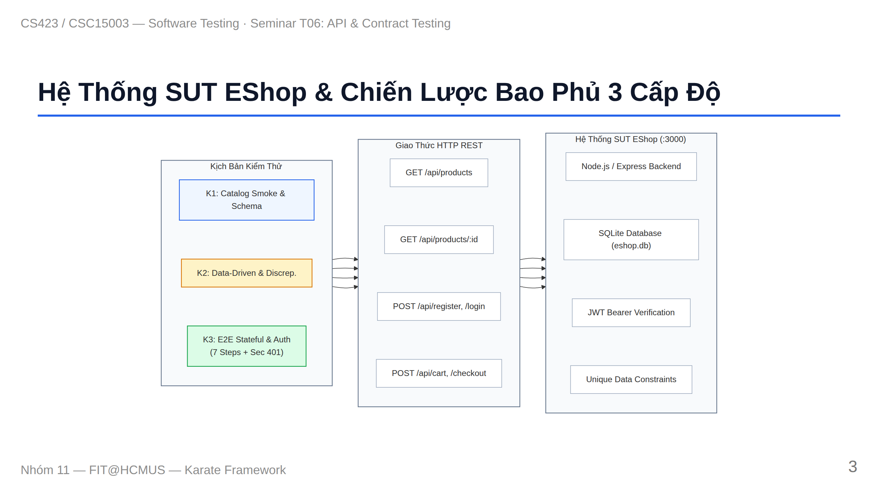
Notes:
Slide 3: SUT Context & 3 Levels Coverage

Slide 4
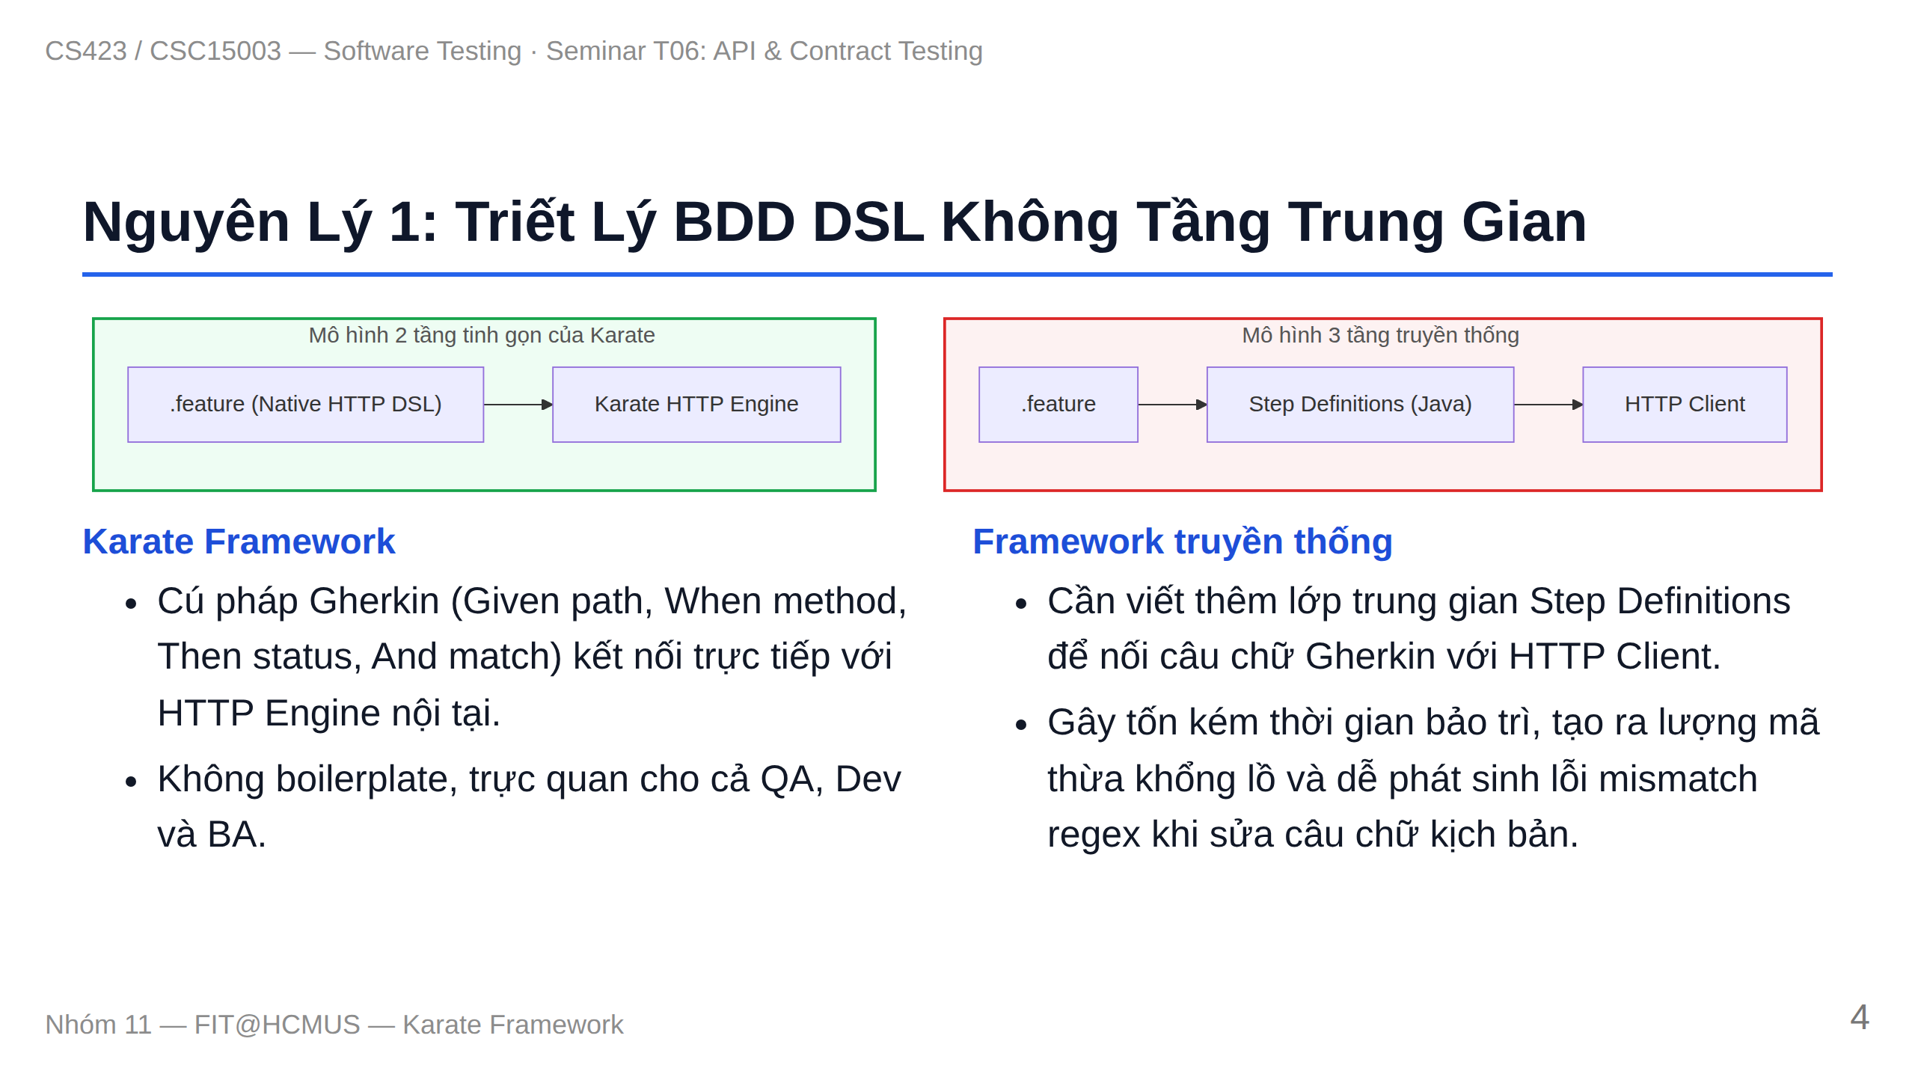
Notes:
Slide 4: Principle 1 - No Step Definitions

Slide 5
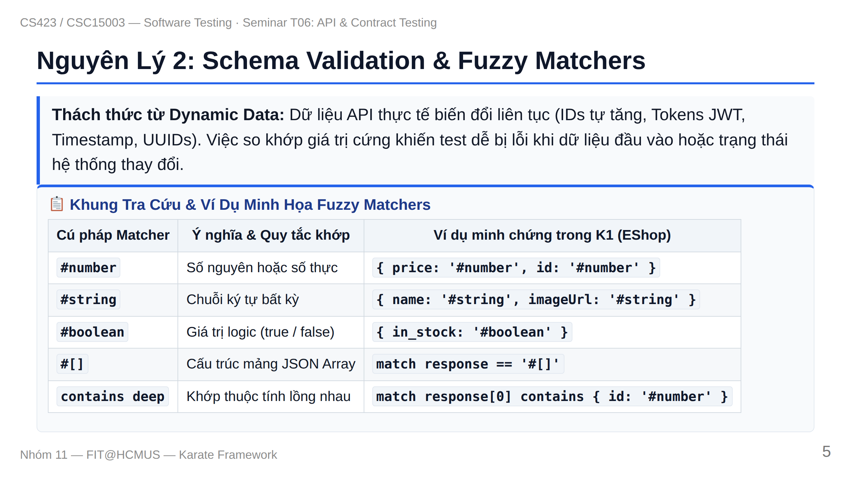
Notes:
Slide 5: Principle 2 - Schema & Fuzzy Matchers

Slide 6
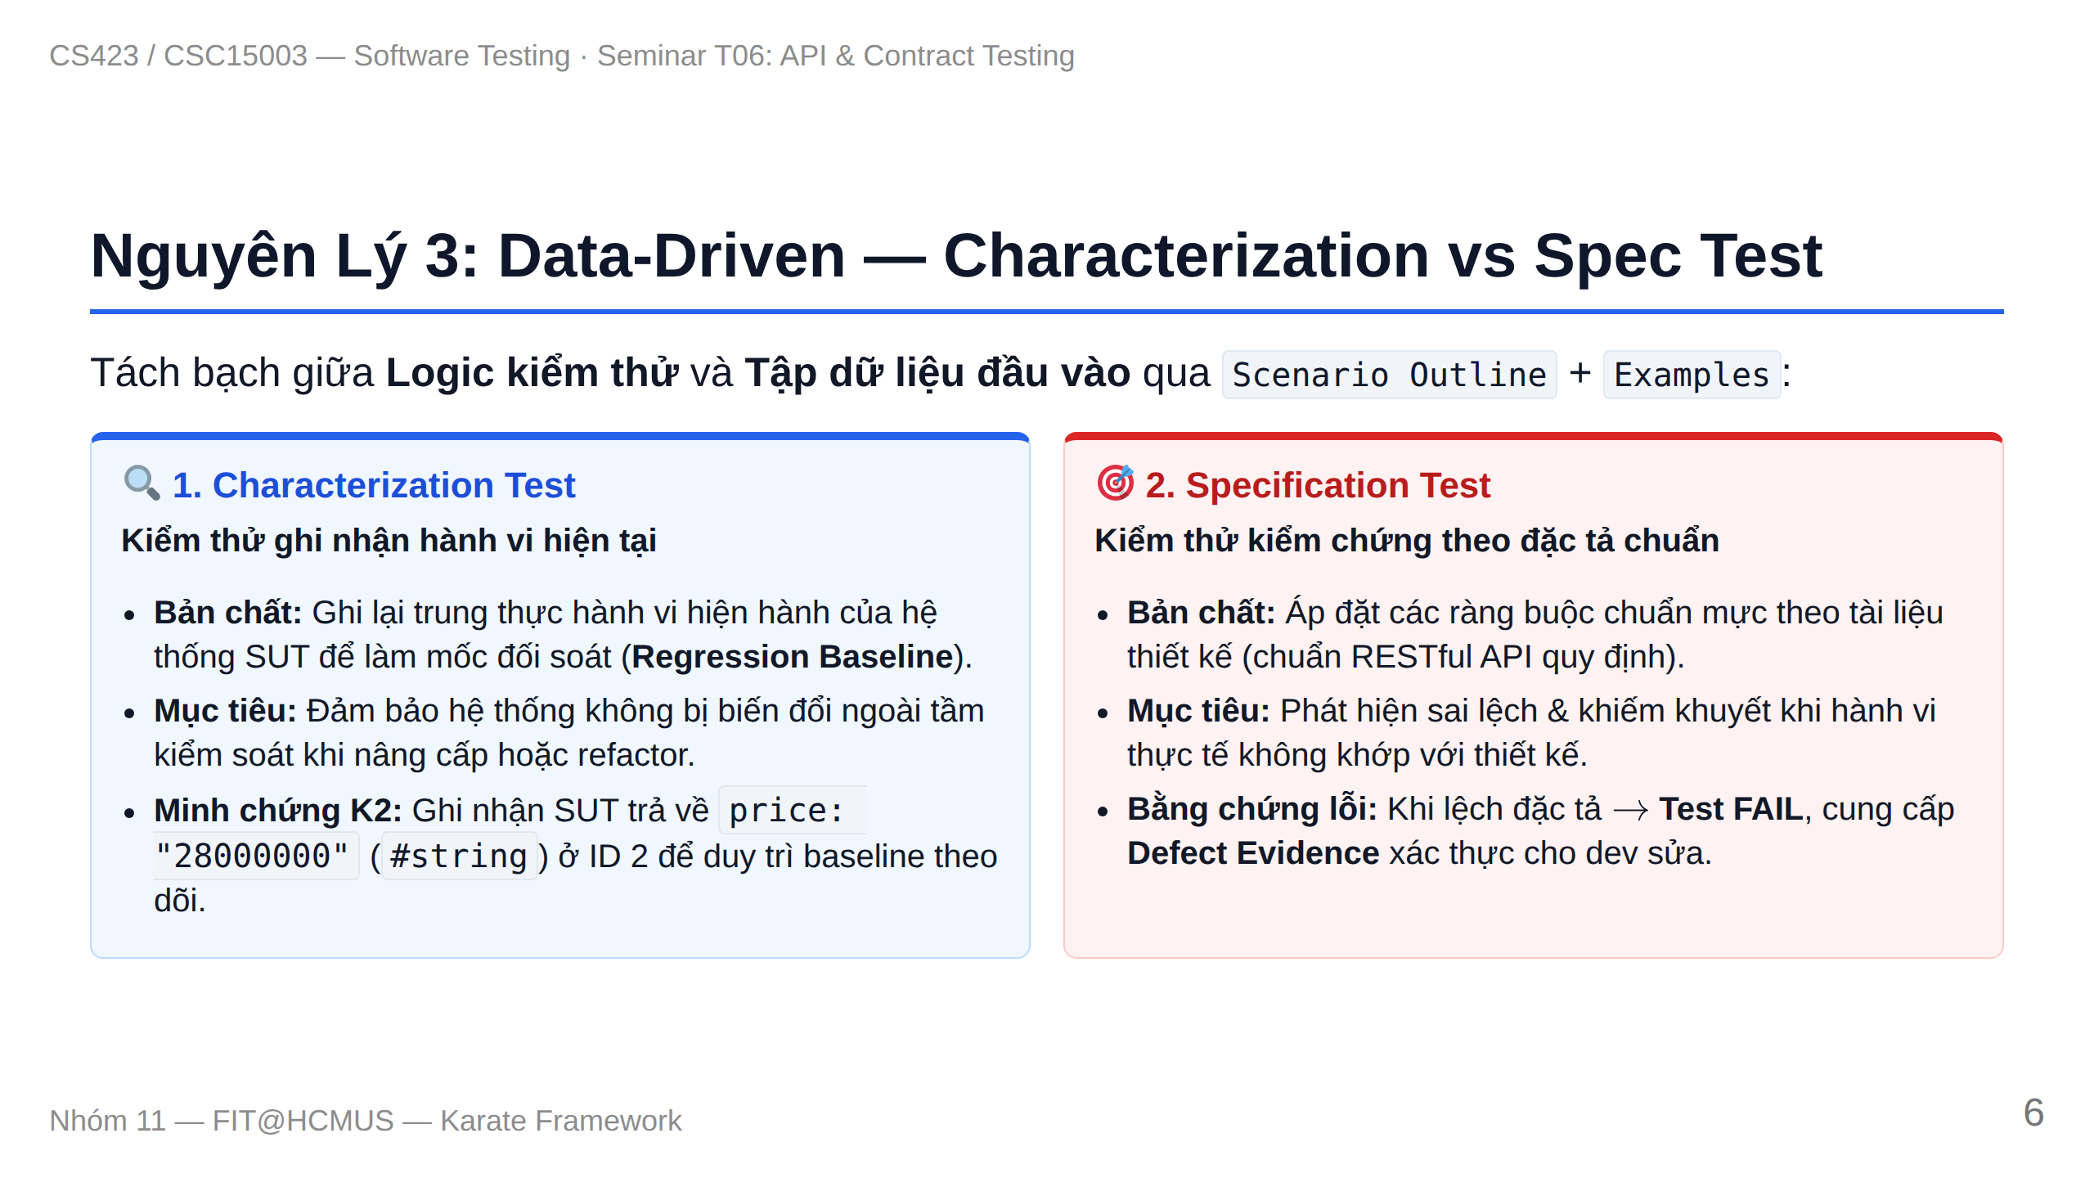
Notes:
Slide 6: Principle 3 - Data-Driven Testing

Slide 7
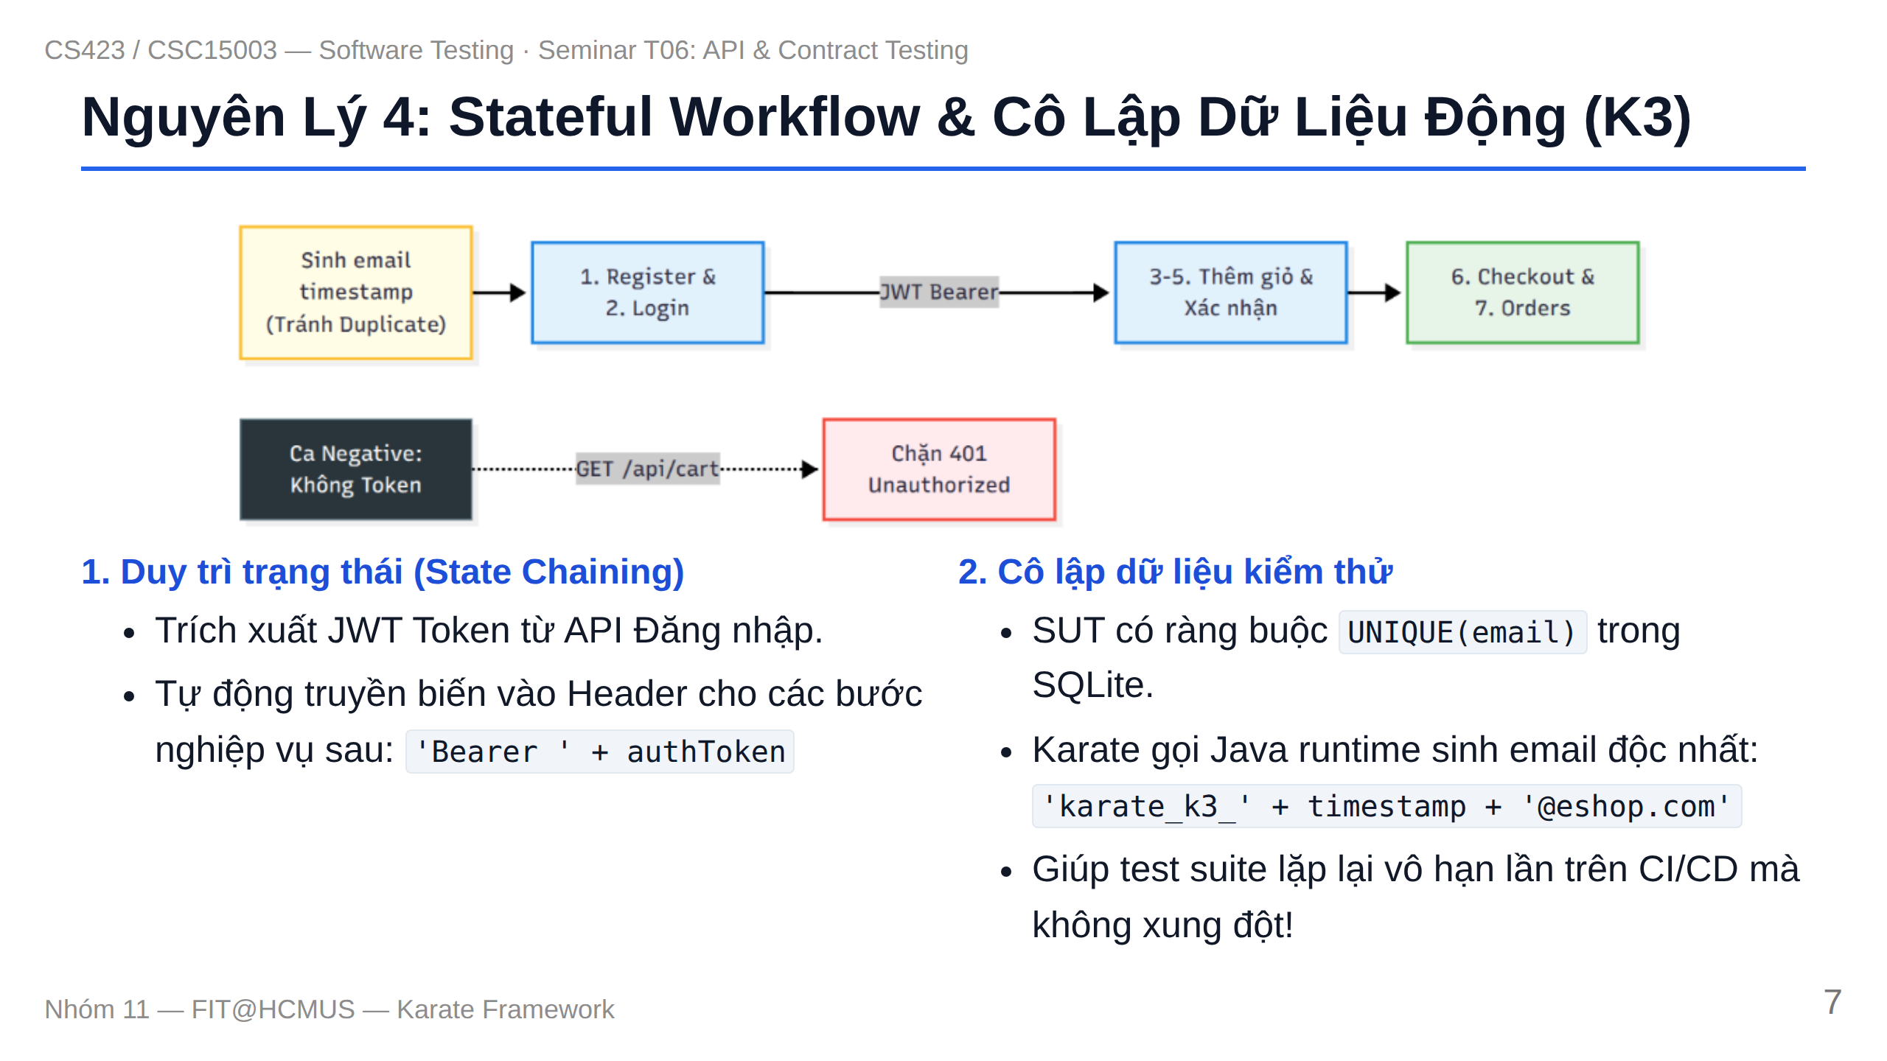
Notes:
Slide 7: Principle 4 - Stateful Workflow & Isolation

Slide 8
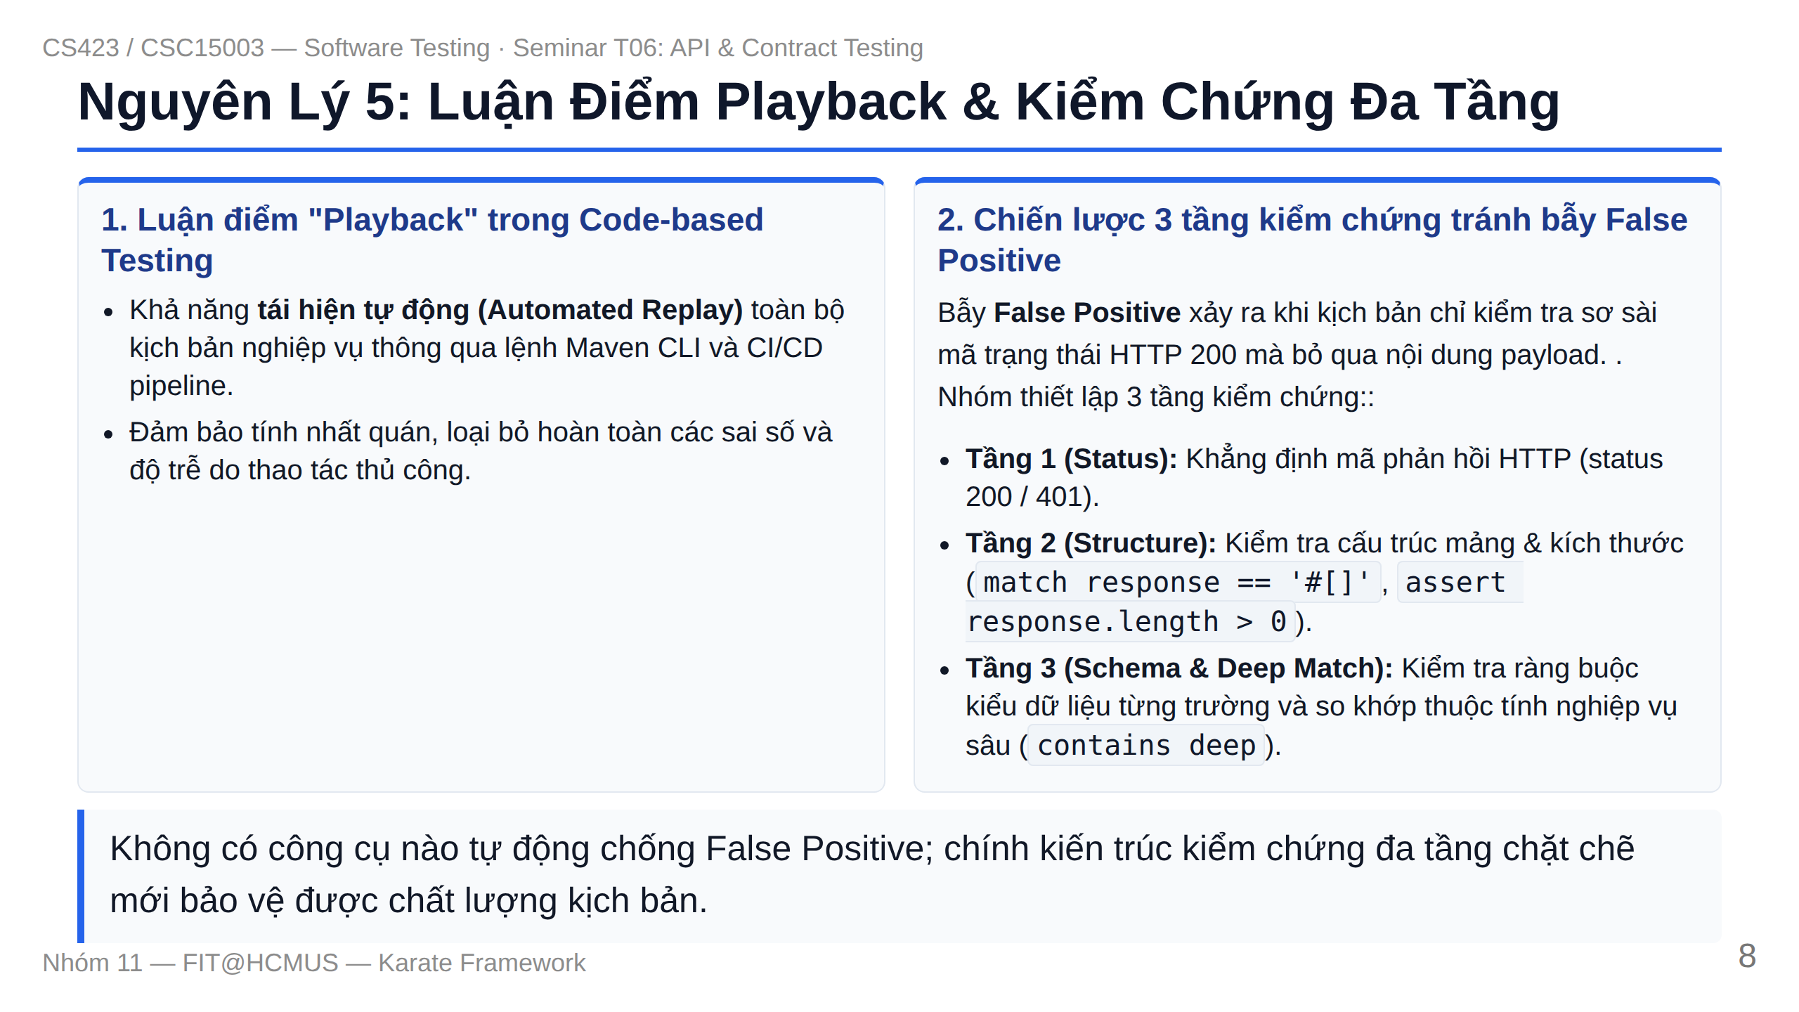
Notes:
Slide 8: Principle 5 - Playback & Multi-Layer Assertions

Slide 9
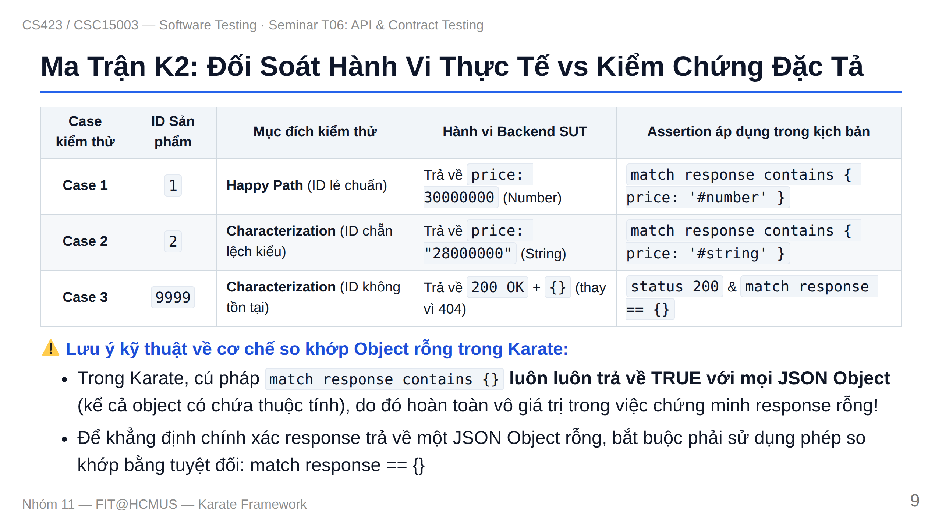
Notes:
Slide 9: Matrix K2 & Discrepancies

Slide 10
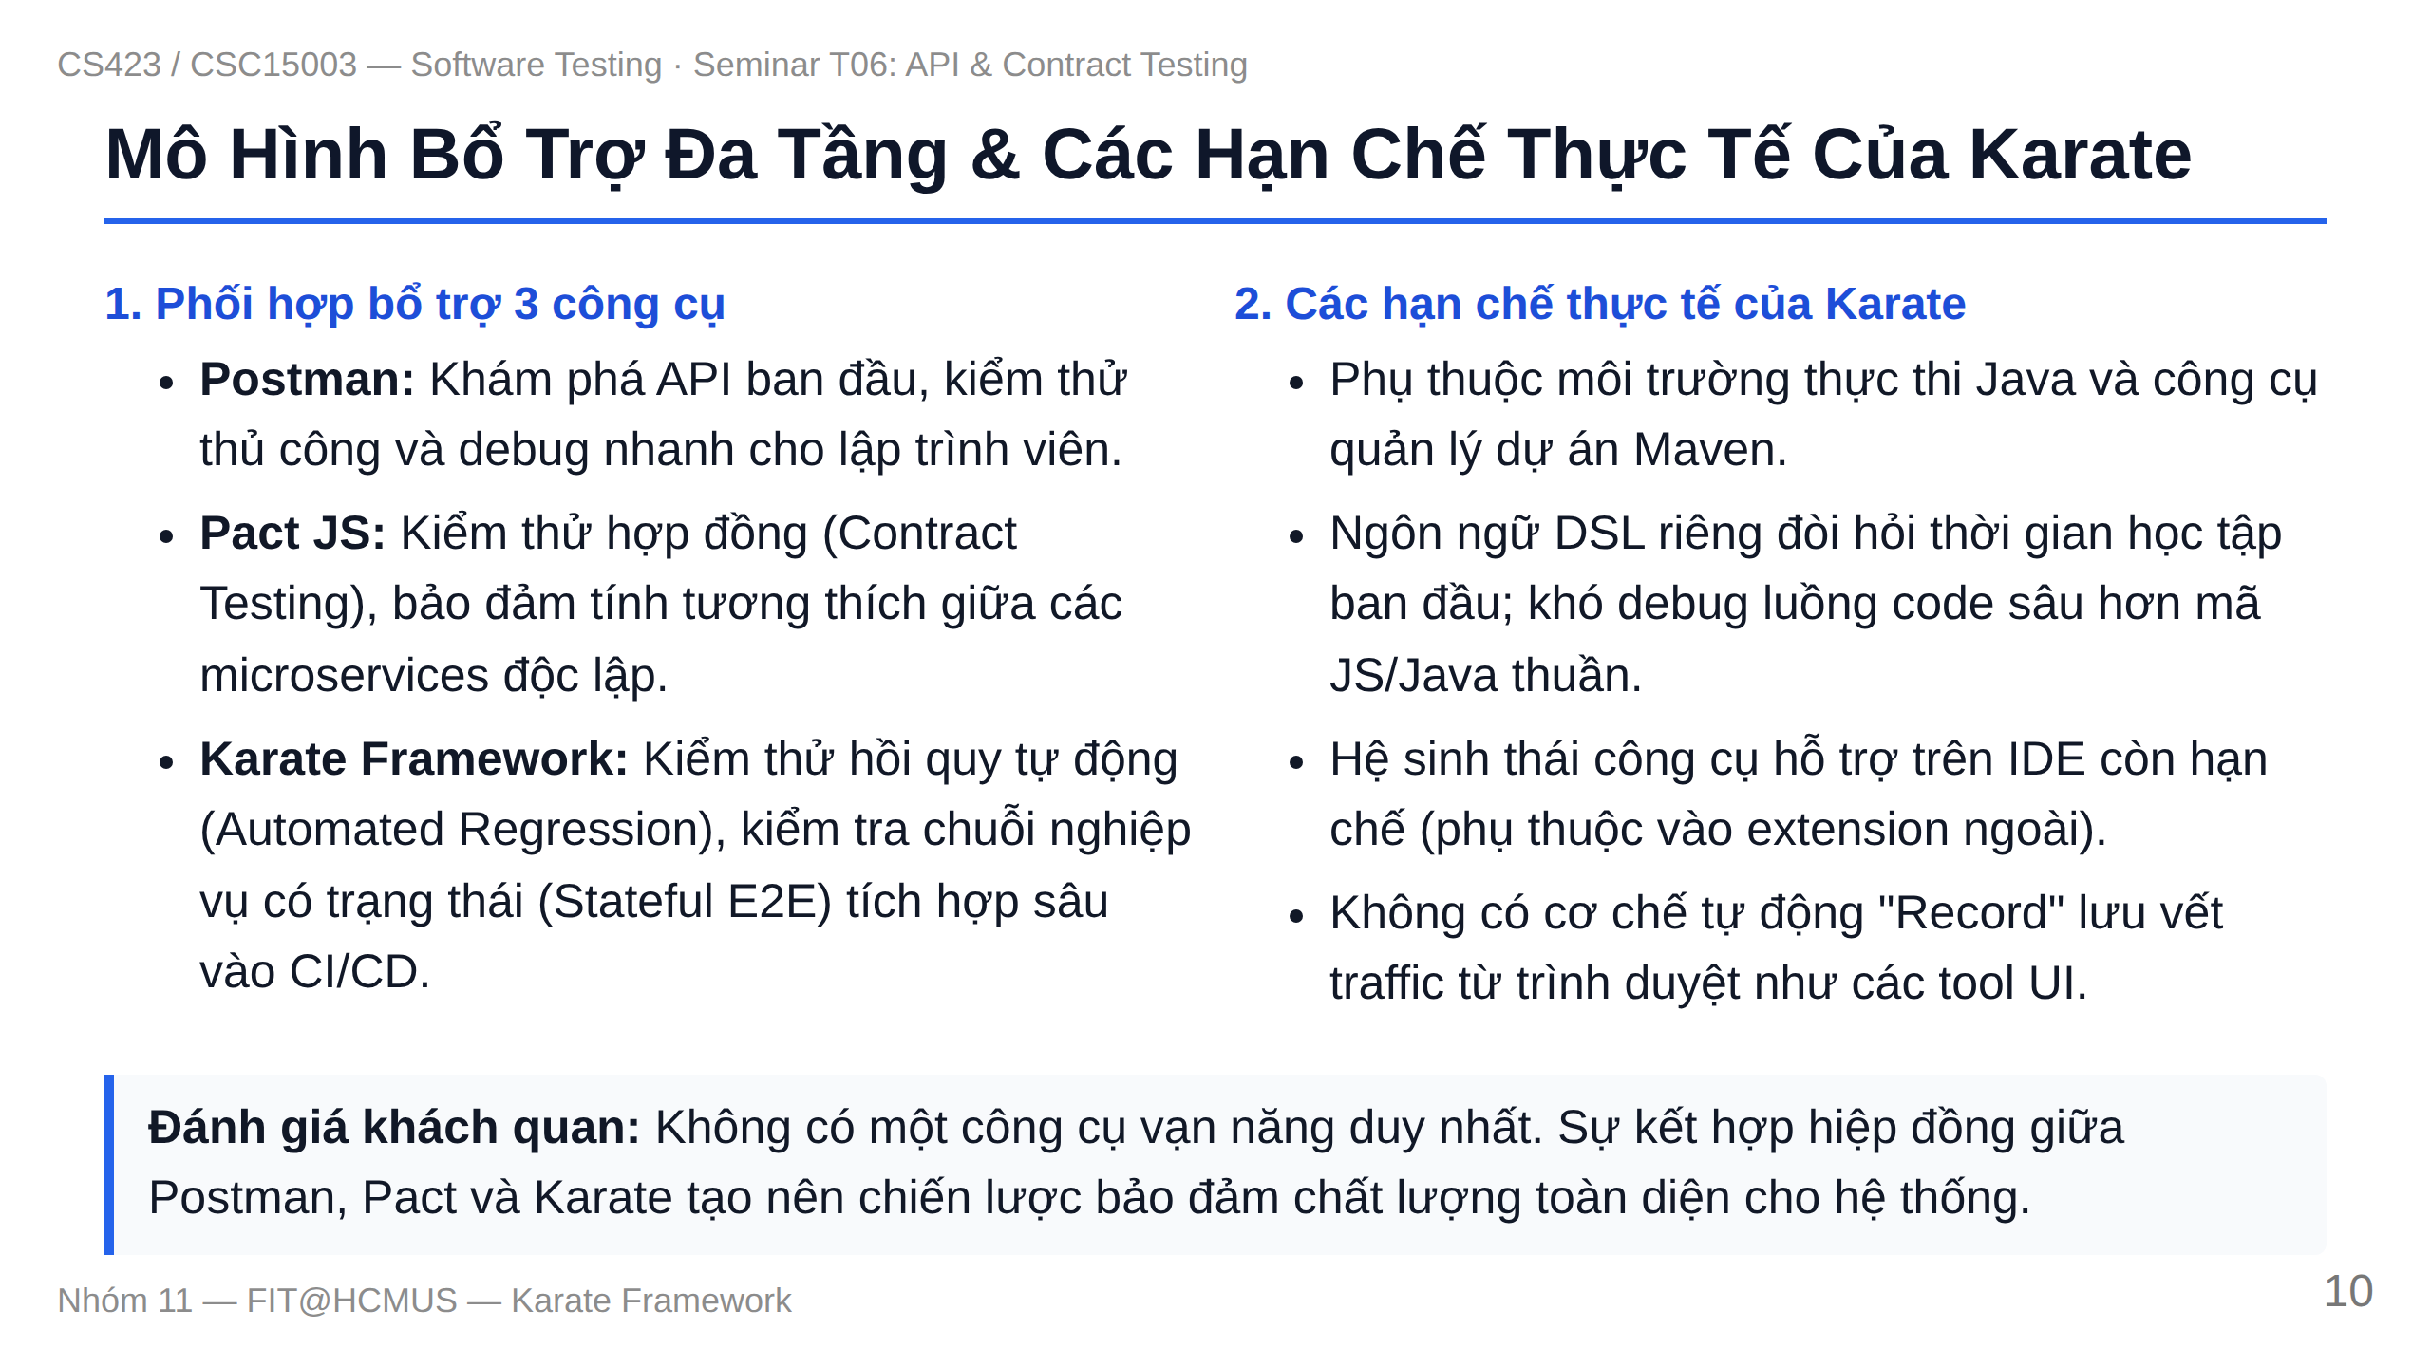
Notes:
Slide 11: Multi-Tool Synergy & Limitations

