Slide 1
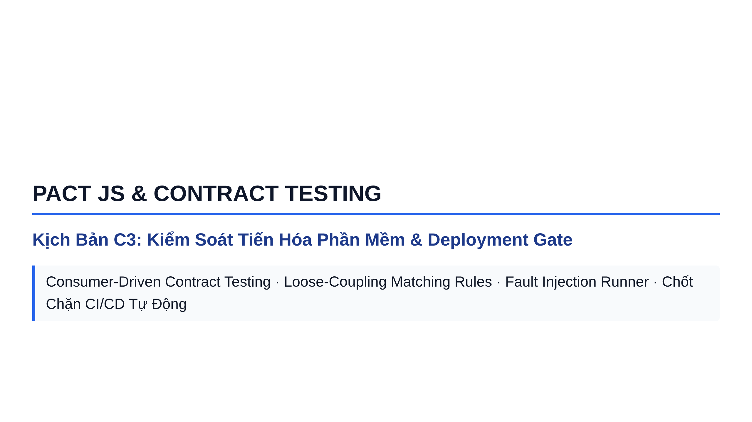
Notes:
Slide 1: Section Title Slide

Slide 2
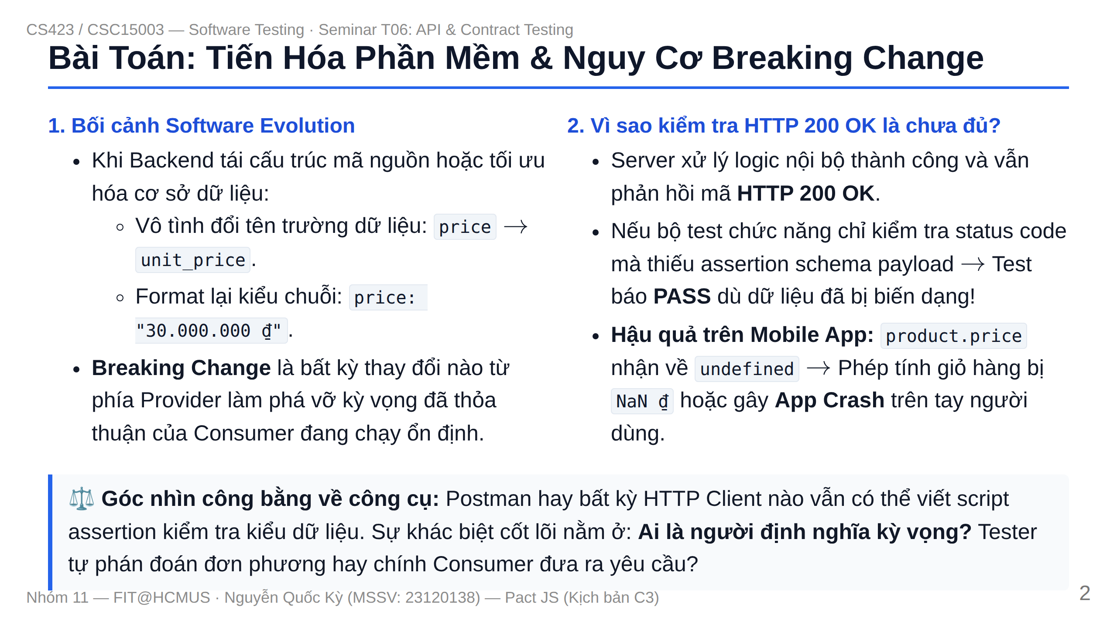
Notes:
Slide 2: Problem - Software Evolution & Breaking Changes

Slide 3
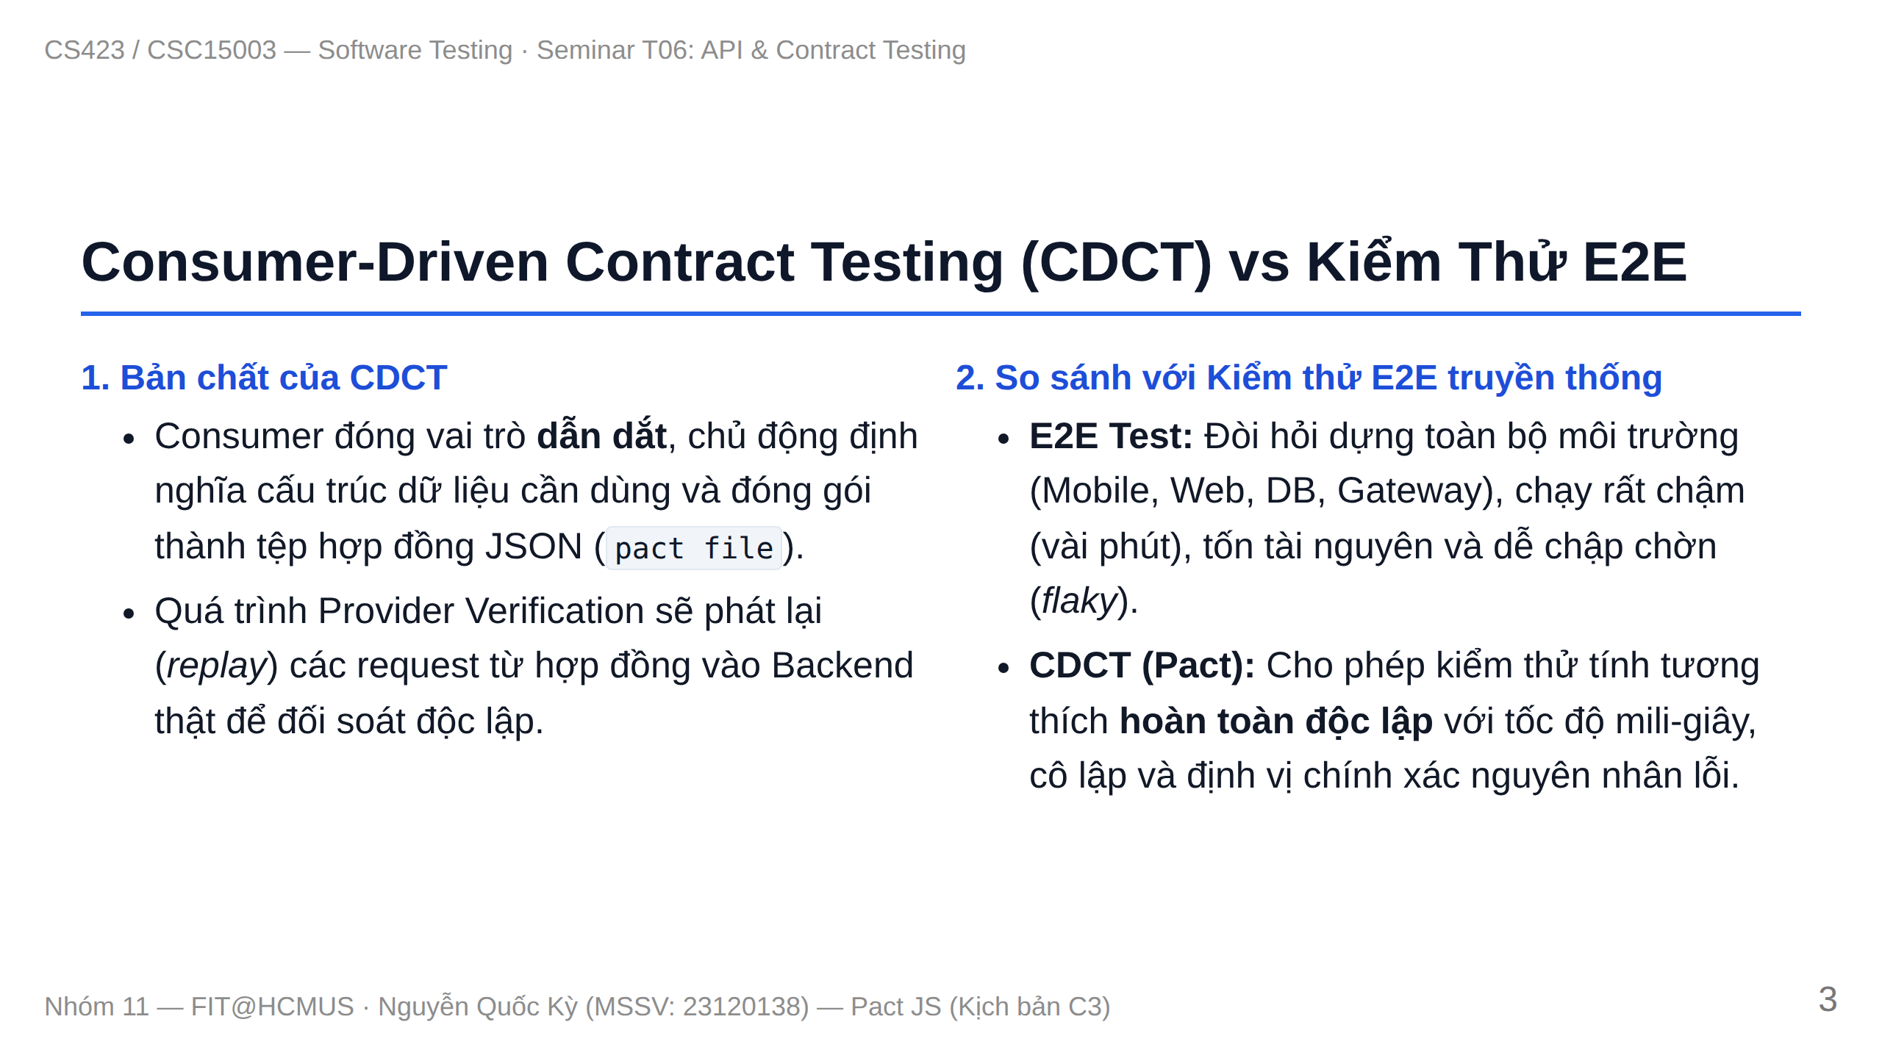
Notes:
Slide 3: CDCT Sequence & E2E Comparison

Slide 4
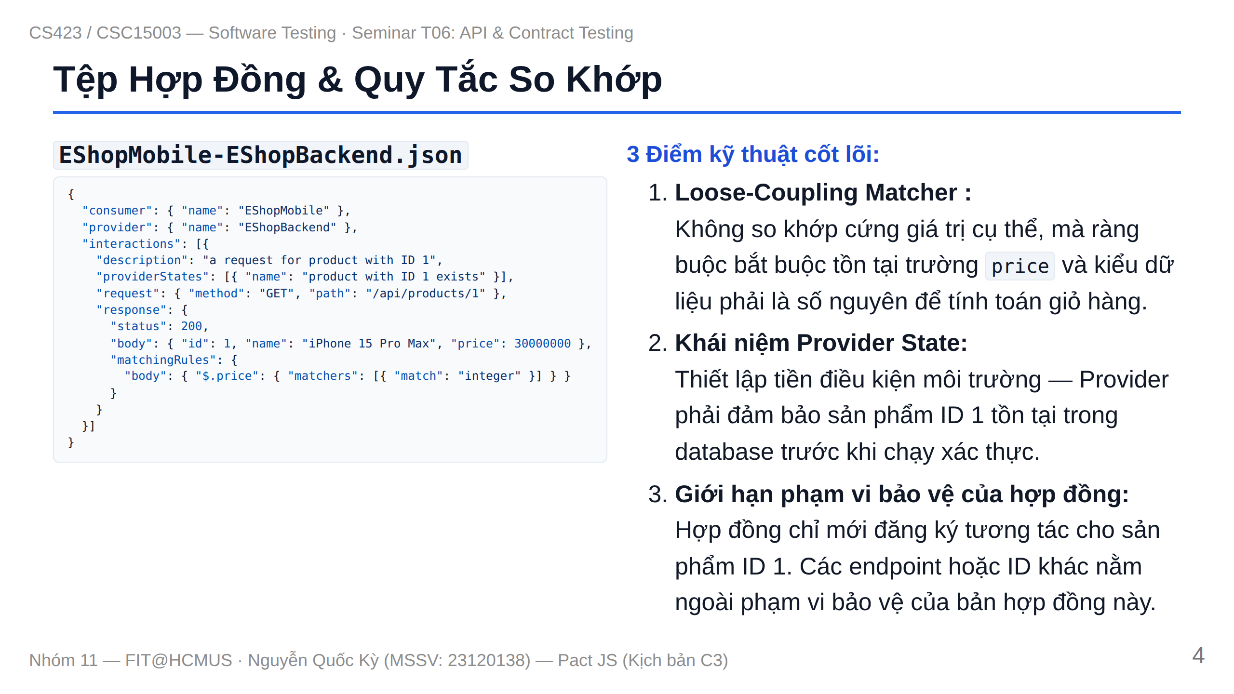
Notes:
Slide 4: Contract JSON, Matching Rules & Provider State

Slide 5
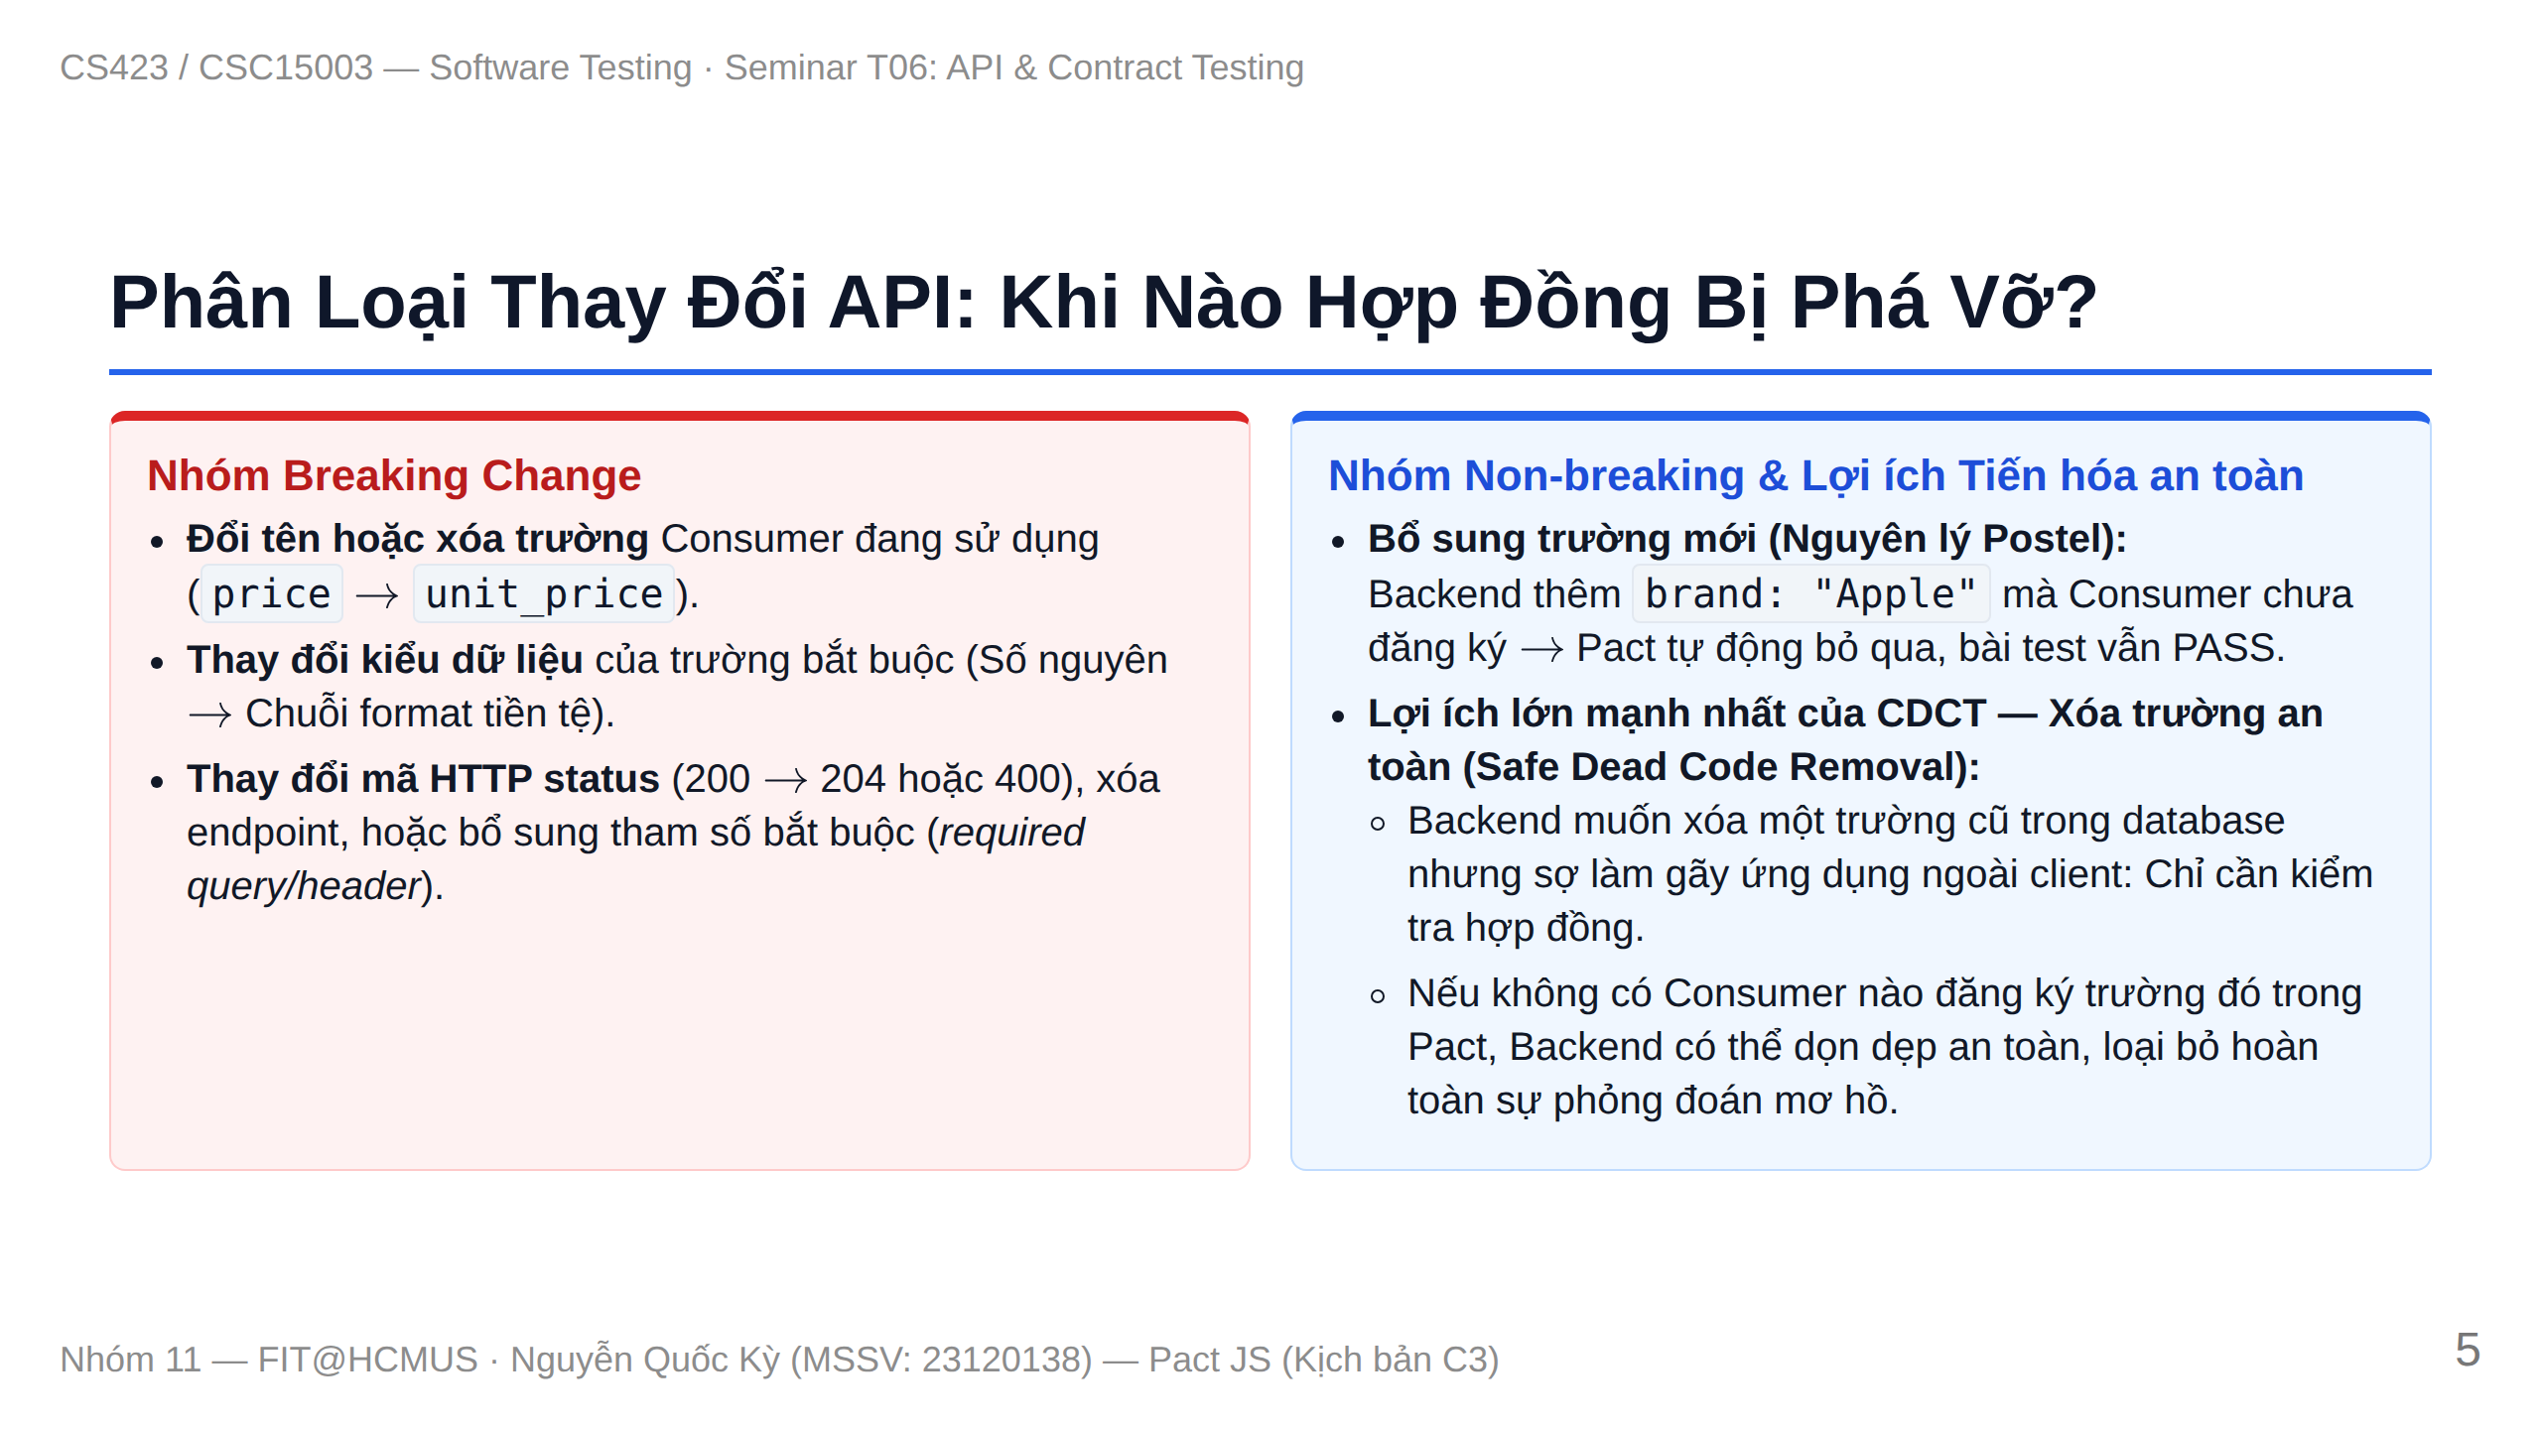
Notes:
Slide 5: Breaking vs Non-breaking & Safe Field Removal

Slide 6
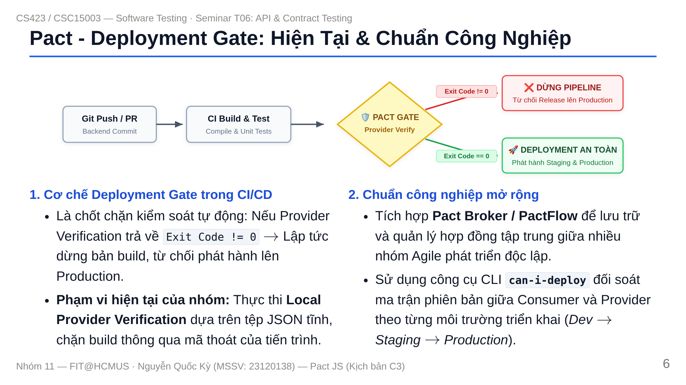
Notes:
Slide 6: Deployment Gate & Pact Broker Roadmap

Slide 7
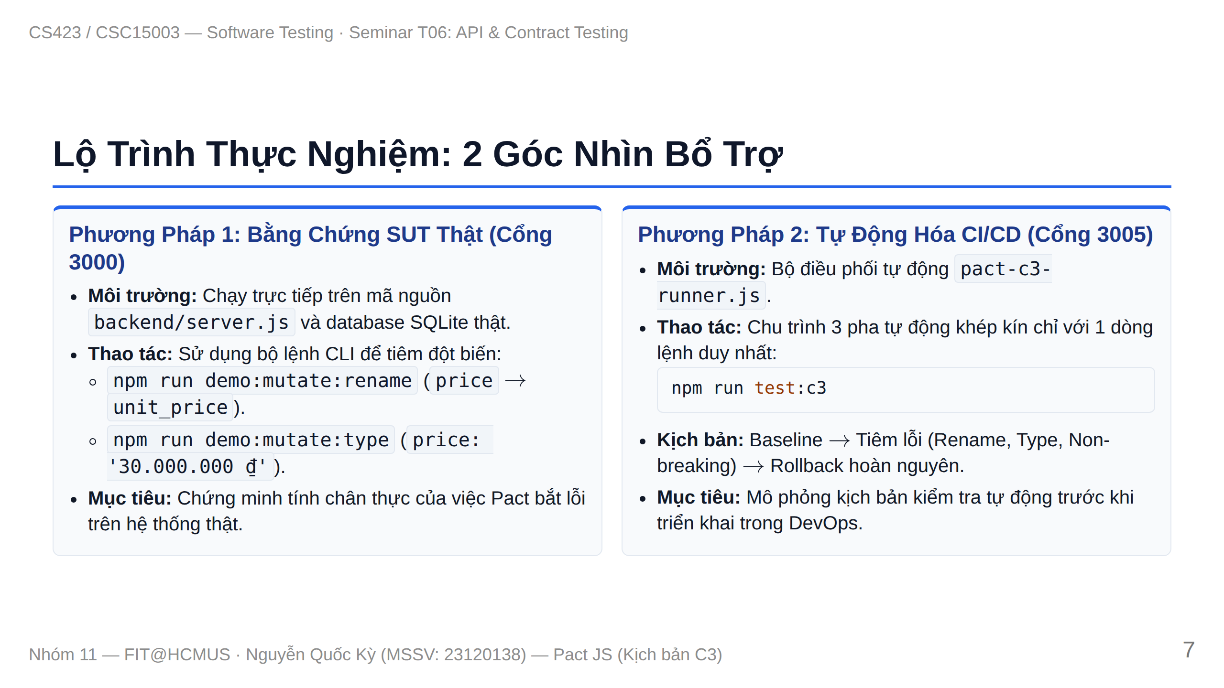
Notes:
Slide 7: Roadmap - 2 Experimental Methods

Slide 8
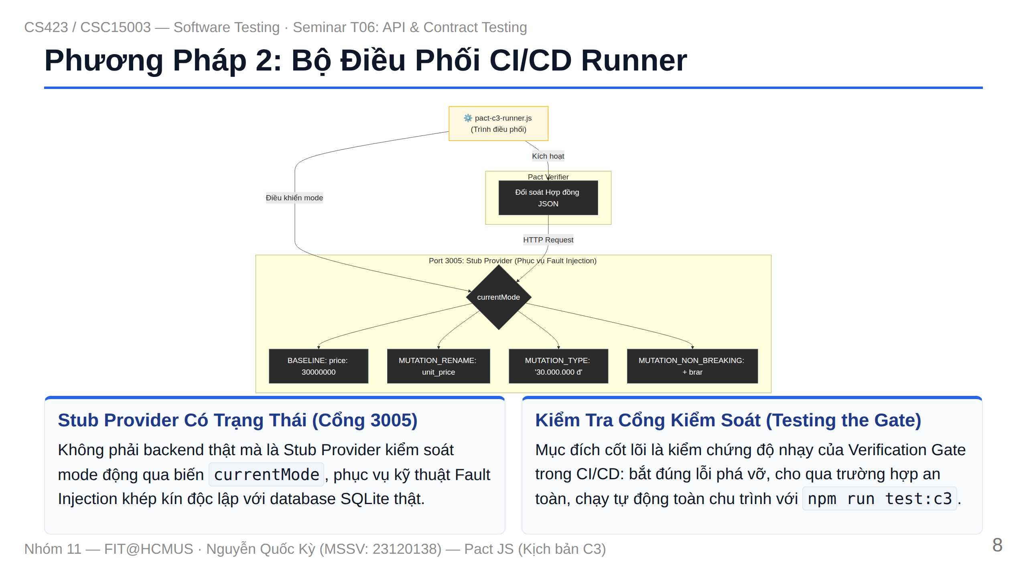
Notes:
Slide 8: Method 2 CI/CD Runner & Stub Architecture

Slide 9
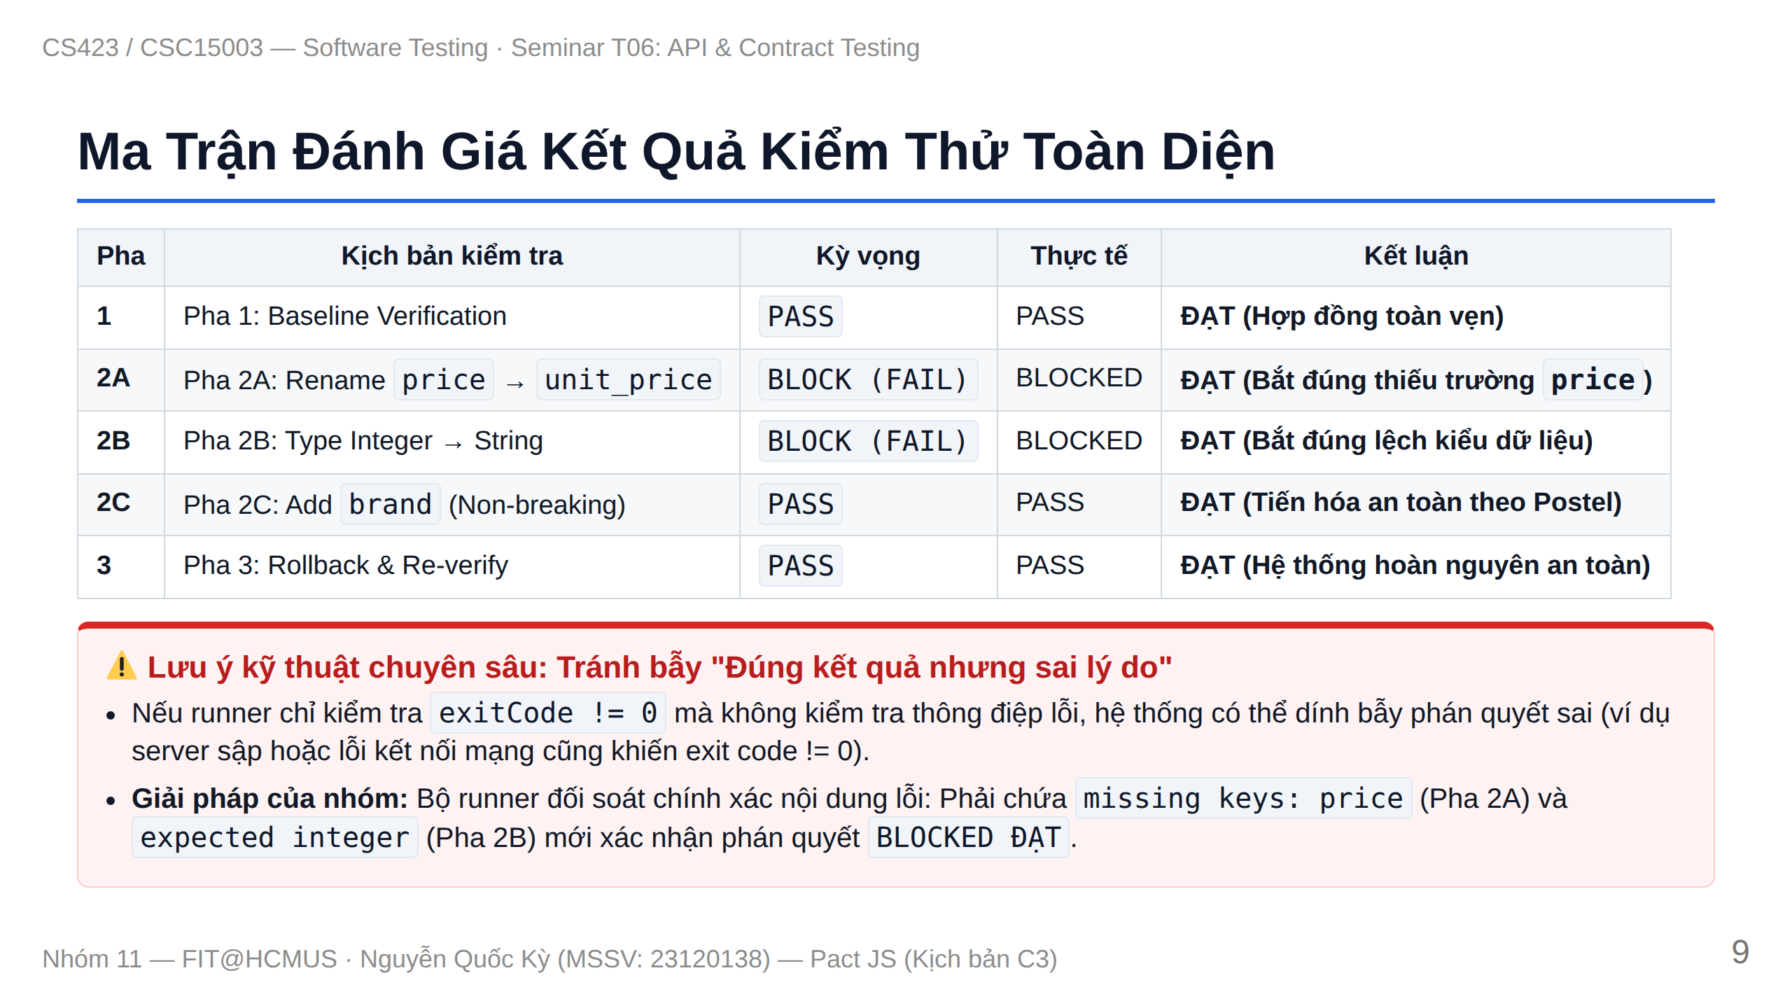
Notes:
Slide 9: Experimental Results Matrix & Assertion Caveat

Slide 10
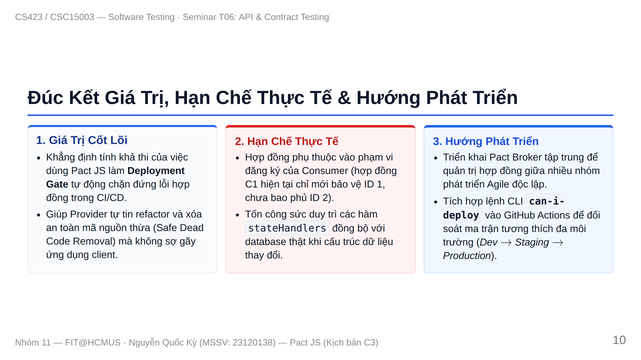
Notes:
Slide 10: Retrospective, Limitations & Future Roadmap

Slide 11
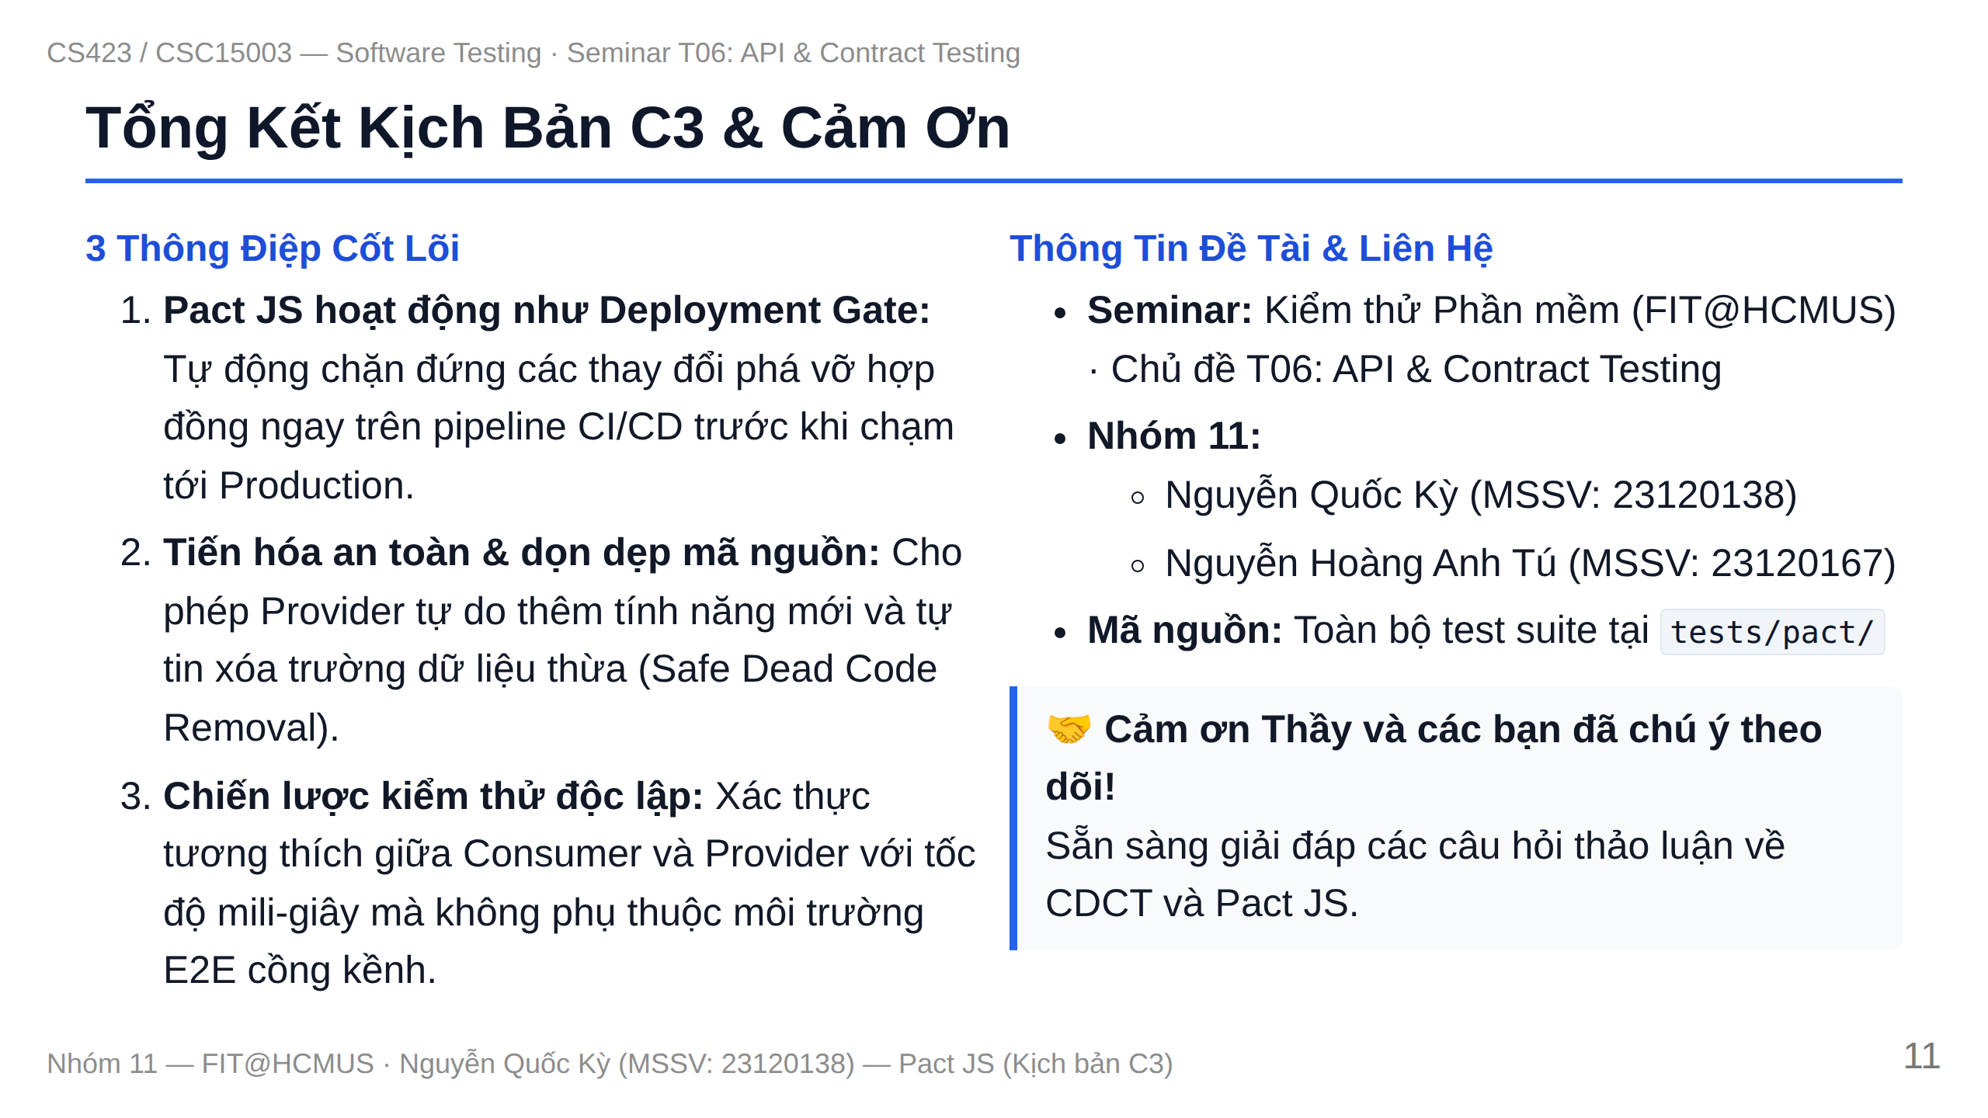
Notes:
Slide 11: Summary & Conclusion

