Slide 1
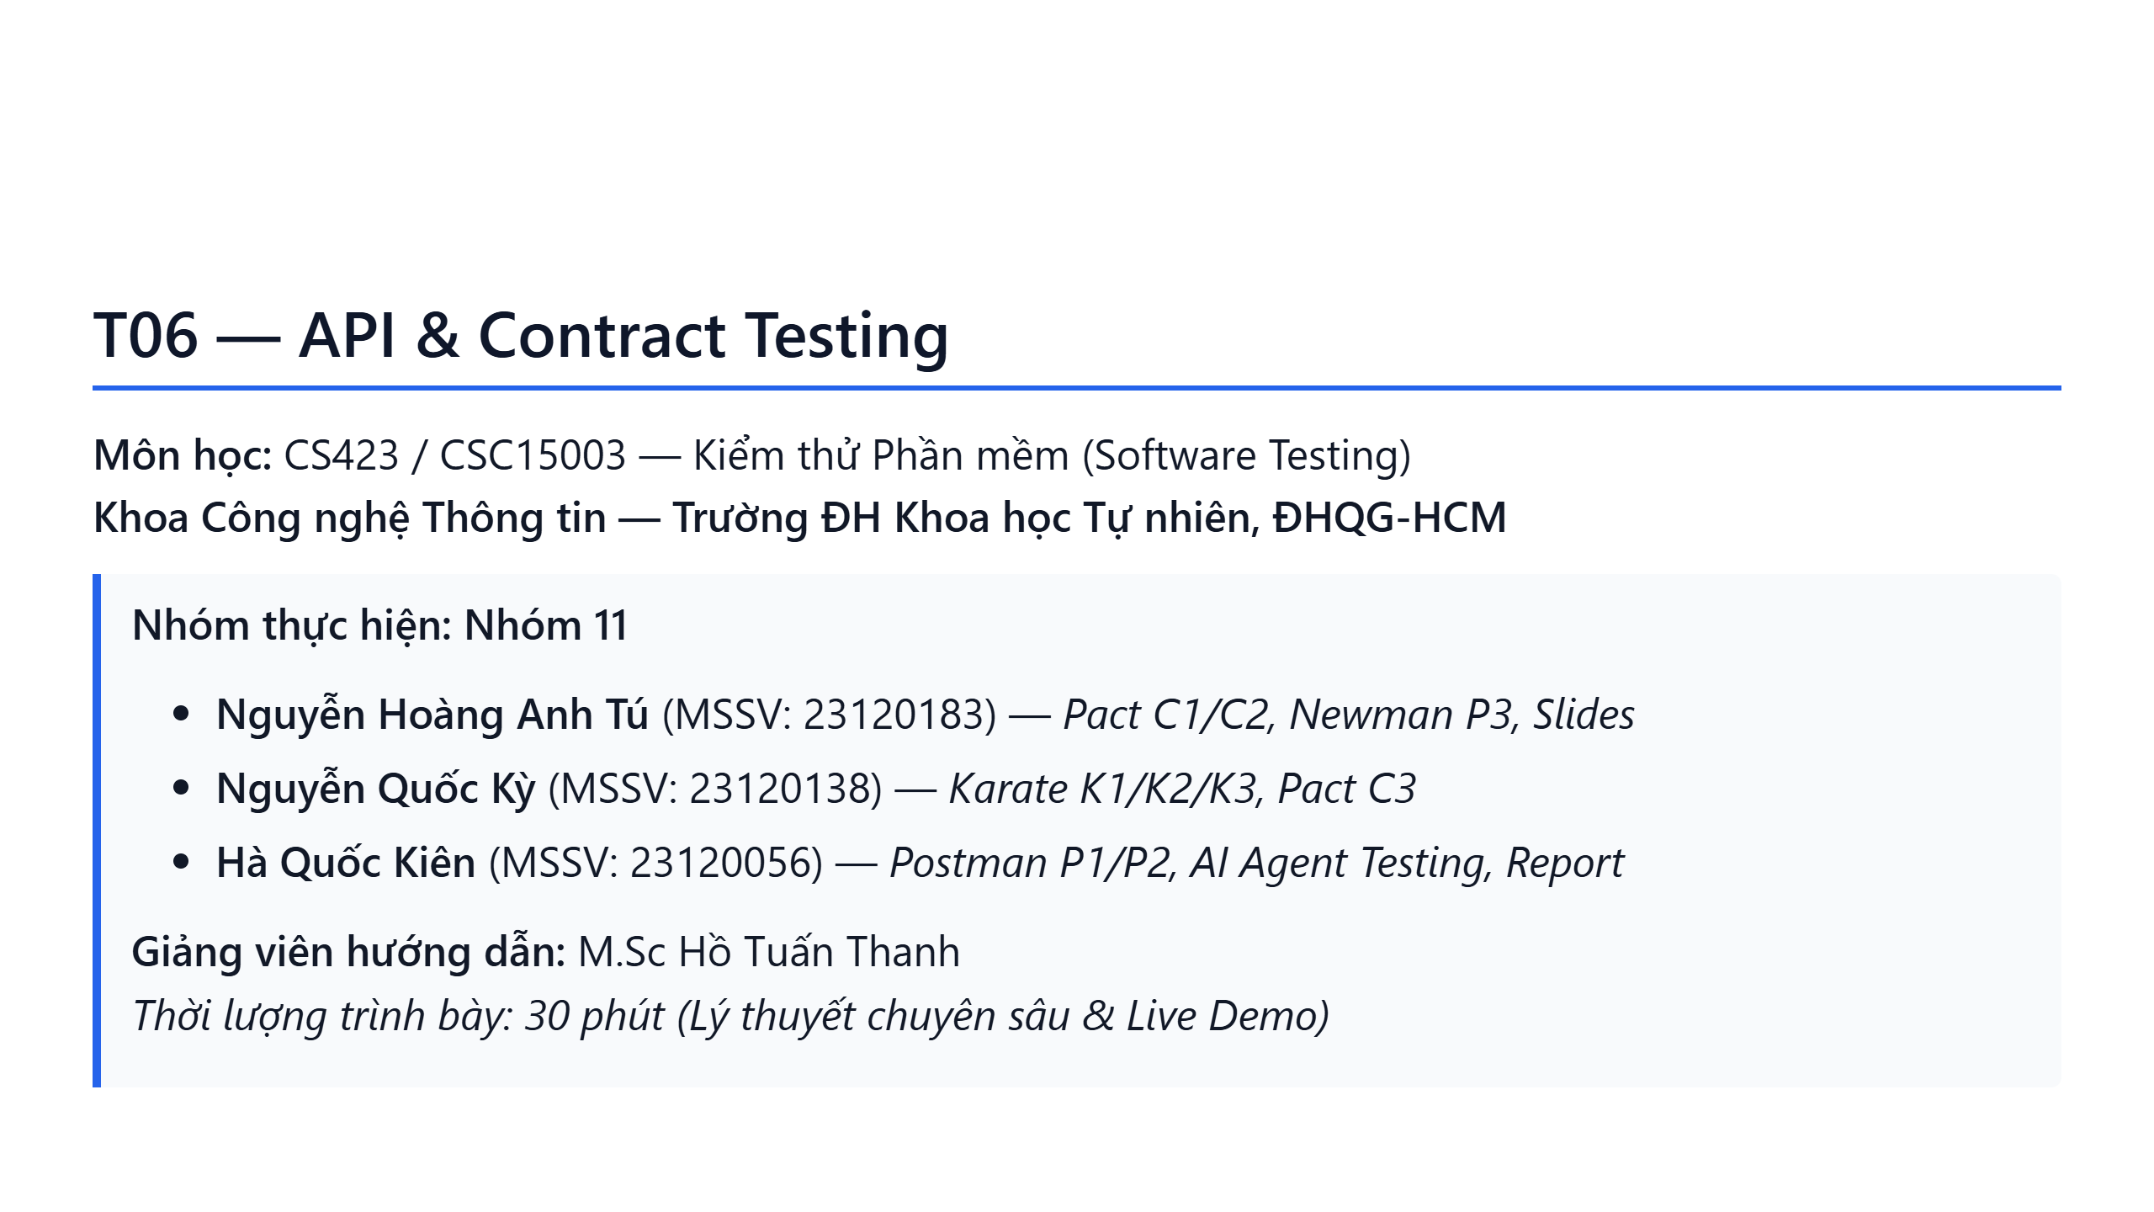
Notes:
Slide 1: Title Slide

Slide 2
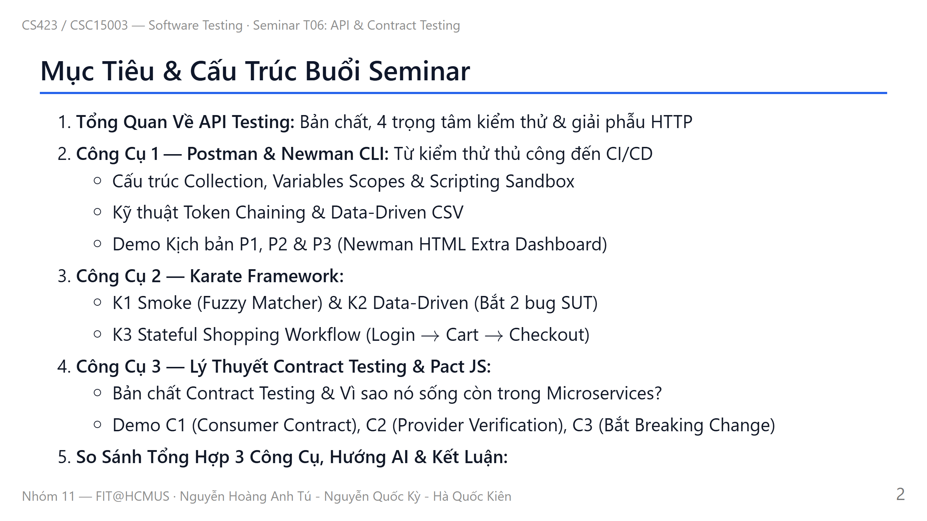
Notes:
Slide 2: Agenda

Slide 3
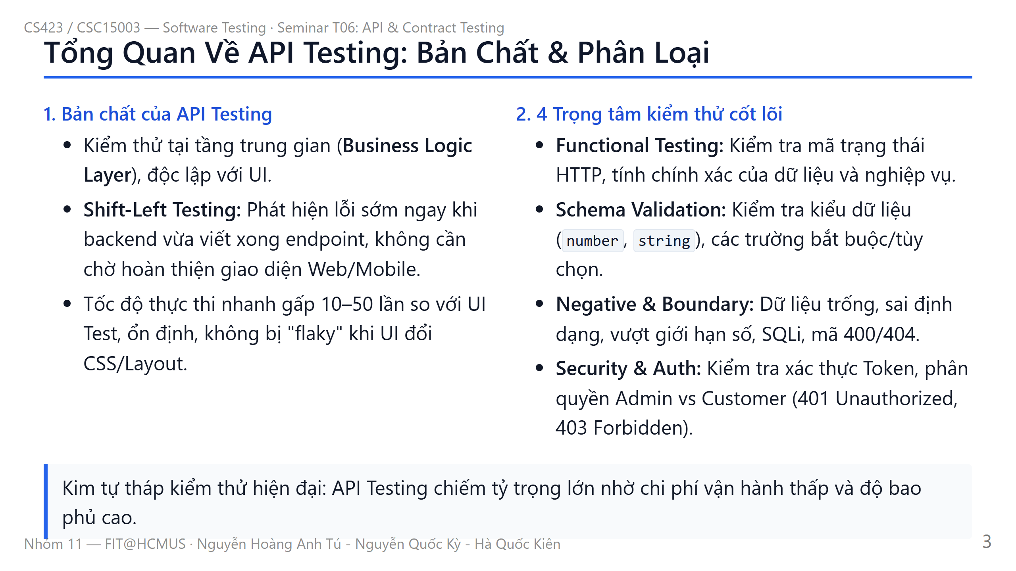
Notes:
Slide 3: API Testing Fundamentals

Slide 4
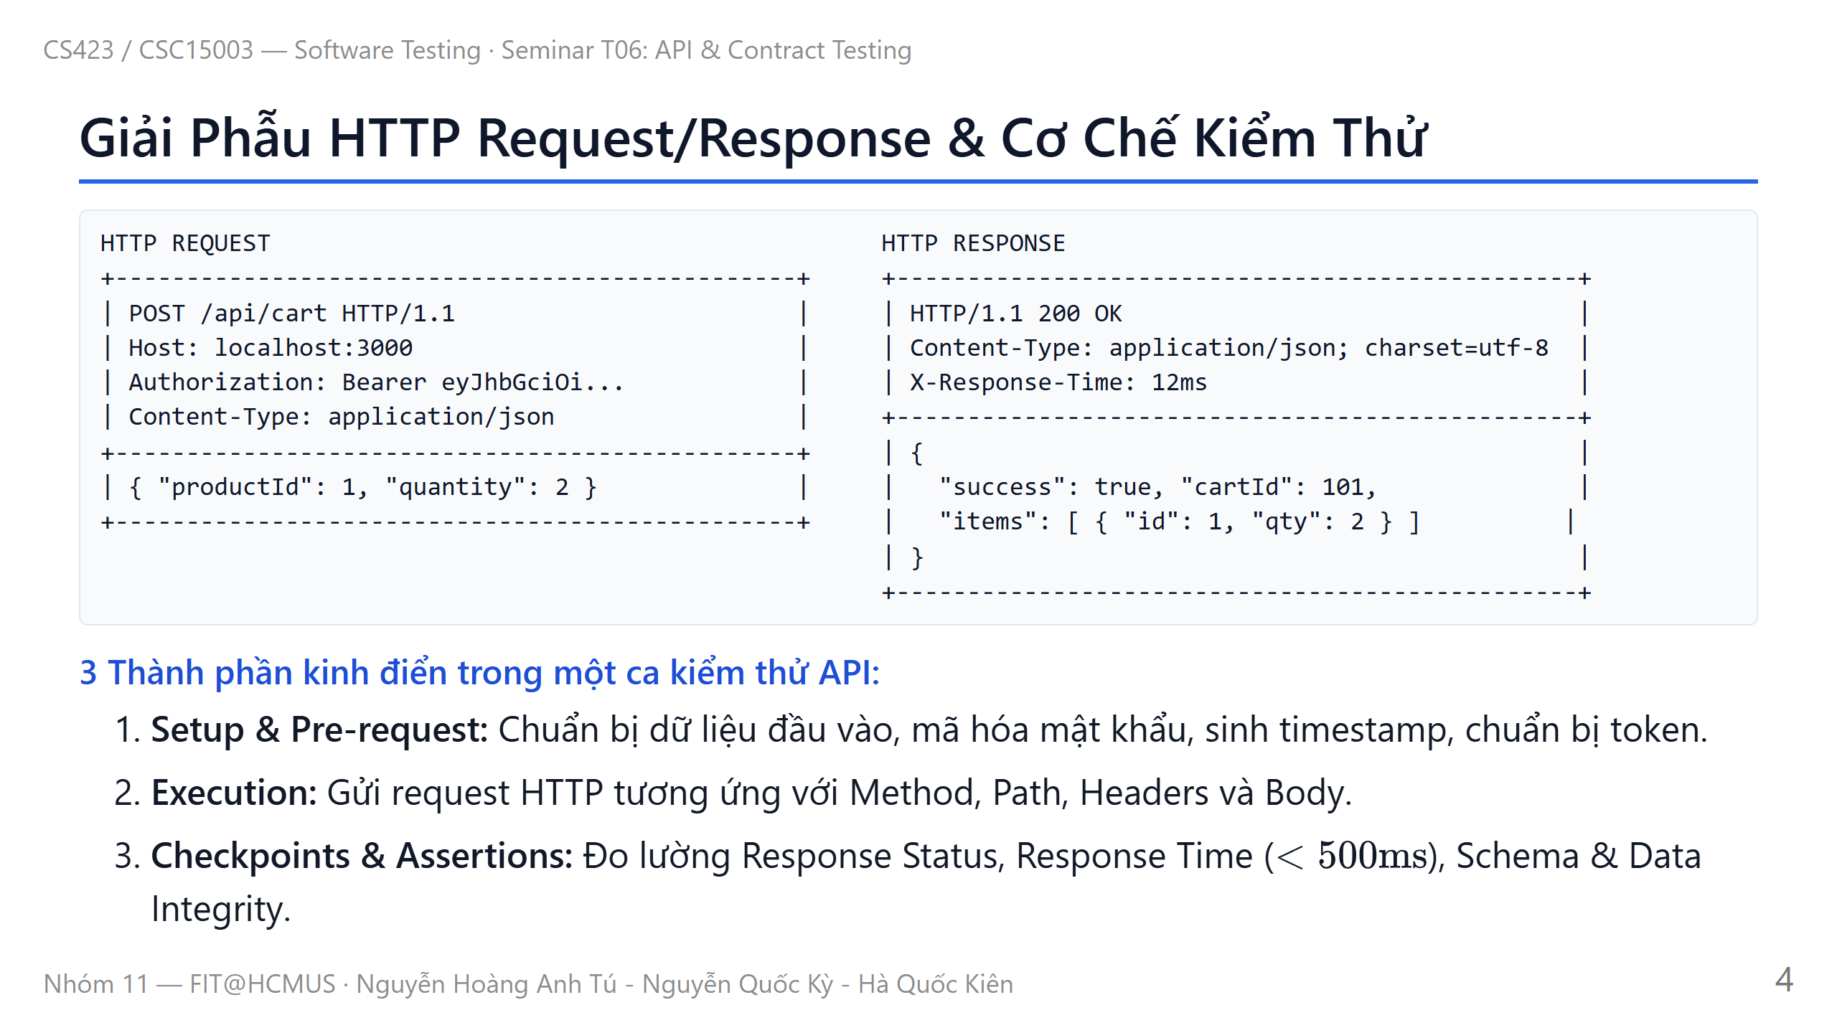
Notes:
Slide 4: HTTP Request & Response Anatomy

Slide 5
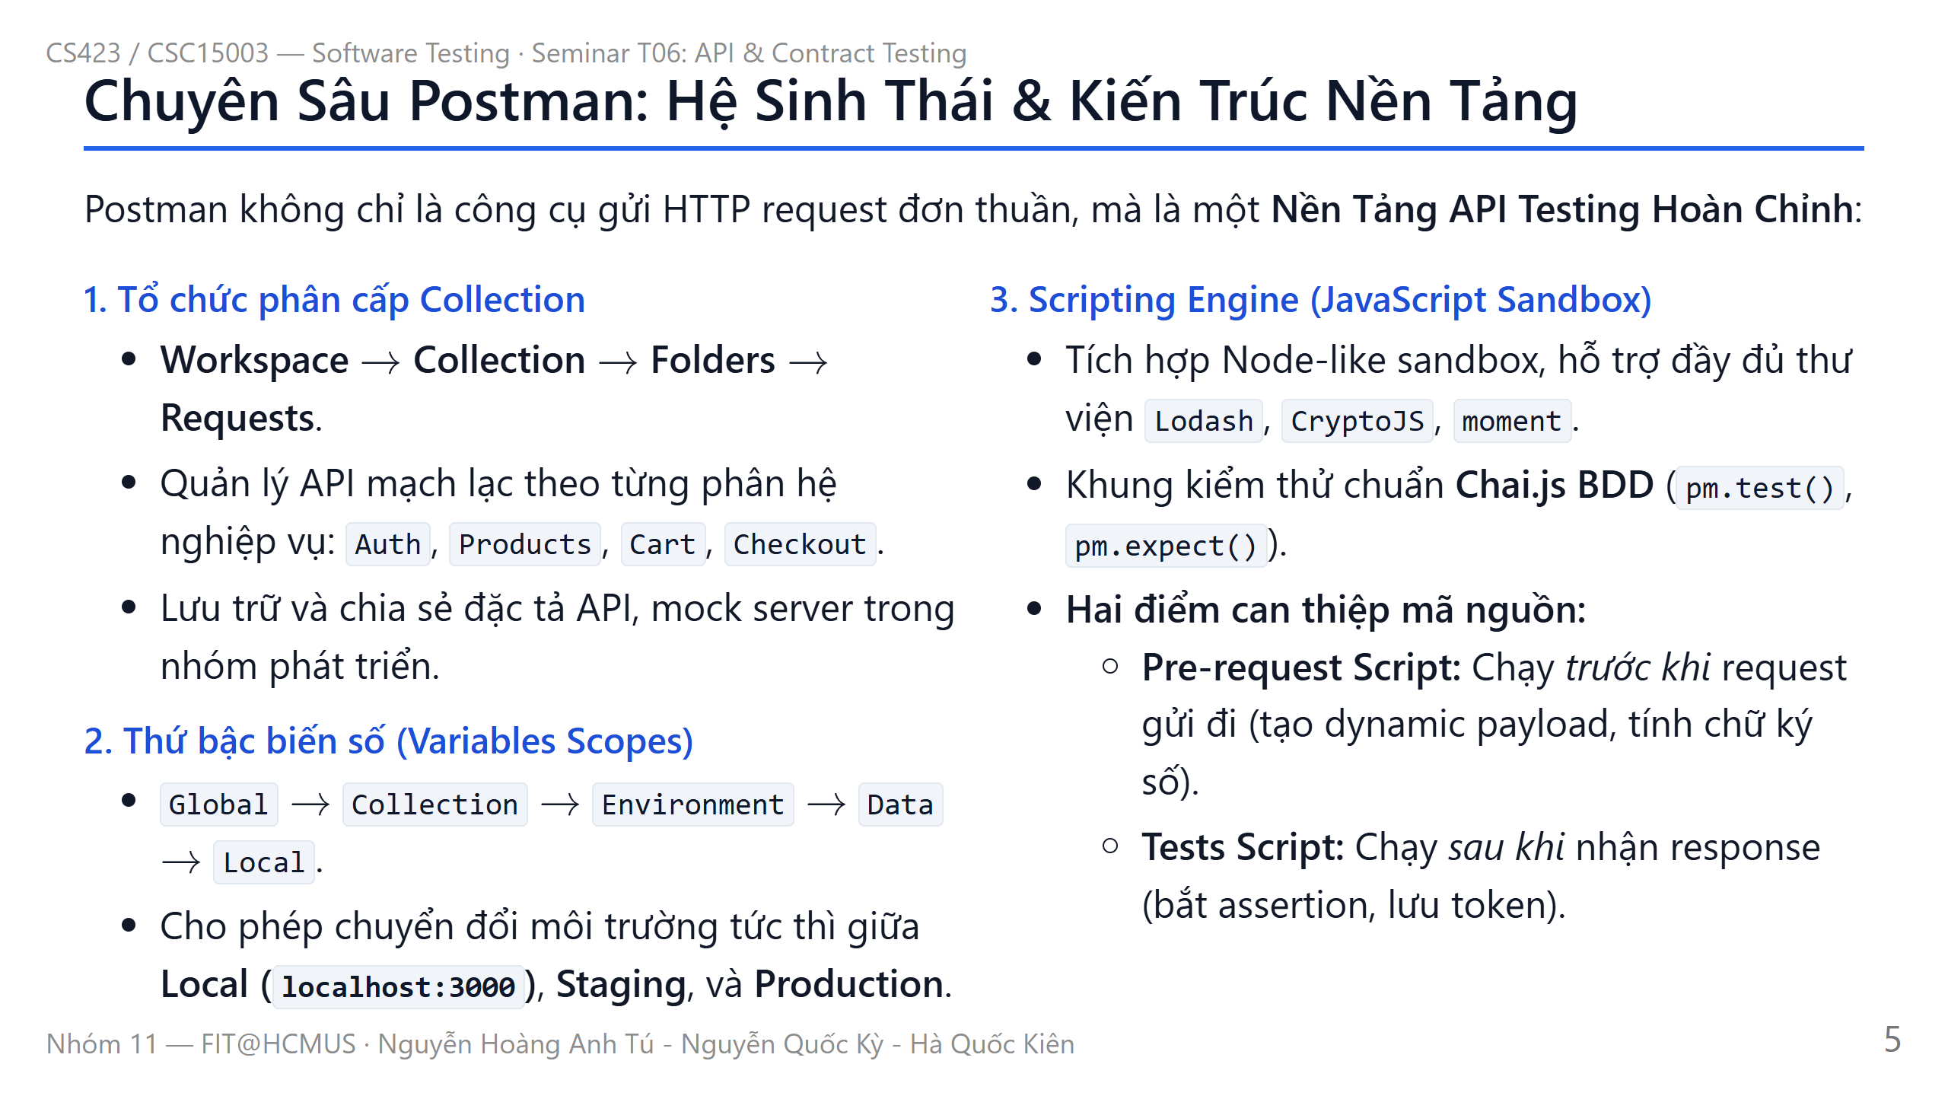
Notes:
Slide 5: Postman Architecture & Ecosystem

Slide 6
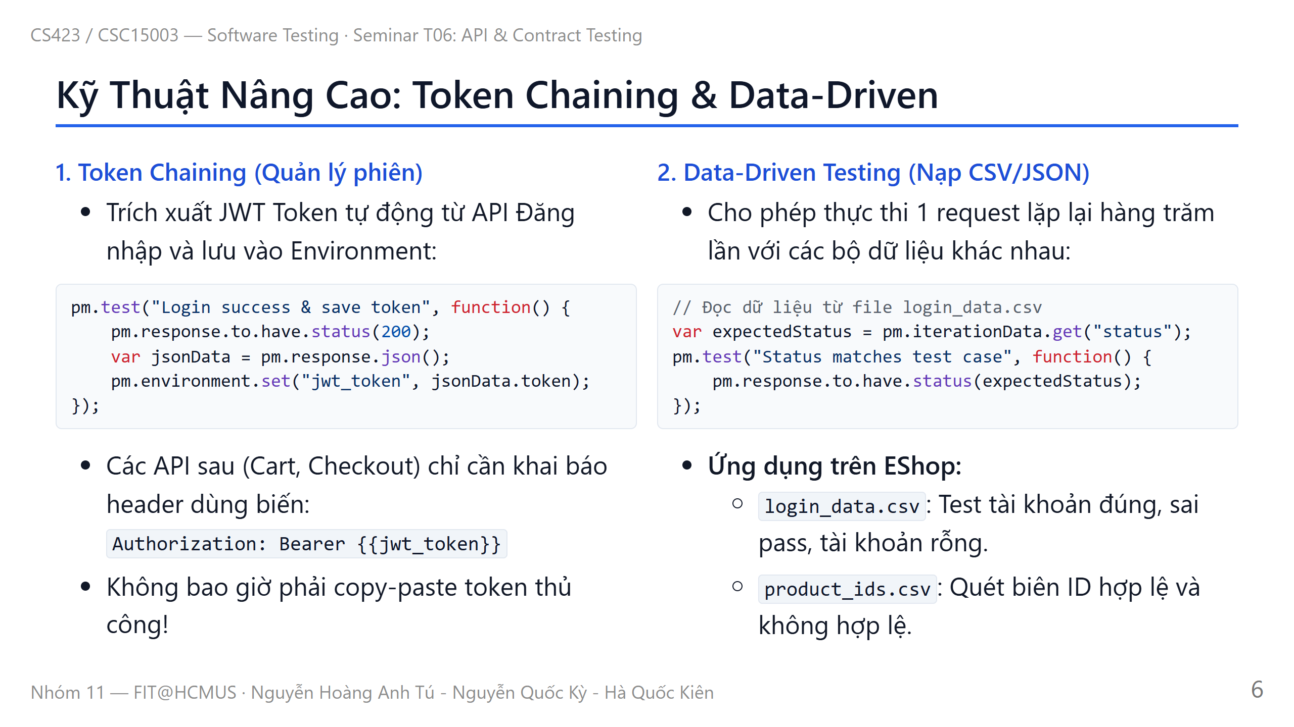
Notes:
Slide 6: Postman Advanced Techniques

Slide 7
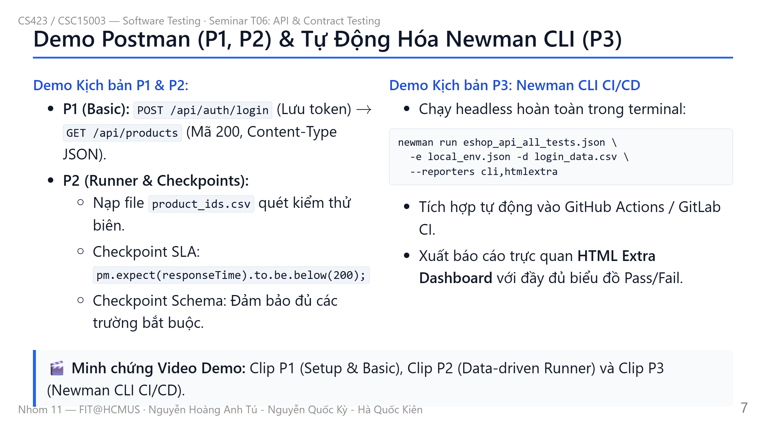
Notes:
Slide 7: Demo Postman P1, P2 & Newman P3

Slide 8
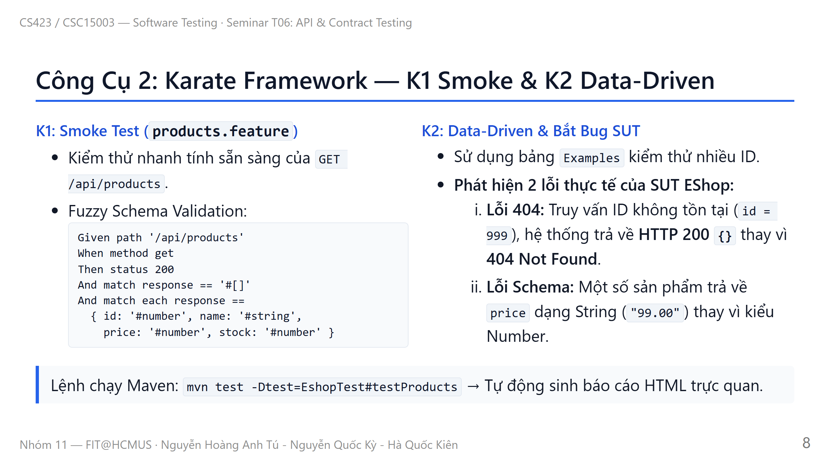
Notes:
Slide 8: Karate K1 & K2

Slide 9
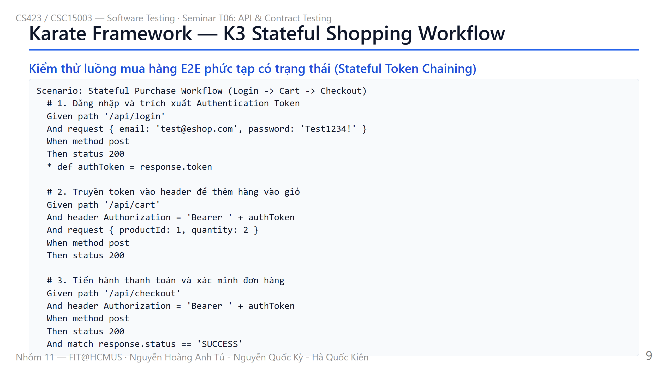
Notes:
Slide 9: Karate K3 Stateful Workflow

Slide 10
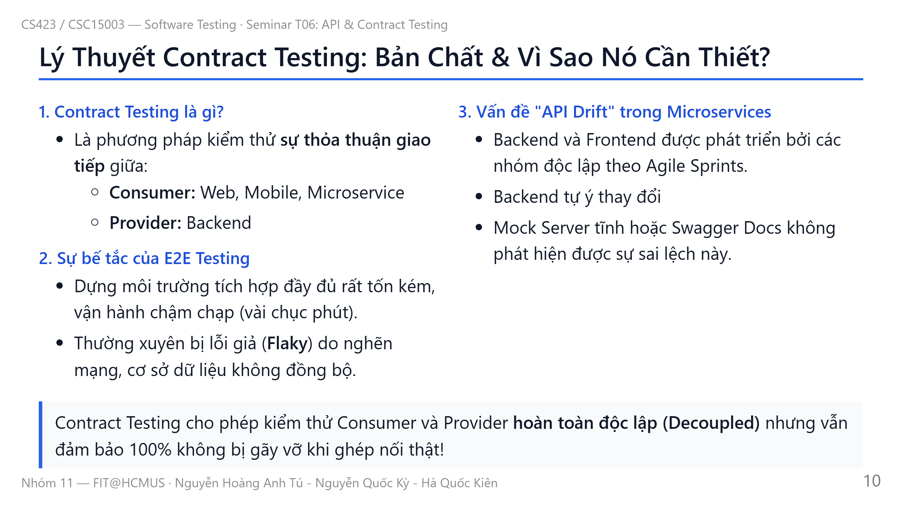
Notes:
Slide 10: Contract Testing Theory

Slide 11
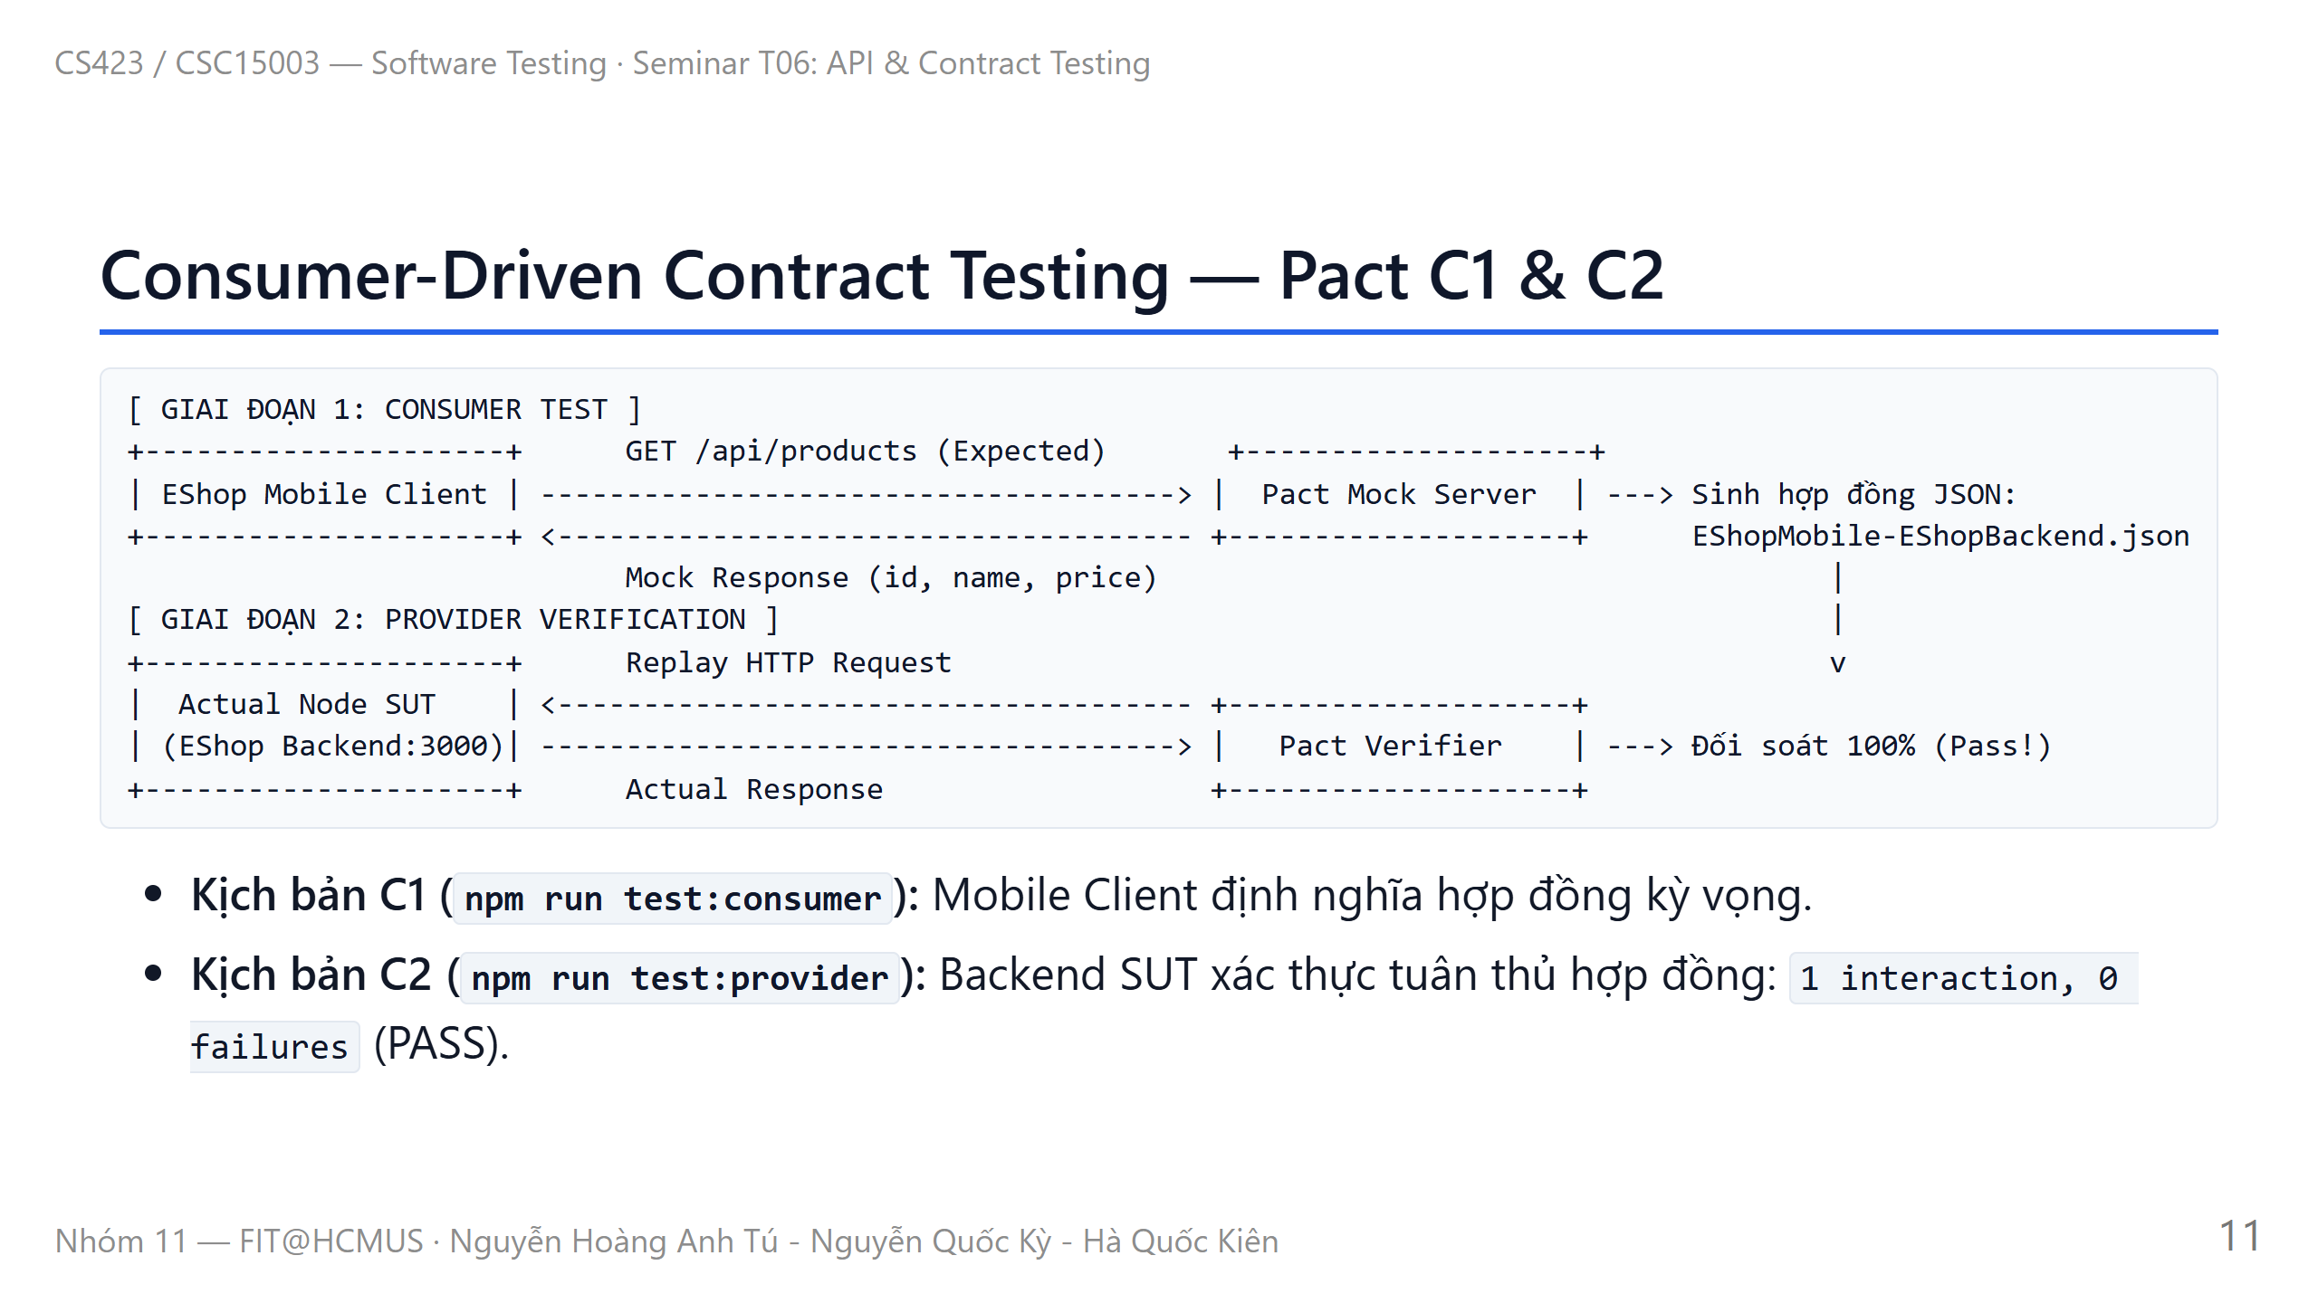
Notes:
Slide 11: Pact Architecture & C1, C2

Slide 12
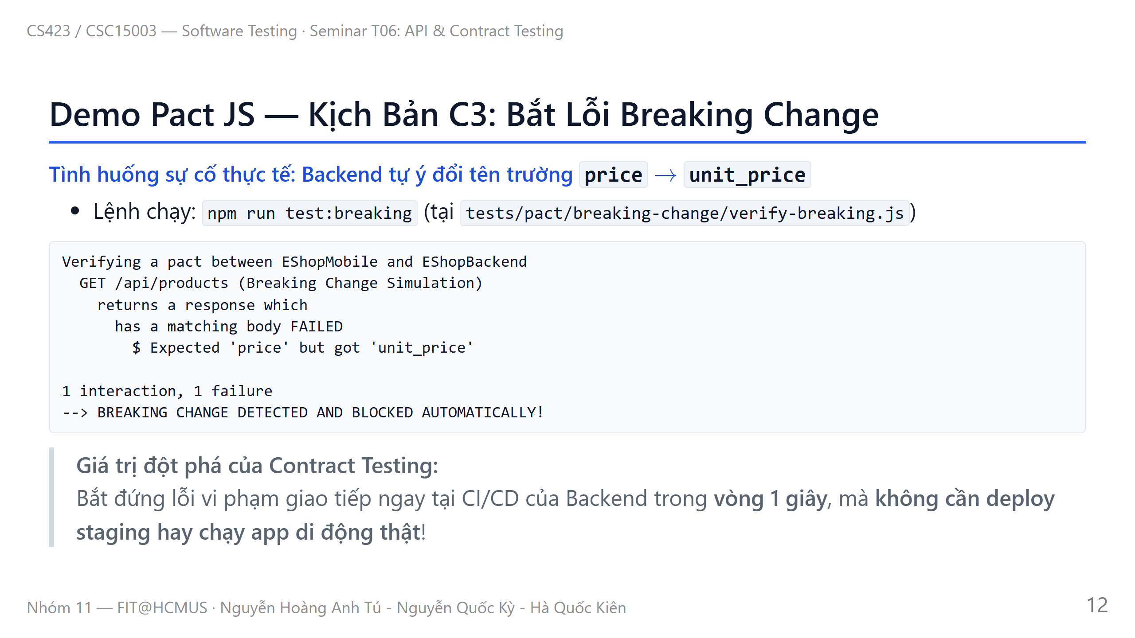
Notes:
Slide 12: Pact C3 Breaking Change

Slide 13
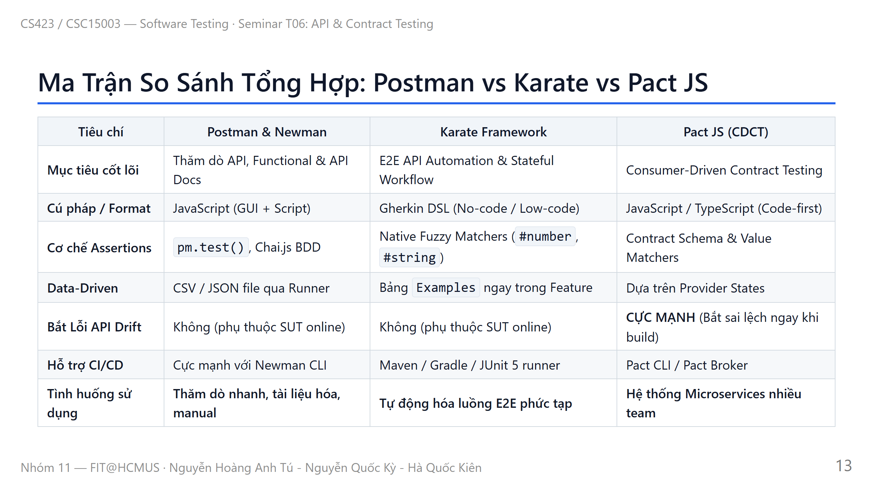
Notes:
Slide 13: Tools Comparison Matrix

Slide 14
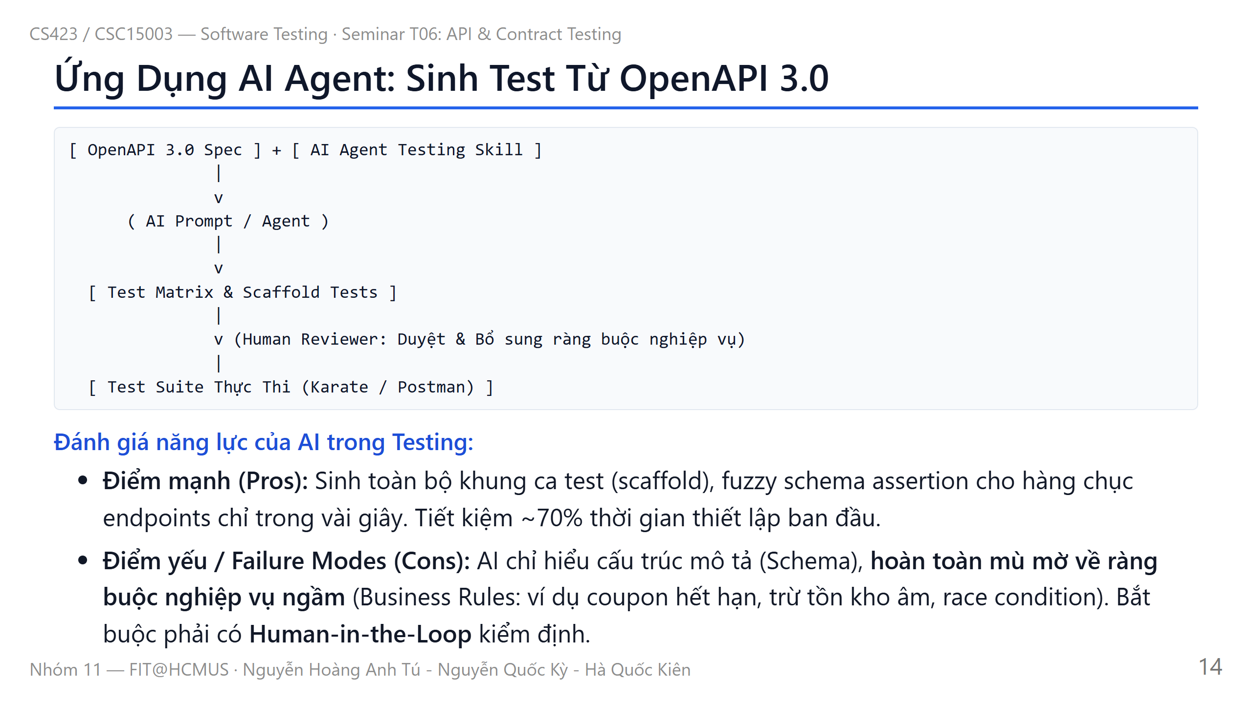
Notes:
Slide 14: AI Agent Testing

Slide 15
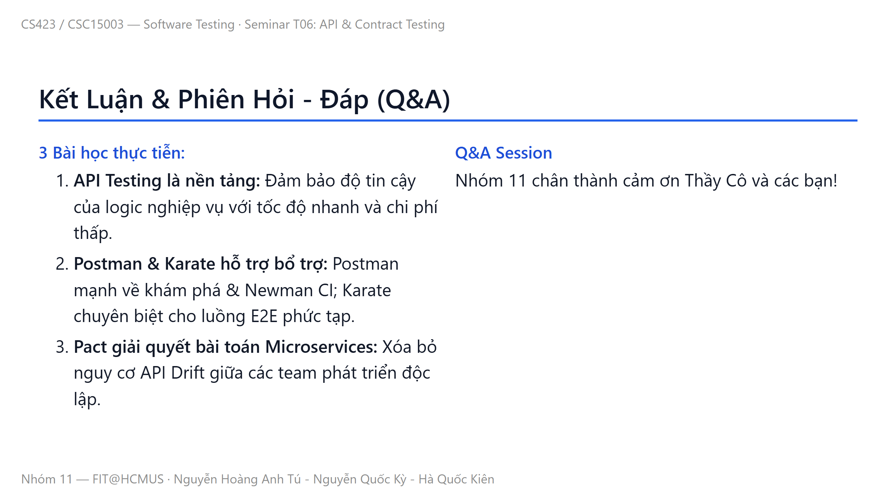
Notes:
Slide 15: Conclusions & QA

