Slide 1
SHORTEST PATH ALGORITHM BASED ON BEHAVIOR OF PHYSARUM POLYCHEPHALUM
Hudson DeVoe & Ryan Anderson

Slide 2
Video
https://www.youtube.com/watch?v=75k8sqh5tfQ

Slide 3
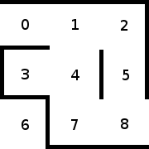
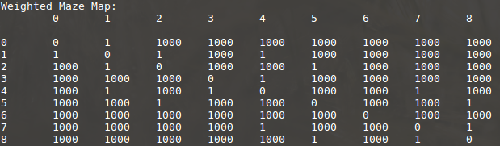
Maze Generation

Slide 4
Established Shortest Path Algorithms
Dijkstra’s Algorithm
Greedy Approach
Returns vertices found in shortest path
Floyd’s Algorithm
Dynamic Programming
Returns matrix of shortest paths between points

Slide 5
Implementation
Each “arm” travels shortest available and unoccupied path until it either finds food, or runs out of resources to grow
As the slime mold moves, a Boolean array “underneath” the maze is changed to show that vertex is occupied
When food is found, that path is saved in a 2D vector
Each path, regardless of length, from the starting position to a specific food source, are saved in this 2D vector
Of the 2D vector of paths, only the shortest is saved, the others are deleted, and their vertices are marked unoccupied (false)

Slide 6
Conclusion
Difficult to implement in standard architecture
Parallel Computing/swarm intelligence
Natural algorithm evolved for shortest path
Further Implementation
Larger mazes/Three-dimensional maps
Additional food sources

