Slide 1

SHORTEST PATH ALGORITHM BASED ON BEHAVIOR OF PHYSARUM POLYCHEPHALUM
Hudson DeVoe & Ryan Anderson

Slide 2
What is an algorithm?
A defined approach to solving a problem or series of problems
Examples:
Compression
Encryption
Sorting/Searching
How is the efficiency of an algorithm determined?
Time complexity

Slide 3
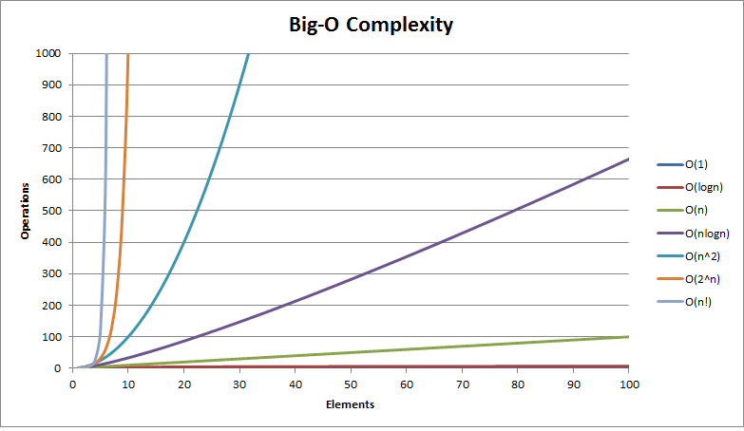

Slide 4
Shortest Path Problem
Finds the path between two nodes in which the distance between the intermediate nodes is minimized
Real world examples:
Subway systems
Highways
Shipping companies
Approaches to solving the shortest path problem?

Slide 5
Shortest Path Algorithms
Brute Force
Finds all available paths then picks shortest
Least efficient approach
Floyd’s
Dynamic Programming (Subproblems)
Order of Complexity N^3
Dijkstra's
Greedy Programming (Best Local)
Order of Complexity N * log(N)

Slide 6
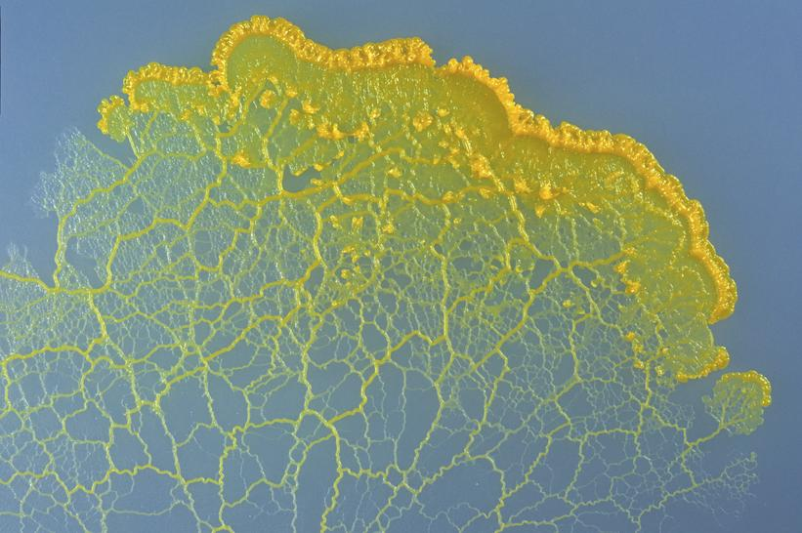
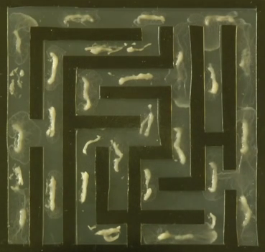
The Slime Mold
Notes:
I’m not a biologist, so bare with me.
Splotches in the maze are where the spores are placed
Blue circles is where food is placed
Go to next slide

Slide 7
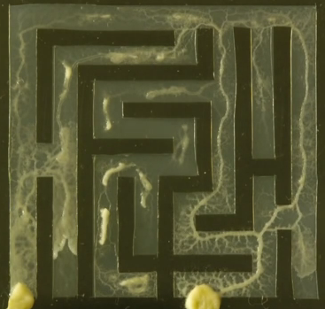
The Slime Mold
Notes:
The arrows are pointing to protoplasmic veins
These are sent out in search of food
At this point, the two pieces of food have been found
Go to next slide

Slide 8
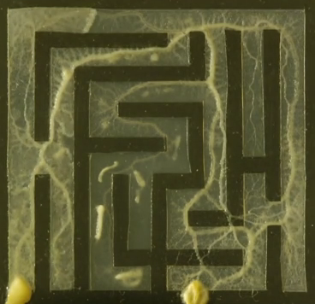
The Slime Mold
Notes:
But the slime mold doesn’t stop when it finds the food
It keeps growing paths, and eventually only the shortest paths stay alive
This sequence is what we recreated
Several stages are not implemented, for example:
Dormant stage: when it hardens its shell, possibly for years, until its environmental conditions improve,
Reproduction stage
Go to next slide

Slide 9

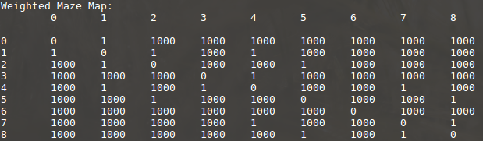
Implementation
Adjacency Matrix generation
Abstraction of physical environment
Notes:
Adjacency Matrix lists the relationship between the nodes of a maze. The maze could be considered as a grid of nodes, and this adjacency matrix could be considered a graph of how these nodes relate to one another.
How the two algs use this

Slide 10
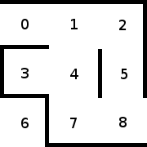
Implementation
Maze Generation
Notes:
Each row contains the distance between the row's index and the columns' indices-
0, 1, or 1000
0 means the row is referencing itself (0,0), (1,1,), etc.
1 means that there is a path between the column and the row (x,y)
1000 means either there is a wall between x and y or there are nodes separating x and y.
Our rules, goals (start at 0, food at final vertex) (no unsolvable maze)
(We needed rules to keep it simple: Always start at 0, food is always at lower-right vertex) – Ryan’s suggestion
Here’s how it works:
The slime mold starts at 0, then moves to the available adjacent vertex with the lowest number
Right now, it’s 1.
*Go to Slide*

Slide 11
Slime Mold Traversal
Notes:
Now it has two options: 2 or 4
It will choose 2 because it is lower
And it continues this action until it finds food
*Go to next slide*

Slide 12
Slime Mold Traversal
Notes:
Once food is found, it saves this path to memory, then
backtracks to the first vertex with an unoccupied adjacent vertex, in our case vertex 1
*Go to next slide*

Slide 13
Slime Mold Traversal
Notes:
Now it will move to 4, then 3
* Go to next slide *

Slide 14
Slime Mold Traversal
Notes:
Now it finds that there is nowhere else to go,
so it backtracks again, taking it back to 4, then 7, and then 8.
*Go to next slide*

Slide 15
Slime Mold Traversal
Notes:
Food is found, once again the current path is saved,
and because there are no more paths, the search phase ends
All of the stored paths are compared, and our algorithm only keeps the shortest.
*Go to next slide*

Slide 16
Conclusion
Nature-based algorithms are… challenging
Future implementations
3d terrain generation
Larger mazes with multiple food sources
Decentralized computing
Multithreading instead of backtracking
Notes:
Challenges:
Implementation – modeling nature is difficult
Some of our future implementations include
3d Terrain:
Instead of 1,0, and 1000, we’d use numbers as weights, -1 for water, 500 for steep hill, and 1000 for a wall
(Instead of the graph)
Our slime mold takes about the same time as an algorithm with n^2 complexity, which if you’ll recall… is bad.
This is because our version has several differences:
Unlike our computer, there isn’t one brain controlling a slime mold.
Arms just grow until they either find food or die, meaning arms don’t wait around for the green light from the previous arm.
Computers call these simultaneous processes ‘threads,’ which would make our algorithm more realistic, and therefore much faster
That being said… in nature, slime molds don’t care about speed.
THE END?
Swarm Intelligence:
Similar to bees: small, unintelligent tasks who collectively efficiently solve a problem

