Slide 1
Principles of Compiler Construction
Lecture 3 Lexical Analysis (II)
Lecturer: Han Lin

Slide 2
A Big QUESTION
如何让计算机识别用正则表达式描述的语言？

Slide 3
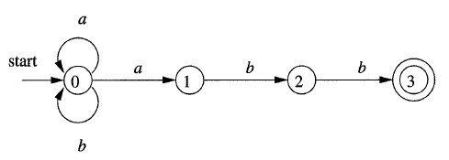
例子：NFA识别语言
识别语言 (a|b)*abb

Slide 4
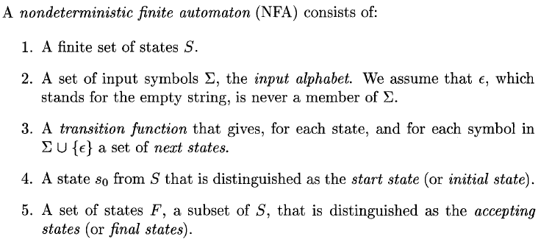
非确定有限自动机（NFA）
The language defined (or accepted) by an NFA is the set of strings labeling some path from the start to an accepting state.

Slide 5
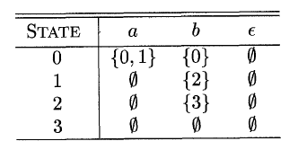
Transition Table
A transition function can be represented by a transition table. Eg:

Slide 6
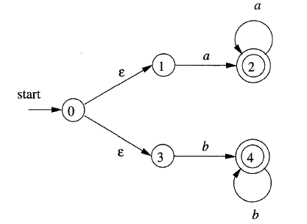
例子：带є的NFA
识别语言aa*|bb*

Slide 7
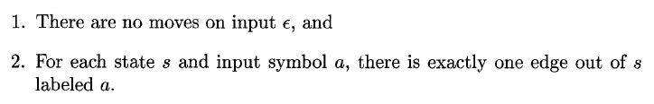
确定有限自动机（DFA）
A deterministic finite automaton (DFA) is a special case of an NFA where:

Slide 8
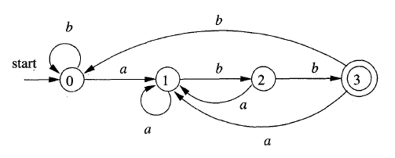
例子
识别(a|b)*abb的DFA

Slide 9
Transition Function: Move
Transition function (table): move(s, c)
 | a | b
s0 | s1 | s0
s1 | s1 | s2
s2 | s1 | s3
s3 | s1 | s0

Slide 10
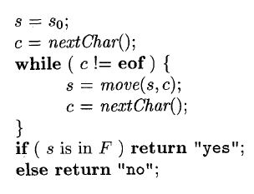
基于DFA的识别算法
时间复杂度：O(|x|)，x为输入的字符串，|x|代表x的长度

Slide 11
思考…
DFA识别语言简单直接，但较难从正则表达式直接转换
正则表达式转换为NFA似乎有章可循
如果能从正则表达式转到NFA，再从NFA转到DFA，则大功告成！
OK, let’s try!

Slide 12


From Regular Expression to NFA

Slide 13
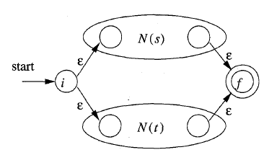
From Regular Expression to NFA

Slide 14

From Regular Expression to NFA

Slide 15
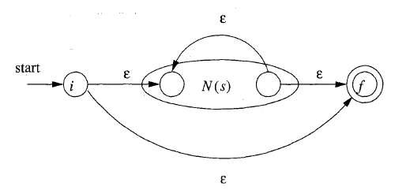
From Regular Expression to NFA

Slide 16


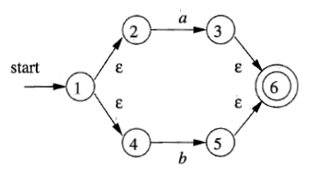
Example
Construct an NFA for (a|b)*abb
a
b
a|b

Slide 17
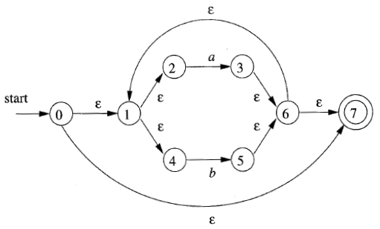
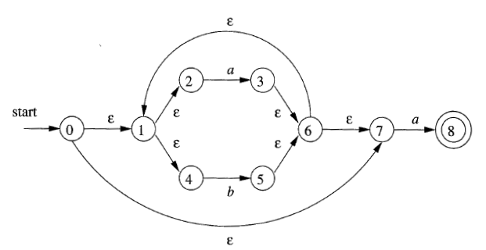
Example
(a|b)*
(a|b)*a

Slide 18
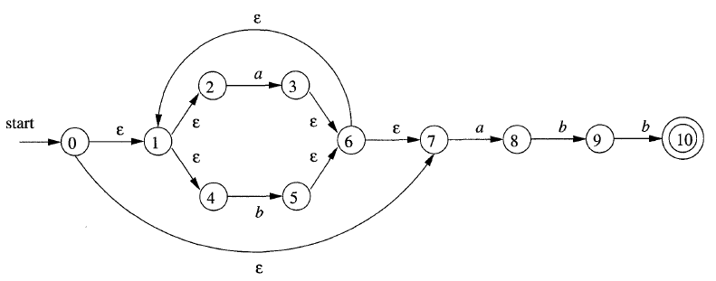
Example
(a|b)*abb

Slide 19
From NFA to DFA
一些记号：
e.g.
Є-closure(0)={0, 1, 2, 4, 7}

Slide 20

From NFA to DFA
e.g.

Slide 21
From NFA to DFA
e.g.
move({0, 1, 2, 4, 7}, a) = {3, 8}

Slide 22
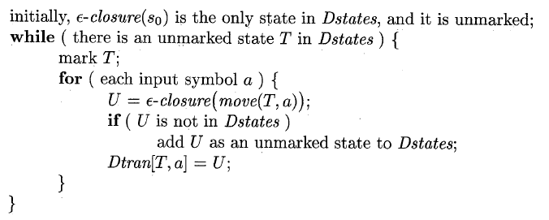
Subset Construction
Algorithm:Subset Construction
Input: An NFA N
Output: A DFA D accepting the same language as N
Method: Each state of D is a set of NFA states. The algorithm constructs a transition table Dtran for D.

Slide 23
Example

Slide 24
Example
NFA states | DFA state | a | b
{0, 1, 2, 4, 7} | A | B | C
{1, 2, 3, 4, 6, 7, 8} | B | B | D
{1, 2, 4, 5, 6, 7} | C | B | C
{1, 2, 4, 5, 6, 7, 9} | D | B | E
{1, 2, 4, 5, 6, 7, 10} | E | B | C

Slide 25
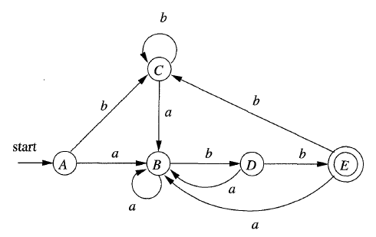
Example
NFA states | DFA state | a | b
{0, 1, 2, 4, 7} | A | B | C
{1, 2, 3, 4, 6, 7, 8} | B | B | D
{1, 2, 4, 5, 6, 7} | C | B | C
{1, 2, 4, 5, 6, 7, 9} | D | B | E
{1, 2, 4, 5, 6, 7, 10} | E | B | C

Slide 26
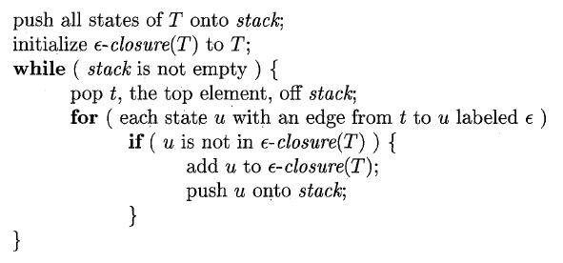
Computing Є-closure(T)

Slide 27
小结

RegularExpression
NFA
DFA


Slide 28
直接用DFA描述语言
用正则表达式描述语言，通常比用DFA容易，但也有例外. 比如对于下面的语言：
含有偶数个0和偶数个1的，由0和1组成的字符串（包括空串）.
能被3整除的2进制数（包括空串）.

Slide 29
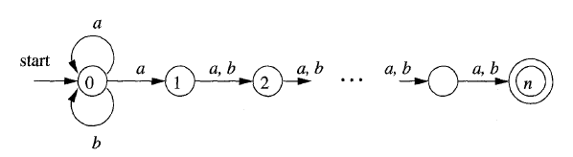
From NFA to DFA
缺点：将NFA转换为DFA可能导致状态空间的指数增长
例如：
求证：与此NFA等价的DFA的状态数必不少于2^n

Slide 30

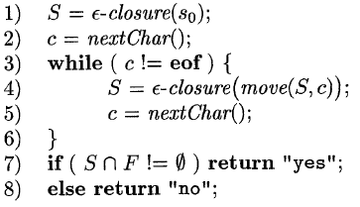
直接用NFA识别语言

Slide 31
讨论
两种识别语言的方法各自的优缺点在哪里？

Slide 32
重要结论
定理：对任何DFA D都存在一个正则表达式r，使得L(D)=L(r).
推论：对任何NFA N都存在一个正则表达式r，使得L(N)=L(r).
结论：DFA，NFA和正则表达式三者的描述能力是一样的.

Slide 33
作业
Assignment2.doc

Slide 34
Next Class
教材Chapter 3.9

Slide 35
See you next time!

