Slide 1
Principles of Compiler Construction
Lecture 7 Syntax Analysis (III)
Lecturer: Han Lin

Slide 2
语法分析方法的分类
Top-down
Bottom-up

Slide 3
Bottom-up Parsing
优点：可以分析更多的文法
缺点：实现较麻烦

Slide 4

Bottom-up Parsing
E
T
E→T
T→T*F
T
F
F→id
F
T→F
F→id
id * id

Slide 5
Reduction（归约）
归约: 用产生式的左边代替产生式的右边
自底向上的语法分析过程就是将只含有终端符号的输入串逐步归约到文法起始符号的过程
反过来，
所以上述归约过程实际上是最右推导的逆过程

Slide 6
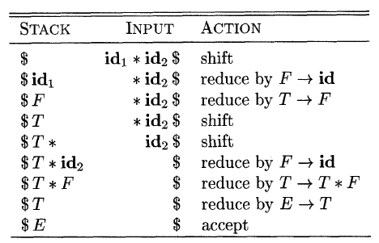
Shift-Reduce（移进-归约）
4类action: shift, reduce, accept, error

Slide 7
问题
为什么是移进而不是将T归约为E？

Slide 8
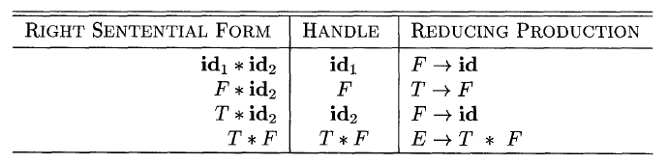
Handle（句柄）

Slide 9
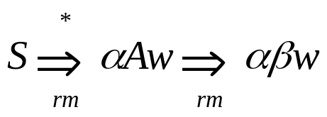

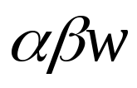
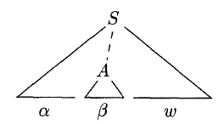
Handle（句柄）
如果 ，则称 是句型 的句柄.
注意：在上式中w是终端符号串，A是非终端符号，α和β中可以有终端符号和非终端符号.
直观的理解：一个句型的句柄就是这个句型的分析树中最左那棵只有父子两代的子树的所有叶子的从左到右的排列

Slide 10

LR Parsing
Proposed by
  D. Knuth (Stanford U.). On the Translation of Languages from Left to Right. Information and Control, 8(6), 1965, pp.607-639
    Prof. 高德纳: The Art of Computer Programming, T_{E}X, KMP Algorithm, LR Parsing, Attribute Grammar, etc.
LR(k) parsing:
"L" : left-to-right scanning of the input
"R“: constructing a rightmost derivation in reverse
k: the number of input symbols of lookahead that are used in making parsing decisions, when (k) is omitted, k is assumed to be 1.

Slide 11
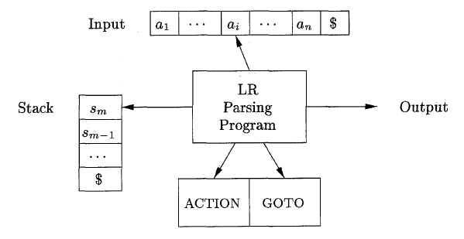
LR Parsing
LR分析表
状态栈

Slide 12
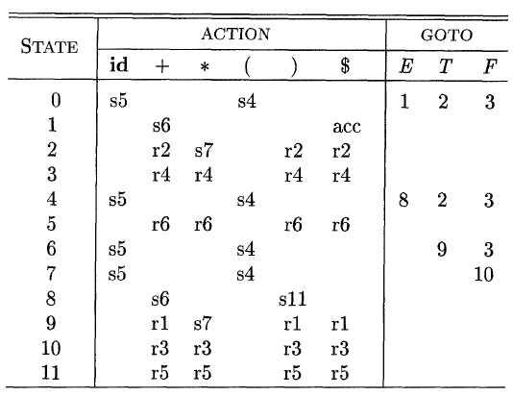



Example

Slide 13
LR Parsing
不同的LR分析法具有相同的LR分析程序
不同之处在于用不同的方法构造出不同的ACTION表和GOTO表.

Slide 14
Simple LR (SLR) Parsing
最简单的LR分析
如何构造SLR的分析表？

Slide 15
LR(0) Items
An LR(0) item (item for short) a production with a dot at some position of the body.
Eg., A→XYZ yields the four items:
A→ ·XYZ
A→X·YZ
A→X Y·Z
A→X YZ·
The production A →є generates only one item, A→ ·

Slide 16
Augmented Grammar
If G is a grammar with start symbol S, then G', the augmented grammar for G, is G with a new start symbol S’ and production S’→ S.

Slide 17
Ideas
Consider the following grammar
  S' → S
  S → a A | b B
  A → c A | d
  B → c B | d

Slide 18
I₀
S' → • S
Initial state

Slide 19
I₀
S' → • S
S → • a A
S → • b B
Equivalent closure

Slide 20
Kernel items
I₀
S' → • S
S → • a A
S → • b B
Nonkernel items or closure items
Equivalent closure

Slide 21
I₀
I₁
S' → • S
S → • a A
S → • b B
S' → S •
S
If the remaining string
can be reduced to S
(expected !)

Slide 22
I₂
S → a • A
a
I₀
I₁
S' → • S
S → • a A
S → • b B
S' → S •
S
If the first symbol of
remaining string is a
(shift !)

Slide 23
I₂
S → a • A
A → • c A
A → • d
a
I₀
I₁
S' → • S
S → • a A
S → • b B
S' → S •
S
Equivalent closure in
state I₂

Slide 24
I₂
S → a • A
A → • c A
A → • d
a
I₀
I₁
S' → • S
S → • a A
S → • b B
S' → S •
S
I₃
b
S → b • B
B → • c B
B → • d
If the first symbol of
remaining string is b
(shift !)

Slide 25
I₆
A → c • A
A → • cA
A → • d
I₅
A → d •
c
I₂
I₄
d
S → a • A
A → • c A
A → • d
S → a A •
A
a
I₀
I₁
S' → • S
S → • a A
S → • b B
S' → S •
S
I₃
b
S → b • B
B → • c B
B → • d
All possible states
from state I₂

Slide 26
c
I₆
I₇
A → c • A
A → • cA
A → • d
A
A → c A •
I₅
d
A → d •
c
I₂
I₄
d
S → a • A
A → • c A
A → • d
S → a A •
A
a
I₀
I₁
S' → • S
S → • a A
S → • b B
S' → S •
S
I₃
b
S → b • B
B → • c B
B → • d
All possible states
from state I₆

Slide 27
c
I₆
I₇
A → c • A
A → • cA
A → • d
A
A → c A •
I₅
d
A → d •
c
I₂
I₄
d
S → a • A
A → • c A
A → • d
S → a A •
A
a
I₀
I₁
S' → • S
S → • a A
S → • b B
S' → S •
S
I₃
I₈
b
S → b • B
B → • c B
B → • d
B
S → b B •
I₉
d
B → d •
c
I₁₀
All possible states
from state I₃
B → c • B
B → • c B
B → • d

Slide 28
c
I₆
I₇
A → c • A
A → • cA
A → • d
A
A → c A •
I₅
d
A → d •
c
I₂
I₄
d
S → a • A
A → • c A
A → • d
S → a A •
A
a
I₀
I₁
S' → • S
S → • a A
S → • b B
S' → S •
S
I₃
I₈
b
S → b • B
B → • c B
B → • d
B
S → b B •
I₉
d
B → d •
c
c
I₁₀
I₁₁
All possible states,
recognized by a DFA
d
B → c • B
B → • c B
B → • d
B → c B •
B

Slide 29
Working with the DFA
Consider the following sentence:
  a c c d
  We have the right-most derivation:
  S' ⇒ S ⇒ a A ⇒ a c A ⇒ a c c A ⇒ a c c d

Slide 30
c
I₆
I₇
A → c • A
A → • cA
A → • d
A
A → c A •
I₅
d
A → d •
c
I₂
I₄
d
S → a • A
A → • c A
A → • d
S → a A •
A
a
I₀
I₁
S' → • S
S → • a A
S → • b B
S' → S •
S
I₃
I₈
b
S → b • B
B → • c B
B → • d
B
S → b B •
I₉
d
B → d •
c
c
I₁₀
I₁₁
Input string
a | c c d
( shift )
d
B → c • B
B → • c B
B → • d
B → c B •
B

Slide 31
c
I₆
I₇
A → c • A
A → • cA
A → • d
A
A → c A •
I₅
d
A → d •
c
I₂
I₄
d
S → a • A
A → • c A
A → • d
S → a A •
A
a
I₀
I₁
S' → • S
S → • a A
S → • b B
S' → S •
S
I₃
I₈
b
S → b • B
B → • c B
B → • d
B
S → b B •
I₉
d
B → d •
c
c
I₁₀
I₁₁
Input string
a c | c d
( shift )
d
B → c • B
B → • c B
B → • d
B → c B •
B

Slide 32
c
I₆
I₇
A → c • A
A → • cA
A → • d
A
A → c A •
I₅
d
A → d •
c
I₂
I₄
d
S → a • A
A → • c A
A → • d
S → a A •
A
a
I₀
I₁
S' → • S
S → • a A
S → • b B
S' → S •
S
I₃
I₈
b
S → b • B
B → • c B
B → • d
B
S → b B •
I₉
d
B → d •
c
c
I₁₀
I₁₁
Input string
a c c | d
( shift )
d
B → c • B
B → • c B
B → • d
B → c B •
B

Slide 33
c
I₆
I₇
A → c • A
A → • cA
A → • d
A
A → c A •
I₅
d
A → d •
c
I₂
I₄
d
S → a • A
A → • c A
A → • d
S → a A •
A
a
I₀
I₁
S' → • S
S → • a A
S → • b B
S' → S •
S
I₃
I₈
b
S → b • B
B → • c B
B → • d
B
S → b B •
I₉
d
B → d •
c
c
I₁₀
I₁₁
Input string
a c c d |
( shift )
d
B → c • B
B → • c B
B → • d
B → c B •
B

Slide 34
Expectation: the dream comes true !
c
I₆
I₇
A → c • A
A → • cA
A → • d
A
A → c A •
I₅
d
A → d •
c
I₂
I₄
d
S → a • A
A → • c A
A → • d
S → a A •
A
a
I₀
I₁
S' → • S
S → • a A
S → • b B
S' → S •
S
I₃
I₈
b
S → b • B
B → • c B
B → • d
B
S → b B •
I₉
d
B → d •
c
c
I₁₀
I₁₁
Input string
a c c A |
( reduce with A → d )
d
B → c • B
B → • c B
B → • d
B → c B •
B

Slide 35
c
I₆
I₇
A → c • A
A → • cA
A → • d
A
A → c A •
I₅
d
A → d •
c
I₂
I₄
d
S → a • A
A → • c A
A → • d
S → a A •
A
a
I₀
I₁
S' → • S
S → • a A
S → • b B
S' → S •
S
I₃
I₈
b
S → b • B
B → • c B
B → • d
B
S → b B •
I₉
d
B → d •
c
c
I₁₀
I₁₁
Input string
a c A |
( reduce with A → c A )
d
B → c • B
B → • c B
B → • d
B → c B •
B

Slide 36
c
I₆
I₇
A → c • A
A → • cA
A → • d
A
A → c A •
I₅
d
A → d •
c
I₂
I₄
d
S → a • A
A → • c A
A → • d
S → a A •
A
a
I₀
I₁
S' → • S
S → • a A
S → • b B
S' → S •
S
I₃
I₈
b
S → b • B
B → • c B
B → • d
B
S → b B •
I₉
d
B → d •
c
c
I₁₀
I₁₁
Input string
a A |
( reduce with A → c A )
d
B → c • B
B → • c B
B → • d
B → c B •
B

Slide 37
c
I₆
I₇
A → c • A
A → • cA
A → • d
A
A → c A •
I₅
d
A → d •
c
I₂
I₄
d
S → a • A
A → • c A
A → • d
S → a A •
A
a
I₀
I₁
S' → • S
S → • a A
S → • b B
S' → S •
S
I₃
I₈
b
S → b • B
B → • c B
B → • d
B
S → b B •
I₉
d
B → d •
c
c
I₁₀
I₁₁
Input string
S |
( reduce with S → a A
and accept )
d
B → c • B
B → • c B
B → • d
B → c B •
B

Slide 38
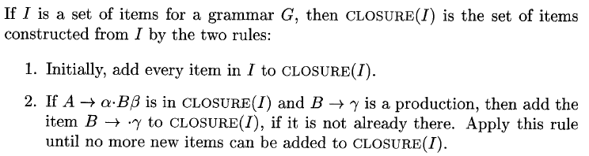
Closure of Item Sets

Slide 39
Example
对于扩充文法
E’→E
E→E+T|T
T→T*F|F
F→(E)|id
求CLOSURE({[E’→ ·E]})

Slide 40
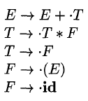
The Function GOTO

Slide 41
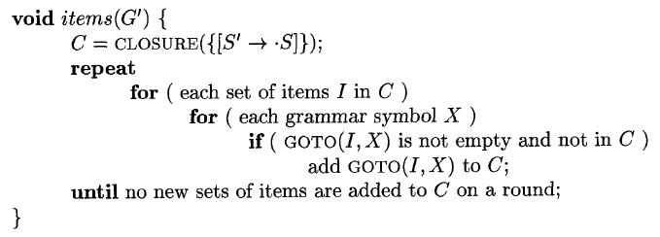
构造LR(0)项的规范集族

Slide 42
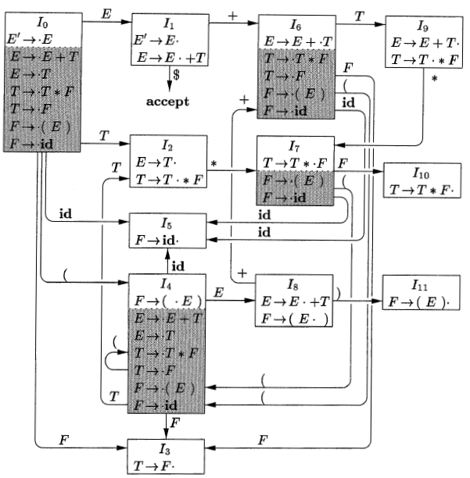

LR(0)自动机

Slide 43
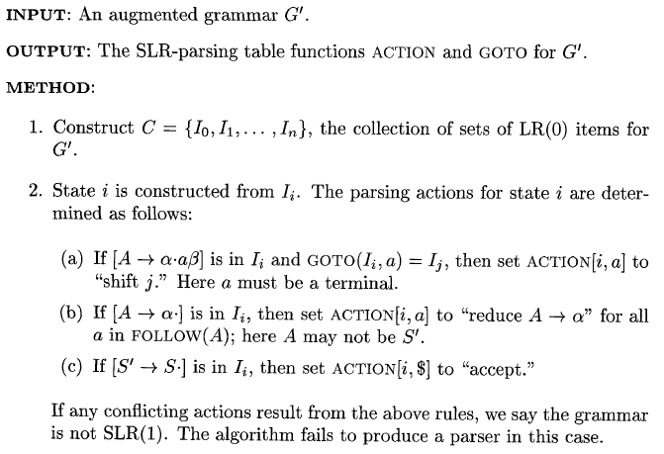

构造SLR分析表

Slide 44
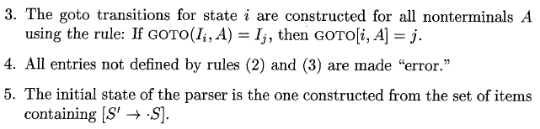
构造SLR分析表

Slide 45
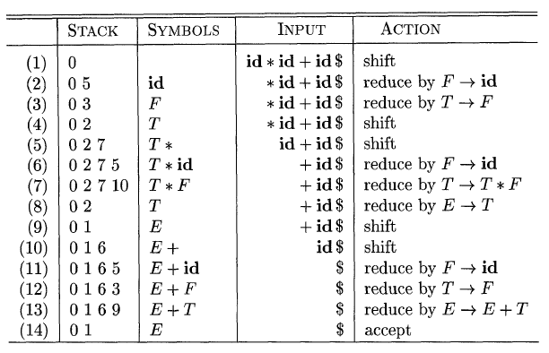
More…
活前缀(Viable Prefixes)

Slide 46

Viable Prefixes
A viable prefix must be a prefix of a right-sentential form.
  S ⇒*_{rm} α ω, where α is the content of the stack and ω contains no nonterminals.
Not all prefixes of a right-sentential form are viable prefixes.
  E ⇒*_{rm} F * n ⇒_{rm} ( E ) * n,
  where (, ( E, ( E ) are viable prefixes,
  but ( E ) * is not, since the parser will perform reduction once the handle appears.

Slide 47

Viable Prefixes
A viable prefix is a prefix of a right-sentential form that does not continue past the right end of the handle of that sentential form.
SLR parsing is based on the fact that LR(0) automata recognize viable prefixes.

Slide 48


SLR(1) Grammar
There are many unambiguous grammars that are not SLR(1).
Eg. DragonBook p255

Slide 49
Next Class
教材4.7-4.8节

Slide 50
作业
Assignment6.doc

Slide 51
See you next time!

