Slide 1
About the data str
about_data_text = " The World Happiness Report is a comprehensive survey of global happiness and well-being. It ranks countries based on various factors, including GDP, social support, life expectancy, freedom to make life choices, trust, and generosity. The data provides valuable insights into the overall happiness and well-being of populations around the world. It's important to note that some data points, such as "explained by health" in 2018 from Palestine and "explained by trust" in 2023 from the United Arab Emirates, are extrapolated values. These values are estimated to provide a more complete dataset, but they are not be directly measured. "

Slide 2
About the dashboard str
dashboard_summary = "This interactive dashboard is designed to explore and visualize data from the World Happiness Report. It provides a user-friendly interface to investigate global happiness trends over time, offering insights into factors influencing well-being worldwide. Explore the interactive features in this dashboard to gain deeper insights into the data and its implications for global well-being."

Slide 3
Creating a
World Happiness Report Dashboard
Portfolioproject
åå

Slide 4
The World Happiness Report
“The World Happiness Report is a publication of the Sustainable Development Solutions Network, powered by the Gallup World Poll data. The World Happiness Report reflects a worldwide demand for more attention to happiness and well-being as criteria for government policy. It reviews the state of happiness in the world today and shows how the science of happiness explains personal and national variations in happiness.”
From : https://worldhappiness.report/about/

Slide 5
The Data
World Happiness Report Data from 2015 to 2023 via Kaggle
Data cleaning:
  Merging the datasets
  Unifying country names
  Adding features for understanding (Population, raw GDP, life expectancy)
  Adding features for plotting (Continent, Iso-Codes)
Exploatory data analysis: to understand the data and evaluate importancy of features

Slide 6
The Panel Project
Goal: creating a World Happiness Dashboard based in the World Happiness Report data
  To explore and understand the data in a user-friendly way
  To provide a platform for visualizing and analyzing
Key Features for:
  interactive map
  Interactive graphs
  Interactive tables
    All with sliders to change variables and years

Slide 7
Our Working Progress
Stage 1:
  creating a demo version to have interactive dashboard while cleaning the data
Stage 3:
  Finalizing dashboard
  Integrating interactive world map into dashboard
  Filling in missing data from other sources
Stage 2:
  creating an interactive world map
  adding new data

Slide 8
Our Working Progress
Stage 1:
  creating a demo version to have interactive dashboard while cleaning the data
Stage 3:
  Finalizing dashboard
  Integrating interactive world map into dashboard
  Filling in missing data from other sources
Stage 2:
  creating an interactive world map
  adding new data

Slide 9
The Packages
Panel:
  builds interactive web-based visualizations, dashboards and apps from data
HvPlot:
  Creates plots that are interactive and can be used in web applications or Jupyter notebooks
GeoPandas:
  Enables working with geospatial data, providing tools for reading, analyzing, and visualizing geographic dataset
Params:
  Framework for declaring and managing parameters and attributes of Python classes

Slide 10
The biggest challenges
Filling in missing values
  Combining different data sources
  Different formatting and shape of columns and values in each data source
Standardization of country names
  Important as key for mapping
  Hard to automate: simple overlap of letters is not sufficient
  Much manual labor required to ensure good quality of data mergiing

Slide 11
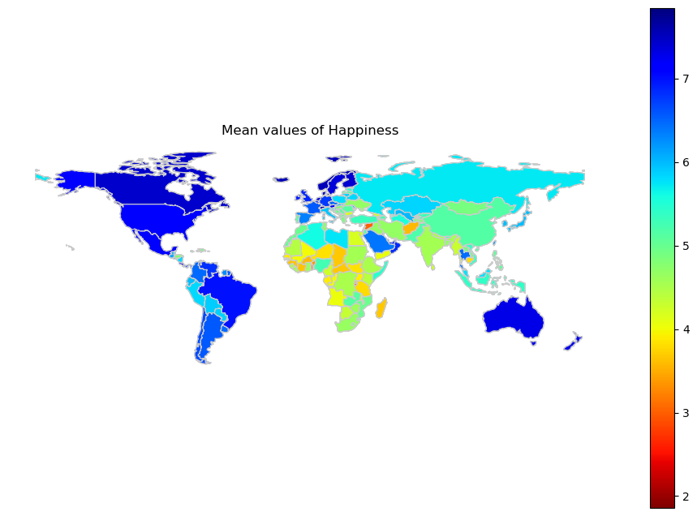
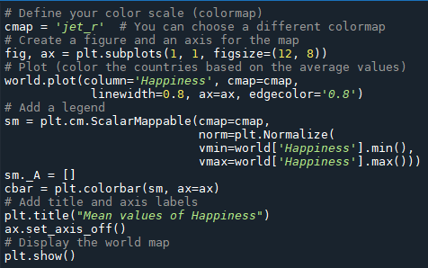
Dynamic World map
There was no template we could use
Mapping was done with matplotlib

Slide 12
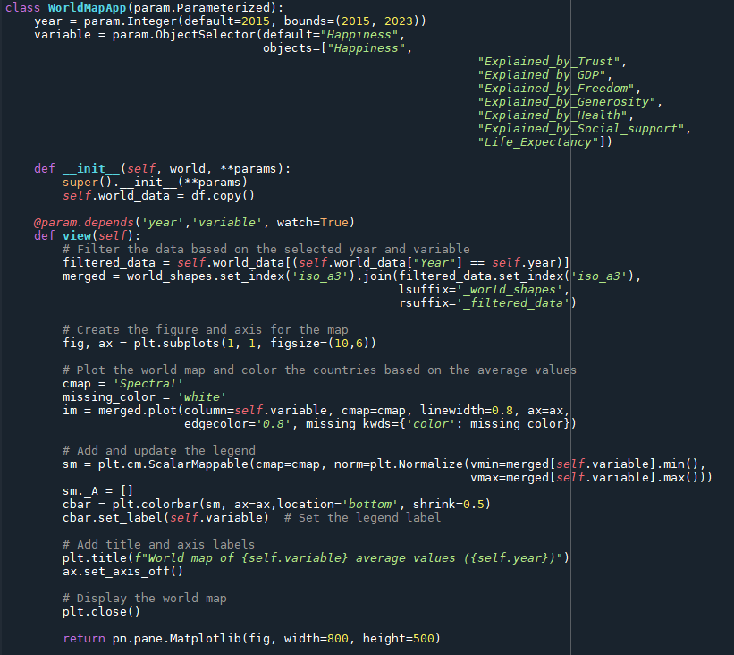
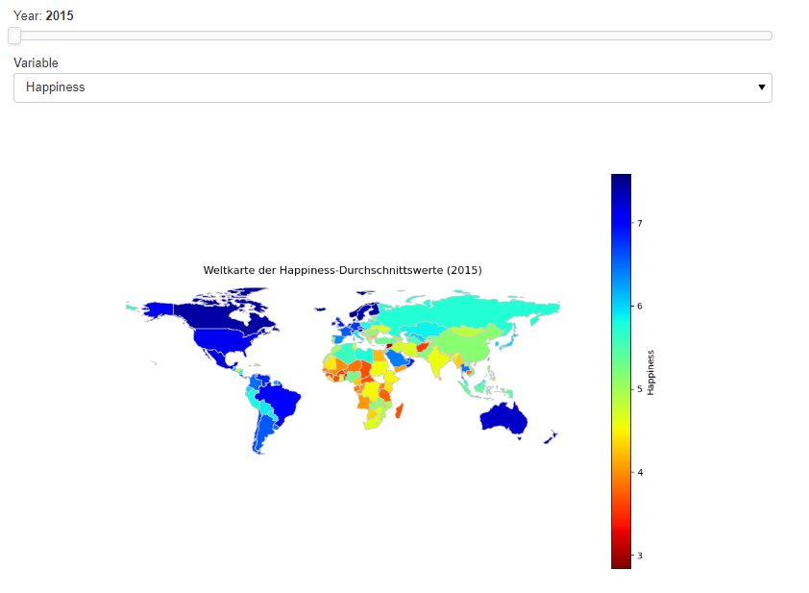
Adding interactivity

Slide 13
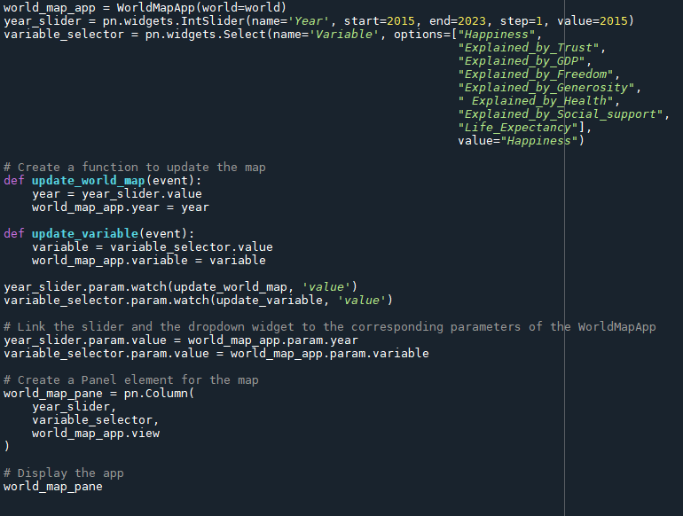
Integrating Map into Dashboard

Slide 14
who we are
Samuel Eleazar
  E-Mail:
  GitHub: https://github.com/Weltall-Erde-Mensch
Aniko Bagyi
  E-Mail:
  https://github.com/AnikoBagyi
Laura Oelke
  E-Mail: laura.oelke@gmx.de
  GitHub: https://github.com/fakesheep38
Repository on GitHub
  https://github.com/fakesheep38/HapPy.git

