Slide 1
Visualizing the World Happiness Report Data
Developing an Interactive Dashboard with Panel:
A Portfolio Project
åå

Slide 2
The World Happiness Report
“The World Happiness Report is a publication of the Sustainable Development Solutions Network, powered by the Gallup World Poll data. The World Happiness Report reflects a worldwide demand for more attention to happiness and well-being as criteria for government policy. It reviews the state of happiness in the world today and shows how the science of happiness explains personal and national variations in happiness.”
https://worldhappiness.report/about/

Slide 3
The Data
World Happiness Report Data from 2015 to 2023 via Kaggle
Exploratory Data Analysis: Understanding the Data and assessing feature importance
Data cleaning:
Merging datasets
Unifying country names
Introducing Features for Better Understanding (Population, Raw GDP, Life Expectancy)
Adding features for visualization (Continents, ISO-3-Codes)

Slide 4
Our project
Goal: creating a World Happiness Dashboard based in the World Happiness Report data
To explore and understand the data in a user-friendly way
To provide a platform for visualizing and analyzing
HvPlot - Key Feature for generating:
Interactive visualizations and elements
World Map
Graphs
Tables
Via sliders, buttons and hover-element
Panel serves as the foundation for the dashboard

Slide 5
The stages of Progress
Stage 1:
EDA + conceptualizing a dashboard layout.
Building an interactive dashboard while cleaning the data
Stage 2:
Creating an interactive world map and other elements
Adding new data
Stage 3:
Finalizing the dashboard
Filling in missing data from other sources
Optimizing the interactive world map and other dashboard elements

Slide 6
Main libraries
Panel:
Enables interactive web-based visualizations, dashboards and data applications
hvPlot:
Can be used for interactive exploration, reporting or data apps
GeoPandas:
Enables working with geospatial data, providing tools for reading, analyzing, and visualizing geographic dataset
Params:
Framework for declaring and managing parameters and attributes of Python classes

Slide 7
challenges
Filling in missing values
Combining csv-files from different data sources
Diverging formatting and shape of columns and values in the data files
Standardization of country names
Important as key for mapping
Hard to automate: simple overlap of letters is not sufficient
Dedicated single step labor was required to ensure the quality of our data merging
Developing an interactive world map

Slide 8
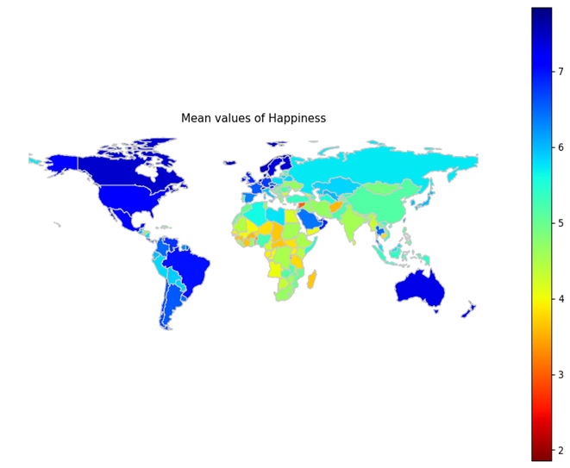
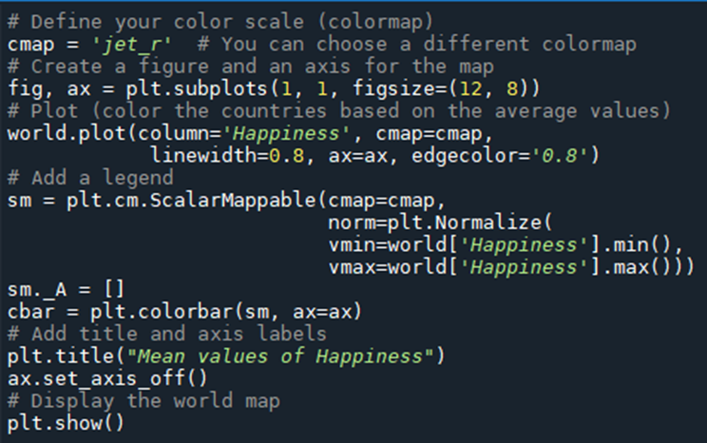
How to plot an interactive world map
There was no template or code we could use out of the box
Initial mapping was achieved with matplotlib

Slide 9
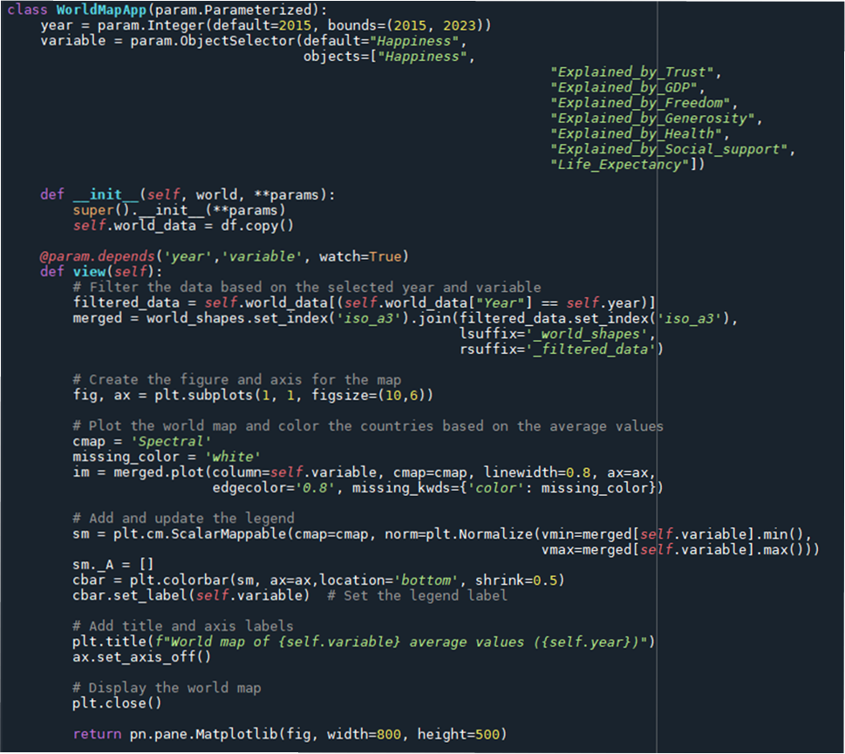
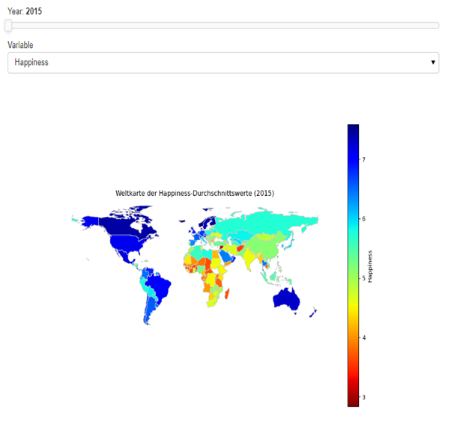
interactivity was added

Slide 10
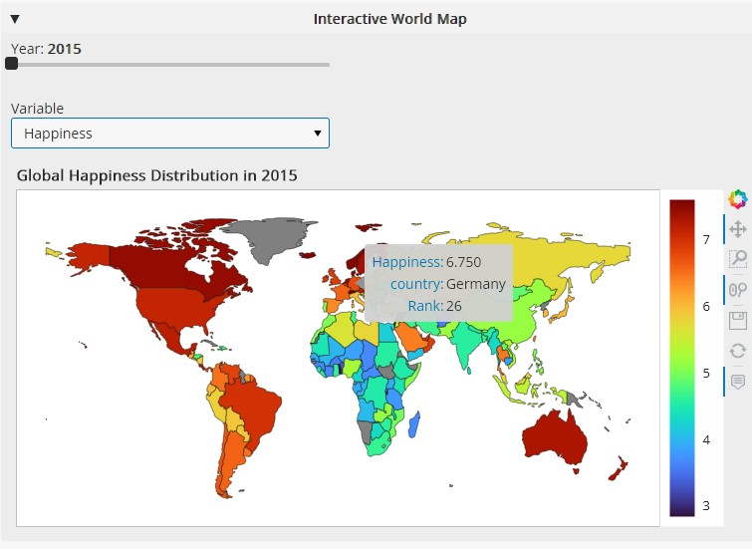
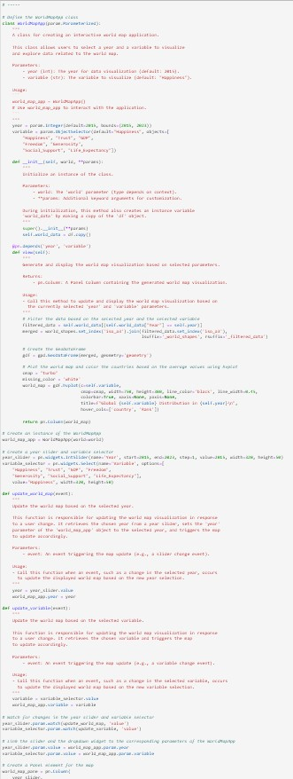
And adapted to be an interactive, explorable hvplot
Code

Slide 11
About
Aniko Bagyi
https://github.com/AnikoBagyi
Laura Oelke
https://github.com/fakesheep38
Samuel Eleazar
https://github.com/Weltall-Erde-Mensch
Project Repository on GitHub
https://github.com/fakesheep38/HapPy.git

