Slide 1
Is the Canadian Home Bias
Mean-Variance Efficient?
CFM301 Project 1: Constructing the Most Efficient Portfolio
Jian | September 2026

Slide 2
The economic question
Canadian investors display one of the world's strongest equity home biases: they allocate roughly 50% of their equity portfolios to domestic stocks (IMF Coordinated Portfolio Investment Survey, via Vanguard 2024).
Yet Canada accounts for only about 3% of global market capitalization — an overweight of roughly 15 to 18 times.
Vanguard's minimum-variance analysis, however, suggests Canadian investors should hold only about 30% in domestic equity.
This project asks whether the observed home bias is actually mean-variance efficient. We trace the long-only efficient frontier over regional equity markets and see what domestic weight the optimizer chooses.

Slide 3
Data and universe
Our universe is five regional equity ETFs, measured in monthly total returns from Yahoo Finance adjusted closes, which reinvest distributions: XIU.TO for Canada, SPY for US large cap, IWM for US small cap, EFA for developed markets ex-North America, and EEM for emerging markets.
Returns on the USD-denominated ETFs are converted to Canadian dollars each month-end using the USD/CAD spot rate, so the analysis is from the perspective of an unhedged Canadian investor.
The sample runs from October 2003 to August 2026 — 275 monthly observations. Means are annualized by ×12 and covariances by ×12.
One caveat: the brief asks for CRSP/Compustat data via WRDS, which we could not access. The ETF series are a documented, reproducible proxy, and the code accepts a WRDS extract as a drop-in replacement.

Slide 4
Estimated inputs (annualized, CAD)
Canada offers the lowest volatility of the five markets at 12.8%, with a mean return of 10.6%.
US large cap has the highest mean return at 12.5% with 16.9% volatility. US small cap (11.9% / 21.6%), developed ex-NA (9.3% / 18.4%), and emerging markets (11.2% / 22.3%) are all riskier.
Correlations range from 0.67 to 0.90: Canada correlates about 0.68 with every other market, while US large and small caps correlate 0.90 and EAFE and emerging markets correlate 0.87.
These high correlations limit the diversification benefit beyond a two-asset portfolio — a hint of why the optimizer will end up concentrating.

Slide 5
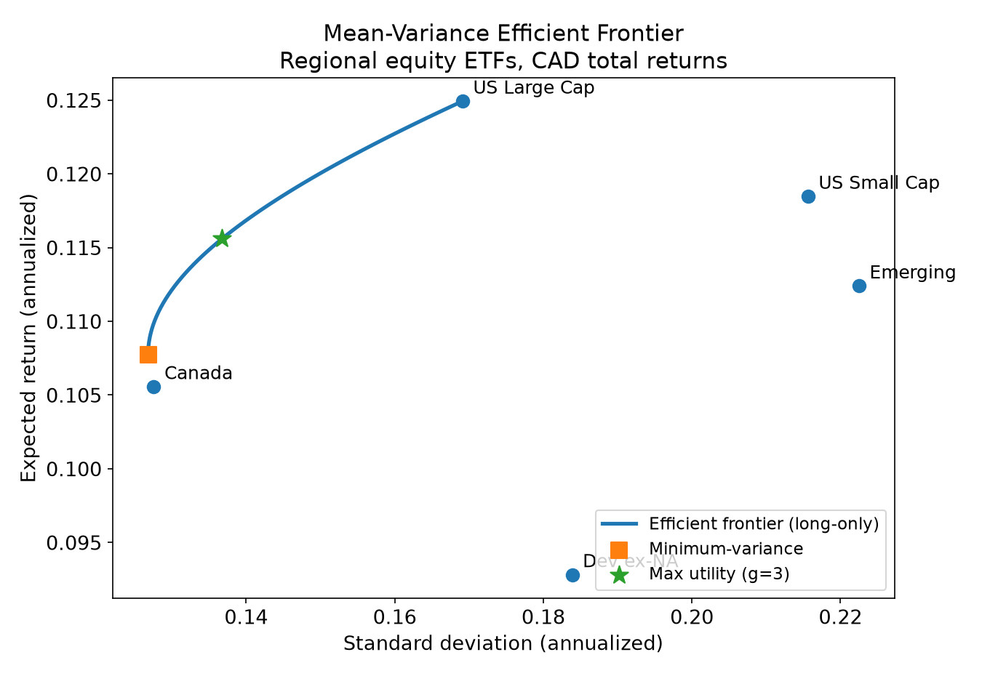
Frontier and selection criterion
We solve min w′Σw subject to w′μ = m*, Σw = 1, w ≥ 0 for a grid of target returns — one quadratic program per point — tracing out the long-only efficient frontier shown here.
With no risk-free asset there is no tangency portfolio or Sharpe-ratio rule, so we select the portfolio that maximizes mean-variance utility U = E[rp] − (γ/2)·Var[rp], with γ = 3 following the course convention.
The long-only constraint reflects the economic question: what would a retail investor's strategic equity allocation look like? It also keeps the answer interpretable.

Slide 6
The most efficient portfolio
At γ = 3, the optimizer holds 48% Canada and 52% US large cap, with an expected return of 11.6% and volatility of 13.7%.
US small cap, developed ex-NA, and emerging markets receive zero weight — a corner solution typical of error-maximizing mean-variance optimizers facing highly correlated assets.
The answer is sensitive to risk aversion: the optimal Canada weight rises from 28% at γ = 2 to 48% at γ = 3 and 64% at γ = 5.
For reference, the minimum-variance portfolio is 89% Canada and 11% US large cap, with E[r] = 10.8% and σ = 12.7%.

Slide 7
Economic conclusion
At γ = 3 the optimizer chooses 48% domestic equity — essentially the 50% that Canadians actually hold.
The home bias is therefore roughly mean-variance efficient for a moderately risk-averse investor, not the glaring inefficiency its 15–18× market-cap overweight suggests.
Vanguard's 30% recommendation sits inside the efficient zone too — it corresponds to a risk aversion of about γ = 4–5.
Caveats: the corner solution is extreme, the minimum-variance criterion implies 89% domestic, and the results depend on the sample, the criterion, unhedged currency — and ignore taxes and fees.

Slide 8
Peer evaluation (paired group)
Three main differences versus the paired group's solution —
to be completed once the paired group is assigned.
The 5–6 minute in-class presentation will explain the paired group's work and methodology, and discuss these differences.

