Slide 1
Reproducing the Equity Return Predictability Table
CFM301 Project 3 | Jian | Ch. 8 slides 24-25, extended sample

Slide 2
Economic question
Is equity return predictability still present after 2011?
Should a long-horizon investor adjust equity exposure on dividend yield?
Audience: pension fund managers setting strategic asset allocation.

Slide 3
Data and methods
Returns: CRSP VWRETD total returns, 1926-2024 (WRDS SAS Studio); EWRETD for the VW-vs-EW check.
Valuation: Shiller dividend yield, earnings yield, CAPE.
Macro: FRED term/credit spreads, inflation, IP, unemployment, oil, VIX, T-bill, GDP growth.
cay: Lettau-Ludvigson consumption-wealth ratio, reconstructed by DOLS cointegration.
Overlapping horizons, Newey-West t-stats (lag = horizon - 1).

Slide 4
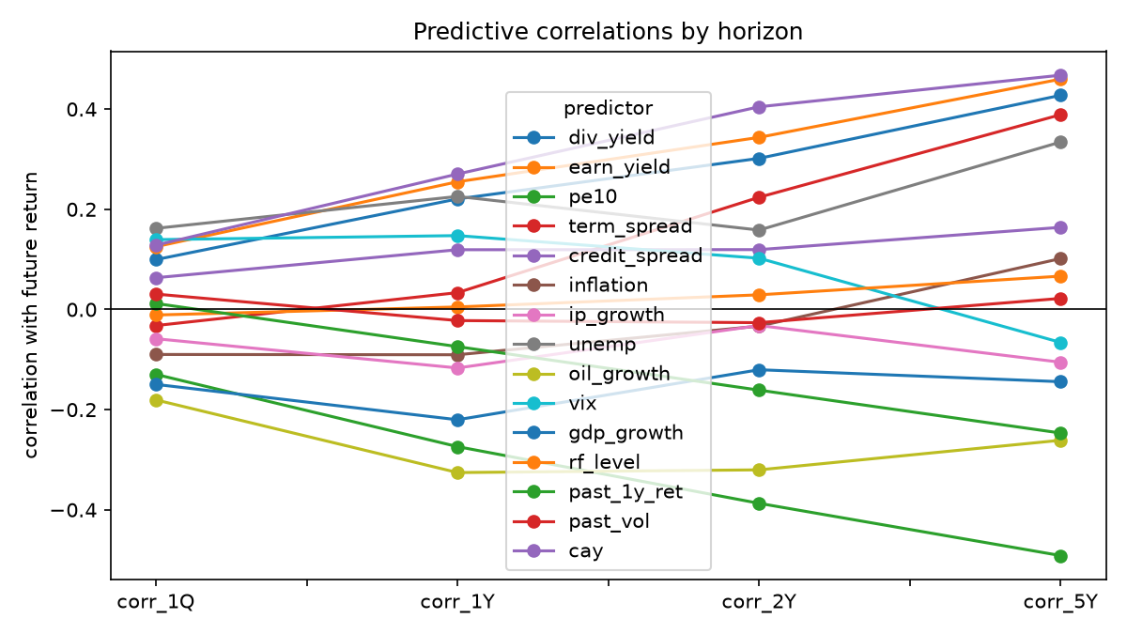
Main result: excess returns, 5-year horizon
Dividend yield: +0.47 (t=+3.26) (slide: +0.49, t=1.95)
Earnings yield: +0.38 (t=+2.08) (slide: +0.48, t=2.31)
Consumption-wealth ratio: +0.67 (t=+7.56) (slide: +0.53, t=1.34)
Unemployment rate: +0.20 (t=+1.17) (slide: +0.22, t=0.75)
The slides replicate in the full 1926-2024 sample.

Slide 5
Comparison with the slides
Sign agreement overall: 52/56 = 93% -- directions and magnitudes replicate.
Caveat: valuation predictability is regime-dependent (0.74 pre-1963, 0.18 in 1963-2011, 0.76 post-2011).
Business cycle: often stronger than the slides (term spread, oil, GDP).
Risk: volatility alone fails in both samples; cay works in both, stronger here.

Slide 6
Volatility: far more predictable than returns
GARCH(1,1): alpha=0.136, beta=0.845, persistence=0.981.
GARCH vs realized vol: 0.95 contemporaneous, 0.61 for next-year realized vol.
Bucket bands (+/- 2 SD) overlap heavily: even real predictability is too weak to trade aggressively.

Slide 7
Conclusion
Predictability survives extension to 2024: the slides' table replicates in the full sample.
But valuation predictability is regime-dependent, not a stable parameter -- do not time on yield alone.
The signals that survive every cut: cay first, cyclical variables second.
Limitations: slide sample window inferred (quarterly sampling matches best); cay is our reconstruction; post-2011 long windows are short and episode-driven.

