Slide 1
Does Earnings Yield Survive Fama-French?
Testing a Factor Beyond Market, Size, Value, and Momentum
CFM301 Project 2: Finding and Testing a Factor
Jian | October 2026

Slide 2
The factor: earnings yield (E/P)
Each month, sort stocks on trailing earnings yield = TTM net income / market cap; go long high-E/P (cheap) and short low-E/P (expensive).
It goes beyond Mkt / SMB / HML / UMD: value intuition (Basu, 1977) plus a profitability tilt — E/P is high both when prices are depressed and when earnings are strong.
Not armchair: five of my own WorldQuant BRAIN alphas (in-sample Sharpe 2.17–2.59) are built on forward earnings yield (analyst EBIT / pre-tax-profit estimates ÷ market cap). This project tests the trailing, accounting-based analog on CRSP/Compustat.

Slide 3
Data & point-in-time construction
CRSP monthly stock file via WRDS (Jan 2000–Dec 2024 — the WRDS vintage ends Dec 2024): 1,294,973 stock-months on 12,802 PERMNOs; RET is the total return (dividends + splits).
Compustat quarterly fundamentals (1.25M firm-quarters) linked via the CCM link table. For formation month-end t: TTM net income = sum of niq over the latest four quarters with report date rdq ≤ t (no lookahead); market cap = |PRC| × SHROUT × 1000.
Cleaning: 0 duplicate rows; 6,407 missing returns dropped; returns winsorized at 1/99% ([-44%, +62%], 25,771 obs); EY missing for 13.1% of stock-months (insufficient filing history); EY winsorized at 1/99% (22,516 obs). All t-stats Newey-West.

Slide 4
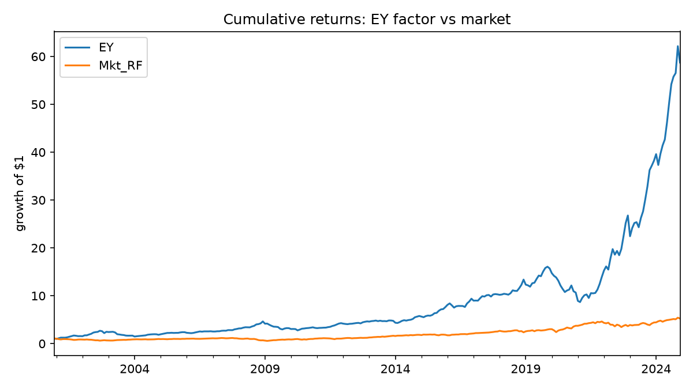
Main result: a monotone, significant premium
EY factor (Q5 − Q1, equal-weighted, 2001–2024, n = 289): +18.68%/yr, Sharpe 1.03, Newey-West t = 4.13.
Quintile returns are monotone: Q1 (low EY) −2.02%/yr → Q5 (high EY) +16.65%/yr; EY loadings in MKT+EY regressions rise monotonically (Q1 β = −0.96, t = −19.7).
Average R² with MKT+EY: 0.821 on the quintiles, 0.766 on the French 25 Size-B/M.

Slide 5
Does it survive the standard benchmarks?
Adding EY to CAPM / FF3 / FF5 raises average R² on the 25 Size-B/M portfolios by 1.57 / 0.54 / 0.27 pp, with 10, 14 and 11 of 25 portfolios showing significant EY loadings.
Spanning test: regressing EY on the five Fama-French factors leaves α = 14.90%/yr (t = 5.11, R² = 0.50) — half of EY's variance is orthogonal to FF5.
Verdict: EY is not repackaged value or profitability. It carries independent information.

Slide 6
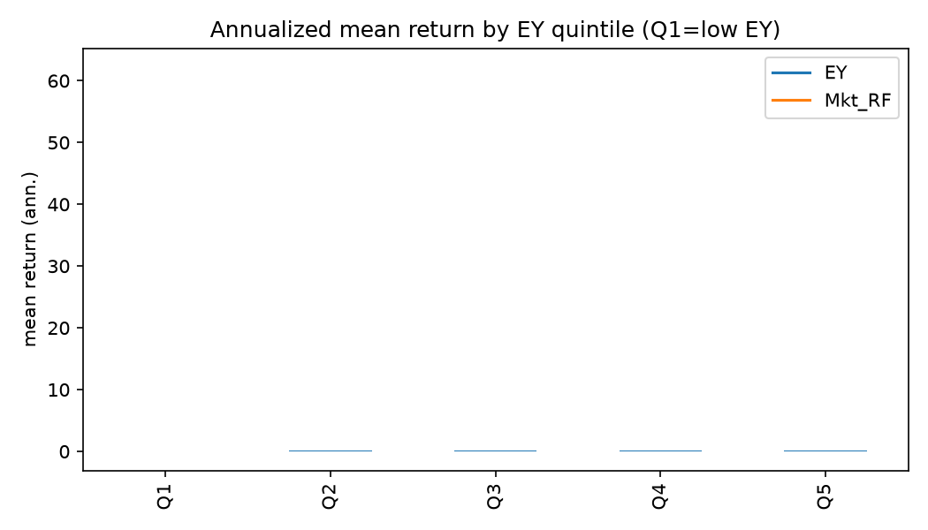
Sensitivity & limits: where the premium lives
Robust: ex-COVID months 19.3%/yr (t = 4.34); subperiods 2002–09: 10.6% (t = 1.38), 2010–19: 16.7% (t = 4.49), 2020–24: 29.7% (t = 2.28).
Fragile: tercile sorts give only 4.2%/yr (t = 0.92, insignificant) — the signal lives in the extremes. Value-weighting the legs halves it to 9.5%/yr (t = 1.80).
The premium is a microcap story: Q1 averages $409mm market cap. Delisting returns were not pulled, so distressed delisters are excluded — this understates the short leg's losses, making 18.68% conservative as a paper number, before trading costs.

Slide 7
Interpretation & takeaway
Rational: compensation for distress/earnings risk — drawdowns cluster in recessions. Behavioral: underreaction to earnings news + neglected microcaps; the nonlinearity (quintiles work, terciles don't) fits mispricing better than a linear risk loading.
Efficiency: rejects strict semi-strong efficiency, but supports Grossman-Stiglitz near-efficiency — where the premium is largest, arbitrage is costliest; at implementable scale (VW, t = 1.80) the market looks much closer to efficient.
For a quant PM: trailing EY holds genuine orthogonal information beyond FF5 — but the harvestable premium is far smaller than the 18.68% headline. Model capacity, turnover and microcap costs before allocating.

