Slide 1
Graphics
Compiled by:
Sarosh shahid

Slide 2
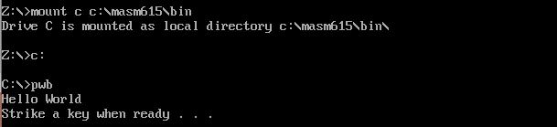
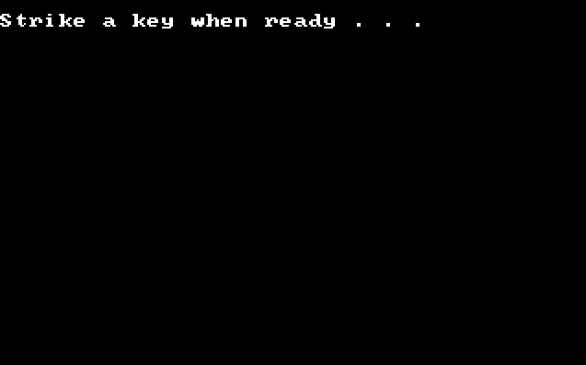

Introduction
Text Mode - can only display ASCII characters
Video Mode
Bit Mapped Image (pixels)
Graphics
Text Mode
to
Video Mode
mov AH,0 ;Interrupt function
mov AL,12h ;Mode #
int 10h
Mode Dimensions Colours

Slide 3
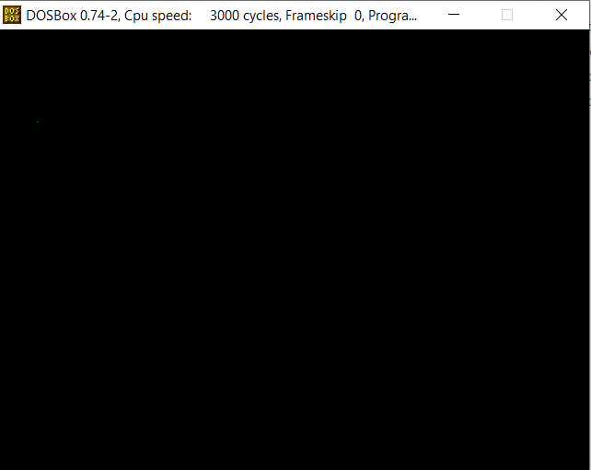
Draw Pixel
Mov AH, 0Ch
Mov AL, colour_number
Mov CX, x_axis
Mov DX, y_axis
Int 10H
DX
CX

Slide 4
Change Background color
AL having Scrol line (always 0)
BH having background
CX having (CH= upper row number, CL left column number)
DX having (DH= lower row number, DL Right column number)
Example
MOV AH, 06h
MOV AL, 0
MOV CX, 0
MOV DH, 80
MOV DL, 80
MOV BH, 14h
INT 10h
CH
CL
DH
DL

Slide 5
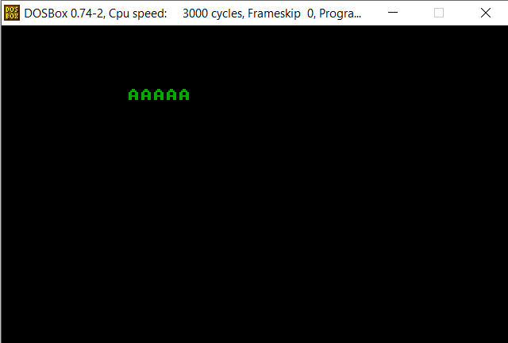
Write Text
Two Steps:
Set Cursor
mov ah,02 ;interrupt function number
mov bh,0 ;page number 0
mov dh,5 ;Row number
mov dl,10 ;column number
int 10h
Write character
mov ah, 09h ;interrupt function number
mov al, 'A‘ ;Character to be printed
mov cx,5 ;Number of times
mov bh,0 ;page number
mov bl,2 ;colour
int 10h

Slide 6


Animation
…..
Frame 01
Frame 02
Frame 03
Frame N
Clear the screen (Erase the already drawn content)
Change the position of line
Delay (timer) so that user can visualize it properly
If not done the previous shape will be retained on the window
If not done the will get to visualize only the last frame because of the speedy execution of instructions (and will not give an illusion of moving objects)

Slide 7
Animation
Clear the screen (Erase the already drawn content)
MOV AH,0
MOV AL,12h (Use the same mode number as used at start throughout your code either 12H or 13H)
INT 10h
Change the position of line
Delay (timer) so that user can visualize it properly
MOV CX, 0FH
MOV DX, 4240H ; CX:DX = interval in microseconds
MOV AH, 86H
INT 15H
NOTE: 1 million in hex is '000f 4240', so CX = 0fh : DX = 4240h = 1 second

Slide 8
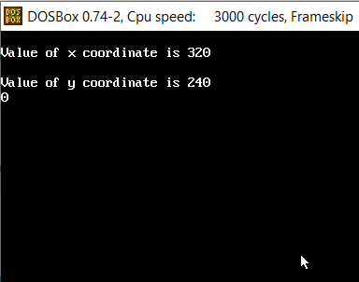
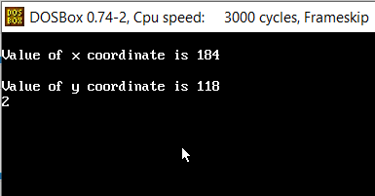
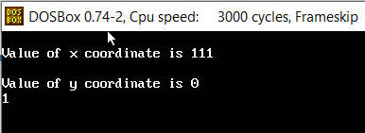
Mouse Programming
No button clicked
Right button clicked
Left button clicked
Gets the current position of the mouse cursor
MOV AX , 03
INT 33H
On return,
if left button is down: BX=1 if right button is down: BX=2 if both buttons are down: BX=3 CX = x DX = y
CX
DX
BX

Slide 9
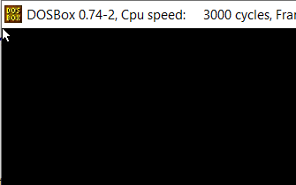
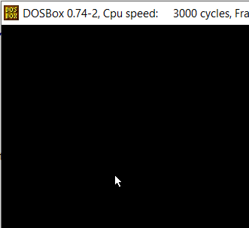
Mouse Programming
CX = 0, DX = 0
MOV AX ,04
INT 33H
When executed set the mouse position such that:
CX = x-coordinate
DX = y-coordinate
CX = 150, DX = 200

Slide 10
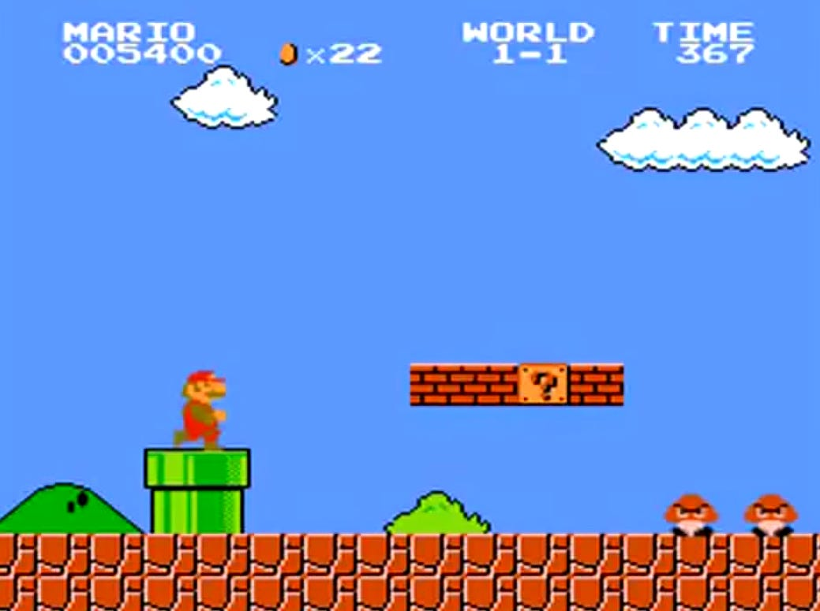
Keyboard Interrupts
When a key is pressed, the OS stores its scan code in memory locations called a keyboard buffer
MOV AH, 00H
INT 16H
return:
AH = Scan code. AL = ASCII character. Returns the next character in the keyboard buffer; if no character is available, this service waits until one is available. (if a keystroke is present, it is removed from the keyboard buffer).
MOV AH, 01H
INT 16H
check for keystroke in the keyboard buffer and return:
ZF = 1 if keystroke is not available. ZF = 0 if keystroke available. AH = Scan code. AL = ASCII character. (if a keystroke is present, it is not removed from the keyboard buffer).

Slide 11
Keyboard Interrupts
MOV AH, 01H
INT 16H
check for keystroke in the keyboard buffer
(if a keystroke is present, it is not removed from the keyboard buffer).
mov ax,0
Again:
mov ah,01
int 16h
cmp ah,4Dh ;right arrow
jne again
INT 21h / AH=0Ch - flush keyboard buffer
MOV AH,0CH
Int 21H
Returns the next character in the keyboard buffer; if no character is available, this service waits until one is available. (if a keystroke is present, it is removed from the keyboard buffer).
MOV AH,00H
Int 21H

