Slide 1
JAVASCRIPT

Slide 2
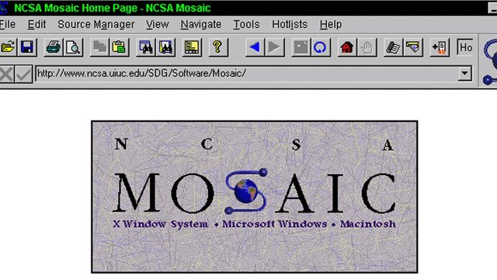
MOSAIC
Notes:
Mosaic was the first widely-distributed graphical browser or viewer for the World Wide Web. It is usually considered to have been the software that introduced the World Wide Web and the Internet to a wide general audience.
First web browser introduce the <img /> tag
The first alpha release (numbered 0.1a) was published in June 1993

Slide 3

NETSCAPE
Notes:
Netscape is the first browser introduce HTML formatting tags

Slide 4

BRENDAN EICH
Notes:
Brendan Eich create javascript in 10 days in May 1995 then working at Netscape and now of Mozilla. JavaScript was not always known as JavaScript: the original name was Mocha, a name chosen by Marc Andreessen, founder of Netscape

Slide 5
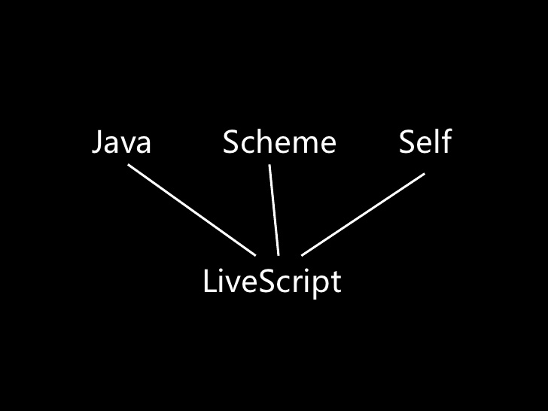

Slide 6
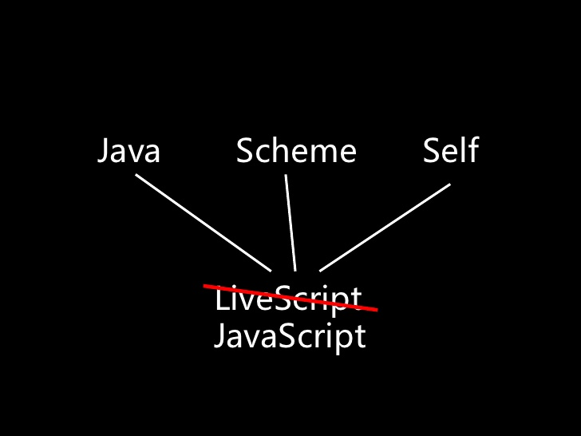

Slide 7
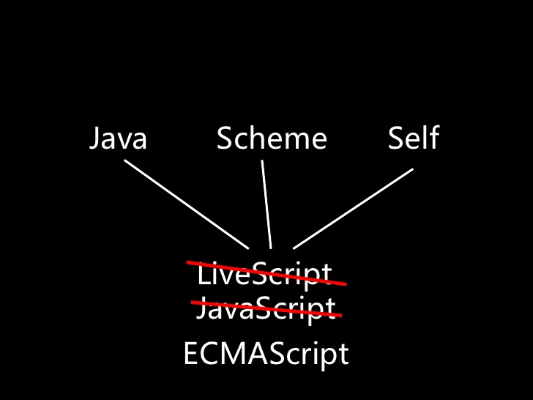

Slide 8
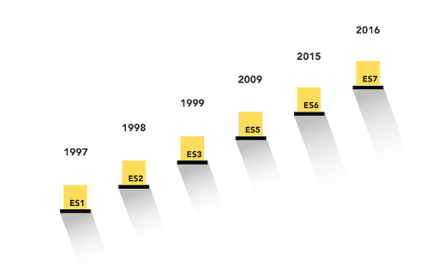

Slide 9
WHAT IS FIRST CLASS OBJECT
A first class object is an entity that can be dynamically created, destroyed, passed to a function, returned as a value, and have all the rights as other variables in the programming language have.
can be assigned to variable
Can be passed as parameter
Can be included as property from object
Can be returned from functions

Slide 10
TYPES
Type | Value example | Value category
Number | 1 , 5 , 6 | Primitive value
String | “ahmed” , “hi ”
Boolean | True , false
Null | Null
undefined | undefined
Object | [1,2,3,4] Function(){} {id:1} Regular expressions | Object values
Notes:
Onlye one number type
Numer need 64 bit

Slide 11
NAN
Special number : Not a number
Any arithmetic operation wit nan as input will have Nan as a result
NaN is not equal anything including NaN
NaN === NaN is false
NaN !== NaN is true
parseInt(‘ss’)===NaN !!
isNan( parseInt(‘ss’) )

Slide 12
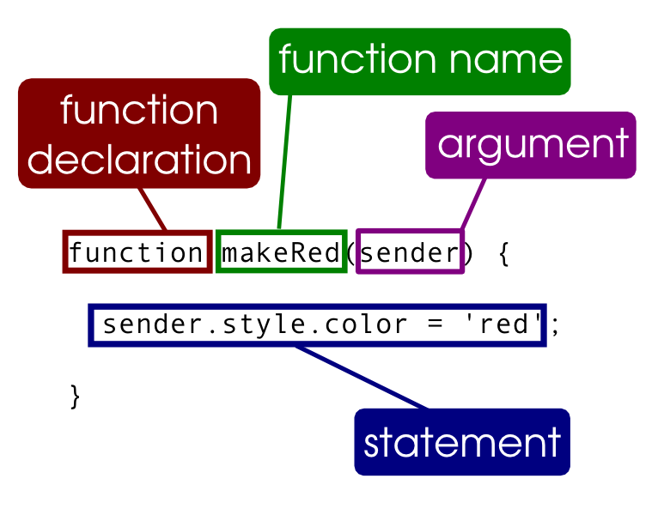
FUNCTIONS

Slide 13
FUNCTIONS
Functions are first class object
May be passed as an argument to a function
May be returned from a function
May be assigned to a variable
May be store in an object or array

Slide 14
VAR STATEMENT
It gets split into two parts :
The declaration part is get hoisted to the top of the function initializing to undefined
var x = 5 ,y=4;
var x ,y;
x=5;
y=4

Slide 15
FUNCTIONS
Function statement
Function expression
Is just a short hand for var statement with a function value
Function foo(){}
Expand to
Var foo;
Foo = function (){}
* the assignment of the function is also hoisted
* name is mandatory
var foo = function() {}
Expand to
Var foo ;
Foo = function() {}
* function declaration is only hoisted
* name is optional

Slide 16
FUNCTIONS
Function foo1() { }
Var f = function foo2() { }
(function foo3(){ })
!function foo4(){}

Slide 17
WHAT WILL BE ALERTED ?
function foo()
{
function bar(){ return 3;}
return bar();
function bar(){return 8;}
}
alert(foo())
function foo()
{
var bar = function() { return 3;}
return bar();
var bar = function() { return 8;}
}
alert(foo())

Slide 18
WHAT WILL BE ALERTED
function foo()
{
return bar();
function bar() { return 3;}
var bar = function() { return 8;}
}
alert(foo())
console.log(foo())
var foo = function()
{
return bar();
function bar() { return 3;}
var bar = function() { return 8;}
}

