Slide 1
ENTERPRISE REAL-TIME DATA ENGINEERING
Session S00: Course Foundations & Enterprise Architecture
The Distributed Data Revolution: Monolithic Failure, Streaming Paradigms & Multi-Broker Infrastructure
Course Leadership & Resources
Core Modules & Architectural Pillars
Lead Instructor:
Mohamed Fouad Fakhruldeen (م/ محمد فؤاد فخرالدين)
Personal Contact & Website:
https://fakhr.me
Course Materials & Slide Portal:
https://fakhr.me/KafkaSpark
Student Labs & Code Repository:
https://github.com/fakhruldeen/KafkaSpark
✔ The Big Data Paradigm Shift: Why monolithic RDBMS failed under 21st-century web-scale loads
✔ Streaming vs Batch Processing: Understanding the latency spectrum from hours to milliseconds
✔ Enterprise Runtime Stack: Docker KRaft mesh, JDK 17 LTS, Python virtual environment & PySpark
✔ The Nile Retail Enterprise Scenario: A realistic 4,000+ transaction retail pipeline case study
Enterprise Real-Time Data Engineering | Instructor: Mohamed Fouad Fakhruldeen (Fakhr.me) | Materials: fakhr.me/KafkaSpark | Repo: github.com/fakhruldeen/KafkaSpark | S00

Slide 2
ENTERPRISE REAL-TIME DATA ENGINEERING · SESSION S00
COURSE ROADMAP & NAVIGATION
The 5-Day Curriculum Journey
Pillar 1: Kafka & Confluent Core
Pillar 2: Distributed PySpark
Pillar 3: Integration & Capstone
Sessions S00 – S07:
• S01: Commit Log, PageCache & Zero-Copy
• S02: Partitions, MurmurHash2 & ISR Failover
• S03: Producers, Batching & Idempotence
• S04: Consumers, Cooperative Rebalance & DLT
• S05: Schema Registry & Avro Contracts
• S06: Distributed Kafka Connect & SMT
• S07: Kafka Streams & ksqlDB Windows
Sessions S08 – S10:
• S08: Spark Topology, Catalyst & Tungsten
• S09: Broadcast Hash Joins, Data Skew & Salting
• S10: Structured Streaming & Watermarking
Core Breakthrough:
Unifying batch dataframe APIs with unbounded real-time event tables.
Sessions S11 – S12:
• S11: Kafka + Spark End-to-End Pipeline
• S12: Production Ops, JMX Telemetry & Chaos
Graduation Deliverable:
9-stage Nile Retail pipeline defense passing automated acceptance gates T1 through T5 with 100% precision.
Enterprise Real-Time Data Engineering | Instructor: Mohamed Fouad Fakhruldeen (Fakhr.me) | Materials: fakhr.me/KafkaSpark | Repo: github.com/fakhruldeen/KafkaSpark | S00

Slide 3
ENTERPRISE REAL-TIME DATA ENGINEERING · SESSION S00
HISTORICAL ORIGIN STORY
The Monolithic Database Collapse (1998–2006)
The Historical Crisis: When Web Scale Shattered Traditional RDBMS
In the late 1990s and early 2000s, enterprises ran entire businesses on single large relational database servers (Oracle, Sybase, Microsoft SQL Server). As the web exploded, companies like Google, Yahoo, eBay, and Amazon found their databases overwhelmed by millions of simultaneous web queries, logging requests, and clickstream events. The conventional answer—buying larger multi-socket Unix servers with proprietary SAN arrays—reached extreme cost ceilings and physical hardware limits.
The Root Flaw of Monolithic Architectures
The Distributed Systems Paradigm Shift
1. Vertical Scaling Ceiling: CPUs and memory buses cannot scale infinitely on one motherboard.
2. ACID Transaction Overhead: Two-Phase Commit (2PC) and distributed row locking create exponential latency penalties as node counts grow.
3. Disk Seek Bottlenecks: Random disk head movements on spinning spindles limited databases to mere hundreds of I/O operations per second (IOPS).
1. Horizontal Commodity Clusters: Aggregating thousands of affordable, commodity x86 servers over standard Ethernet.
2. Share-Nothing Architecture: Nodes communicate strictly via message-passing over network sockets with zero shared physical memory.
3. Partitioned Data Primitives: Sharding datasets across independent physical logs to achieve linear scaling.
Enterprise Real-Time Data Engineering | Instructor: Mohamed Fouad Fakhruldeen (Fakhr.me) | Materials: fakhr.me/KafkaSpark | Repo: github.com/fakhruldeen/KafkaSpark | S00

Slide 4
ENTERPRISE REAL-TIME DATA ENGINEERING · SESSION S00
TERMINOLOGY ENCYCLOPEDIA
Foundational Concepts: OLTP, OLAP & Distributed Sharding
OLTP (Online Transaction Processing)
OLAP (Online Analytical Processing)
Horizontal Sharding
OPERATIONAL DATABASE SYSTEMS
ANALYTICAL WAREHOUSES & LAKES
DISTRIBUTED PARTITIONING
Formal Definition:
Database systems architected for high volumes of immediate, highly concurrent, and low-latency insert/update transactions on individual records.
Kernel / Technical Mechanics:
Employs normalized schema designs (3NF), B-Tree indexes, and ACID guarantees (Atomicity, Consistency, Isolation, Durability) to prevent financial double-spending.
Critical Failure Mode:
Catastrophic lock contention and complete database freezes when running analytical aggregations (SUM/AVG) across millions of historical rows.
Formal Definition:
Storage and query systems optimized for reading, scanning, and aggregating massive historical datasets across multiple dimensions.
Kernel / Technical Mechanics:
Uses columnar storage layouts (Parquet/ORC), data compression (Snappy/Zstd), and vectorized SIMD query execution to read only relevant attributes.
Critical Failure Mode:
Unusable for real-time single-row lookups or high-frequency point updates; heavy write overhead when updating single records.
Formal Definition:
The architectural practice of partitioning a massive dataset horizontally into distinct subsets distributed across a cluster of independent physical servers.
Kernel / Technical Mechanics:
Applies deterministic mathematical hash functions (e.g. MurmurHash2, Consistent Hashing) to route each key to an isolated shard/partition.
Critical Failure Mode:
Data Skew (Hot Partitioning): When a disproportionate volume of keys routes to a single node, causing localized CPU and memory exhaustion.
Enterprise Real-Time Data Engineering | Instructor: Mohamed Fouad Fakhruldeen (Fakhr.me) | Materials: fakhr.me/KafkaSpark | Repo: github.com/fakhruldeen/KafkaSpark | S00

Slide 5
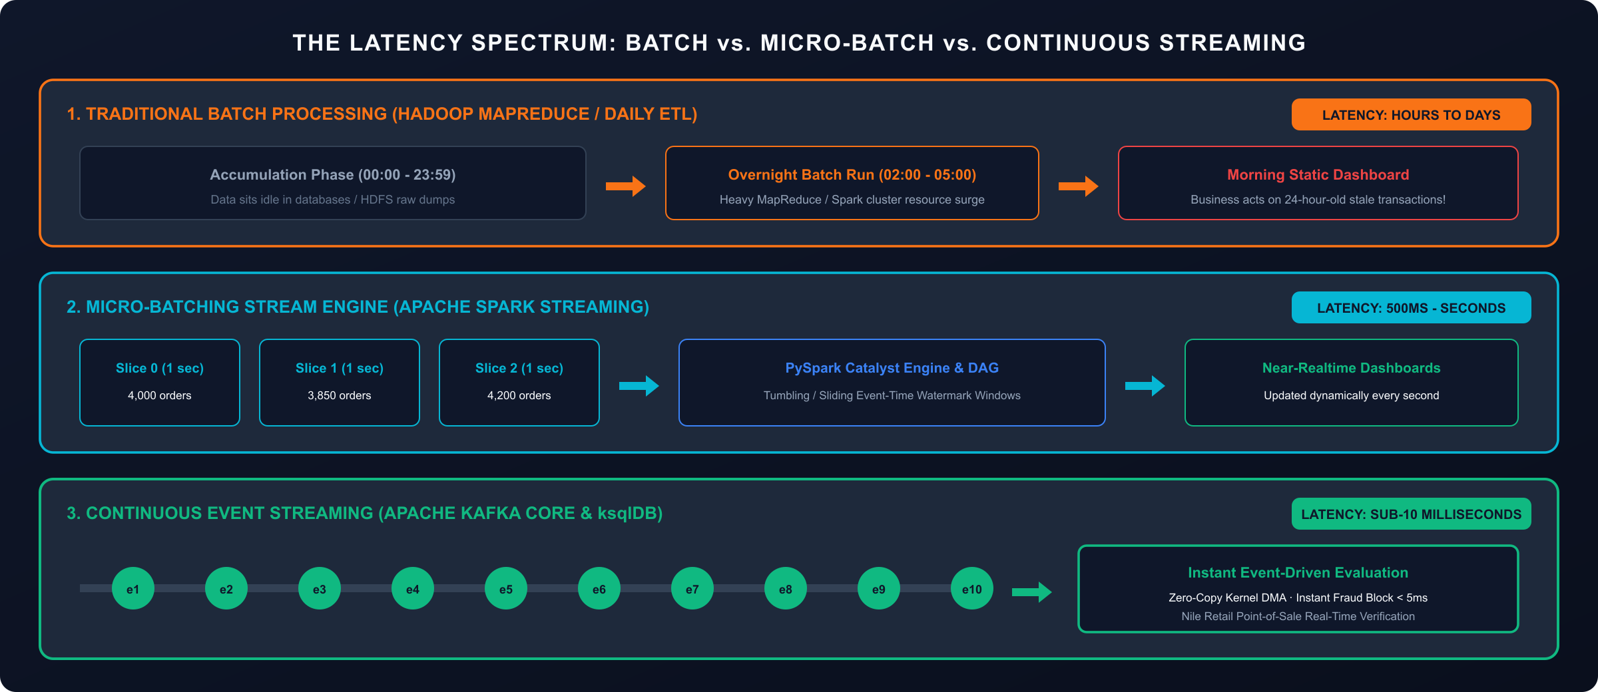
ENTERPRISE REAL-TIME DATA ENGINEERING · SESSION S00
PARADIGM COMPARISON
The Latency Spectrum: Batch, Micro-Batch & Continuous Streaming
Enterprise Real-Time Data Engineering | Instructor: Mohamed Fouad Fakhruldeen (Fakhr.me) | Materials: fakhr.me/KafkaSpark | Repo: github.com/fakhruldeen/KafkaSpark | S00

Slide 6
ENTERPRISE REAL-TIME DATA ENGINEERING · SESSION S00
VISUAL ARCHITECTURE DIAGRAM
The Enterprise Real-Time Data Plane: Ingestion to Serving
01
02
03
04
Event Generation
Distributed Log Buffer
Continuous Computation
Serving & Analytics
Mobile apps, POS terminals, and e-commerce carts publish continuous JSON/Avro events via idempotent producers.
Apache Kafka KRaft cluster buffers append-only logs across multiple brokers with RF=3 replication and PageCache zero-copy.
Spark Structured Streaming consumes micro-batches, enforces Catalyst schemas, watermarks event time, and isolates DLT.
Clean KPIs route to Kafka topics, PostgreSQL analytics tables, and real-time Kafka UI / Grafana executive dashboards.
Architectural Decoupling Invariant
Publishers and subscribers operate completely asynchronously. If processing engines crash or experience network partitions, Kafka safely buffers billions of records without back-propagating failures to point-of-sale clients.
Enterprise Real-Time Data Engineering | Instructor: Mohamed Fouad Fakhruldeen (Fakhr.me) | Materials: fakhr.me/KafkaSpark | Repo: github.com/fakhruldeen/KafkaSpark | S00

Slide 7
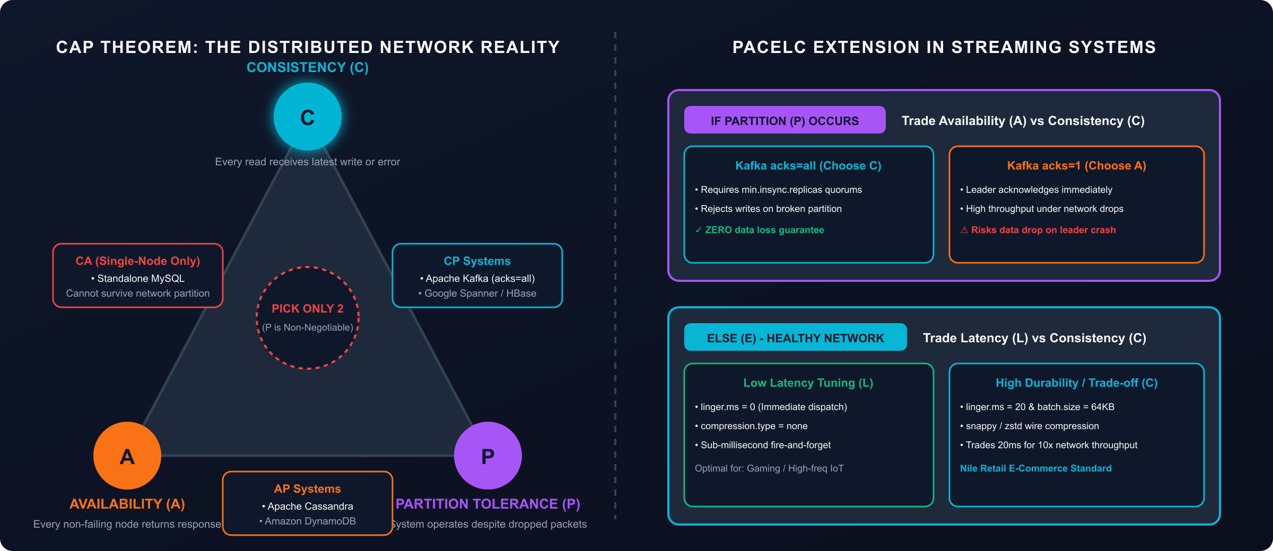
ENTERPRISE REAL-TIME DATA ENGINEERING · SESSION S00
DISTRIBUTED SYSTEMS THEORY
The CAP Theorem & PACELC Trade-Offs in Streaming Systems
Enterprise Real-Time Data Engineering | Instructor: Mohamed Fouad Fakhruldeen (Fakhr.me) | Materials: fakhr.me/KafkaSpark | Repo: github.com/fakhruldeen/KafkaSpark | S00

Slide 8
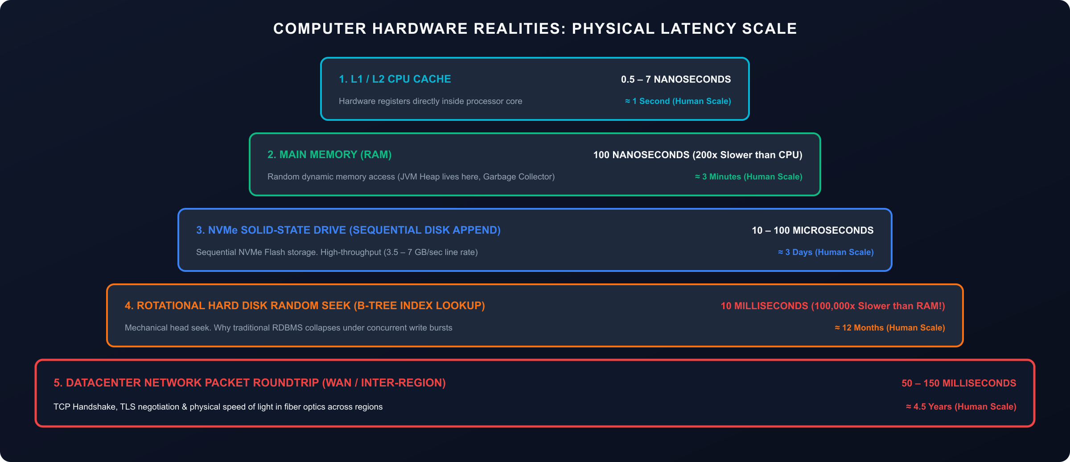
ENTERPRISE REAL-TIME DATA ENGINEERING · SESSION S00
COMPUTER ARCHITECTURE & HARDWARE
Latency Numbers Every Real-Time Data Engineer Must Know
Enterprise Real-Time Data Engineering | Instructor: Mohamed Fouad Fakhruldeen (Fakhr.me) | Materials: fakhr.me/KafkaSpark | Repo: github.com/fakhruldeen/KafkaSpark | S00

Slide 9
ENTERPRISE REAL-TIME DATA ENGINEERING · SESSION S00
INFRASTRUCTURE & TOOLING
Containerization Primitives: Docker & Multi-Broker KRaft
Docker Virtualization Primitives
The 8-Container Lab Cluster Architecture
1. OS-Level Virtualization:
Containers share the host Linux kernel while isolating processes via cgroups (CPU/RAM limits) and namespaces (PID, NET, MNT).
2. Bridge Network Topologies:
Docker Compose provisions a software-defined bridge network (`lab-net`) allowing containers to resolve each other by hostname (`kafka1`, `kafka2`, `kafka3`, `schema-registry`).
3. Volume Persistence:
Container storage is ephemeral by default. Docker volumes bind host disk directories to persist Kafka commit logs and PostgreSQL data across container restarts.
• kafka1, kafka2, kafka3: 3-Broker Apache Kafka cluster in modern KRaft mode (no ZooKeeper required).
• schema-registry (8081): Confluent Schema Registry for schema evolution, Avro serialization & contract governance.
• connect (8083): Distributed Kafka Connect worker running source/sink connector pipelines.
• ksqldb-server (8088): Declarative SQL streaming engine for continuous queries and tumbling windows.
• postgres (5432) & kafka-ui (8080): Relational sink storage and live web visual observability.
Enterprise Real-Time Data Engineering | Instructor: Mohamed Fouad Fakhruldeen (Fakhr.me) | Materials: fakhr.me/KafkaSpark | Repo: github.com/fakhruldeen/KafkaSpark | S00

Slide 10
ENTERPRISE REAL-TIME DATA ENGINEERING · SESSION S00
RUNTIME ARCHITECTURE
Python & PySpark Architecture: The Py4J Gateway Bridge
How Python Talks to Java: The Py4J Gateway
Java 17 LTS Environment Mandate
The Architectural Problem:
Apache Spark is written in Scala/Java and runs on the Java Virtual Machine (JVM). Data scientists and data engineers prefer Python.
The Py4J IPC Bridge:
PySpark launches a local JVM instance. Python calls SparkSession via Py4J, which translates Python method invocations into Java bytecode calls over local loopback sockets.
Performance Hazard:
Using Python User-Defined Functions (UDFs) forces Spark to serialize JVM objects to Python workers via IPC pipes, destroying Catalyst optimization. Always prefer native Spark SQL functions (`pyspark.sql.functions`).
Runtime Requirements:
PySpark 3.5 requires Java 17 LTS (Eclipse Temurin JDK 17.0.21).
Environment Variables Configuration:
export JAVA_HOME=/path/to/jdk-17
export PATH=$JAVA_HOME/bin:$PATH
export PYSPARK_PYTHON=.venv/bin/python
export PYSPARK_DRIVER_PYTHON=.venv/bin/python
JVM Security Notice:
Java 21+ disables `Subject.getSubject` with UnsupportedOperationException. Java 17 LTS is strictly enforced across our production cluster.
Enterprise Real-Time Data Engineering | Instructor: Mohamed Fouad Fakhruldeen (Fakhr.me) | Materials: fakhr.me/KafkaSpark | Repo: github.com/fakhruldeen/KafkaSpark | S00

Slide 11
ENTERPRISE REAL-TIME DATA ENGINEERING · SESSION S00
INDUSTRY ROLES & TEAM DYNAMICS
The Real-Time Data Engineering Role in Modern Enterprises
Data Engineer (Our Focus)
Software / Backend Engineer
Data Scientist / ML Engineer
Primary Mandate:
Building reliable, fault-tolerant distributed pipelines that move and transform data in real time.
Core Tooling:
Apache Kafka, Spark Structured Streaming, Flink, Kafka Connect, Docker, Kubernetes.
Key KPIs:
Zero data loss (SLAs), sub-second latency, 99.99% pipeline uptime, zero-gap disaster recovery.
Primary Mandate:
Building user-facing web services, APIs, and microservices that write to transactional databases.
Core Tooling:
Go, Java Spring Boot, Node.js, PostgreSQL, Redis, REST / gRPC.
Interaction with Data Team:
Produces events adhering to Confluent Schema Registry contracts.
Primary Mandate:
Training predictive models, analyzing business trends, and building recommendation engines.
Core Tooling:
PyTorch, Scikit-learn, XGBoost, Pandas, Jupyter, MLflow.
Interaction with Data Team:
Consumes clean, deduplicated feature stores curated by Spark pipelines.
Enterprise Real-Time Data Engineering | Instructor: Mohamed Fouad Fakhruldeen (Fakhr.me) | Materials: fakhr.me/KafkaSpark | Repo: github.com/fakhruldeen/KafkaSpark | S00

Slide 12
ENTERPRISE REAL-TIME DATA ENGINEERING · SESSION S00
CASE STUDY ARCHITECTURE
The Nile Retail Case Study: 4,000+ Real-Time Store Orders
The Business Context: Egypt's Leading Multi-Store Retail Chain
Nile Retail operates nationwide retail branches across Cairo, Alexandria, Giza, Mansoura, and Aswan. During promotional flash sales, thousands of store POS terminals and mobile app customers execute simultaneous checkout transactions. Legacy nightly batch jobs delayed inventory depletion reporting by 24 hours, resulting in massive product overselling, customer cancellations, and out-of-stock branch store shelves.
The Transaction Challenges
The Unified Real-Time Solution
• 4,033 raw events generated with randomized network delays.
• 23 corrupted/malformed transactions missing event IDs or money amounts.
• Network retries causing duplicated transactions.
• High-velocity payment anomalies requiring instant fraud detection.
• Apache Kafka buffers incoming transactions with RF=3 reliability.
• Confluent Schema Registry prevents breaking contract changes.
• PySpark Structured Streaming processes micro-batches with watermark deduplication.
• Dual-branch routing isolates corrupt records to DLT (`orders.connect.dlq`).
Enterprise Real-Time Data Engineering | Instructor: Mohamed Fouad Fakhruldeen (Fakhr.me) | Materials: fakhr.me/KafkaSpark | Repo: github.com/fakhruldeen/KafkaSpark | S00

Slide 13
ENTERPRISE REAL-TIME DATA ENGINEERING · SESSION S00
DIAGNOSTIC EXIT QUIZ
Knowledge Check & Interview Traps
Diagnostic Self-Check Questions
Common Engineering Traps & Pitfalls
Q1: What is the primary difference between OLTP and OLAP?
A: OLTP handles low-latency single-row transactions (B-Tree/ACID); OLAP scans and aggregates millions of columnar rows for analytics.
Q2: In the PACELC theorem, what trade-off does Kafka make in normal state?
A: Kafka allows engineers to trade latency for consistency (acks=0/1 vs acks=all).
Q3: Why is Java 17 LTS mandatory for PySpark 3.5?
A: Java 21+ removes `Subject.getSubject`, causing PySpark driver authentication crashes.
Trap 1: Writing Python UDFs for Streaming Transforms
Python UDFs force serialization across Py4J pipes, destroying throughput. Use native `pyspark.sql.functions`.
Trap 2: Ignoring Sequential I/O Reality
Thinking in-memory JVM heap is always faster than disk. OS PageCache with sequential I/O outperforms JVM garbage-collected memory.
Trap 3: Ephemeral Docker Storage
Restarting Docker containers without named volumes wipes Kafka's commit log history.
Enterprise Real-Time Data Engineering | Instructor: Mohamed Fouad Fakhruldeen (Fakhr.me) | Materials: fakhr.me/KafkaSpark | Repo: github.com/fakhruldeen/KafkaSpark | S00

Slide 14
ENTERPRISE REAL-TIME DATA ENGINEERING · SESSION S00
CONCLUSION & NEXT STEPS
Session S00 Key Mastery Takeaways & Transition to S01
Foundations Mastered
Cluster Verified
Next Up: Session S01
✔ Architecture Transition: Mastered why monolithic databases fail at web-scale and why horizontal partitioning is mandatory.
✔ Streaming Spectrum: Distinguished between batch, micro-batch, and low-latency continuous stream processing.
✔ Docker Mesh Active: Verified the 8-container workstation stack running 3 KRaft brokers, Schema Registry, Connect & Spark.
✔ Java 17 LTS Runtime: Enforced Temurin JDK 17 LTS runtime for rock-solid PySpark execution.
Session S01 Focus:
Kafka Foundations, the Commit Log, Linux PageCache, and Zero-Copy `sys_sendfile` Mechanics.
Hands-on Lab:
Producing and consuming the first live Nile Retail transactions via terminal CLI tools.
Enterprise Real-Time Data Engineering | Instructor: Mohamed Fouad Fakhruldeen (Fakhr.me) | Materials: fakhr.me/KafkaSpark | Repo: github.com/fakhruldeen/KafkaSpark | S00

Slide 15
ENTERPRISE REAL-TIME DATA ENGINEERING · SESSION S00
LAB & ENVIRONMENT ONBOARDING GUIDE
Workstation Setup Verification & 3-Broker Cluster Boot
⚡ Hands-On Lab S00: Workstation Setup & Docker Boot
🎯 Lab S00: Environment Verification Gate
1. Terminal Working Directory:
cd 00_Lab_Environment # or ~/labs/00_Lab_Environment
2. Run Automated Workstation Health Diagnostics:
./test_workstation.sh
• Verifies >=16GB RAM, >=4 CPU cores, Docker Compose v2, Java 17 LTS, Python 3.10+.
3. Boot 3-Broker KRaft Cluster & Web UI:
docker compose up -d && make check
4. Verify Web UI & Cluster Quorum in Browser:
Open http://localhost:8080 (Kafka UI) — ensure 3 KRaft brokers report healthy.
1. Python Virtual Environment Activation:
source .venv/bin/activate
python3 -c "import pyspark, confluent_kafka; print('Runtime OK')"
2. Run Offline Unit & Dataset Tests:
pytest tests/test_dataset.py tests/test_common.py -v
3. Essential Network Ports Checklist:
• 9092, 9093, 9094: Kafka Brokers 1, 2, 3 (KRaft)
• 8080: Kafka Web UI | 8081: Schema Registry
• 5432: PostgreSQL Database
4. Readiness for Session S01:
Keep terminal session active in 00_Lab_Environment for S01 CLI commands.
Enterprise Real-Time Data Engineering | Instructor: Mohamed Fouad Fakhruldeen (Fakhr.me) | Materials: fakhr.me/KafkaSpark | Repo: github.com/fakhruldeen/KafkaSpark | S00

