Slide 1

FINAL YEAR PROJECT
ELITE
FITNESS APP
AI-Powered Personalized Fitness, Nutrition & Exercise Analysis Platform
Nour Fakih • Oliver Mattar
Supervisor: Dr. Joseph Gmayel
Antonine University | Faculty of Engineering
Computer Science
PERSONALIZE • ANALYZE • PROGRESS
Notes:
TARGET TIME: 0:35

Slide 2
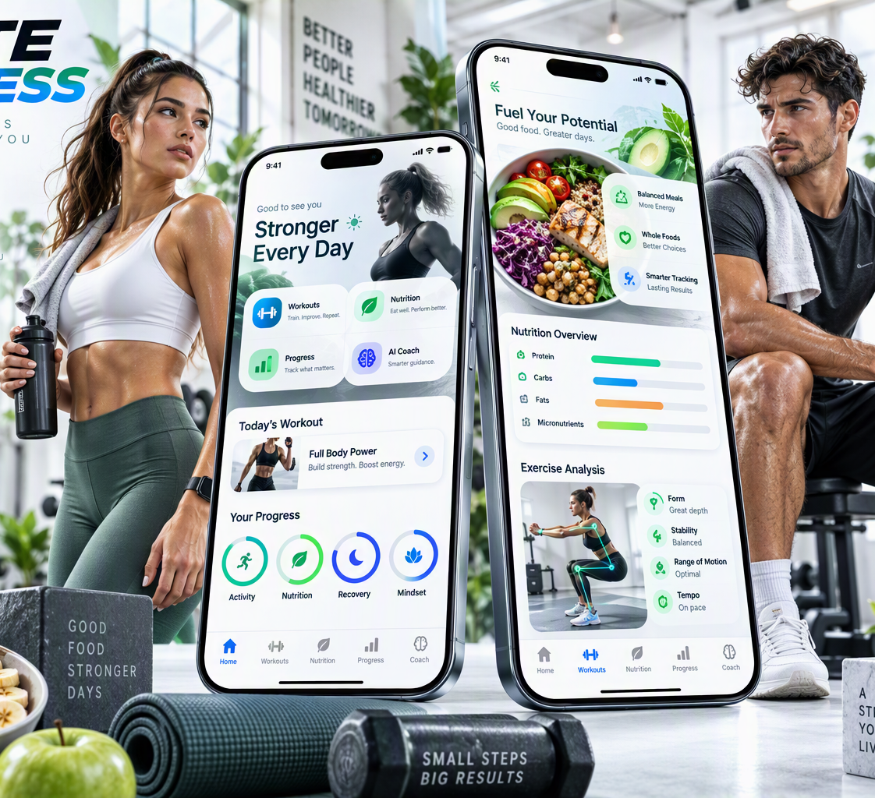
01 — MOTIVATION
The Problem
01
Generic Fitness Plans
Recommendations are rarely deeply personalized.
02
Fragmented Experience
Workout, nutrition, tracking and motivation stay separated.
03
Safety & Restrictions
Injuries, allergies and dietary restrictions require care.
04
Lack of Exercise Feedback
A plan does not guarantee correct execution.
Users need one system that understands their profile, adapts recommendations and continuously tracks progress.
Notes:
TARGET TIME: 0:55

Slide 3
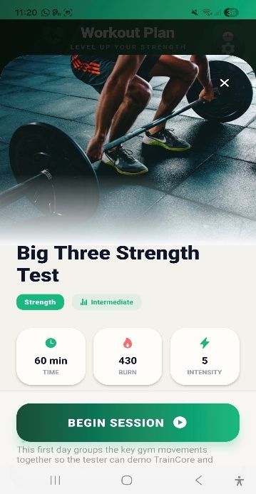
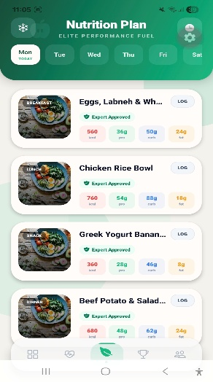
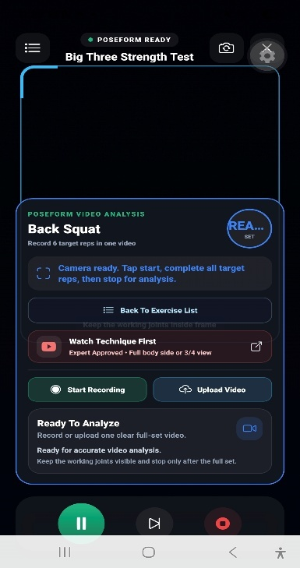
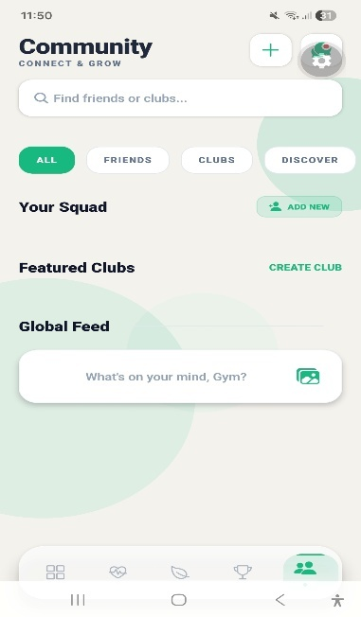
PRODUCT VISION
The product: four connected experiences
TRAIN
EAT
ANALYZE
CONNECT
Personalized workout
Daily nutrition plan
Recorded-video form
Community
ELITE FITNESS
FINAL YEAR PROJECT 3
Notes:
TARGET TIME: 0:45

Slide 4
03 — OBJECTIVES
Project Objectives
01
02
03
Personalization
Artificial Intelligence
Nutrition
Workouts and nutrition for each profile.
Multiple AI modules for recommendations.
Meals respecting allergies and preferences.
04
05
06
Exercise Analysis
Progress Tracking
Engagement
Video-based form feedback.
Weight, measurements and activity.
Challenges, rewards and community.
Notes:
TARGET TIME: 0:45

Slide 5
03 — COMPETITIVE EDGE
What makes Elite Fitness different?
Capability
Nike Training Club
Fitbod
MyFitnessPal
Strava
Elite Fitness
Personalized workout
✓
✓
—
—
✓
Nutrition generation
—
—
Limited
—
✓
Fridge-based swaps
—
—
—
—
✓
Expert meal approval
—
—
—
—
✓
Exercise form analysis
Limited
—
—
—
✓
Injury-aware planning
Limited
Limited
—
—
✓
Social + rewards
Limited
Limited
Limited
✓
✓
The key value is not one isolated feature — it is the integration of the entire journey in one system.
ELITE FITNESS APP • FYP 2026
4
Notes:
TARGET TIME: 0:55

Slide 6
TECHNICAL FOUNDATION
System Architecture
M
B
AI
H
MOBILE LAYER
BACKEND & DATA
INTELLIGENCE
EXPERT CONTROL
React Native + Expo
PHP API + MySQL
4 Specialized AI Modules
Human-in-the-Loop
The mobile application never communicates directly with the AI models or database.
Requests pass through the PHP backend for authentication, business logic, database operations and routing. Structured AI results are then processed and returned to the mobile interface.
Notes:
TARGET TIME: 1:00

Slide 7
AI ENGINE
Four AI Components, Four Different Problems
TrainCore AI
Workout Recommendation
NutriCore AI
Nutrition Recommendation
T
N
Builds personalized plans from exercise suitability scores.
Ranks meals under nutritional and personal constraints.
PredictionAI
Progress Intelligence
PoseForm AI
Computer Vision
P
V
Supports weight-trend prediction from progress data.
Analyzes repetitions, form quality and mistakes.
AI is not one generic feature. Each model solves a specific technical problem and connects to the application through the backend.
Notes:
TARGET TIME: 0:45

Slide 8
TECHNICAL DEEP DIVE
TrainCore AI — Personalized Workout Generation
TrainCore AI is implemented as a local feed-forward neural network. It receives fitness goal, gender, physical measures, training level, workout location, frequency, preferred intensity, injuries, pain points and available equipment. After numerical preprocessing, the model assigns a suitability score from 0 to 1 to each candidate exercise. Higher-scoring exercises are selected while safety filters remove conflicts with physical limitations.
USER PROFILE
FEATURE PREPROCESSING
FEED-FORWARD NETWORK
SUITABILITY SCORE
SAFETY FILTERING
PERSONALIZED WORKOUT
3,960
74,250
191
0.0329
synthetic profiles
exercise slots ranked
unique exercises
validation MAE
Notes:
TARGET TIME: 1:10

Slide 9
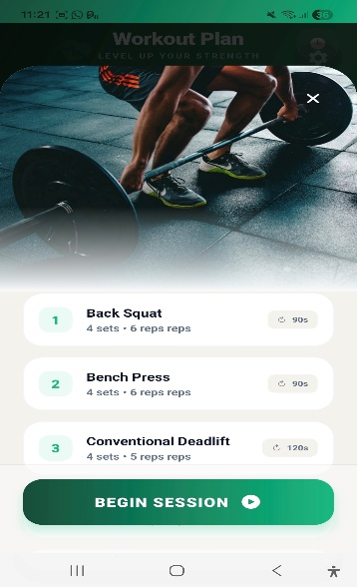
WORKOUT EXPERIENCE
TrainCore in the actual mobile app
From profile to plan
Goal, level, location and injuries are read from the saved profile.
TrainCore scores candidate exercises; safety rules exclude conflicts.
The PHP backend stores the plan and returns it to the phone.
ELITE FITNESS
FINAL YEAR PROJECT 9
Notes:
TARGET TIME: 0:55

Slide 10
TECHNICAL DEEP DIVE
NutriCore AI — Intelligent Nutrition Recommendation
USDA FOUNDATION FOODS
NutriCore AI is a local neural-network model that estimates meal suitability. It combines nutritional targets with calories, macronutrients, allergies, disliked foods, preferences and available fridge ingredients. Candidate meals are scored by the model, then passed through filtering and validation before reaching the user.
PROCESSED MEAL DATASET
NEURAL NETWORK
MEAL SUITABILITY SCORE
ALLERGY + PREFERENCE FILTER
EXPERT APPROVAL
USER
AI recommends. Rules protect. Experts approve.
Notes:
TARGET TIME: 1:10

Slide 11
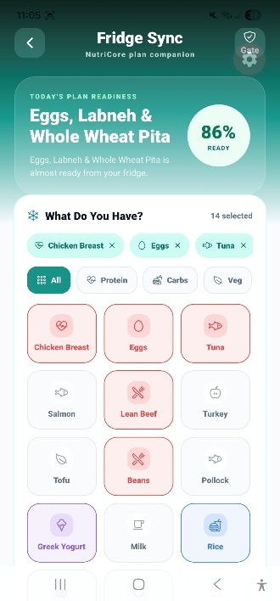
NUTRITION EXPERIENCE
NutriCore: plans, fridge and approved meals
Every suggestion passes two gates
1
Allergy and dislike filters
2
Expert approval before display
The fridge feature proposes swaps using ingredients the user already has.
ELITE FITNESS
FINAL YEAR PROJECT 11
Notes:
TARGET TIME: 1:00

Slide 12
VIDEO INTELLIGENCE
PoseForm AI — Computer Vision for Exercise Form
Recorded Video
Pose Landmarks
Movement Phases
Joint Angles
Rep Detection
Form Score
Mistake + Feedback
LANDMARK + ANGLE ANALYSIS
PoseForm converts recorded exercise video into structured technical feedback by extracting landmarks, analyzing movement phases and joint angles, estimating repetitions, scoring form, and returning corrective guidance.
Notes:
TARGET TIME: 1:10

Slide 13
POSEFORM EXPERIENCE
From uploaded video to form feedback
1
Record or upload
The phone sends a complete exercise clip.
2
Detect landmarks
MediaPipe finds body joints frame by frame.
3
Apply local rules
Angles and movement phases estimate reps and form.
4
Return JSON
The phone displays score, mistakes and feedback.
ELITE FITNESS
FINAL YEAR PROJECT 13
Notes:
TARGET TIME: 1:10

Slide 14
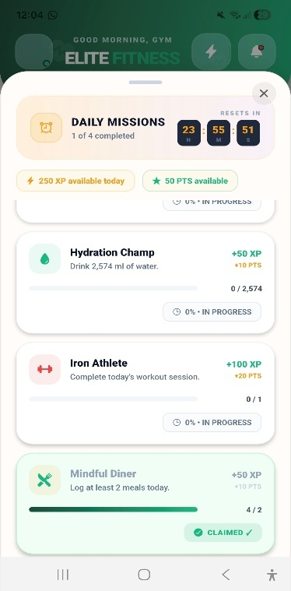
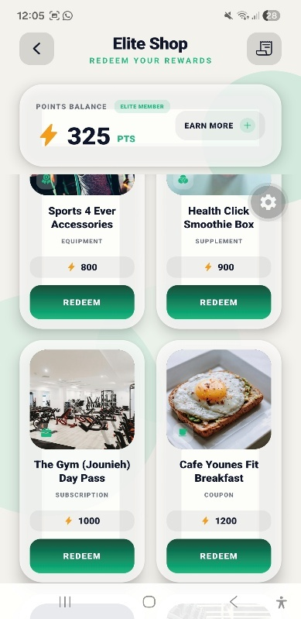
DAILY ENGAGEMENT
Community, challenges and rewards
COMMUNITY
CHALLENGES
REWARDS
Friends, clubs and posts
Daily missions and points
Redeem earned points
ELITE FITNESS
FINAL YEAR PROJECT 14
Notes:
TARGET TIME: 0:45

Slide 15
RESPONSIBLE AI
Why AI Alone Is Not Enough
INTELLIGENCE + RULES + HUMAN VALIDATION
A
+
R
+
E
AI
RULES
EXPERT
Ranks and recommends
Block unsafe conflicts
Reviews final content
Nutrition recommendations are filtered for allergies and user constraints, generated meals are reviewed before acceptance, and exercise resources are subject to review. This design improves reliability and demonstrates responsible AI integration in a health and fitness context.
Notes:
TARGET TIME: 0:50

Slide 16
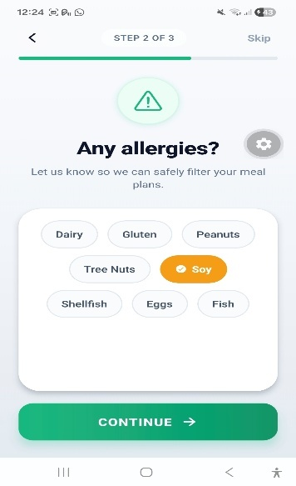
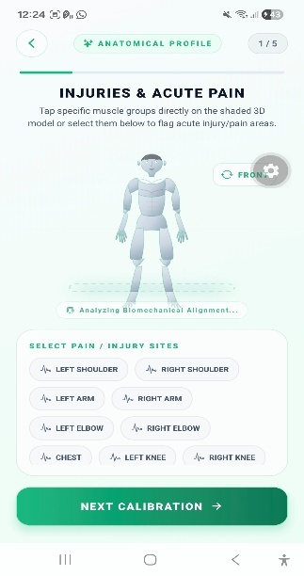
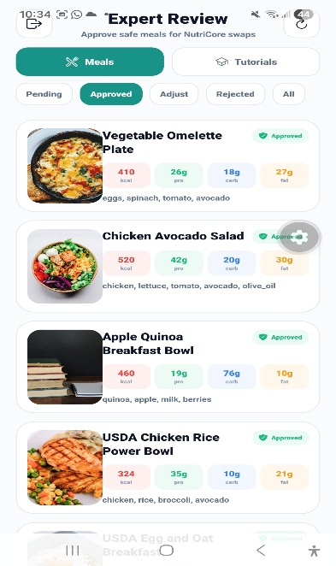
SAFETY BY DESIGN
Onboarding and expert review in the app
Allergies
Injuries
Expert review
Profile input
Training constraints
Meal approval
ELITE FITNESS
FINAL YEAR PROJECT 16
Notes:
TARGET TIME: 0:55

Slide 17
EXPERIMENTAL VALIDATION
System Testing & Validation
TEST 01
Authentication & Onboarding
TEST 02
TrainCore AI
✓
Registration
✓
Login
✓
AI execution
✓
Workout generation
✓
Token
✓
Profile storage
✓
Database storage
✓
Mobile display
PASSED
PASSED
TEST 03
NutriCore AI
TEST 04
PoseForm AI
✓
Meal generation
✓
Allergy filtering
✓
Video upload
✓
Pose detection
✓
Expert approval
PASSED
✓
Repetition counting
✓
Form evaluation
PASSED
Notes:
TARGET TIME: 1:05

Slide 18
TECHNICAL OUTCOMES
Key Results
0.0329
99%
100%
100%
17/17
TrainCore Model-Fit MAE
NutriCore Training Accuracy
NutriCore Prepared-Set Accuracy
Allergy Filtering
PoseForm Template Validation
The prototype integrates multiple forms of artificial intelligence into one mobile system. TrainCore produced stable suitability predictions, NutriCore combined high validation performance with safety filtering, and PoseForm returned structured exercise feedback.
Internal project tests; these metrics do not establish clinical performance for new users.
Notes:
TARGET TIME: 0:55

Slide 19
LIMITATIONS & FUTURE DEVELOPMENT
From Functional Prototype to Production System
DATA
Larger + more diverse
The current system is a functional prototype validated mainly in a local development environment. The datasets remain limited compared with commercial platforms, PoseForm depends on recorded videos and recording conditions, and long-term validation with a large population of real users has not yet been performed.
VISION
More exercises + conditions
Future development can expand the datasets, introduce more regional nutrition data, support more exercises, improve analysis across varied conditions, enable real-time feedback, and move toward secure production deployment.
REAL TIME
Immediate form feedback
DEPLOYMENT
Secure production stack
Notes:
TARGET TIME: 0:50

Slide 20
CONCLUSION
More Than a Fitness App
FROM USER DATA → TO AI → TO PERSONALIZED ACTION
Elite Fitness demonstrates how mobile development, backend engineering, database systems, artificial intelligence, computer vision, safety validation, and gamification can work together inside one practical application. The key contribution is not a single AI model, but the integration of multiple specialized models into a complete personalized fitness ecosystem.
TrainCore
NutriCore
PoseForm
PredictionAI
TRAIN SMARTER
EAT SMARTER
MOVE BETTER
TRACK THE FUTURE
Notes:
TARGET TIME: 0:40

Slide 21
ELITE FITNESS
THANK YOU
Questions?
Nour Fakih • Oliver Mattar
Notes:
TARGET TIME: 0:20

