Slide 1
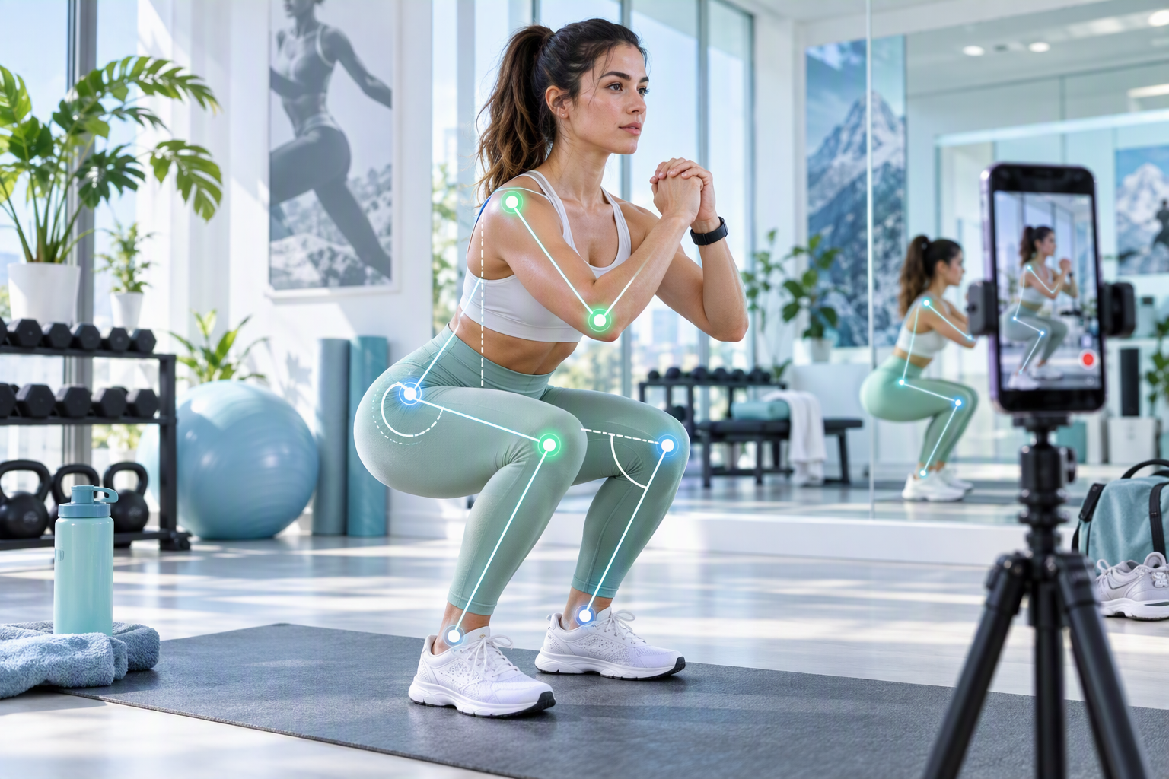
FINAL YEAR PROJECT
ELITE
FITNESS APP
AI-Powered Personalized Fitness, Nutrition & Exercise Analysis Platform
Nour Fakih • Oliver Mattar
Supervisor: Dr. Joseph Gmayel
Antonine University | Faculty of Engineering
Computer Science
PERSONALIZE • ANALYZE • PROGRESS
Notes:
[Sources]
Visuals generated with Microsoft Copilot. Title visual is a conceptual application mockup because original application screenshots were not provided.

Slide 2
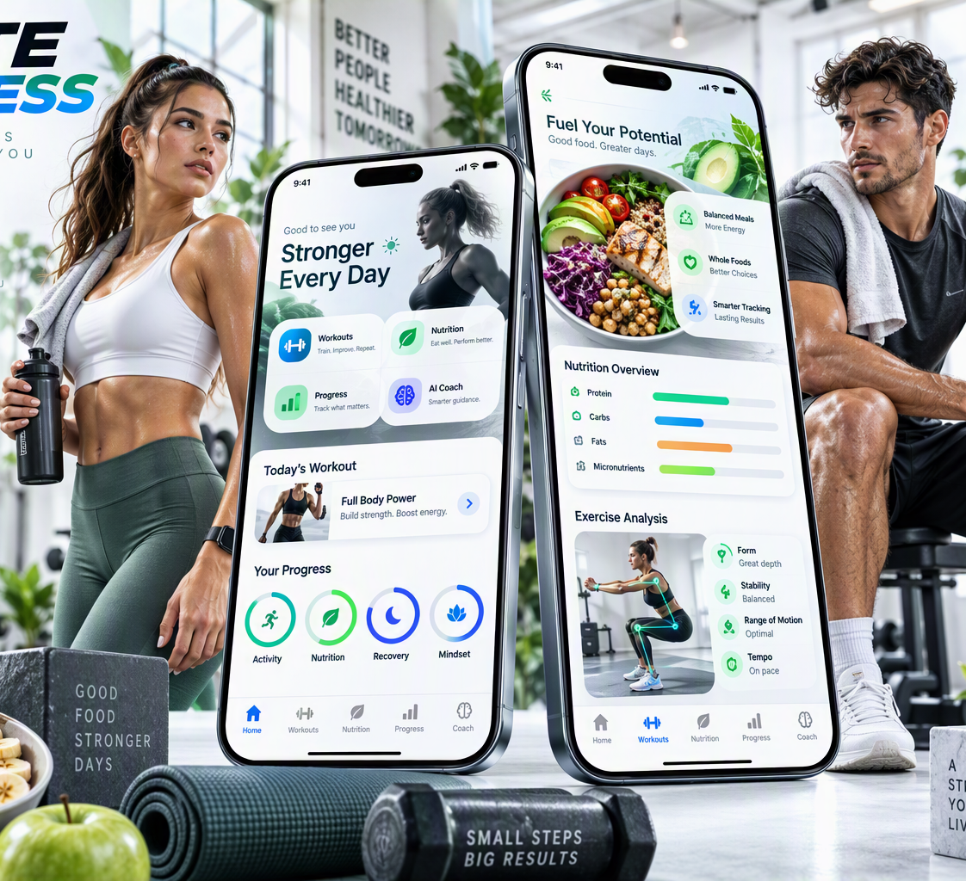
01 — MOTIVATION
The Problem
01
Generic Fitness Plans
Recommendations are rarely deeply personalized.
02
Fragmented Experience
Workout, nutrition, tracking and motivation stay separated.
03
Safety & Restrictions
Injuries, allergies and dietary restrictions require care.
04
Lack of Exercise Feedback
A plan does not guarantee correct execution.
Users need one system that understands their profile, adapts recommendations and continuously tracks progress.
Notes:
[Sources]
Visuals generated with Microsoft Copilot.

Slide 3

02 — PRODUCT VISION
Our Proposed Solution
One intelligent platform for the complete fitness journey.
🏋
Personalized Workouts
🥗
Personalized Nutrition
↗
Progress Tracking
◎
Exercise Analysis
★
Community & Gamification
AI + PERSONALIZATION + SAFETY + MOTIVATION
WHAT DID WE BUILD?
A complete, integrated fitness platform.
Notes:
[Sources]
Visuals generated with Microsoft Copilot.

Slide 4
03 — OBJECTIVES
Project Objectives
01
02
03
Personalization
Artificial Intelligence
Nutrition
Workouts and nutrition for each profile.
Multiple AI modules for recommendations.
Meals respecting allergies and preferences.
04
05
06
Exercise Analysis
Progress Tracking
Engagement
Video-based form feedback.
Weight, measurements and activity.
Challenges, rewards and community.
Notes:
[Sources]
Visuals generated with Microsoft Copilot.

Slide 5
03 — COMPETITIVE EDGE
What makes Elite Fitness different?
Capability
Nike Training Club
Fitbod
MyFitnessPal
Strava
Elite Fitness
Personalized workout
✓
✓
—
—
✓
Nutrition generation
—
—
Limited
—
✓
Fridge-based swaps
—
—
—
—
✓
Expert meal approval
—
—
—
—
✓
Exercise form analysis
Limited
—
—
—
✓
Injury-aware planning
Limited
Limited
—
—
✓
Social + rewards
Limited
Limited
Limited
✓
✓
The key value is not one isolated feature — it is the integration of the entire journey in one system.
ELITE FITNESS APP • FYP 2026
4

Slide 6
TECHNICAL FOUNDATION
System Architecture
M
B
AI
H
MOBILE LAYER
BACKEND & DATA
INTELLIGENCE
EXPERT CONTROL
React Native + Expo
PHP API + MySQL
4 Specialized AI Modules
Human-in-the-Loop
The mobile application never communicates directly with the AI models or database.
Requests pass through the PHP backend for authentication, business logic, database operations and routing. Structured AI results are then processed and returned to the mobile interface.

Slide 7
AI ENGINE
Four AI Components, Four Different Problems
TrainCore AI
Workout Recommendation
NutriCore AI
Nutrition Recommendation
T
N
Builds personalized plans from exercise suitability scores.
Ranks meals under nutritional and personal constraints.
PredictionAI
Progress Intelligence
PoseForm AI
Computer Vision
P
V
Supports weight-trend prediction from progress data.
Analyzes repetitions, form quality and mistakes.
AI is not one generic feature. Each model solves a specific technical problem and connects to the application through the backend.

Slide 8
TECHNICAL DEEP DIVE
TrainCore AI — Personalized Workout Generation
TrainCore AI is implemented as a local feed-forward neural network. It receives fitness goal, gender, physical measures, training level, workout location, frequency, preferred intensity, injuries, pain points and available equipment. After numerical preprocessing, the model assigns a suitability score from 0 to 1 to each candidate exercise. Higher-scoring exercises are selected while safety filters remove conflicts with physical limitations.
USER PROFILE
FEATURE PREPROCESSING
FEED-FORWARD NETWORK
SUITABILITY SCORE
SAFETY FILTERING
PERSONALIZED WORKOUT
3,960
74,250
191
0.0329
synthetic profiles
exercise slots ranked
unique exercises
validation MAE

Slide 9
INTEGRATION PROOF
TrainCore AI — From Model to Mobile App
Mobile App
PHP /generatePlan
TrainCore AI
Workout Database
Workout Screen
Validation covered the complete pipeline rather than the model alone. The mobile application sent profile information to the backend, the backend loaded TrainCore AI and ranked candidate exercises, the generated plan was saved in MySQL, and the workout was returned to the mobile interface. The average recommendation score was 67.33%, while validation MAE was 0.0329.
ELITE
TODAY’S PLAN
ELITE
FORM SCORE
67.33% average recommendation score · 0.0329 validation MAE

Slide 10
TECHNICAL DEEP DIVE
NutriCore AI — Intelligent Nutrition Recommendation
USDA FOUNDATION FOODS
NutriCore AI is a local neural-network model that estimates meal suitability. It combines nutritional targets with calories, macronutrients, allergies, disliked foods, preferences and available fridge ingredients. Candidate meals are scored by the model, then passed through filtering and validation before reaching the user.
PROCESSED MEAL DATASET
NEURAL NETWORK
MEAL SUITABILITY SCORE
ALLERGY + PREFERENCE FILTER
EXPERT APPROVAL
USER
AI recommends. Rules protect. Experts approve.

Slide 11
RESULTS
NutriCore AI — AI + Safety Validation
99%
100%
100%
Training Accuracy
Validation Accuracy
Allergy Filtering
HUMAN-IN-THE-LOOP ARCHITECTURE
NutriCore generated personalized meals and smart alternatives during validation. Restricted ingredients are filtered before display, and generated meals must pass expert approval. AI performs recommendation while safety rules and human review control the final output.

Slide 12
VIDEO INTELLIGENCE
PoseForm AI — Computer Vision for Exercise Form
Recorded Video
Pose Landmarks
Movement Phases
Joint Angles
Rep Detection
Form Score
Mistake + Feedback
LANDMARK + ANGLE ANALYSIS
PoseForm converts recorded exercise video into structured technical feedback by extracting landmarks, analyzing movement phases and joint angles, estimating repetitions, scoring form, and returning corrective guidance.

Slide 13
INTEGRATED COMPUTER VISION
PoseForm AI — Validation
17 / 17
3 / 3
24 / 24
Template checks passed
Python analyzer checks passed
Smoke-test profiles passed
MOBILE VIDEO UPLOAD
PHP TEMP PROCESSING
LOCAL PYTHON ANALYZER
STRUCTURED JSON
The complete video-analysis pipeline returned repetitions, form score, detected mistakes and corrective feedback to the application, demonstrating an integrated service rather than an isolated computer-vision script.

Slide 14
PREDICTIONAI
Turning Tracking Data into Predictions
The system uses stored physical information and historical progress to move beyond simple tracking. PredictionAI supports weight-trend prediction, connecting daily activity and measurements with longer-term progress analysis. The presentation intentionally does not claim a specific algorithm architecture because the available report detail does not justify one.
WEIGHT PROGRESS
HISTORICAL
PROJECTED

Slide 15
RESPONSIBLE AI
Why AI Alone Is Not Enough
INTELLIGENCE + RULES + HUMAN VALIDATION
A
+
R
+
E
AI
RULES
EXPERT
Ranks and recommends
Block unsafe conflicts
Reviews final content
Nutrition recommendations are filtered for allergies and user constraints, generated meals are reviewed before acceptance, and exercise resources are subject to review. This design improves reliability and demonstrates responsible AI integration in a health and fitness context.

Slide 16
MODEL TO APPLICATION
One Request. Multiple Technical Layers.
USER REQUEST
MOBILE APP
PHP API
MYSQL PROFILE
TRAINCORE AI
SAFETY FILTER
SAVE PLAN
JSON RESPONSE
MOBILE UI
Technical significance comes from integration: mobile data collection, backend orchestration, database history, specialized AI processing, safety control, persistence, and structured return to the user.

Slide 17
EXPERIMENTAL VALIDATION
System Testing & Validation
TEST 01
Authentication & Onboarding
TEST 02
TrainCore AI
✓
Registration
✓
Login
✓
AI execution
✓
Workout generation
✓
Token
✓
Profile storage
✓
Database storage
✓
Mobile display
PASSED
PASSED
TEST 03
NutriCore AI
TEST 04
PoseForm AI
✓
Meal generation
✓
Allergy filtering
✓
Video upload
✓
Pose detection
✓
Expert approval
PASSED
✓
Repetition counting
✓
Form evaluation
PASSED
Notes:
[Sources]
Visuals generated with Microsoft Copilot. Test outcomes are based on the supplied final report summary.

Slide 18
TECHNICAL OUTCOMES
Key Results
0.0329
99%
100%
100%
17/17
TrainCore Validation MAE
NutriCore Training Accuracy
NutriCore Validation Accuracy
Allergy Filtering
PoseForm Template Validation
The prototype integrates multiple forms of artificial intelligence into one mobile system. TrainCore produced stable suitability predictions, NutriCore combined high validation performance with safety filtering, and PoseForm returned structured exercise feedback.

Slide 19
LIMITATIONS & FUTURE DEVELOPMENT
From Functional Prototype to Production System
DATA
Larger + more diverse
The current system is a functional prototype validated mainly in a local development environment. The datasets remain limited compared with commercial platforms, PoseForm depends on recorded videos and recording conditions, and long-term validation with a large population of real users has not yet been performed.
VISION
More exercises + conditions
Future development can expand the datasets, introduce more regional nutrition data, support more exercises, improve analysis across varied conditions, enable real-time feedback, and move toward secure production deployment.
REAL TIME
Immediate form feedback
DEPLOYMENT
Secure production stack

Slide 20
CONCLUSION
More Than a Fitness App
FROM USER DATA → TO AI → TO PERSONALIZED ACTION
Elite Fitness demonstrates how mobile development, backend engineering, database systems, artificial intelligence, computer vision, safety validation, and gamification can work together inside one practical application. The key contribution is not a single AI model, but the integration of multiple specialized models into a complete personalized fitness ecosystem.
TrainCore
NutriCore
PoseForm
PredictionAI
TRAIN SMARTER
EAT SMARTER
MOVE BETTER
TRACK THE FUTURE

Slide 21
ELITE FITNESS
THANK YOU
Questions?
Nour Fakih • Oliver Mattar
Notes:
[Sources]
Visuals generated with Microsoft Copilot. Background is a conceptual application mockup because original application screenshots were not provided.

