Slide 1



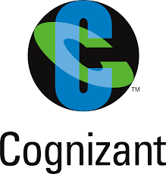

















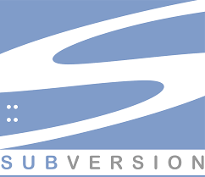














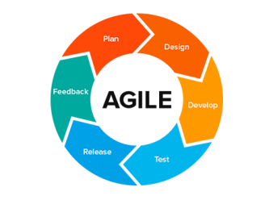

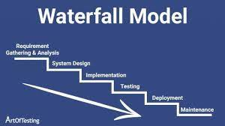
Roles and Responsibilities
Employers
Gathering clear vision for a project, and understand clients’ needs, gather and examine functional requirements and specifications from clients and users, Understand there long term and short term goals.
Developed the architectural solutions by decomposing the complex technical challenges to actionable and explainable decisions, by applying architectural standards/principles, global product-specific guidelines, security standards, usability design standards, as appropriate.
Provided insight, direction to teams and is doing hand-on development on Platform/product for integrating complex heterogeneous systems, API formulation, Design & development of many microservices.
Ensured re-use through consumption and expansion of shared platform technology assets in the product.
Developed the architecture artifacts like ADR, ABB and SBB for the workstreams based on TOGAF std.
Involved in various review teams like Design review, functional reviews, PR reviews etc.
Drove the initiative to adhere to quality through CI / CD automated test runs.
Contributed during formation of teams by taking interviews and setting up bootcamps.
Technology & Tools Stack
Clients
22 + Years In IT
SDLC

Slide 2
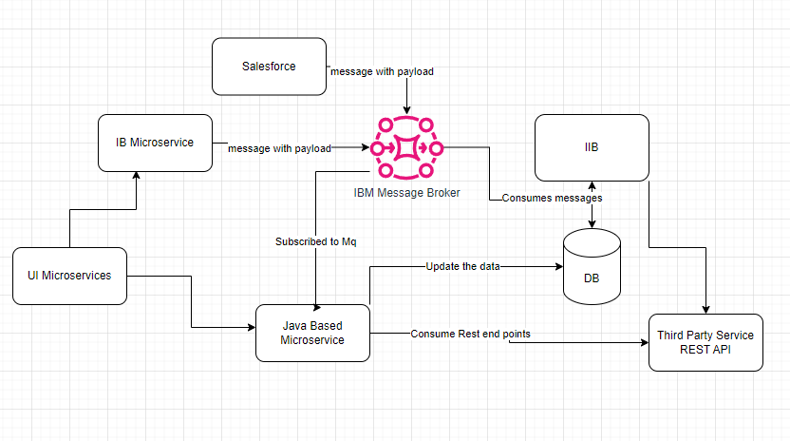

Slide 3
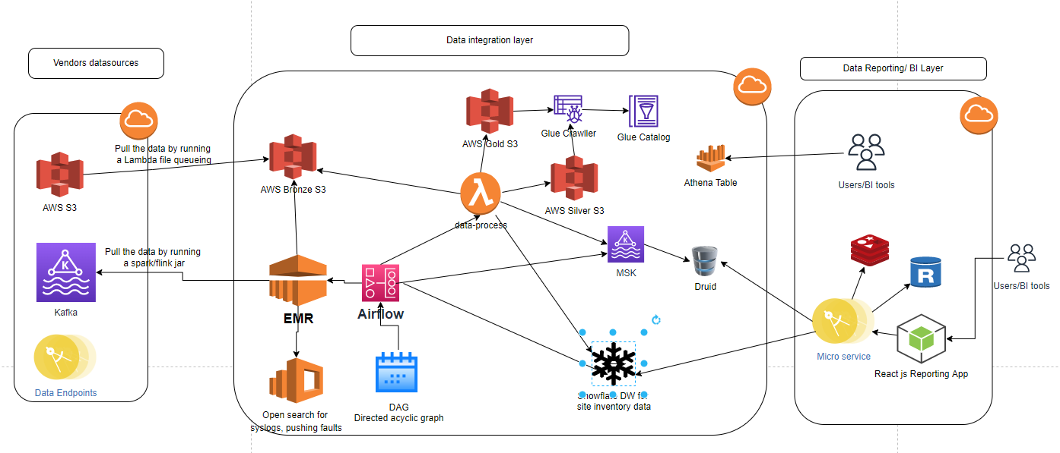

Slide 4
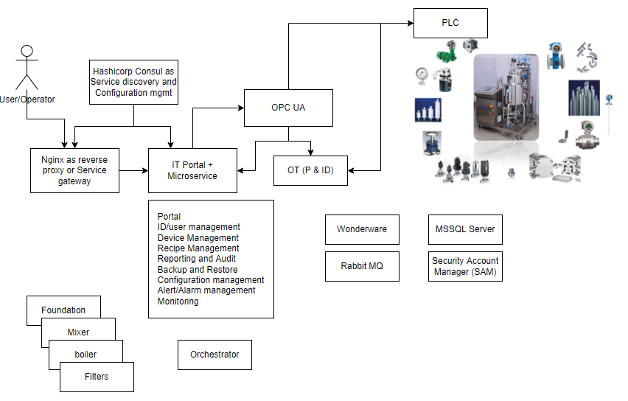

Slide 5
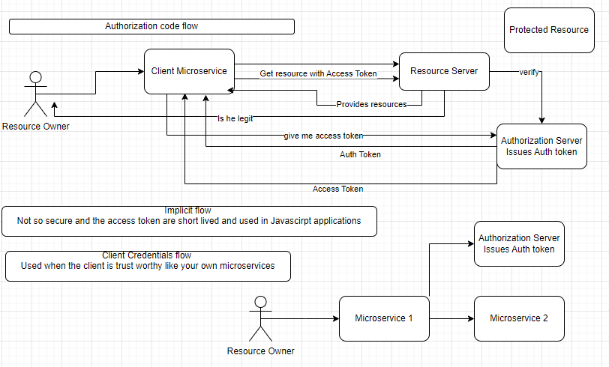

Slide 6
OWASP - Open Web Application Security Project
1.Injection
2. Broken Authentication
3. Sensitive Data Exposure
4. XML External Entities (XEE)
5. Broken Access Control
6. Security Misconfiguration
7. Cross-Site Scripting
8. Insecure Deserialization
9. Using Components With Known Vulnerabilities
10. Insufficient Logging And Monitoring

Slide 7
Architectural Principles
Business Principles
Data Principles
Application Principles
Technology Principles
Requirements-Based Change
Responsive Change Management

Slide 8
Architectural Principles
Business Principles
Data Principles
Application Principles
Technology Principles
Requirements-Based Change
Responsive Change Management

