Slide 1
Chapter 0
Introduction

Slide 2
Objectives
Introduction
Why .NET framework?
Learning by doing
Contents and Schedule
Resource

Slide 3
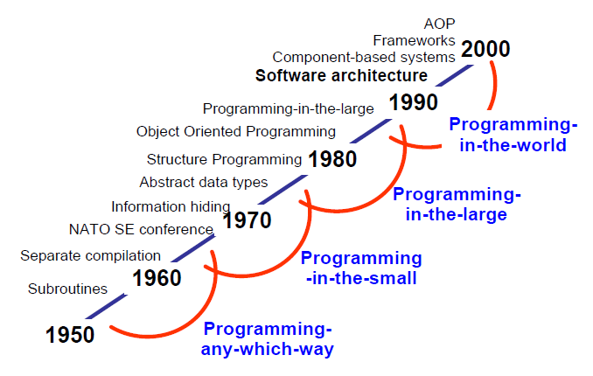
Evolution of Software Design
Notes:
AOP: Aspect-Oriented Programming: Lập trình hướng vấn đề

Slide 4
.NET Framework value
Microsoft has created a whole new platform for development.
This platform overcomes many of the problems:
  Long development times
  Inability to change applications quickly
  High total cost of ownership of software
  Difficult to deployment.

Slide 5
The .NET and Return on investment (ROI)
ROI = Total benefit/Total cost of development
.NET help ROI: Less time to develop application (much re-useable code and so many re-useable components)
  Scalability (can scale and support the additional load)
  Maintainability (configuration settings that can be modified without having to re-write code)
  Deployment (different versions of the same DLL)
  Reliability (built-in checks and balances)
  Security
  Cross Platform (desktop, browser, mobile browser, PDA)
  Services-Oriented Architecture

Slide 6
Learning by doing - 1
There is really no learning without doing.
There maybe appearance of learning by memorizing things and be able to passing tests but there is minimum retention afterward.
Students build their knowledge by actually trying things out and improve their skills by learning what works and what does not work.
Learning and retention rate are the key factor in the “Learning by Doing” method. Research has shown that students will only retain their knowledge about:

Slide 7
Learning by doing - 2
  5% if it focus only on lecturing
  10% if it is focusing on reading
  20% if the focus is on audiovisual and demonstration
  50% by group discussions
  75% by actual practicing
  90% by actual teach others.

Slide 8
Learning by doing - 3
Students will be asked to go over reading and practice for the week, before coming to class. They must complete the weekly homeworks before class to demonstrate that they have read all reading assignments and have some knowledge of the materials. (This will help that they could retain 20% of the knowledge).
In class, students will spent more time on class discussion on certain topic and perform team works where they actually implement what they learned in class based on team scenarios (This will help improve their knowledge and skills via practicing and improve retention rate to 80%)

Slide 9
Learning by doing - 3
As students learn the subject, they will be asked to actually lead the discussion and teach the subject to their classmates (That will help build their knowledge, skills and retention rate to over 90%)

Slide 10
Contents
Part 1: Introduction
Part 2: C# language
Part 3: Programming with .NET assemblies
Part 4: Programming with .NET libraries
Part 5: Web applications and Web services

Slide 11
Schedule - 1
Week 1:
  Phylosophy of .NET (ch.1), Building application (ch. 2)
  Language fundamentals (ch. 3)
  OOP (ch. 4), Structured exception handling (ch.6), Project report 1 guide
Week 2: submit Lab 1 (4%)
  Interfaces and collections (ch. 7), Generics (ch. 10)
  Callback interfaces, delegates, and events (ch. 8)
  Lab 1: C# programming guide

Slide 12
Schedule - 2
Week 3: submit Project report 1
  .NET assemblies (ch. 11), Multithreaded applications (ch. 14)
  Lab 2: .NET assemblies guide
  System IO namespaces (ch. 16)
Week 4: submit Lab 2 (3%)
  Windows with System.Windows.Forms (ch. 19)
  Windows forms controls (ch. 21)
  Project Report 2 guide

Slide 13
Schedule - 3
Week 5: submit Project report 2 – SRS
  Database Access (ch. 22)
  Database Access (ch. 22)
  Project Report 3 - Software design guide
Week 6: submit Lab3 (4%)
  Lab 3 : Windows forms guide
  Project assistant
  Progress test 1 (7.5%)

Slide 14
Schedule - 5
Week 7: submit Project report 3 – software design
  Web pages and controls (ch. 23)
  Web applications (ch. 24)
  Web services (chapter 25), Lab 4: Web application
Week 8 : submit Lab 4 (4%)
  Lab 4: Web applications guide
  Lab 4: Web applications guide
  Doing Project

Slide 15
Schedule - 6
Week 9 :
  Project presentations
  Project presentations
  Project presentations
Week 10: submit final Project (20%)
  Review
  Progress test 2 (7.5%)
  Practical Exam (20%)
Week 11: Final Exam (30%)

Slide 16
Resources
Tools
  SQL server 2008
  Visual studio 2010
Text books
  Apress.Pro.C.Sharp.with.dot.NET.3.0.Special.Edition.Jan.2007
  Beginning C# ObjectOriented (for doing Project)

Slide 17
Q & A

