Slide 1
Chapter 3
C# Language Fundamentals

Slide 2
Objectives
Understanding C# console application
Member visibility
Method parameter modifier
The static keyword
Value types and Reference types
Boxing and Unboxing operations
Object type
Understanding fully qualified name

Slide 3
Content
The Main() method
Member visibility
Variables and Constants
The static keyword
Method parameter modifier
Decision and Iteration constructs
Value types and Reference types
Boxing and Unboxing operations
Working with Enumerations
The master class: System.Object
Defining custom namespaces

Slide 4
The Main() method
Is used to signify the entry point of the application
Variations
  No return type, array of strings as argument
  No return type, no arguments
  Integer return type, no arguments
  Integer return type, array of strings as argument
Processing command-line arguments
Specify command-life arguments with Visual Studio 2008

Slide 5
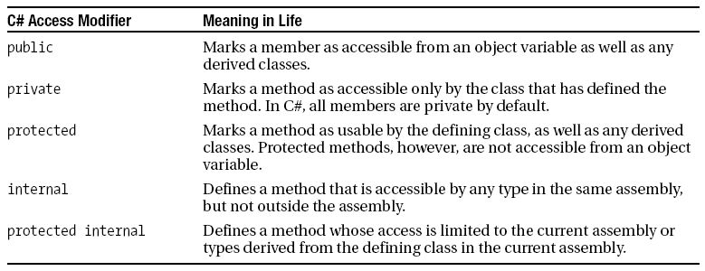
Member visibility

Slide 6
Member visibility
Establishing Type visibility
  Types (classes, interfaces, structures, enumerations, and delegates) are limited to public or internal (default).

Slide 7
Variables and Constants
Default values and local variables
  Local variables (within a member scope) must be assigned an initial value before used.
  If the variable is used as an output parameter, the variable doesn’t need to be assigned an initial value.

Slide 8
Defining Constant data
C# offers the const keyword to define variables with a fixed, unalterable value.
Once the value of a constant has been established, any attempt to alter it results in a compiler error.
It is important to understand that the value assigned to a constant variable must be known at compile time => constant member cannot be assigned to an object reference

Slide 9
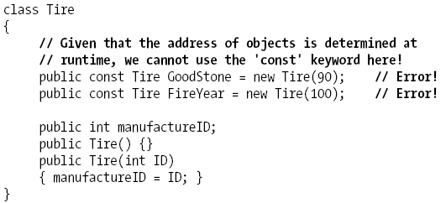
Defining Constant data

Slide 10
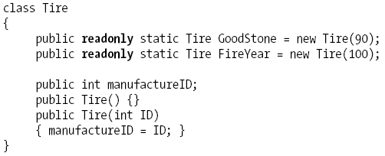
Defining Read-only fields
Read-only fields allow you to establish a point of data whose value is not known at compile time, but that should never change once established

Slide 11
The static keyword
The member is defined using the static keyword must be invoked directly from the class level
Static members can operate only on static class members
Static data is allocated once and shared among all object instances of the same type
Read more about static constructors in textbook

Slide 12
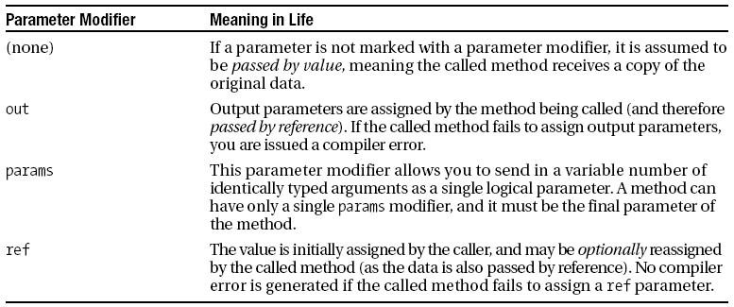
Method parameter modifiers

Slide 13
Method parameter modifiers
Output parameters do not need to be initialized before they passed to the method
Reference parameters must be initialized before they are passed to the method

Slide 14
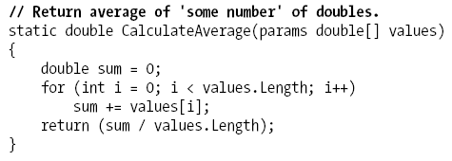
Method parameter modifiers
params modifier allows you to create a method that may be sent to a set of identically typed arguments as a single logical parameter

Slide 15
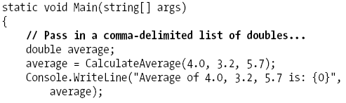
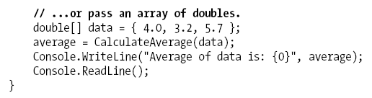
Method parameter modifiers

Slide 16
Decision and Iteration constructs
The if/else statement
The switch statement

Slide 17
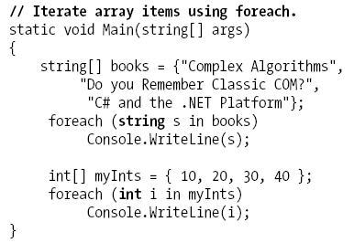
Decision and Iteration constructs
for loop
foreach/in loop
while loop
do/while loop

Slide 18
Value types and Reference types
Value-based types
  Directly contain data
  Include all numerical data types
  Enumerations and structures
  Cannot be null
Reference types
  Contain references to objects
  May be null

Slide 19
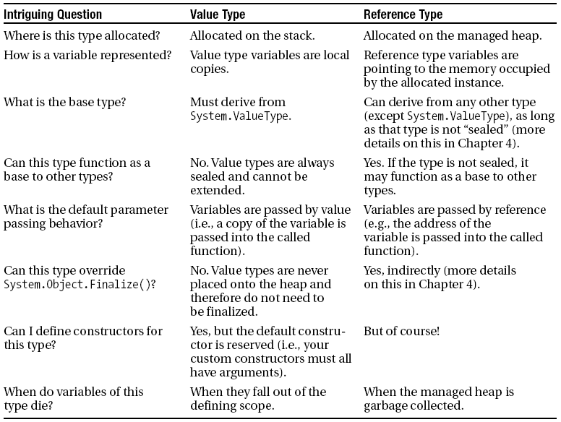
Value types and Reference types

Slide 20
Boxing and Unboxing operations
Boxing can be formally defined as the process of explicitly converting a value type into a corresponding reference type by storing the variable in a System.Object.
Unboxing is the process of converting the value held in the object reference back into a corresponding value type on the stack.

Slide 21
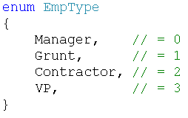
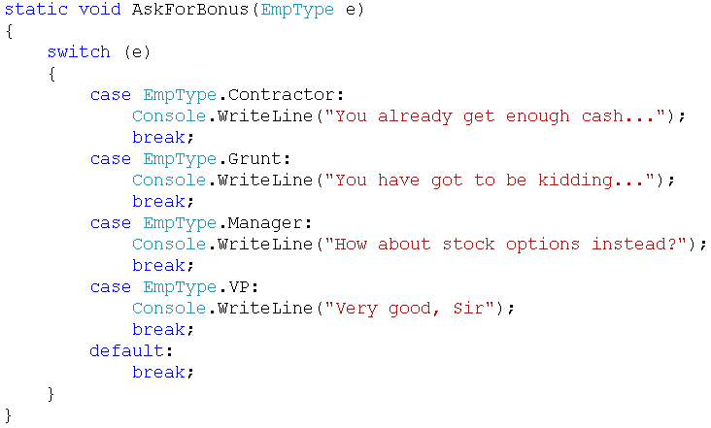
Working with Enumerations

Slide 22
The master class: System.Object
The Default Behavior of System.Object
Overriding Some Default Behaviors of System.Object
  Overriding System.Object.ToString()
  Overriding System.Object.Equals()
  Overriding System.Object.GetHashCode()

Slide 23
Defining custom namespaces
A Type’s Fully Qualified Name
Defining using Aliases
Creating nested namespaces
The “Default namespace” of Visual Studio

Slide 24
Q & A

